Slide 1
“How can I be an effective personal tutor and what is out there to help me do this?”
Enhancing the role of the personal tutor at the University of Lincoln through funded research on the role and the influence of key resources.
Ben W Walker SFHEA
Senior Lecturer – Intervention for Success Project
bewalker@lincoln.ac.uk benwwalker.co.uk
NACADA International Conference, Dublin, July 2018

Slide 2

Cathedral was the world’s tallest building until the spire collapsed in 1549
At the centre of the 18th century agricultural revolution
Lincolnshire recorded the UK’s highest Brexit vote
Cathedral city
County town of Lincolnshire
Pop: 94,600 (2012)

Slide 3

University of Lincoln
‘Modern’, ‘post 1992’ university
Serves a distinctive local demographic - includes a high proportion of white working class students from rural areas
‘WP’, ‘Polar’ groups…more of which later….

Slide 4


Slide 5

A note on terminology
‘Personal tutor’ – UK & international differences
Higher Education (HE)
Widening participation
POLAR quintiles

Slide 6
Today…
understand the background, rationale, key issues, and methodology behind our Lincoln-based research on personal tutoring
identify and discuss the findings and evaluation of this research
consider the implications of this research on personal tutoring
for tutoring/advising practice
areas for potential future work.
As part of this….
assess the value of tailored personal tutoring resources (both student-facing and for staff development in the role)
Thinking and discussion points
All activities and resources:
https://padlet.com/bewalker/NACADA18

Slide 7
Research background
What Works? Phases 1 and 2 (2012; 2017)
It is the human side of education which comes first – finding friends, feeling confident and above all, feeling a part of your course of study and the institution – that is the necessary starting point for student success
At the heart of student retention and success is a strong sense of belonging
The academic sphere is the most important site for nurturing engagement which creates a sense of belonging. This puts inclusive teaching and learning at the heart of effective student retention and success
Tutors can improve student retention and success in the following ways: relationships; reassurance; guidance; feedback; partnership
Academic tutoring should be embedded into the curriculum / be proactive / be holistic
Thomas, 2012; 2017
Causes of Differences in Student Outcomes (HEFCE, 2015)
Engagement is a critical factor in differential outcomes
Not all students have the social or cultural capital needed to engage readily or ask for support
Mountford-Zimdars et al, 2015

Slide 8

What is the context?
Expansion of the HE sector, coupled with widening access = more students and more diversity
Increased competition in the sector = concern about league tables (influenced by retention)
Differential outcomes for under-represented groups
The TEF (Teaching Excellence Framework)
Adapted from Thomas, 2017b

Slide 9

The contradiction?
Increasing importance of the personal tutor role and yet….
(in the UK) it remains an under-developed and under-researched area
what creates the need for personalised tutoring simultaneously renders it impossible possible to deliver effectively?

Slide 10
Some ‘definitions’ of personal tutoring
an anchor, a stable point of contact between the student and the institution’
promote academic well-being through educational socialisation
The personal tutor is one who improves the intellectual and academic ability, and nurtures the emotional well-being, of learners through individualised, holistic support.
Wheeler and Birtle in Thomas, 2006
Yorke, 2001
Stork and Walker, 2015
Thinking & discussion point 1
Is this possible to achieve in your context?
Post your answers at:
https://padlet.com/bewalker/TP1

Slide 11
Research questions
How effective do personal tutors perceive their support of level one students to be when working with students at risk of underachievement and/or withdrawal?
In answering this question, we will also seek to answer the following.
Prior to the provision of tailored personal tutor resources for level one students and staff, what resources and support do personal tutors draw on to address challenges in supporting level one students at risk of underachievement and/or withdrawal?
After engagement with tailored personal tutor resources for students and staff, what are personal tutors’ perceptions of the support and resources available to address the challenges in supporting level one students at risk of underachievement and/or withdrawal?

Slide 12
Methodology
Practice-related research
Qualitative data
semi-structured interviews
two stages: pre and post intervention
(also - student focus group)
Research population
8 personal tutors across range of subject discipline & level of experience
The intervention – tailored development materials for tutoring (created as part of the Intervention for Success Project), both
student-facing (for use in individual and group tutorials)
staff-facing (to enhance professional development in the role)

Slide 13



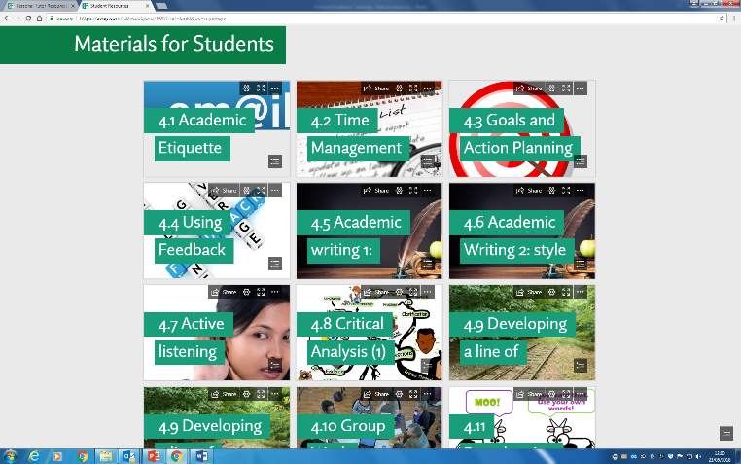
The intervention – resources for personal tutors
http://lncn.eu/ptmaster
Thinking & discussion point 2
Look at the topics of the staff development materials
Are the topics relevant and is breadth sufficient? Any gaps?
Too generic or is being generic necessary? Why?
Post your answers at:
https://padlet.com/bewalker/TP2

Slide 14
What we've found (so far)
There are some commonly held notions of effective tutoring in terms of qualities and functions
Factors affecting confidence in the role and gaps in training and ongoing support
Level of experience
Boundary issues
Teaching & research comes first
The resources provided were positively welcomed and seen as meeting some of these needs
High level of importance tutors place on the role combined, however, with the difficulty of performing it ‘on the ground’

Slide 15
So what?
Thinking & discussion point 3
What do you think the implications are?
…think levels (policy / institutional / practitioner)?
Post your answers at:
https://padlet.com/bewalker/TP3
Structural organisation
Specialised roles
Professional development
Pedagogical relationship of personal tutoring and teaching

Slide 16
References
Mountford-Zimdars. A. et al (2015) Causes of Differences in Student Outcomes. HEFCE.
Stork, A. and Walker, B. (2015) Becoming an Outstanding Personal Tutor: Supporting Learners Through Personal Tutoring and Coaching. Northwich: Critical Publishing.
Thomas, L. and Hixenbaugh, P. (eds.) (2006) Personal Tutoring in Higher Education. Stoke on Trent: Trentham Books.
Thomas, L. (2012) What Works? Student Retention and Success. Building Student Engagement and Belonging in Higher Education at a Time of Change. HEA. Available from https://www.heacademy.ac.uk/system/files/what_works_summary_report_0.pdf
Thomas, L. (2017a) What Works 2? Student Retention and Success. Supporting Student Success: Strategies for Institutional Change. HEA. Available from https://www.heacademy.ac.uk/system/files/hub/download/what_works_2_-_full_report.pdf
Thomas, L. (2017b) Using Tutoring to Advance Success To Improve Student Success. Keynote Presentation Slides to UKAT conference, 5 April 2017.
Wheeler, S. and Birtle, J. (1993) A Handbook for Personal Tutors. Buckingham: Society for Research into Higher Education and Open University Press.
Yorke, M. (2001) Formative Assessment and its Relevance to Retention. Higher Education Research and Development, 20(2), 115-126.

Slide 17
Questions and follow up
Are single definitions helpful?
Your context = mission impossible?
Tutor = teacher or specialist?
Ben W Walker

