Slide 1


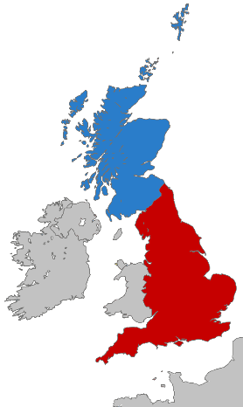


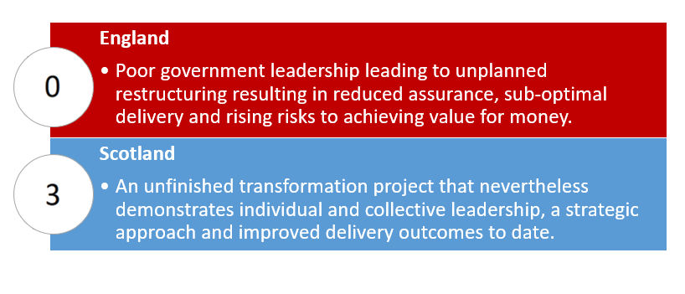
Scoring the Fire Reforms: England 0-3 Scotland
A comparative appraisal of recent changes to the Fire and Rescue Services in England and Scotland
Pete Murphy, Katarzyna Lakoma, Kirsten Greenhalgh and Lynda Taylor
2010 - 2015
Austerity localism
Post 2015
Police and Crime Commissioners
New national framework 2018
HMICFRS
Pre 2010
NAO and PAC reports
Sector-led Improvement
Fire and Rescue Services Act 2004
Audit Commission
Continuous improvement focus
BACKGROUND
RESEARCH APPROACH AND METHODS
DIFFERING CONTEXTS
The regimes for developing policy, delivering services and providing assurance to the public for Fire and Rescue Services in Scotland and England have diverged significantly since 2010, facilitated by the devolution of responsibility for local public services to the Scottish Government.
1
3
2
Literature review
Document analysis
A series of interviews drawn from key stakeholders
The divergence has generated an opportunity to compare two service regimes that for over 150 years shared the same antecedents and history. The catalyst for this has been the publication of a series of new key policy documents in both countries.
National Fire Chiefs Council
External Auditors
National Regulators
HMICFRS (Inspectorate)
Central Government
Local Government
Improvement Agencies
Fire Standards Board
2010 - 2015
A new single national service by 2013
Post 2015
Consultation on future of SFRS
Pre 2010
Fire (Scotland) Act 2005
8 Local authority FRS
HMFSI
Christie Commission
Audit Scotland
Post legislative scrutiny of the Reform Act
RESEARCH QUESTION
Policy Development
Public Assurance
Service Delivery
How does policy development, service delivery and public assurance compare between the two countries?
This project is intended to identify systemic inadequacies and propose solutions to improve the policy development, service delivery and public assurance arrangements for Fire and Rescue Services in the UK and further afield.
CRITICAL ISSUES
Leadership
Operational
Changing services
Challenge
Strategic alignment
The difficulties of tackling change, responding to austerity and financial issues while maintaining a resilient service.
Integrated Risk Management Planning has been introduced in both countries and forms the basis for risk assessment.
Falling numbers of fire incidents but diversification and more complexity in the types of incident attended.
There were consistent criticism around governance arrangements, adequacy of scrutiny and service performance.
The need for better interoperability of the emergency services and alignment with wide public services.
GOVERNANCE, PERFORMANCE AND SERVICE CONFIGURATION
CONCLUSIONS
Prior to 2010 Governance, service configuration, strategic and operational service management were all on the same models.
Post 2010 Although the options considered for delivering the service have looked remarkably similar the responses have radically differed.
This project compares two alternative approaches to policy development, service delivery and public assurance. It demonstrates significant differences in the economy, efficiency and effectiveness between the two systems.

