Slide 1
Classifiers used in data analysis
Ed Cheetham, Principal Terminology Specialist

Slide 2
The problem of ‘multiple views’
Not all familiar or useful views/aggregations are supported [as intended] by existing content:
Alcohol-related disease
Soft tissue inflammation
Joint aspiration
Visceral injury
Systemically administered steroids
Preparations with lanolin excipient
Notes:
Examples of clinical FAQ’s/views/aggregations which aren’t directly represented by SNOMED CT aggregating concepts

Slide 3
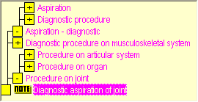
Use of a classifier to aid aggregation e.g. Joint aspiration (ED Dataset, 2009)
90131007|Arthrocentesis (procedure)|
281808001|Aspiration of elbow joint (procedure)|
281809009|Aspiration of hip joint (procedure)|
281810004|Aspiration of knee joint (procedure)|
431848008|Barbotage of joint using ultrasound guidance (procedure)|
274391001|Diagnostic aspiration of joint (procedure)|
430108006|Fine needle aspiration biopsy of joint (procedure)|
274426001|Therapeutic aspiration - joint (procedure)|
SNOB: http://snob.eggbird.eu/
Use does not indicate endorsement, but extremely valuable to illustrate points discussed
Notes:
Examples of classes we would wish to retrieve when looking for instances of ‘joint aspiration’ – not all organised beneath a single class

Slide 4
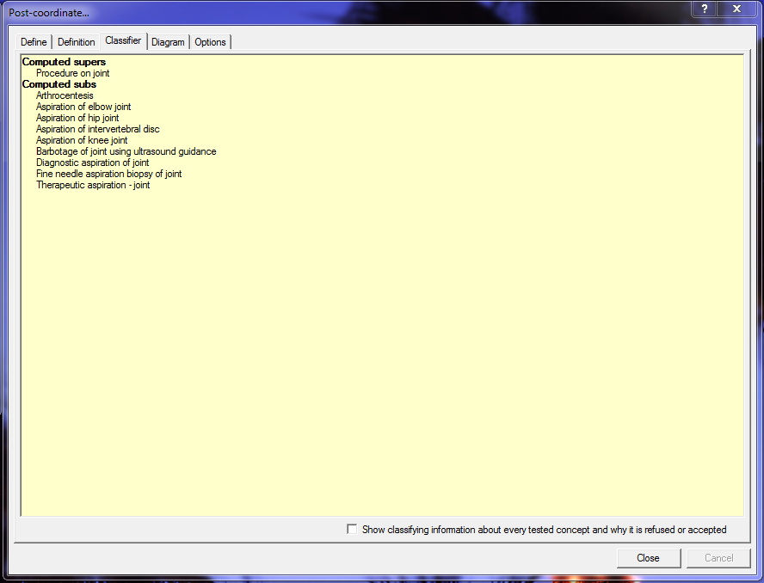
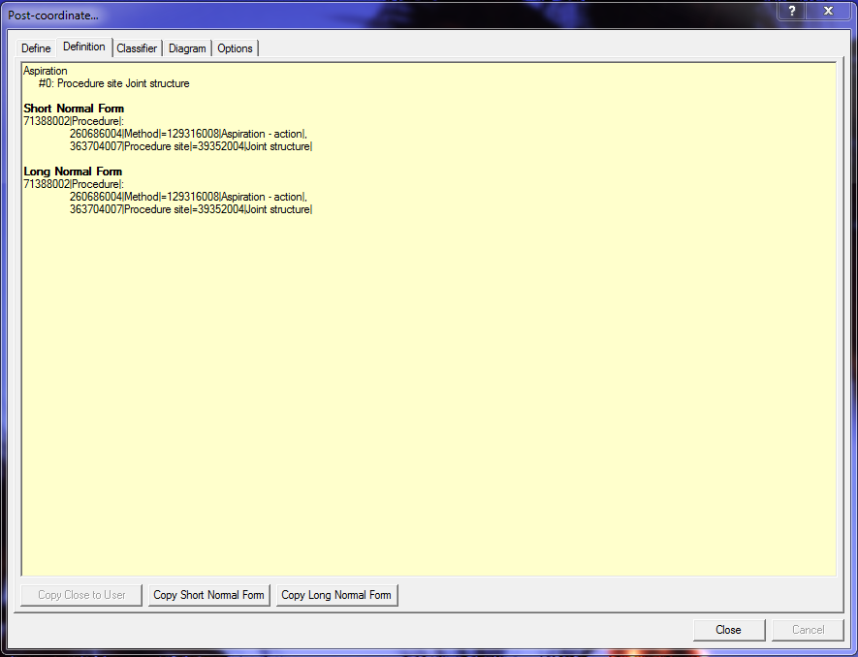
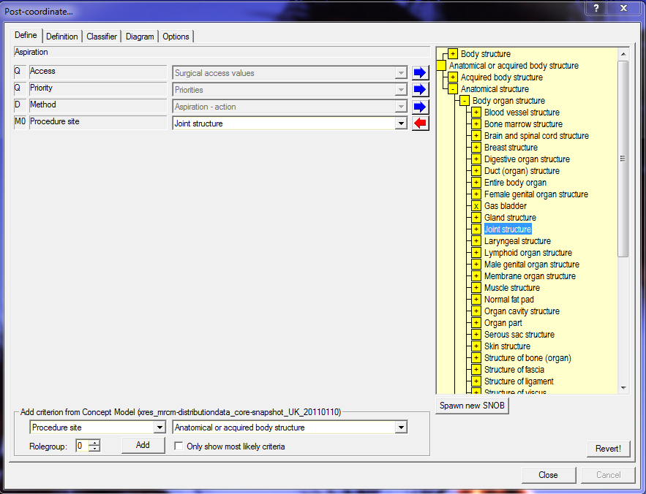
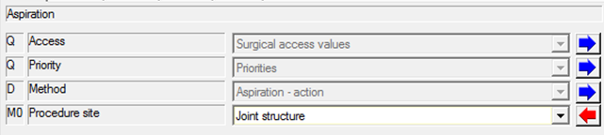
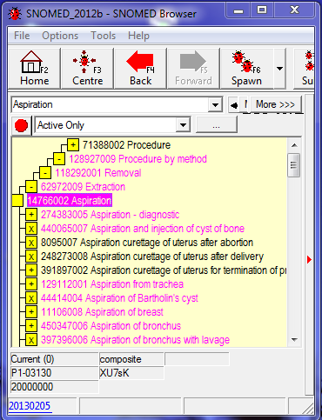
Use of a classifier to aid aggregation e.g. Joint aspiration
Looks like a candidate aggregation point, but definition too stringent.
Added to SNOMED in July 2012 (plus two children added July 2011)
Notes:
Ad-hoc creation of a SNOMED CT class definition (not an actual concept) of ‘joint aspiration’ to serve as query predicate for the earlier instances.

Slide 5
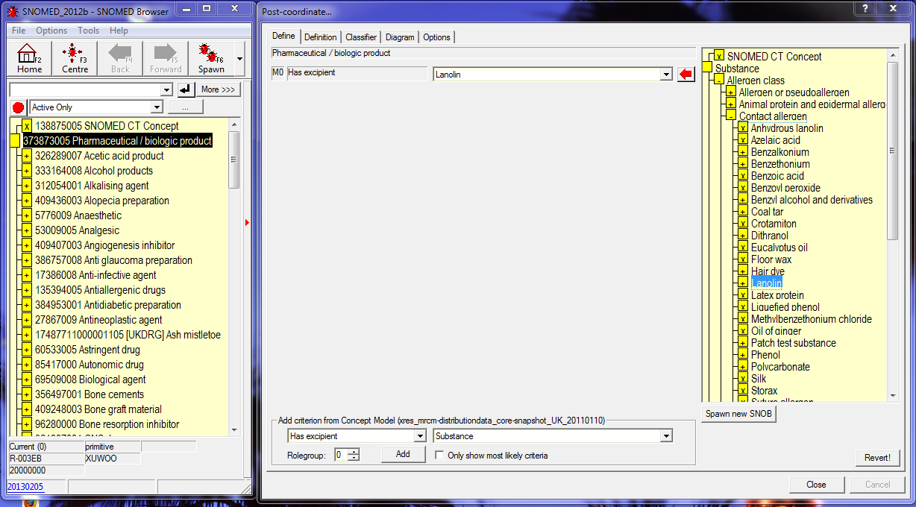
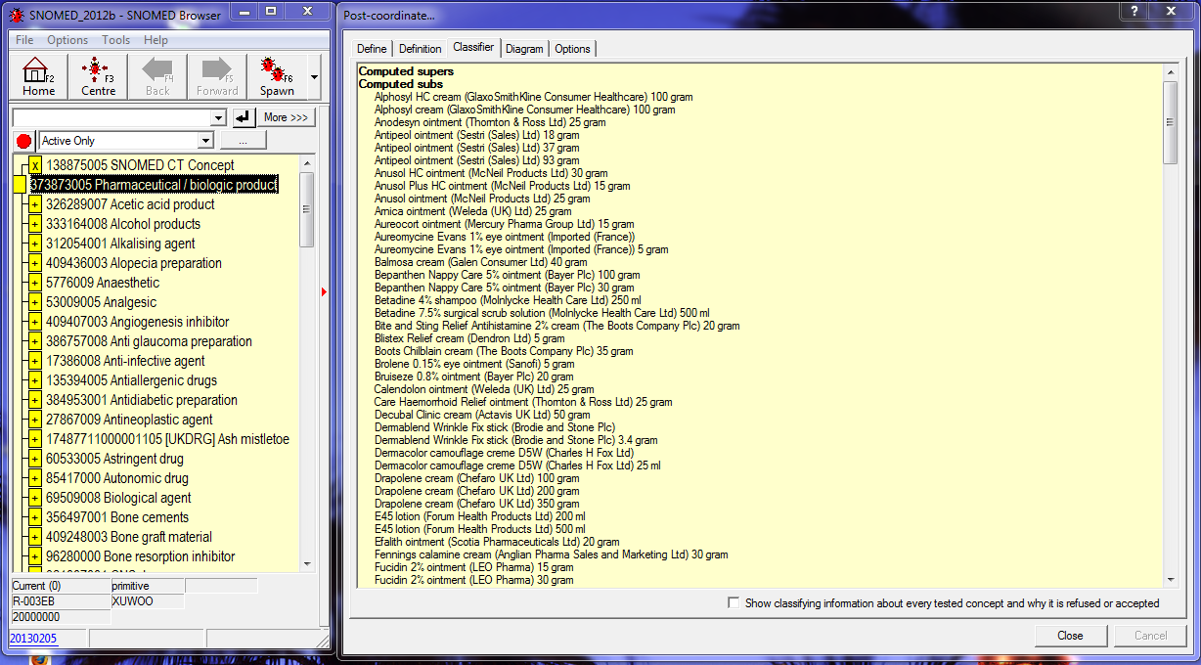

Lanolin containing drugs…
Long list of 234 products
Notes:
Similar ad-hoc definition to discover all (formally represented) lanolin-containing drugs (false negatives if some drugs are incompletely ‘modelled’).

Slide 6
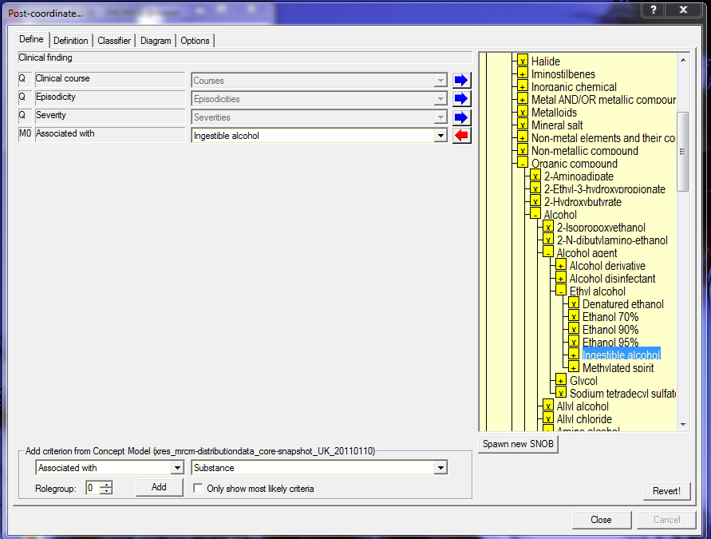
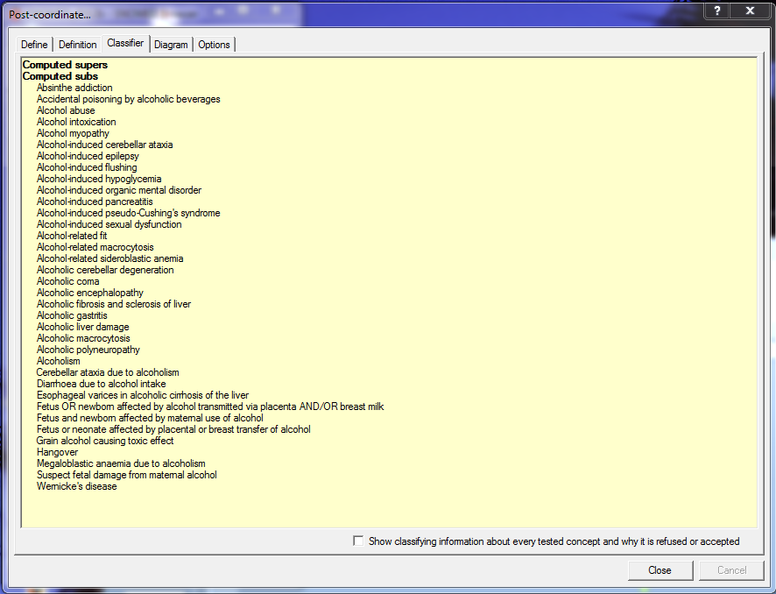
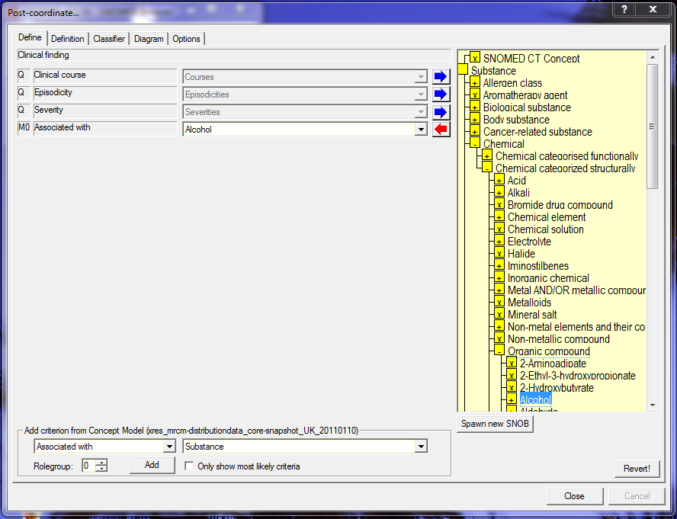
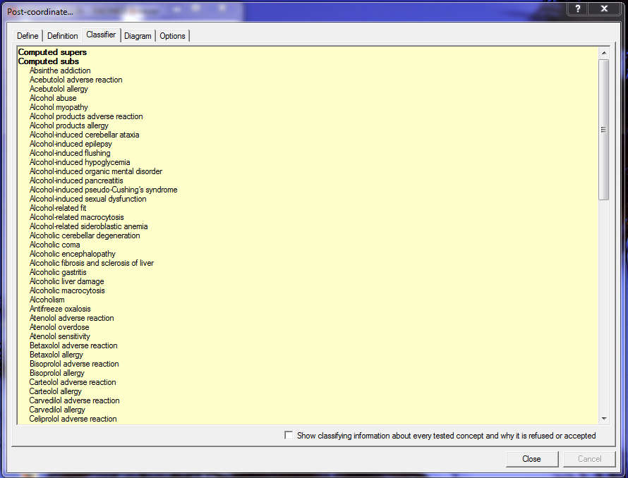
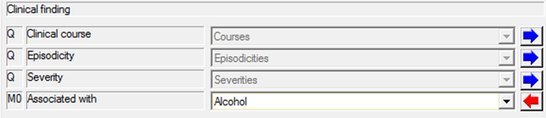
Alcohol-related diseases
Acebutolol adverse reaction?
Bisoprolol allergy?
Antifreeze oxalosis?
‘Alcohol’ too broad…
Notes:
First-pass ad-hoc query predicate class definition for ‘alcohol-related diseases’, resulting in logically explicable but clinically unwanted false positives. Refined class definition narrows associative agent to ‘ingestible’ alcohol (the intention of the clinical idea) rather than the more general ‘chemical’ understanding of ‘alcohol’.

Slide 7
Well, you say...
That’s just using SNOMED CT classes as query predicates, we could do the same thing another way...
You almost certainly can, but sometimes it might be significantly more efficient to use native classifier features
Extended DL ‘constructs’
Right identities / Property chains

Slide 8
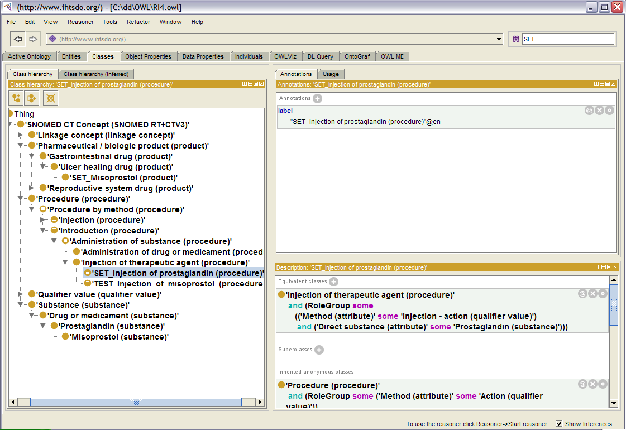
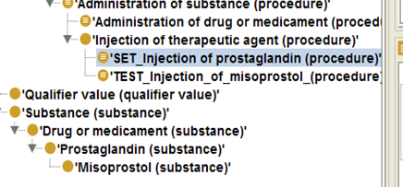
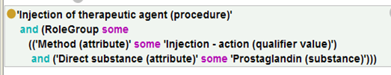
Protégé: http://protege.stanford.edu/
Use does not indicate endorsement, but extremely valuable to illustrate points discussed
Notes:
Set of slides illustrating the potential value of certain DL-specific extensions. Comparable results can be achieved by e.g. SQL constructs, but approach may be simplified if DL-enabled analysis environment available/features included in routine classification.
Here we see that the procedure ‘injection of prostaglandin’ is defined in terms of ‘prostaglandin (substance)’...

Slide 9
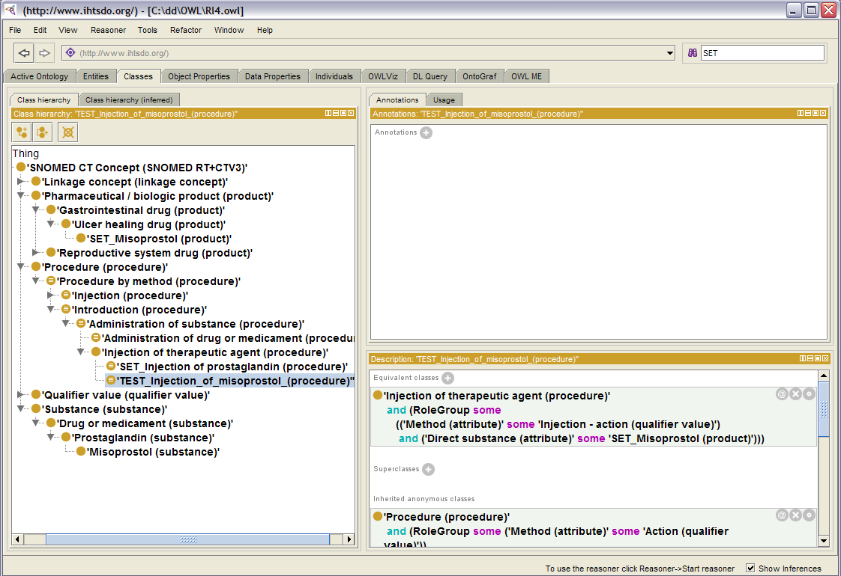
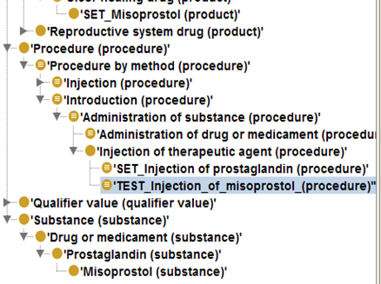


Notes:
A ‘TEST’ class ‘injection of misoprostol’ is introduced to the data defined in terms of the medicinal product ‘misoprostol’ [allowable in SNOMED CT instance data] – which is in turn defined in terms of misoprostol (substance) – a kind of prostaglandin substance.

Slide 10
To catch all “injections of prostaglandin” we need to say...
“...select all kinds of “injection of prostaglandin”
plus any injections which use a product which has an active ingredient which is a kind of “prostaglandin (substance)”
Step forward DL ‘right identity’ / ‘property chain’
Notes:
Ensuring that all injections of prostaglandin (where the direct substance is represented as a product or a substance) can be achieved by retrieval of the simple case OR the more complex case (second bullet)...

Slide 11
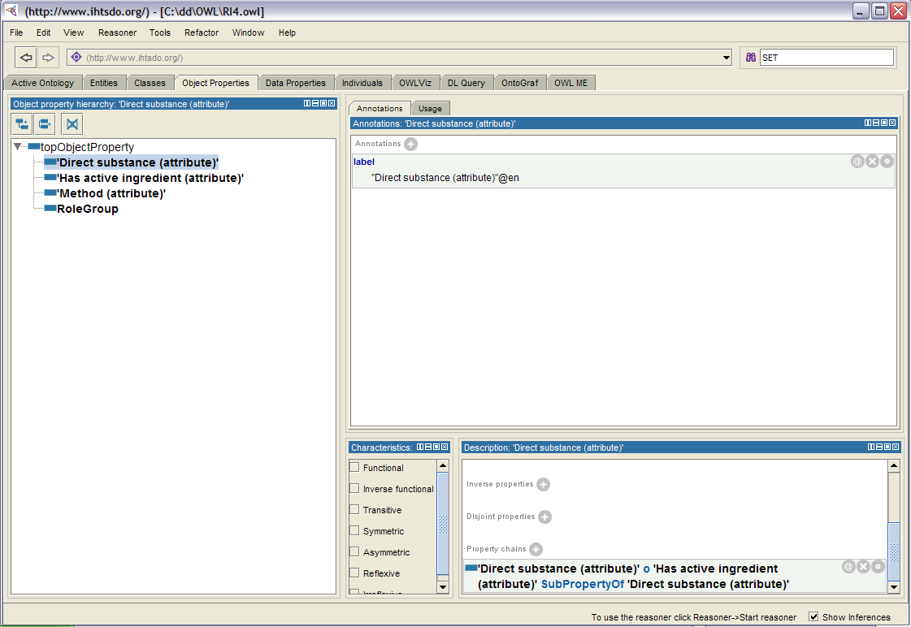

Notes:
Suggestion here that the use of the DL ‘property chain’ / ‘right identity’ between direct substance and has active ingredient may be an alternative (and possibly simpler) technique for achieving this more inclusive (lower false negatives) retrieval.

Slide 12
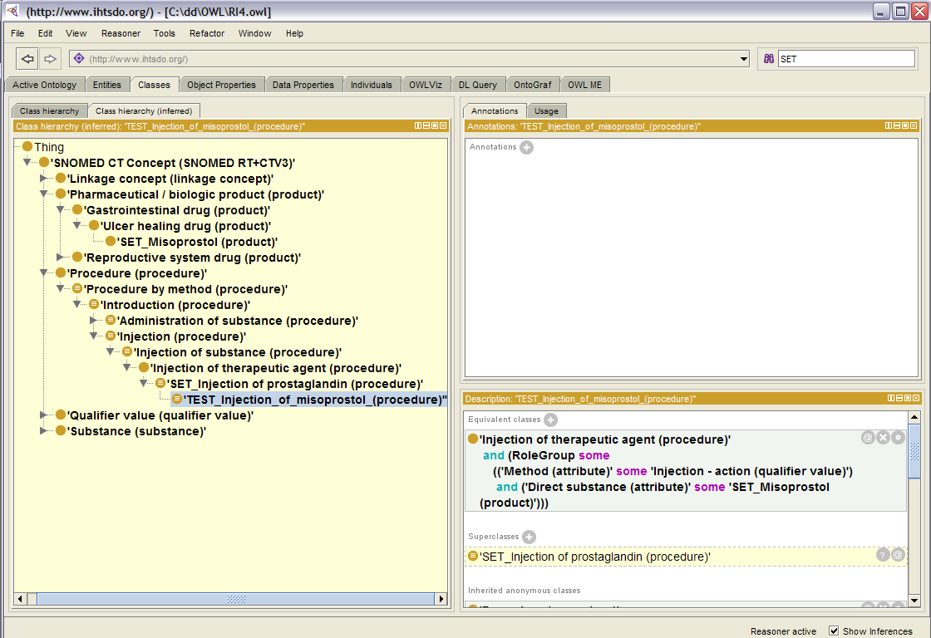


Slide 13
Conclusions
To date we have probably associated classifiers with the creation of the reference data, and used classifier-independent mechanisms for analysis
The distinction is probably subtle, but experimentation and familiarity with both will help identify the circumstances where each are most suited.

