Slide 1


Could choice
benefit your patients?
November 2015
GOV.UK/monitor

Slide 2
Index
Target audience
Using local choice in your area
Monitor’s assessment of choice in adult hearing services
Our evidence – the benefits and costs of choice
Where to go for further support

Slide 3


Target audience

Slide 4
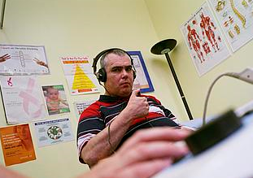

Target audience
The information in these slides aims to provide helpful information for CCGs who are:
considering Any Qualified Provider (AQP) for adult hearing services
in the process of renewing AQP for adult hearing services
considering AQP in other services, as lessons learnt from adult hearing services could apply to other services
All of the information included here comes from our report, NHS adult hearing services in England: exploring how choice is working for partners.

Slide 5
Why is choice important?

Slide 6
Why is choice important?
Five Year Forward View
The role of commissioners
Choice as a tool to achieve local objectives
The Five Year Forward View identified patient empowerment and patient choice as priorities for the future of the NHS.
Following the Procurement, Patient Choice and Competition Regulations, when commissioning services, CCGs should:
secure the needs of the people who use the services,
improve the quality of the services,
improve efficiency in the provision of the services
When improving quality and efficiency, commissioners should also consider if allowing patients a choice of provider can achieve these aims.
Patient choice can be used by commissioners to achieve their duties and their local objectives for patients.
Commissioners have told us they would like more evidence on the risks, costs and benefits of introducing local choice.
Click here for more information on local choice in adult hearing services

Slide 7
How the AQP approach works
Choice in a nutshell
Choice (through local AQP) allows any provider, who meets the qualification criteria set by the commissioner (eg minimum quality of care and price) to provide the service in that area. Patients can then choose any qualified provider they wish.
How choice works from
a commissioner perspective
In 2012, the Department of Health asked commissioners to choose services for which they would implement choice through local AQP. Initial priorities were:
Adult hearing services in the community
Musculo-skeletal services for back and neck pain
Continence services (adults and children)
Diagnostic tests closer to home
Wheelchair services (children)
Podiatry services
Venous leg ulcer and wound healing
Primary care psychological therapies (adults)
Adult hearing services was the most popular option chosen by commissioners.
Commissioners are free to set the service specification, prices and other requirements for a local health service funded by the NHS.
Commissioners invite providers to apply to be a qualified provider. Commissioners assess the potential providers and if they comply with the requirements, the commissioner will issue the provider with a contract.
If any new providers want to provide the service after the initial qualification phase, commissioners should consider these new providers.
GPs can refer and patients can choose to go to any provider in the area who is qualified.
Commissioners will need to monitor the contracts to make sure providers are delivering services at standard required.

Slide 8
Key information on hearing loss in England
Hearing loss in adults can lead to:
social isolation
depression
loss of independence and employment challenges
14.5m
people are likely to
have hearing loss by 2031
By 2030 hearing
loss will be in the
top 10 disease
burdens in UK
Over 70% of
people over 70
and over 40%
of people over 50
will have
hearing loss
2m people
have a hearing aid,
and 4m more
people would benefit
from hearing aids
The NHS spends £200m on adult hearing services each year, which includes half a million
people referred

Slide 9

Before and after
Before the introduction of choice:
Adoption of choice in adult hearing services:
Adult hearing services (for people with age-related hearing loss, who are typically aged 55+) were routinely delivered by acute providers as a part of a wider group of audiology services and often delivered alongside or integrated with ear, nose and throat (ENT) services.
After the introduction of choice:
Now, hearing services are provided by a wide variety of providers and in a wide variety of places (eg hospitals, the high street, GP surgeries, care homes).
125 of 211 CCGs (60%) have implemented local choice (as of 2015)

Slide 10
Monitor’s assessment of choice in adult hearing services

Slide 11
Monitor’s assessment of choice in adult hearing services
In 2015 Monitor published its review of choice in adult hearing services.
Our findings are set out in our report:
NHS adult hearing services in England: exploring how choice is working for patients
What we wanted to know:
How choice has been working for patients and commissioners
Whether current arrangements serve patients effectively
Whether there is scope for improvement
Offer insights for commissioners who are deciding whether and how to introduce choice
How we conducted our research
Policy desk research
Survey of 1,200 service users
Invited views from stakeholders - over 600 responses
Meetings and site visits
Structured interviews with GPs

Slide 12
What we found

Slide 13
What we found (pt1)
Benefits
Costs
Patients value choice
Improved access to services
Providers have increased incentive to be responsive to patients’ needs
Better value for money for commissioners
Ability to improve service quality through setting the service specification
Resources required to qualify providers
Resources required to manage multiple contracts
Possibility of increased overall spending for the service due to increased numbers of patients getting treated
✓
✗
✓
✓
✗
✓
✗
✓

Slide 14
What we found (pt2)
Benefits and costs will vary in local areas
Intensity of benefits and costs can vary depending on the geographical area (eg due to the number of providers already in place before AQP)
Cost of alternative commissioning approaches
Alternatives to choice could require similar or higher costs for commissioners.
Commissioners should have a clear understanding of the current local situation, the local goals they want to achieve and the feasibility of achieving them, before looking to implement AQP.

Slide 15
Benefits: patients value choice
Monitor conducted a survey of 1,200 patients to understand how service users were experiencing patient choice in adult hearing services. Most respondents indicated that choice was of value to them.

Slide 16
What patients said about having a choice:
It’s always good to have a choice. More choice means better service in my opinion
Some places you get a good service, and some places are bad,
this way you have a choice to pick from
There are many aspects to hearing rehabilitation of which technology is only one.
I would have liked the opportunity to go to a practitioner who is prepared to discuss social, emotional and employment aspects
I feel that choice is better even if I choose to stay with the service I’m with now
See chapter 3.1 of the report for more details

Slide 17
Benefits: better access to services for patients
We found that several aspects of access can be improved through choice. These are:
Closer proximity of provider location to patients
Shorter waiting times
Improved access for specific patient groups (eg housebound patients, residents in care homes)
Location
More providers after choice was introduced
Wide range of accessible locations eg high street, GP clinic
Convenient appointments
Weekend appointments
Wider opening times during weekdays
Waiting times
Shorter waits
In areas with waiting times of 6 weeks or more, waiting times fell by 2 weeks
Hard to reach patients
New providers
Services tailored to housebound people, care home residents
See chapter 3.1 of the report for more details

Slide 18
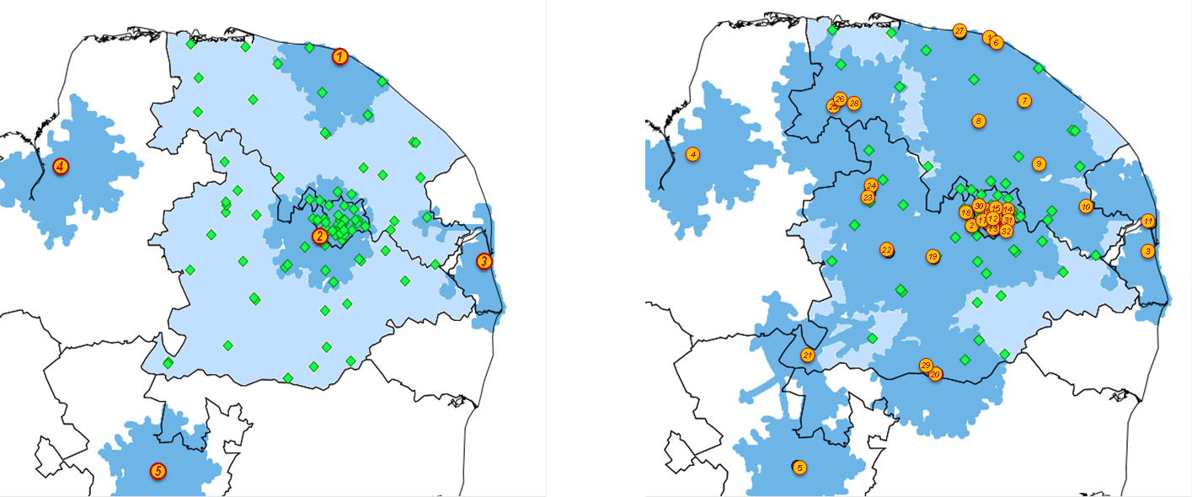
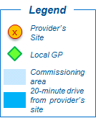
Benefits: better access to services for patients
In many areas the introduction of choice has made it easier for patients to access services.
This case study shows that the number of provider sites increased from 5 to 32, and the number of providers increased from 4 to 6. This means that 90% of patients (by using GP practices as proxies for patients’ location) are able to access a provider within a 20 minute drive. Up from 50% before the introduction of choice.
Accessibility in North Norfolk, South Norfolk and Norwich CCGs
Before choice
After choice

Slide 19
In contrast:
Before the introduction of choice, patients in Brighton and Hove already had access to multiple sites.
Following the introduction of choice, the number of provider sites increased from 6 to 7, and the number of providers increased from 1 to 3. The increase in access was limited, only 5% more patients were able to access a provider within a 10 minute drive.
Accessibility in Brighton and Hove CCG
Before choice
After choice

Slide 20

Benefits: innovation and quality, value for money
Innovation and responsiveness:
New providers added with the introduction of choice need to offer high quality services and differentiate themselves to attract patients.
Differentiation we have seen includes:
Extending the range of hearing aids offered to patients
Tailoring aftercare to patients’ needs and preferences
Offering other support services
Higher expectations of service quality:
Most commissioners used the service specification set by the Department of Health.
This specification sets out higher or more explicit requirements on providers than previous arrangements.
It also sets out key service outcomes which providers have to measure, record and report periodically to commissioners. This way commissioners can monitor whether providers are delivering to the standard required.

Slide 21
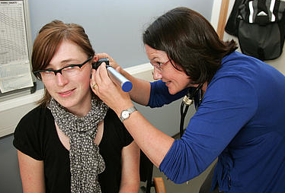
Benefits: lower price per patient and better access to data
Lower price per patient
The service specification included a suggested price, but commissioners are free to set prices for the service.
Many commissioners have amended the original DH specification price.
In some cases the locally determined prices have been 20-25% lower than the national non-mandated tariff.
Access to service-level data
The service specification establishes a set of quality requirements, KPIs and other outcome measures.
Providers are required to collect data and report to commissioners.
Commissioners can use data to:
secure the needs of patients and improve the quality and efficiency of services (eg by comparing providers’ data)
understand more precisely how their budget is spent
forecast their expenditure more accurately

Slide 22
Costs: manage multiple contracts
1. Commissioners will need to manage multiple contracts
Commissioners will need to provide each qualified provider with a contract
The number of contracts is likely to increase following the introduction of choice
Managing these contracts can take time and resources
Please note:
Some commissioners said once initial reporting systems and arrangements were in place, the resources required to manage contracts was not disproportionate to the value gained from implementing choice.

Slide 23
Costs: qualification process
2. Qualification process
Qualifying providers will require commissioners’ resources
Providers can find applying to a qualification process costly
Please note:
Any commissioning process will involve some degree of resources to select providers most suited to delivering services
The process should be proportionate. Commissioners can find ways of making the process less burdensome (eg early engagement with providers)
See Top Tips 2 & 4 in our Top Tips for Commissioners

Slide 24
Costs: potential increase in overall spending
3. Increase in overall spending
Increased access can lead to more patients being treated
Some commissioners reported increases in spending in excess of 30% in the first year
Although the price per patient may go down, overall spending on hearing services may increase
Please note:
We found no evidence of provider-induced demand. Increased spending is likely to cover demand that was previously unmet
See Top Tip 6 in our Top Tips for Commissioners

Slide 25
Weighing up the costs and benefits
Commissioners need to consider both the local impact in terms of costs,
as well as the benefits of introducing choice.
Costs
Benefits:
There are both short and long term benefits for patients
In the long term, choice has the potential to reduce pressures on health and social services that could result from unaddressed hearing loss
Costs:
Some costs are one-off or short-term
Some costs may be incurred using other commissioning approaches
Benefits

Slide 26
Where to go for further support

Slide 27
Where to go for more support
Many helpful resources can be found on the Monitor website, including:
The full report and supporting research (such as the patient survey and the interviews with GPs)
Top tips on implementing choice well in adult hearing services
Access to the joint webinar between Monitor and NHS Clinical Commissioners on practical learning from the report.
Other resources, such as the original Department of Health service specification for AQP adult hearing services.
Please contact Monitor if you have any questions about the report:
Phone: Luke Dealtry on 020 3747 0228
Email: cooperationandcompetition@monitor.gov.uk

