Slide 1


Slide 2




Slide 3
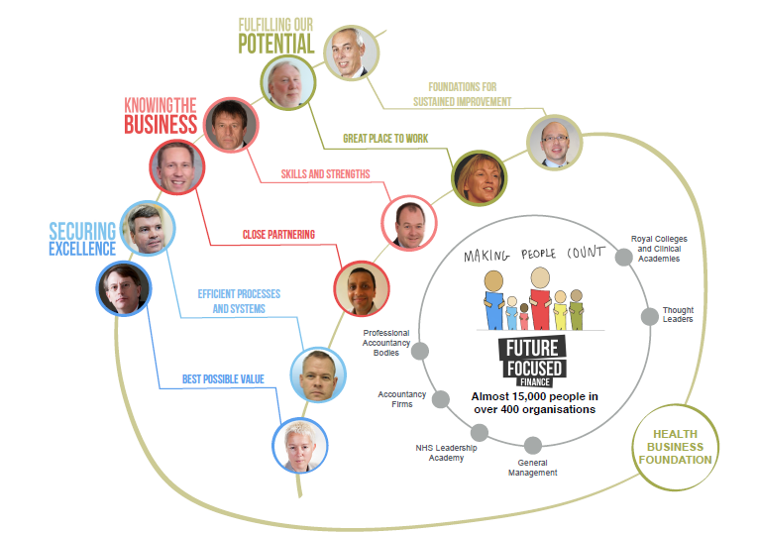

Slide 4
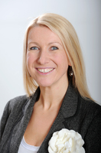
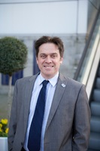
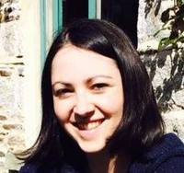
Team FFF
Sam Sherrington
David Ellcock
Becky
Vine

Slide 5



Caroline Clarke Bill Shields Dr Sanjay Agrawal Richard Alexander Cathy Kennedy Mark Orchard

Slide 6
Best Possible Value
How do we ensure best value for public & patients?
Conference held to scope project:
Develop evidence-based products to help finance professionals frame difficult questions and make good decisions
Using Porter’s value framework as basis
Value = (Outcome + Safety + Experience) / Cost
Two practical products available by Dec 14

Slide 7
Efficient Systems and Processes
‘Building on World Class Finance’
Maturity model – what does good look like?
Measurement – how do we compare to good?
Methodology – how do we improve where necessary?
Recommendations on best processes, systems, structures & mechanisms for all parts of NHS Finance

Slide 8
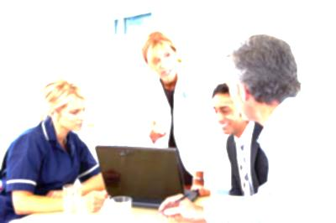
Decision support / BI
Accounts Payable
Financial Accounting
Planning & Budgeting
Accounts Receivable
Capital Accounting
Forecasting
Inter-NHS trading
Management Accounting
Costing & Pricing
Treasury Management
Payroll
Finance Systems
Business development

Slide 9
Close Partnering
360º feedback on finance departments
Clinical colleagues (Sep)
Finance departments (Sep)
Patients & public (Oct)
External colleagues with links to NHS finance (Nov)
Will use outputs to increase engagement and understanding from early 2015

Slide 10
Strengths & Skills
Intentionally last to get going
Focus on effective framework for personal development
Online / App-based
Regular / Frequent / Useful
Not just tied to annual appraisal / CPD request
Not a huge competencies document

Slide 11
Great Place to Work
Finance Director DECLARATION

Slide 12
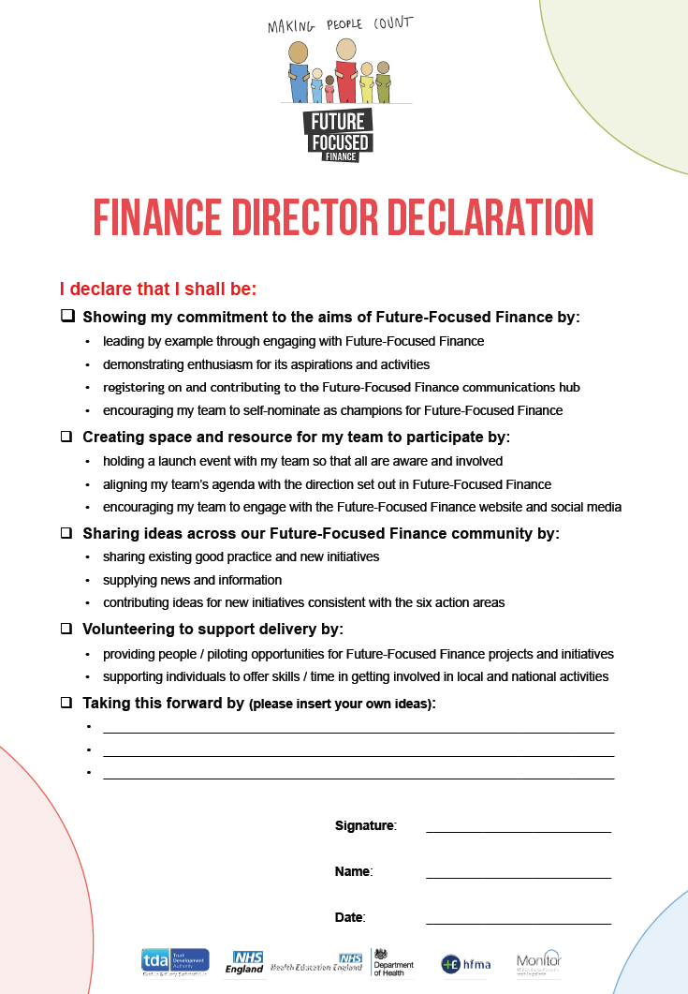

Slide 13
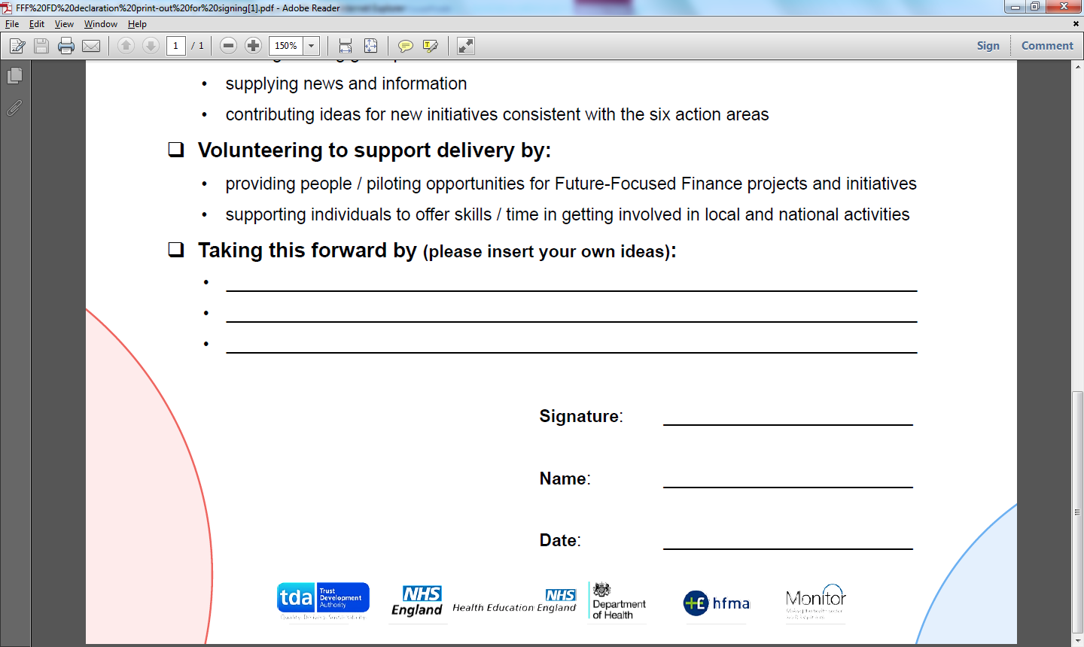

Slide 14
Great Place to Work
Finance Director DECLARATION
Great Place to Work PILOTS

Slide 15
Great Place to Work Pilots
NHS England (Kent and Medway)
Lincolnshire Partnership NHS FT
North Derbyshire CCG
Tameside and Glossop CCG
North Somerset Community Partnership
Calderdale CCG / Greater Huddersfield CCG
North Hampshire CCG
NHS England (Bristol, North Somerset, Somerset and South Gloucestershire)
Chesterfield Royal NHS FT
NHS England (Shropshire and Staffordshire)
Plymouth Hospitals NHS Trust
NHS Business Services Authority
Leeds Teaching Hospitals NHS Trust
Bedfordshire CCG
Wye Valley NHS Trust
NHS England (Essex)
County Durham and Darlington NHS FT
Guy’s & St. Thomas’ NHS FT
Greater Manchester West Mental Health NHS FT
South London CSU

Slide 16
Great Place to Work Pilots
NHS England (Kent and Medway)
Lincolnshire Partnership NHS FT
North Derbyshire CCG
Tameside and Glossop CCG
North Somerset Community Partnership
Calderdale CCG / Greater Huddersfield CCG
North Hampshire CCG
NHS England (Bristol, North Somerset, Somerset and South Gloucestershire)
Chesterfield Royal NHS FT
NHS England (Shropshire and Staffordshire)
Plymouth Hospitals NHS Trust
NHS Business Services Authority
Leeds Teaching Hospitals NHS Trust
Bedfordshire CCG
Wye Valley NHS Trust
NHS England (Essex)
County Durham and Darlington NHS FT
Guy’s & St. Thomas’ NHS FT
Greater Manchester West Mental Health NHS FT
South London CSU

Slide 17
Foundations for Sustained Improvement
Communications hub

Slide 18
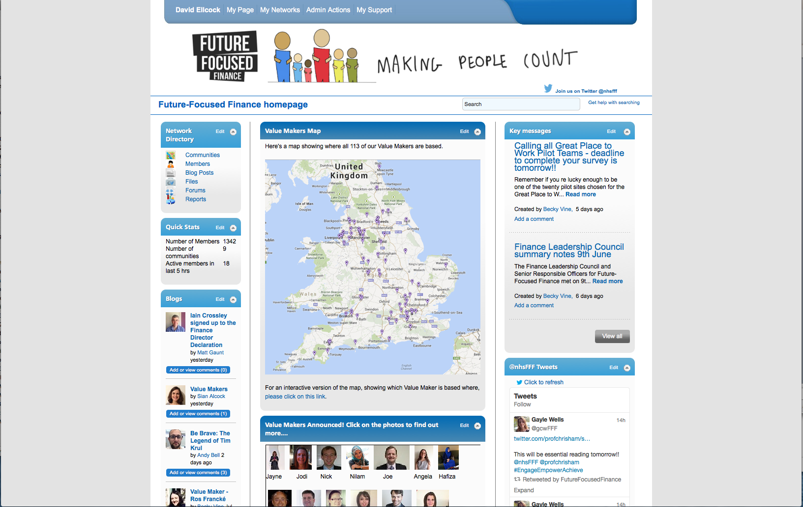
www.futurefocusedfinance.nhs.uk

Slide 19
Foundations for Sustained Improvement
Communications hub
Twitter

Slide 20
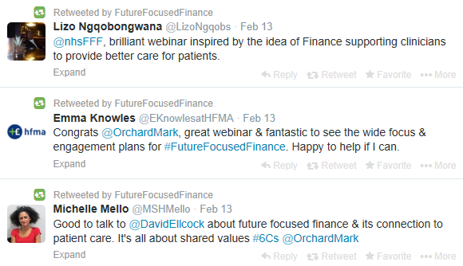
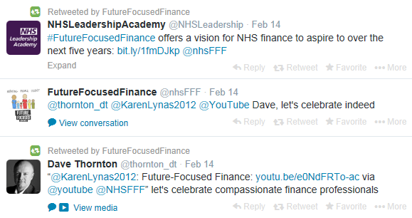
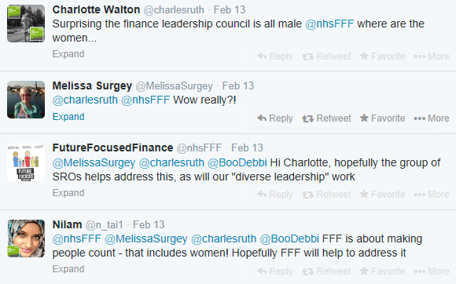
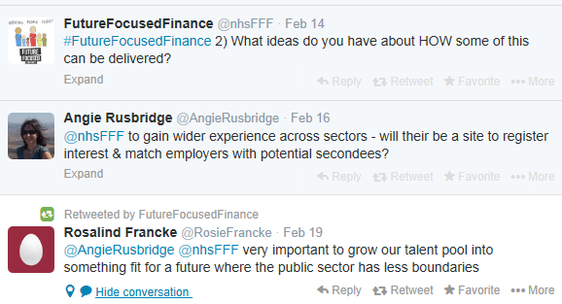
@nhsFFF
#FutureFocusedFinance

Slide 21
Foundations for Sustained Improvement
Communications hub
Twitter
YouTube

Slide 22

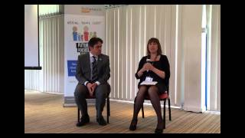
Videos on our YouTube Channel
Birmingham Wednesday 5 March
Newmarket Friday 7 March
Preston Tuesday 11 March
Leeds Wednesday 12 March
Durham Thursday 13 March
London Monday 17 March
Nottingham Friday 21 March
Gatwick Tuesday 25 March
Newbury Wednesday 26 March
Taunton Friday 28 March
locally Delivered
(Search for “Future Focused Finance” on the YouTube home page)
Supported Nationally

Slide 23
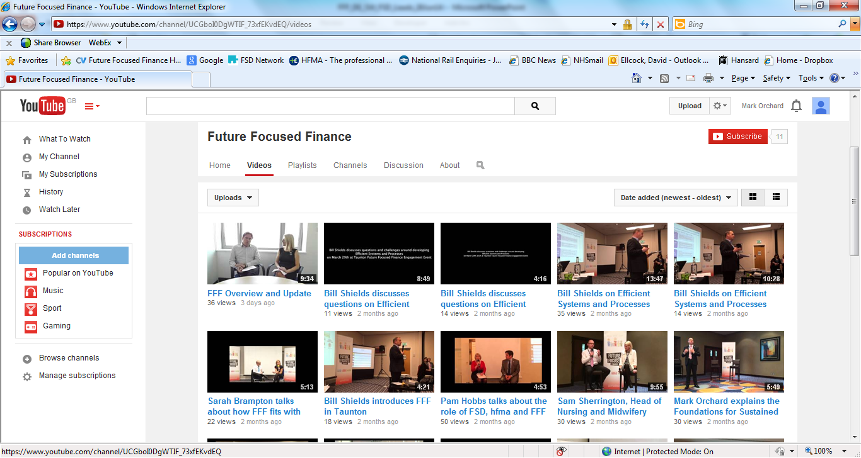

Slide 24
Foundations for Sustained Improvement
Communications hub
Twitter
YouTube
Value Makers

Slide 25
Value Makers
“ Being a value maker involves being an ambassador for Future-Focused Finance. It means broadening your experiences and networking with like-minded people whilst helping to spread important messages and shared development.
“ Value makers will attend occasional forums (nationally, locally and virtually) and receive tailored support with this role which may include mentoring, coaching and specific action-based learning.”

Slide 26
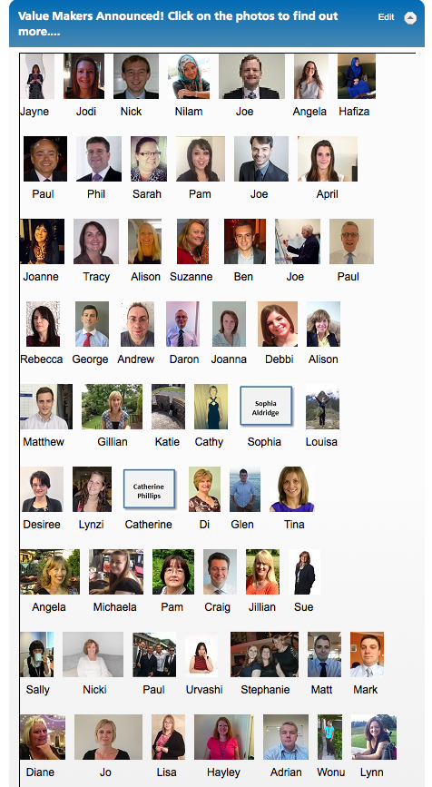
Value Makers
First cohort recruited
Second Cohort will be recruited soon

Slide 27
Foundations for Sustained Improvement
Communications hub
Twitter
YouTube
Value Makers
Healthcare Business Foundation

Slide 28
Get Involved!
Register on the website
Contribute to the discussion
Follow us on Twitter
Discuss the Declaration with your CFO / FD & ask them to sign it
Join a delivery group
Apply to become a Value Maker

