Slide 1
Margaret thatcher
THE PRIME MINISTER THAT MATTERED

Slide 2
Week one: above the shop
VERY HUMBLE BEGINNINGS

Slide 3
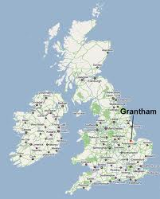
GRANTHAM, ENGLAND
THE MIDLANDS
MAP SHOWING GRANTHAM
112 MILES NORTH OF LONDON
THE CENTRE OF ENGLAND
THE INDUSTRIAL HEARTLAND
UK POLL: “OUR MOST BORING TOWN”

Slide 4
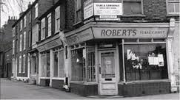
A LOWER MIDDLE CLASS LIFE
WORK-SCHOOL-CHURCH
PHOTO OF THE STORE
ROBERT’S GROCERY STORE(S)
METHODIST BELIEFS
THRIFT
HARD WORK
CHARITY

Slide 5
THE EARLY YEARS
THE ROBERTS FAMILY
LITTLE TIME FOR IDLE PURSUITS
MARGARET IS BORN 13 OCTOBER 1925
FATHER IS A LAY PREACHER
MOTHER IS WITHDRAWN
OLDER SISTER LACKS MARGARET’S DRIVE
THE SHOP IS OPEN SIX DAYS A WEEK
SUNDAY IS DEVOTED TO CHURCH
NO INDOOR TOILETS
NO CAR
SKIMPING AND SAVING

Slide 6
HER FATHER’S PHILOSOPHIES:
“IT IS EASY TO BE A STARTER, BUT ARE YOU A STICKER TOO?”
IT’S EASY ENOUGH TO BEGIN A JOB, IT’S HARDER TO SEE IT THROUGH!”
SOURCE: Thatcher, Margaret. Margaret Thatcher – The Downing Street Years (MTTDSY). Harper/Collins. NY. 1993. p. 17.

Slide 7
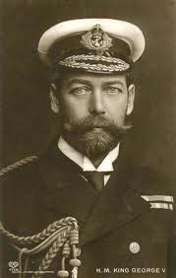
BRITAIN OF HER YOUTH
RECOVERING FROM WORLD WAR 1
KING GEORGE V REIGNS:
06 MAY 1910 TO 20 JUNE 1936
UNEMPLOYED VETERANS
HUGE WAR COSTS
MONARCHY IN TRANSITION
A WORLD OF RAPID CHANGES

Slide 8
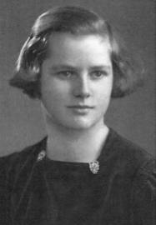
EMERGING CHALLENGES
UPSETTING THE OLD ORDER
THESE WOULD IMPACT MARGARET’S FUTURE
SOCIALISM
COMMUNISM
FASCISM
IRISH REPUBLICANISM
AMERICAN INFLUENCE IS INCREASING

Slide 9
YOUNG MARGARET ROBERTS
THE SCHOOLGIRL
SHE OUTGROWS GRANTHAM
WONDERS WHAT ELSE IS OUT THERE
WORRY OVER APPEARANCE
DESCRIBED AS IRRITATING
NOT WIDELY POPULAR
WORLD WAR II OPENS UP OPPORTUNITIES
MAJOR U.S. MILITARY PRESENCE NEARBY
A LIFE BEYOND THE FAMILIAR ROUTINES

Slide 10
The game changer:
OXFORD UNIVERSITY SCHOLARSHIP

Slide 11
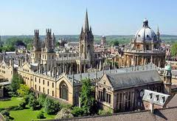
OXFORD UNIVERSITY

Slide 12
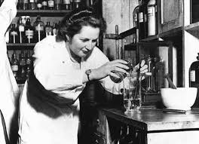
SOMERVILLE COLLEGE STUDENT
THE FIRST FAMILY UNIVERISTY STUDENT
THE CHEMISTRY STUDENT IN THE LAB
INTELLECTUAL CURIOSITY
SNUBBED BY LIBERALS
PINCHING PENNIES
FACTS MATTER IN CHEMISTRY AND LATER LIFE
PROUDER OF DEGREE THAN BEING PM!

Slide 13
THE OXFORD EXPERIENCE
LIBERAL OXFORD
RESPECTS KNOWLEDGE
MARGARET IS OUT OF SYNC
POORER THAN MOST STUDENTS
NOT POPULAR
A GRINDER
FORTHRIGHT VIEWS
GRAVITATING TOWARDS OLDER MEN
SELF-IMPROVEMENT
VALUES SUBSTANCE
RESPECTS KNOWLEDGE

Slide 14
Oxford liberals:
“CONSERVATIVISM IS A MENTAL DEFECT”

Slide 15
ASSESSMENT OF MARGARET
From The President of Somerville College:
“She always stood out…Somerville had always been a radical establishment and there weren’t many Conservatives about then…she was set as steel as a Conservative…we used to entertain a great deal at weekends, but she didn’t get invited. She had nothing to contribute, you see.”
Source: Wapshot, Nicholas; Brock, George. Thatcher. McDonald. 1983. p.46.

Slide 16
MEN CENTRAL TO HER LIFE
ROBERT HENDERSON - THE MAN SHE LOVED
DENIS THATCHER – THE MAN SHE MARRIED
TWENTY FOUR YEARS HER SENIOR
A PRACTICING DOCTOR
HE NEVER COURTED HER
REMAINED IN CONTACT LATER IN LIFE
WORLD WAR II OFFICER
MARRIED 1942-1948
OLDER THAN SHE
ADMIRES HER “POWERFUL MIND AND CHARACTER”

Slide 17
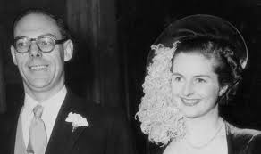
THEY MARRY: 13 DEC 1951

Slide 18
WHAT DOES DENIS BRING?
RESPECTIBILITY
MONEY
BUSINESS EXPERIENCE
A FAITHFUL LIFE PARTNER
REALISTIC VIEWS OF THE WORLD
HE ACCEPTS HER POLITICAL AMBITIONS!

Slide 19
GRAVITATING TO THE LAW
PASSING BAR FINALS O1 DEC 1953
CALLED TO THE BAR FOLLOWING YEAR
A PUPIL AT LINCOLN’S INN
“DILIGENT, QUICK ON THE UPTAKE, A FEELING FOR THE LAW”
ACCURATE AND METICULOUS IN HER LAW WORK
“THE LAW DISTINGUISHES FREE FROM UNFREE SOCIETIES”

Slide 20
LAW TRAINING
LEARNING HOW TO THINK
BASIS OF FUTURE BELIEFS
DEVELOPING A SECOND SKILLS SET
THINKING LIKE A BARRISTER
DETAILS AND NUANCES MATTER
RULE OF LAW IS FOUNDATION OF POLITICS
COLLECTIVISM THREATENS FREEDOM
A FREE SOCIETY MADE BRITAIN GREAT

Slide 21
MARGARET’S FOUNDATIONS
“As a Methodist in Grantham, I learned the laws of God. When I read chemistry at Oxford, I learnt the laws of science, which derive from the laws of God; and when I studied for the Bar, I learnt the laws of man.”
Source: Moore, Charles. Margaret Thatcher – The Authorized Biography – From Grantham to the Falklands. (MTTAB). Alfred A. Knopf. N.Y. 2013. p. 49.

Slide 22
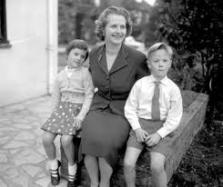
THE TWINS ARE BORN – 14 AUG 1953
MARGARET IS NOT A DEVOTED MOTHER
MARK AND CAROL WITH “MUM”
WORK TAKES PRECEDENCE
CHILDREN WILL ATTEND BOARDING SCHOOL
CONSUMED BY POLITICS
UNUSUAL FOR POST-WAR BRITAIN

Slide 23
Standing for elections
A FRESH NEW FACE ON THE SCENE

Slide 24
LOSING THEN WINNING BY 1959
EXCELLENT ORATORY SKILLS
OPPOSING THE UTOPIAN STATE
DEVELOPED WITH MUCH PRACTICE
APPEALING TO THE MIDDLE CLASS
CLOSE TO SMALL BUSINESS OWNERS
A WOMAN WITH CORE VALUES
LABOR PARTY KILLING UPWARD MOBILITY
TAXES – CONTROLS – NATIONALIZATION
THE DEPENDENCY CULTURE

Slide 25
RUNNING FOR FINCHLEY’S SEAT
MARGARET WINS 54% OF THE VOTE
FINCHLEY, ENGLAND
OPPOSED BY MANY WOMEN
UPSETTING TO MEN
FIRST OF MANY PRECEDENTS
SHE HOLDS THE SEAT UNTIL 1993
CLOSE TO THE CITY
NINE MILES FROM PARLIAMENT
A RESIDENTAL SUBURB

Slide 26
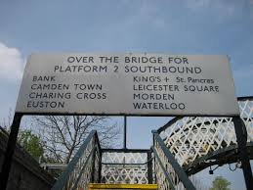
FINCHLEY, ENGLAND
A NORTH LONDON SUBURB
FINCHLEY TRAIN PLATFORM
SHE IS RETURNED MANY TIMES
LEARNS TO ADMIRE AND RESPECT ENGLAND’S JEWS
NEITHER “POSH” NOR POOR

Slide 27
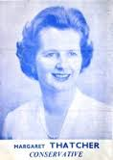
TIMING IS EVERYTHING
BRITAIN’S RISING PROSPERITY
THATCHER CAMPAIGN POSTER
HAROLD MACMILLAN IS PM IN JANUARY 1957
TAXES CUT IN 1959 INCLUDING BEER
CONSERVATIVES HAVE 107 VOTE MAJORITY – THE LARGEST SINCE WWII

Slide 28
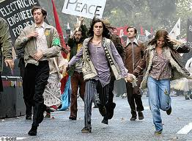
NEW CHALLENGES EMERGE
THE COLD WAR IS HEATING UP
THE LONDON SCENE
RUSSIA VS AMERICA
NATO EMERGES AS A SHIELD
THE SWINGING SIXTIES
DRUGS, SEX, ROCK AND ROLL
TRADITIONAL VALUES ARE WANING

Slide 29
Week two
PARLIAMENT: 1959-1979

Slide 30
THE BASICS
HOW DOES THE BRITISH GOVERNMENT FUNCTION?
THE MAJORITY PARTY FORMS A GOVERNMENT
COMMONS AND LORDS BALANCE EACH OTHER
NO SUPREME COURT UNTIL LATE 199O’S
LOCAL AUTHORITIES RETAIN SOME POWERS
ENGLISH COMMON LAW
CONSENT OF THE GOVERNED
THE RIGHTS OF COMMON CITIZENS
NATIONAL ELECTIONS EVERY 4-5 YEARS
THE MONARCHY PROVIDES STABILITY
EUROPEAN PARLIAMENT IS ANOTHER LAYER

Slide 31
STRUCTURE AND TRADITION
CENTURIES OF CUSTOM
UPSETTING THE SYSTEM
FEW ELECTED WOMEN
HIDEBOUND WAYS AND MEANS
THE ARISTOCRACY DOMINATES
CLUBBY OLD-BOY NETWORK
LOOKING FOR SUBSTANTIVE ROLES
USING HER SEX TO ADVANTAGE
SOLUTIONS VICE COMPROMISE
AGAINST MANAGED DECLINE

Slide 32
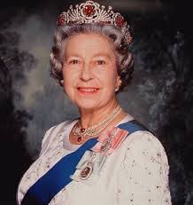
BRITAIN’S HEAD OF STATE
HER ROYAL HIGHNESS THE QUEEN
NOT THE HEAD OF THE GOVERMENT
NEUTRAL IN POLITICAL AFFAIRS
THE FACE OF BRITAIN
APPROVES AND SIGNS LAWS
ROYAL PEROGATIVE POWERS

Slide 33
HRH’S PEROGRATIVE POWERS
DOMESTIC POWERS
FOREIGN POWERS
TO APPOINT AND DISMISS A PM
ROYAL ASSENT TO BILLS MAKES THEM LAW
COMMAND THE ARMED FORCES
GRANT HONOURS
ISSUE AND WITHDRAW PASSPORTS
RATIFY AND MAKE TREATIES
DECLARE WAR & CONCLUDE PEACE
TO RECOGNIZE STATES
TO DEPLOY MILITARY
CREDIT AND RECEIVE DIPLOMATS

Slide 34
THE PRIME MINISTER
ACTS AS DAY-TO-DAY EXECUTIVE
MANAGES AND EXECUTES PROGRAMS
RESPONSIBLE TO PARLIAMENT
TYPICALLY THE PARTY CHIEF
ELECTED FOR 4-5 YEARS
PRIME MINISTER’S QUESTIONS

Slide 35
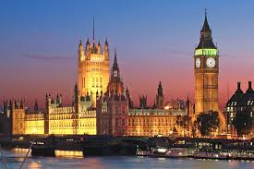
THE BRITISH PARLIAMENT

Slide 36
MULTI-FACETED PARLIAMENT
THE HOUSE OF COMMONS
THE HOUSE OF LORDS
650 MEMBERS
ELECTED ALONG WITH THE PRIME MINISTER
CLOSEST TO THE VOTERS
MEMBERS RUN WHERE THEY ARE ELECTABLE
COUNTY OR BOROUGH CONSTITUENCIES
A BODY OF ADVISORS AND EXPERTS
700 LIFE PEERS APPOINTED BY THE MONARCH
92 HEREDITARY PEERS
26 ARCHBISHOPS AND BISHOPS

Slide 37
WHO HOLDS THE POWER???
COMMONS
LORDS
ORIGINATES MONEY BILLS
DEPARTMENTAL RESPONSIBILITIES
WHERE PM’S COME FROM SINCE KING EDWARD VII
CONFIDENCE OF COMMONS IS KEY
LITTLE REAL POLITICAL POWER
INFLUENCE COMES FROM KNOWLEDGE
DEBATE PUBLIC POLICY
HOLD GOVERNMENT TO ACCOUNT

Slide 38
MARGARET’S MAIDEN SPEECH
05 FEBRUARY 1960
PASSES BY 152-39 VOTE
SUBSTANTIVE AND LEGISLATIVE
ISSUE: ADMISSION OF PRESS TO MEETINGS
“PUBLIC SHOULD KNOW HOW THEIR MONEY IS SPENT”
OPPOSED BY LABOUR AND GOVERNMENT
WRITES NOTES TO 250 COLLEAGUES
27 MINUTES LONG
THE PRESS TAKES NOTICE
WEAKENED IN DEBATES
LORDS DELETES POLICE

Slide 39
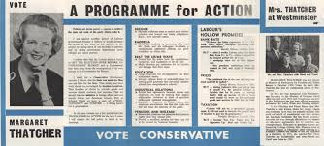
“PUBLIC BODIES (ADMISSION TO MEETINGS) BILL” OCTOBER 1960

Slide 40
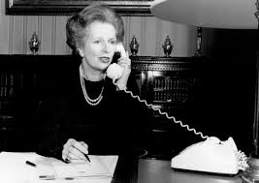
MARGARET’S VIEWS AS MP?
NO SURPRISES HERE
1964-1970: SITTING IN OPPOSITION
HELP UNFORTUNATES NOT IDLERS
PROTECT UNMARRIED MOMS AND TOTS
TAXES SHOULD BENEFIT NOT PUNISH
REVISE TRADES UNION LAWS

Slide 41
HER RECORD IN “OPPOSITION”
SIX “SHADOW” GOVERNMENT POSITIONS
DETESTS ARBITRARY STATE POWER
SUPPORTS TAX RELIEF NOT SUBSIDIES
CAN ABSORB ALMOST ANY AMMOUNT OF DETAIL
SURPRISINGLY DIVERSE VIEWS ON ISSUES

Slide 42

1967: FIRST VISIT TO U.S.
INVITED TO AMERICA
THE LAND OF OPPORTUNITY
IMPRESSED BY UNITED STATES
ADMIRES YANKEE TECHNOLOGY
VISITS CITIES, FACTORIES, NASA
NOTES LOW U.S. TAXATION RATES

Slide 43
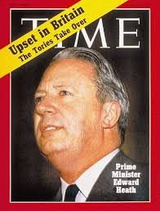
1970: A CABINET OFFICER IN TORY GOVERNMENT
GAINING VALUABLE EXPERIENCE
APPOINTED UNDER PM EDWARD HEATH
SECSTATE FOR EDUCATION/SCIENCE
“NO DIRECT CONTROL OF ANYTHING”
“MILKSNATCHER”
GAINED $$ FOR EDUCATION

Slide 44
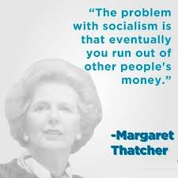
1972-1979: A RISING FORCE
MP THATCHER
OPPOSING THE LABOURITES
A FORCE FOR CONSERVATIVE IDEALS
CANNOT STAND COMPROMISE
“UNIONS ARE HURTING THE PEOPLE”
FAITH IN RULE OF LAW

Slide 45
CHALLENGING PM HEATH
TAKING ON FELLOW CONSERVATIVES
EXPOSING COMPROMISE AS FAILURE
COUNCIL HOUSES MAY BE PURCHASED
GIVING OWNERS AN INDEPENDENT STAKE
FREEDOM VERSUS A CONTROLLED SOCIETY
PROSPERITY EMPOWERS ALL CLASSES
WHAT DO WE STAND FOR?
HATES “MANAGED DECLINE”
SENSES UK MAY SOON COLLAPSE
EDGING CLOSER TO PARTY LEADERSHIP

Slide 46
1975: BECOMING TORY CHIEF
RISING TO THE TOP
WHAT SHE BRINGS
DIRECTLY CHALLENGES HEATH
MULTIPLE PARTY VOTES
WINS ON SECOND BALLOT
ANOTHER FIRST – FEMALE PARTY CHIEF
REALISTIC VIEW OF BRITISH LIFE
TRAINED AT THE BAR
FORMIDABLE DEBATING SKILLS
BROAD EXPERIENCE
LOYAL CITIZEN OF BRITAIN

Slide 47
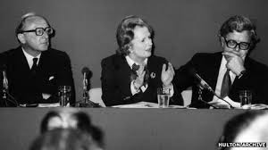
NEW DIRECTIONS FOR TORIES
DEFINING PROBLEMS CRISPLY
ACTION VERSUS DO-NOTHING
OFFER SOLUTIONS TO VOTERS
“INSPIRE HOPE NOT FEAR”
SHARPEN TORY FOCUS TO CAPTURE PM POST
PUT MONEY IN PEOPLE’S POCKETS

Slide 48
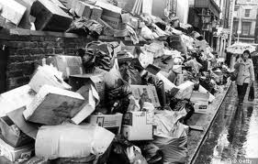
1978-1979: “THE WINTER OF DISCONTENT”
NEAR ANARCHY ACROSS BRITAIN
BASIC SERVICES COLLAPSING
STRIKES AND LABOUR STOPPAGES
TRAINS DON’T RUN
GARBAGE ACCUMULATES
DEAD ARE UNBURIED
COAL MINERS ARE AGITATING

Slide 49
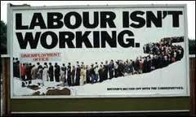
THE PEOPLE HAVE NO MONEY
SHARP CONTRAST WITH U.S.
TO HER THE CAUSE IS OBVIOUS
TWO-THIRDS HAVE NO PHONES
ONLY HALF CAN AFFORD A CAR
FAR LESS OWN THEIR HOMES
TOO MANY ARE WELFARE DEPENDENT

Slide 50
PAIN AND MISERY FOR ALL
HIGH INCOME TAX RATES
SOARING INFLATION
PENSIONERS ARE ALMOST WIPED OUT
ECONOMY IS IN TATTERS
UNIONS ARE IN CONTROL
12 MILLION WORKING DAYS ARE LOST
A NATION IN RAPID DECLINE

Slide 51
1979: WINNING THE ELECTIONS
LOOK OUT MAGGIE’S COMING!
REFORMING THE ECONOMY
NOT FOR CODDLING UNIONS
SHE MUST TAME INFLATION
WRESTLING WITH INTEREST RATES
GET A GRIP ON ECONOMY
LOOSEN FINANCIAL MARKETS
PRIVATIZE FAILING INDUSTRIES
TAX CONSUMPTION, NOT EARNING
ENCOURAGE FOREIGN INVESTMENT

Slide 52
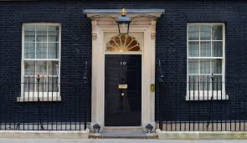
MOVING INTO NO 10
HER CABINET
THE PM’S RESIDENCE
FROM ALL REGIONS OF BRITAIN
DIVERSITY OF OPINION
22 MEMBERS TOTAL
ANNOUNCED IN 24 HOURS
MP’S ROTATE AMONG POSITIONS

Slide 53
FOLLOWING THE ELECTION
Speaking to reporters in front of No 10 Downing Street for the first time, following a summons to Buckingham Palace by HRH to form a new government:
“Where there is discord, may we bring harmony. Where there is error, may we bring truth. Where there is doubt, may we bring faith, and where there is despair may we bring hope. (Quote attributed to St. Francis of Assisi).
Source: Thatcher, Margaret. MTTDSY. p. 19.

Slide 54
A LIFE OF PRACTICALITY
A FRUGAL EXISTENCE
MEETING WITH THE QUEEN
SMALL OFFICIAL STAFF
DENIS AND MAGGIE DO THEIR OWN COOKING
NO LIVE-IN DOMESTIC HELP
ART WORKS ARE ON LOAN FROM MUSEUMS
SHE PAYS FOR REDECORATING
WEEKLY AUDIENCES
VERY CIRCUMSPECT
HRH SUGGESTS AND SHAPES
FORMAL AND CORRECT
NO STAFF PRESENT
A MEETING OF TITANS

Slide 55
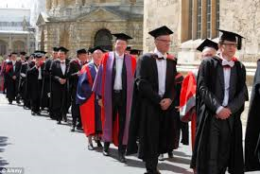
“MARGARET’S THE PM – OH GOD!”
ANOTHER FIRST FOR MAGGIE
OXFORD DONS
(UPPER CLASS TWITS)
OXFORD IS ASTONISHED!
IT DENIES HER AN HONORARY DEGREE
CAMBRIDGE STEPS INTO THE BREACH
REVULSION OF HER POLITICS
SOCIALISM VERSUS FREE MARKETS

Slide 56
A NATION IN DISTRESS
RACE AND LABOUR RIOTS
MAGGIE STANDS TOUGH
UNION LEADERS FORMENT UNREST
POLICE, FIRE, EMS ARE ASSAULTED
FIRES AND LOOTING
SHOPS DESTROYED
RALLIES PUBLIC SUPPORT
CALLS FOR LAW AND ORDER
VISITS VICTIMS
TAPS INTO MAINSTREAM VIEWS

Slide 57
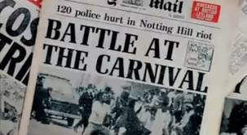
NOTTING HILL IN FLAMES

Slide 58
CHARTING A NEW COURSE
CUTS TO PUBLIC SPENDING
CASH LIMITS ON PUBLIC OUTLAYS
GETTING ABLE-BODIED OFF THE DOLE
ENRAGING THE OPPOSITION
REGAINING CONTROL FROM THE UNIONS

Slide 59
HER POLICIES ARE NOT WORKING
ECONOMY IS STILL SPUTTERING
“THE LADY’S NOT FOR TURNING”
INTEREST RATES ARE RISING
UNEMPLOYMENT IS UP
WILL THATCHERISM EVER WORK?
CALLS FOR ABOUT-FACE WITHIN PARTY
NOT WILLING TO YIELD
STUBBORN REFUSAL TO BEND
REBELLION WITHIN HER CABINET
THE LEFT SMELLS BLOOD IN THE WATER

Slide 60
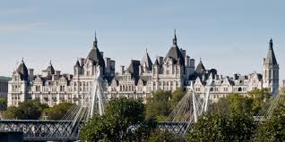
WHITEHALL: THE ENEMY WITHIN

Slide 61
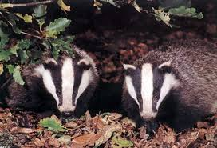
“FORMIDABLE FORCES”
CONDITIONED TO RESIST
ENTRENCHED LIKE BADGERS
MINISTERIAL DEPARTMENTS (24)
NON-MINISTERIAL DEPARTMENTS (25)
TOO MANY “QUANGOS”

Slide 62
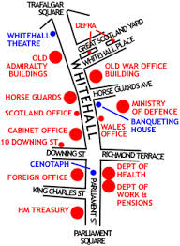
MINISTERIAL DEPARTMENTS
DIRECT POLITICAL OVERSIGHT
WHITEHALL – THE SQUARE MILE
EACH HEADED BY A “SECRETARY OF STATE”
WHO IS A CABINET MEMBER
WHO COMES FROM THE COMMONS
WHO IS MIGRATORY
WITH THEIR OWN VIEWS

Slide 63
TWENTY FOUR MAJOR BODIES
ATTORNEY GENERAL’S OFFICE
CABINET OFFICE
DEPT FOR BUSINESS/INNOVATION/SKILLS
DEPT FOR COMMUNITIES/LOCAL GOVERNMENT
DEPT FOR CULTURE/MEDIA/SPORT
DEPT FOR EDUCATION
DEPT FOR ENVIRONMENT/FOOD/RURAL AREAS
DEPT FOR INTERNATIONAL DEVELOPMENT
DEPT FOR TRANSPORT
DEPT FOR WORK AND PENSIONS
DEPT OF ENERGY/CLIMATE CHANGE
DEPT OF HEALTH
FOREIGN AND COMMONWEALTH OFFICE
HER MAJESTY’S TREASURY
HOME OFFICE
MINISTRY OF DEFENSE
MINISTRY OF JUSTICE
NORTHERN IRELAND OFFICE
OFFICE OF AG FOR SCOTLAND
OFFICE OF LEADER OF HOUSE OF COMMONS
OFFICE OF LEADER OF HOUSE OF LORDS
SCOTLAND OFFICE
UK EXPORT FINANCE
WALES OFFICE

Slide 64
NON-MINISTERIAL DEPARTMENTS
CHARITY COMMISSION FOR ENGLAND AND WALES
COMMISSIONERS FOR THE REDUCTION OF THE NATIONAL DEBT
COMPETITION AND MARKETS AUTHORITY
CROWN PROSECUTION SERVICE
FOOD STANDARDS AGENCY
FORESTRY COMMISSION
GOVERNMENT’S ACTUARY DEPARTMENT
HER MAJESTY’S LAND REGISTRY
HER MAJESTY’S REVENUE AND CUSTOMS
NATIONAL CRIME AGENCY
NATIONAL SAVINGS AND INVESTMENTS
OFFICE FOR STANDARDS IN EDUCATION, CHILDREN’S SERVICES AND SKILLS
OFFICE OF FAIR TRADING
OFFICE OF GAS AND ELECTRICITY MARKETS
OFFICE OF QUALIFICATIONS AND EXAMINATIONS REGULATION
OFFICE OF RETAIL REGULATION
ORDNANCE SURVEY
PUBLIC WORKS LOAN BOARD
SERIOUS FRAUD OFFICE
SUPREME COURT OF THE UNITED KINGDOM
THE NATIONAL ARCHIVES
TREASURY SOLICITOR’S DEPARTMENT
UK STATISTICS AUTHORITY
UK TRADE AND INVESTMENT
WATER SERVICES REGULATION AUTHORITY

Slide 65
“QUANGOS”
QUASI-AUTONOMOUS NON-GOVERNMENT AGENCIES
2009 STATISTICS
OPERATE WITH DEVOLVED POWER
ARM’S LENGTH GOVERNMENT BODIES
FUNDED BY THE GOVERNMENT
NOT A FORMAL PART OF STATE STRUCTURE
111,000 PERSONS
46.5 BILLION UK POUNDS WERE SPENT
766 ENTITIES SPONSORED BY GOVERNMENT
UNDEMOCRATIC
WASTEFUL

Slide 66
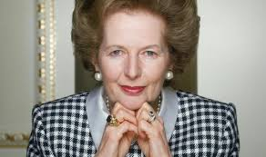
REMAKING BRITISH SOCIETY
THE MEDIA
THE IMAGE OF POWER
SUPPORTED BY TIMES AND SUNDAY TIMES
MANY PAPERS IN OPPOSITION
BBC IS BIASED IN ITS ASSESSMENTS
CAREFULLY CRAFTING HER APPEARANCE

Slide 67
IS MAGGIE FINISHED??!!
CONDITIONS ARE WORSENING
BUT DON’T WRITE HER OFF JUST YET!
UNEMPLOYMENT SOARING
NATIONAL DISCONTENT
ALLIES ARE DEFECTING
TOO MANY OPPOSING FORCES
INFLATION WILL EVENTUALLY RECEDE
HER PROGRAMS NEED TIME TO WORK
SHE’S NOT BACKING DOWN
NO CHANCE OF RETREATING

Slide 68
Week three:
BRITAIN’S CONFIDENCE GETS A BOOST

Slide 69
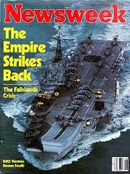
HELP IN UNEXPECTED PLACES!

Slide 70
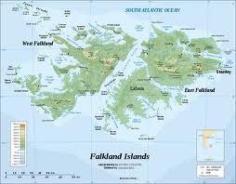
1982: THE FALKLANDS WAR
FAILURE OF GLOBAL DIPLOMACY
MAP OF FALKLANDS
AT THE ENDS OF THE EARTH
FIGHTING OVER REMOTE ISLANDS
HISTORY OF TANGLED CLAIMS
IMPACT WILL SAVE THATCHER

Slide 71
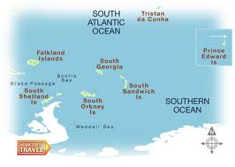
SOUTH GEORGIA AND SOUTH SANDWICH ISLANDS

Slide 72
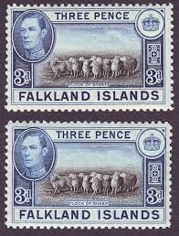
“LIKE TWO BALD MEN FIGHTING OVER A COMB”
LITTLE OF STRATEGIC VALUE
IMPORTANT INCOME SOURCE
SHEEP
GRASS
ROCKS
FISH
STAMPS
PENGUINS

Slide 73
WHO OWNS THE FALKLANDS??!
1690: BRITISH LANDFALL
1770: DISPUTE WITH SPAIN
1883: CONTINUOUS UK PRESENCE
1971: AIR-SEA LINKS WITH ARGENTINA
1981: ARGENTINA JUNTA REACHES OUT
1982: ARGIES INVADE THE ISLANDS

Slide 74
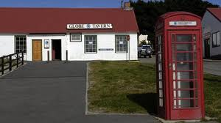
VEDDY BRITISH

Slide 75
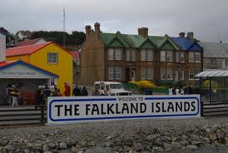
BUENOS AIRES MOTIVES
JUNTA NEEDS A DISTRACTION
DISREGARDING ISLANDERS’ ALLEGIANCE TO UK
ATTEMPTING TO SUPPORT CLAIMS
PRESS SPECULATES ON MILITARY ACTION
ARGENTINA BELIEVES IT HAS U.S. SUPPORT
THEIR ECONOMY IS IN BAD SHAPE

Slide 76
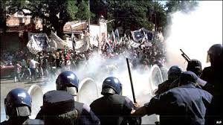
“A DIVERSION FROM INEPTITUDE”
ARGENTINA’S ECONOMIC HISTORY
PHOTO OF UNREST
A SERIES OF MISADVENTURES
DEFLATION
UNEMPLOYMENT
HOARDING
GOVERNMENT BUNGLING
CONTINUES TODAY

Slide 77
BRITISH RESPONSE!
OBTAIN SUPPORT OF YANKS, EUROPE, UN
WE’RE DEFENDING UK TERRITORY
SOVREIGNTY IS NOT NEGOTIABLE
REMINDING WORLD WE’LL RESIST AGGRESSION
THE ISLANDERS ARE NOT LOYAL TO ARGENTINA
LEAVE OR WE’LL TAKE EM’ BACK!

Slide 78
WAR IN THE SOUTH ATLANTIC
NEITHER FORSEEN OR PREVENTABLE
THIS WAR IS DIFFERENT
ANTARCTIC SURVEY SHIP GIVES WARNING
UK FOREIGN OFFICE MISJUDGED JUNTA
THATCHER IS DETERMINED TO OUST ARGENTINA
A TEST OF WILLS
LOGISTICS DIFFICULT AT BEST
BRITAIN EMPTIES THE BARN
FIRST WAR AT SEA SINCE WORLD WAR II
U.S. SUPPORT ESSENTIAL TO VICTORY

Slide 79
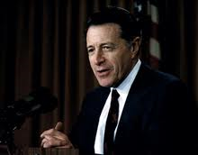
BUT, U.S. POLICY IS DIVIDED
THE PENTAGON PROVIDES BROAD ASSISTANCE
CAP WEINBERGER BELIEVES IN BRITAIN
INTELLIGENCE ACTIVITIES ARE INTEGRATED
OFFERS ASSISTANCE WITHOUT CONDITIONS
INCLUDING SATELLITES AND A CARRIER
NAVY SECRETARY CAMBRIDGE GRAD

Slide 80
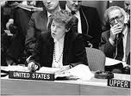
THE STATE DEPT DOES NOT AGREE
AL HAIG THE GREAT MEDIATOR
JEANNE KIRKPATRICK, UNITED NATIONS REPRESENTATIVE
ATTEMPTS TO WOO BOTH BRITAIN AND ARGENTINA
SHUTTLE DIPLOMACY
ANNOYS MARGARET
DUPED BY BUENOS AIRES
FAILS TO PREVENT BRITISH LANDINGS

Slide 81
A GLOBAL CLASH OF IDEOLOGY
NORTH VERSUS SOUTH
EAST VERSUS WEST
RULE OF LAW VERSUS ARMED AGRESSION
PROXY NATIONS ASSIST
UNITED NATIONS DEBATES DIVIDE
THE SHADOW WARS

Slide 82
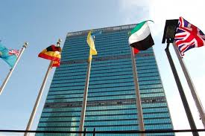
ON BRITAIN’S SIDE
SKILLFUL MANEUVERING
OUTFLANKING ARGENTINA ON THE WORLD STAGE
UN RESOLUTION – AR MUST WITHDRAW
FR – DISSIMILAR AIRCRAFT TRAINING
FR- BLOCK EXOCET SALES WORLDWIDE
EEC – SUPPORT UK OBJECTIVES
NZ – FREES UP UK FRIGATE
CHILE – TIES UP ARGENTINE TROOPS

Slide 83
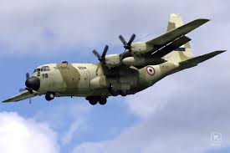
DON’T CRY FOR ME ARGENTINA
BUENOS AIRES HAS FRIENDS TOO
PERUVIAN C-130 HERCULES AIRCRAFT
PERU – SENDS AIRCRAFT, PILOTS, MISSILES
LIBYA – SA-7 MANPADS MISSILES, MINES, MACHINE GUNS, MORTARS
NON-ALIGNED MOVEMENT SUPPORT
GUATEMALA – OFFERS PARATROOPS
SPAIN – DIPLOMATIC SUPPORT

Slide 84
UN RESOLUTION 502
ADOPTED 3 APRIL 1982
SECURITY COUNCIL VOTING
UK DIPLOMATIC TRIUMPH
CESSATION OF HOSTILITIES
COMPLETE ARGENTINE WITHDRAWAL
SEEK DIPLOMATIC SOLUTIONS
TEN YES MEMBER VOTES
ONE VOTE AGAINST
FOUR ABSTENTIONS
FINAL TALLY CONFIRMS LONDON’S POSITION
A SLAP AT BUENOS AIRES

Slide 85
THE EARLY STAGES: MAR & APR
17 MAR 82 – Argentine Marines ashore on S. Georgia
01 APR 82 – Buenos Aires lands in Falklands
02 APR 82 – Further AR landings on South Georgia
03 APR 82 – House of Commons endorses UK response; UN RES 502 calls for AR withdrawal
12 APR 82 – UK imposes Economic Exclusion Zone
30 APR 82 – UK imposes Total Exclusion Zone; Ronald Reagan voices support for UK

Slide 86
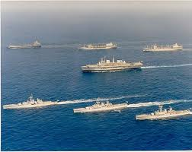
THE ROYAL NAVY SAILS TO WAR
MARGARET IS ABLY ASSISTED
TASK FORCE HEADS FOR THE SOUTH ATLANTIC
MILITARY CHIEFS ARE WAR II VETERANS
FORCES ARE TOP-NOTCH
SKILLFUL DIPLOMACY
EUROPE LINES UP BEHIND HER (MOSTLY)
SKILLFULLY WORKING THE UNITED NATIONS

Slide 87
WARTIME THATCHER INTERVIEW
Interviewed on television, she was asked whether she would resign if the enterprise failed. ‘Failure?’ she replied. ‘Do you remember what Queen Victoria once said?’ ‘Failure – the possibilities do not exist!’,
SOURCE: MTTAB, p. 677. ITN News Interview, 05 April 1982.

Slide 88
DEPARTING 04 APRIL-12 MAY 1982
127 SHIPS IN ALL
NOTABLE SHIPS
43 ROYAL NAVY
22 FLEET AUXILIARIES
62 MERCHANT SHIPS
SSN HMS CONQUEROR
CV HMS INVINCIBLE
CV HMS HERMES
RMS QUEEN ELIZABETH
SS CANBERRA

Slide 89
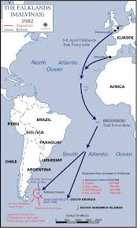
8,000 MILE VOYAGE AT SEA!

Slide 90
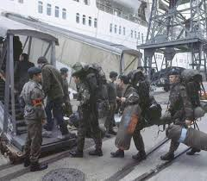
HITCHING A RIDE
A MIX OF CAPABILITIES
GOING TO WAR
SPECIAL FORCES (SAS)
5th INFANTRY BRIGADE
SUPPORT UNITS
2nd/3rd PARAS
MARINES OF 42 COMMANDO
SPECIAL BOAT SERVICE (SBS)

Slide 91
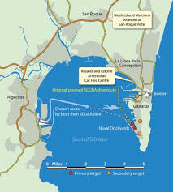
A VERY WEIRD MOMENT!
ARGENTINE OPERATION “ALGECIRAS”
THE TARGET? GIBRALTAR ANCHORAGES
CONCEIVED BY JUNTA
LIMPET MINES POUCHED TO SPAIN
SCUBA DIVERS WILL MINE RN SHIPS
RENTAL CAR AGENCY TURNS THEM IN
OPERATIVES RETURN TO ARGENTINA

Slide 92
THE WAR: MAY & JUNE
01 MAY: RAF VULCAN RAIDS COMMENCE
02 MAY: ROYAL NAVY SINKS GENERAL BELGRANO
04 MAY: ARGENTINE EXOCETS SINK HMS SHEFFIELD
14 MAY: SAS PEBBLE ISLAND RAID
21-25 MAY: ARGENTINE AIRCRAFT RAIDS
27-28 MAY: BATTLE OF GOOSE GREEN
27-30 MAY: SPECIAL FORCES CLASH ON MT. KENT
01-07 JUNE: BLUFF COVE DEBACLE
11-13 JUNE: BATTLE FOR STANLEY
14 JUNE: ARGENTINA SURRENDERS

Slide 93
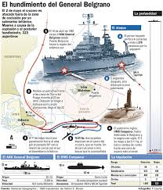
THE BELGRANO TORPEDOED!

Slide 94
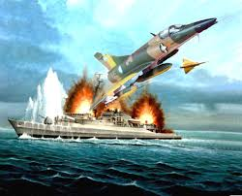
HMS SHEFFIELD IS SUNK!

Slide 95
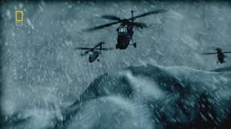
14 MAY 82: SAS RAID
PEBBLE ISLAND
FLYING IN FOUL WEATHER
45 MEN OF D SQUADRON
CLANDESTINE HELO INSERTION
6 KM “STROLL” TO AIRFIELD TARGET
11 AIRCRAFT, FUEL, AMMO DUMPS DESTROYED
SUCCESSFUL EXFILTRATION

Slide 96
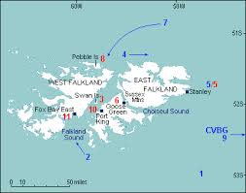
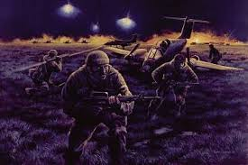
PEBBLE ISLAND RAID
MAP SHOWING PEBBLE ISLAND
DEPICTION OF THE RAID

Slide 97
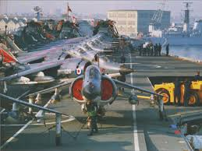
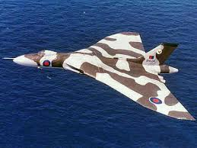
ROYAL AIR FORCE CONTRIBUTES
LONG RANGE VULCAN BOMBERS
42 HARRIER JUMP JETS

Slide 98
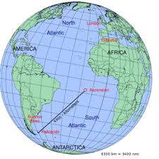
ASCENSION ISLAND STAGING

Slide 99

ROYAL NAVY COVERS LANDINGS
NAVAL GUNFIRE ESSENTIAL
HMS EXETER TYPE 42 DESTROYER
MOBILE ARTILLERY FOR GROUND FORCES
A FEW CIVILIAN CASUALTIES
PROVIDES LEVERAGE TO WIN
ARGENTINES LACK COMPARABLE POWER

Slide 100
A SLUGFEST ON LAND, SEA, AIR
RN SHIPS DAMAGED OR LOST
BRITS PREVAIL
HMS ARGONAUT
HMS BRILLIANT
HMS ARDENT
HMS COVENTRY
HMS SHEFFIELD
HMS GLAMORGA
SS ATLANTIC CONVEYOR
SINK ARGIE CRUISER BELGRANO
SINK SUBMARINE SANTE FE
SAVAGE GROUND FIGHTING FOR DAYS
ARGIES SURRENDER 15 JUN 82

Slide 101

MARCHING TO VICTORY
BUENOS AIRES IS DEFEATED
A GRITTY TRIUMPH OF WILL
648 AR CASUALTIES
BUT DOES NOT ABANDON CLAIMS
GOVERNMENT FALLS FROM POWER
THE SUBJECT REMAINS SENSITIVE TODAY

Slide 102

ANXIOUS MOMENTS FOR MAGGIE
ANGUISH OVER CASUALTIES
THE PRIME MINISTER VISITS WAR GRAVES
252 MILITARY AND CIVILIANS KILLED
777 ARE WOUNDED
SHE WORRIES ABOUT THE TRUE COSTS OF WAR
OUTRAGE AT BBC BROADCAST LEAKS!

Slide 103

WHY FIGHT AT ALL???!!
BECAUSE IT MATTERS
THE WORLD TAKES NOTICE
SYMBOLICALLY RESISTING ARMED AGGRESSION
SENDS A WORLD-WIDE MESSAGE
SHOWS BRITAIN IS NO PATSY
THE ENABLER OF ALL ELSE

Slide 104
MAGGIE AFTER THE WAR’S END
Invoking Rudyard Kipling (one of her heroes, she was awarded a prize for an essay on Kipling as a secondary student), she spoke of “might, right, and majesty”.
“The Falklands proved that the unexpected happens, and this included the reappearance of a fantastic pride of country. I believe that Britain has now found a role. It is in upholding international law and teaching the nations of the world how to live”.
Source: Speech given to the Mid-Bedfordshire Conservatives, Shuttleworth Agricultural College, 30 April 1982. http://www.Margaret thatcher.org/document 104929.

Slide 105

MINEFIELDS ARE LEFT BEHIND
FULLY MAPPED BY 2011
PENGUIN OBSERVING MINEFIELD WARNING
20,000 MINES
117 MINEFIELDS
13 SQUARE KILOMETERS
PENGUINS PROTECTED BY MINES
THEY CAN’T TRIGGER THEM

Slide 106
THE CONSEQUENCES
ARGENTINE WAR JUNTA IS DEPOSED
FIRST FREE ELECTIONS IN A DECADE
UK CANCELS PLANNED DEFENSE CUTS
LONDON REARMS FALKLANDS AND S. GEORGIA
RESTORES FULL CITIZENSHIP TO ISLANDERS
UK-AR RESTORE FULL RELATIONS BY 1990
UK WILL NOT DISCUSS SOVEREIGNITY

Slide 107
WEEK FOUR
1982-2013: TRIUMPH AND DESPAIR

Slide 108

TIME MAGAZINE COVER

Slide 109
MARGARET’S TRANSENDENCE
HER POLITICAL FORTUNE IS REVERSED
FIRST FEMALE WAR LEADER SINCE ELIZABETH I
RESTORES BRITAIN’S NATIONAL PRIDE
REVISES WORLD OPINION OF UK
ENABLES ENGAGEMENT ON BIGGER ISSUES

Slide 110

EUROPE: A KEY ISSUE
BRITAIN’S SHARE OF EU BUDGET
EU HEADQUARTERS IN BELGIUM
MARGARET WANTS ONE BILLION POUNDS REFUNDED
CONTRIBUTIONS NOT WEIGHED AGAINST ECONOMIES
“PATENTLY UNFAIR AND UNJUST”
A FIVE-YEAR TUSSLE

Slide 111
WARY OF EUROPEAN MOTIVES
CENTURIES OF ARMED CONFLICT WITH UK
BRITAIN ALSO HAS STRONG U.S. LINKS
EUROPEANS GIVING AWAY THEIR RIGHTS
TREADING CAREFULLY ON ISSUES
PRESERVING “BRITISHNESS”
EUROPEAN LEADERS DISMISS HER
SHE RETALIATES IN KIND

Slide 112

BRITAIN AND EUROPE?

Slide 113
OTHER BIG INTERNATIONAL ISSUES
“THE IRISH PROBLEM”
THE RUSSIAN BEAR
NORTHERN IRELAND IS BRITISH
REMAINDER OF ISLAND BELONGS TO IRELAND
WAR BETWEEN CATHOLICS AND PROTESTANTS
NO END IN SIGHT
AGGRESSIVE WORLDWIDE BEHAVIOR
AFGHANISTAN INVASION
DEPLOYMENT OF NUCLEAR MISSILES
ATTEMPTING GLOBAL DOMINANCE

Slide 114

1979 VISIT TO AMERICA:
JAMES EARL CARTER, JR.
THATCHER REVIEWS THE HONOR GUARD
REALIZES MARGARET IS A TOUGH COOKIE
GRATEFUL FOR IRAN HOSTAGE SUPPORT
CARTER WHITE HOUSE ANTI-THATCHER
LIMITED BY FIXATION WITH DETENTE

Slide 115
WORKING RONALD REAGAN
HE VISITS LONDON APRIL 1975
HOW SHE SEES RUSSIA
THEY CLICKED FROM THE START
HE WAS OUT OF OFFICE
POORLY REGARDED BY BRITISH OBSERVERS
“A LIGHTWEIGHT OF NO SUBSTANCE”
UNLIKELY TO BE ELECTED PRESIDENT
WANTS TO END DEMOCRACY
UNDERMINING NATIONAL WILL
USED DÉTENTE TO EXPAND NOT CONTRACT
ARRAYED AGAINST ALL OUR PRINCIPALS

Slide 116

“THE SPECIAL RELATIONSHIP”
A MERGER OF COLD WARRIORS
RELAXING AT THE WHITE HOUSE
THEY SHARE SIMILAR BACKGROUNDS
HARDSCRABBLE CHILDHOODS
MODEST FAMILY RESOURCES
DISREGARDED BY ELITES
INTENSELY PATRIOTIC

Slide 117

ACTING AS A BRIDGE
EUROPE AND AMERICA
NATO HEADQUARTERS
MUST COME TOGETHER
BRITAIN IS THE KEY
AMERICA MUST UNDERSTAND NATO
NATO MUST DRAW ON YANKEE STRENGTH
ONE TEAM ONE FIGHT

Slide 118

STANDING UP TO RUSSIA
REVERSING ACCOMODATION
THATCHER AND RUSSIAN PRESIDENT GORBACHEV
NATO MUST RESIST COMMUNISM
NO ACCOMODATION OF TYRANNY
REALIZING BRITS NEED U.S. HELP
EVOKING THE PAST
OPENING A DIALOGUE

Slide 119

REAGAN COMES TO LONDON
DURING FALKLANDS WAR
THE PRESIDENT’S SPEECH TO PARLIAMENT
ADDRESSES MP’S AND PEERS
IN THE ROYAL GALLERY
A MAJOR POLICY STATEMENT
RATTLES RUSSIA
STIFFENS EUROPE

Slide 120
WHAT DOES REAGAN SAY?
The Soviet State inspired by that “barbarous assault on the human spirit called Marxism-Leninism” was collapsing under the weight of its own contradictions.
He called for a “crusade for freedom,” an attempt to establish “the infrastructure of democracy” and to subvert Soviet tyranny just as the Soviets tried to subvert Western freedom.
He invited people to consign Marxism-Leninism to the “ash-heap of history.”
Source: MTTAB, Page 551.

Slide 121
SHE REMINDS THE WORLD:
“THE FIRST DUTY OF ANY GOVERNMENT IS TO SAFEGUARD ITS PEOPLE AGAINST EXTERNAL AGRESSION”
SOURCE: MTTAB. CHAPTER 12, PAGE 330.

Slide 122
ORGANIZING TO DEFEND EUROPE
RUSSIAN MILITARY POWER
RUSSIAN SS-20 MISSILES
THREATENS WESTERN EUROPE
MUST BE MATCHED
NEGOTIATE THROUGH STRENGTH
BRING U.S. MILITARY MUSCLE TO THE TABLE
THEN TALK WITH MOSCOW
FORWARD DEPLOYED
3,400 NM RANGE
ROAD MOBILE
THREE NUCLEAR WARHEADS

Slide 123

RUSSIAN SS-20 MOBILE MISSILE

Slide 124
SHOWING NATO RESOLVE
DEFENDING EUROPE
RUSSIANS TAKE NOTICE
108 U.S. PERSHING MISSILES
464 GROUND LAUNCHED CRUISE MISSILES
DEPLOYMENTS BEGIN IN 1984
DESPITE MASSIVE PROTESTS
BRINGS MOSCOW TO THE TABLE
RUSSIANS REALIZE EUROPE WILL NOT FOLD
CALCULATING MUTUAL ADVANTAGES
PAVING THE WAY FOR ARMS CONTROLS

Slide 125


GUTSY NATO MOVES
PERSHING II BALLISTIC MISSILE
RAF GREENHAM COMMON PROTESTORS

Slide 126

THE END RESULT??
NEGOTIATIONS EXPAND
REAGAN AND GORBACHEV SIGN INF TREATY
U.S. AND NATO ARE A UNITED FRONT
MOSCOW ALSO WANTS SECURITY
BOTH SIDES AGREE
ELIMINATE ALL INF WEAPONS IN EUROPE
TREATY SIGNED IN 1987

Slide 127
IRELAND DEFIES LOGIC
MARGARET HAS NO FIXED AGENDA
U.S. COMPLICATES HER WORK
VIEWS SECURITY ISSUES AS KEY
OVERCOMING CULTURAL DIFFERENCES
NO YIELDING TO IRA TERROR
STANDING TOUGH BUT EXPLORING SOLUTIONS
THE PROFESSIONAL IRISH LOBBY
U.S. CONGRESS
IRISH-AMERICANS
IRA FUND-RAISING IN AMERICAN SALOONS
ENABLING VIOLENCE

Slide 128

IRA BOMBINGS
AIREY NEAVE IN CAR PARK
LORD MOUNTBATTEN’S YACHT
WARRENPOINT NORTHERN IRELAND
MANCHESTER PUBS
BRIGHTON HOTEL TORY CONVENTION
HORSE GUARDS PARADE IN LONDON
60 PERSONS KILLED
215 INJURED
7 HORSES KILLED

Slide 129

IRA TARGETS MAGGIE

Slide 130
“KEEP CALM AND CARRY ON”
MAGARET DOES NOT YIELD
A GUTSY APPROACH
TORIES CONTINUE CONFERENCE
WORLD LEARNS TERROR WILL NOT WIN
NO POLITICAL STATUS FOR PRISONERS
DEFIES PRISON HUNGER STRIKES
IRELAND WANTS A SAY IN NORTHERN RULE
STUBBORN HARD LINE PROTESTANTS
SHE OFFERS SECURITY FOR BOTH SIDES
N. IRELAND REMAINS DIVIDED TODAY

Slide 131
ANGLO-IRISH HILLSBOROUGH AGREEEMENT
15 NOVEMBER 1985
FAILS TO RESOLVE KEY ISSUES
MAJORITY CONSENT REQUIRED TO CHANGE STATUS OF N IRELAND
DUBLIN MAY PROPOSE CHANGES TO EXISTING CONDITIONS
CRAFTED WITHOUT UNIONIST SUPPORT
IRA NOT RESTRAINED BY DUBLIN
TROOPS, POLICE, CIVILIANS STILL DIE
WORLD TREATS IRA PRISONERS AS MARTYRS NOT CRIMINALS

Slide 132
MARGARET IS EASED OUT
BY HER OWN PARTY
SHE GETS THE BOOT IN 1990
TIRED OF HER STUBBORN WAYS
LOOKING FOR NEW APPROACHES
SHE IS DRIVING TALENT AWAY
A NEW PARTY LEADER IS REQUIRED
REMOVED AS TORY CHIEF
REMAINS IN PARLIAMENT UNTIL 1992
HRH GRANTS LIFE PEERAGE IN LORDS
DENIS PASSES IN 1993

Slide 133

NO LONGER TORY CHIEF OR PM

Slide 134
TORIES GET ONE MORE CHANCE
THEY HAVE WON THREE ELECTIONS
BUT NOTHING LASTS FOREVER
UK ECONOMY FINALLY RECOVERS
BRITS HAVE WON FALKLANDS WAR
LONDON’S REPUTATION HAS BEEN RESTORED
U.S.-UK-EUR BOND OVER RUSSIA
ELECTORATE IS FICKLE AND RESTLESS
TORIES WIN WITH JOHN MAJOR IN 1993
LABOUR COMES TO POWER IN 1997
DENIS BLAIR RUNS A BRILLIANT CAMPAIGN

Slide 135
WHAT ABOUT DENIS THATCHER?
“…all through his wife’s career, he chose a self-effacing role, revealing little of himself even to friends, let alone the news media…his wife must have known from their earliest days together his value as a friend, philosopher and guide lay in deep rooted common sense…he was a sound judge of men, helped as some of us were by experience in the wartime Army, but also by his principal recreation, which was refereeing rugby matches…his ability to sum up people who crossed the political scene was one of the gifts that he brought to the marriage scene…
SOURCE: Margaret Thatcher Foundation. 27 June 2003 commentary in the “Daily Telegraph” by William Deedes

Slide 136

THE GEOPOLITICAL LEGACY
RESTORED BRITAIN’S CONFIDENCE
RALLYING FOR THE COMMON GOOD
GETTING PEOPLE OFF THE DOLE
STANDING UP TO TRADES UNIONS
ENDING THE TERMINAL ROT WITHIN
MAKING AN INTERNATIONAL IMPACT

Slide 137
A WATERSHED ERA ENDS
FIRST FEMALE PRIME MINSTER
HER CRITICS ENDURE
DEFENDING BRITISH VALUES
REVERSED DECADES OF DECLINE
HELPED BREAK COMMUNISM
THE ENEMY OF SOCIALISM
DETESTED BY UNIONS
PRIVATIZATION MIXED SCORECARD
ANATHEMA TO ACADEMICS
FEARED BY CIVIL SERVANTS
RESENTED WITHIN TORY PARTY

Slide 138

SHE DIES on 08 APRIL 2013

Slide 139

A FINAL PARADE THROUGH LONDON

Slide 140


HER SEND OFF
UP THE STEPS OF ST. PAUL’S CATHEDRAL
ROYAL FAMILY ATTENDS THE SERVICE

Slide 141

R.I.P. MAGGIE THATCHER…

Slide 142
AND AFTER ALL THIS
WHAT HAS SHE CHANGED?

Slide 143
THE WEEK.CO.UK/POLITICS. 09 APRIL 2013
THE BIG BANG: Financial deregulation was successful. The City Of London became Europe’s biggest financial center and challenged New York.
PRIVATISATION: She sold or privatized more than 50 state-run companies, including power and water industries, raising 50 billion pounds for the Exchequer.
EDUCATION REFORM: Introduced a national curriculum, set up school standards and inspections, and devolved management of school budgets to the schools.

Slide 144
THE WEEK.CO.UK/POLITICS (CONT)
ENDING THE COLD WAR: Working with Ronald Reagan, and Mikhail Gorbachev, she “helped bring change and tear down the Iron Curtain,” according to Gorbachev.
RIGHT TO BUY SCHEME: More than 1.25 million Britons signed up to buy their council flats, adding 18 billion pounds to the government coffers, but also depleting the stock of social housing.
PUSHING LABOUR PARTY TO THE RIGHT: Margaret self-described her greatest achievement thusly: “New Labour”; which forced the party “to drag itself into the modern era”. Labour PM Blair (1997-2007) governs from the center.

Slide 145
THE WEEK.CO.UK/POLITICS (CONT)
THE FALKLANDS WAR: By ignoring her own military advisors, she prevailed at great risk and victory led directly to her landslide second victory as PM in 1983.
SCEPTICISM OF EUROPE: Resisting European vigorously and publically helped lead to her eventual downfall over economic sovereignty issues.
THE POLL TAX: The single flat-rate tax on every adult replaced taxation on home value with taxation based on the number of occupants, causing the Trafalgar Riot in 1990. (It was later repealed under John Major, her Tory PM successor prior to Labour PM Blair).

Slide 146

QUESTIONS AND COMMENTS?

