Slide 1
Co-ordinating child injury prevention in Bristol
Jessica Williams
Bristol City Council
Julie Mytton
University of the West of England, Bristol

Slide 2

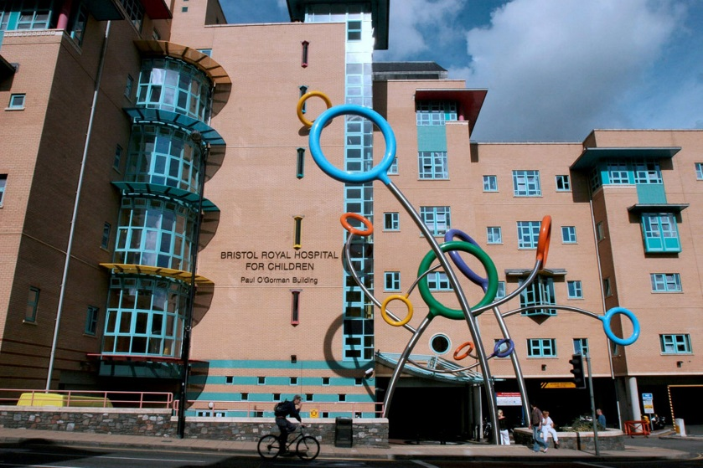


How big is the problem?

Slide 3
Pyramid of injuries
Deaths
Admissions
Emergency Department attendance
No medical attention

Slide 4
Pyramid of injuries
Deaths
Admissions
ED attendance
No medical attention
Data completeness
Data accuracy

Slide 5
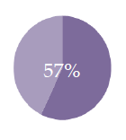
Child deaths
Very low numbers, but lots of information
Child Death Overview Panel reviews circumstances of each death to identify ‘modifiable factors’
Serious Case Review for those with concern regarding neglect or intentional harm
104/178 traumatic deaths reviewed in year to 31st March 2015 had modifiable factors

Slide 6
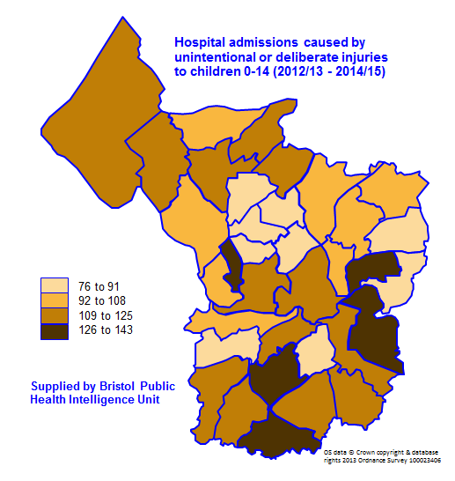
Admissions to hospital with injury
Hospital Episode Statistics
Specialist databases
Trauma Audit and Research Network (TARN)
International Burn Injury Database (iBID)

Slide 7
Major causes of emergency hospital admission for unintentional injuries among under fives, 2008/09–2012/13
Falls | 93,315
Impacts, entrapments, lacerations | 40,558
Accidental poisoning | 23,014
Thermal injuries | 11,115
Struck or bumped into by a person, and dog bites | 6,553
Suffocation and strangulation | 2,024
These six causes represent almost 90% of emergency admissions in this age group.
Source: Hospital Episode Statistics (HES). Copyright © 2014 Re‐used with the permission of The Health and Social Care Information Centre. All rights reserved.
Slide: Unintentional injuries in children under 5. Public Health England 2014
Notes:
This slide shows the six major causes of admissions. The remaining slides on admissions (14-34) will concentrate on these causes as they constitute about 90% of unintentional injury admissions.
Slides 14-34 show the analysis behind the hospital admission headline figures presented under the heading ‘Key findings from the five-year study’ in the briefing document.

Slide 8
Context is important
Location | Emergency hospital admissions due to hot water burns (2008/09-2012/13)
Bristol | 111.3
England | 38.4
Source: PHE unintentional injuries in and around the home among children under five years; Bristol Local Authority area report. 2014.
Q - Does Bristol have a really serious problem with hot water scalds in children?

Slide 9
Context is important
Location | Emergency hospital admissions due to hot water burns (2008/09-2012/13)
Bristol | 111.3
England | 38.4
Source: PHE unintentional injuries in and around the home among children under five years; Bristol Local Authority area report. 2014.
Q - Does Bristol have a really serious problem with hot water scalds in children?
The regional paediatric burns centre is in the Bristol Children’s Hospital
The burns centre admits children with smaller burns than elsewhere in England

Slide 10
Attendance in the emergency department
Home accident surveillance system (HASS) and Leisure accident surveillance system (LASS)
18 A&E departments in England, collected data on 6.8m attendances
Funding ceased in 2003
No national estimates of child injuries presenting to A&E
No system for routinely collecting and analysing local data

Slide 11
Local ED data
Local ED data can be extracted
But
Requires cleaning & coding
Missing data
Does not enable ongoing monitoring for action

Slide 12

Warning! Child injury data ahead
No consistent use of
Definitions of injury
Age groups
Geographical regions
Data incomplete
Very little information on setting / mechanism of injury
No A&E injury surveillance system in the UK
Difficult to collect, collate and interpret
Notes:
Making policy or strategy decisions based on incomplete, poorly coded, out of date data is potentially harmful

Slide 13
So what next?
CIPIC HIT will work with Public Health team at Bristol City Council
Understand injury data
Understand current prevention and care services
Develop a strategy for what to do next

Slide 14
Changes to Public Health Bristol
New structure. Children and Young People’s Public Health Team
Responsible for Health Visitor commissioning (also School Nurses)
Play, parks and leisure services in Bristol now sit within the Public Health Team

Slide 15
Children’s Public Health Injury Prevention
Children and Young People’s Strategic Team
Dr Jo Copping, Public Health Consultant
Jessica Williams, Public Health Principal
Children’s Service Delivery Team
Alex Wood, Advanced Health Improvement Practitioner
Community health development teams in localities

Slide 16
Role of Public Health
Needs assessments
Strategy development
Commissioning services
Providing services
Health promotion, campaigns and training
Working with vulnerable communities
Influencing council policy
Working in partnership- NHS, VCS, Universities

Slide 17

Opportunities Within the Council
Transport
Planning
Housing
Parks, sports and leisure
Early Years
Schools
Social Care
Safeguarding
And still work closely with NHS

Slide 18
Injury Prevention – Needs Assessment
Gathering various source of data
Quantitative
Qualitative
Review of current levels of service provision
Gather patient/public/staff views
Review evidence of effectiveness
… to determine gaps and recommendations
Notes:
To make a start in the packs is a form – name/name of service, contact details and short description of service provided

Slide 19
Needs Assessment- Stakeholders
Identifying the key stakeholders
Identifying what resources are available
Notes:
Post it note activity

Slide 20



How you can help
Pink Post-it = your priorities for child injury and care
Green post-it = your name and contact details to take part in the consultation for the child injury needs assessment
Yellow form = Give us details of services to prevent and support children with injuries

Slide 21
Thank you
Jessica Williams j.Williams@Bristol.gov.uk
Julie Mytton julie.mytton@uwe.ac.uk

