Slide 1
Analytics Terminologies, classifications and information models
UKTC Analytics Workshop February 7th 2013
Notes:
Many of the slides in this presentation pack have extensive explanatory speakers notes

Slide 2
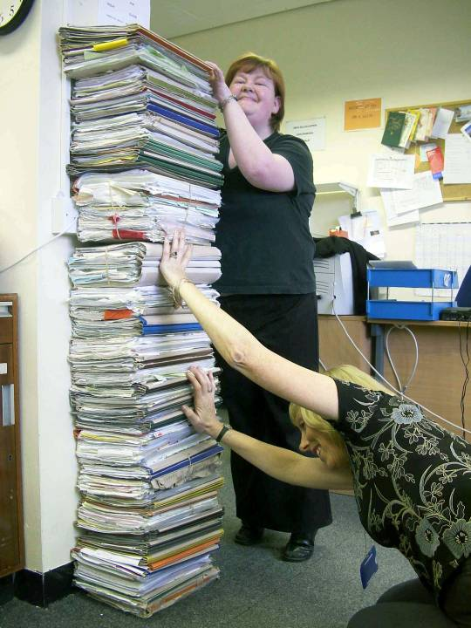
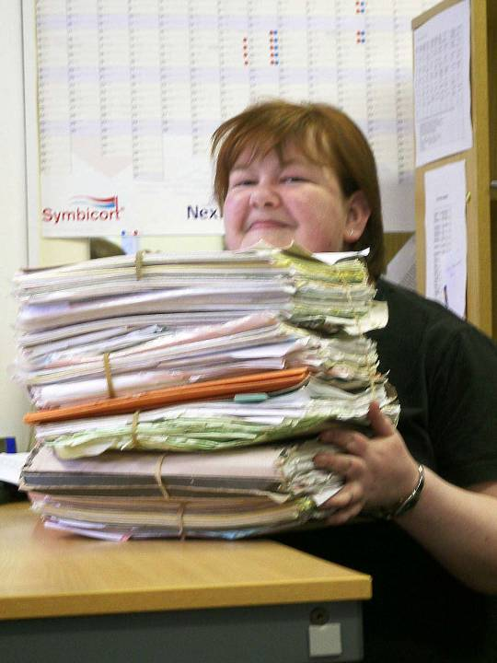
21st Century Data A Physical Tower of Paper
ONE CLINIC
ONE PATIENT
Photos: Mike Bainbridge

Slide 3
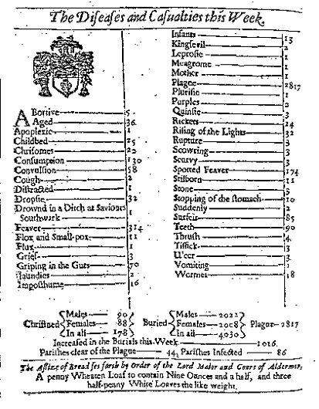
400 years of ‘Analytics’ London Bills of Mortality (1603-)
Notes:
The 15th century analytics problem was simple:
When did you need to get out of town in order to avoid an outbreak of plague (of which there were many)?
The solution involved 15th century information and terminology models: a unique code was required for every unique phenomenon you wanted to count
The London Bills of Mortality are the direct genetic precursor and inspiration for ICD, through the work of John Graunt, William Cullen and then William Farr.
Originally introduced in response to the plague outbreaks of 1592-94, they were published (after a short gap) every Thursday from 1603 until the 1830s.
Annual aggregate reports were also issued.

Slide 4
21st Century Analytics A Virtual Tower of Babel?
ICD10
HRG
OPCS
Choose
& Book
Exclusion
sets
ED
Specialty
READ DD
QOF
1° Care
5-Byte
READ2
Renal
PBCL / NLMC
EoLC
CTV3
eNOIDS
NICIP
SNOMED CT
Dietetics
dm+d
Endoscopy
CRE
MIM
Care Planning
Notes:
The present day informatics infrastructure comprises an accretion of earlier, and generally simpler, attempts to solve the analytics problem.
At the centre (at least, from the perspective of a terminology specialist where what you do is always the centre of everybody else’s world) sit the three clinical terminologies (READ2, CTV3 and SNOMED) supplemented by some cross mapping tables (black arrows). The representation of drug information is handled separately in the NHS Drug Dictionary and dm+d.
This ‘core’ of knowledge representation tools is then referenced by a range of other products. These products can be organised into one of four groups:
In blue are subdomain-sepcific vocabularies like the PBCL or Choose and Book code lists. These are expressed in one or more of the core terminologies, and they typically act to constrain data capture, in some specific clinical context, to some specific fraction of the whole terminology.
In green are minimum dataset specifications for specific reporting requirements, such as the Quality and Outcomes Framework (QOF) for primary care, or the Emergency Dataset (ED) for statutory reporting to the centre of activity in A&E departments.
In maroon are links to classification schemes (similar in some ways to the green reporting datasets in that they primarily drive reporting), and in pink are message specification lists (similar in some ways to the initial data capture lists, in that they act to restrict which bits of the terminology can be used).

Slide 5
Different technical properties Mono vs Polyhierarchies
A1
A1234
Notes:
This animated slide seeks to illustrate the consequences, for querying, of the fact that the different terminologies may choose to arrange the same set of active concepts in different ways. The most obvious difference is between READ2 where a concept can only have one parent, and either CTV3 and SNOMED where a concept can have more than one parent.
Graphically, the animation starts showing an imaginary fragment of the READ2 code hierarchy: each of the 20 coded concepts shown has only one parent, and the hierarchy of concepts is fairly shallow (only four levels deep). The fragment is divided between two discrete chapters or branches.
As the slide animation progresses, simulating the changes in how CTV3 and SNOMED represent the same space of all clinical concepts, it will be seen that the relationship between the original 20 codes and all the other codes changes as the hierarchy changes about them.
Both CTV3 and SNOMED CT contain the same clinical concepts as READ2, but they also add more detailed ones. This results in more concepts and more levels to the hierarchy. Additionally, both may add further parent-child relationships so that some concepts have more than one parent (e.g. to make infective carditis BOTH a kind of infectious disease AND a kind of cardiovascular disease).
Significantly, both CTV3 and SNOMED can also remove parent-child relationships that were present in one or other of the other two terminologies (e.g. [C10FK Hyperosmolar non-ketotic state in type 2 diabetes mellitus] is a subtype of [C10F. Type 2 diabetes mellitus] in READ2 but the corresponding [395204000 Hyperosmolar non-ketotic state in type 2 diabetes mellitus] in SNOMED is not a subtype of 44054006 Diabetes mellitus type 2, since it’s a complication of the condition not a subtype of it.)
Also, significantly, both CTV3 and SNOMED can inactivate concepts: whilst both schemes always retain all concept identifiers ever issued, and neither ever reuses a previously released identifier, both include a subset of concept codes that are flagged as inactive. Critically, in both CTV3 and SNOMED, one of the consequences of inactivation is that a concept ceases to have any (clinically useful) parents or children. They continue to exist in the terminology as a whole, but are situated outside the main reporting hierarchy.
Finally, because both CTV3 and SNOMED are polyhierarchical (=concepts can have more than one parent), it is not possible to encode the hierarchy using the code itself. As a result, you can not test whether code A is an ancestor of code B purely by comparing the code strings. Another technical solution is required for this ‘subsumption testing’ operation.

Slide 6
Different knowledge properties Changing extension of ‘Diabetes’
READ2 L.... Complications of pregnancy, childbirth and the puerperium
L1... Pregnancy complications
L18.. Other medical condition during pregnancy, childbirth and the puerperium
L180. Diabetes mellitus during pregnancy, childbirth and the puerperium
L1806 Pre-existing diabetes mellitus, non-insulin-dependent
C10.. Diabetes mellitus CTV3
X40J5 Type II diabetes mellitus
C1090 Type II diabetes mellitus with renal complications
C1091 Type II diabetes mellitus with ophthalmic complications
C1092 Type II diabetes mellitus with neurological complications
C1093 Type II diabetes mellitus with multiple complications
C1094 Type II diabetes mellitus with ulcer
C1095 Type II diabetes mellitus with gangrene
C1097 Type II diabetes mellitus - poor control
L1806 Pre-existing diabetes mellitus, non-insulin-dependent
XaELQ Type II diabetes mellitus without complication
XaFWI Type II diabetes mellitus with hypoglycaemic coma
XaFn7 Type II diabetes mellitus with peripheral angiopathy
XaFn8 Type II diabetes mellitus with arthropathy
C10.. Diabetes mellitus CTV3
X40J5 Type II diabetes mellitus
C1090 Type II diabetes mellitus with renal complications
C1091 Type II diabetes mellitus with ophthalmic complications
C1092 Type II diabetes mellitus with neurological complications
C1093 Type II diabetes mellitus with multiple complications
C1094 Type II diabetes mellitus with ulcer
C1095 Type II diabetes mellitus with gangrene
C1097 Type II diabetes mellitus - poor control
L1806 Pre-existing diabetes mellitus, non-insulin-dependent
XaELQ Type II diabetes mellitus without complication
XaFWI Type II diabetes mellitus with hypoglycaemic coma
XaFn7 Type II diabetes mellitus with peripheral angiopathy
XaFn8 Type II diabetes mellitus with arthropathy
Disease (disorder) SNOMED CT
Diabetic complication (disorder)
Kidney disease (disorder)
Renal disorders in systemic disease (disorder)
Diabetic renal disease (disorder)
Diabetic complication (disorder)
Disorder associated with type 2 diabetes mellitus (disorder)
Renal disorder associated with type II diabetes mellitus (disorder)
Persistent microalbuminuria associated with type II diabetes mellitus (disorder)
Persistent proteinuria associated with type II diabetes mellitus (disorder)
Notes:
A more detailed example of how the meaning of codes can change between the terminologies is shown here.
In READ2, because the code L1806 sits in Chapter L, it is implicit that the patient is currently pregnant – though this isn’t explicitly stated in the rubric. However, this omission in the original term (which is in fact inherited directly from ICD) is probably why the code has subsequently been moved within CTV3 and also in SNOMED to an area of the respective hierarchies that no longer necessarily imply concurrent pregnancy.
Similarly, in both READ2 and CTV3, complications of diabetes are classified as subtypes of diabetes. This classification is really a convenience, again inherited directly from ICD, and most likely intended to make reporting specifications simpler. But its not true in the general case, and so SNOMED has systematically moved ‘complications of disease X’ out from under ‘disease X’ throughout its heirachies.

Slide 7
Different requirements Commissioning Intelligence Model
Support information needs of commissioners, based on the full life-cycle of commissioning activities.
Key element is the availability of data from primary care; this is required if commissioners are to be best in class.
The most requested requirement from CCGs commissioners is to provide access to primary care data and to link it to other care settings to facilitate a holistic view of care across care settings. From a national commissioning perspective, the prime requirement is to ensure that the linkage of primary care with other datasets supports the outcomes frameworks, to identify variation in CCG practice.
Notes:
These changes in the technical and knowledge content of the three clinical terminologies have occurred over a period of three decades, in response to evolving understanding of how to construct ‘general purpose’ terminologies capable of supporting increasingly advanced expectations of clinical reporting and reasoning.
The current shift towards an information-led commissioning model for healthcare introduces new requirements and expectations.

Slide 8
Different information model boundaries What’s a terminology?
A heuristically (dis)organised list of symbols for every arbitrary constellation of phenomena or completed clinical narratives that anybody wants to count (Hint: no, that’s a dataset)
A formally organised set of symbols to represent only that part of knowledge which is formally representable and organisable (but that therefore isn’t a dataset out of the box)

Slide 9
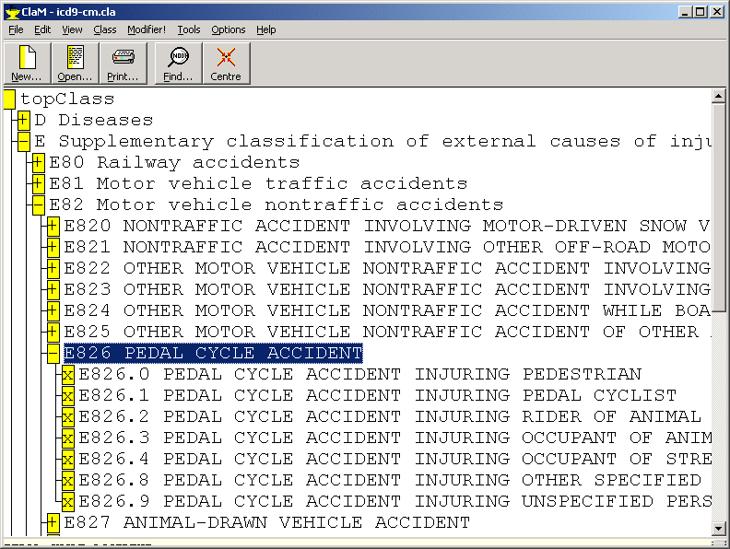
16th Century Information Models A code for each thing you want to count
1972 ICD-9 8
READ-2 81
CTV3 87
1999 ICD-10 ……
Notes:
ICD-9-CM was released in 1972. Over the following 15 years or so, the number of codes made available in similar schemes for coding pedal cycle accidents gradually increased, to around 87 by the time of CTV3 in the mid- to late 1990s.

Slide 10
16th Century Information Models 587 codes for each thing you want to count
topClass
I Certain infectious and parasitic diseases
II Neoplasms
III Diseases of the blood and blood-forming organs and certain disorders involving the immune mechanism
IV Endocrine, nutritional and metabolic diseases
V Mental and behavioural disorders
VI Diseases of the nervous system
VII Diseases of the eye and adnexa
VIII Diseases of the ear and mastoid process
IX Diseases of the circulatory systems
X Diseases of the respiratory system
XI Diseases of the digestive system
XII Diseases of the skin and subcutaneous tissue
XIII Diseases of the musculoskeletal system and connective tissue
XIV Diseases of the genitourinary system
XV Pregnancy, childbirth and the puerperium
XVI Certain conditions originating in the perinatal period
XVII Congenital malformations, deformations and chromosomal abnormalities
XVIII Symptoms, signs and abnormal clinical and laboratory findings, not elsewhere classified
XIX Injury, poisoning and certain other consequences of external causes
XX External causes of morbidity and mortality
V01-V99 Transport accidents
V01-V09 Pedestrian injured in transport accident
V10-V19 Pedal cyclist injured in transport accident
V10 Pedal cyclist injured in collision with pedestrian or animal
V10.0 Pedal cyclist injured in collision with pedestrian or animal, driver, nontraffic accident
V10.00 Pedal cyclist injured in collision with pedestrian or animal, driver, nontraffic accident, while engaged in sports activity
V10.01 Pedal cyclist injured in collision with pedestrian or animal, driver, nontraffic accident, while engaged in leisure activity
V10.02 Pedal cyclist injured in collision with pedestrian or animal, driver, nontraffic accident, while working for an income
V10.03 Pedal cyclist injured in collision with pedestrian or animal, driver, nontraffic accident, while engaged in other types of work
V10.04 Pedal cyclist injured in collision with pedestrian or animal, driver, nontraffic accident, while resting, sleeping, eating or engaging in other vital activities
V10.08 Pedal cyclist injured in collision with pedestrian or animal, driver, nontraffic accident, while engaged in other specified activities
V10.09 Pedal cyclist injured in collision with pedestrian or animal, driver, nontraffic accident, during unspecified activity
V10.1 Pedal cyclist injured in collision with pedestrian or animal, passenger, nontraffic accident
V10.10 Pedal cyclist injured in collision with pedestrian or animal, passenger, nontraffic accident, while engaged in sports activity
V10.11 Pedal cyclist injured in collision with pedestrian or animal, passenger, nontraffic accident, while engaged in leisure activity
V10.12 Pedal cyclist injured in collision with pedestrian or animal, passenger, nontraffic accident, while working for an income
V10.13 Pedal cyclist injured in collision with pedestrian or animal, passenger, nontraffic accident, while engaged in other types of work
V10.14 Pedal cyclist injured in collision with pedestrian or animal, passenger, nontraffic accident, while resting, sleeping, eating or engaging in other vital activities
V10.18 Pedal cyclist injured in collision with pedestrian or animal, passenger, nontraffic accident, while engaged in other specified activities
V10.19 Pedal cyclist injured in collision with pedestrian or animal, passenger, nontraffic accident, during unspecified activity
V10.2 Pedal cyclist injured in collision with pedestrian or animal, unspecified pedal cyclist, nontraffic accident
V10.20 Pedal cyclist injured in collision with pedestrian or animal, unspecified pedal cyclist, nontraffic accident, while engaged in sports activity
V10.21 Pedal cyclist injured in collision with pedestrian or animal, unspecified pedal cyclist, nontraffic accident, while engaged in leisure activity
V10.22 Pedal cyclist injured in collision with pedestrian or animal, unspecified pedal cyclist, nontraffic accident, while working for an income
V10.23 Pedal cyclist injured in collision with pedestrian or animal, unspecified pedal cyclist, nontraffic accident, while engaged in other types of work
V10.24 Pedal cyclist injured in collision with pedestrian or animal, unspecified pedal cyclist, nontraffic accident, while resting, sleeping, eating or engaging in other vital activities
V10.28 Pedal cyclist injured in collision with pedestrian or animal, unspecified pedal cyclist, nontraffic accident, while engaged in other specified activities
V10.29 Pedal cyclist injured in collision with pedestrian or animal, unspecified pedal cyclist, nontraffic accident, during unspecified activity
V10.3 Pedal cyclist injured in collision with pedestrian or animal, while boarding or alighting
V10.30 Pedal cyclist injured in collision with pedestrian or animal, while boarding or alighting, while engaged in sports activity
V10.31 Pedal cyclist injured in collision with pedestrian or animal, while boarding or alighting, while engaged in leisure activity
V10.32 Pedal cyclist injured in collision with pedestrian or animal, while boarding or alighting, while working for an income
V10.33 Pedal cyclist injured in collision with pedestrian or animal, while boarding or alighting, while engaged in other types of work
V10.34 Pedal cyclist injured in collision with pedestrian or animal, while boarding or alighting, while resting, sleeping, eating or engaging in other vital activities
V10.38 Pedal cyclist injured in collision with pedestrian or animal, while boarding or alighting, while engaged in other specified activities
V10.39 Pedal cyclist injured in collision with pedestrian or animal, while boarding or alighting, during unspecified activity
V10.4 Pedal cyclist injured in collision with pedestrian or animal, driver, traffic accident
V10.40 Pedal cyclist injured in collision with pedestrian or animal, driver, traffic accident, while engaged in sports activity
V10.41 Pedal cyclist injured in collision with pedestrian or animal, driver, traffic accident, while engaged in leisure activity
V10.42 Pedal cyclist injured in collision with pedestrian or animal, driver, traffic accident, while working for an income
V10.43 Pedal cyclist injured in collision with pedestrian or animal, driver, traffic accident, while engaged in other types of work
V10.44 Pedal cyclist injured in collision with pedestrian or animal, driver, traffic accident, while resting, sleeping, eating or engaging in other vital activities
V10.48 Pedal cyclist injured in collision with pedestrian or animal, driver, traffic accident, while engaged in other specified activities
V10.49 Pedal cyclist injured in collision with pedestrian or animal, driver, traffic accident, during unspecified activity
V10.5 Pedal cyclist injured in collision with pedestrian or animal, passenger, traffic accident
V10.50 Pedal cyclist injured in collision with pedestrian or animal, passenger, traffic accident, while engaged in sports activity
V10.51 Pedal cyclist injured in collision with pedestrian or animal, passenger, traffic accident, while engaged in leisure activity
V10.52 Pedal cyclist injured in collision with pedestrian or animal, passenger, traffic accident, while working for an income
V10.53 Pedal cyclist injured in collision with pedestrian or animal, passenger, traffic accident, while engaged in other types of work
V10.54 Pedal cyclist injured in collision with pedestrian or animal, passenger, traffic accident, while resting, sleeping, eating or engaging in other vital activities
V10.58 Pedal cyclist injured in collision with pedestrian or animal, passenger, traffic accident, while engaged in other specified activities
V10.59 Pedal cyclist injured in collision with pedestrian or animal, passenger, traffic accident, during unspecified activity
V10.9 Pedal cyclist injured in collision with pedestrian or animal, unspecified pedal cyclist, traffic accident
V10.90 Pedal cyclist injured in collision with pedestrian or animal, unspecified pedal cyclist, traffic accident, while engaged in sports activity
V10.91 Pedal cyclist injured in collision with pedestrian or animal, unspecified pedal cyclist, traffic accident, while engaged in leisure activity
V10.92 Pedal cyclist injured in collision with pedestrian or animal, unspecified pedal cyclist, traffic accident, while working for an income
V10.93 Pedal cyclist injured in collision with pedestrian or animal, unspecified pedal cyclist, traffic accident, while engaged in other types of work
V10.94 Pedal cyclist injured in collision with pedestrian or animal, unspecified pedal cyclist, traffic accident, while resting, sleeping, eating or engaging in other vital activities
V10.98 Pedal cyclist injured in collision with pedestrian or animal, unspecified pedal cyclist, traffic accident, while engaged in other specified activities
V10.99 Pedal cyclist injured in collision with pedestrian or animal, unspecified pedal cyclist, traffic accident, during unspecified activity
V11 Pedal cyclist injured in collision with other pedal cycle
V11.0 Pedal cyclist injured in collision with other pedal cycle, driver, nontraffic accident
V11.00 Pedal cyclist injured in collision with other pedal cycle, driver, nontraffic accident, while engaged in sports activity
V11.01 Pedal cyclist injured in collision with other pedal cycle, driver, nontraffic accident, while engaged in leisure activity
V11.02 Pedal cyclist injured in collision with other pedal cycle, driver, nontraffic accident, while working for an income
V11.03 Pedal cyclist injured in collision with other pedal cycle, driver, nontraffic accident, while engaged in other types of work
V11.04 Pedal cyclist injured in collision with other pedal cycle, driver, nontraffic accident, while resting, sleeping, eating or engaging in other vital activities
V11.08 Pedal cyclist injured in collision with other pedal cycle, driver, nontraffic accident, while engaged in other specified activities
V11.09 Pedal cyclist injured in collision with other pedal cycle, driver, nontraffic accident, during unspecified activity
V11.1 Pedal cyclist injured in collision with other pedal cycle, passenger, nontraffic accident
V11.10 Pedal cyclist injured in collision with other pedal cycle, passenger, nontraffic accident, while engaged in sports activity
V11.11 Pedal cyclist injured in collision with other pedal cycle, passenger, nontraffic accident, while engaged in leisure activity
V11.12 Pedal cyclist injured in collision with other pedal cycle, passenger, nontraffic accident, while working for an income
V11.13 Pedal cyclist injured in collision with other pedal cycle, passenger, nontraffic accident, while engaged in other types of work
V11.14 Pedal cyclist injured in collision with other pedal cycle, passenger, nontraffic accident, while resting, sleeping, eating or engaging in other vital activities
V11.18 Pedal cyclist injured in collision with other pedal cycle, passenger, nontraffic accident, while engaged in other specified activities
V11.19 Pedal cyclist injured in collision with other pedal cycle, passenger, nontraffic accident, during unspecified activity
V11.2 Pedal cyclist injured in collision with other pedal cycle, unspecified pedal cyclist, nontraffic accident
V11.20 Pedal cyclist injured in collision with other pedal cycle, unspecified pedal cyclist, nontraffic accident, while engaged in sports activity
V11.21 Pedal cyclist injured in collision with other pedal cycle, unspecified pedal cyclist, nontraffic accident, while engaged in leisure activity
V11.22 Pedal cyclist injured in collision with other pedal cycle, unspecified pedal cyclist, nontraffic accident, while working for an income
V11.23 Pedal cyclist injured in collision with other pedal cycle, unspecified pedal cyclist, nontraffic accident, while engaged in other types of work
V11.24 Pedal cyclist injured in collision with other pedal cycle, unspecified pedal cyclist, nontraffic accident, while resting, sleeping, eating or engaging in other vital activities
V11.28 Pedal cyclist injured in collision with other pedal cycle, unspecified pedal cyclist, nontraffic accident, while engaged in other specified activities
V11.29 Pedal cyclist injured in collision with other pedal cycle, unspecified pedal cyclist, nontraffic accident, during unspecified activity
V11.3 Pedal cyclist injured in collision with other pedal cycle, while boarding or alighting
V11.30 Pedal cyclist injured in collision with other pedal cycle, while boarding or alighting, while engaged in sports activity
V11.31 Pedal cyclist injured in collision with other pedal cycle, while boarding or alighting, while engaged in leisure activity
V11.32 Pedal cyclist injured in collision with other pedal cycle, while boarding or alighting, while working for an income
V11.33 Pedal cyclist injured in collision with other pedal cycle, while boarding or alighting, while engaged in other types of work
V11.34 Pedal cyclist injured in collision with other pedal cycle, while boarding or alighting, while resting, sleeping, eating or engaging in other vital activities
V11.38 Pedal cyclist injured in collision with other pedal cycle, while boarding or alighting, while engaged in other specified activities
V11.39 Pedal cyclist injured in collision with other pedal cycle, while boarding or alighting, during unspecified activity
V11.4 Pedal cyclist injured in collision with other pedal cycle, driver, traffic accident
V11.40 Pedal cyclist injured in collision with other pedal cycle, driver, traffic accident, while engaged in sports activity
V11.41 Pedal cyclist injured in collision with other pedal cycle, driver, traffic accident, while engaged in leisure activity
V11.42 Pedal cyclist injured in collision with other pedal cycle, driver, traffic accident, while working for an income
V11.43 Pedal cyclist injured in collision with other pedal cycle, driver, traffic accident, while engaged in other types of work
V11.44 Pedal cyclist injured in collision with other pedal cycle, driver, traffic accident, while resting, sleeping, eating or engaging in other vital activities
V11.48 Pedal cyclist injured in collision with other pedal cycle, driver, traffic accident, while engaged in other specified activities
V11.49 Pedal cyclist injured in collision with other pedal cycle, driver, traffic accident, during unspecified activity
V11.5 Pedal cyclist injured in collision with other pedal cycle, passenger, traffic accident
V11.50 Pedal cyclist injured in collision with other pedal cycle, passenger, traffic accident, while engaged in sports activity
V11.51 Pedal cyclist injured in collision with other pedal cycle, passenger, traffic accident, while engaged in leisure activity
V11.52 Pedal cyclist injured in collision with other pedal cycle, passenger, traffic accident, while working for an income
V11.53 Pedal cyclist injured in collision with other pedal cycle, passenger, traffic accident, while engaged in other types of work
V11.54 Pedal cyclist injured in collision with other pedal cycle, passenger, traffic accident, while resting, sleeping, eating or engaging in other vital activities
V11.58 Pedal cyclist injured in collision with other pedal cycle, passenger, traffic accident, while engaged in other specified activities
V11.59 Pedal cyclist injured in collision with other pedal cycle, passenger, traffic accident, during unspecified activity
V11.9 Pedal cyclist injured in collision with other pedal cycle, unspecified pedal cyclist, traffic accident
V11.90 Pedal cyclist injured in collision with other pedal cycle, unspecified pedal cyclist, traffic accident, while engaged in sports activity
V11.91 Pedal cyclist injured in collision with other pedal cycle, unspecified pedal cyclist, traffic accident, while engaged in leisure activity
V11.92 Pedal cyclist injured in collision with other pedal cycle, unspecified pedal cyclist, traffic accident, while working for an income
V11.93 Pedal cyclist injured in collision with other pedal cycle, unspecified pedal cyclist, traffic accident, while engaged in other types of work
V11.94 Pedal cyclist injured in collision with other pedal cycle, unspecified pedal cyclist, traffic accident, while resting, sleeping, eating or engaging in other vital activities
V11.98 Pedal cyclist injured in collision with other pedal cycle, unspecified pedal cyclist, traffic accident, while engaged in other specified activities
V11.99 Pedal cyclist injured in collision with other pedal cycle, unspecified pedal cyclist, traffic accident, during unspecified activity
V12 Pedal cyclist injured in collision with two- or three-wheeled motor vehicle
V12.0 Pedal cyclist injured in collision with two- or three-wheeled motor vehicle, driver, nontraffic accident
V12.00 Pedal cyclist injured in collision with two- or three-wheeled motor vehicle, driver, nontraffic accident, while engaged in sports activity
V12.01 Pedal cyclist injured in collision with two- or three-wheeled motor vehicle, driver, nontraffic accident, while engaged in leisure activity
V12.02 Pedal cyclist injured in collision with two- or three-wheeled motor vehicle, driver, nontraffic accident, while working for an income
V12.03 Pedal cyclist injured in collision with two- or three-wheeled motor vehicle, driver, nontraffic accident, while engaged in other types of work
V12.04 Pedal cyclist injured in collision with two- or three-wheeled motor vehicle, driver, nontraffic accident, while resting, sleeping, eating or engaging in other vital activities
V12.08 Pedal cyclist injured in collision with two- or three-wheeled motor vehicle, driver, nontraffic accident, while engaged in other specified activities
V12.09 Pedal cyclist injured in collision with two- or three-wheeled motor vehicle, driver, nontraffic accident, during unspecified activity
V12.1 Pedal cyclist injured in collision with two- or three-wheeled motor vehicle, passenger, nontraffic accident
V12.10 Pedal cyclist injured in collision with two- or three-wheeled motor vehicle, passenger, nontraffic accident, while engaged in sports activity
V12.11 Pedal cyclist injured in collision with two- or three-wheeled motor vehicle, passenger, nontraffic accident, while engaged in leisure activity
V12.12 Pedal cyclist injured in collision with two- or three-wheeled motor vehicle, passenger, nontraffic accident, while working for an income
V12.13 Pedal cyclist injured in collision with two- or three-wheeled motor vehicle, passenger, nontraffic accident, while engaged in other types of work
V12.14 Pedal cyclist injured in collision with two- or three-wheeled motor vehicle, passenger, nontraffic accident, while resting, sleeping, eating or engaging in other vital activities
V12.18 Pedal cyclist injured in collision with two- or three-wheeled motor vehicle, passenger, nontraffic accident, while engaged in other specified activities
V12.19 Pedal cyclist injured in collision with two- or three-wheeled motor vehicle, passenger, nontraffic accident, during unspecified activity
V12.2 Pedal cyclist injured in collision with two- or three-wheeled motor vehicle, unspecified pedal cyclist, nontraffic accident
V12.20 Pedal cyclist injured in collision with two- or three-wheeled motor vehicle, unspecified pedal cyclist, nontraffic accident, while engaged in sports activity
V12.21 Pedal cyclist injured in collision with two- or three-wheeled motor vehicle, unspecified pedal cyclist, nontraffic accident, while engaged in leisure activity
V12.22 Pedal cyclist injured in collision with two- or three-wheeled motor vehicle, unspecified pedal cyclist, nontraffic accident, while working for an income
V12.23 Pedal cyclist injured in collision with two- or three-wheeled motor vehicle, unspecified pedal cyclist, nontraffic accident, while engaged in other types of work
V12.24 Pedal cyclist injured in collision with two- or three-wheeled motor vehicle, unspecified pedal cyclist, nontraffic accident, while resting, sleeping, eating or engaging in other vital activities
V12.28 Pedal cyclist injured in collision with two- or three-wheeled motor vehicle, unspecified pedal cyclist, nontraffic accident, while engaged in other specified activities
V12.29 Pedal cyclist injured in collision with two- or three-wheeled motor vehicle, unspecified pedal cyclist, nontraffic accident, during unspecified activity
V12.3 Pedal cyclist injured in collision with two- or three-wheeled motor vehicle, while boarding or alighting
V12.30 Pedal cyclist injured in collision with two- or three-wheeled motor vehicle, while boarding or alighting, while engaged in sports activity
V12.31 Pedal cyclist injured in collision with two- or three-wheeled motor vehicle, while boarding or alighting, while engaged in leisure activity
V12.32 Pedal cyclist injured in collision with two- or three-wheeled motor vehicle, while boarding or alighting, while working for an income
V12.33 Pedal cyclist injured in collision with two- or three-wheeled motor vehicle, while boarding or alighting, while engaged in other types of work
V12.34 Pedal cyclist injured in collision with two- or three-wheeled motor vehicle, while boarding or alighting, while resting, sleeping, eating or engaging in other vital activities
V12.38 Pedal cyclist injured in collision with two- or three-wheeled motor vehicle, while boarding or alighting, while engaged in other specified activities
V12.39 Pedal cyclist injured in collision with two- or three-wheeled motor vehicle, while boarding or alighting, during unspecified activity
V16.4 Pedal cyclist injured in collision with other nonmotor vehicle, driver, traffic accident
V16.40 Pedal cyclist injured in collision with other nonmotor vehicle, driver, traffic accident, while engaged in sports activity
V16.41 Pedal cyclist injured in collision with other nonmotor vehicle, driver, traffic accident, while engaged in leisure activity
V16.42 Pedal cyclist injured in collision with other nonmotor vehicle, driver, traffic accident, while working for an income
V16.43 Pedal cyclist injured in collision with other nonmotor vehicle, driver, traffic accident, while engaged in other types of work
V16.44 Pedal cyclist injured in collision with other nonmotor vehicle, driver, traffic accident, while resting, sleeping, eating or engaging in other vital activities
V16.48 Pedal cyclist injured in collision with other nonmotor vehicle, driver, traffic accident, while engaged in other specified activities
V16.49 Pedal cyclist injured in collision with other nonmotor vehicle, driver, traffic accident, during unspecified activity
V16.5 Pedal cyclist injured in collision with other nonmotor vehicle, passenger, traffic accident
V16.50 Pedal cyclist injured in collision with other nonmotor vehicle, passenger, traffic accident, while engaged in sports activity
V16.51 Pedal cyclist injured in collision with other nonmotor vehicle, passenger, traffic accident, while engaged in leisure activity
V16.52 Pedal cyclist injured in collision with other nonmotor vehicle, passenger, traffic accident, while working for an income
V16.53 Pedal cyclist injured in collision with other nonmotor vehicle, passenger, traffic accident, while engaged in other types of work
V16.54 Pedal cyclist injured in collision with other nonmotor vehicle, passenger, traffic accident, while resting, sleeping, eating or engaging in other vital activities
V16.58 Pedal cyclist injured in collision with other nonmotor vehicle, passenger, traffic accident, while engaged in other specified activities
V16.59 Pedal cyclist injured in collision with other nonmotor vehicle, passenger, traffic accident, during unspecified activity
V16.9 Pedal cyclist injured in collision with other nonmotor vehicle, unspecified pedal cyclist, traffic accident
V16.90 Pedal cyclist injured in collision with other nonmotor vehicle, unspecified pedal cyclist, traffic accident, while engaged in leisure activity
V16.91 Pedal cyclist injured in collision with other nonmotor vehicle, unspecified pedal cyclist, traffic accident, while engaged in sports activity
V16.92 Pedal cyclist injured in collision with other nonmotor vehicle, unspecified pedal cyclist, traffic accident, while working for an income
V16.93 Pedal cyclist injured in collision with other nonmotor vehicle, unspecified pedal cyclist, traffic accident, while engaged in other types of work
V16.94 Pedal cyclist injured in collision with other nonmotor vehicle, unspecified pedal cyclist, traffic accident, while resting, sleeping, eating or engaging in other vital activities
V16.98 Pedal cyclist injured in collision with other nonmotor vehicle, unspecified pedal cyclist, traffic accident, while engaged in other specified activities
V16.99 Pedal cyclist injured in collision with other nonmotor vehicle, unspecified pedal cyclist, traffic accident, during unspecified activity
V17 Pedal cyclist injured in collision with fixed or stationary object
V17.0 Pedal cyclist injured in collision with fixed or stationary object, driver, nontraffic accident
V17.00 Pedal cyclist injured in collision with fixed or stationary object, driver, nontraffic accident, while engaged in sports activity
V17.01 Pedal cyclist injured in collision with fixed or stationary object, driver, nontraffic accident, while engaged in leisure activity
V17.02 Pedal cyclist injured in collision with fixed or stationary object, driver, nontraffic accident, while working for an income
V17.03 Pedal cyclist injured in collision with fixed or stationary object, driver, nontraffic accident, while engaged in other types of work
V17.04 Pedal cyclist injured in collision with fixed or stationary object, driver, nontraffic accident, while resting, sleeping, eating or engaging in other vital activities
V17.08 Pedal cyclist injured in collision with fixed or stationary object, driver, nontraffic accident, while engaged in other specified activities
V17.09 Pedal cyclist injured in collision with fixed or stationary object, driver, nontraffic accident, during unspecified activity
V17.1 Pedal cyclist injured in collision with fixed or stationary object, passenger, nontraffic accident
V17.10 Pedal cyclist injured in collision with fixed or stationary object, passenger, nontraffic accident, while engaged in sports activity
V17.11 Pedal cyclist injured in collision with fixed or stationary object, passenger, nontraffic accident, while engaged in leisure activity
V17.12 Pedal cyclist injured in collision with fixed or stationary object, passenger, nontraffic accident, while working for an income
V17.13 Pedal cyclist injured in collision with fixed or stationary object, passenger, nontraffic accident, while engaged in other types of work
V17.14 Pedal cyclist injured in collision with fixed or stationary object, passenger, nontraffic accident, while resting, sleeping, eating or engaging in other vital activities
V17.18 Pedal cyclist injured in collision with fixed or stationary object, passenger, nontraffic accident, while engaged in other specified activities
V17.19 Pedal cyclist injured in collision with fixed or stationary object, passenger, nontraffic accident, during unspecified activity
V17.2 Pedal cyclist injured in collision with fixed or stationary object, unspecified pedal cyclist, nontraffic accident
V17.20 Pedal cyclist injured in collision with fixed or stationary object, unspecified pedal cyclist, nontraffic accident, while engaged in sports activity
V17.21 Pedal cyclist injured in collision with fixed or stationary object, unspecified pedal cyclist, nontraffic accident, while engaged in leisure activity
V17.22 Pedal cyclist injured in collision with fixed or stationary object, unspecified pedal cyclist, nontraffic accident, while working for an income
V17.23 Pedal cyclist injured in collision with fixed or stationary object, unspecified pedal cyclist, nontraffic accident, while engaged in other types of work
V17.24 Pedal cyclist injured in collision with fixed or stationary object, unspecified pedal cyclist, nontraffic accident, while resting, sleeping, eating or engaging in other vital activities
V17.28 Pedal cyclist injured in collision with fixed or stationary object, unspecified pedal cyclist, nontraffic accident, while engaged in other specified activities
V17.29 Pedal cyclist injured in collision with fixed or stationary object, unspecified pedal cyclist, nontraffic accident, during unspecified activity
V17.3 Pedal cyclist injured in collision with fixed or stationary object, while boarding or alighting
V17.30 Pedal cyclist injured in collision with fixed or stationary object, while boarding or alighting, while engaged in sports activity
V17.31 Pedal cyclist injured in collision with fixed or stationary object, while boarding or alighting, while engaged in leisure activity
V17.32 Pedal cyclist injured in collision with fixed or stationary object, while boarding or alighting, while working for an income
V17.33 Pedal cyclist injured in collision with fixed or stationary object, while boarding or alighting, while engaged in other types of work
V17.34 Pedal cyclist injured in collision with fixed or stationary object, while boarding or alighting, while resting, sleeping, eating or engaging in other vital activities
V17.38 Pedal cyclist injured in collision with fixed or stationary object, while boarding or alighting, while engaged in other specified activities
V17.39 Pedal cyclist injured in collision with fixed or stationary object, while boarding or alighting, during unspecified activity
V17.4 Pedal cyclist injured in collision with fixed or stationary object, driver, traffic accident
V17.40 Pedal cyclist injured in collision with fixed or stationary object, driver, traffic accident, while engaged in sports activity
V17.41 Pedal cyclist injured in collision with fixed or stationary object, driver, traffic accident, while engaged in leisure activity
V17.42 Pedal cyclist injured in collision with fixed or stationary object, driver, traffic accident, while working for an income
V17.43 Pedal cyclist injured in collision with fixed or stationary object, driver, traffic accident, while engaged in other types of work
V17.44 Pedal cyclist injured in collision with fixed or stationary object, driver, traffic accident, while resting, sleeping, eating or engaging in other vital activities
V17.48 Pedal cyclist injured in collision with fixed or stationary object, driver, traffic accident, while engaged in other specified activities
V17.49 Pedal cyclist injured in collision with fixed or stationary object, driver, traffic accident, during unspecified activity
V17.5 Pedal cyclist injured in collision with fixed or stationary object, passenger, traffic accident
V17.50 Pedal cyclist injured in collision with fixed or stationary object, passenger, traffic accident, while engaged in sports activity
V17.51 Pedal cyclist injured in collision with fixed or stationary object, passenger, traffic accident, while engaged in leisure activity
V17.52 Pedal cyclist injured in collision with fixed or stationary object, passenger, traffic accident, while working for an income
V17.53 Pedal cyclist injured in collision with fixed or stationary object, passenger, traffic accident, while engaged in other types of work
V17.54 Pedal cyclist injured in collision with fixed or stationary object, passenger, traffic accident, while resting, sleeping, eating or engaging in other vital activities
V17.58 Pedal cyclist injured in collision with fixed or stationary object, passenger, traffic accident, while engaged in other specified activities
V17.59 Pedal cyclist injured in collision with fixed or stationary object, passenger, traffic accident, during unspecified activity
V17.9 Pedal cyclist injured in collision with fixed or stationary object, unspecified pedal cyclist, traffic accident
V17.90 Pedal cyclist injured in collision with fixed or stationary object, unspecified pedal cyclist, traffic accident, while engaged in sports activity
V17.91 Pedal cyclist injured in collision with fixed or stationary object, unspecified pedal cyclist, traffic accident, while engaged in leisure activity
V17.92 Pedal cyclist injured in collision with fixed or stationary object, unspecified pedal cyclist, traffic accident, while working for an income
V17.93 Pedal cyclist injured in collision with fixed or stationary object, unspecified pedal cyclist, traffic accident, while engaged in other types of work
V17.94 Pedal cyclist injured in collision with fixed or stationary object, unspecified pedal cyclist, traffic accident, while resting, sleeping, eating or engaging in other vital activities
V17.98 Pedal cyclist injured in collision with fixed or stationary object, unspecified pedal cyclist, traffic accident, while engaged in other specified activities
V17.99 Pedal cyclist injured in collision with fixed or stationary object, unspecified pedal cyclist, traffic accident, during unspecified activity
V18 Pedal cyclist injured in noncollision transport accident
V18.0 Pedal cyclist injured in noncollision transport accident, driver, nontraffic accident
V18.00 Pedal cyclist injured in noncollision transport accident, driver, nontraffic accident, while engaged in sports activity
V18.01 Pedal cyclist injured in noncollision transport accident, driver, nontraffic accident, while engaged in leisure activity
V18.02 Pedal cyclist injured in noncollision transport accident, driver, nontraffic accident, while working for an income
V18.03 Pedal cyclist injured in noncollision transport accident, driver, nontraffic accident, while engaged in other types of work
V18.04 Pedal cyclist injured in noncollision transport accident, driver, nontraffic accident, while resting, sleeping, eating or engaging in other vital activities
V18.08 Pedal cyclist injured in noncollision transport accident, driver, nontraffic accident, while engaged in other specified activities
V18.09 Pedal cyclist injured in noncollision transport accident, driver, nontraffic accident, during unspecified activity
V18.1 Pedal cyclist injured in noncollision transport accident, passenger, nontraffic accident
V18.10 Pedal cyclist injured in noncollision transport accident, passenger, nontraffic accident, while engaged in sports activity
V18.11 Pedal cyclist injured in noncollision transport accident, passenger, nontraffic accident, while engaged in leisure activity
V18.12 Pedal cyclist injured in noncollision transport accident, passenger, nontraffic accident, while working for an income
V18.13 Pedal cyclist injured in noncollision transport accident, passenger, nontraffic accident, while engaged in other types of work
V18.14 Pedal cyclist injured in noncollision transport accident, passenger, nontraffic accident, while resting, sleeping, eating or engaging in other vital activities
V18.18 Pedal cyclist injured in noncollision transport accident, passenger, nontraffic accident, while engaged in other specified activities
V18.19 Pedal cyclist injured in noncollision transport accident, passenger, nontraffic accident, during unspecified activity
V18.2 Pedal cyclist injured in noncollision transport accident, unspecified pedal cyclist, nontraffic accident
V18.20 Pedal cyclist injured in noncollision transport accident, unspecified pedal cyclist, nontraffic accident, while engaged in sports activity
V18.21 Pedal cyclist injured in noncollision transport accident, unspecified pedal cyclist, nontraffic accident, while engaged in leisure activity
V18.22 Pedal cyclist injured in noncollision transport accident, unspecified pedal cyclist, nontraffic accident, while working for an income
V18.23 Pedal cyclist injured in noncollision transport accident, unspecified pedal cyclist, nontraffic accident, while engaged in other types of work
V18.24 Pedal cyclist injured in noncollision transport accident, unspecified pedal cyclist, nontraffic accident, while resting, sleeping, eating or engaging in other vital activities
V18.28 Pedal cyclist injured in noncollision transport accident, unspecified pedal cyclist, nontraffic accident, while engaged in other specified activities
V18.29 Pedal cyclist injured in noncollision transport accident, unspecified pedal cyclist, nontraffic accident, during unspecified activity
V18.3 Pedal cyclist injured in noncollision transport accident, while boarding or alighting
V18.30 Pedal cyclist injured in noncollision transport accident, while boarding or alighting, while engaged in sports activity
V18.31 Pedal cyclist injured in noncollision transport accident, while boarding or alighting, while engaged in leisure activity
V18.32 Pedal cyclist injured in noncollision transport accident, while boarding or alighting, while working for an income
V18.33 Pedal cyclist injured in noncollision transport accident, while boarding or alighting, while engaged in other types of work
V18.34 Pedal cyclist injured in noncollision transport accident, while boarding or alighting, while resting, sleeping, eating or engaging in other vital activities
V18.38 Pedal cyclist injured in noncollision transport accident, while boarding or alighting, while engaged in other specified activities
V18.39 Pedal cyclist injured in noncollision transport accident, while boarding or alighting, during unspecified activity
V18.4 Pedal cyclist injured in noncollision transport accident, driver, traffic accident
V18.40 Pedal cyclist injured in noncollision transport accident, driver, traffic accident, while engaged in sports activity
V18.41 Pedal cyclist injured in noncollision transport accident, driver, traffic accident, while engaged in leisure activity
V18.42 Pedal cyclist injured in noncollision transport accident, driver, traffic accident, while working for an income
V18.43 Pedal cyclist injured in noncollision transport accident, driver, traffic accident, while engaged in other types of work
V18.44 Pedal cyclist injured in noncollision transport accident, driver, traffic accident, while resting, sleeping, eating or engaging in other vital activities
V18.48 Pedal cyclist injured in noncollision transport accident, driver, traffic accident, while engaged in other specified activities
V18.49 Pedal cyclist injured in noncollision transport accident, driver, traffic accident, during unspecified activity, during unspecified activity
V18.5 Pedal cyclist injured in noncollision transport accident, passenger, traffic accident
V18.50 Pedal cyclist injured in noncollision transport accident, passenger, traffic accident, while engaged in sports activity
V18.51 Pedal cyclist injured in noncollision transport accident, passenger, traffic accident, while engaged in leisure activity
V18.52 Pedal cyclist injured in noncollision transport accident, passenger, traffic accident, while working for an income, while working for an income
V18.53 Pedal cyclist injured in noncollision transport accident, passenger, traffic accident, while engaged in other types of work
V18.54 Pedal cyclist injured in noncollision transport accident, passenger, traffic accident, while resting, sleeping, eating or engaging in other vital activities
V18.58 Pedal cyclist injured in noncollision transport accident, passenger, traffic accident, while engaged in other specified activities
V18.59 Pedal cyclist injured in noncollision transport accident, passenger, traffic accident, during unspecified activity, during unspecified activity
V18.9 Pedal cyclist injured in noncollision transport accident, unspecified pedal cyclist, traffic accident
V18.90 Pedal cyclist injured in noncollision transport accident, unspecified pedal cyclist, traffic accident, while engaged in sports activity
V18.91 Pedal cyclist injured in noncollision transport accident, unspecified pedal cyclist, traffic accident, while engaged in leisure activity
V18.92 Pedal cyclist injured in noncollision transport accident, unspecified pedal cyclist, traffic accident, while working for an income, while working for an income
V18.93 Pedal cyclist injured in noncollision transport accident, unspecified pedal cyclist, traffic accident, while engaged in other types of work
V18.94 Pedal cyclist injured in noncollision transport accident, unspecified pedal cyclist, traffic accident, while resting, sleeping, eating or engaging in other vital activities
V18.98 Pedal cyclist injured in noncollision transport accident, unspecified pedal cyclist, traffic accident, while engaged in other specified activities
V18.99 Pedal cyclist injured in noncollision transport accident, unspecified pedal cyclist, traffic accident, during unspecified activity, during unspecified activity
V12.4 Pedal cyclist injured in collision with two- or three-wheeled motor vehicle, driver, traffic accident
V12.40 Pedal cyclist injured in collision with two- or three-wheeled motor vehicle, driver, traffic accident, while engaged in sports activity
V12.41 Pedal cyclist injured in collision with two- or three-wheeled motor vehicle, driver, traffic accident, while engaged in leisure activity
V12.42 Pedal cyclist injured in collision with two- or three-wheeled motor vehicle, driver, traffic accident, while working for an income
V12.43 Pedal cyclist injured in collision with two- or three-wheeled motor vehicle, driver, traffic accident, while engaged in other types of work
V12.44 Pedal cyclist injured in collision with two- or three-wheeled motor vehicle, driver, traffic accident, while resting, sleeping, eating or engaging in other vital activities
V12.48 Pedal cyclist injured in collision with two- or three-wheeled motor vehicle, driver, traffic accident, while engaged in other specified activities
V12.49 Pedal cyclist injured in collision with two- or three-wheeled motor vehicle, driver, traffic accident, during unspecified activity
V12.5 Pedal cyclist injured in collision with two- or three-wheeled motor vehicle, passenger, traffic accident
V12.50 Pedal cyclist injured in collision with two- or three-wheeled motor vehicle, passenger, traffic accident, while engaged in sports activity
V12.51 Pedal cyclist injured in collision with two- or three-wheeled motor vehicle, passenger, traffic accident, while engaged in leisure activity
V12.52 Pedal cyclist injured in collision with two- or three-wheeled motor vehicle, passenger, traffic accident, while working for an income
V12.53 Pedal cyclist injured in collision with two- or three-wheeled motor vehicle, passenger, traffic accident, while engaged in other types of work
V12.54 Pedal cyclist injured in collision with two- or three-wheeled motor vehicle, passenger, traffic accident, while resting, sleeping, eating or engaging in other vital activities
V12.58 Pedal cyclist injured in collision with two- or three-wheeled motor vehicle, passenger, traffic accident, while engaged in other specified activities
V12.59 Pedal cyclist injured in collision with two- or three-wheeled motor vehicle, passenger, traffic accident, during unspecified activity
V12.9 Pedal cyclist injured in collision with two- or three-wheeled motor vehicle, unspecified pedal cyclist, traffic accident
V12.90 Pedal cyclist injured in collision with two- or three-wheeled motor vehicle, unspecified pedal cyclist, traffic accident, while engaged in sports activity
V12.91 Pedal cyclist injured in collision with two- or three-wheeled motor vehicle, unspecified pedal cyclist, traffic accident, while engaged in leisure activity
V12.92 Pedal cyclist injured in collision with two- or three-wheeled motor vehicle, unspecified pedal cyclist, traffic accident, while working for an income
V12.93 Pedal cyclist injured in collision with two- or three-wheeled motor vehicle, unspecified pedal cyclist, traffic accident, while engaged in other types of work
V12.94 Pedal cyclist injured in collision with two- or three-wheeled motor vehicle, unspecified pedal cyclist, traffic accident, while resting, sleeping, eating or engaging in other vital activities
V12.98 Pedal cyclist injured in collision with two- or three-wheeled motor vehicle, unspecified pedal cyclist, traffic accident, while engaged in other specified activities
V12.99 Pedal cyclist injured in collision with two- or three-wheeled motor vehicle, unspecified pedal cyclist, traffic accident, during unspecified activity
V13 Pedal cyclist injured in collision with car, pick-up truck or van
V13.0 Pedal cyclist injured in collision with car, pick-up truck or van, driver, nontraffic accident
V13.00 Pedal cyclist injured in collision with car, pick-up truck or van, driver, nontraffic accident, while engaged in sports activity
V13.01 Pedal cyclist injured in collision with car, pick-up truck or van, driver, nontraffic accident, while engaged in leisure activity
V13.02 Pedal cyclist injured in collision with car, pick-up truck or van, driver, nontraffic accident, while working for an income
V13.03 Pedal cyclist injured in collision with car, pick-up truck or van, driver, nontraffic accident, while engaged in other types of work
V13.04 Pedal cyclist injured in collision with car, pick-up truck or van, driver, nontraffic accident, while resting, sleeping, eating or engaging in other vital activities
V13.08 Pedal cyclist injured in collision with car, pick-up truck or van, driver, nontraffic accident, while engaged in other specified activities
V13.09 Pedal cyclist injured in collision with car, pick-up truck or van, driver, nontraffic accident, during unspecified activity
V13.1 Pedal cyclist injured in collision with car, pick-up truck or van, passenger, nontraffic accident
V13.10 Pedal cyclist injured in collision with car, pick-up truck or van, passenger, nontraffic accident, while engaged in sports activity
V13.11 Pedal cyclist injured in collision with car, pick-up truck or van, passenger, nontraffic accident, while engaged in leisure activity
V13.12 Pedal cyclist injured in collision with car, pick-up truck or van, passenger, nontraffic accident, while working for an income
V13.13 Pedal cyclist injured in collision with car, pick-up truck or van, passenger, nontraffic accident, while engaged in other types of work
V13.14 Pedal cyclist injured in collision with car, pick-up truck or van, passenger, nontraffic accident, while resting, sleeping, eating or engaging in other vital activities
V13.18 Pedal cyclist injured in collision with car, pick-up truck or van, passenger, nontraffic accident, while engaged in other specified activities
V13.19 Pedal cyclist injured in collision with car, pick-up truck or van, passenger, nontraffic accident, during unspecified activity
V13.2 Pedal cyclist injured in collision with car, pick-up truck or van, unspecified pedal cyclist, nontraffic accident
V13.20 Pedal cyclist injured in collision with car, pick-up truck or van, unspecified pedal cyclist, nontraffic accident, while engaged in sports activity
V13.21 Pedal cyclist injured in collision with car, pick-up truck or van, unspecified pedal cyclist, nontraffic accident, while engaged in leisure activity
V13.22 Pedal cyclist injured in collision with car, pick-up truck or van, unspecified pedal cyclist, nontraffic accident, while working for an income
V13.23 Pedal cyclist injured in collision with car, pick-up truck or van, unspecified pedal cyclist, nontraffic accident, while engaged in other types of work
V13.24 Pedal cyclist injured in collision with car, pick-up truck or van, unspecified pedal cyclist, nontraffic accident, while resting, sleeping, eating or engaging in other vital activities
V13.28 Pedal cyclist injured in collision with car, pick-up truck or van, unspecified pedal cyclist, nontraffic accident, while engaged in other specified activities
V13.29 Pedal cyclist injured in collision with car, pick-up truck or van, unspecified pedal cyclist, nontraffic accident, during unspecified activity
V13.3 Pedal cyclist injured in collision with car, pick-up truck or van, while boarding or alighting
V13.30 Pedal cyclist injured in collision with car, pick-up truck or van, while boarding or alighting, while engaged in sports activity
V13.31 Pedal cyclist injured in collision with car, pick-up truck or van, while boarding or alighting, while engaged in leisure activity
V13.32 Pedal cyclist injured in collision with car, pick-up truck or van, while boarding or alighting, while working for an income
V13.33 Pedal cyclist injured in collision with car, pick-up truck or van, while boarding or alighting, while engaged in other types of work
V13.34 Pedal cyclist injured in collision with car, pick-up truck or van, while boarding or alighting, while resting, sleeping, eating or engaging in other vital activities
V13.38 Pedal cyclist injured in collision with car, pick-up truck or van, while boarding or alighting, while engaged in other specified activities
V13.39 Pedal cyclist injured in collision with car, pick-up truck or van, while boarding or alighting, during unspecified activity
V13.4 Pedal cyclist injured in collision with car, pick-up truck or van, driver, traffic accident
V13.40 Pedal cyclist injured in collision with car, pick-up truck or van, driver, traffic accident, while engaged in sports activity
V13.41 Pedal cyclist injured in collision with car, pick-up truck or van, driver, traffic accident, while engaged in leisure activity
V13.42 Pedal cyclist injured in collision with car, pick-up truck or van, driver, traffic accident, while working for an income
V13.43 Pedal cyclist injured in collision with car, pick-up truck or van, driver, traffic accident, while engaged in other types of work
V13.44 Pedal cyclist injured in collision with car, pick-up truck or van, driver, traffic accident, while resting, sleeping, eating or engaging in other vital activities
V13.48 Pedal cyclist injured in collision with car, pick-up truck or van, driver, traffic accident, while engaged in other specified activities
V13.49 Pedal cyclist injured in collision with car, pick-up truck or van, driver, traffic accident, during unspecified activity
V13.5 Pedal cyclist injured in collision with car, pick-up truck or van, passenger, traffic accident
V13.50 Pedal cyclist injured in collision with car, pick-up truck or van, passenger, traffic accident, while engaged in sports activity
V13.51 Pedal cyclist injured in collision with car, pick-up truck or van, passenger, traffic accident, while engaged in leisure activity
V13.52 Pedal cyclist injured in collision with car, pick-up truck or van, passenger, traffic accident, while working for an income
V13.53 Pedal cyclist injured in collision with car, pick-up truck or van, passenger, traffic accident, while engaged in other types of work
V13.54 Pedal cyclist injured in collision with car, pick-up truck or van, passenger, traffic accident, while resting, sleeping, eating or engaging in other vital activities
V13.58 Pedal cyclist injured in collision with car, pick-up truck or van, passenger, traffic accident, while engaged in other specified activities
V13.59 Pedal cyclist injured in collision with car, pick-up truck or van, passenger, traffic accident, during unspecified activity
V13.9 Pedal cyclist injured in collision with car, pick-up truck or van, unspecified pedal cyclist, traffic accident
V13.90 Pedal cyclist injured in collision with car, pick-up truck or van, unspecified pedal cyclist, traffic accident, while engaged in sports activity
V13.91 Pedal cyclist injured in collision with car, pick-up truck or van, unspecified pedal cyclist, traffic accident, while engaged in leisure activity
V13.92 Pedal cyclist injured in collision with car, pick-up truck or van, unspecified pedal cyclist, traffic accident, while working for an income
V13.93 Pedal cyclist injured in collision with car, pick-up truck or van, unspecified pedal cyclist, traffic accident, while engaged in other types of work
V13.94 Pedal cyclist injured in collision with car, pick-up truck or van, unspecified pedal cyclist, traffic accident, while resting, sleeping, eating or engaging in other vital activities
V13.98 Pedal cyclist injured in collision with car, pick-up truck or van, unspecified pedal cyclist, traffic accident, while engaged in other specified activities
V13.99 Pedal cyclist injured in collision with car, pick-up truck or van, unspecified pedal cyclist, traffic accident, during unspecified activity
V14 Pedal cyclist injured in collision with heavy transport vehicle or bus
V14.0 Pedal cyclist injured in collision with heavy transport vehicle or bus, driver, nontraffic accident
V14.00 Pedal cyclist injured in collision with heavy transport vehicle or bus, driver, nontraffic accident, while engaged in sports activity
V14.01 Pedal cyclist injured in collision with heavy transport vehicle or bus, driver, nontraffic accident, while engaged in leisure activity
V14.02 Pedal cyclist injured in collision with heavy transport vehicle or bus, driver, nontraffic accident, while working for an income
V14.03 Pedal cyclist injured in collision with heavy transport vehicle or bus, driver, nontraffic accident, while engaged in other types of work
V14.04 Pedal cyclist injured in collision with heavy transport vehicle or bus, driver, nontraffic accident, while resting, sleeping, eating or engaging in other vital activities
V14.08 Pedal cyclist injured in collision with heavy transport vehicle or bus, driver, nontraffic accident, while engaged in other specified activities
V14.09 Pedal cyclist injured in collision with heavy transport vehicle or bus, driver, nontraffic accident, during unspecified activity
V14.1 Pedal cyclist injured in collision with heavy transport vehicle or bus, passenger, nontraffic accident
V14.10 Pedal cyclist injured in collision with heavy transport vehicle or bus, passenger, nontraffic accident, while engaged in sports activity
V14.11 Pedal cyclist injured in collision with heavy transport vehicle or bus, passenger, nontraffic accident, while engaged in leisure activity
V14.12 Pedal cyclist injured in collision with heavy transport vehicle or bus, passenger, nontraffic accident, while working for an income
V14.13 Pedal cyclist injured in collision with heavy transport vehicle or bus, passenger, nontraffic accident, while engaged in other types of work
V14.14 Pedal cyclist injured in collision with heavy transport vehicle or bus, passenger, nontraffic accident, while resting, sleeping, eating or engaging in other vital activities
V14.18 Pedal cyclist injured in collision with heavy transport vehicle or bus, passenger, nontraffic, while engaged in other specified activities accident
V14.19 Pedal cyclist injured in collision with heavy transport vehicle or bus, passenger, nontraffic, during unspecified activity accident
V14.2 Pedal cyclist injured in collision with heavy transport vehicle or bus, unspecified pedal cyclist, nontraffic accident
V14.20 Pedal cyclist injured in collision with heavy transport vehicle or bus, unspecified pedal cyclist, nontraffic accident, while engaged in sports activity
V14.21 Pedal cyclist injured in collision with heavy transport vehicle or bus, unspecified pedal cyclist, nontraffic accident, while engaged in leisure activity
V14.22 Pedal cyclist injured in collision with heavy transport vehicle or bus, unspecified pedal cyclist, nontraffic accident, while working for an income
V14.23 Pedal cyclist injured in collision with heavy transport vehicle or bus, unspecified pedal cyclist, nontraffic accident, while engaged in other types of work
V14.24 Pedal cyclist injured in collision with heavy transport vehicle or bus, unspecified pedal cyclist, nontraffic accident, while resting, sleeping, eating or engaging in other vital activities
V14.28 Pedal cyclist injured in collision with heavy transport vehicle or bus, unspecified pedal cyclist, nontraffic accident, while engaged in other specified activities
V14.29 Pedal cyclist injured in collision with heavy transport vehicle or bus, unspecified pedal cyclist, nontraffic accident, during unspecified activity
V14.3 Pedal cyclist injured in collision with heavy transport vehicle or bus, while boarding or alighting
V14.30 Pedal cyclist injured in collision with heavy transport vehicle or bus, while boarding or alighting, while engaged in sports activity
V14.31 Pedal cyclist injured in collision with heavy transport vehicle or bus, while boarding or alighting, while engaged in leisure activity
V14.32 Pedal cyclist injured in collision with heavy transport vehicle or bus, while boarding or alighting, while working for an income
V14.33 Pedal cyclist injured in collision with heavy transport vehicle or bus, while boarding or alighting, while engaged in other types of work
V14.34 Pedal cyclist injured in collision with heavy transport vehicle or bus, while boarding or alighting, while resting, sleeping, eating or engaging in other vital activities
V14.38 Pedal cyclist injured in collision with heavy transport vehicle or bus, while boarding or alighting, while engaged in other specified activities
V14.39 Pedal cyclist injured in collision with heavy transport vehicle or bus, while boarding or alighting, during unspecified activity
V12.24 Pedal cyclist injured in collision with two- or three-wheeled motor vehicle, unspecified pedal cyclist, nontraffic accident, while resting, sleeping, eating or engaging in other vital activities
V31.22 Occupant of three-wheeled motor vehicle injured in collision with pedal cycle, person on outside of vehicle, nontraffic accident, while working for income
W65.40 Drowning and submersion while in bath-tub, street and highway, while engaged in sports activity
V90.27XS Drowning and submersion due to falling or jumping from burning water-skis, sequela
X35.44 Victim of volcanic eruption, street and highway, while resting, sleeping, eating or engaging in other vital activities
V14.4 Pedal cyclist injured in collision with heavy transport vehicle or bus, driver, traffic accident
V14.40 Pedal cyclist injured in collision with heavy transport vehicle or bus, driver, traffic accident, while engaged in sports activity
V14.41 Pedal cyclist injured in collision with heavy transport vehicle or bus, driver, traffic accident, while engaged in leisure activity
V14.42 Pedal cyclist injured in collision with heavy transport vehicle or bus, driver, traffic accident, while working for an income
V14.43 Pedal cyclist injured in collision with heavy transport vehicle or bus, driver, traffic accident, while engaged in other types of work
V14.44 Pedal cyclist injured in collision with heavy transport vehicle or bus, driver, traffic accident, while resting, sleeping, eating or engaging in other vital activities
V14.48 Pedal cyclist injured in collision with heavy transport vehicle or bus, driver, traffic accident, while engaged in other specified activities
V14.49 Pedal cyclist injured in collision with heavy transport vehicle or bus, driver, traffic accident, during unspecified activity
V14.5 Pedal cyclist injured in collision with heavy transport vehicle or bus, passenger, traffic accident
V14.50 Pedal cyclist injured in collision with heavy transport vehicle or bus, passenger, traffic accident, while engaged in sports activity
V14.51 Pedal cyclist injured in collision with heavy transport vehicle or bus, passenger, traffic accident, while engaged in leisure activity
V14.52 Pedal cyclist injured in collision with heavy transport vehicle or bus, passenger, traffic accident, while working for an income
V14.53 Pedal cyclist injured in collision with heavy transport vehicle or bus, passenger, traffic accident, while engaged in other types of work
V14.54 Pedal cyclist injured in collision with heavy transport vehicle or bus, passenger, traffic accident, while resting, sleeping, eating or engaging in other vital activities
V14.58 Pedal cyclist injured in collision with heavy transport vehicle or bus, passenger, traffic accident, while engaged in other specified activities
V14.59 Pedal cyclist injured in collision with heavy transport vehicle or bus, passenger, traffic accident, during unspecified activity
V14.9 Pedal cyclist injured in collision with heavy transport vehicle or bus, unspecified pedal cyclist, traffic accident
V14.90 Pedal cyclist injured in collision with heavy transport vehicle or bus, unspecified pedal cyclist, traffic accident, while engaged in sports activity
V14.91 Pedal cyclist injured in collision with heavy transport vehicle or bus, unspecified pedal cyclist, traffic accident, while engaged in leisure activity
V14.92 Pedal cyclist injured in collision with heavy transport vehicle or bus, unspecified pedal cyclist, traffic accident, while working for an income
V14.93 Pedal cyclist injured in collision with heavy transport vehicle or bus, unspecified pedal cyclist, traffic accident, while engaged in other types of work
V14.94 Pedal cyclist injured in collision with heavy transport vehicle or bus, unspecified pedal cyclist, traffic accident, while resting, sleeping, eating or engaging in other vital activities
V14.98 Pedal cyclist injured in collision with heavy transport vehicle or bus, unspecified pedal cyclist, traffic accident, while engaged in other specified activities
V14.99 Pedal cyclist injured in collision with heavy transport vehicle or bus, unspecified pedal cyclist, traffic accident, during unspecified activity
V15 Pedal cyclist injured in collision with railway train or railway vehicle
V15.0 Pedal cyclist injured in collision with railway train or railway vehicle, driver, nontraffic accident
V15.00 Pedal cyclist injured in collision with railway train or railway vehicle, driver, nontraffic accident, while engaged in sports activity
V15.01 Pedal cyclist injured in collision with railway train or railway vehicle, driver, nontraffic accident, while engaged in leisure activity
V15.02 Pedal cyclist injured in collision with railway train or railway vehicle, driver, nontraffic accident, while working for an income
V15.03 Pedal cyclist injured in collision with railway train or railway vehicle, driver, nontraffic accident, while engaged in other types of work
V15.04 Pedal cyclist injured in collision with railway train or railway vehicle, driver, nontraffic accident, while resting, sleeping, eating or engaging in other vital activities
V15.08 Pedal cyclist injured in collision with railway train or railway vehicle, driver, nontraffic accident, while engaged in other specified activities
V15.09 Pedal cyclist injured in collision with railway train or railway vehicle, driver, nontraffic accident, during unspecified activity
V15.1 Pedal cyclist injured in collision with railway train or railway vehicle, passenger, nontraffic accident
V15.10 Pedal cyclist injured in collision with railway train or railway vehicle, passenger, nontraffic accident, while engaged in sports activity
V15.11 Pedal cyclist injured in collision with railway train or railway vehicle, passenger, nontraffic accident, while engaged in leisure activity
V15.12 Pedal cyclist injured in collision with railway train or railway vehicle, passenger, nontraffic accident, while working for an income
V15.13 Pedal cyclist injured in collision with railway train or railway vehicle, passenger, nontraffic accident, while engaged in other types of work
V15.14 Pedal cyclist injured in collision with railway train or railway vehicle, passenger, nontraffic accident, while resting, sleeping, eating or engaging in other vital activities
V15.18 Pedal cyclist injured in collision with railway train or railway vehicle, passenger, nontraffic accident, while engaged in other specified activities
V15.19 Pedal cyclist injured in collision with railway train or railway vehicle, passenger, nontraffic accident, during unspecified activity
V15.2 Pedal cyclist injured in collision with railway train or railway vehicle, unspecified pedal cyclist, nontraffic accident
V15.20 Pedal cyclist injured in collision with railway train or railway vehicle, unspecified pedal cyclist, nontraffic accident, while engaged in sports activity
V15.21 Pedal cyclist injured in collision with railway train or railway vehicle, unspecified pedal cyclist, nontraffic accident, while engaged in leisure activity
V15.22 Pedal cyclist injured in collision with railway train or railway vehicle, unspecified pedal cyclist, nontraffic accident, while working for an income
V15.23 Pedal cyclist injured in collision with railway train or railway vehicle, unspecified pedal cyclist, nontraffic accident, while engaged in other types of work
V15.24 Pedal cyclist injured in collision with railway train or railway vehicle, unspecified pedal cyclist, nontraffic accident, while resting, sleeping, eating or engaging in other vital activities
V15.28 Pedal cyclist injured in collision with railway train or railway vehicle, unspecified pedal cyclist, nontraffic accident, while engaged in other specified activities
V15.29 Pedal cyclist injured in collision with railway train or railway vehicle, unspecified pedal cyclist, nontraffic accident, during unspecified activity
V15.3 Pedal cyclist injured in collision with railway train or railway vehicle, while boarding or alighting
V15.30 Pedal cyclist injured in collision with railway train or railway vehicle, while boarding or alighting, while engaged in sports activity
V15.31 Pedal cyclist injured in collision with railway train or railway vehicle, while boarding or alighting, while engaged in leisure activity
V15.32 Pedal cyclist injured in collision with railway train or railway vehicle, while boarding or alighting, while working for an income, while working for an income
V15.33 Pedal cyclist injured in collision with railway train or railway vehicle, while boarding or alighting, while engaged in other types of work
V15.34 Pedal cyclist injured in collision with railway train or railway vehicle, while boarding or alighting, while resting, sleeping, eating or engaging in other vital activities
V15.38 Pedal cyclist injured in collision with railway train or railway vehicle, while boarding or alighting, while engaged in other specified activities
V15.39 Pedal cyclist injured in collision with railway train or railway vehicle, while boarding or alighting, during unspecified activity
V15.4 Pedal cyclist injured in collision with railway train or railway vehicle, driver, traffic accident
V15.40 Pedal cyclist injured in collision with railway train or railway vehicle, driver, traffic accident, while engaged in sports activity
V15.41 Pedal cyclist injured in collision with railway train or railway vehicle, driver, traffic accident, while engaged in leisure activity
V15.42 Pedal cyclist injured in collision with railway train or railway vehicle, driver, traffic accident, while working for an income
V15.43 Pedal cyclist injured in collision with railway train or railway vehicle, driver, traffic accident, while engaged in other types of work
V15.44 Pedal cyclist injured in collision with railway train or railway vehicle, driver, traffic accident, while resting, sleeping, eating or engaging in other vital activities
V15.48 Pedal cyclist injured in collision with railway train or railway vehicle, driver, traffic accident, while engaged in other specified activities
V15.49 Pedal cyclist injured in collision with railway train or railway vehicle, driver, traffic accident, during unspecified activity
V15.5 Pedal cyclist injured in collision with railway train or railway vehicle, passenger, traffic accident
V15.50 Pedal cyclist injured in collision with railway train or railway vehicle, passenger, traffic accident, while engaged in sports activity
V15.51 Pedal cyclist injured in collision with railway train or railway vehicle, passenger, traffic accident, while engaged in leisure activity
V15.52 Pedal cyclist injured in collision with railway train or railway vehicle, passenger, traffic accident, while working for an income
V15.53 Pedal cyclist injured in collision with railway train or railway vehicle, passenger, traffic accident, while engaged in other types of work
V15.54 Pedal cyclist injured in collision with railway train or railway vehicle, passenger, traffic accident, while resting, sleeping, eating or engaging in other vital activities
V15.58 Pedal cyclist injured in collision with railway train or railway vehicle, passenger, traffic accident, while engaged in other specified activities
V15.59 Pedal cyclist injured in collision with railway train or railway vehicle, passenger, traffic accident, during unspecified activity
V15.9 Pedal cyclist injured in collision with railway train or railway vehicle, unspecified pedal cyclist, traffic accident
V15.90 Pedal cyclist injured in collision with railway train or railway vehicle, unspecified pedal cyclist, traffic accident, while engaged in sports activity
V15.91 Pedal cyclist injured in collision with railway train or railway vehicle, unspecified pedal cyclist, traffic accident, while engaged in leisure activity
V15.92 Pedal cyclist injured in collision with railway train or railway vehicle, unspecified pedal cyclist, traffic accident, while working for an income
V15.93 Pedal cyclist injured in collision with railway train or railway vehicle, unspecified pedal cyclist, traffic accident, while engaged in other types of work
V15.94 Pedal cyclist injured in collision with railway train or railway vehicle, unspecified pedal cyclist, traffic accident, while resting, sleeping, eating or engaging in other vital activities
V15.98 Pedal cyclist injured in collision with railway train or railway vehicle, unspecified pedal cyclist, traffic accident, while engaged in other specified activities
V15.99 Pedal cyclist injured in collision with railway train or railway vehicle, unspecified pedal cyclist, traffic accident, during unspecified activity
V16 Pedal cyclist injured in collision with other nonmotor vehicle
V16.0 Pedal cyclist injured in collision with other nonmotor vehicle, driver, nontraffic accident
V16.00 Pedal cyclist injured in collision with other nonmotor vehicle, driver, nontraffic accident, while engaged in sports activity
V16.01 Pedal cyclist injured in collision with other nonmotor vehicle, driver, nontraffic accident, while engaged in leisure activity
V16.02 Pedal cyclist injured in collision with other nonmotor vehicle, driver, nontraffic accident, while working for an income
V16.03 Pedal cyclist injured in collision with other nonmotor vehicle, driver, nontraffic accident, while engaged in other types of work
V16.04 Pedal cyclist injured in collision with other nonmotor vehicle, driver, nontraffic accident, while resting, sleeping, eating or engaging in other vital activities
V16.08 Pedal cyclist injured in collision with other nonmotor vehicle, driver, nontraffic accident, while engaged in other specified activities
V16.09 Pedal cyclist injured in collision with other nonmotor vehicle, driver, nontraffic accident, during unspecified activity
V16.1 Pedal cyclist injured in collision with other nonmotor vehicle, passenger, nontraffic accident
V16.10 Pedal cyclist injured in collision with other nonmotor vehicle, passenger, nontraffic accident, while engaged in sports activity
V16.11 Pedal cyclist injured in collision with other nonmotor vehicle, passenger, nontraffic accident, while engaged in leisure activity
V16.12 Pedal cyclist injured in collision with other nonmotor vehicle, passenger, nontraffic accident, while working for an income
V16.13 Pedal cyclist injured in collision with other nonmotor vehicle, passenger, nontraffic accident, while engaged in other types of work
V16.14 Pedal cyclist injured in collision with other nonmotor vehicle, passenger, nontraffic accident, while resting, sleeping, eating or engaging in other vital activities
V16.18 Pedal cyclist injured in collision with other nonmotor vehicle, passenger, nontraffic accident, while engaged in other specified activities
V16.19 Pedal cyclist injured in collision with other nonmotor vehicle, passenger, nontraffic accident, during unspecified activity
V16.2 Pedal cyclist injured in collision with other nonmotor vehicle, unspecified pedal cyclist, nontraffic accident
V16.20 Pedal cyclist injured in collision with other nonmotor vehicle, unspecified pedal cyclist, nontraffic accident, while engaged in sports activity
V16.21 Pedal cyclist injured in collision with other nonmotor vehicle, unspecified pedal cyclist, nontraffic accident, while engaged in leisure activity
V16.22 Pedal cyclist injured in collision with other nonmotor vehicle, unspecified pedal cyclist, nontraffic accident, while working for an income
V16.23 Pedal cyclist injured in collision with other nonmotor vehicle, unspecified pedal cyclist, nontraffic accident, while engaged in other types of work
V16.24 Pedal cyclist injured in collision with other nonmotor vehicle, unspecified pedal cyclist, nontraffic accident, while resting, sleeping, eating or engaging in other vital activities
V16.28 Pedal cyclist injured in collision with other nonmotor vehicle, unspecified pedal cyclist, nontraffic accident, while engaged in other specified activities
V16.29 Pedal cyclist injured in collision with other nonmotor vehicle, unspecified pedal cyclist, nontraffic accident, during unspecified activity
V16.3 Pedal cyclist injured in collision with other nonmotor vehicle, while boarding or alighting
V16.30 Pedal cyclist injured in collision with other nonmotor vehicle, while boarding or alighting, while engaged in sports activity
V16.31 Pedal cyclist injured in collision with other nonmotor vehicle, while boarding or alighting, while engaged in leisure activity
V16.32 Pedal cyclist injured in collision with other nonmotor vehicle, while boarding or alighting, while working for an income
V16.33 Pedal cyclist injured in collision with other nonmotor vehicle, while boarding or alighting, while engaged in other types of work
V16.34 Pedal cyclist injured in collision with other nonmotor vehicle, while boarding or alighting, while resting, sleeping, eating or engaging in other vital activities
V16.38 Pedal cyclist injured in collision with other nonmotor vehicle, while boarding or alighting, while engaged in other specified activities
V16.39 Pedal cyclist injured in collision with other nonmotor vehicle, while boarding or alighting, during unspecified activity
V19 Pedal cyclist injured in other and unspecified transport accidents
V19.0 Driver injured in collision with other and unspecified motor vehicles in nontraffic accident
V19.00 Driver injured in collision with other and unspecified motor vehicles in nontraffic accident, while engaged in sports activity
V19.01 Driver injured in collision with other and unspecified motor vehicles in nontraffic accident, while engaged in leisure activity
V19.02 Driver injured in collision with other and unspecified motor vehicles in nontraffic accident, while working for an income
V19.03 Driver injured in collision with other and unspecified motor vehicles in nontraffic accident, while engaged in other types of work
V19.04 Driver injured in collision with other and unspecified motor vehicles in nontraffic accident, while resting, sleeping, eating or engaging in other vital activities
V19.08 Driver injured in collision with other and unspecified motor vehicles in nontraffic accident, while engaged in other specified activities
V19.09 Driver injured in collision with other and unspecified motor vehicles in nontraffic accident, during unspecified activity
V19.1 Passenger injured in collision with other and unspecified motor vehicles in nontraffic accident
V19.10 Passenger injured in collision with other and unspecified motor vehicles in nontraffic accident, while engaged in sports activity
V19.11 Passenger injured in collision with other and unspecified motor vehicles in nontraffic accident, while engaged in leisure activity
V19.12 Passenger injured in collision with other and unspecified motor vehicles in nontraffic accident, while working for an income
V19.13 Passenger injured in collision with other and unspecified motor vehicles in nontraffic accident, while engaged in other types of work
V19.14 Passenger injured in collision with other and unspecified motor vehicles in nontraffic accident, while resting, sleeping, eating or engaging in other vital activities
V19.18 Passenger injured in collision with other and unspecified motor vehicles in nontraffic accident, while engaged in other specified activities
V19.19 Passenger injured in collision with other and unspecified motor vehicles in nontraffic accident, during unspecified activity
V19.2 Unspecified pedal cyclist injured in collision with other and unspecified motor vehicles in nontraffic accident
V19.20 Unspecified pedal cyclist injured in collision with other and unspecified motor vehicles in nontraffic accident, while engaged in sports activity
V19.21 Unspecified pedal cyclist injured in collision with other and unspecified motor vehicles in nontraffic accident, while engaged in leisure activity
V19.22 Unspecified pedal cyclist injured in collision with other and unspecified motor vehicles in nontraffic accident, while working for an income
V19.23 Unspecified pedal cyclist injured in collision with other and unspecified motor vehicles in nontraffic accident, while engaged in other types of work
V19.24 Unspecified pedal cyclist injured in collision with other and unspecified motor vehicles in nontraffic accident, while resting, sleeping, eating or engaging in other vital activities
V19.28 Unspecified pedal cyclist injured in collision with other and unspecified motor vehicles in nontraffic accident, while engaged in other specified activities
V19.29 Unspecified pedal cyclist injured in collision with other and unspecified motor vehicles in nontraffic accident, during unspecified activity
V19.3 Pedal cyclist [any] injured in unspecified nontraffic accident
V19.30 Pedal cyclist [any] injured in unspecified nontraffic accident, while engaged in sports activity
V19.31 Pedal cyclist [any] injured in unspecified nontraffic accident, while engaged in leisure activity
V19.32 Pedal cyclist [any] injured in unspecified nontraffic accident, while working for an income
V19.33 Pedal cyclist [any] injured in unspecified nontraffic accident, while engaged in other types of work
V19.34 Pedal cyclist [any] injured in unspecified nontraffic accident, while resting, sleeping, eating or engaging in other vital activities
V19.38 Pedal cyclist [any] injured in unspecified nontraffic accident, while engaged in other specified activities
V19.39 Pedal cyclist [any] injured in unspecified nontraffic accident, during unspecified activity
V19.4 Driver injured in collision with other and unspecified motor vehicles in traffic accident
V19.40 Driver injured in collision with other and unspecified motor vehicles in traffic accident, while engaged in sports activity
V19.41 Driver injured in collision with other and unspecified motor vehicles in traffic accident, while engaged in leisure activity
V19.42 Driver injured in collision with other and unspecified motor vehicles in traffic accident, while working for an income
V19.43 Driver injured in collision with other and unspecified motor vehicles in traffic accident, while engaged in other types of work
V19.44 Driver injured in collision with other and unspecified motor vehicles in traffic accident, while resting, sleeping, eating or engaging in other vital activities
V19.48 Driver injured in collision with other and unspecified motor vehicles in traffic accident, while engaged in other specified activities
V19.49 Driver injured in collision with other and unspecified motor vehicles in traffic accident, during unspecified activity
V19.5 Passenger injured in collision with other and unspecified motor vehicles in traffic accident
V19.50 Passenger injured in collision with other and unspecified motor vehicles in traffic accident, while engaged in sports activity
V19.51 Passenger injured in collision with other and unspecified motor vehicles in traffic accident, while engaged in leisure activity
V19.52 Passenger injured in collision with other and unspecified motor vehicles in traffic accident, while working for an income
V19.53 Passenger injured in collision with other and unspecified motor vehicles in traffic accident, while engaged in other types of work
V19.54 Passenger injured in collision with other and unspecified motor vehicles in traffic accident, while resting, sleeping, eating or engaging in other vital activities
V19.58 Passenger injured in collision with other and unspecified motor vehicles in traffic accident, while engaged in other specified activities
V19.59 Passenger injured in collision with other and unspecified motor vehicles in traffic accident, during unspecified activity
V19.6 Unspecified pedal cyclist injured in collision with other and unspecified motor vehicles in traffic accident
V19.60 Unspecified pedal cyclist injured in collision with other and unspecified motor vehicles in traffic accident, while engaged in sports activity
V19.61 Unspecified pedal cyclist injured in collision with other and unspecified motor vehicles in traffic accident, while engaged in leisure activity
V19.62 Unspecified pedal cyclist injured in collision with other and unspecified motor vehicles in traffic accident, while working for an income
V19.63 Unspecified pedal cyclist injured in collision with other and unspecified motor vehicles in traffic accident, while engaged in other types of work
V19.64 Unspecified pedal cyclist injured in collision with other and unspecified motor vehicles in traffic accident, while resting, sleeping, eating or engaging in other vital activities
V19.68 Unspecified pedal cyclist injured in collision with other and unspecified motor vehicles in traffic accident, while engaged in other specified activities
V19.69 Unspecified pedal cyclist injured in collision with other and unspecified motor vehicles in traffic accident, during unspecified activity
V19.8 Pedal cyclist [any] injured in other specified transport accidents
V19.80 Pedal cyclist [any] injured in other specified transport accidents, while engaged in sports activity
V19.81 Pedal cyclist [any] injured in other specified transport accidents, while engaged in leisure activity
V19.82 Pedal cyclist [any] injured in other specified transport accidents, while working for an income
V19.83 Pedal cyclist [any] injured in other specified transport accidents, while engaged in other types of work
V19.84 Pedal cyclist [any] injured in other specified transport accidents, while resting, sleeping, eating or engaging in other vital activities
V19.88 Pedal cyclist [any] injured in other specified transport accidents, while engaged in other specified activities
V19.89 Pedal cyclist [any] injured in other specified transport accidents, during unspecified activity
V19.9 Pedal cyclist [any] injured in unspecified traffic accident
V19.90 Pedal cyclist [any] injured in unspecified traffic accident, while engaged in sports activity
V19.91 Pedal cyclist [any] injured in unspecified traffic accident, while engaged in leisure activity
V19.92 Pedal cyclist [any] injured in unspecified traffic accident, while working for an income
V19.93 Pedal cyclist [any] injured in unspecified traffic accident, while engaged in other types of work
V19.94 Pedal cyclist [any] injured in unspecified traffic accident, while resting, sleeping, eating or engaging in other vital activities
V19.98 Pedal cyclist [any] injured in unspecified traffic accident, while engaged in other specified activities
V19.99 Pedal cyclist [any] injured in unspecified traffic accident, during unspecified activity

Slide 11
Things people want to count…
Pandemic flu immunisations given using a particular vaccine, by schedule part and place of administration
Newborn blood spot screening tests for congenital hypothyroidism that need to be repeated on a new sample
Deaths by volcano whilst on a farm
Smoking habits
People judged ‘moderately inactive’ using the General Practice Physical Activity questionnaire
Holders of firearms license but not competent on medical grounds to have one

Slide 12
Countable … but not organisable
2010/01/05 14:48:00 123456789|Newborn blood spot screening programme – congenital hypothyroidism (CHT): too soon after blood transfusion (<72 hours); reason for repeat|
DELIVERY SUITE 2010/01/01 08:15::00 133933007|Newborn (person)|
SCBU 2010/01/01 12:05:00 116859006|Transfusion of blood product (procedure)|
SCBU 2010/01/03 08:00:00 77262006|Heel stick (procedure)|
SCBU 2010/01/03 08:00:00 440500007|Blood spot specimen (specimen)|
- SPECIMEN UUID {0123456789}
BIOCHEMISTRY 2010/01/03 15::23:00 [400984005|Congenital hypothyroidism screening test (procedure)|:
116686009|Has specimen (attribute)|=440500007|Blood spot specimen (specimen)|]
- SPECIMEN UUID {0123456789}
BIOCHEMISTRY 2010/01/03 15:23:01 [302721000000105|Too soon after blood transfusion for reliable screening (finding)|:
363714003|Interprets (attribute)|= 401102003|Blood spot TSH level (procedure)|]
- SPECIMEN UUID {0123456789}
MATERNITY 2010/01/05 08:05:00 77262006|Heel stick (procedure)|
MATERNITY 2010/01/05 08:05:00 440500007|Blood spot specimen (specimen)|
- SPECIMEN UUID {0123456790}
BIOCHEMISTRY 2010/01/05 14:48:00 400984005|Congenital hypothyroidism screening test (procedure)|
BIOCHEMISTRY 2010/01/05 14:48:00 440500007|Blood spot specimen (specimen)|
- SPECIMEN UUID {0225469821}
BIOCHEMISTRY 2010/01/05 14:48:00 401102003|Blood spot TSH level (procedure)|
Notes:
Taken to their extreme, the 16th century dataset approach relies on the busy clinician reliably finding and using some very specific codes.
Its obviously unlikely that all clinicians will always reliably remember to do so every time such a complex clinical narrative completes. But there’s no mechanism to reliably measure the ‘forgot to code’ rate, particularly because (at the moment) it isn’t typically possible to query the electronic record for the coded record of each step of the story as it unfolds, especially when that data may be distributed across several different systems and even organisational boundaries. As a result, whilst you can certainly get a number of codes to count, the validity of the data is entirely unknowable and so its value highly questionable.

Slide 13
Organisable … but not usable
EGTON MEDICAL INFORMATION SYSTEMS LTD.
Information Document
LV00486 Coding guidance for the swine flu vaccine
Dear colleagues,
We have noticed that a significant number of practices are miscoding swine flu vaccine as swine flu itself. This is tending to distort the surveillance figures for swine flu.
It could also mean that you may not get the payments for the swine flu vaccines administered, as they have been coded incorrectly.
To code swine flu illness, please use one of the following codes or a more general code for influenza like illness
1J72-1 - Suspected swine influenza
H2A-1 - Influenza A (H1N1) swine flu
To code swine flu vaccine, please use one of the following codes:
65E9 - PANDEMRIX - first influenza A (H1N1v) 2009 vaccination given
65EA - PANDEMRIX - second influenza A (H1N1v) 2009 vaccination give
65EB - PANDEMRIX - 1st flu A (H1N1v) 2009 vac by othr hlth provider
65EC - PANDEMRIX - 2nd flu A (H1N1v) 2009 vac by othr hlth provider
65E5 - CELVAPAN - first influenza A (H1N1v) 2009 vaccination given
65E7 - CELVAPAN - 1st flu A (H1N1v) 2009 vacc by othr hlth provider
65E6 - CELVAPAN - second influenza A (H1N1v) 2009 vaccination given
65E8 - CELVAPAN - 2nd flu A (H1N1v) 2009 vacc by othr hlth provider
You are urged to check your existing coding and correct any miscoding.
Best wishes and seasons greetings from the QSurveillance team
December 23rd 2009
Notes:
A real instance of this phenomenon occurred in 2009 at the start of the H1N1 Swine flu outbreak.
At the time, it was feared that the global supply of the only two vaccines (Pandemrix, and Celvapan) might run out and so a high priority was to determine whether one was intinsically more effective than the other, particularly when given as only a single dose schedule.
The nationally deployed terminologies in primary care (READ2 and CTV3) already included codes for pandemic flu vaccination procedures, though they weren’t specific to H1N1. Similarly, dm+d already provided codes to record which vaccine had been given. Unfortunately, the existing data extraction and/or subsequent analytics engines couldn’t support extracting and analysing code combinations (a code for which vaccine dose and another for which vaccine) and so new ‘composite’ codes were issued.
By Christmas it was clear that the data returns being obtained using these codes was very likely inaccurate; suppliers sent notices out to practices encouraging them to code differently.

Slide 14
Organisable … but not usable
EGTON MEDICAL INFORMATION SYSTEMS LTD.
Information Document
LV00491 Further coding guidance for the swine flu vaccine
Dear colleagues,
Further to our recent update regarding coding guidance for swine flu vaccinations, LV00486 Coding guidance for the swine flu vaccine, through our analysis of QSurveillance from LV practices, we have noticed that a number of practices are coding a single dose of swine flu as Second Influenza Vaccine Given. This is tending to distort the figures for the vaccine uptake.
It is important a clinical record is correctly maintained. The data submitted to ImmForm is a measure of vaccine uptake only, but may also be used by PCTs to help validate payment claims for swine flu vaccines administered.
To code a single swine flu vaccination, please use one of the following codes:
65E9 - PANDEMRIX - first influenza A (H1N1v) 2009 vaccination given
65EB - PANDEMRIX - 1st flu A (H1N1v) 2009 vac by othr hlth provider
65E5 - CELVAPAN - first influenza A (H1N1v) 2009 vaccination given
65E7 - CELVAPAN - 1st flu A (H1N1v) 2009 vacc by othr hlth provider
The following codes should only be used if the patient has had two doses of vaccine:
65E8 - CELVAPAN - 2nd flu A (H1N1v) 2009 vacc by othr hlth provider
65EA - PANDEMRIX - second influenza A (H1N1v) 2009 vaccination give
65EC - PANDEMRIX - 2nd flu A (H1N1v) 2009 vac by othr hlth provider
65E6 - CELVAPAN - second influenza A (H1N1v) 2009 vaccination given
You are urged to check your existing coding and correct any miscoding.
Best wishes from the QSurveillance team.
March 1st 2010
Notes:
…and again three months later….

Slide 15
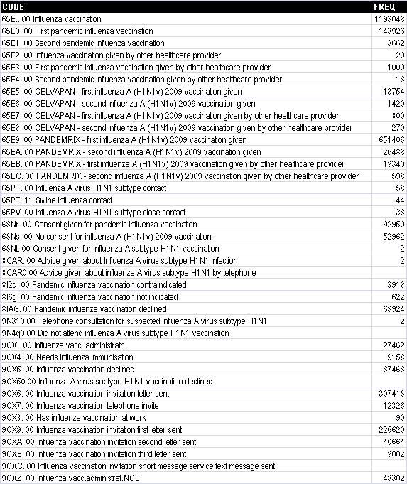
Organised but not usable: Cognitive overload
Actual usage of codes for pandemic flu vaccination by 383 practices reporting to THIN database between 1st June 2009 and 31st May 2010
81% Pandemrix
(=14M doses in entire UK pop)
2% Celvapan
17% not known
2.6% by other provider
830,226 1st part doses
=27.4% population
(cf flu jab 45% in 2008,
39% in 2009)
FREQ Column : Recording rates shown are actual absolute observed
End-period covered population: 3,028,421 registered to 383 reporting practices (4.9% UK population)
Total coded EPR Items in period: 36,299,421
Notes:
…but to no avail.
This slide shows how 383 practices used the available codes relating to both pandemic H1N1 and regular flu vaccination during the 12 months including Xmas 2009.
Extrapolating from the figures, only 14 million doses explicitly coded as using Pandemrix were given to the entire UK population. Only just over a quarter of the population received any kind of swine flu vaccine, compared with almost 40% receiving the regular flu jab in the same year, and 45% the preceding year.
1 in six swine flu vaccination procedures was coded using one of the older codes that didn’t specify which vaccine was used.

Slide 16
Abstract & Classify Using a reference Terminology
UKTC Analytics Workshop February 7th 2013

Slide 17
Classifications? Not dead yet
Statistics needs
monoaxial ‘classifications’
Polyhierarchical terminologies
can’t directly replace classifications
(and were never meant to)
But…
Its easier to transform a logical polyhierarchy into an arbitrary heuristic monohierarchy than the reverse

Slide 18
Choices for abstraction… SNOMED CT Chapters
38 months activity: 403,856 episodes using 12,314 codes
(disorder) 235215
(finding) 116055
(morphologic abnormality) 17194
Inactive 11190
(procedure) 7146
(qualifier value) 4796
(body structure) 3636
(substance) 2370
(attribute) 1291
(situation) 893
(regime/therapy) 843
(observable entity) 745
(physical object) 742
(event) 483
(life style) 245
(product) 202
(organism) 199
(physical force) 154
(record artifact) 96
(ethnic group) 17
(environment) 15
(assessment scale) 14
(person) 10
(specimen) 9
(navigational concept) 8
(administrative concept) 7
(tumor staging) 5
(social concept) 4
(occupation) 2
Notes:
Although SNOMED CT is organised into ‘chapters’, these are not intended to support traditional reporting.
This slide shows what happens if you take 38 months of data from a real A&E department, where each attendance gains one SNOMED code to record the reason for the attendance, and then report it back by top-level SNOMED chapter.
Whilst not clinically terribly useful, however, this view isn’t entirely without value: the very many categories with very low counts are strongly suggestive of miscoding.

Slide 19
Choices for abstraction… READ2 Chapters
38 months activity: 403,856 episodes using 12,314 codes
0 Occupations 2
1 History / symptoms 101626
2 Examination / Signs 18379
3 Diagnostic procedures 706
4 Laboratory procedures 388
5 Radiology/physics in medicine 126
6 Preventive procedures 2175
7 Operations, procedures, sites 4685
8 Other therapeutic procedures 2797
9 Administration 2277
A Infectious/parasitic diseases 10320
B Neoplasms 335
C Endocr/nutr/metab/immun.diseas 2303
D Blood/blood forming organs dis 1785
E Mental disorders 4450
F Nervous system/sense organ dis 9205
G Circulatory system diseases 9630
H Respiratory system diseases 22150
J Digestive system diseases 11798
K Genitourinary system diseases 8255
L Pregnancy/childbrth/puerperium 3236
M Skin/subcutaneous tissu diseas 8653
N Musculoskelet/connectiv tissue 14907
P Congenital anomalies 142
Q Perinatal conditions 571
R [D]Symptoms,signs,ill-def.cond 9235
S Injury and poisoning 90972
T Causes of injury and poisoning 3848
U [X]Extern caus morbid/mortal 3312
Z Unspecified conditions 60261
A. Infectious/parasitic diseases 1011
A0 Intestinal infectious diseases 1337
A1 Tuberculosis 162
A3 Other bacterial diseases 1533
A5 Viral diseases with exanthem 649
A7 Other viral/chlamydial diseas. 5020
A8 Rickettsioses/arthropod diseas 137
A9 Syphilis + other venereal dis. 36
AB Mycoses 343
AD Other infectious/parasitic dis 47
H. Respiratory system diseases 1163
H0 Acute respiratory infections 11907
H1 Other upper resp.tract disease 428
H2 Pneumonia and influenza 2030
H3 Chronic obstructive pulm.dis. 4451
H5 Other resp.system diseases 2164
Notes:
Although the data was originally captured as SNOMED codes, however, it is possible to cross-map the data into a more traditional clinical classification and then use the structure of that classification to derive more familiar ‘abstract and aggregate’ reports.
This screen shows the result of mapping the same 38 months of A&E data to the READ2 code system, and then aggregating the codes by the READ chapters (which are similar to ICD9).

Slide 20
Choices for abstraction… ICD10 Chapters
38 months activity: 403,856 episodes using 12,314 codes
? No ICD Map 9293
01 Certain infectious and parasitic diseases 12898
02 Neoplasms 658
03 Diseases of the blood and blood-forming organs and certain disorders involving the immune mechanism 2063
04 Endocrine, nutritional and metabolic diseases 1600
05 Mental and behavioural disorders 6266
06 Diseases of the nervous system 3807
07 Diseases of the eye and adnexa 3204
08 Diseases of the ear and mastoid process 4119
09 Diseases of the circulatory system 8907
10 Diseases of the respiratory system 19419
11 Diseases of the digestive system 13855
12 Diseases of the skin and subcutaneous tissue 7916
13 Diseases of the musculoskeletal system and connective tissue 23919
14 Diseases of the genitourinary system 14641
15 Pregnancy, childbirth and the puerperium 2604
16 Certain conditions originating in the perinatal period 624
17 Congenital malformations, deformations and chromosomal abnormalities 198
18 Symptoms, signs and abnormal clinical and laboratory findings, not elsewhere classified 71947
19 Injury, poisoning and certain other consequences of external causes 97846
20 External causes of morbidity and mortality 115
21 Factors influencing health status and contact with health services 2602
Twice as many as READ2
Notes:
Equally, you can map the data to ICD, as shown here.
However, even at this level of aggregation some of the differences between the classification systems becomes apparent.
According to this ICD10 aggregation, twice as many A&E presentations were in relation to Neoplasms than the preceding aggregation using READ2.

Slide 21
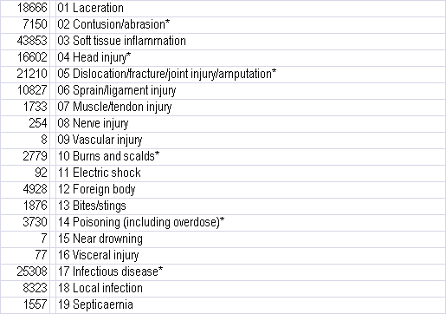
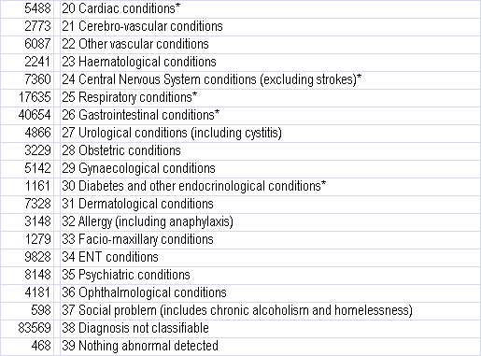
Choices for abstraction… ED Dataset
Notes:
The number of possible different aggregations of the same data is limited only by the number of different classifications to which the primary data capture terminology and information model combination are linked.
This slide shows the same A&E episode data, this time aggregated using the A&E HES Data Dictionary ‘A&E Diagnosis’ valueset
http://www.hesonline.nhs.uk/

Slide 22
Choices for abstraction… Arbitrarily, defined in terms of SNOMED CT
❶
❷
❸
❷
❸
❶
❷
❷
❸
❸
❶
❹
❶
❸
→
❷
→
❶
❷
❷
❷
❹
❷
→
❷
❷
❷
❹
❹
❹
❹
❷
❷
❷
❷
❸
❸
❸
Notes:
In addition to links between SNOMED and ‘off the peg’ monoaxial classifications, its also possible to devise transforms that aggregate SNOMED- or CVT3-encoded data according to arbitrarily defined monoaxial systems of classification.
This slide shows how the membership of a multiaxial classification can be collapsed (‘transformed’) onto a much simpler system of just four categories, but where each original code can be in only one of those four categories. The basic step is to annotate points in the original hierarchy with statements to the effect that ‘everything below this point is in category X’.
These annotations will unambiguously determine the categorisation of much of the original terminology. However, there will be some concepts that could inherit more than one category (and some that won’t inherit any). Where more than one different category is found as being attached to the ancestors of the concept under consideration, a system of ranking of the categories must be invoked to provide a clear and explicit order of categorial precedence. Thus, in the example, all the ambiguous concepts are assigned to Category 2 because (in this example) that category has precedence over the other candidates.

Slide 23
Writing Queries
UKTC Analytics Workshop February 7th 2013

Slide 24
UKTC Data Migration Workbench
DEMO

Slide 25
Running Queries
UKTC Analytics Workshop February 7th 2013

Slide 26
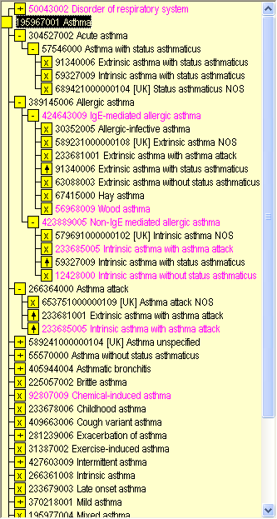
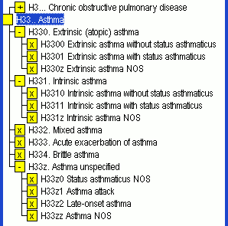
Reporting…
‘Find me all patients with X’
QOF, CQI, Statutory reporting, Audit, Research, DSS
Newer terminologies (CTV3 or SNOMED) have different way of representing subsumption
A1
A1234
Notes:
A lot of the nervousness around how to report over SNOMED starts with the observation that, unlike READ, the code itself doesn’t tell you what the ancestor and descendent codes are. In READ, getting everything that’s a descendent of H33 is as simple as a string comparison:
SELECT patients WHERE INSTR(code,’H33’) = 1;
This approach doesn’t work for SNOMED. But, it doesn’t work in CTV3 either - so this isn’t a new problem or one that’s unique to SNOMED.

Slide 27
Typical Reporting Architecture (example from CTV3)
Query Writer
Query Library
X40Gd%
Endocrine
disorder
☑
Transitive Closure Table 8.5M Rows
Hierarchy Table
Xa4g7 subtype-of X40Gd ?
Data Entry
Clinical Data
Xa4g7 Unstable type I
diabetes mellitus
NB Some graph databases, or graph-optimised RDBMS servers, include SQL transitivity extensions
such as CONNECT BY that mean you don’t have to explicitly build a transitive closure table
Notes:
The typical engineering solution to this problem of how to test subsumption is known variously as an ‘ancestor’ or ‘transitive closure’ table. Basically, it’s a (large) pre-computed table that lists every ancestor-descendent code pairing. Technically, ut’s the recursively exhaustive, transitive JOIN of the parent-child table with itself.

Slide 28
UKTC Data Migration Workbench
DEMO

Slide 29
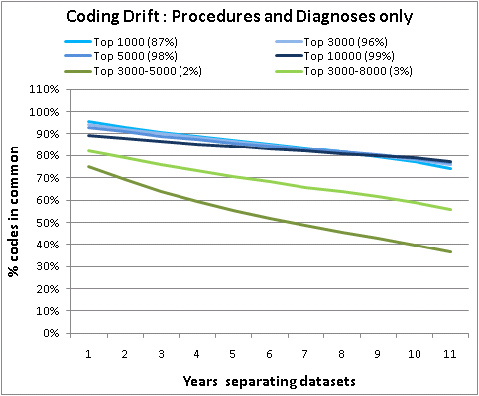
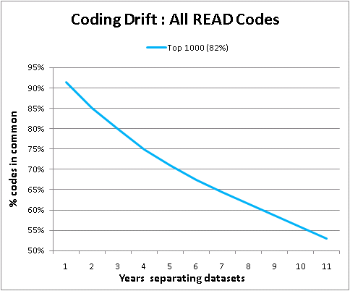
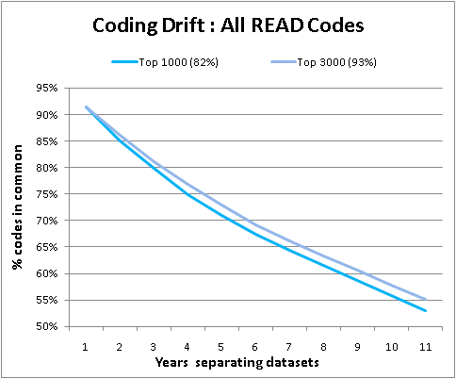
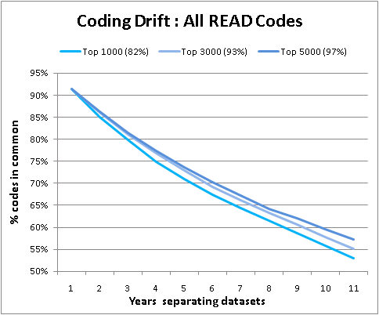
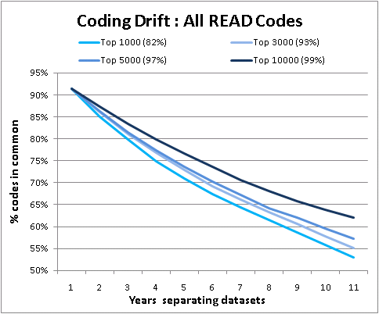
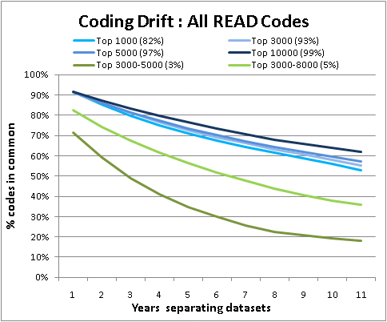
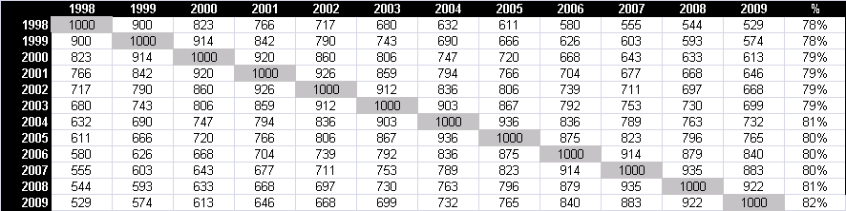
How accurate is my result Garbage in, Garbage Out…
Notes:
The results of data reporting, however, can only be as good as the original data capture – and there’s good reason to question the quality of existing clinical coded data.
The THIN Database collects data from over 300 practices (so, 1200 doctors), all of whom use the same clinical software and all of whom have been encoding their clinical data using 5-Byte READ 2 for more than a decade.
In any one 12 months reporting period, of the 90k or so READ codes that actually exist to be used, only around 30,000 are ever used at least once. However, within this 30,000 are a core of just 1000 READ codes that are used very commonly – they are the 1000 most popular codes, and they consistently account for about 82% of all clinical statements that carry a READ code.
The problem is, the list of most popular codes used by these 1200 GPs changes from year to year.
The table shows the overlap between various pairs of years – for example, 900 codes were in the top 1000 for both 1999 and 1998. Or, 100 codes that were popular in 1999 had fallen out of favour by the following year. What’s especially interesting is that this coding drift is cumulative: only a little over half the codes popular in 1999 were still popular 11 years later (2009).
Maybe the codes that were in the top 1000 have simply moved into the not-quite-so-popular range? Unfortunately, no: if you compare the top 3000, 5000 or 10,000 codes, you see the same thing. The top 10,000 codes, incidentally, accounts for 96% of all coded items.
Well, maybe all the ‘churn’ is occuring in the top1000 only, and maybe all the codes that fall in and out of fashion are related to administration codes, perhaps in response to the various ‘payment by results’ initiatives.
Again, not entirely: if you restrict the comparison to only the popular codes from those chapters of READ that are exclusively to do with recording symptoms or diseases or surgical procedures, you see the same effect (though the curves *are* flatter – after 11 years there’s still 80% overlap).

Slide 30
Different technical properties Concept inactivation
What
about
these?
Notes:
In addition to these interrater variability effects on coding quality at the point of data capture, data processing must also properly handle changes within the terminology itself. A full exposition of this isn’t possible within the current presentation, but one area of particular brief note concerns what happens to the inactive codes – which may be encountered in either or both of your instance data or your report specifications.

Slide 31
UKTC SNOMED Query Table
Query Writer
Query Library
Substitutions
Table
Merge the transitive closure and substitutions tables into a single table
Result: logical on-the-fly transform of all possible data or queries
Transitive Closure Table 8.5M rows
SNOMED Query Table 12.3M rows
Substitutions
Table
Data Entry
Clinical Data
Notes:
The UKTC draft product ‘SNOMED Query Table’ attempts to offer an elegant solution to this problem.

Slide 32
Porting Queries UKTC Data Migration Workbench
UKTC Analytics Workshop February 7th 2013

Slide 33
Terminology Interoperability
5-Byte READ2
RctCtv3Map
Ctv3RctMap
!
SctRctMap
Clinical Terms Version 3
RctSctMap
!
Ctv3SctMap
SctCtv3Map
!
SNOMED CT
OPCS 4.6
ICD10

Slide 34
What is the DM Workbench ?
Reference implementation
load the Data Migration subpack contents
(and all 3 terminologies and 2 classifications too)
Full Working Prototype
author queries in one terminology
translate to another terminology
fake/import SNOMED instance data
analyse, repair, xmap, query, report..
tokenised search with word equivalents

Slide 35
Under the hood…
Software ‘stack’
GUI for most functions
Command Line Interface with scripting
Terminology services API
Zero install
MS Access under OGL (WinXP/Win7 Access 2003,2007,2010,2013)
Data Load
One-button import of TRUD data (WHO data for ICD10)
Common information model
Range of query and instance data formats

Slide 36
UKTC Data Migration Workbench
DEMO

Slide 37
Known limitations
SNOMED Query Table
Impact of terminology update
No mapping for Drugs
Postcoordinated ICD and OPCS expressions
Postcoordinated SNOMED CT

Slide 38
Flowing data from secondary care?
5-Byte READ2
Ctv3RctMap
!
SctRctMap
Clinical Terms Version 3
!
SctCtv3Map
!
SNOMED CT
!
!
ICD10, OPCS

Slide 39
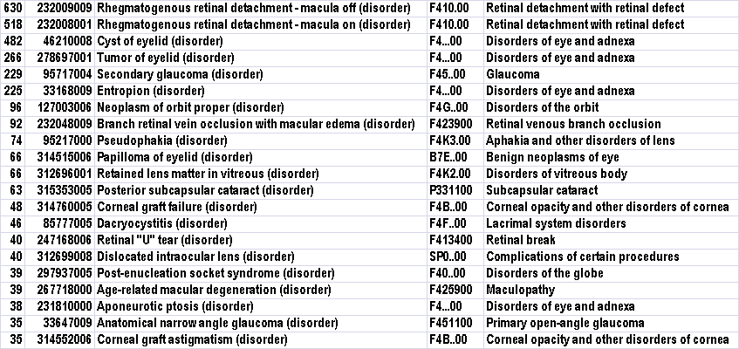
27,564 SNOMED-coded eye surgeries 16.5% only ‘lossy’ backmap to READ2 (1.6% to CTV3)
Top 21, accounting for 69% of all data with a lossy backmap

Slide 40
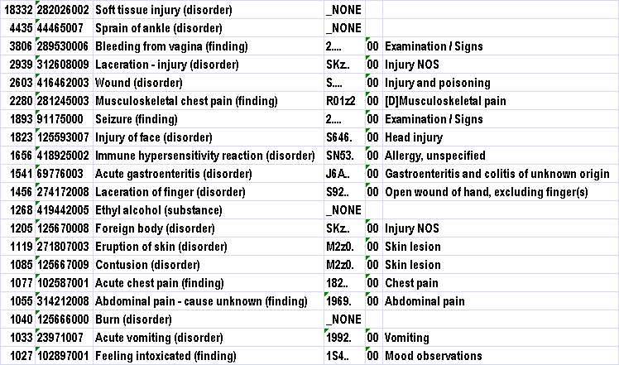
417,210 SNOMED-coded A&E attendances 34.9% only ‘lossy’ backmap to READ2 (8.1% to CTV3)
Top 20, accounting for 36% of all data with a lossy backmap

