Slide 1
Understanding the financial implications of the Care Act in London – A council perspective Anastasia Lungu-Mulenga
1 July 2015

Slide 2
AGENDA
Context
2015/16 costs
Self funders
The Care Cap
Means Testing Threshold
Modelling
Risks

Slide 3
Context:
Integration/partnership working –
more joined up working, closer partnerships with health, resulting in better joined up services, BCF.
Workforce: aging, technology is advancing, issue of low pay, high turn over etc. extra 2 million needed by 2025.
Personalisation and choice: people are more empowered to make decisions about their care. Implications for LAs residential vs. domiciliary care, implications on commissioning.
Prevention – conflict with meeting immediate need
Funding pressures – not restricted to Care Act e.g. DoLS

Slide 4
Demographics
Forecast population growth in London 2014-30
Over 65s: 44%
People with learning disabilities: 15%
People with physical disabilities: 21%
People with a mental health problem:14%
Growth in complex and multiple long term conditions
Notes:
Over 65s – from 976k to 1.4m
Analysis by one borough suggests complex needs of top 27% of people lead to 84% of social care costs

Slide 5
Population Growth 2014-2030
Notes:
London the fastest growing for all 4 client groups – significantly so for under 65s age group as we have a younger population.

Slide 6
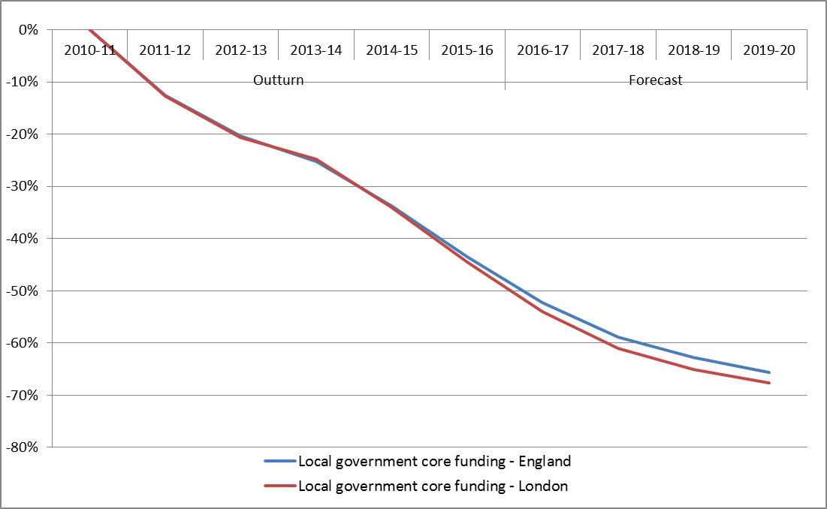
Context
Local Government Funding: 2010 – 2020
Notes:
By 2019-20, London local government is facing a reduction in core funding of close to 70 per cent in real terms compared with 2010-11
London worse off than other areas due to the way in which the Government applies funding reductions. Larger cuts fall in grant dependent authorities who have higher levels of deprivation.

Slide 7

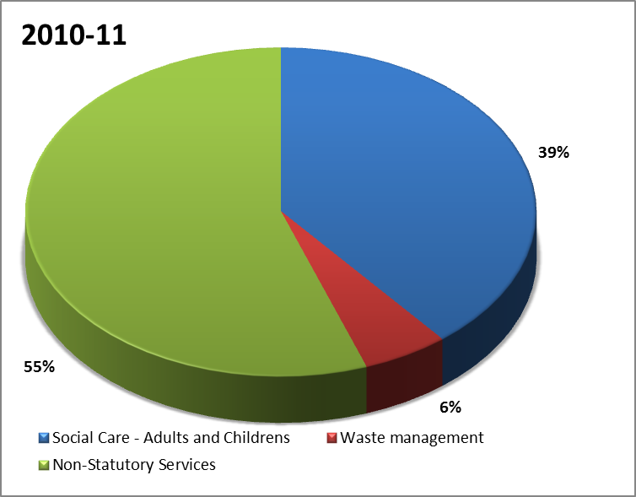
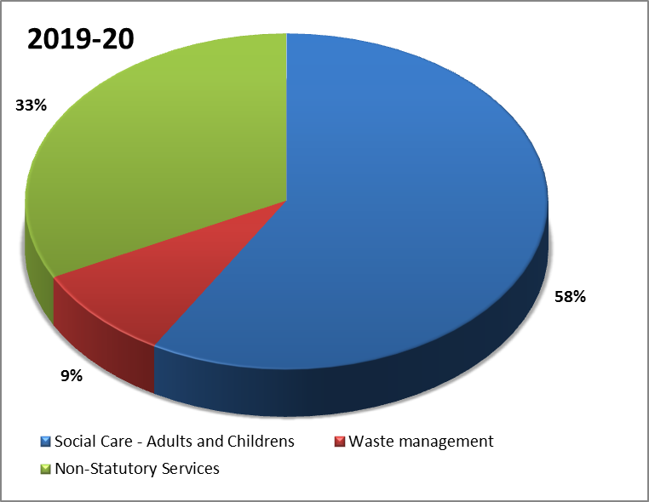
The Potential Impact on Services
2013/14 London Adult Social Care Spend £2.3bn
Notes:
Combined with a rapidly increasing demand for local services, London’s local authorities face a funding pressure of up to £3.4 billion by the end of the decade.
Without including the costs of the care act:
Adult social care and children's social care will form a higher proportion of budgets leaving little room in budgets for non statutory services.
The ADASS Budget survey of 2014 found that despite everything that is being done to prioritise Adult Social Care – the cash invested in Adult Social Care reduced by a further 1.9% (£266m) in 2014-15 to £13.68bn representing the third year of continuing cash reductions and the fifth year of real terms reductions in social care spending. These reductions have come at a time when the population of those looking for support has increased by 14%. This is leading to fewer people receiving support, with councils over the last 4 years having made efficiency savings to Adult Social Care budgets totalling £3.53bn.

Slide 8
2015/16 reforms
Carers assessment and support
Assessing self-funders
Deferred Payments
IT systems
Care Account Management Information and Advice
National eligibility at substantial
Uncertainty in allocations and costs
Final allocations December 2014 | £34m
Plus: Funding from the BCF for the Care Act | £21m
Less: Estimated costs | £85m
Leaves Estimated Shortfall of: | £29m
Notes:
IT – Info&advice, Deferred payments, care account
December 2013 indicative allocations £44.0m
Summer Consultation £31.5m

Slide 9
Self Funders
IPC commissioned work
Estimates for over 65s:
12,400 care home self funders
20,400-32,400 home care self funders
Estimates for working age (25-64):
“There is no good data on [the number of working age adults self-funding their care] number, but it is unlikely that there is no one in this category.” DH Impact Assessment

Slide 10
The Cost Cap
Costs in London of residential care, 14% higher than national average, 30% higher than North West
Around 27% of people stay in a care home for more than three years, only 10% stay for more than 6 years.
Notes:
In London, the average residential care user will hit the cost cap in 3.5 years, so mid 2019.
In the north west, this will take 5.5 years, they will hit the cap in mid 2021.
A BUPA study found that around 27% of people stay in a care home for more than three years.

Slide 11
Means Testing
Notes:
Homeowners in London are much less likely to fall within the means test threshold than in other regions

Slide 12
Notes:
But there are more people who have a care need and don’t own their own homes.

Slide 13
Modelling
National modelling exercise:
Sample of 30 local authorities
Joint ADASS/LGA/DH
Modelling subject to further refinement
Notes:
If we assume working age self funders are same proportion as over 65s
£'000
Total Cost 2016/17 to 2019/20
Over 65s £270m
Working Age £330m
Total £600m
Total Cost 2016/17 to 2025/26
Over 65s £1.3bn
Working Age £1.5bn
Total £2.8bn
Impact assessment revised down, initial impact assessment 2013.
In April 2013 government committed to provide £5.6 billion to councils between April 2016 and March 2021 to implement the reforms. New figures published by the Department of Health show government has now reduced this five-year commitment by £650 million – a reduction of almost 12 per cent. (LGA)
Estimated costs have reduced by £1.3bn over the 10 year period.
Traditionally London has received 15% through adult social care funding formula. The recent 15-16 care act funding gave London 12%

Slide 14
Risk and Uncertainty
Self funder behaviour
Overall take up – council readying for high take up. LGA is calling for a delay to ensure all are ready
16/17 funding and distribution
Long term funding of social care
Short timescales for implementation
Notes:
Publicly funded social care is at risk of becoming a residual service, available only to those with the lowest incomes and the highest needs, leaving thousands of people and their families struggling to meet the costs of the care and support they need.
This also risks exacerbating pressures on the NHS by increasing emergency admissions and delayed discharges from hospital. With estimates suggesting a potential funding gap of more than £4 billion by 2020/21 (Local Government Association 2015), finding additional funding for social care must be an urgent priority in the forthcoming Spending Review.

Slide 15
Anastasia Lungu Mulenga Policy and Projects Manager London Councils anastasia.mulenga@londoncouncils.gov.uk Tel: 020 7934 9809

