Slide 1
Headteacher Briefing 15.12.20

Slide 2
AGENDA
Xmas Welcome – Enfield Music Service
Headteacher representative feedback
iii) COVID19 update – Public health data: vaccinations: schools information
iv) Data Protection – moving forward
v) Inspection feedback – St Edmunds & Tottenhall Infants
vi) AOB
Winter hardship fund
Ofsted next term (removal of Outstanding exemption)
DfE funding
Xmas LA cover arrangements
Next briefing – 12th January

Slide 3

Primary Headteacher Representative – Reflections since March
The journey has been unprecedented – we have moved from one crisis to another
Typified by the questions I was asked to raise:
March: What is a ‘bubble’?
August: Can we sing?
November: When can we claim for all this money we have lost?
December: Why are we the government’s best track and tracers?
But, there have been positives:
We have learned there is a solution for almost anything!
It puts into context our previous ‘big issues’ – the threshold for a challenging conservation has somewhat increased!
Advice and support has come from everywhere
New levels of collaboration
Shown everyone, no matter what their role, is working towards the same goal – providing the best for our young people.

Slide 4



Enfield COVID19 Dashboard
View in Power BI
Last data refresh:
11/12/2020 14:15:59 GMT Standard Time
Downloaded at:
11/12/2020 14:18:50 GMT Standard Time

Slide 5



ENFIELD COVID-19 DATA
TOTALS
(05 – 12 Dec*)
06th Mar-12th Dec
05 – 11 Dec
TOTAL CASES
8,447
NEW CASES*
1,487
TESTS*
2,503
INFECTION RATE PER 100,000*
445
AGE GROUP
0-29 30-59 60+
INFECTION RATE RANK*
NCL# = 1st
LON= 4th ; ENG= 7th
per 100,000
(PCR = 8.017 tests, lateral flow = 625 tests)
TESTING RATE RANK
NCL# = 1st
LONDON = 5th
ENGLAND= 46th
441
501
195
06 Mar – 27th Nov
11 Dec update
14th Dec update
TOTAL DEATHS
421
RECENT DEATHS*
<5
SCHOOLS AFFECTED
56
WARDS WITH MOST CASES* (TOP THREE)
ENFIELD HIGHWAY (74)
SOUTHBURY (73)
LOWER EDMONTON (69)
CARE HOMES AFFECTED
13
Staff = 21 cases
Residents = 9 cases
Staff = 124 cases
Students = 178 cases
DOM CARE AFFECTED
12
Care Staff = 12 cases
Clients = 8 cases
#North Central London includes Camden, Barnet, Enfield, Haringey & Islington
Change since last week of data

Slide 6
Table: Weekly COVID-19 infection rate* between 6th and 12th Dec for selected local authorities/ regions and England
*Number of new cases in the seven days ending on 12th Dec 2020
Data source: NHS dashboard- Data available- https://digital.nhs.uk/dashboards/progression-full-width
Accessed on 14th December 2020 at 22:00 pm.

Slide 7
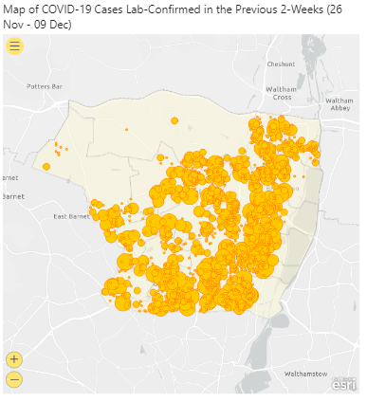
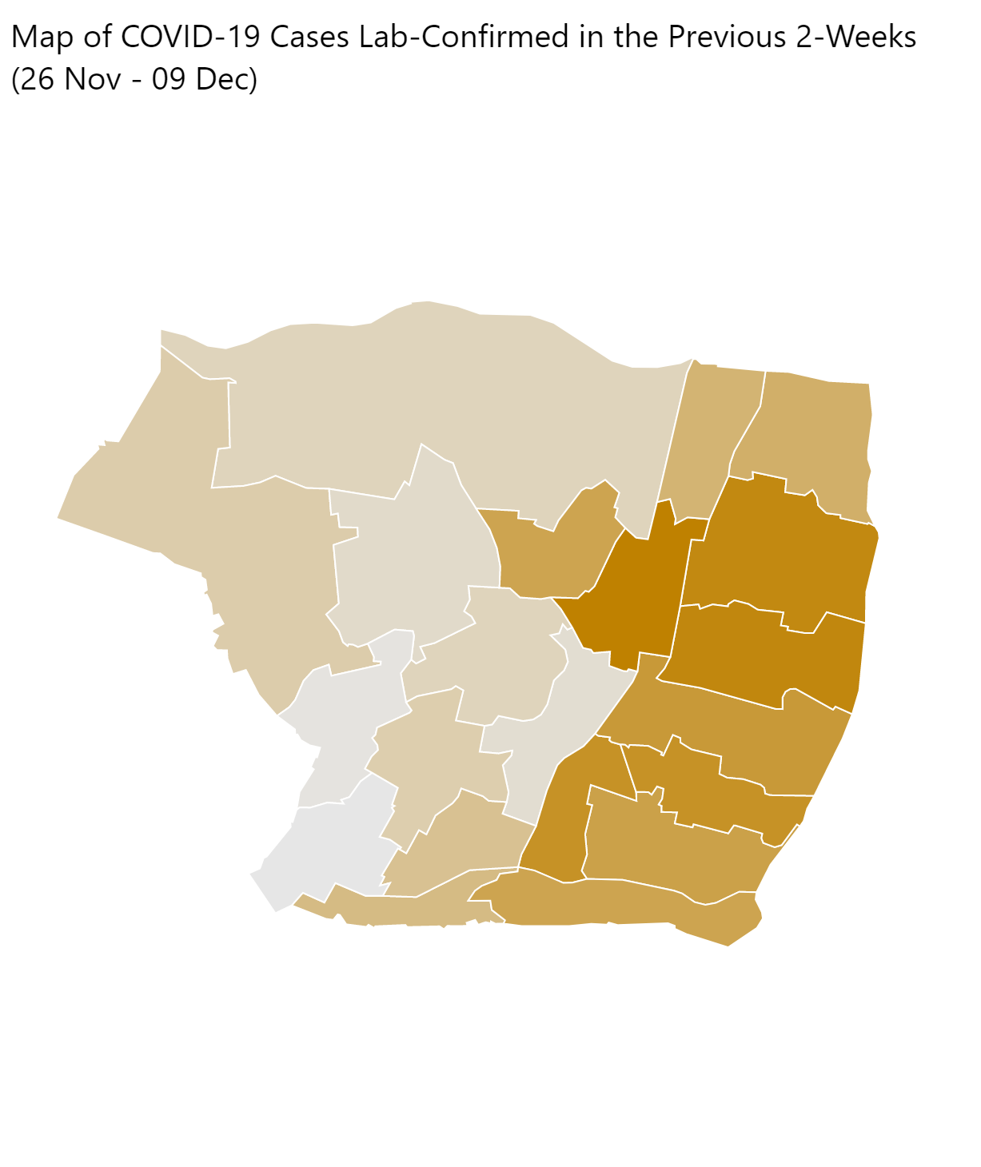

Slide 8


Public Health Update
Dudu Sher Arami
Consultant in Public Health
Striving for excellence
www.enfield.gov.uk

Slide 9
UPDATES
Change in self isolation guidance 14-10 days
Testing
Contact tracing over the holidays
And non COVID ..…
NCMP
Flu vaccine
E consent for vaccines from 2021

Slide 10
Change to self isolation guidance for contacts
Changed from 14 days to 10 days for contacts of confirmed cases.
‘Your isolation period includes the day your symptoms started (or the day your test was taken if you do not have symptoms), and the next 10 full days. This means that if, for example, your symptoms started at any time on the 15th of the month (or if you did not have symptoms but your first positive COVID-19 test was taken on the 15th), your isolation period ends at 23:59 hrs on the 25th’.
https://www.gov.uk/government/publications/covid-19-stay-at-home-guidance/stay-at-home-guidance-for-households-with-possible-coronavirus-covid-19-infection

Slide 11
Testing
Widespread community testing – plans to roll out.
Number of sites identified.
Discussions regarding which year groups this should focus on.

Slide 12
Contact tracing over the holidays
From the Department of Education
Public Health England has agreed a 6 day window after the final day of teaching in which schools and further education providers are asked to remain contactable so they can assist with contact tracing where necessary. This will allow enough time for positive coronavirus (COVID-19) cases to be identified and confirmed by a test and for relevant contacts in the education setting to be traced. We are clear that beyond 6 days after the final day of teaching, school and further education staff are not asked to play a role in any contact tracing.

Slide 13
National Childhood Measurement Programme
Ceased when schools closed in March
Resume in 2021
North Middlesex University Hospital (new provider of Health Visiting and School Nursing Service) currently in planning phase.
NMUH will contact schools in Jan.

Slide 14
Flu vaccine
Just under 100% offered
Between 40-45% uptake
Nos non returned consent forms
Year Grps/ individuals in isolation
Catch up clinics

Slide 15
E consent
Parents and young people in Enfield can give e-consent for their children’s school-based immunisations from the start of 2021 as Barnet, Enfield and Haringey NHS mental health trust introduces a new online consent system.
quicker and easier for schools, families and nurses.
Schools will be asked to send parents the e-consent form that can be completed online on any platform including mobile phone, tablet or computer.
Dr Mo Abedi, ECS Clinical Director, says: “We are really pleased to be offering parents in Enfield the chance to give e-consent for their children’s immunisations.’’
The process is safe and secure, and is much easier and simpler for families to complete compared to the previous paper forms.
E Consents will be launched for young people having the HPV vaccination in January.

Slide 16
Data Protection Service
Martin Sanders
Head of Service Management and Governance
Striving for excellence
www.enfield.gov.uk

Slide 17
Provision of Data Protection Service
The current Data Protection service is provided by Enfield Council
Until 31/03/21, the council will continue to use Ex Cathedra Solutions to assist in providing the service
The cost of the contract exceeds the budget we have even with the grant we receive for schools training
The council has a full time permanent Data Protection Officer post and will be recruiting into that role between now and the end of March and will continue to provide the same services as now while controlling it’s cost
Contact, training and raising issues will be through the same process as now (just a different person in the role)
We are improving both our Information Governance and Cyber Security Training to align with Data Protection including on line training to increase standards and service provided
Our Information Governance and Security Teams are now in place

Slide 18
THANK YOU !!!
If you can keep your head when all about you Are losing theirs and blaming it on you, If you can trust yourself when all men doubt you, But make allowance for their doubting too; If you can wait and not be tired by waiting, Or being lied about, don’t deal in lies, Or being hated, don’t give way to hating, And yet don’t look too good, nor talk too wise:
-----------------------------------------------------------
If you can talk with crowds and keep your virtue, Or walk with Kings – nor lose the common touch, if neither foes nor loving friends can hurt you, If all men count with you, but none too much; If you can fill the unforgiving minute With sixty seconds’ worth of distance run, Yours is the Earth and everything that’s in it, And – which is more – you’ll be a Man, my son!

