Slide 1
Legislative reform of Statistics Act (No. 6 of 1999)
Presentation to the Portfolio Committee
Presenter: Dr Pali Lehohla
Date: 30 November 2016

Slide 2
Outline of presentation
Background to legislative reform
Key areas of the Act no.6 of 1999
The focal areas of consultation
Progress made and Recommendations from national and provincial consultations
Mexico and UK Study Tours
Next steps

Slide 3
Background
1
Stats SA and Stats Council held a Symposium in July 2014 to consult on how to strengthen the national statistics system of South Africa.
2
DGs from Department of Cooperative Governance, the National Treasury and representative of the DG of DPME outlined the demand for data.
Representatives of countries such as Mexico, Canada, Argentina, Uganda, France, Ghana, Kenya, Cape Verde and others spoke about the need for a strong national statistics system.
Uneven distribution of the population
3
High but improving poverty levels
4
Key recommendation from the symposium was that for the SANSS to be fully functional the statistics act had to be strengthened.
4
4
5
Cabinet gave approval for Stats SA to sconsult on legislative reform

Slide 4
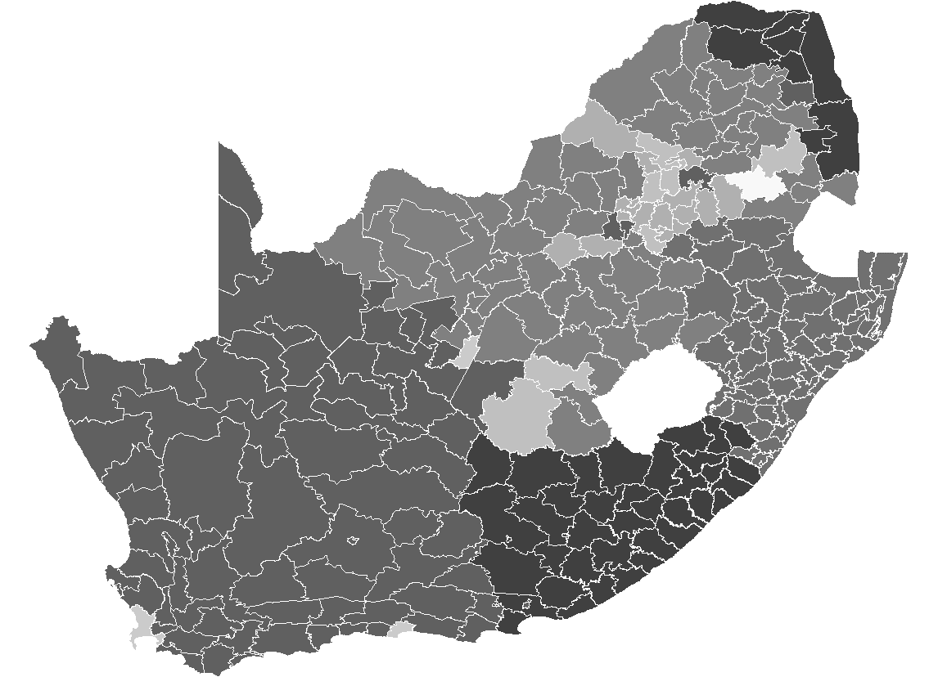
Statistics Act
To advance planning, production, analysis, documentation, storage and dissemination of official and other statistics
1. Statistical production
2. Statistical coordination
Purpose of the Act
1. Minister
2. Statistician-General (also head of Stats SA)
3. Statistics Council
4. Outline responsibility of other Ministers/Heads of Organs of State (Section 14)
Defines duties, powers
and relationships of

Slide 5

To ensure that the SANSS produces Statistics for:
Transparency
Accountability
Results-based management
Transformation
Fully implement the coordinating role of the SG across the SANSS (i.e. beyond the confines of Stats SA)
Align statistical production with user needs (i.e. statistical production to remain relevant to user needs)
Review of Statistics Act is needed to

Slide 6
Proposed Legislative changes overview
Purpose of Amendments: To strengthen statistical production and coordination of the national statistics system
Implementing statistical geography as a deliberate strategy for transforming the national development information landscape;
Strengthening coordination mechanisms and compliance in order to optimise informatics efficiency and effectiveness;
Embrace data revolution in order to ease the methods of doing business by dramatically changing the capabilities of information collection, access, analysis, use, retrieval, storage and archiving, thereby increasing and deepening our knowledge basis;
Creating a state-wide statistics service through professionalising, training and deployment; and
Establishing institutional arrangements and protocols that will lead and deliver a professional and sustainable National Statistics System.

Slide 7
Statistical Geography
Geospatial information is about the location and names of features beneath, on or above the surface of the earth
The Spatial Data Infrastructure Act, 2003 (Act No. 54 of 2003) provides for the establishment of the South African Spatial Data Infrastructure (SASDI) to regulate the collection, management, maintenance, integration, distribution and utilisation of spatial information in the country. However Geospatial information – is currently not meeting planning and policy requirements to implement the NDP 2030.
Issues for discussion
Statistics Act & SDI Act
The role of Stats SA in the SDI Act.
Strategic change:
Demand a high level of informatics platform as an enabler

Slide 8
Strengthening coordination mechanism and compliance
Stats Act mandates the Statistician-General to coordinate production of statistics produced by other organs of state
Formulating quality criteria and establishing standards, classifications and procedures;
Providing statistical advice; and
Designating statistics as official
Issues for discussion on strengthening coordination
National Strategy for Development of Statistics (NSDS) for strategic management of the SANSS;
Statistical information systems in other organs of state (Statistics Units: reporting, independence etc);
SANSS governance structures (National Coordinating Committees, Statistical Clearing House, Sectoral working groups, etc)
Administrative data (conversion to statistics, access to data, confidentiality)
SASQAF for designating statistics as official
Strategic change:
Responsibility of Heads of Organs of State towards statistical production

Slide 9
Embracing data revolution
Emerging international discussion led by the UN to respond to SDG Agenda therefore Stats Act not specific on data revolution
Issues for discussion to embrace data revolution
Public private civil society partnerships
Bringing together traditional and new data sources (including big data)
Data sharing and open data sources; Promoting innovation to fill data gaps
Modelling; Capacity building
Quality of data; Privacy and confidentiality
Strategic change:
Responsiveness of the statistics system to emerging data demands e.g. Sustainable development goals and African Union Agenda 2063

Slide 10
Creating a State-wide Statistics Service
Stats Act not specific on State-Wide Statistics Service
Issues for discussion to create a State-wide Statistics Service
Professional body of statisticians
Code of ethics
Statistical literacy and capability
Statistics Institute for capacity building
Statistical leadership
Strategic change:
A capable statistics system based on ethical conduct

Slide 11
Institutional arrangements
Stats Act provides for:
SG reporting to the Minister
Statistics Council advisory role to both the Minister and SG
Issues for discussion in terms of Institutional arrangements
Fundamental principles of Official Statistics
Independence of reporting (Reporting to Parliament)
Coordination of statistical reporting; Referee and Player
Asymmetry vs Symmetry; Various scenarios
Establishing a statistics authority?
SG for Statistics System and DG for Stats SA?
Strategic change:
Delivery model coordinating statistical production to respond to state needs based on Fundamental principles of Official Statistics

Slide 12

Progress made
A national workshop was held with senior government officials, members of the statistics council, civil society and private sector where the focal areas of the legislative reform were discussed.
1
2
Provincial workshops on legislative reform were held in all provinces
4
3
Study tours were done in Mexico and the United Kingdom
An exercise to compare the statsitics laws of UK, Mexico, Uganda, Tanzania, Mozambique, France and the Phillipines was started and will be finished on November 30.
4
High but improving poverty levels
4

Slide 13
National and Provincial Consultation – Recommendations on the five focal areas
Strategic change:
Delivery model coordinating statistical production to respond to state needs based on Fundamental principles of Official Statistics

Slide 14
Statistical Geography
Create mechanisms to ensure compliance to geospatial standards
Review the Spatial Data Infrastructure (SDI) Act, Municipal Structures Act and Statistics Act to ensure alignment
Review Income Tax Act to ensure that valid physical addresses are a requirement for businesses and enterprises
Users demand that policy outcomes be reported both in time and space (i.e. geographic location), Include statistical geography requirements in revised Act
State of geographic information
Current state of geographic information is that it is:
Fragmented, &
Lack common standards on geospatial information – this is to be addressed

Slide 15
Coordination & Compliance
Decentralised system of statistical production to continue in line with statistical standards as set out by the SG
The Statistics Act to specify the instruments available to the SG and Minister responsible for statistics to coordinate statistical planning, production and reporting
Statistical production to be incubated in existing M&E units where functional statistics units do not exist
statistical production (while the act is clear that organs of state cannot terminate or start a series without consulting the Minister, this has not been enforced.
Empower the SG to guide departments w.r.t compliance & specify consequences for non-compliance

Slide 16
Data Revolution
Ensure that big data used for M&E are compiled in a scientific manner
Encourage data sharing among organs of state
Encourage the formation of public, private, & civil society partnerships on data
Revised Statistics Act to encourage the use of non-traditional data sources
Promote innovative methods to fill data gaps that exist
Revised Statistics Act to specify the quality criteria for both traditional and non-traditional data sources

Slide 17
State-wide statistical service
The SSS to service the capacity needs of the SANSS
Officials in the SSS will be professionally accountable to the SG and administratively to their respective DGs/HoDs
Create a state-wide statistical service (SSS)
The SSS professionals to be supported by a statistics institute to build statistical capacity and capability. The link, if any to the School of government to be explored.
The SSS to consist of professional statisticians/content people and SSS to be governed by a professional code of ethics

Slide 18
Institutional arrangements and protocols
Make provision for a SANSS governance structure and describe its role & limitations
Empower the SG to issue rules on matters pertaining to statistical production and use
Require all statistical work in the SANSS to be free of political interference
Describe the relationship between the SG, Minister(s), Organs of state, and the Statistics Council
Principles of Official Statistics” is adopted and implemented by all SANSS members (i.e. not only Stats SA)
Consider new institutional arrangements that eliminate an organ of state being both a referee & player in the SANSS
Empower the SG to specify the institutional arrangements and protocols to coordinate the SANSS (i.e. specify rules of engagement)
Describe remedial action(s) available to the SG to enforce compliance

Slide 19
Institute of National Statistics and Geography (INEGI) - Mexico
Law: The law of the national system of statistical and geography information published in 2008 and made INEGI autonomous
Institutional arrangements:
INEGI: responsible for regulation and coordination
Government Board - made up of five members designated by the President of the Republic with the approval of the Senate : the five members are the President of Inegi and the Vice Presidents of Inegi – role is to build relations between INEGI and line Ministries
National Consulting Council: Made of senior government officials, the academia and chaired by the President of Inegi – role is to advise the Board and Inegi.
Coordination mechanisms: Through subsystems: Demographic and social, Economic, Geographic and Environmental and Justice, peace and security – these are headed by Vice Presidents
Strategic change:
Delivery model coordinating statistical production to respond to state needs based on Fundamental principles of Official Statistics

Slide 20
UK Statistics Authority- United Kingdom
Law: Statistics and Registration Service Act enacted in 2008 and created the UK Statistics Authority, independent from Government and directly accountable to parliament and the devolved legislatures.
Institutional arrangements:
UK Statistics Authority: Statutory objective to promote and safeguard the production and publication of official statistics that serve the public good.
Main functions:
Production of statistics through the office for National Statistics
Oversight of the wider Government Statistical Service (GSS)
Production of a Code of Practice for Statistics and assessment of official statistics against the code.
Composition :
Non Executive Chairperson
National Statistician and Head of the Office of the National Statistician
Director for Regulation (responsible for assessment of all statistical products in the NSS)
Executive and Non Excecutive Members
Strategic change:
Delivery model coordinating statistical production to respond to state needs based on Fundamental principles of Official Statistics

Slide 21
UK Statistics Authority- United Kingdom
Government Statistical Service:
40 Government departments devolved administrations and agencies
7 000 staff, economists, IT specialists, etc
1 500 professional statisticians
Common recruitment, competencies, professional standards
Mobility between departments
A single professional cadre across government
Coordination Mechanism: Through the Heads of Profession in the Government Statistical Service
Strategic change:
Delivery model coordinating statistical production to respond to state needs based on Fundamental principles of Official Statistics

Slide 22

NEXT STEPS

Slide 23
Legislative Process
1
Draft Bill (either New Act or Amendment) – By February 2017
2
Take to state advisors to certify
Validate in line with the constitution- March 2017
3
Submit to Minister in the Presidency to table at Cabinet – April 2017
Take to parliament and
Hold public consultations – May to December 2017
4
High but improving poverty levels
4

Slide 24
Thank You

