Slide 1
Better statistics, Better Decisions
Better access to data for statistics and research
Ross Young

Slide 2
1. Better statistical research

Slide 3
Access for accredited research
De-identified linked data
for accredited research purposes only
Trusted third party model
Accredited indexing
Accredited researchers and research projects
Accredited access facilities
UK Statistics Authority - the accrediting body
Public good/public interest test

Slide 4
Dataset A
Dataset B
Dataset ‘A’
Dataset ‘B’
Identified information replaced with unique identifier
Unique identifier added
Unique identifier added
Identified information replaced with unique identifier
De-identified dataset
Identity dataset
Identity dataset
De-identified dataset
Accredited Indexer
STAGE 1:
Identity datasets linked & matched cases confirmed (INDEX)
Accredited Access Facility
STAGE 2:
De-identified datasets linked using index
Controlled conditions
Accredited Researcher

Slide 5
2. Better National and
official statistics

Slide 6


Slide 7
Current obstacles and challenges
Structural
Legislation
Information Sharing Orders
Respondent and administrative burden/costs
Declining survey response rates
Cultural
Risk-aversion
Data sharing seen to be of ‘secondary’ importance
Public acceptability

Slide 8
External drivers for change
Data Revolution
“Collect once, Use many times”
Admin Data Taskforce
Bean review of UK economic statistics
EU Peer Review report
European statistical system
UK is now lagging behind internationally

Slide 9
What we are trying to achieve
Give ONS a right of access to data for statistical purposes only
Enable secure data shares with Devolved Administrations to support their statistical needs from devolution
Protect privacy and security of data; reaffirm rigorous penalties for misuse
Duty to consult statisticians on changes to data systems

Slide 10
Safeguarding public trust
Limited purpose
Governance and accountability
Code of practice and principles
Transparency and standards
Security and controls
External scrutiny and ethical framework

Slide 11
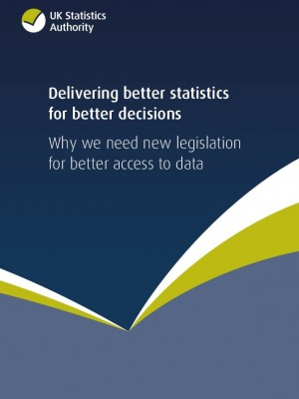

Slide 12
Benefits for ‘UK plc’
More efficient
Better statistics
Better research
Better decisions

Slide 14


Slide 15
More information
https://www.statisticsauthority.gov.uk/national-statistician/data-access-policy-and-legislation/
https://www.gov.uk/government/consultations/better-use-of-data-in-government
Consultation closes: 22 April 2016
data-sharing@cabinetoffice.gov.uk

