Slide 1
East-Central Hub Development Group Integrated Hubs for Families and Young People
7 August 2017

Slide 2
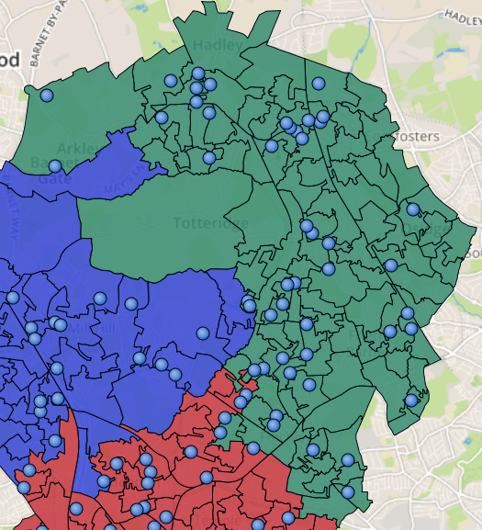
The East – Central Locality
36,933 children and young people aged 0-18
1,074 open Common Assessment Frameworks (0-19 yr old)
647 Children in Need, 67 Child Protection cases
333 with Special Educational Needs and/or Disability (0-19 year olds)
4 Children’s Centres, 1 Youth Centre
55 PVIs
64 Schools and Colleges
4 Health Clinics
31 GPs

Slide 3

The Challenge for Families
Why are services so far away?
Why do we have to keep re-telling my story?
?
?
?
?
?
Why do we have to speak to lots of people before we find the right person?
?
?
?
We don’t understand what is on offer to help us
?
?
?
?
?
?
?
Why can’t someone help us earlier than crisis point?
We are confused by the number of people helping our family

Slide 4
The Challenge for Professionals
The service landscape is so complicated
I don’t know which professionals are involved
!
!
!
!
!
My budget doesn’t match demand
!
!
!
I don’t feel confident in supporting this family
!
!
!
!
!
!
!
Services are far away from this family
I am not clear what works to help this family

Slide 5
Our Foundation for Hub Working
In response to feedback from you, families and partners, the Early Intervention and Prevention group has been:
Building a common way of identifying families needing early help
Developing our partnership service offer for those who don’t require statutory (social care) intervention
Online Menu of
Intervention now
launched to clarify the
service offer
https://familyservices.barnet.gov.uk/MenuOfInterventions/SynergyEnglishHome.aspx

Slide 6
What is going to change in the East Central area…
Improving ways of working between organisations and different professional backgrounds
Develop multi agency panel to identify the lead agency and support for families in need of Early Help
Co-location of staff from different organisations in the same place(s)
Reviewing our partnership offer in the locality, so it is delivered in the right places, to the right people, has the right impact and is clear
Building professional networks and training so that our staff feel they have the skills and confidence to work with our families

Slide 7
… And what isn’t going to change during the pilot
Multi Agency Safeguarding Hub (MASH) continues to be the single point of contact for all referrals where a child may have additional needs for services, or be at risk of harm - https://www.barnet.gov.uk/wwc-home/practitioner-guidance/multi-agency-safeguarding-hub-mash.html
Reporting lines for staff will remain the same, and each partner will retain overall responsibility for their budget
Use of Common Assessment Framework (CAF) and Universal Plus to assess families in need of early help and plan interventions - https://www.barnet.gov.uk/wwc-home/practitioner-guidance/early-help-offer/common-assessment-framework-caf-practitioners-information

Slide 8
Who and when?
Pilot starts in September 2017
We are starting small and building up the pilot, rather than going “big bang” from September
Schools, Children’s Centres, Local Authority, SEND, Joint Health Commissioners and Providers (Community Services and CAMHS), JobCentre Plus, Barnet Homes, Police, Substance Misuse Services and Voluntary Sector are all actively working together to develop the approach
We want to give you an early chance to discuss this approach and think about how you can be involved.

Slide 9
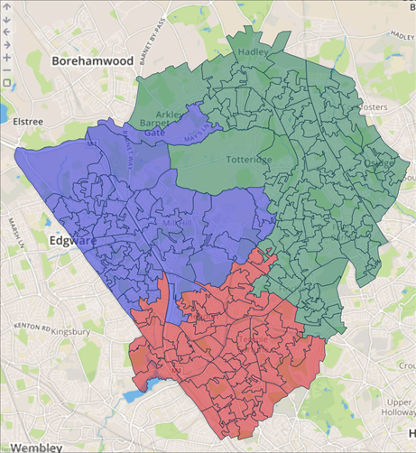
What about the other localities?
Locality pilot programmes are being rolled out across Barnet – they will have common features, but may operate differently in each area depending on need and the partnership
East Central pilot
starts:
September 2017
West pilot starts:
January 2018
South pilot starts:
April 2018
Depending on the outcome of the pilots, the way that services are structured may change in the long term – we are using on the ground learning to help us make that decision

Slide 10
Want to get involved?
East Central Hub Development Lead
Jack Newton, Executive Headteacher, Underhill School and Children’s Centre, exec@underhill.barnetmail.net, 020 8449 2423
Local Authority Lead
Karen Pearson, Head of Early Years and Early Help, karen.pearson@barnet.gov.uk, 020 8359 2459
Project Manager
Claire O’Callaghan, Strategy and Insight Officer, London Borough of Barnet, claire.o’callaghan@barnet.gov.uk, 020 8359 2724

