Slide 1
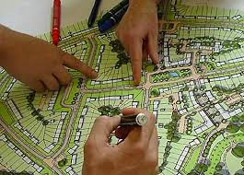

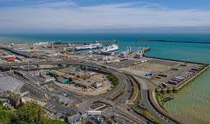
What are neighbourhood plans and why do we need one in Dover?
Dover Neighbourhood Development Plan
“Getting Started” event : 29 November 2018
Lindsay Frost : Independent planning consultant

Slide 2
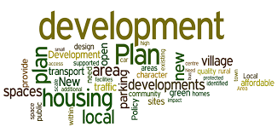
The purpose of the planning system in England
1. Regulate the development and use of land in the public interest ( not to advance ,or harm, the interests of any individual or organisation )
2. Balance the need for development ( such as homes, jobs and infrastructure) with the need to protect and enhance important features of the local environment
3. Deliver sustainable development : meeting social and economic needs without compromising the legacy to future generations
4. Test applicants schemes through the planning application process and giving a say ( but not a veto) to people affected by development schemes

Slide 3

The role of development plans in the English planning system
In England , there is a “plan-led” system , which has two main components:
preparation of a development plan to set out local planning policies and identify allocations of land for new development
making decisions on planning applications
The Development Plan comprises two documents:
The Local Plan prepared by district/borough council or unitary authority with a mix of strategic and local planning policies
(N.B. County Councils prepares minerals and waste plans, and local transport plans)
The Neighbourhood Plan prepared by town and parish councils with detailed local planning policies

Slide 4

Key Components of Planning
European Law
English Planning Law and Regulations
National Planning Policy Framework
Sustainable Community Strategy
Monitor
The Development Plan:
Local Plan
Neighbourhood Plans
Community Involvement
Delivery
Development Management
Enforcement

Slide 5
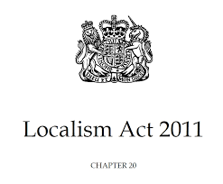
What is neighbourhood planning ?
“A Conservative government will introduce a new ‘open source’ planning system. This will mean that people in each neighbourhood will be able to specify what kind of development they want to see in their area. “
Conservative manifesto 2010 election
Neighbourhood planning was introduced under the Localism Act 2011 :the idea is that decisions affecting local life are best made by the people most closely affected
It has two main components:
Neighbourhood Development Plan
Neighbourhood Development Order
Detailed legislation followed in the Neighbourhood
Planning (General) Regulations 2012 and 2017

Slide 6
Neighbourhood Development Plan (NDP)
This is a new plan , prepared by a local community to help them influence the future planning of their area and can be used to :
Develop a vision for the future of the neighbourhood ( what sort of place do you want to be in 15-20 years time?)
Decide where new homes, shops, offices and other development should be built
Identify and provide the infrastructure needed to support new development
Identify and protect important elements of the built and natural environment
Protect and enhance community facilities
Influence what new buildings should look like , to fit in with local character
Link planning with other aspects of local life ( such as traffic management, health and wellbeing, community development, skills and training ) which are important to you

Slide 7
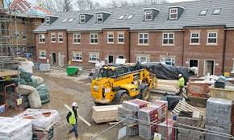

Neighbourhood Development Orders (NDOs)
NDOs can be used as either an alternative , or an addition , to the NDP – for example taking forward the plan’s proposals
Offers a quicker way to deliver community development objectives
Essentially , the NDO grants planning permission for a specific development on a specific site , for example affordable housing or a community centre

Slide 8
What’s been happening since the Localism Act in 2011?
Neighbourhood planning has been enthusiastically embraced across England : over 2000 NDPs started and over 400 completed and “made”
Ministers consider it a great success and want to strengthen it further because:
it is one of the main planks of “localism”, in an era where the main local authorities are having to handle significantly reduced budgets
of the strong take up , and more decisions, at local level
of evidence that neighbourhood planning can disarm “nimbyism” and provide more housing ,through making local decisions rather than imposition “from above”
The overall trend has been for the Government to strengthen the role of neighbourhood plans since they were first introduced. This trend was continued with more proposals in the October 29 2018 budget

Slide 9

What can a neighbourhood plan do?
It can be as broad, or as narrow, in scope as you like , but must be about the development and use of land : but you don’t need to “say something about everything”
It can decide where and what type of development should happen in the neighbourhood
It can promote more development than is indicated in the local plan (but not less)
It can seek to protect areas from harmful development
It can promote local environmental
improvements

Slide 10

What can’t a neighbourhood plan do?
It cannot conflict with the strategic policies in the Local Plan being prepared by the local planning authority (DDC)
It cannot block development proposed in the Local Plan , or propose less housing development than indicated there
It cannot do things covered by other legislation , such as designate listed buildings or conservation areas , speed limits or parking controls on the highway ( but can refer to them as “community aspirations”)
Propose development which would breach other legal requirements, such as EU regulations
Be prepared by a body other than a town
or parish council , or a designated
neighbourhood forum

Slide 11
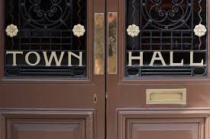
The role of the local planning authority (DDC)
Designates the neighbourhood plan area
Has a “duty to support” and provides assistance , encouragement and advice
Provides information or evidence to assist NDP preparation
Checks that the NDP has been prepared correctly
Arranges an examination by an independent Inspector
Organises a local referendum
Adopts the “made” NDP as part
of the Development Plan

Slide 12

What is the process for preparing a neighbourhood plan?
1. Getting started ( designation, setting up teams, mobilising volunteer effort ) *
2. Identifying the issues and gathering evidence*
3. Develop a vision and objectives*
4. Generate options to deliver your objectives*
5. Draft the plan
6. Consult on it *, review comments received
and submit to LPA
7. More consultation* and Examination*
8. Referendum* and adoption
* The public can be engaged at all these stages

Slide 13
Why bother? What are the benefits?
allows the local community to tackle the issues it faces and find its own solutions, rather than having decisions imposed “from above”
provides a plan with real teeth in the planning system which will have strong influence over decisions on planning applications
can promote regeneration opportunities to developers and investors
can raise design quality in new development
can generate significant extra money in future to spend locally by increasing Community Infrastructure Levy receipts channelled to town council (up from 15% > 25%)
only three year housing land supply ( not five) required in areas with recently approved NDP:
can bring a community together in a shared effort
puts you in a stronger position when seeking external project funding, such as Coastal Communities Fund

Slide 14
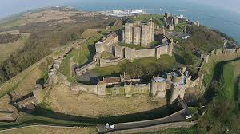
The potential benefits for Dover
The town is facing many challenges but , at the same time, its location, its heritage and its people give it great potential
Timing is good : can proceed in step with DDC’s new Local Plan , which is looking ahead to 2037
Can tap into existing community initiatives such as Big Local
Government grants can assist with some costs of preparing the Neighbourhood Plan
The Town Council is ready to provide the leadership , but it will need a big community effort

Slide 15
Finding out more : check these web pages
Locality : Neighbourhood Plans Road Map-A Step-by-Step Guide 2018 edition , written by Dave Chatwin
https://neighbourhoodplanning.org/toolkits-and-guidance/create-neighbourhood-plan-step-by-step-roadmap-guide/
NALC : The Good Councillors Guide to Neighbourhood Planning
https://www.nalc.gov.uk/news/entry/819-good-councillors-guide-to-neighbourhood-planning-%E2%80%93-designing-the-future-of-local-communities
Dover District Council web site: neighbourhood planning pages
https://www.dover.gov.uk/Planning/Planning-Policy-and-Regeneration/Neighbourhood-Planning/Home.aspx

Slide 16
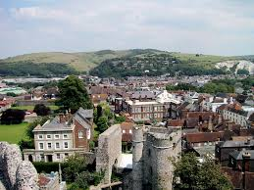

Thank you for listening
Lindsay Frost
Independent planning consultant
Lewes , East Sussex
Tel: 01273 4856448/07722 297676
E: lfrost5@aol.com

