Slide 1

Local Plan review consultation
Hotwells and Cliftonwood Community Association
Holy Trinity Church – 9th April 2018

Slide 2
What is the Local Plan?
Decisions on planning application required by law to accord with the Local Plan – unless there are material reasons not to;
Sets out a strategy for development over a 15 – 20 year period;
Reviewed every five years.

Slide 3
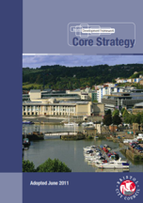
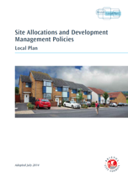
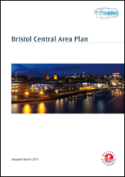
Current Local Plan
Plans adopted between June 2011 and March 2015
Replaced the 1997 Bristol Local Plan providing up to date coverage
Set a direction to 2026
Aspires to 30,600 new homes between 2006 and 2026 – 20,00 completed to date
Allocates land to provide more than 8,000 new homes
115 policies guide development.

Slide 4
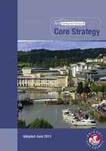


Reasons for the review
Core Strategy commitment to interim review
Joint Spatial Plan
National Planning Policy (including current NPPF update process)
Bristol City Council Corporate Strategy

Slide 5
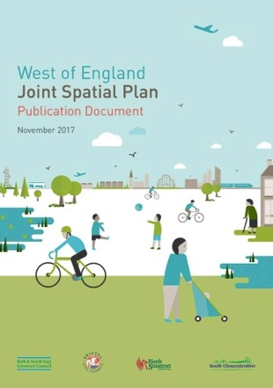
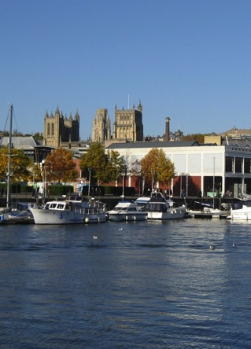

New Local Plan
Bristol Local Plan
to 2036

Slide 6
Local Plan Review
Local Plan review - consultation (stage 1) | February - April 2018
Local Plan review consultation (stage 2) | October - December 2018
PUBLICATION | April 2019
Submission to Secretary of State | September 2019
Examination hearings | January 2020
Modifications
ADOPT new local plan | July 2020

Slide 7
Two main consultation phases
Feb – Apr 2018
Proposed development strategy
Proposals for new and updated policies
Oct – Dec 2018
Draft plan
Site allocation proposals
Proposed policy designations

Slide 8
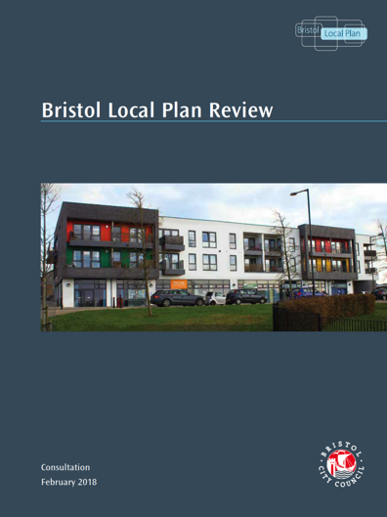
Local Plan review – consultation document
37 proposals for new and updated policies
Proposal to retain 77 existing policies

Slide 9
Themes
Inclusive growth and development
33,500 new homes by 2036
‘Urban living’
Economy and employment land
Health and well-being
Resilience

Slide 10
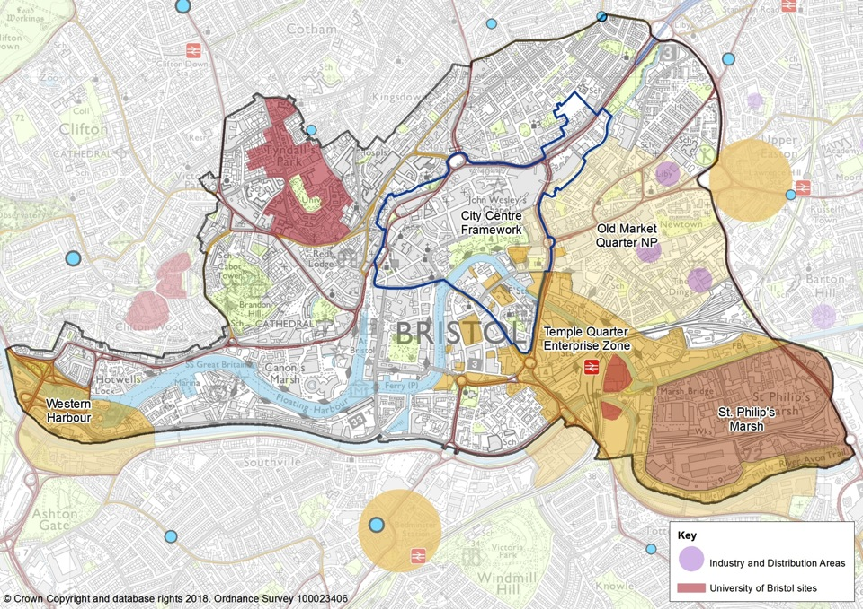
Central Bristol

Slide 11
Policy Proposals (1)
Delivering homes through urban living
New homes
Urban living
Tall Buildings
Fire Safety

Slide 12
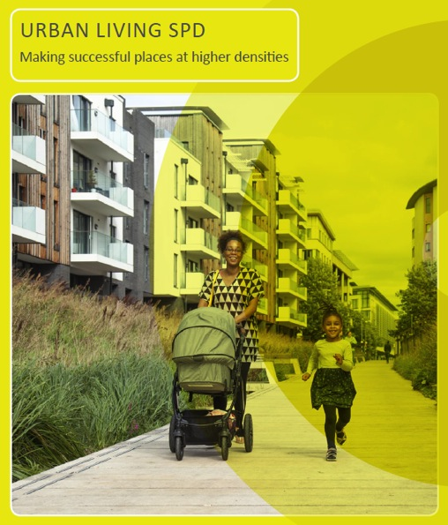
Urban Living
consultation
Replaces SPD1
Creation of characterful urban areas where people can live, work and socialise, relying on sustainable transport
Parallel consultation

Slide 13
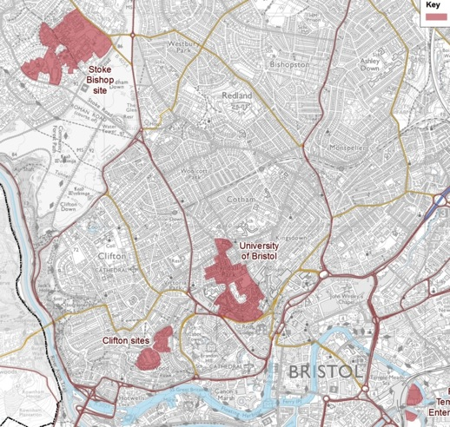
Policy Proposals (2)
Managing student housing and University development
Older people’s housing
Self build accommodation
Accessible homes

Slide 14
Policy Proposals (3)
Economy and employment land
Central Bristol
Avonmouth Industrial Areas including Bristol Port
The City’s core industrial estates
New work space
Digital connectivity
Health and well being
Air quality
New protection for open space
Takeaways
Resilience
Climate change
Food Systems – food growing

Slide 15
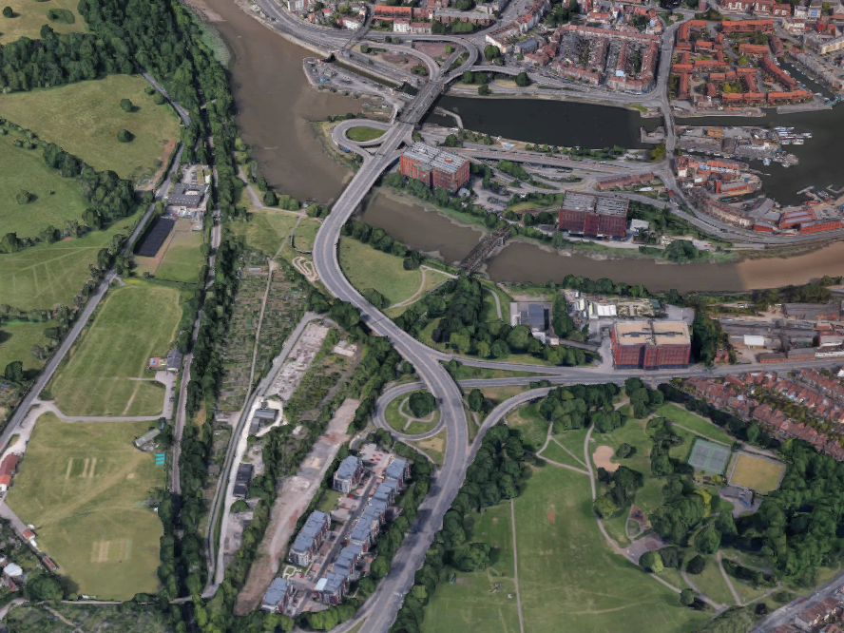
Western Harbour –
background
Current Local Plan (Core Strategy 2011) proposes regeneration at city centre gateways including Cumberland Basin
Bristol Central Area Local Plan (2015) allocates land south of Brunel Lock Road for housing/offices

Slide 16
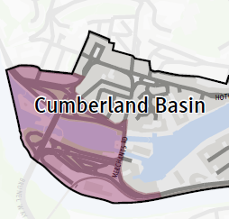
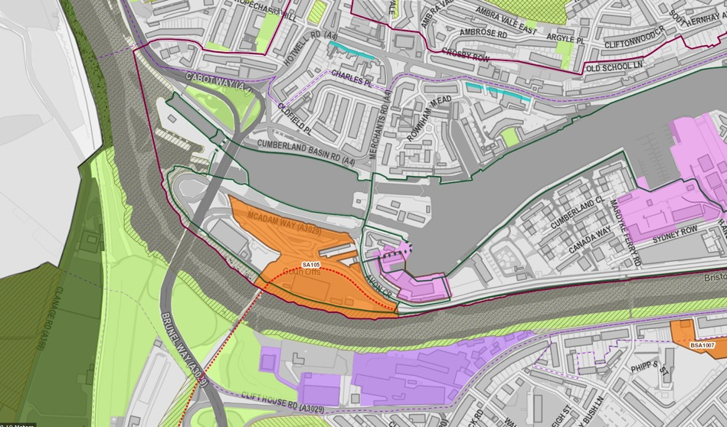

Slide 17
Western Harbour proposals
Replace aging and outdated roads with simpler new system
Will unlock additional development potential
New and affordable homes with complementary mix of uses, services and infrastructure
Make efficient use of land
Open spaces and important heritage assets
Views to and from Suspension Bridge and Gorge
Maintain maritime industries at Underfall Yard

Slide 18
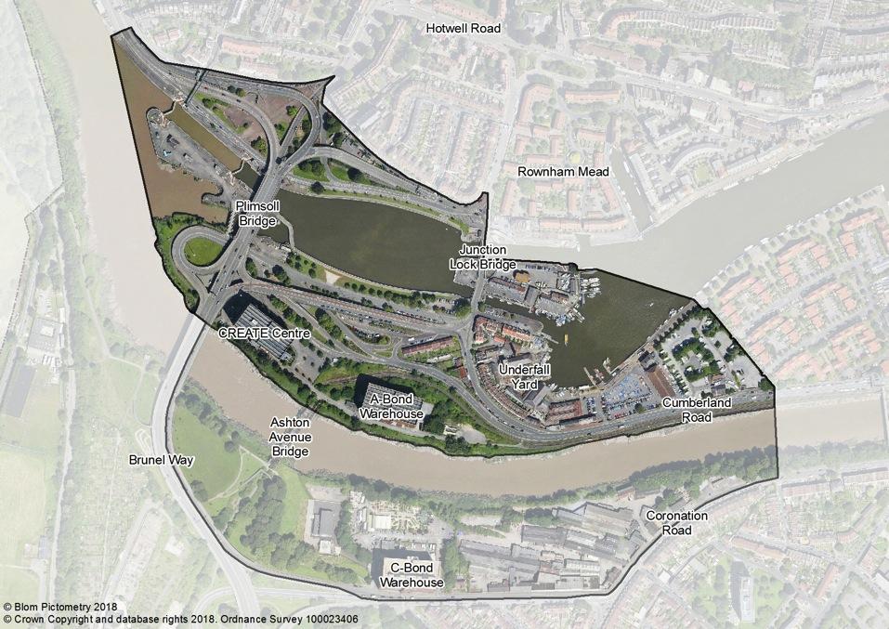
Western Harbour proposal

Slide 20
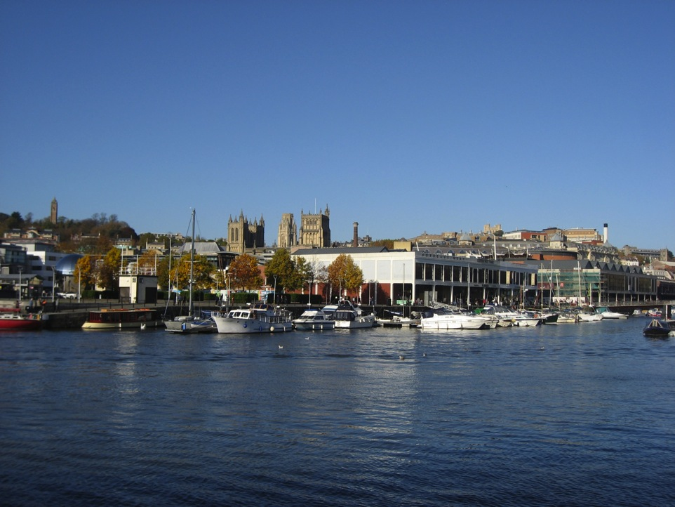

This consultation closes 13th April Next consultation – October 2018 www.bristol.gov.uk/localplanreview blp@bristol.gov.uk

