Slide 1



NHS Long Term Plan: Update

Slide 2
Agenda
1. NHS Long Term Plan
2. Local translation - What could this mean for us?
3. Q&A

Slide 3

NHS Long Term Plan
In June 2018 the Prime Minister set out a funding settlement for the NHS in England to cover the next five years
= £20bn over the next 5 years.
In return, the NHS was asked to come together to develop a long term plan for the future of the service

Slide 4


The Long Term Plan is all about…
Making sure everyone gets the best start in life
Delivering world-class care for major health problems
Supporting people to age well
Ensuring NHS staff get the support they need
Digitally enabled care
Effective use of resources

Slide 5

Headlines from the Long Term Plan
A new service model for the 21st century
with a series of improvements to be
delivered in the following five key areas :-
Improving out of hospital care (primary and
community services)
Reducing pressure on emergency hospital services
Delivering person-centred care
Digitally enabled primary and outpatient care
A focus on population health and local partnerships through Integrated Care Systems (ICSs)

Slide 6
Headlines from the Long Term Plan
A strong start in life for children and young people
Action on prevention and health inequalities
Reduction in stillbirth and mortality
Continuity of care
Perinatal mental health
Children and Young Peoples MH services with a 0-25 focus including an increased focus on school and college based teams
A more comprehensive offer

Slide 7
Headlines from the Long Term Plan
World class care- major health conditions:
Integrated pre-hospital urgent care
Urgent Treatment centre offer by 2020
Same day emergency care increasing on the day discharges
Preventing heart disease, strokes, and dementia cases
Earlier cancer diagnosis
Spending at least £2.3bn more a year on mental health care
More people to get therapy for depression and anxiety by 2023/24
Increased focus on community-based physical and mental care for people with severe mental illness by 2023/24

Slide 8
Headlines from the Long Term Plan
Ageing well:
Increasing funding for primary and community care by at least £4.5bn, bringing together different professionals to coordinate care better
Helping more people to live independently at home for longer with more rapid community response teams to prevent unnecessary hospital spells
Upgrading NHS staff support to people living in care homes
Improving the recognition of carers and support they receive
Giving more people more say about the care they receive, particularly towards the end of their lives

Slide 9
Delivering ambitions
Doing things differently
Preventing illness and tackling health inequalities
Backing our workforce
Making better use of data and digital technology
Getting the most out of taxpayers’
investment in the NHS

Slide 10
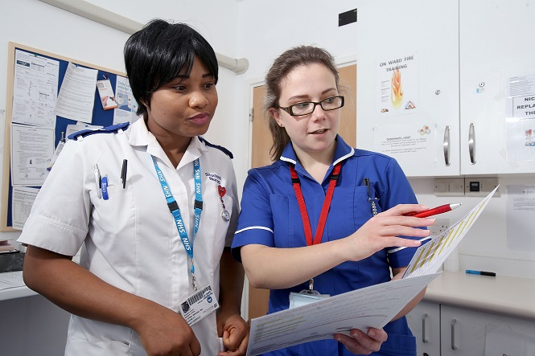
Workforce
Increase the NHS workforce, training and recruiting more professionals (including more clinical placements for undergraduate nurses, more medical school places, and more routes into the NHS such as apprenticeships)
Take steps to make the NHS a better place to work, so fewer staff leave and more feel able to make better use of their skills and experience for patients

Slide 11

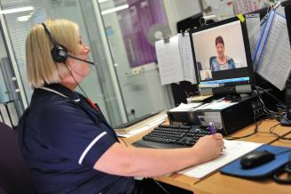
Digital
Provide more convenient access to services and health information for patients, with the new NHS App as a digital ‘front door’
“Revolutionise the approach to Outpatients”
Provide better access to digital tools and patient records for staff
Improve the planning and delivery of services through the greater use of analysis of patient and population data

Slide 12

Finance
Return the NHS to financial balance
Cash releasing productivity of a minimum of 1.1% per year
Reduce growth in demand through integration and prevention
Accelerate turnaround for the 30 worst performing trusts
Efficiency improvements including the use of E rostering, Carter review

Slide 13


Other key themes
Integrated Care Systems (ICS)
Every STP to transition to an ICS by 2021
Each ICS will have a Strategic commissioning function and at least one provider alliance
80% of the work will happen at “place level”
Takes responsibility for population health

Slide 14
Local translation:
Many of the key areas of work outlined in the Plan are already being developed by our local Sustainability and Transformation Partnership covering Shropshire, Telford & Wrekin
These priorities are consistent with the themes outlined in the 10 year plan, including;
improving outcomes in areas such as cancer and stroke,
greater focus on mental health and learning disability services
providing more care and treatment at home to reduce unnecessary admissions to traditional acute hospital services, and
putting real emphasis on prevention where individuals are better equipped to manage more aspects of their long-term conditions themselves, and where communities are supported to live healthier and active lives.

Slide 15

Stakeholder Engagement
Long Term Plan presents opportunity for wider staff and stakeholder engagement on our local priorities
Activity will build upon which has already been engagement carried out within the STP footprint
Working very closely with Healthwatch who will support this engagement by targeting hard to reach areas of our communities to ensure all voices are heard
Views will inform the development of the Long Term Plan for Shropshire, Telford & Wrekin.

Slide 16
We want your views…
What do you like about the NHS Long Term Plan?
Is there anything you don’t like about the NHS Long Term Plan?
How could we improve the health and care services for the local people in Shropshire, Telford & Wrekin?

