Slide 1
Tuesday 19th January

Slide 2
AGENDA
Welcome
Public Health update – COVID data update: testing: vaccinations. In-school LTF testing (Sec/Prim)
Lockdown updates until February half-term including Free School Meals: Remote Learning (LA document): Early Years Census: IT & broadband provision.
Approach/Restraint Training alternatives (N.Ellerby-Jones)
Support to Schools (S.Francis) – staff welfare & mental health
Holiday & Food fund (Easter, Summer, Xmas breaks)
Professional Learning update

Slide 3



Enfield COVID19 Dashboard
View in Power BI
Last data refresh:
13/01/2021 13:03:47 GMT Standard Time
Downloaded at:
13/01/2021 14:08:10 GMT Standard Time

Slide 4




ENFIELD COVID-19 DATA
TOTALS
(10 – 16 Jan 21*)
06 Mar 20- 16 Jan 21
TOTAL CASES
25,248
NEW CASES*
2,444
TESTS*
5,354
VACCINATIONS
11,322 1ST DOSES
INFECTION RATE PER 100,000*
708
AGE GROUP
0-29 30-59 60+
INFECTION RATE RANK*
NCL# = 1
LON= 9; Eng= 21
per 100,000
(PCR = 10,324 tests,
CT LFT total – 7,662 tests)
TESTING RATE RANK
NCL# = 1
LON=12; Eng= 44
586
1,020
701
06 Mar – 1st Jan 21
13 Jan
15 Jan /18 Jan update
18 Jan update
TOTAL COVID DEATHS
485
(463 excess)
RECENT COVID DEATHS*
40
(36 excess)
SCHOOLS/ EARLY YEARS AFFECTED
37
WARDS WITH MOST CASES* (TOP THREE)
Enfield Lock (225)
Edmonton Green (210)
Enfield Highway (208)
CARE HOMES AFFECTED
34
No of deaths= 6 (3)
Staff = 69 cases
Residents = 79 cases
Staff = 63 cases
Students = 42 cases
DOM CARE AFFECTED
31
Care Staff = 87 cases
Clients = 39 cases
#North Central London includes Camden, Barnet, Enfield, Haringey & Islington
Change since last week of data

Slide 5
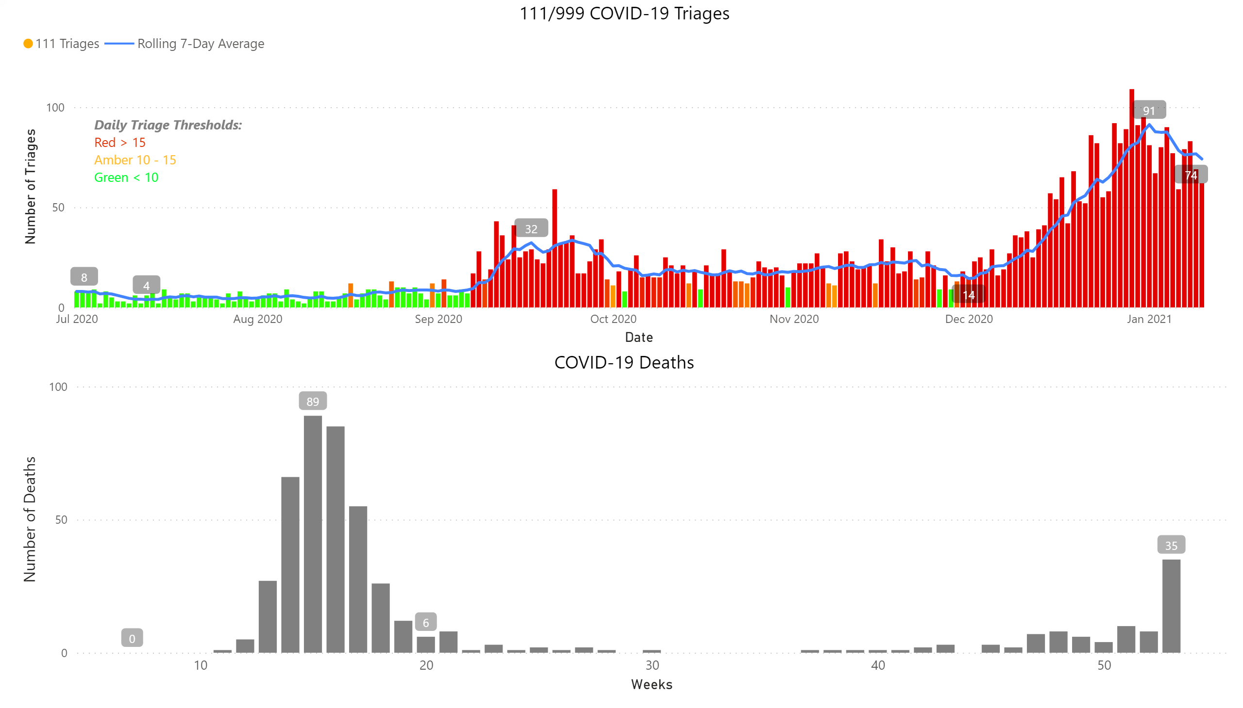
Charts

Slide 6
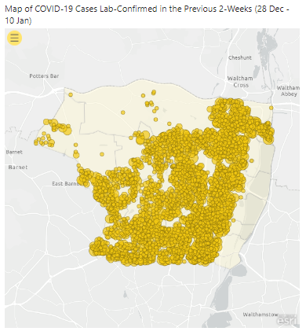
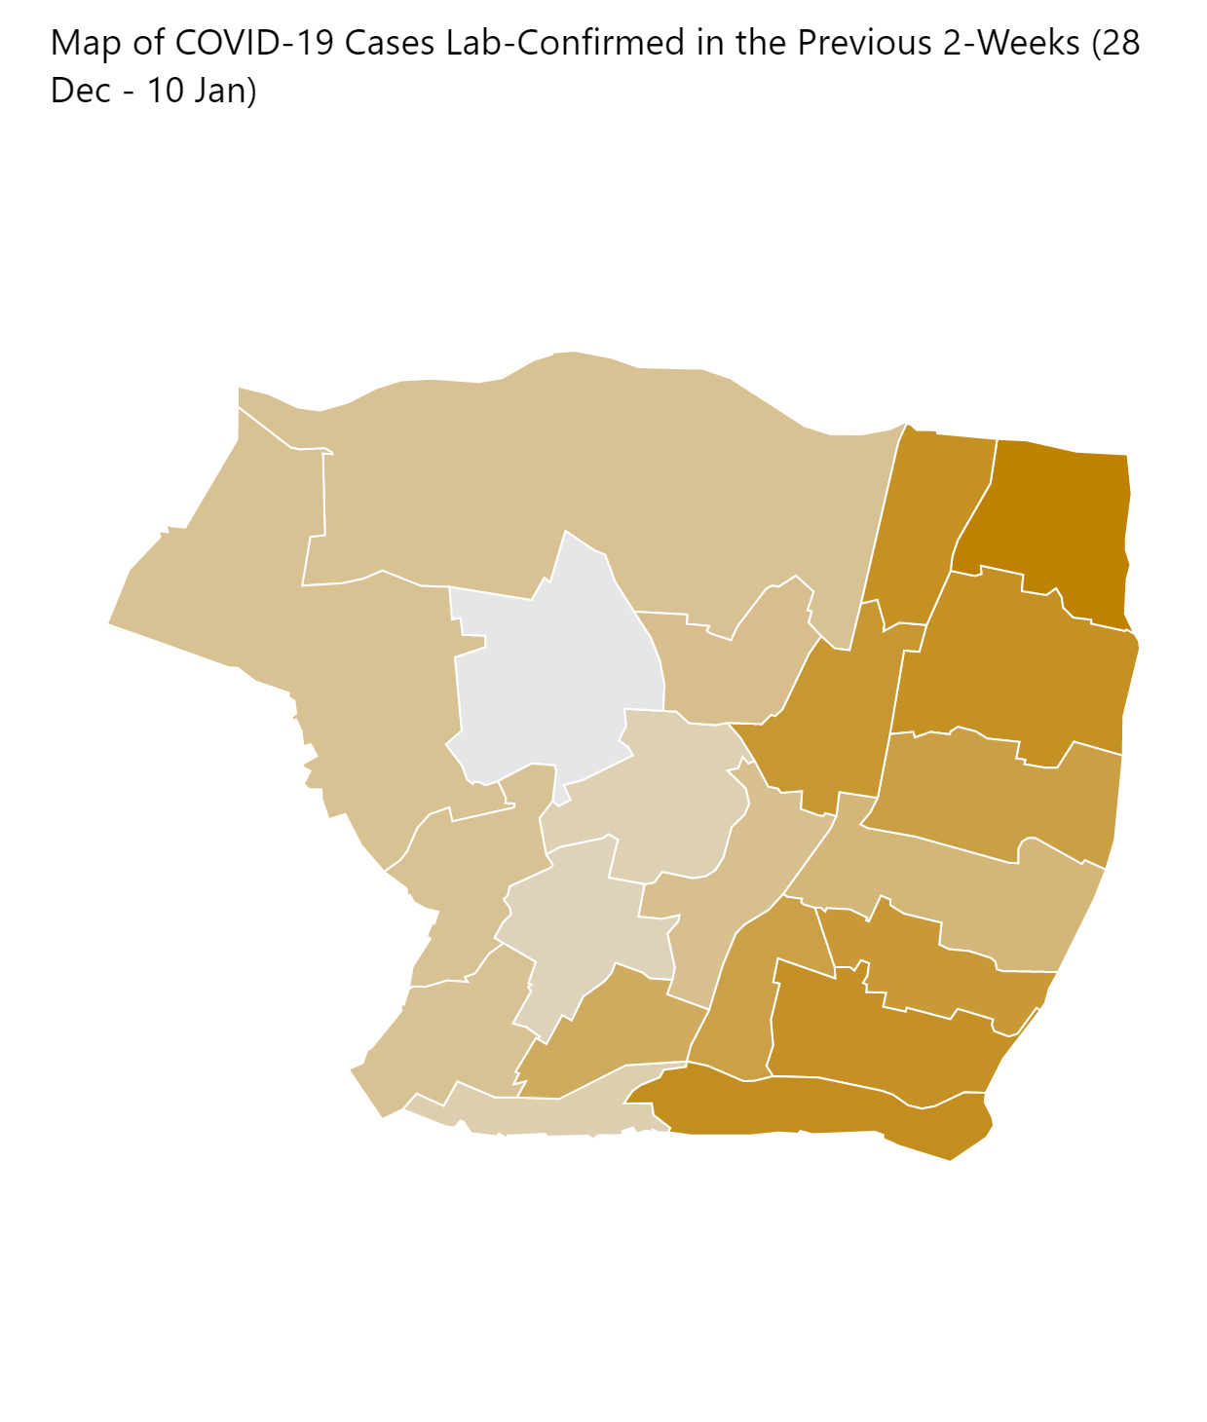
Maps

Slide 7
Weekly Age Stratified Infection Rates – 5-Year Age Brackets
 | Average weekly infection rate (last week) | Average weekly infection rate (last two weeks)
0-4 years | 314.24 | 374.99
5-9 years | 295.89 | 354.67
10-14 years | 461.97 | 496.19
15-19 years | 846.94 | 984.69
20-24 years | 1,619.35 | 1,744.53
25-29 years | 1,373.41 | 1,469.42
30-34 years | 1,356.35 | 1,503.77
35-39 years | 1,343.66 | 1,456.29
40-44 years | 1,293.42 | 1,525.02
45-49 years | 1,291.73 | 1,549.18
50-54 years | 1,029.00 | 1,272.14
55-59 years | 1,199.02 | 1,339.07
60-64 years | 1,300.89 | 1,372.08
65-69 years | 1,020.74 | 1,077.45
70-74 years | 741.69 | 888.20
75-79 years | 789.16 | 824.50
80-84 years | 657.69 | 665.34
85-89 years | 807.27 | 794.65
90+ years | 1,430.43 | 1,213.70

Slide 8
COVID-19 Vaccine uptake: Enfield as at 15th Jan 2021
Number of Vaccine decliners as at 14th Jan= 167
Mostly;
Black and
Cypriot community
Data source: NCL HealtheAnalytics COVID-19 vaccinations dashboard EMIS refresh 15th Jn 2021.
Updated on 18th Jan 2021 at 7.00 pm.

Slide 9


Community - Lateral Flow Testing in Enfield
January 2021
Striving for excellence
www.enfield.gov.uk

Slide 10
Identifying sites
Enfield has now set up 6 community asymptomatic (LFT) testing sites with a good geographic spread across the borough aimed at addressing uptake and health inequalities.
We have been particularly keen to set up sites in areas of deprivation and have been led by ‘heat maps’ of infection provided by the public health intelligence team.

Slide 11
Current Sites
Opened - 19.12.20 | Klinger Community Hall | N18 1PF
Opened - 21.12.20 | Brigadier hall | EN2 0NL
Opened - 21.12.20 | Kempe Hall | EN1 4QS
Opened - 24.12.20 | Southgate Library | N9 0BT
Opened - 29.12.20 | Green Towers Community Centre | N14 6BP
Opened - 04.01.21 | John Wilkes House | EN3 4EN
Opened – 14.01.21 | Morson Road Depot (Staff site) | EN3 4NQ

Slide 12
Daily Testing Numbers
December stats available | Jan 21
 | 1 | 2 | 3 | 4 | 5 | 6 | 7 | 8 | 9 | 10 | 11 | 12 | 13 | 14 | 15 | 16 | 17
Klinger Hall | 55 | 87 | 66 | 76 | 48 | 72 | 75 | 59 | 67 | 67 | 73 | 48 | 52 | 58 | 68 | 58 | 47
Kempe Hall | 120 | 164 | 142 | 233 | 162 | 184 | 107 | 164 | 135 | 140 | 133 | 142 | 166 | 126 | 137 | 117 | 118
Brigadier Hall | 166 | 248 | 270 | 254 | 191 | 245 | 224 | 204 | 247 | 212 | 224 | 180 | 180 | 181 | 200 | 175 | 196
Southgate Library | 242 | 398 | 320 | 436 | 318 | 332 | 275 | 326 | 340 | 343 | 342 | 280 | 275 | 255 | 344 | 276 | 292
Green Towers Hall | 19 | 52 | 35 | 100 | 73 | 123 | 106 | 101 | 95 | 116 | 150 | 151 | 124 | 92 | 117 | 78 | 42
John Wilkes House |  |  |  | 30 | 58 | 125 | 120 | 154 | 125 | 100 | 214 | 144 | 159 | 122 | 151 | 143 | 120
Morson Road Depot |  |  |  |  |  |  |  |  |  |  |  |  |  | 47 | 0
Daily Total | 602 | 949 | 833 | 1129 | 850 | 1081 | 907 | 1008 | 1009 | 978 | 1136 | 945 | 956 | 881 | 1017 | 847 | 815
Cumulative Total | 10121 | 11070 | 11903 | 13032 | 13882 | 14963 | 15870 | 16878 | 17887 | 18865 | 20001 | 20946 | 21902 | 22783 | 23800 | 24647 | 25,462
Total = 25,462

Slide 13
Positive tests
Positive Tests
December stats available | Jan
 | 1 | 2 | 3 | 4 | 5 | 6 | 7 | 8 | 9 | 10 | 11 | 12 | 13 | 14 | 15 | 16 | 17
Klinger Hall | 8 | 13 | 7 | 7 | 9 | 5 | 14 | 6 | 4 | 3 | 6 | 7 | 3 | 5 | 2 | 2 | 2
Kempe Hall | 16 | 15 | 17 | 33 | 21 | 18 | 11 | 11 | 17 | 8 | 8 | 14 | 17 | 7 | 3 | 5 | 3
Brigadier Hall | 21 | 26 | 25 | 21 | 19 | 12 | 14 | 10 | 11 | 8 | 14 | 8 | 3 | 6 | 2 | 13 | 2
Southgate Library | 30 | 32 | 20 | 29 | 32 | 22 | 19 | 16 | 12 | 22 | 23 | 29 | 26 | 20 | 24 | 9 | 12
Green Towers Hall | 0 | 8 | 6 | 7 | 6 | 12 | 3 | 4 | 7 | 4 | 13 | 8 | 6 | 7 | 4 | 9 | 5
John Wilkes House |  |  |  | 2 | 6 | 6 | 6 | 5 | 6 | 5 | 10 | 11 | 7 | 6 | 5 | 6 | 13
Morson Road Depot |  |  |  |  |  |  |  |  |  |  |  |  |  | 0 | 0
Daily Total | 75 | 94 | 75 | 99 | 93 | 75 | 67 | 52 | 57 | 50 | 74 | 77 | 62 | 51 | 40 | 44 | 37
Cumulative Total | 751 | 845 | 920 | 1019 | 1112 | 1187 | 1254 | 1306 | 1363 | 1413 | 1487 | 1564 | 1626 | 1677 | 1717 | 1761 | 1798
% Positive
 | January
 | 1 | 2 | 3 | 4 | 5 | 6 | 7 | 8 | 9 | 10 | 11 | 12 | 13 | 14 | 15 | 16 | 17
Klinger Hall | 15% | 15% | 11% | 9% | 19% | 7% | 19% | 10% | 6% | 4% | 8% | 15% | 6% | 9% | 3% | 3% | 4%
Kempe Hall | 13% | 9% | 12% | 14% | 13% | 10% | 10% | 7% | 13% | 6% | 6% | 10% | 10% | 6% | 2% | 4% | 3%
Brigadier Hall | 13% | 10% | 9% | 8% | 10% | 5% | 6% | 5% | 4% | 4% | 6% | 4% | 2% | 3% | 1% | 7% | 1%
Southgate Library | 12% | 8% | 6% | 7% | 10% | 7% | 7% | 5% | 4% | 6% | 7% | 10% | 9% | 8% | 7% | 3% | 4%
Green Towers Hall | 0% | 15% | 17% | 7% | 8% | 10% | 3% | 4% | 7% | 3% | 9% | 5% | 5% | 8% | 3% | 12% | 12%
John Wilkes House |  |  |  | 7% | 10% | 5% | 5% | 3% | 5% | 5% | 5% | 8% | 4% | 5% | 3% | 4% | 11%
Morson Road Depot |  |  |  |  |  |  |  |  |  |  |  |  |  | 0%
Daily Total | 12% | 10% | 9% | 9% | 11% | 7% | 7% | 5% | 6% | 5% | 7% | 8% | 6% | 6% | 4% | 5% | 5%
Cumulative Total | 7.4% | 7.6% | 7.7% | 7.8% | 8.0% | 7.9% | 7.9% | 7.7% | 7.6% | 7.5% | 7.4% | 7.5% | 7.4% | 7.4% | 7.2% | 7.1% | 7.1%
Of 25,462 tests 1,798 positive
Current + rate = 7.1%

Slide 14
Comms
Social media
Posters in local shops, areas
Banners on sites
Leaflets in surrounding areas
Leaflets – whole borough distribution
Schools via email to parents/carers
Targeted – Key Worker Comms
_______________________________________
In London, in the last 7 days, the second highest number of LFTs conducted among residents was in LBE.

Slide 15
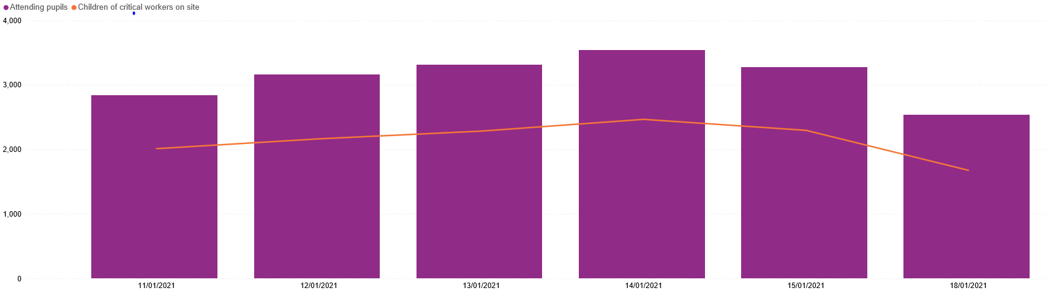
LOCKDOWN 3 ATTENDANCE
Total pupils 3878
(2415 critical workers children)
2pm 18.1.21 – response rate 56.76%
Total pupils 2541
(1677 critical workers children).

Slide 16

Staff Wellbeing & Mental Health
Suzy Francis
(Principal Educational Psychologist/Strategic Lead for CYP Emotional Wellbeing)
&
Emma Gore Langton
(Senior Specialist EP for SEMH/Project Lead for Wellbeing for Education Return)
Follow us on Twitter @ENFIELDEPS

Slide 17
Free School Meals
Christmas voucher update
Christmas food parcels
February Half Term - The approach
Edenred National Vouchers
Food parcels
Enfield Catering
Food parcels
Curriculum Sequencing
Chefs in Schools
Co-owned model

Slide 18

Traded Services
Trading is now live
Business Support
Customer Satisfaction Survey
How will Enfield Catering and Music Service
Support Children's Mental Health Week…

Slide 19

1st Pivotal – Leading Behaviour Change PRIMARY – 25th Jan 10 a.m.
2nd Pivotal – Leading Behaviour Change SECONDARY – 8th Feb 2 p.m.

Slide 20
Digital & Online Learning Support
Recording of 21st Century Skills session from Digital Transformation PL Program: https://youtu.be/GRBt8jihADM
Upcoming Sessions from Digital Transformation PL Program:
Online Safeguarding: Empowerment; Strategies & Key Issues 26th Jan
Strategic Planning for Online Safety & Safe Implementation 2nd Feb
Eduprotocols for primary (live from California!) 23rd Feb
Eduprotocols for secondary “ 2nd Mar
Online Teaching & Learning (UCL/IOE; Michigan Virtual; LGfL) 16th Mar
Sharing School Stories; Launching Digital Community 30th Mar
EdTech Demonstrator
Guides from our VLE
Oak National Academy
No-cost!

Slide 21
School Expertise – Input Into Our New
Professional Learning Offer
Advertised April 2021 for September
Mail primary heads & secondary PL leads to confirm
Meet with staff member; go through:
PL protocols
QA framework
Structure
Agreement
If proceeding; confirm title & dates
Plan support for content

