Slide 1


Oxford Citizens Assembly
on Climate Change
19th and 20th October 2019
Weekend Two
Oxford City Council and Ipsos MORI

Slide 2
A word from Councillor Tom Hayes

Slide 3
Welcome (back) to the Citizens Assembly!
Lots of people in the room…
Assembly Members – most importantly!
Ipsos MORI staff and note takers
Observers – the City Council, Oxford residents, other organisations
Notes:
The building, sustainable operations.
- solar panels on the roof - energy for use within the building or back into the national grid.
- solar-thermal water heating, and ground source heat pumps that supply up to 70% of heating needs.
LED and motion detector lighting installations to improve energy efficiency.
Park’s 37 acres feature extensive biodiversity including a wildflower meadow managed under an Environmental Stewardship scheme.
12,000-20,000 trees absorb up to almost a million pounds of carbon per year from the city.

Slide 4
Oxford Citizens Assembly on Climate Change
The UK Government has legislation to reach ‘net zero’ by 2050. Should Oxford be more proactive and seek to achieve ’net zero’ sooner than 2050?
What trade-offs are we prepared to make?
How ambitious should Oxford be?
How can Oxford City Council help drive that change?

Slide 5
Structure of the Assembly
Weekend one (28th and 29th September)
Hear from a broad range of expert speakers
A chance to question the expert speakers
Weekend two (19th and 20th October)
Deliberate and vote on what might be done
Develop recommendations to help the Council

Slide 6
Tone and nature of our discussions
Relaxed and informal
Share everyone’s views
No right or wrong questions or answers
Feel free to (respectfully!) disagree with one another
Avoid talking over one another
Lots to get through, so we may have to move people on from time to time

Slide 7
Three requests…
Please do not take pictures or videos during the Assembly, in particular of other Assembly Members (or staff)
Please refrain from using social media to discuss other Assembly Members’ views
Please turn phones to silent during presentations and discussions

Slide 8
General housekeeping
Bathrooms
Water available just outside
Filming during presentations
Lunch and refreshments
Fire alarm
Safety

Slide 9
Agenda for this weekend

Slide 10
This morning
09:45-10:15 – New tables, reflect on weekend one
10:15-10.30 – Nick Chater, behaviour change
10.30-11.15 – Rob Hopkins, imagining the future
11:15-11:30 – Break
11.30-12.30 – Theme 1: Waste reduction
12:30-13:15 – Lunch break
Notes:
Reference to impact of meat on climate change as rationale for vegetarian/vegan food
Any allergies – let catering staff know

Slide 11
This afternoon
13.15-14:45 – Theme 2: Buildings
14:45-15:00 – Break
15.00-16:30 – Theme 3: Transport
16:30-17:20 – Theme 4: Biodiversity & Offsetting
17.20-17.30 – Close

Slide 12
Tomorrow morning
09:00-09:30 – Arrival and breakfast
09:30-09:45 – Me
09:45-11:15 – Theme 5: Renewable Energy
11:15-11:35 – Break
11:35-12:45 – Voting session 1
12.45-13.45 – Lunch

Slide 13
Tomorrow afternoon
13:45-14:30 – Voting session 2
14:30-15:30 – Reflecting on it all
15:30-15:50 – Break
15.50-16:10 – Voting session 3
16.10-16.20 – Final vote
16.20-16.45 – Wrap up

Slide 14
Any questions before we begin?

Slide 15
Table discussion: Reflecting on weekend one 09:45-10:15

Slide 16
Behaviour change Nick Chater (University of Warwick) 10:15-10:30

Slide 17
What might the future look like? Rob Hopkins (The Transition Network) 10:30-11:15

Slide 18
Break 11:15-11:30

Slide 19
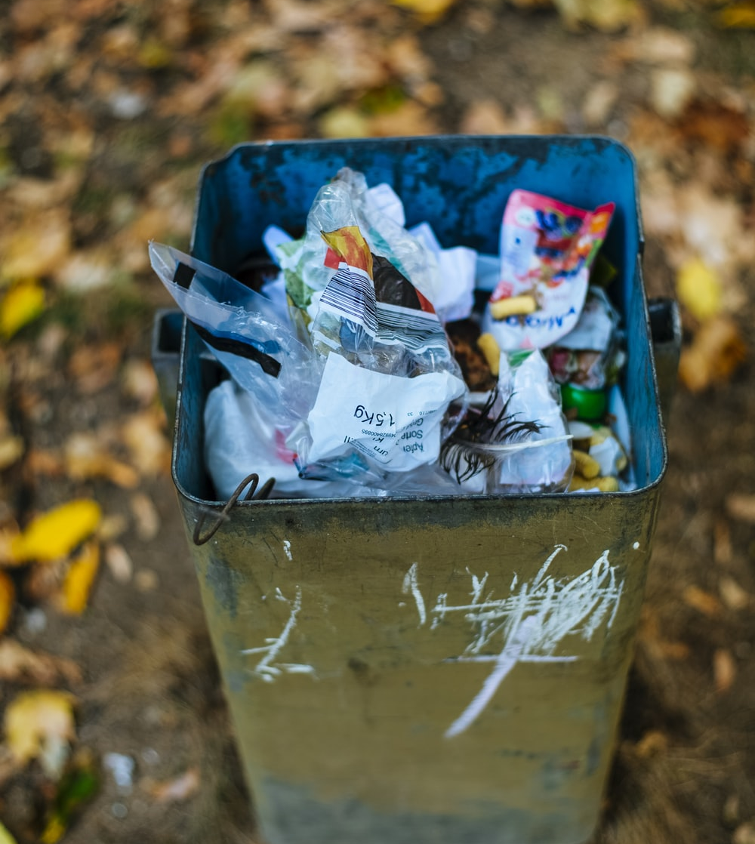
Theme 1
Waste reduction
11:30-12:30

Slide 20
Lunch 12:30-13:15
Notes:
Any allergies – let catering staff know

Slide 21
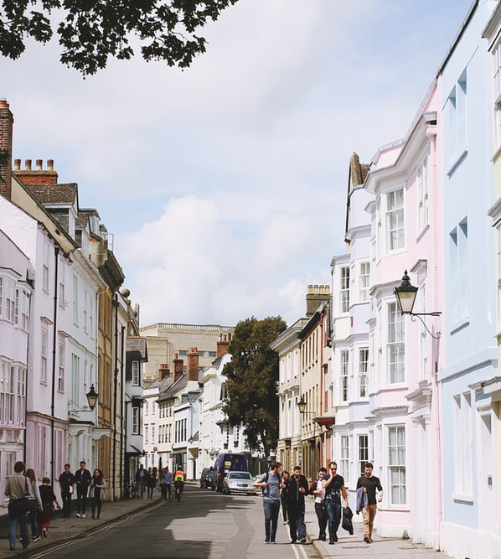
Theme 2
Buildings
13:15-14:45

Slide 22
Break 14:45-15:00

Slide 23
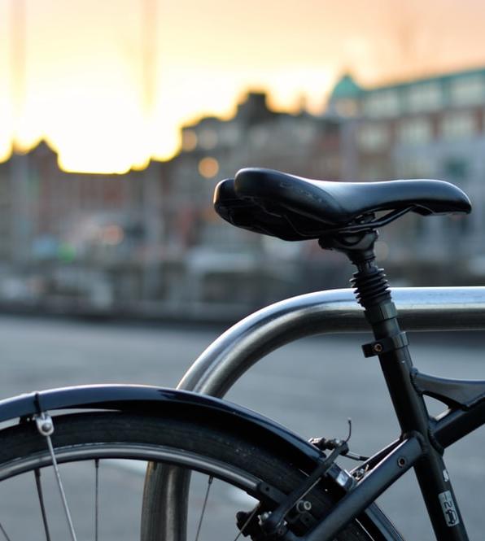
Theme 3
Transport
15:00-16:15

Slide 24
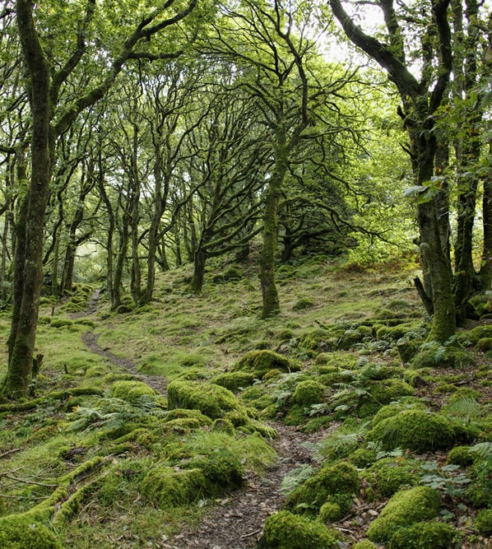
Theme 4
Biodiversity & offsetting
16:20-17:20

Slide 25
Thank you! See you tomorrow morning at 09.00…

Slide 26
Oxford Citizens Assembly
on Climate Change
19th and 20th October 2019
Weekend Two
Oxford City Council and Ipsos MORI

Slide 27
Welcome back!
Notes:
Something that stood out yesterday…

Slide 28
Things we did yesterday…
Reflecting on weekend one
Behaviour change and thinking about the future
Theme 1: Waste Reduction
Theme 2: Buildings
Theme 3: Transport
Theme 4: Biodiversity & offsetting

Slide 29
This morning
09:00-09:30 – Arrival and breakfast
09:30-09:45 – Me
09:45-11:15 – Theme 5: Renewable Energy
11:15-11:35 – Break
11:35-12:45 – Voting session 1
12.45-13.45 – Lunch

Slide 30
This afternoon
13:45-14:30 – Voting session 2
14:30-15:30 – Reflecting on it all
15:30-15:50 – Break
15.50-16:10 – Voting session 3
16.10-16.20 – Final vote
16.20-16.45 – Wrap up

Slide 31
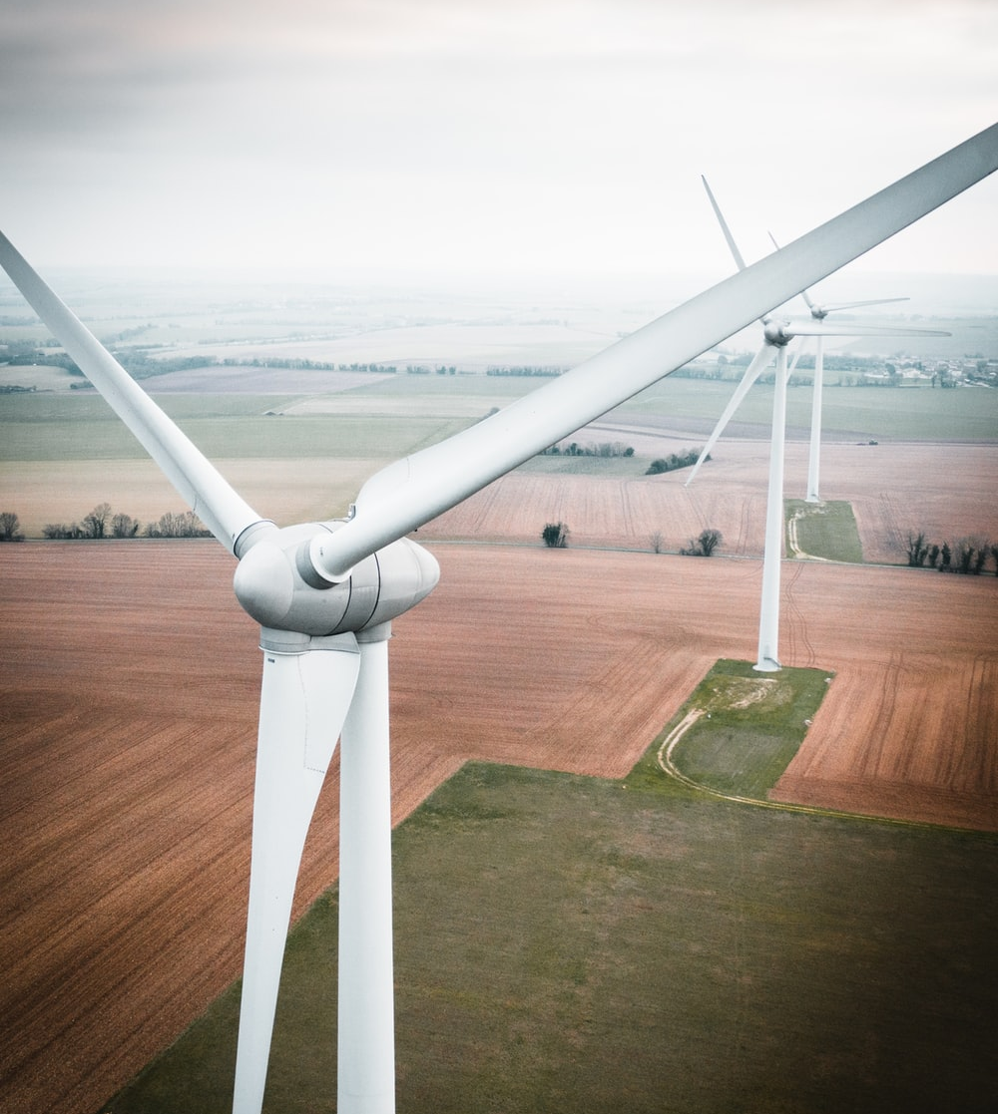
Theme 5
Renewable energy
09:45-11:15

Slide 32
Break 11:15-11:35

Slide 33
Voting session 1 11:35-12:45

Slide 34
Lunch 12:45-13:45
Notes:
Any allergies – let catering staff know

Slide 35
Voting session 2 13:45-14:30

Slide 36
Reflection 14:30-15:30

Slide 37
Voting session 3 15:30-16.10

Slide 38
Final vote 16:10-16.20

Slide 39
The UK Government has legislation to reach ‘net zero’ by 2050. Should Oxford be more proactive and seek to achieve ’net zero’ sooner than 2050 and what trade-offs are we prepared to make?

Slide 40
What the most important thing
for the City Council
to bear in mind?

Slide 41
Thank you!

