Slide 1
The Prevent Duty
and its implications for
schools leaders

Slide 2
Kirsten Joppe
Prevent duty lead
Due Diligence and Counter Extremism Group

Slide 3
Objectives of the counter extremism programme in DfE
OUR OBJECTIVES
Improve the resilience of the system to extremist and radicalising influences, giving people the knowledge, skills and confidence to act.
Enable safeguarding to operate effectively in protecting vulnerable children and young people from extremist influences.
Strengthen our intelligence on extremism, financial and reputational risk in the education sector.
Continue to pursue action in Birmingham in response to the Clarke report.
Undertake casework, on individuals, institutions and areas where extremism concerns arise, increasingly seeking to stay ahead of risks, rather than reacting to events.

Slide 4
Threats
Children and young people are vulnerable to a wide range of safeguarding risks, and vulnerability to radicalisation needs to be seen in that context.
The online threat is particularly acute among under-18 year olds.
A small but growing number of children and young people are being drawn into terrorism – both in the UK and abroad.
Families.
Local threat assessment (LA, police)

Slide 5
The Prevent duty
The Prevent duty legally requires a range of organisations including schools to have “due regard to the need to prevent people from being drawn into terrorism”.
The duty came into force on 1 July 2015.
Four general themes:
Risk assessment,
working in partnership,
staff training, and
IT policies.

Slide 6
The Prevent duty in DfE’s sectors
Education and childcare specified authorities:
proprietors of maintained schools non-maintained special schools, maintained nursery schools, independent schools (including academies and free schools) and alternative provision academies
pupil referral units
registered early years childcare providers
registered later years childcare providers
providers of holiday schemes for disabled children

Slide 7
Safeguarding - general
“Schools can help to protect children from extremist and violent views in the same ways that they help to safeguard children from drugs, gang violence or alcohol. Schools’ work on Prevent needs to be seen in this context.”
Prevent Strategy, 2011
The department’s statutory guidance for schools on safeguarding, Keeping Children Safe in Education, is clear that radicalisation is one of a number of safeguarding concerns.

Slide 8
School leadership and Prevent
Crucial role of head teachers and school governors in ensuring your school protects children and young people from the risks of radicalisation.
Prevent implementation should be led by those who have the responsibility for putting policies and procedures in place and ensuring that they are adhered to.
Includes appropriate IT policies
Prevent can sometimes entail the sharing of sensitive information and other bodies may expect to engage with the school leadership.

Slide 9
Referral mechanisms and information sharing
“Knowing what to look for is vital to the early identification of abuse and neglect. If staff members are unsure they should always speak to the designated safeguarding lead.”
Keeping children safe in education
“no professional should assume that someone else will pass on information which they think may be critical to keeping a child safe. If a professional has concerns about a child’s welfare and believes they are suffering or likely to suffer harm, then they should share the information with local authority children’s social care.”
Working together to safeguard children
Channel

Slide 10
Working in partnership
The Prevent duty builds on existing local partnership arrangements, including those with
your Local Safeguarding Children Board (LSCB), local authority, Police service, civil society organisations and families and parents.
LSCBs are responsible for coordinating how agencies promote and safeguard the welfare of children in the local area.

Slide 11
Training
“Local authorities will be expected to ensure appropriate frontline staff…have a good understanding of Prevent, are trained to recognise vulnerability to being drawn into terrorism and are aware of available programmes to deal with this issue.” (Prevent Duty Guidance)
Workshop to Raise Awareness of Prevent is an hour long DVD-led interactive workshop
Aimed at front line staff (police, social services, education and health)
Attendees leave WRAP sessions able to understand what makes individuals susceptible to radicalisation and how to raise a concern

Slide 12
Building resilience
Building resilience of young people and the promotion of fundamental British values is at the heart of preventing radicalisation.
Safe spaces for discussion
Critical thinking
Curriculum
PSHE
Citizenship

Slide 13
DfE advice
Advice for schools and childcare providers to complement the statutory guidance.
Sent to schools on 30 June, published on GOV.UK on 1 July

Slide 14

DfE helpline
Intended to enable people to raise concerns about extremism – not to be used instead of following normal safeguarding procedures, or in an emergency.

Slide 15
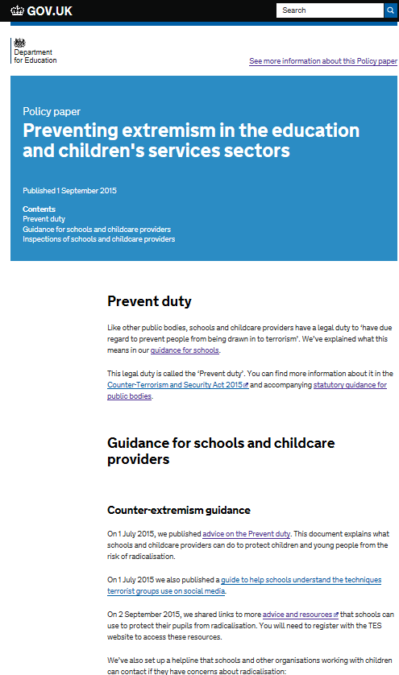
DfE preventing extremism advice
The new preventing extremism gov.uk page went live on 2nd September. It includes links to further advice and resources for teachers for classroom use as well as all existing and related government advice and helpline information.
It includes links to the statutory guidance for the Prevent duty, the additional advice we published in July and a guide to techniques used by terrorist groups on social media.
In addition, it includes links to guidance on promoting British values, safeguarding and inspection.

