Slide 1






Rural Transport In Cornwall
Working In Partnership:
wheels 2 Work
Jodie Boex CC Peter Jefferson CRCC 13th May 2014

Slide 2
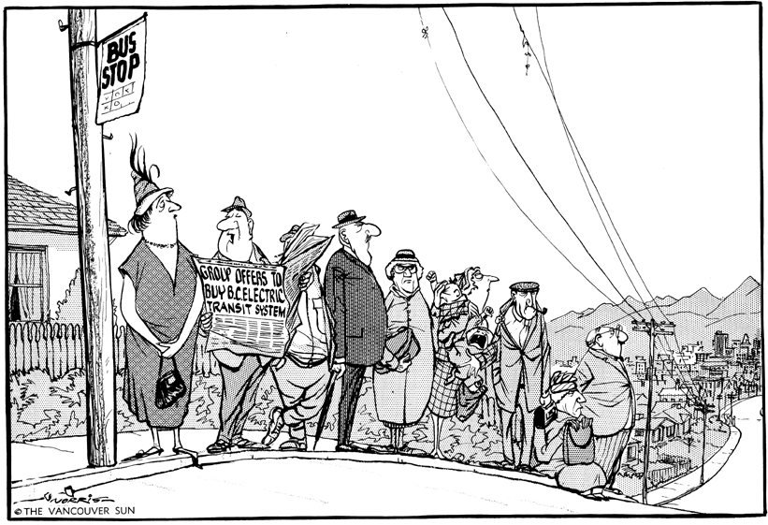
Communities With A Transport
Need Contact Many Agencies

Slide 3
There Is A Lot Of
Transport Going On In Cornwall
CC
SUS-TRANS
CN4C
Wheel Chair
First GW
WRVS
VC
Vol Cornwall
PCDT
Dial A Ride
West’n G’hound
Cornwall Blind
Age UK
Community Car
Fal River
W2W
CRCC
Community
Bus

Slide 4
Different Types Of
Community Transport
Community minibus
Voluntary car service
Car clubs
Car share
Pool bicycles and cycle hire
Employer supported transport
Taxi share
Taxi discount
Wheels to work
Shopmobility

Slide 5
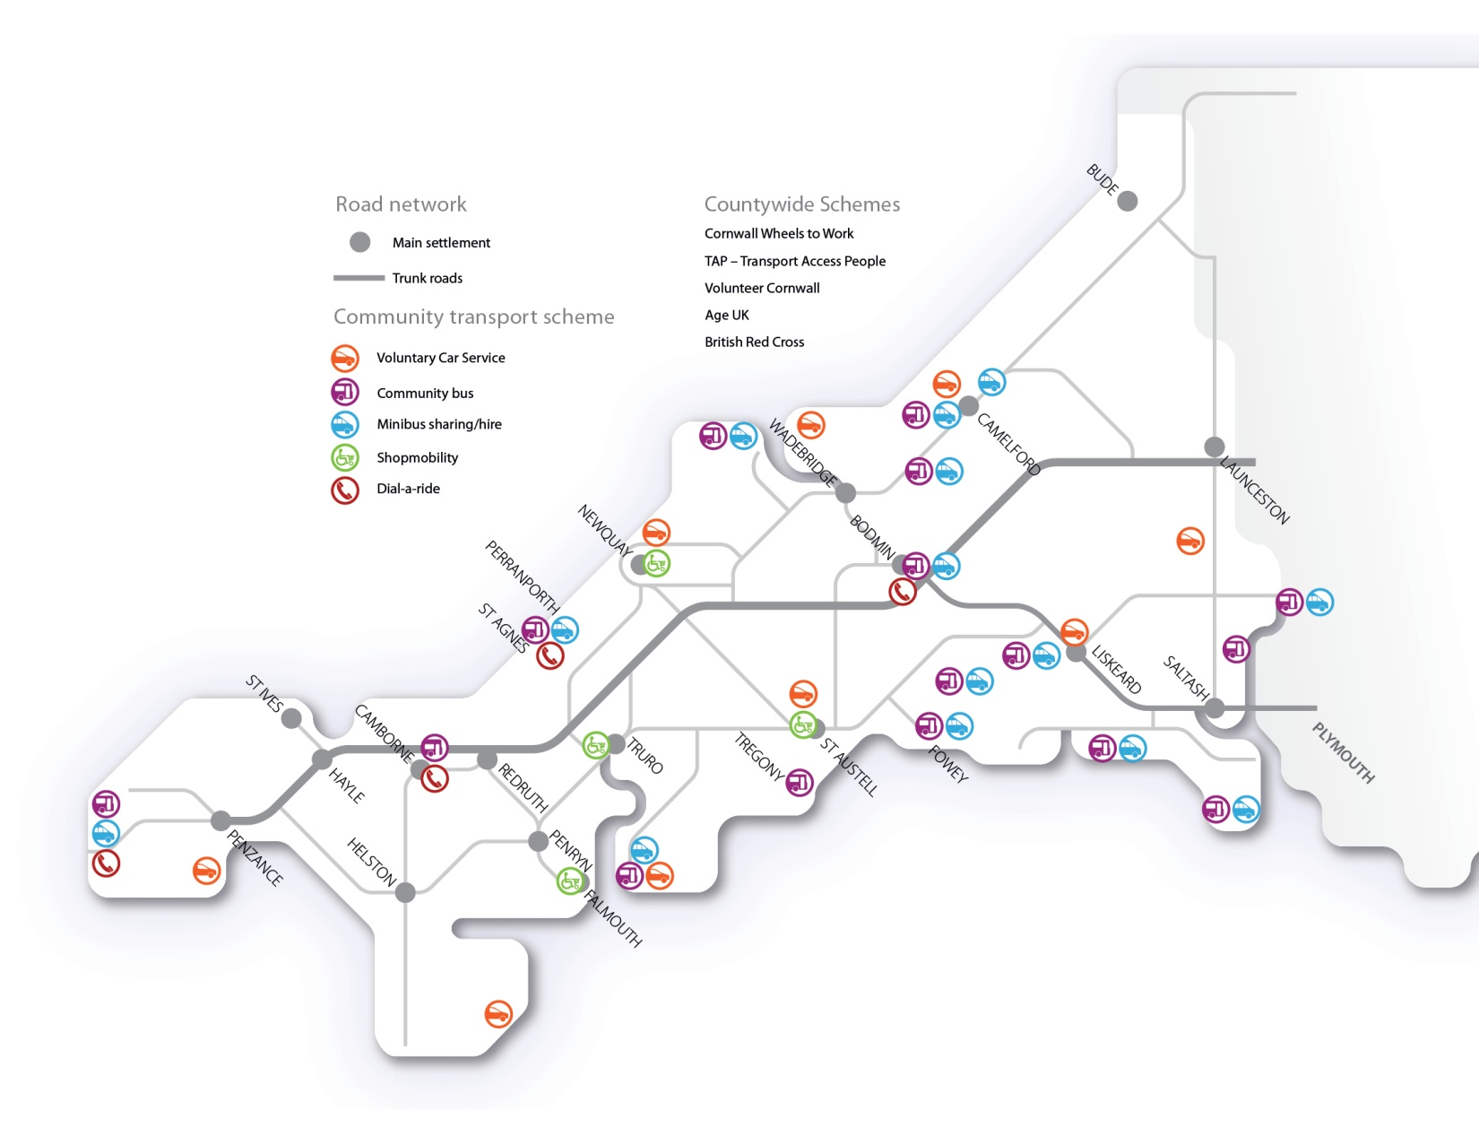
What Is Already Available

Slide 6
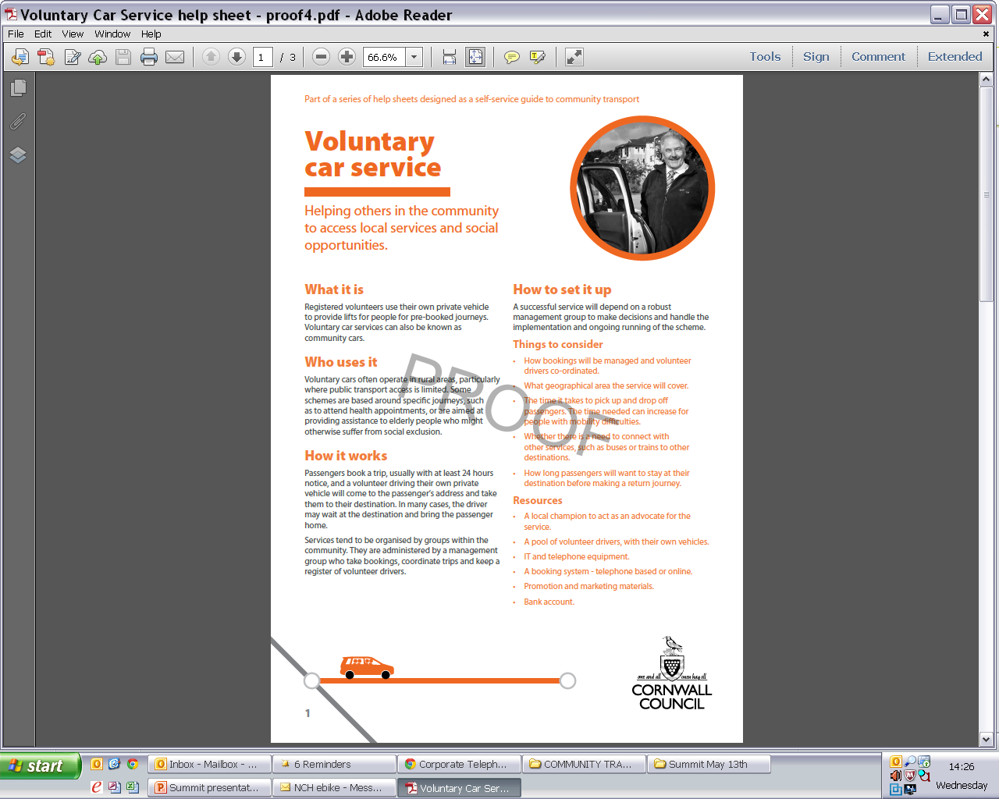
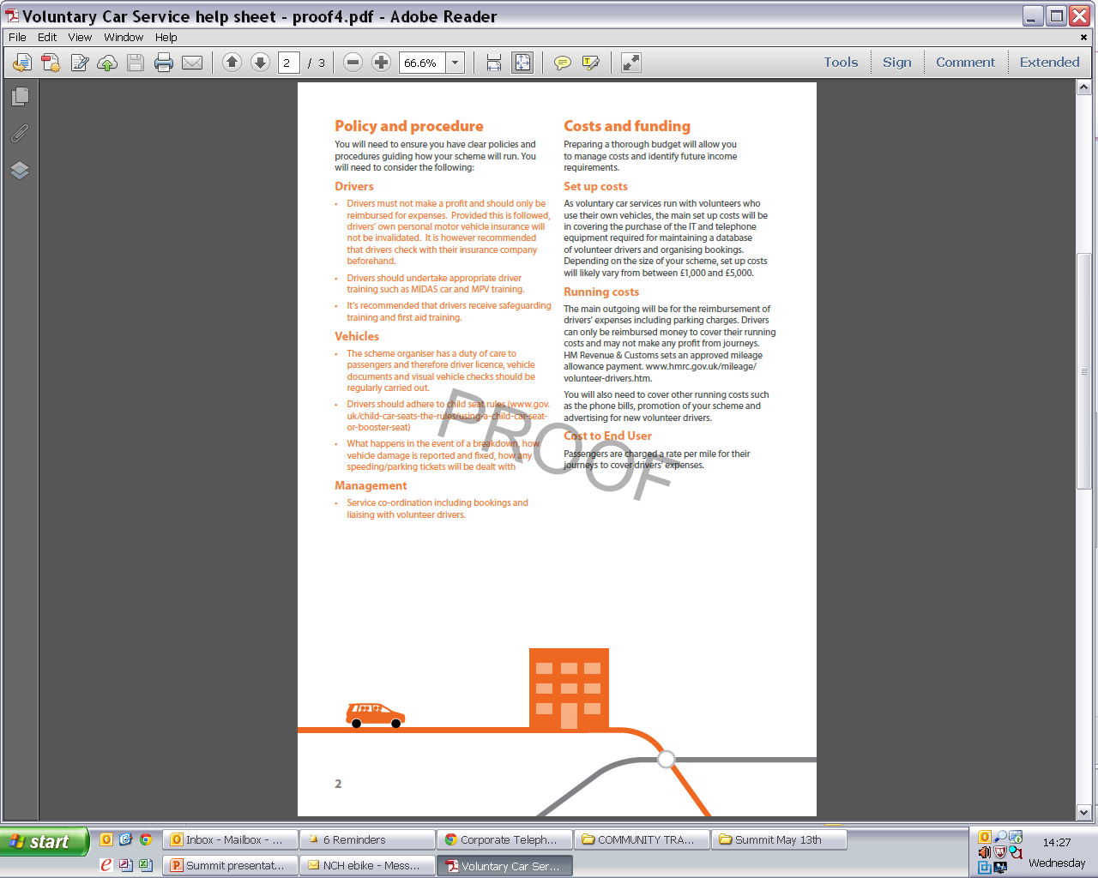
Toolkit Help Sheets

Slide 7

Community Transport
Questionnaire
WHY: Need?
What evidence?
What consultation?
HOW: Who will operate it?
Who will manage it?
How will you cover costs?
WHO: How will it be publicised?
What difference will your
transport solution make?
CTQ
Why?
How?
Who?

Slide 8
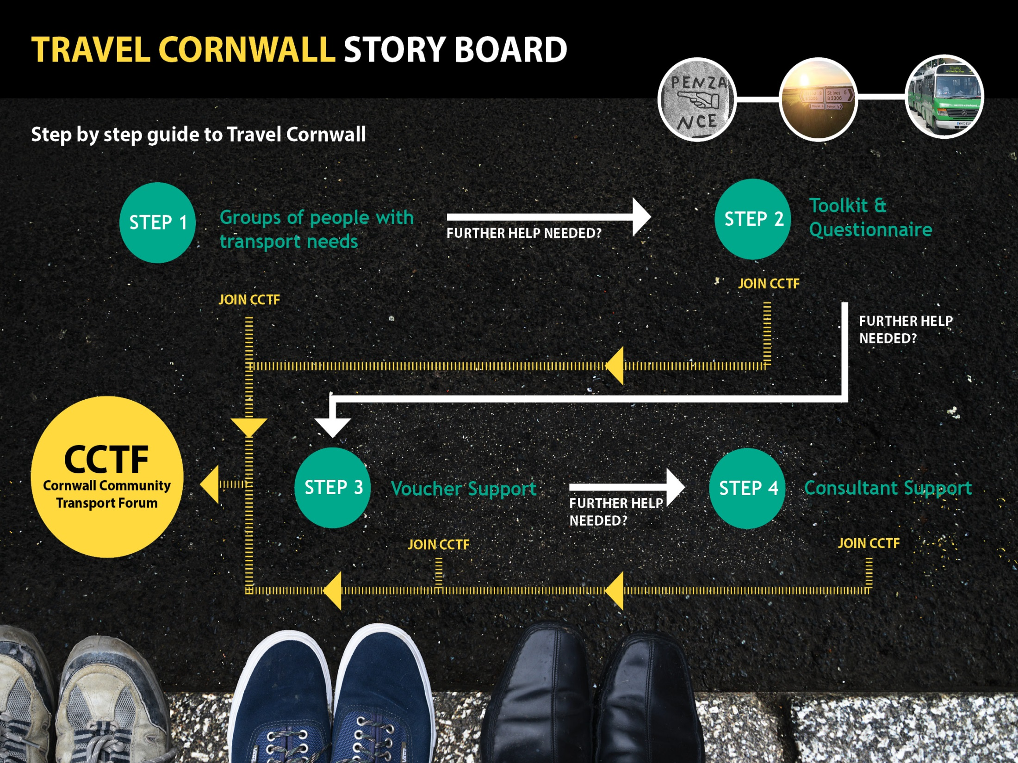

Slide 9

Cornwall Community Transport
Forum CCTF
What transport solutions serve my community?
Best Practice – Case Studies
Legal Requirements
Information by ‘Pull’- Web site or ‘Push’- Email
Brand Marketing
Education
Town & Parish Councils its not all about buses
Awareness of local travel solutions
Tourism opportunities
Further Work

Slide 10
Peter Jefferson CRCC
Peter.jefferson@cornwallrcc.org.uk
Jodie Boex
sustainabletransport@cornwall.gov.uk

