Slide 1
FY1 Induction
Manveer Rahi, FY1
Manveer.rahi@nhslothian.scot.nhs.uk

Slide 2
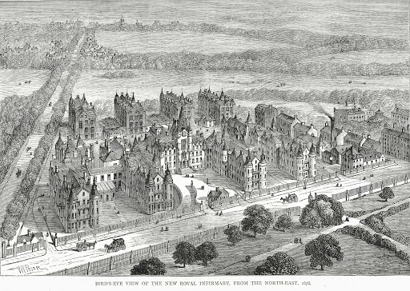
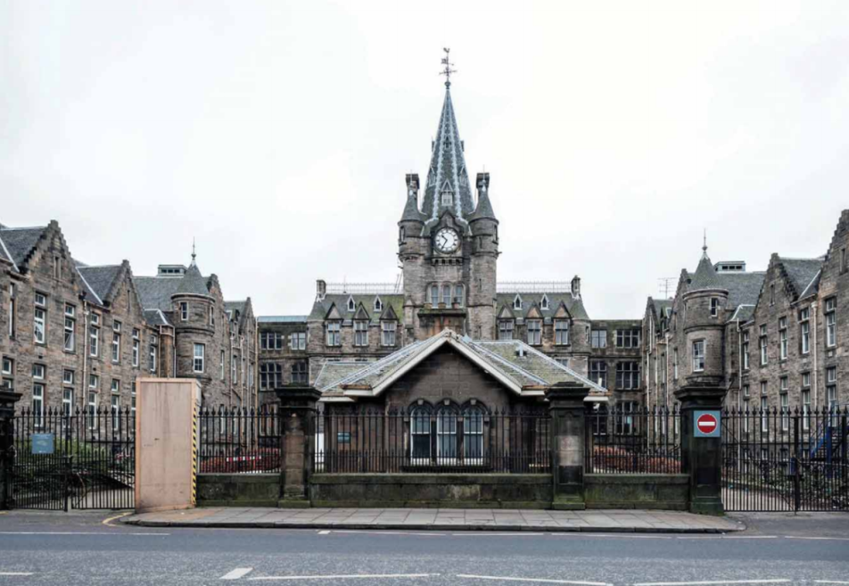
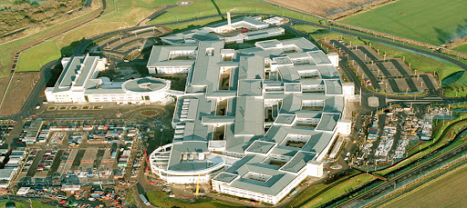
Welcome!

Slide 3
MED & FY1 Reps
MED is focused on YOUR education, training and wellbeing
FY1 representatives
Opportunities to shape training in Lothian
Listen to and represent ~200 doctors across SE Scotland
Engage senior management

Slide 4
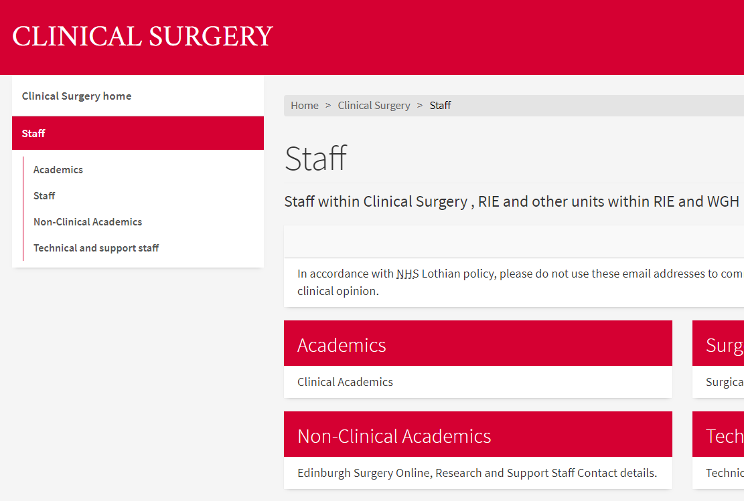
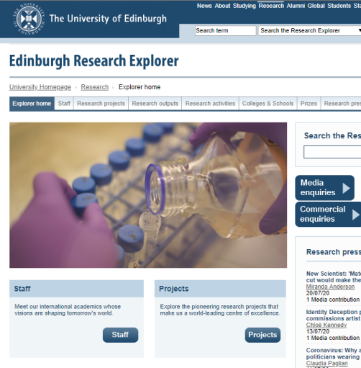
Research in Edinburgh
Research is everywhere!
Tips:
Engage with local registrars
Search the University of Edinburgh academic profiles page
Find an area of interest or methodology e.g. Speciality; systematic review/data work etc.
Audits and QI
Listen to your instinct, if it doesn’t feel right ask why and what can be done about it
Plug into existing audits

Slide 5
Tips for FY1
Listen and ask questions
FY1 is all about experiential learning
Ask for help
Everyone will help you, no matter how small the task
Don’t forget to care about yourself too
Don’t take mistakes personally
Recognise if you are getting stressed/burning out
Support each other

Slide 6

Good luck!

Slide 7
Contact details
Discuss: MED FY1 representative, research, AFP
Manveer.rahi@nhslothian.scot.nhs.uk

