Slide 1
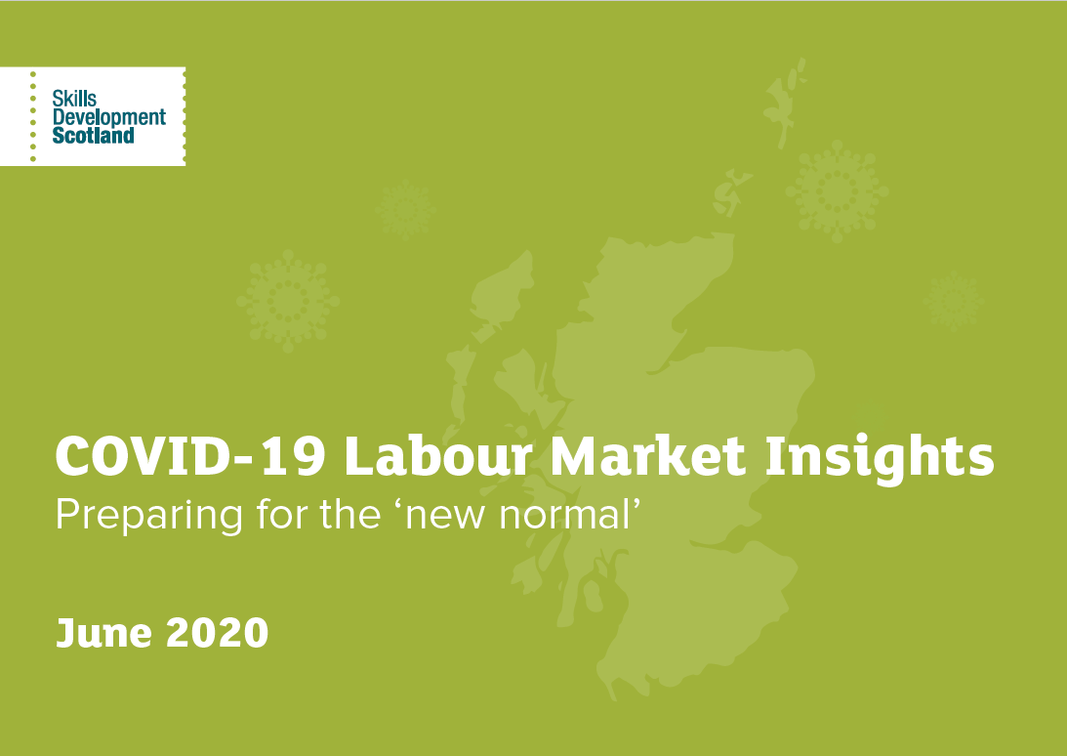
- Highlands & Islands

Slide 2
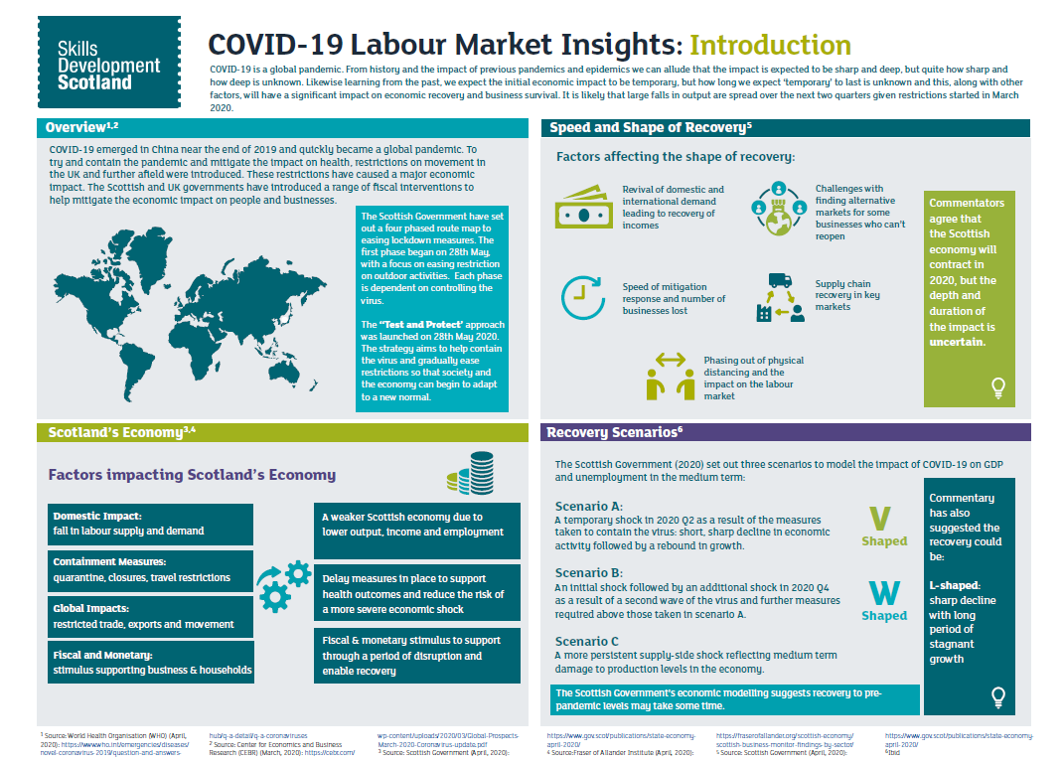

Slide 3
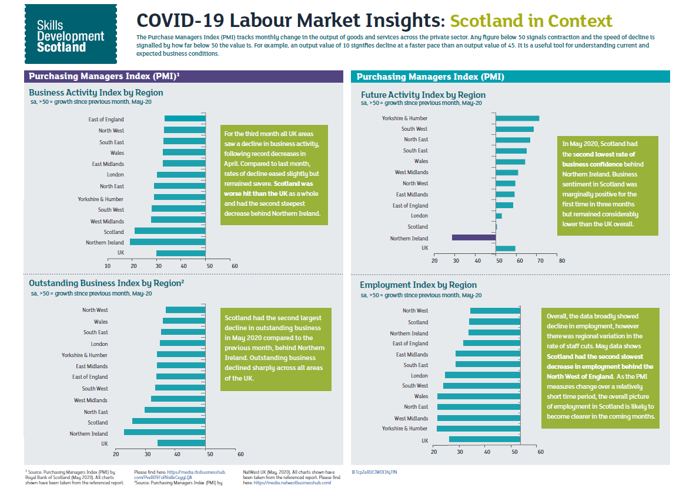

Slide 4
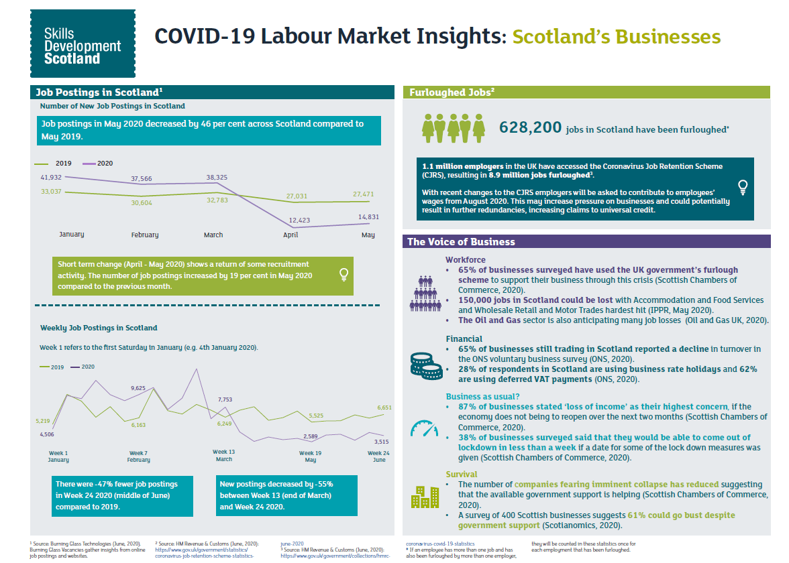

Slide 5
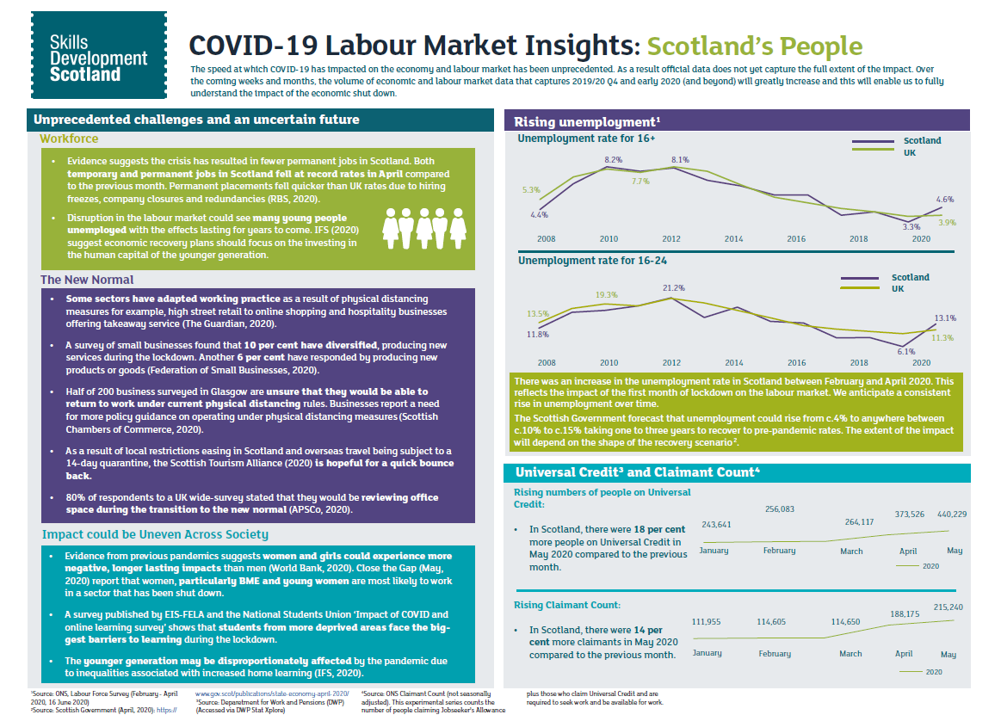

Slide 6
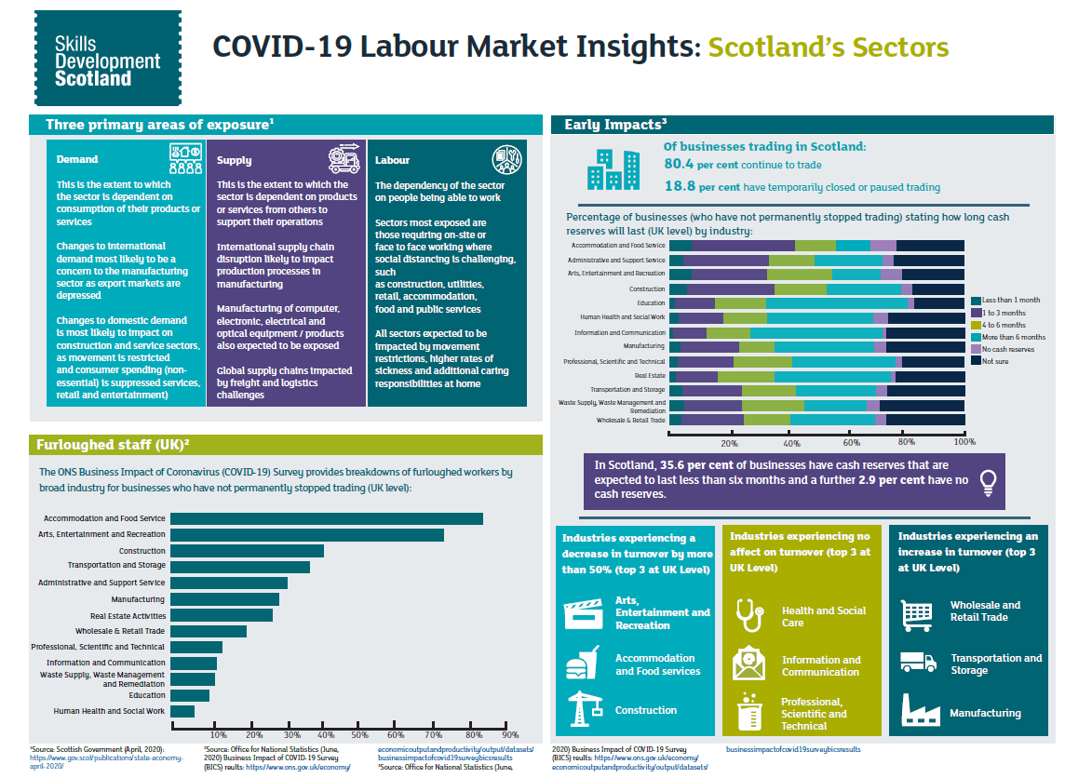

Slide 7
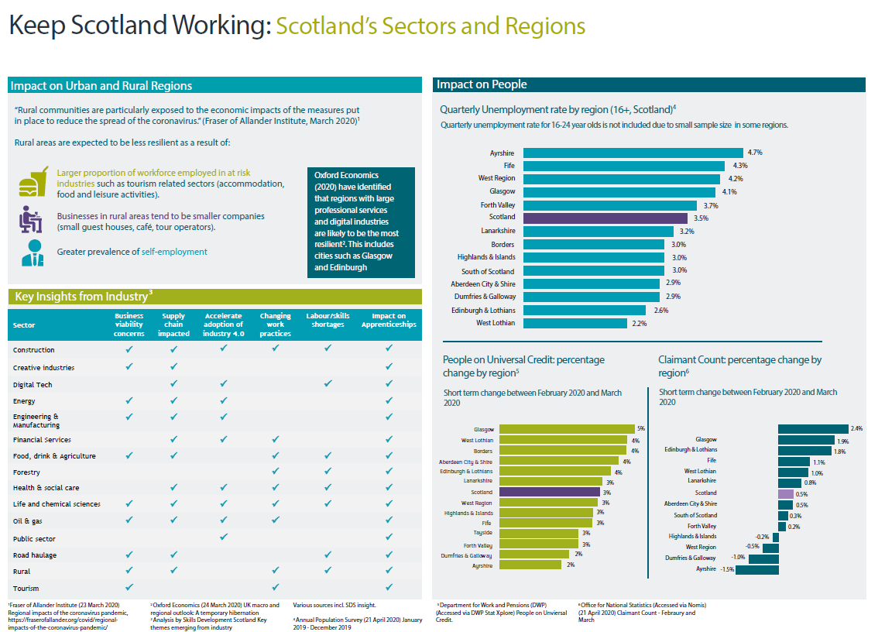
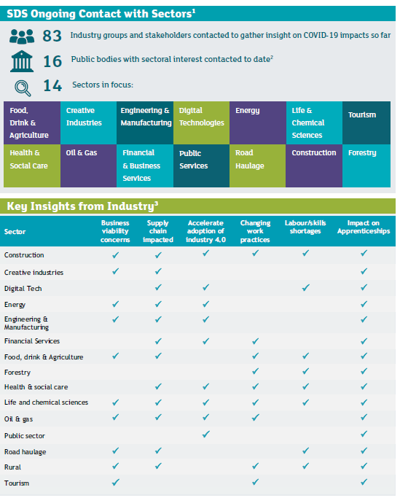
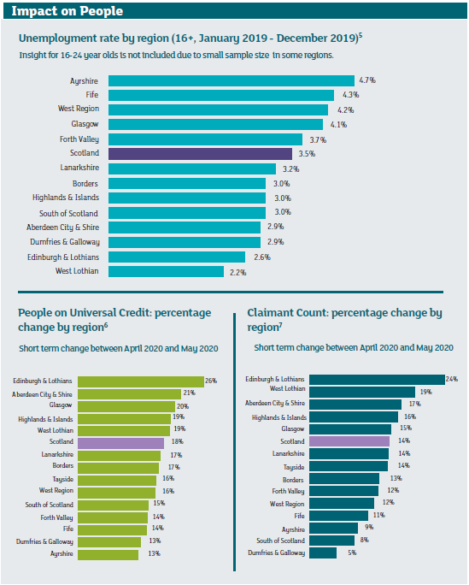
4. Including SDS insight

Slide 8











Lanarkshire (ROA Area) COVID-19 current and future skills demand This infographic presents data for the Lanarkshire region, comprising the local authorities of East Dunbartonshire, North Lanarkshire, and South Lanarkshire. .
Employment¹
Impact on People
Lanarkshire total jobs in 2020:
298,500 (11% of Scottish total)
Unemployment rate (16+)⁵
Lanarkshire: 3.2%
Scotland: 3.5 %
Job postings ²
Unemployment rate (16-24) ⁶
New job postings in May 2020:
1,197
Lanarkshire: 11%
Scotland: 8%
Long term change
May 2019 – May 2020:
Decrease of 28%
Compared to Scotland: -46 % over the same period
Universal Credit ⁷
56,440 people on Universal Credit (7.3% of the regional
population⁸)
Up 40% between March and April 2020
Scotland: increase of 41%
Top advertised occupations in the region (May 2020)³:
Care workers and home carers
Nurses
Programmes & software developers
Customer service occupations
Managers and proprietors
Claimant Count ⁹
27,405 claimants (3.6% of the regional population)
up by 66% between March and April 2020
Scotland: increase of 64.1%
Participation of 16-19 year olds¹⁰
Participating:
Not participating
COVID-19 Business Support Fund Grant⁴
Gender Split⁵
Ethnicity Split⁶
Education: 73.3%
Scotland: 71.4%
Employment:
17.1%
Scotland: 18.2%
Training:
1.7%
Scotland: 2.0%
8,833 applications received up to 2nd June
7,236
grants awarded up to 2nd June
£80.2m
value of grants awarded up to 2nd June
10% female
90% male
2.6%
Scotland: 3.1%
1 Forecasts by Oxford Economics (unless otherwise stated). Employment data for 2020 is itself forecast. These figures should be treated with caution and use only as an indication. Data was produced in April 2020 and captures some early impact of COVID-19.
2 Based on Burning Glass job postings data
3 Source: Burning Glass data, based on 4 digit SOC
4 Data published by Scottish Government
5 Source: NOMIS Annual Population Survey (APS). Figures for
12 months to December 2019
6 Source: APS. Figures for 12 months to December 2019
7 Source: DWP Stat Xplore
8 Based on NRS Mid-Year Population Estimates for 2019.
9 Source: NOMIS Claimant Count
10 Published by SDS as Participation Measure (2019 figures used)

Slide 9
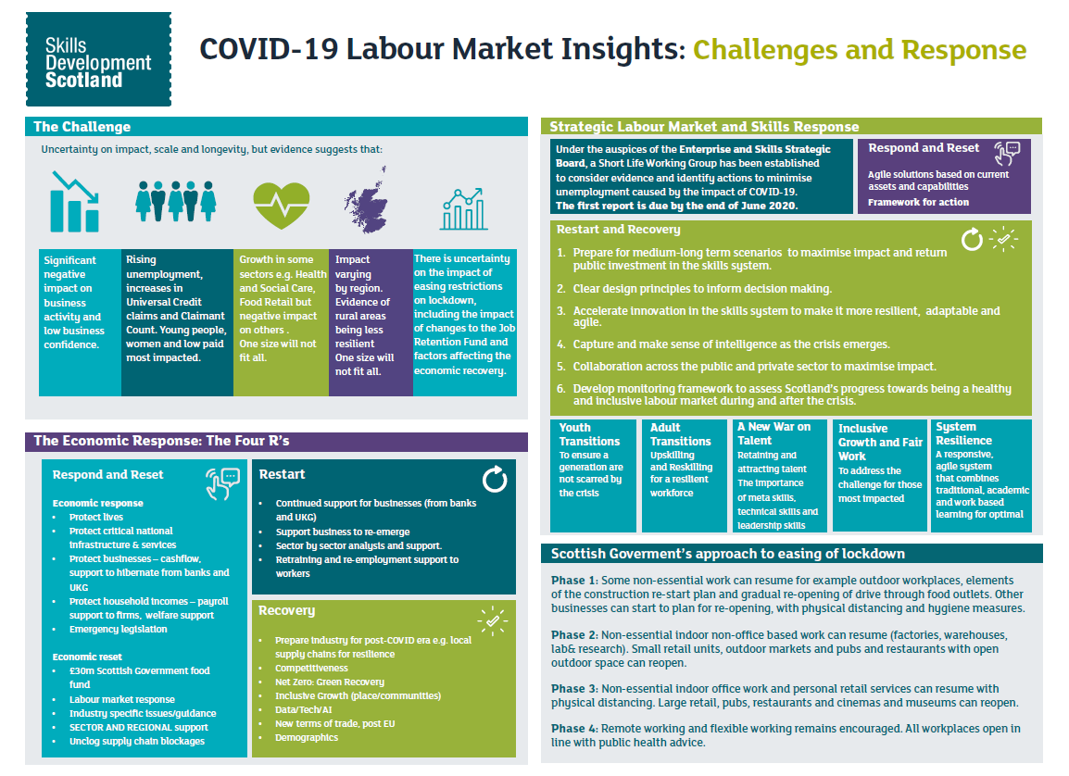

Slide 10
