Slide 1
Progression to Higher Education in London
Dr. Graeme Atherton, Head AccessHE & Director National Education Opportunities Network (NEON)

Slide 2
Aim today
Detailed look at young participation in London
Explore what progress really means and importance of local understanding
Identity thematic areas where we need more understanding

Slide 3
The London Miracle
‘We were looking for communities, schools, programmes or business sectors that could be said to buck the trend of poor social mobility in Britain.
Time and again, that search led back to London, so the project morphed into one looking at London’s exceptionalism, in terms of educational attainment and social mobility. Why does the capital outperform? What could be learned and, ideally, copied?’
SOCIAL MOBILITY GOLDSPOTS: Capital Mobility The all-party parliamentary group on social mobility December 2013

Slide 4
Widening Participation: The Data Landscape
Data | Type of data
Department of Education | Destinations of key stage 4 and key stage 5 students
BIS | Widening Participation in Higher Education (FSM at 15)
UCAS | UCAS End of Cycle Report (POLAR/FSM/Gender/Ethnicity)
HESA | HESA Performance Indicators (POLAR/NS-SEC/disability/ethnicity) (by institution)
HEFCE | POLAR 3
OFFA | Students receiving full state support (by institution)

Slide 5
POLAR
POLAR is a classification of small areas according to rates of young participation in higher education.
Assigns wards into one of five groups or ‘quintiles’.
Quintile 1 contains areas with the lowest participation rates. Quintile 5 contains areas with the highest.
Designed by HEFCE

Slide 6
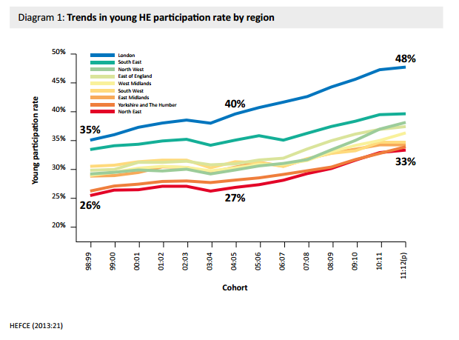
London leads the way (1)
http://www.hefce.ac.uk/pubs/year/2013/201328/

Slide 7
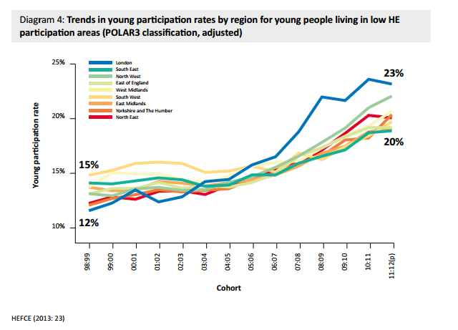
London leads the way (2)
http://www.hefce.ac.uk/pubs/year/2013/201328/

Slide 8
London leads the way (3)
 | 2006/07 | 2007/08 | 2008/09 | 2009/10 estimated % entered HE | 2010/11 estimated % entered HE | 2011/12 estimated % entered HE | 2012/13 estimated % entered HE
Local Authority ^{[1]} | FSM ^{[2]} | FSM ^{[2]} | FSM ^{[2]} | FSM ^{[2]} | FSM ^{[2]} | FSM ^{[2]} | FSM ^{[2]}
North East | 9% | 10% | 11% | 11% | 13% | 15% | 15%
North West | 12% | 13% | 14% | 16% | 16% | 18% | 20%
Yorkshire and the Humber | 11% | 11% | 13% | 13% | 15% | 15% | 17%
East Midlands | 10% | 11% | 13% | 13% | 14% | 15% | 15%
West Midlands | 14% | 15% | 17% | 18% | 19% | 19% | 22%
East of England | 10% | 13% | 14% | 14% | 16% | 16% | 18%
London | 24% | 27% | 31% | 33% | 35% | 37% | 39%
South East | 10% | 11% | 12% | 12% | 13% | 14% | 15%
South West | 9% | 9% | 10% | 11% | 13% | 13% | 15%
Total England | 14% | 15% | 17% | 18% | 20% | 21% | 23%
https://www.gov.uk/government/statistics/widening-participation-in-higher-education-2015

Slide 9
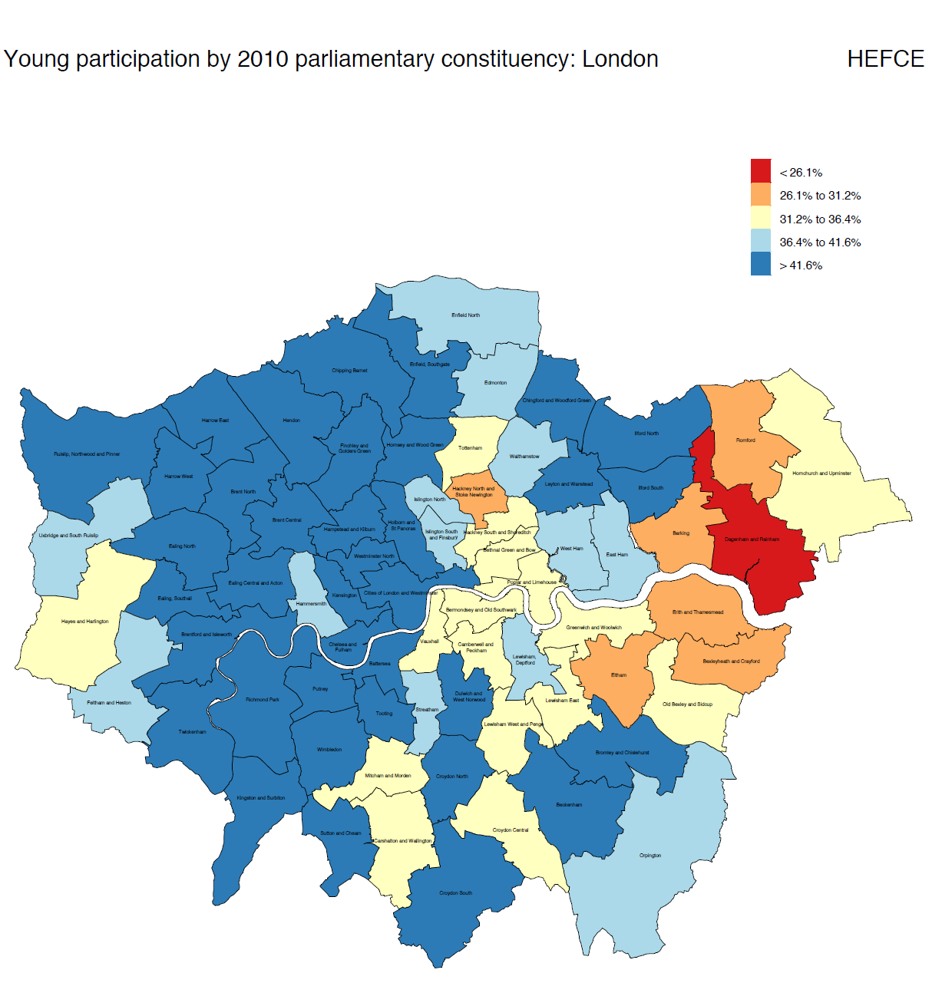
http://www.hefce.ac.uk/analysis/yp/POLAR/

Slide 10
London leads the way (4)
 |  |  | UK higher education institution | Top third of HEIs¹² | Russell Group (incl. Ox. and Cam.) | All other HEIs | Other HE providers¹³
Code | Local authority | Region | FSM | FSM | FSM | FSM | FSM
NAT | ENGLAND - Total state-funded mainstream |  | 44% | 9% | 5% | 32% | 2%
NE | North East |  | 38% | 6% | 5% | 27% | 5%
NW | North West |  | 42% | 7% | 5% | 32% | 3%
YH | Yorkshire and the Humber |  | 41% | 5% | 5% | 32% | 4%
EM | East Midlands |  | 37% | 7% | 4% | 27% | 3%
WM | West Midlands |  | 42% | 9% | 5% | 31% | 2%
EE | East of England |  | 37% | 8% | 4% | 28% | 1%
IL | Inner London |  | 57% | 13% | 6% | 43% | 1%
OL | Outer London |  | 55% | 15% | 7% | 40% | 1%
SE | South East |  | 33% | 9% | 4% | 22% | 2%
SW | South West |  | 31% | 7% | 4% | 21% | 3%
https://www.gov.uk/government/statistics/destinations-of-ks4-and-ks5-pupils-2013-to-2014

Slide 11
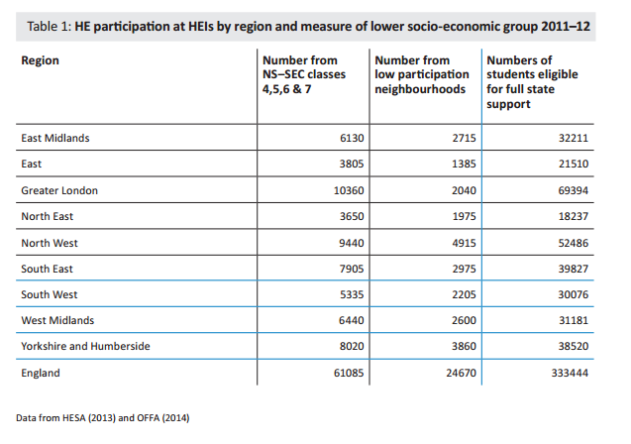
Picture may not be so clear though…

Slide 12
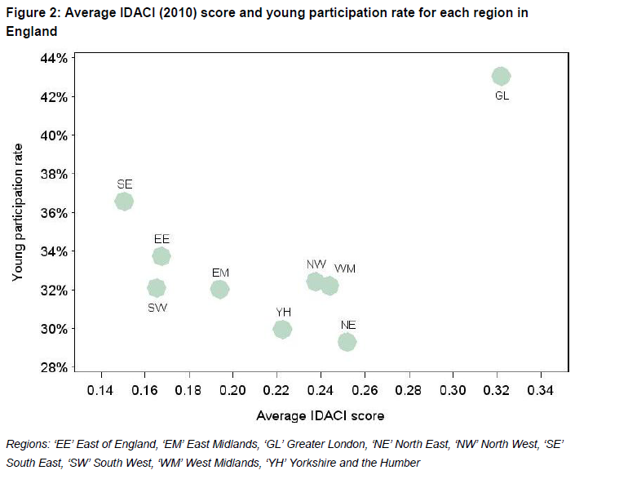
Young participation rate and IDACI
http://www.hefce.ac.uk/pubs/year/2014/201401/

Slide 13
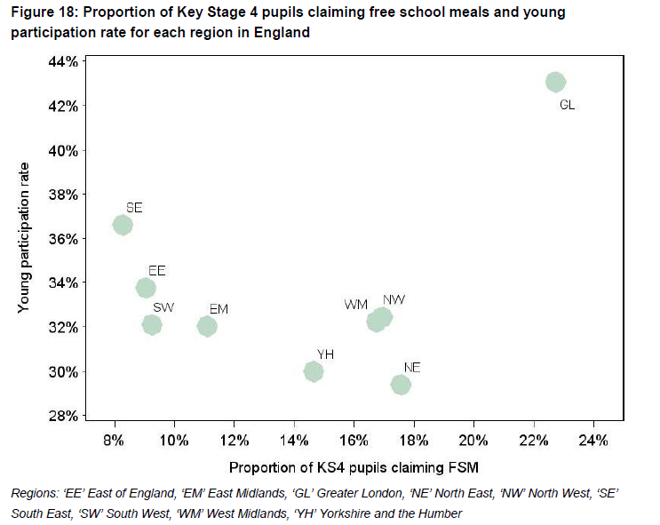
Young Participation and FSM pupils
http://www.hefce.ac.uk/pubs/year/2014/201401/

Slide 14
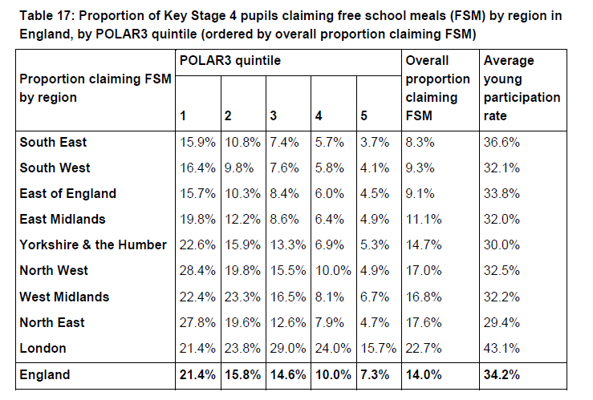
POLAR quintile and FSM pupils
http://www.hefce.ac.uk/pubs/year/2014/201401/

Slide 15
FSM participation vs FSM achievement
https://www.gov.uk/government/statistics/widening-participation-in-higher-education-2015 and https://www.gov.uk/government/statistics/gcse-and-equivalent-attainment-by-pupil-characteristics-2012-to-2013

Slide 16
But do all benefit – Participation by LA
www.gov.uk/government/statistics/widening-participation-in-higher-education-2015 and https://www.gov.uk/government/statistics/gcse-and-equivalent-attainment-by-pupil-characteristics-2012-to-2013

Slide 17
FSM participation at 15 vs FSM participation at 19
www.gov.uk/government/statistics/widening-participation-in-higher-education-2015 & https://www.gov.uk/government/statistics/destinations-of-key-stage-4-and-key-stage-5-pupils-2012-to-2013

Slide 18
FSM Participation by LA at 15 and 19
www.gov.uk/government/statistics/widening-participation-in-higher-education-2015 & https://www.gov.uk/government/statistics/destinations-of-key-stage-4-and-key-stage-5-pupils-2012-to-2013

Slide 19
Who are best performing authorities(3)?
http://www.londoncouncils.gov.uk/our-key-themes/children-and-young-people/14-19-young-people-education-and-skills/publications/higher

Slide 20
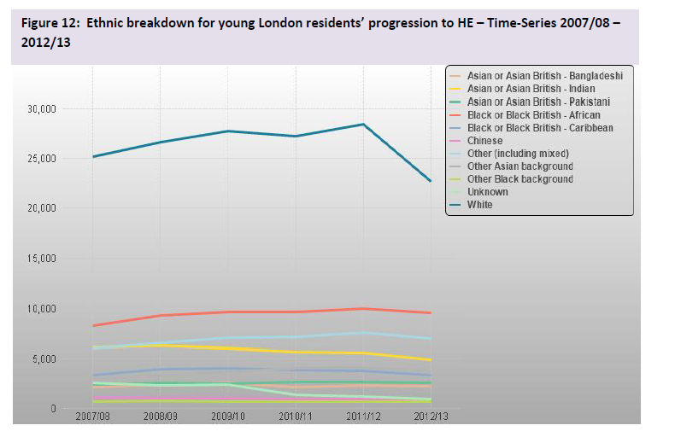
Participation by ethnic background
http://www.londoncouncils.gov.uk/our-key-themes/children-and-young-people/14-19-young-people-education-and-skills/publications/higher

Slide 21
The £180m per year Access Investment for London
https://www.offa.org.uk/wp-content/uploads/2013/07/2013-04-Access-agreements-2014-15.pdf

Slide 22
Key points
Data landscape complex
London leads way
BUT
London is unique
London has access challenges
London has access need

Slide 23
Where are knowledge gaps?
How Access Agreement investment is used
Why there are local differences in HE progression?
How to accurately portray progression of young disadvantaged learners in London?
What widening participation activities have greatest impact in London?
What is interaction between gender/ethnicity/socio-economic group is understanding localised progression patterns?
How do you extend progression knowledge across student lifecycle?

