Slide 1

Measuring inequalities: Trends in mortality and life expectancy in Abertawe Bro Morgannwg
December 2011

Slide 2
Using these slides
These slides accompany the presentation slides for the inequalities in Wales profile.
These slides are a resource to demonstrate examples of findings from the Public Health Wales Observatory ‘Measuring Inequalities’ profiles.
The presentation can be used as a whole or as individual slides.
Please acknowledge the work of the Public Health Wales Observatory when using these slides.

Slide 3
Abertawe Bro Morgannwg

Slide 4
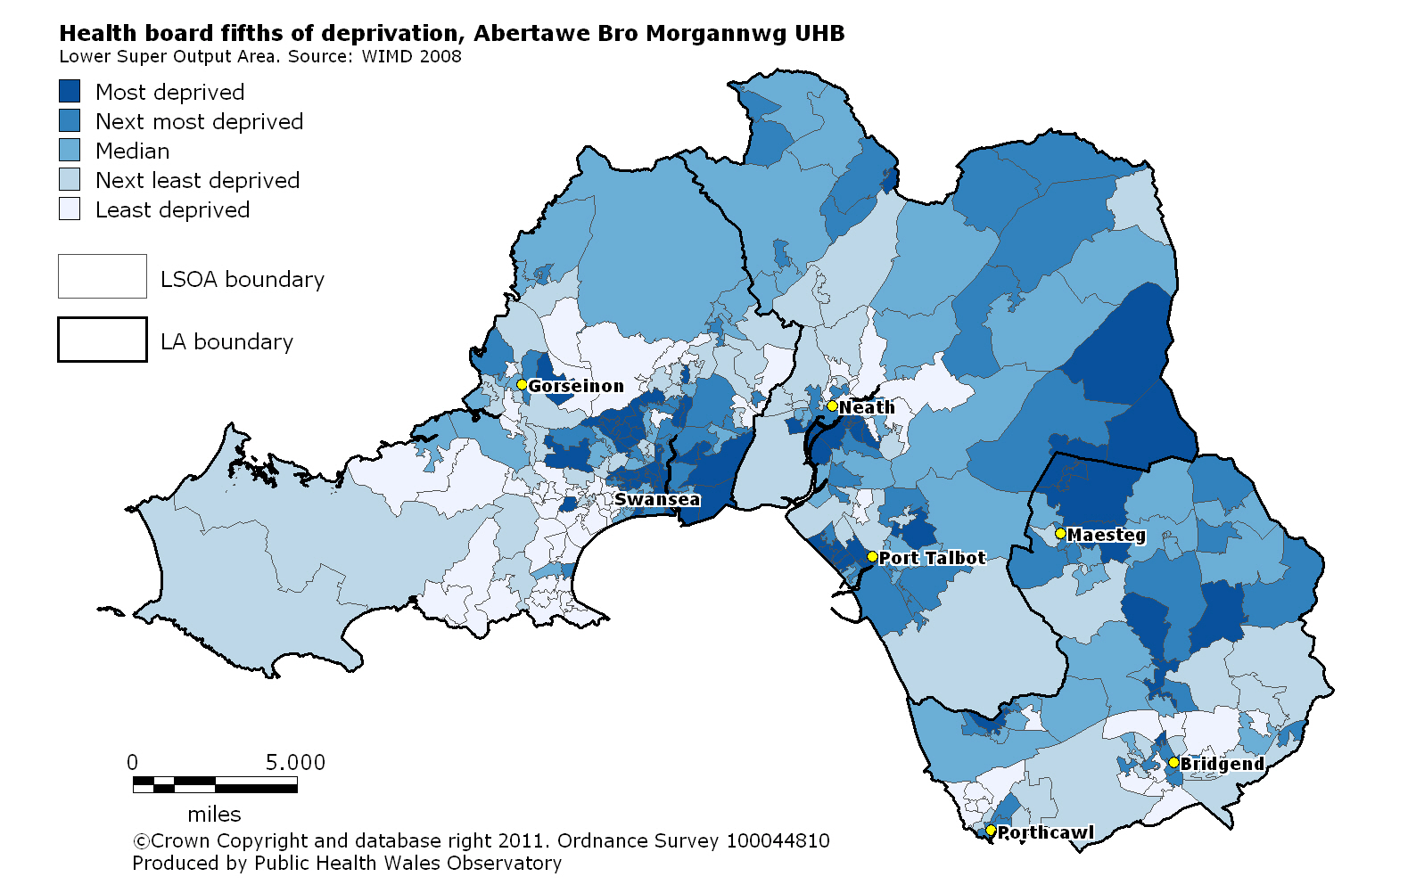
Local fifths of deprivation:
Abertawe Bro Morgannwg
Notes:
Local deprivation fifths for each health board have been produced by ranking all Lower Super Output Areas (LSOAs) within the area and grouping them into fifths, based on the Welsh Index of Multiple Deprivation (2008). Each health board therefore has its own local fifths depending on the deprivation distribution within that area which are shown here.

Slide 5
Life expectancies in Abertawe Bro Morgannwg
Produced by the Public Health Wales Observatory, using ADDE/MYE (ONS), WIMD/WHS (WG)
Notes:
This slide shows three measures of life expectancy in males and females.
Life expectancy at birth is a statistical measure of the average expected years of life for a newborn based on currently observed mortality rates and is a measure of mortality across all ages.
In addition to general life expectancy it is important to consider quality of life and so two further measures are represented here.
Healthy life expectancy at birth (HLE) represents the number of years a person can expect to live in good health.
Disability-free life expectancy at birth (DFLE) estimates the number of years of life expected to be free from a limiting long-term illness.
or disability.

Slide 6
Mortality in males under 75 in
Abertawe Bro Morgannwg
European age-standardised rates (EASR) per 100,000 population
Produced by the Public Health Wales Observatory, using ADDE/MYE (ONS), WIMD 2008 (WG)
Notes:
This chart shows the mortality trend between 2001-03 and 2007-09 for all causes of death in males under 75 in the health board. The mortality rate in the most and the least deprived fifths is shown together with the rates for Wales and the health board as a whole as a comparison.

Slide 7
Mortality in females under 75 in
Abertawe Bro Morgannwg
European age-standardised rates (EASR) per 100,000 population
Produced by the Public Health Wales Observatory, using ADDE/MYE (ONS), WIMD 2008 (WG)
Notes:
This chart shows the mortality trend between 2001-03 and 2007-09 for all causes of death in females under 75 in the health board. The mortality rate in the most and the least deprived fifths is shown together with the rates for Wales and the health board as a whole as a comparison.

Slide 8
Smoking-attributable mortality in males aged 35+ in Abertawe Bro Morgannwg
European age-standardised rates (EASR) per 100,000 population
Produced by the Public Health Wales Observatory, using ADDE/MYE (ONS), WHS/WIMD 2008 (WG)
Notes:
This chart shows the mortality trend between 2001-03 and 2007-09 for smoking-attributable deaths in males aged 35 and over in the health board. The mortality rate in the most and the least deprived fifths is shown together with the rates for Wales and the health board as a whole as a comparison.

Slide 9
Smoking-attributable mortality in females aged 35+ in Abertawe Bro Morgannwg
European age-standardised rates (EASR) per 100,000 population
Produced by the Public Health Wales Observatory, using ADDE/MYE (ONS), WHS/WIMD 2008 (WG)
Notes:
This chart shows the mortality trend between 2001-03 and 2007-09 for smoking-attributable deaths in females aged 35 and over in the health board. The mortality rate in the most and the least deprived fifths is shown together with the rates for Wales and the health board as a whole as a comparison.

Slide 10
Alcohol-attributable mortality in persons
in Abertawe Bro Morgannwg
European age-standardised rates (EASR) per 100,000 population
Produced by the Public Health Wales Observatory, using ADDE/MYE (ONS), WIMD 2008 (WG)
Notes:
This chart shows the mortality trend between 2001-03 and 2007-09 for alcohol attributable causes of death in persons in the health board. The mortality rate in the most and the least deprived fifths is shown together with the rates for Wales and the health board as a whole as a comparison.

Slide 11
Swansea

Slide 12
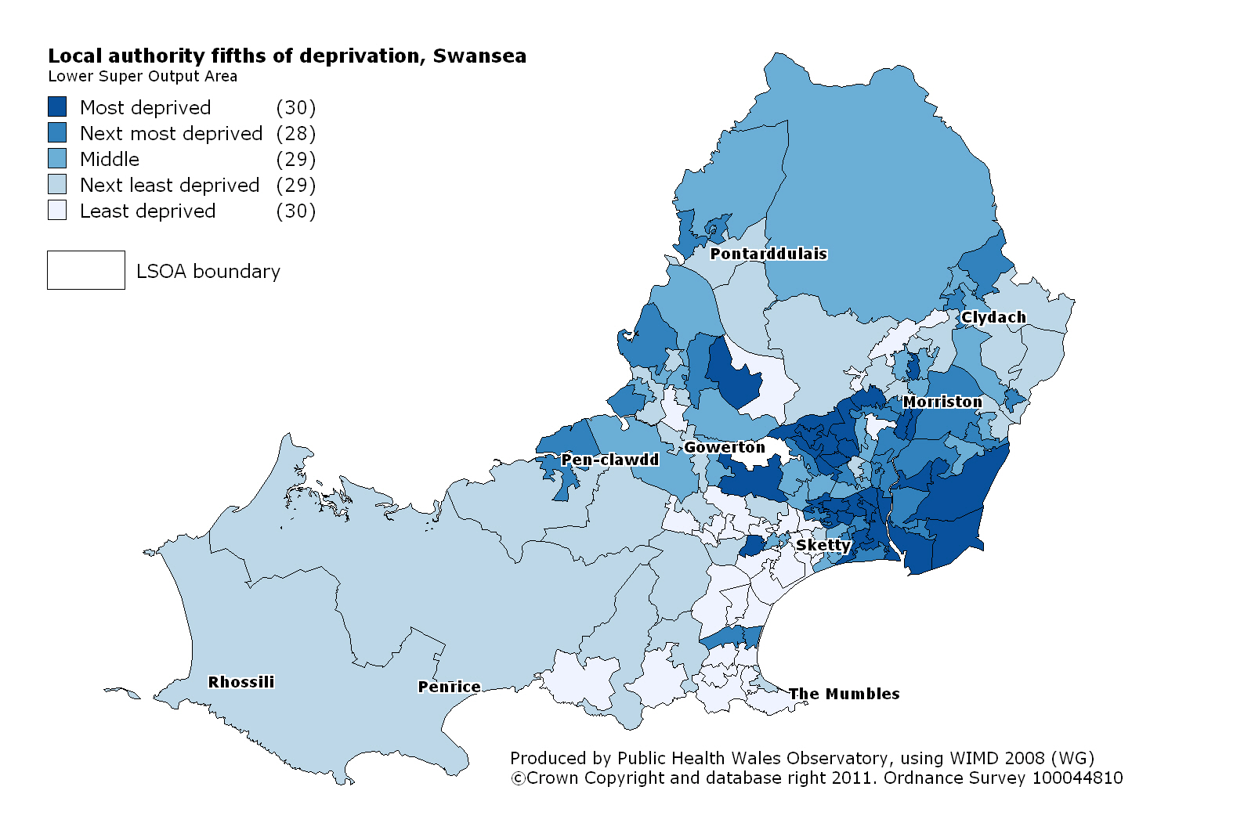
Local fifths of deprivation:
Swansea
Notes:
Local deprivation fifths for each local authority have been produced by ranking all Lower Super Output Areas (LSOAs) within the area and grouping them into fifths, based on the Welsh Index of Multiple Deprivation (2008). Each local authority therefore has its own local fifths depending on the deprivation distribution within that area which are shown here.

Slide 13
Life expectancies in Swansea
Produced by the Public Health Wales Observatory, using ADDE/MYE (ONS), WIMD/WHS (WG)
Notes:
This slide shows three measures of life expectancy in males and females.
Life expectancy at birth is a statistical measure of the average expected years of life for a newborn based on currently observed mortality rates and is a measure of mortality across all ages.
In addition to general life expectancy it is important to consider quality of life and so two further measures are represented here.
Healthy life expectancy at birth (HLE) represents the number of years a person can expect to live in good health.
Disability-free life expectancy at birth (DFLE) estimates the number of years of life expected to be free from a limiting long-term illness or disability.

Slide 14
Mortality in males, all ages,
in Swansea
European age-standardised rates (EASR) per 100,000 population
Produced by the Public Health Wales Observatory, using ADDE/MYE (ONS), WIMD 2008 (WG)
Notes:
This chart shows the mortality trend between 2001-03 and 2007-09 for all causes of death in males of all ages within the local authority. The mortality rate in the most and the least deprived fifths is shown together with the rates for Wales and the local authority as a whole as a comparison.

Slide 15
Mortality in females, all ages,
in Swansea
European age-standardised rates (EASR) per 100,000 population
Produced by the Public Health Wales Observatory, using ADDE/MYE (ONS), WIMD 2008 (WG)
Notes:
This chart shows the mortality trend between 2001-03 and 2007-09 for all causes of death in females of all ages within the local authority. The mortality rate in the most and the least deprived fifths is shown together with the rates for Wales and the local authority as a whole as a comparison.

Slide 16
Neath Port Talbot

Slide 17
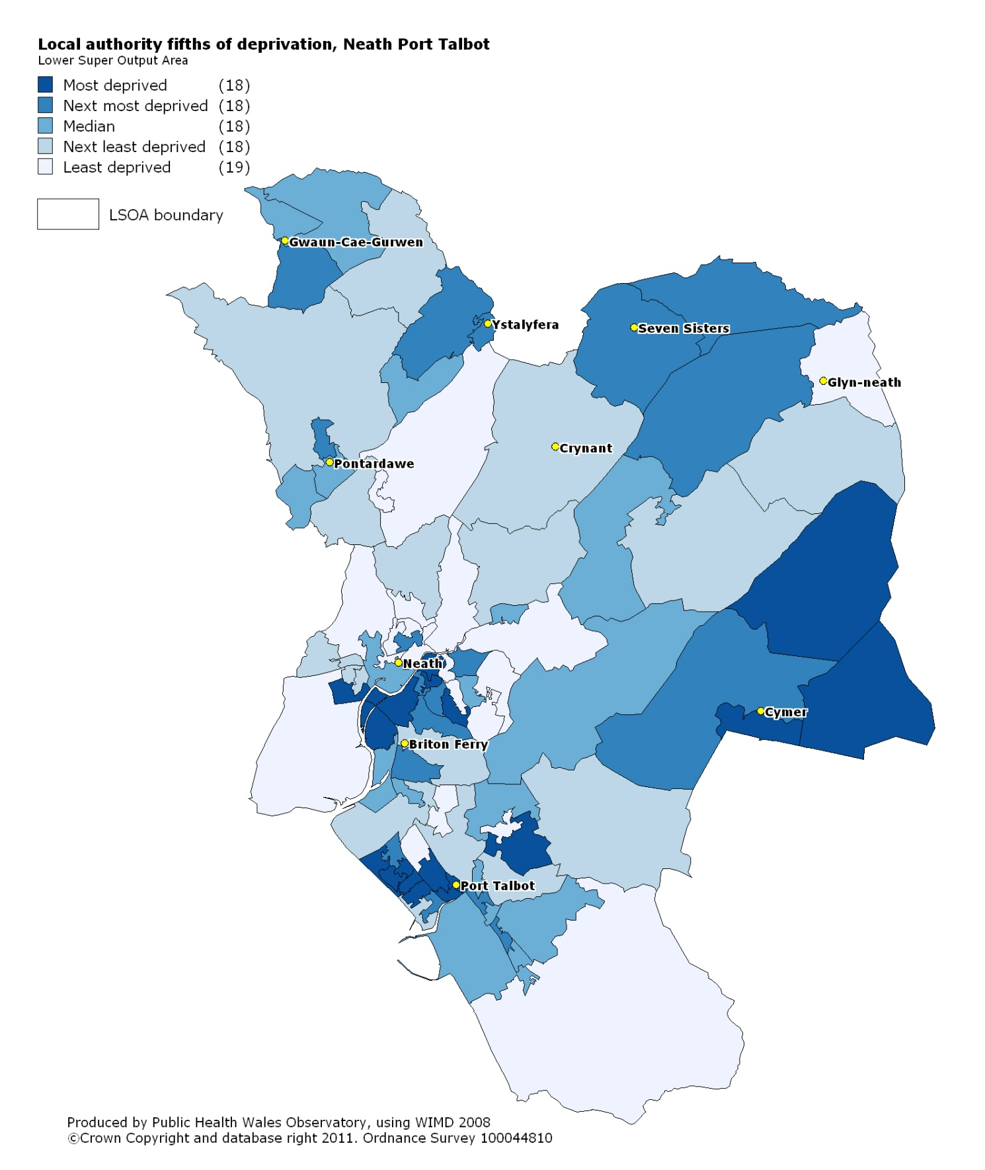
Local fifths of deprivation: Neath Port Talbot
Notes:
Local deprivation fifths for each local authority have been produced by ranking all Lower Super Output Areas (LSOAs) within the area and grouping them into fifths, based on the Welsh Index of Multiple Deprivation (2008). Each local authority therefore has its own local fifths depending on the deprivation distribution within that area which are shown here.

Slide 18
Life expectancies in Neath Port Talbot
Produced by the Public Health Wales Observatory, using ADDE/MYE (ONS), WIMD/WHS (WG)
Notes:
This slide shows three measures of life expectancy in males and females.
Life expectancy at birth is a statistical measure of the average expected years of life for a newborn based on currently observed mortality rates and is a measure of mortality across all ages.
In addition to general life expectancy it is important to consider quality of life and so two further measures are represented here.
Healthy life expectancy at birth (HLE) represents the number of years a person can expect to live in good health.
Disability-free life expectancy at birth (DFLE) estimates the number of years of life expected to be free from a limiting long-term illness or disability.

Slide 19
Mortality in males, all ages,
in Neath Port Talbot
European age-standardised rates (EASR) per 100,000 population
Produced by the Public Health Wales Observatory, using ADDE/MYE (ONS), WIMD 2008 (WG)
Notes:
This chart shows the mortality trend between 2001-03 and 2007-09 for all causes of death in males of all ages within the local authority. The mortality rate in the most and the least deprived fifths is shown together with the rates for Wales and the local authority as a whole as a comparison.

Slide 20
Mortality in females, all ages,
in Neath Port Talbot
European age-standardised rates (EASR) per 100,000 population
Produced by the Public Health Wales Observatory, using ADDE/MYE (ONS), WIMD 2008 (WG)
Notes:
This chart shows the mortality trend between 2001-03 and 2007-09 for all causes of death in females of all ages within the local authority. The mortality rate in the most and the least deprived fifths is shown together with the rates for Wales and the local authority as a whole as a comparison.

Slide 21
Bridgend

Slide 22
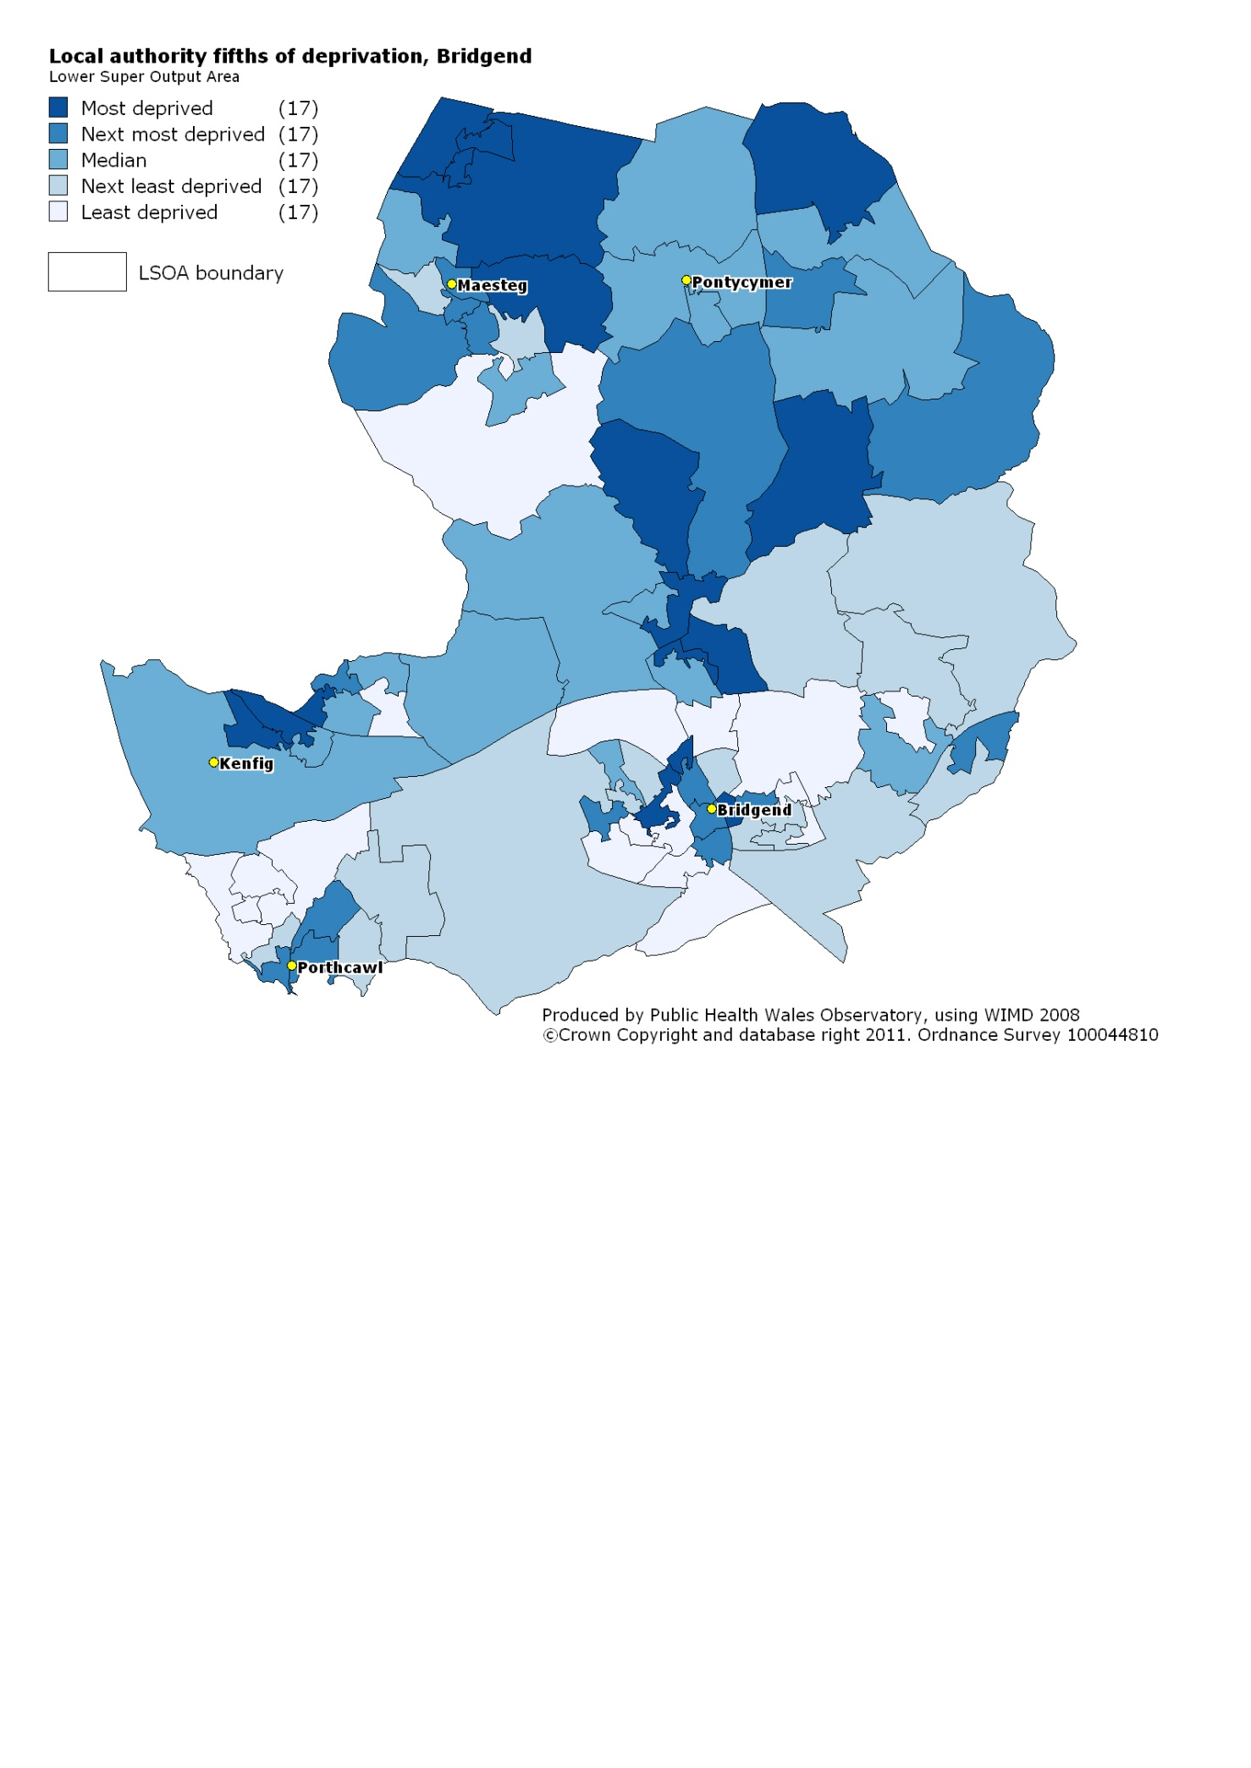
Local fifths of deprivation: Bridgend
Notes:
Local deprivation fifths for each local authority have been produced by ranking all Lower Super Output Areas (LSOAs) within the area and grouping them into fifths, based on the Welsh Index of Multiple Deprivation (2008). Each local authority therefore has its own local fifths depending on the deprivation distribution within that area which are shown here.

Slide 23
Life expectancies in Bridgend
Produced by the Public Health Wales Observatory, using ADDE/MYE (ONS), WIMD/WHS (WG)
Notes:
This slide shows three measures of life expectancy in males and females.
Life expectancy at birth is a statistical measure of the average expected years of life for a newborn based on currently observed mortality rates and is a measure of mortality across all ages.
In addition to general life expectancy it is important to consider quality of life and so two further measures are represented here.
Healthy life expectancy at birth (HLE) represents the number of years a person can expect to live in good health.
Disability-free life expectancy at birth (DFLE) estimates the number of years of life expected to be free from a limiting long-term illness.
or disability.

Slide 24
Mortality in males, all ages, in
Bridgend
European age-standardised rates (EASR) per 100,000 population
Produced by the Public Health Wales Observatory, using ADDE/MYE (ONS), WIMD 2008 (WG)
Notes:
This chart shows the mortality trend between 2001-03 and 2007-09 for all causes of death in males of all ages within the local authority. The mortality rate in the most and the least deprived fifths is shown together with the rates for Wales and the local authority as a whole as a comparison.

Slide 25
Mortality in females, all ages, in
Bridgend
European age-standardised rates (EASR) per 100,000 population
Produced by the Public Health Wales Observatory, using ADDE/MYE (ONS), WIMD 2008 (WG)
Notes:
This chart shows the mortality trend between 2001-03 and 2007-09 for all causes of death in females of all ages within the local authority. The mortality rate in the most and the least deprived fifths is shown together with the rates for Wales and the local authority as a whole as a comparison.

Slide 26
More information
www.publichealthwalesobservatory.wales.nhs.uk/inequalities

Slide 27
Acknowledgements
Project team
Project Board
Project manager:
Andrea Gartner
Team: Margaret Webber, Hugo Cosh, Gareth Davies, Anna Childs, Bethan Patterson, Claire Tiffany, Ruth Davies
Ciarán Humphreys
Annie Delahunty
Nathan Lester
Public Health Wales: Susan Belfourd, Chris Lines, Carolyn Lester
Others: Welsh Government, Office for National Statistics, London Health Observatory, East Midlands Public Health Observatory

