Slide 1
What’s in Part 1
the basics, common to all languages.
variables, lists, if statements, dictionaries, input from users, write functions, classes, work with files and handle errors, write tests for your code to check that your programs work the way intended. Testing is one of the first skills to transition from beginner to intermediate programmer.

Slide 2
Getting started
Run your first python program hello_world.py
check if you have a recent version of python, install if you don’t.
Install text editor that recognizes python code, there are various favored text editors, like Sublime Text, Atom, Emac, etc., including one in python IDLE.
advanced text editors will highlight sections such as errors, helping you write better code.

Slide 3

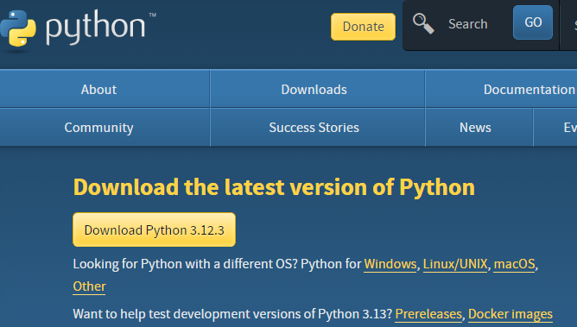
Setting Up your Programming Environment
Python Versions
Running Snippets of Python Code
latest version is 3.12.3
every version is more verstaile and powerful than the last.
You can run python interpreter in a terminal window.
>>> means use prompt (terminal window)
About the VS Code Editor
VS Code is free, beginner friendly, great for simple and complex projects, installs on all modern OS, supports most progarmming languages.
See Appendix B for more text editors

Slide 4
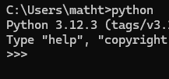

Python on Different Operating Systems
Python on Windows
Installing Python
Windows doesn’t come with Python. VS Code is from Windows. You need to install both.
command
Command Prompt
python
Downloads
Add Python to PATH (always select, it’ll make your life easier)

Slide 5
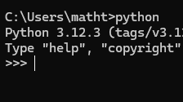


Install Python and VS Code on Windows
this is your interpreter
Enter to the python session
To close terminal session press CTRL-Z ENTER or type exit()

Slide 6


Install Python and VS Code on macOS
Python on macOS
Now you have the interpreter!
Python isn’t installed on macOS by default. Open a terminal window. Enter python3
if you get messages telling you to install other things don’t do it until you install python.
python command on macOS points to outdated version or nothing.
After installer runs double-click the Install Certificates.command file.
Open a terminal window and type python3
To close the python interpreter press CTRL-D type exit()
New macOS replaced $ with % for the terminal prompt.
Installing VS Code
Follow the instructions at VS Code website.

Slide 7

Python on Linux (Ubuntu)
Linux expects you to code
Check python ver. on Linux
Linux is designed for programming.
Python is already installed on most Linux dist.
very little else to install, you can start using python right away.
Ubuntu: run terminal window (CTRL-ALT-T).
enter python3
>>> means you can enter python commands.
To exit the terminal press CTRL-D or type exit()
See Appendix A for updates

Slide 8

Python on Ubuntu
Running a Hello World program
Running Python in a Terminal Session >>>
Installing VS Code
Click the Ubuntu Software icon in your menu and search vscode. Click Visual Studio Code (or code) then click Install.
Installing the Python Extension for VS Code
VS Code works with man different programming langugaes.
to do this install the python extension
the extension adds support for writing, editing, and running python programs.
follow the directions on page 9 for installation.

Slide 9
Runnning hello_world.py
Troubleshooting
make a folder called python_work
Open VS Code, make a new file called hello_world.py in your python folder.
enter the following line in the editor: print(“Hello Python world!”)
Run or CTRL-F5
If you don’t see your program check for errors.
If you can’t get hello_world.py to run
Check the traceback

Slide 10
Troubleshooting
if you can’t get your file to run think about this:
Running Python Programs from a Terminal
step away from your computer, take a break
delete your file, and recreate
ask someone else to do it and watch their steps
check Appendix A
look around if any python pros are nearby
https://ehmathes.github.io/pcc_3c
ask for help online (See Appendix C)
Run most programs from text editors.
You can run any python file on any system python is on.

Slide 11

Running Python Programs from a Terminal
On Windows
On macOS and Linux
text editor
terminal
cd, change directory
dir, directory
terminal session is same on macOS and Linux
cd, change directory
ls, list
You’ll run most things from text editor, but as work becomes more complex you’ll run more programs from a terminal.

Slide 12
TRY IT YOURSELF
1-1 python.org
1-3 Infinite Skills
Find topics that interest you at python.org, different parts will interest you the more you learn about python.
If you had infinite skills, what would you build? Keep an “ideas” notebook. Describe 3 programs you want to create.
Summary
learned some python
installed python
installed text editor
ran snippets of python in a terminal
ran your first program hellp_world.py
learned some troubleshooting

Slide 13
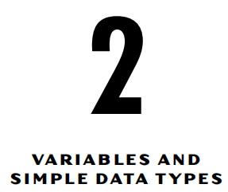
Variables and Simple Data Types
How to use variables to represent youdata in your programs.
hello_world.py
editor runs the file in Python interpreter
syntax highlighting

Slide 14
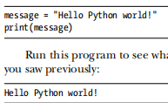
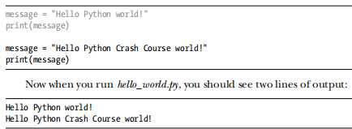
Variables
hello_world_py
variable
Run program
adding a variable made the python interpreter work harder, it’s trying to decode the true meaning of our code!
change the value of the variable and python interpreter will keep track.

Slide 15
Variables
Naming and Using Variables
Avoiding Name Errors When Using Variables
message_1 not 1_message
greeting_message not greeting message
avoid python keywords and functions names
short but descriptive variable names
caution with 1,0 and l,O
reading other people’s code you’ll get better at naming variables.
use lower case variables for now
every coder makes errors, most every day
pro coders know how to respond to errors
python interpreter will help you find errors through traceback
traceback is a record where the interpreter ran into a problem

Slide 16

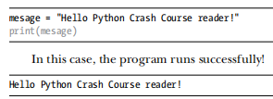
traceback says error is on line 2
name error, mesage not identified
name error usually means either forgot to set a variable’s value before using it, or made a spelling mistake on the variable.
python doesn’t check proper english spelling or grammar rules.
many errors are simple, single character typos.
many experienced and talented programmers spend hours chasing these kinds of tiny errors.
Variables are Lables
think of variables as labels that you can assign to values, a variable references a certain value.

Slide 17
19
Variables are Labels
Strings
standard python naming convention; simple_message.py
2-2 Simple Messages: Try this exercise.
Most programs define and gather some sort of data and then do something useful with it.
A string is a series of characters.
Anything inside quotes is a string.
“” or ‘’.

Slide 18
20
Changing Case in a String with Methods
Using Variables in Strings
A method is an action that Python can perform on a piece of data.
The dot (.) after name in name.title() tells Python to make the title() method act on the variable name.
lower(), convert strings to lowercase before storing the string.
You can use variable values inside a string.

Slide 19
21
Using Variables in String
Adding Whitespace to Strings with Tabs or Newlines
full_name = f"{first_name} {last_name}"
these are called f-strings (format)
we can assign the f-string.
whitespace refers to any nonprinting characters.
whitespace organizes output so it’s easier for users to read.

Slide 20
22
Adding Whitespace to String with Tabs or Newlines
Stripping Whitespace
\t = tab
\n = newline
\n\t = combine newline and tab
whitespace to a python interpreter are distinct values.
for example, comparing if strings are the same (username logins, for example).
rstrip()

Slide 21
23
Stripping Whitespace
Removing Prefixes
use a method on a string, then assign this new value with the original variable. Changing a variable’s value is done often and is how a variable’s value is updated as a program is executed or in response to user input.
stripping functions are used most often to clean up user input before it’s stored in a progam.
.removeprefix()
removes the prefix defined in ‘’.

Slide 22
24
Removing Prefixes
Avoiding Syntax Errors with Strings
If you want to keep the new value with the prefix removed, either reassign it to the original variable or assign it to a new variable.
a syntax error occurs when the python interpreter doesn’t recognize a section of your code as valid python.
i.e., apostrophe in single quotes
ok; “ ‘ “

Slide 23
25
Avoiding Syntax Errors with Strings
TRY IT YOURSELF
you might see syntax errors often as learn to write proper python
syntax errors are the least specific kind of error, can be difficult and frustrating to identify and correct.
See Appendix C, if you get stuck on a particularly stubborn error.
to spot syntax errors, try your text editor’s highlighting feature.
use your favored text editor or IDE and try the exercises from 2-3 to 2-8.
All these exercises use ideas from the chapter.
Exercises you don’t finish in class, do as homework. If you return it to me the next day it will serve as bonus to your final grade.

Slide 24
26 Numbers
Integers
Floats
In a terminal session, python returns the result of the operation.
python supports mathematical order of operations
whitespace has no effect on mathematical operations
floats are any number with a decimal.
float refers to the fact that a decimal can appear anywhere in a number, hence the decimal floats around in the number.

Slide 25
27
Floats
Integers and Floats
programming languages are carefully designed to handle floats properly.
sometimes you can get an arbitrary number of decimal places in your solution.
we will learn how to deal with this later.
when you divide two numbers, even int, you always get float.
if you mix int with float, you get float.
python defaults to float in any operation that uses a float.

Slide 26
28
Underscores in Numbers
Multiple Assignment | Constants
you can use underscores in numbers to make them more readable, the python interpreter will print the numbers without the underscore.
you need to separate the variable names with commas and do the same with the values.
x,y,z=0,1,2
a constant is a variable whose value stays the same.
use all caps as variable name for constants, python doesn’t have built-in constant types.

Slide 27
29 Comments
How Do You Write Comments?
What Kinds of Comments Should You Write?
# hash mark indicates comment, anything following it is ignored by the python interpreter.
as your code becomes more complex, you should insert notes describing your approach to solving the problem.
the main reason to write comments is to explain what your code does and how you make it work.

Slide 28
30
What Kinds of Comments Should You Write?
Zen of Python
writing comments helps you remember why you wrote it in the first place.
pro programmers collaborate, they leave eachother notes.
make comments concise and clear.
get in the habit early, and practice comments now.
avoid complexity, aim for simplicity.
“Zen of Python” by Tim Peters reflects the python community philosophy.

Slide 29
31
Zen of Python
if you a have choice between a simple and complex solution, choose simple.
use the simplest solution that works (elegance).
when your code is complex, make it readable, write comments.
much of programming consists of using small, common approaches to simple situations within a larger, more creative project.
the core of your code should make sense to other programmers.
write what works, refactor later, don’t get stuck on being perfect right at the start.

Slide 30
30
Summary
worked with variables
resolve name and syntax errors
worked with int, float
how to use comments
Zen of python philosophy

