Slide 1
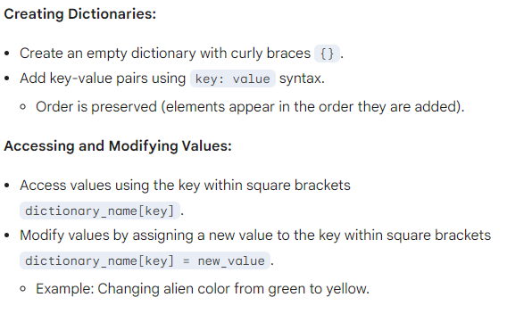
dictionaries, page 94

Slide 2
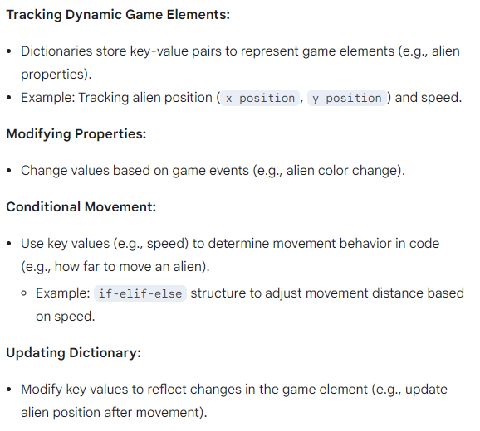
dictionaries for game dev, page 95

Slide 3
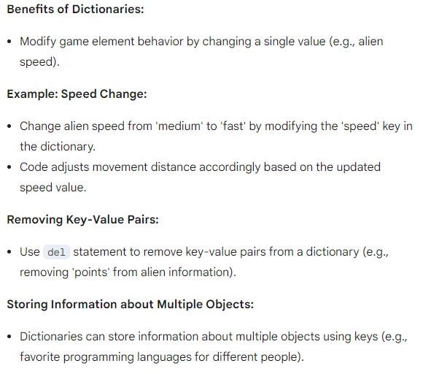
dictionaries for game dev, page 96

Slide 4
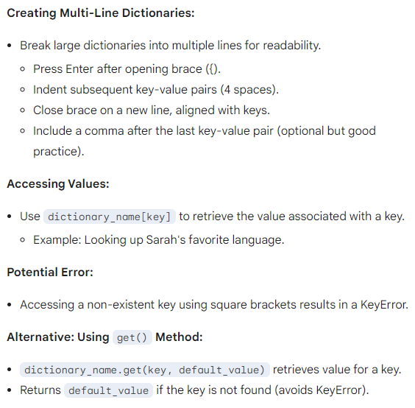
dictionaries, page 97

Slide 5
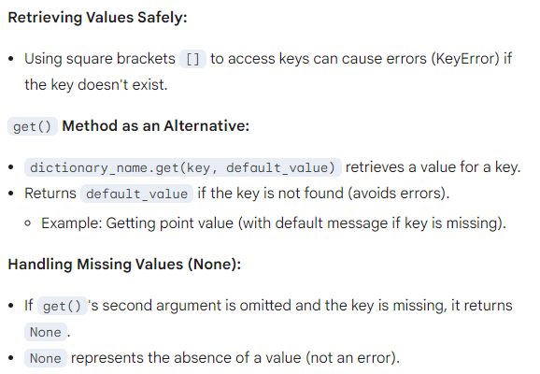
handling missing keys in dictionaries, page 98

Slide 6
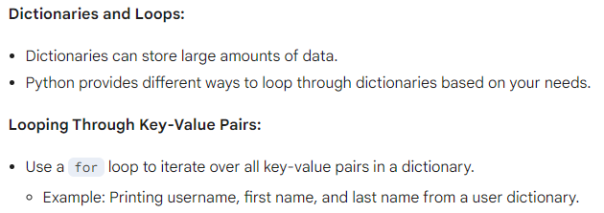
looping through dictionaries, page 99

Slide 7
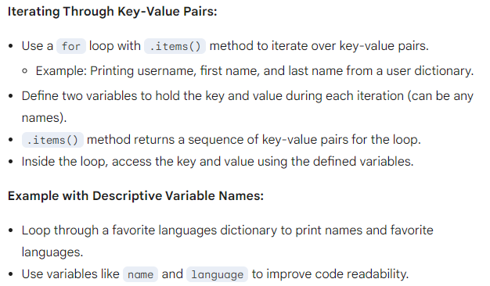
looping through key-value pairs in dictionaries, page 100

Slide 8
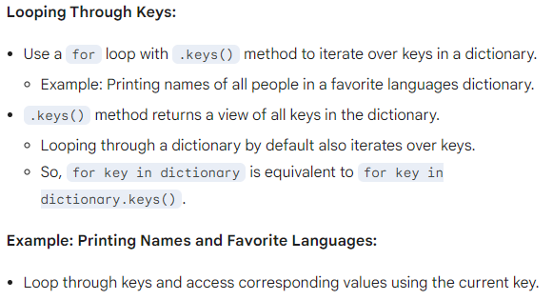
looping through dictionaries, page 101

Slide 9
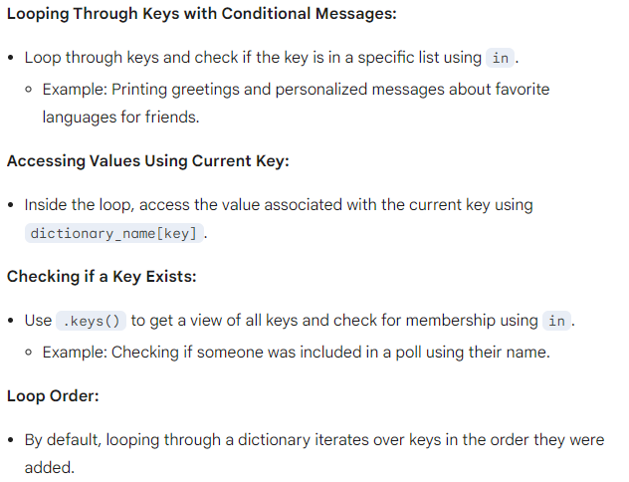
looping through dictionaries and checking for keys, page 102

Slide 10
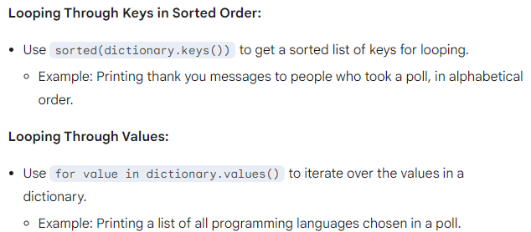
looping through dictionaries and sorting keys, page 103

Slide 11
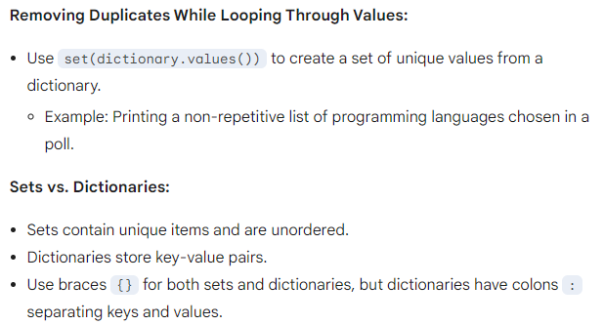
looping through dictionaries and sets, page 104

Slide 12
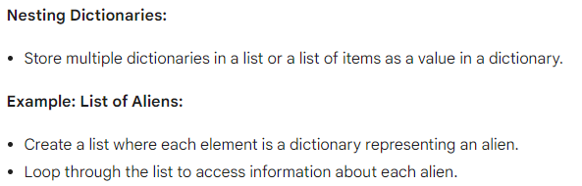
nesting, page 105

Slide 13
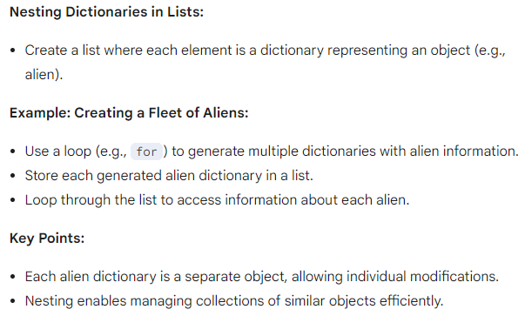
nesting dictionaries and creating lists of aliens, page 106

Slide 14
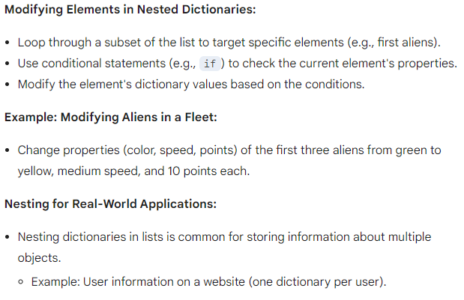
nesting dictionaries and modifying elements, page 107

Slide 15
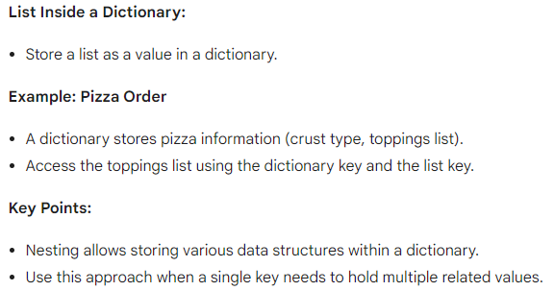
nesting in dictionaries, page 108

Slide 16
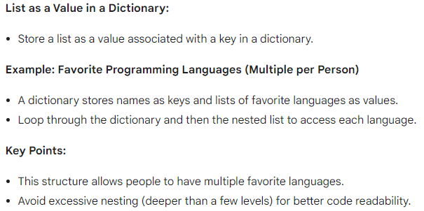
nesting lists inside dictionaries, page 109

Slide 17
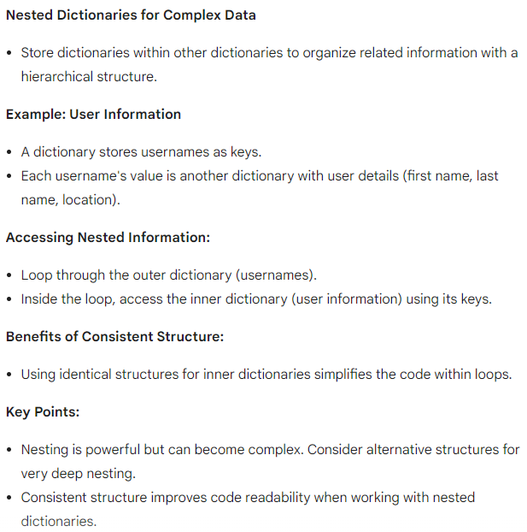
nesting dictionaries, page 110

Slide 18
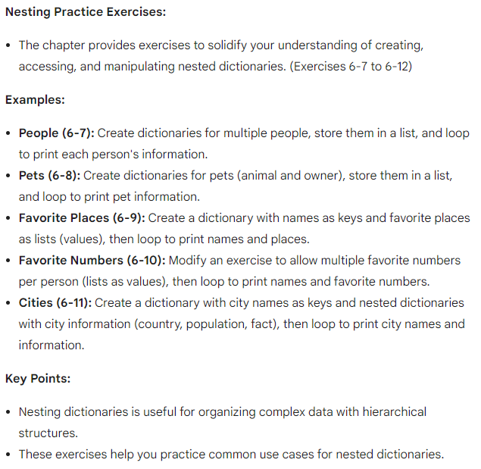
exercises and summary, page 111

Slide 19
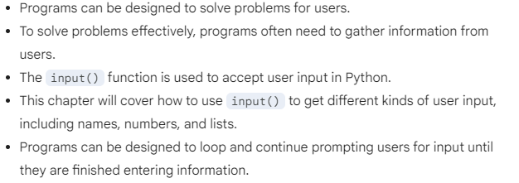
Accepting user input in programs, page 113

Slide 20
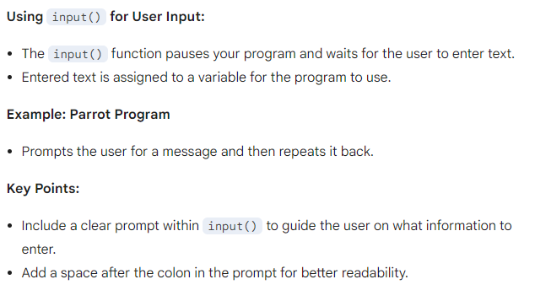
user input, page 114

Slide 21
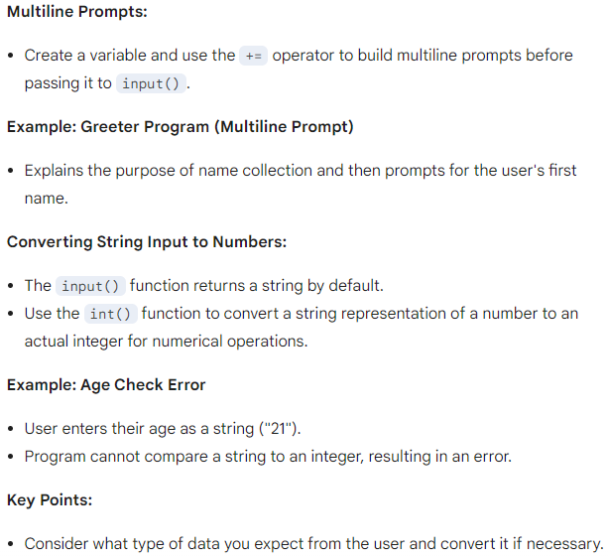
handling user input, page 115

Slide 22
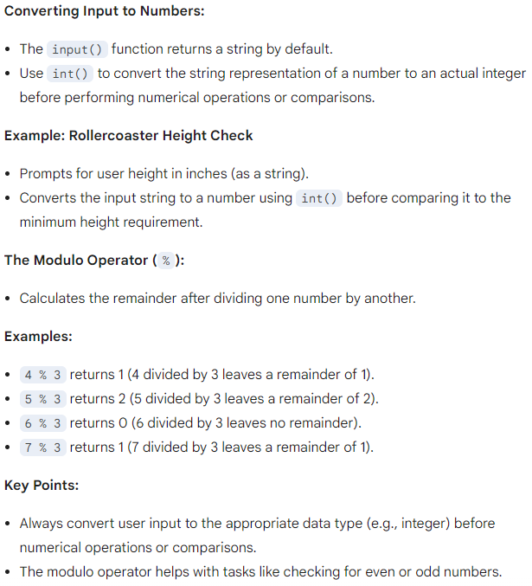
converting user input and the modulo operator, page 116

Slide 23
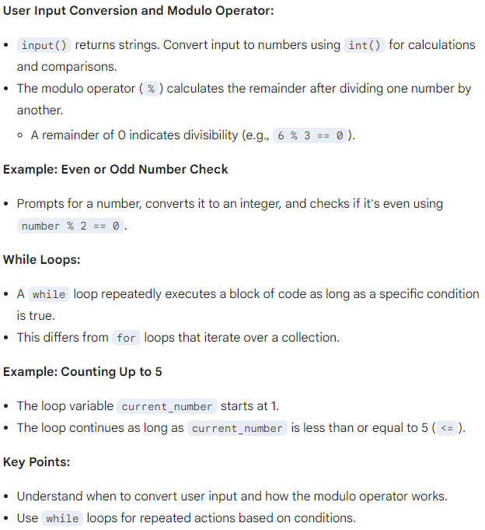
user input, modulo operator, while loops, page 117

Slide 24
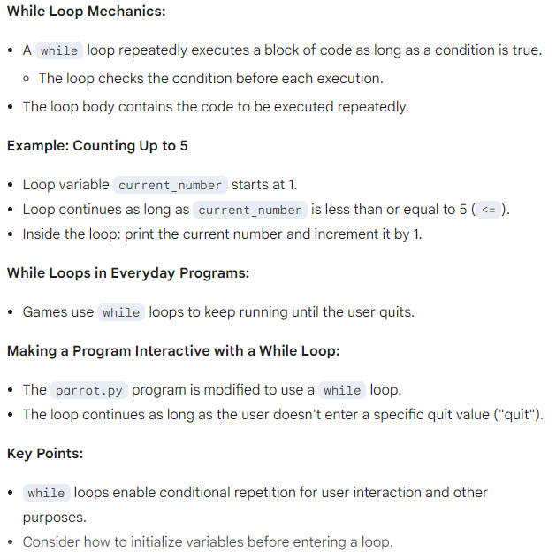
while loops and user input, page 118

Slide 25
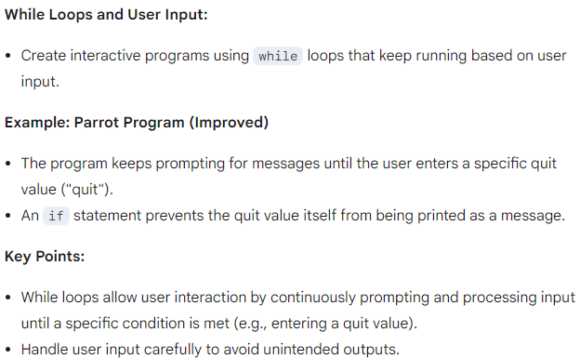
while loops with user input, page 119

Slide 26
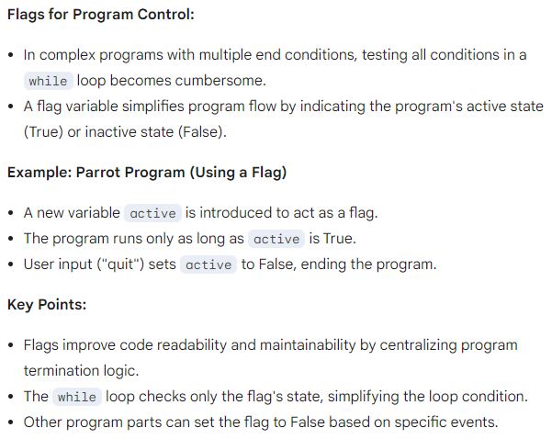
flags, page 120

Slide 27
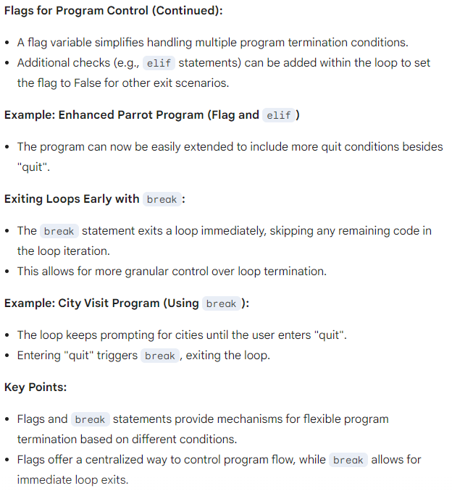
flags and break statements, page 121

Slide 28
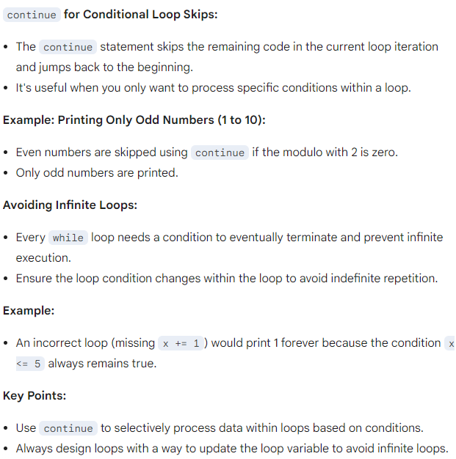
continue statements and infinite loops, page 122

Slide 29
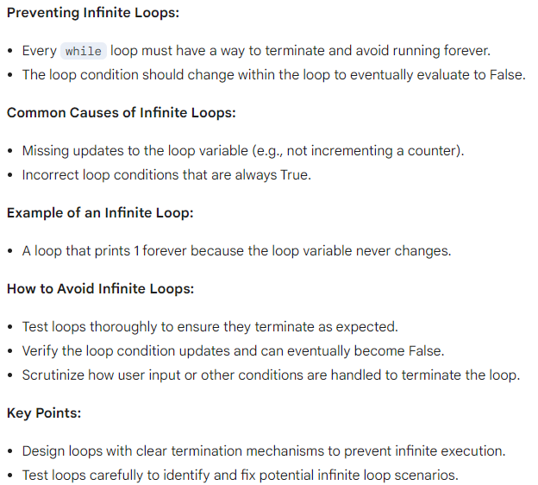
avoiding infinite loops in while loops, page 123

Slide 30
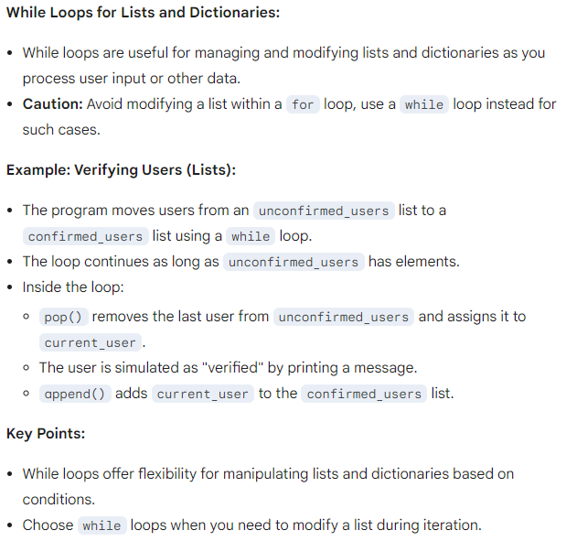
while loops with lists and dictionaries, page 124

