Slide 1
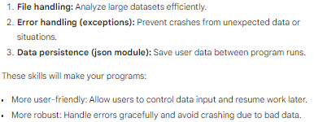
183: Ch 10 Brief

Slide 2
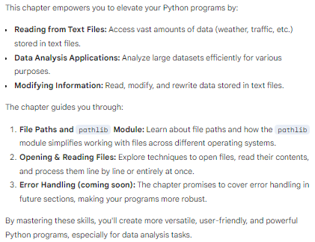

Mastering File Handling for Powerful Data Analysis page 184

Slide 3
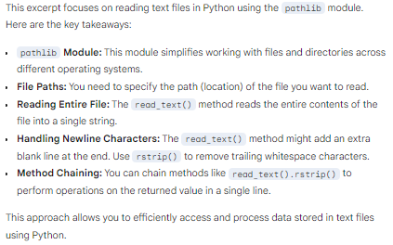
Reading Text Files with pathlib page 185

Slide 4
186
This page focuses on the fundamentals of reading data from text files in Python:
* **Importance of Text Files:** Stores various data (weather, traffic, literature, etc.) for analysis and manipulation.
* **Reading Approaches:**
* Entire file contents at once.
* Processing line by line for large files or specific line-based operations.
* **`open()` Function:**
* Opens a file for access.
* Takes the filename (including path if necessary) as an argument.
* Returns a file object representing the opened file.
* **Example (`file_reader.py`):**
* Opens `pi_digits.txt` containing pi digits on separate lines.
* Reads the entire file contents using `file_object.read()`.
* Prints the file contents to the screen.

Slide 5
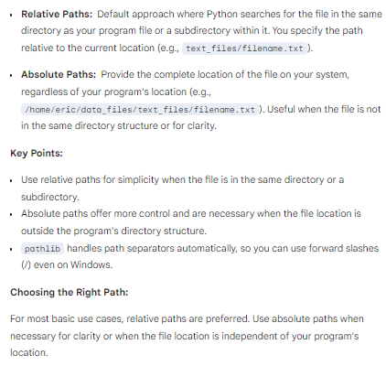
Specifying File Paths: Relative vs. Absolute page 186

Slide 6
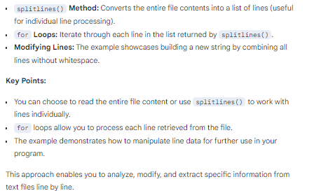
Processing Text Files Line by Line page 187

Slide 7
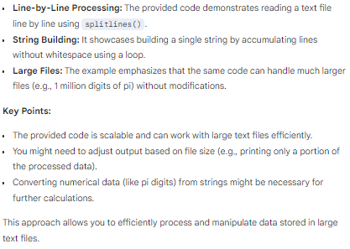
Working with Large Text Files page 188

Slide 8
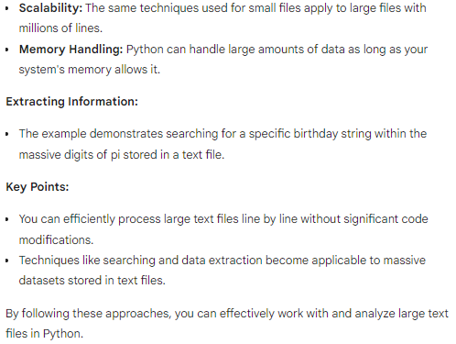
Analyzing Large Text Files Line by Line page 189

Slide 9
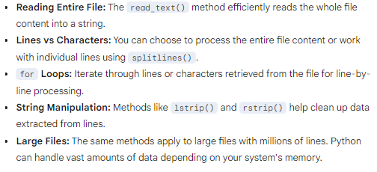
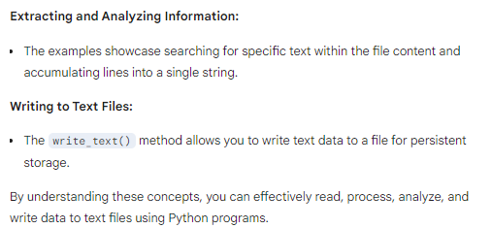
Reading, Analyzing, and Writing Text Files page 190

Slide 10
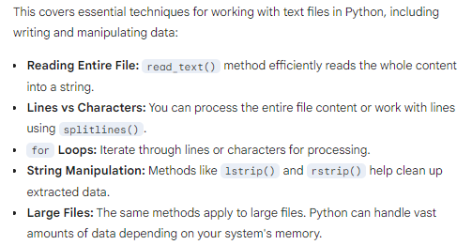
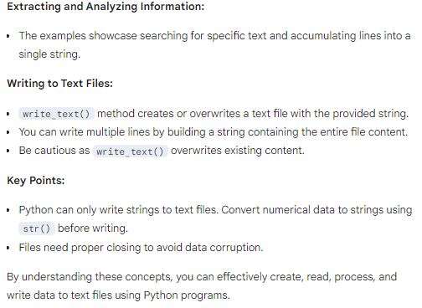
Reading, Writing, and Manipulating Text Files page 191

Slide 11
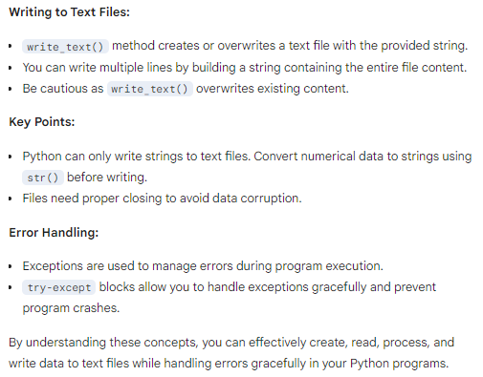
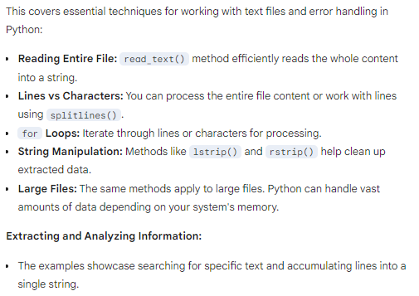
Working with Text Files and Exceptions page 192

Slide 12
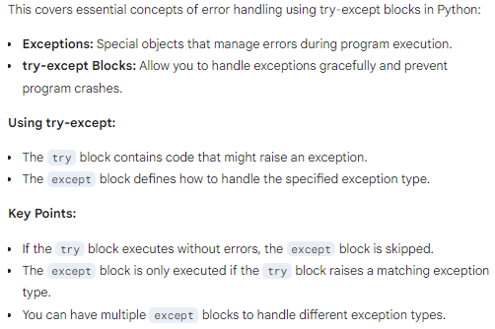
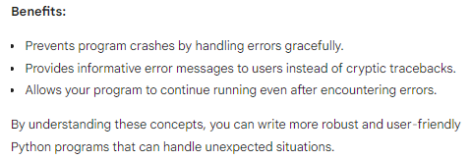
Error Handling with try-except Blocks page 193

Slide 13
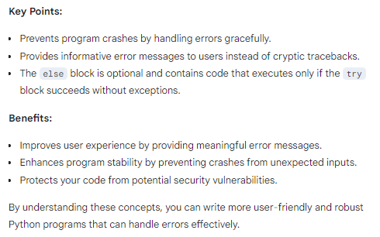
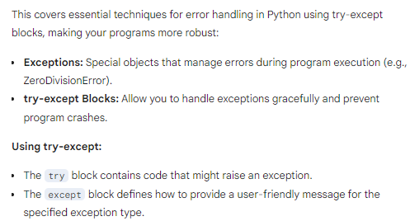
Building Robut Calculators with Error Handling page 194

Slide 14
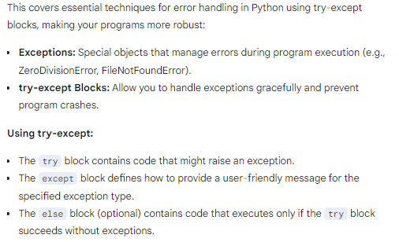
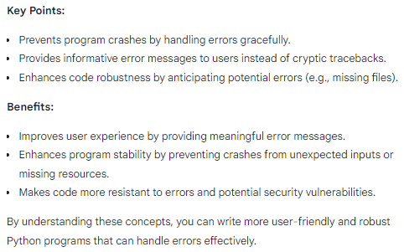
Enhancing Program Robustness with Error Handling page 195

Slide 15
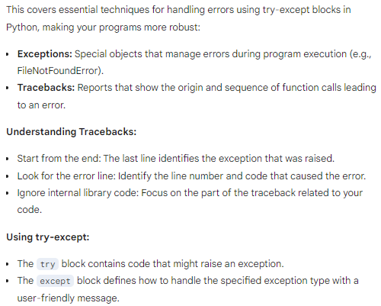
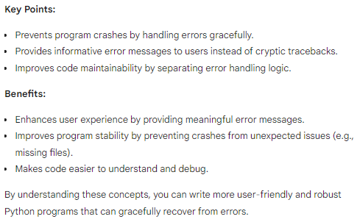
Recovering from Errors Gracefully with try-except page 196

Slide 16
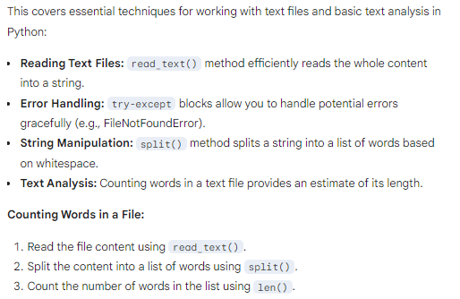
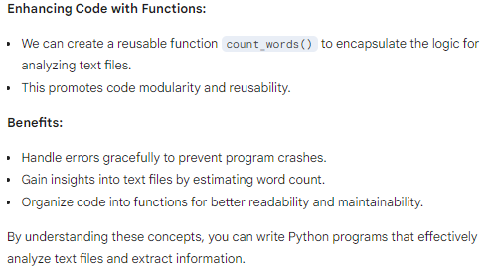
Analyzing Text Files and Counting Words page 197

Slide 17
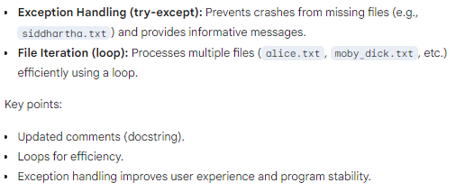
198

Slide 18
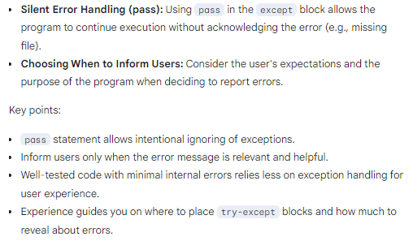
199

Slide 19
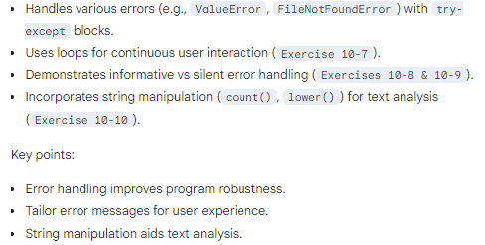
200

Slide 20
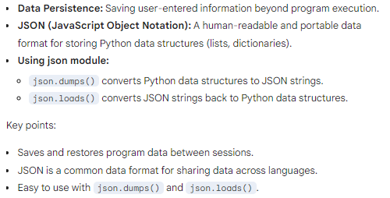
201

Slide 21

203

Slide 22
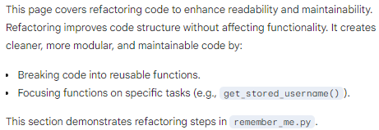
204

Slide 23
206
This page focuses on the benefits of refactoring code into well-defined functions using the `remember_me.py` example:
* Improved code clarity and maintainability
* Each function (`greet_user()`, future `get_stored_username()`, and `get_new_username()`) has a single responsibility
Exercises test these concepts with user data storage and retrieval.

Slide 24
207
This page refactors `remember_me.py` for better modularity by:
* Creating functions:
* `get_stored_username()`: Retrieves username from storage (implementation omitted). Returns username or None.
* `get_new_username()`: Prompts for a new username, stores it, and returns the username.
* Benefits:
* Improved code clarity and organization.
* Easier testing and potential reuse of functions.

Slide 25
208
* **File I/O:**
* Reading entire files at once.
* Reading files line by line.
* Writing to files.
* Appending text to files.
* **Error Handling:**
* Using `try-except` blocks to handle exceptions.
* **Data Persistence with JSON:**
* Storing and retrieving Python data structures using `json.dumps()` and `json.loads()`.
* **Code Refactoring:**
* Breaking down complex code into smaller, well-defined functions for improved readability, maintainability, and potential reuse.

