Slide 1
329 16 DOWNLOADING DATA, The CSV File Format
In Chapter 16, we embark on a journey to explore the vast landscape of online datasets, uncovering troves of untapped information.
Through Python, we delve into CSV and JSON formats, unearthing weather data gems.
Utilizing the csv module, we meticulously analyze temperature trends in Sitka, Alaska, and Death Valley, California, employing Matplotlib to craft visual narratives of climatic nuances.
Later, we traverse the domain of GeoJSON, unraveling seismic events with Plotly's prowess, mapping recent earthquakes worldwide.
By chapter's end, equipped with an arsenal of data-handling techniques, we cultivate a deeper comprehension of complex visualization methodologies, essential for navigating the rich tapestry of real-world datasets, fostering a new era of data-driven exploration.

Slide 2
330 Parsing the CSV File Headers
The parsing of CSV file headers using Python's csv module facilitates efficient data extraction.
By importing requisite modules and leveraging Path, we pinpoint the target CSV file.
Employing csv.reader(), a reader object is instantiated, enabling line-by-line parsing.
The initial invocation of next() retrieves the header row, crucial for delineating data structure.
Each header within this row signifies a distinct data attribute, e.g., 'STATION' denotes the weather station code.
Notably, 'DATE', 'TMAX', and 'TMIN' are of particular interest, representing temporal and temperature data.
While our focus here is on temperature-related metrics, the extensibility of this approach allows for the inclusion of diverse meteorological measurements.
This methodology underscores Python's versatility in data handling and analysis.

Slide 3
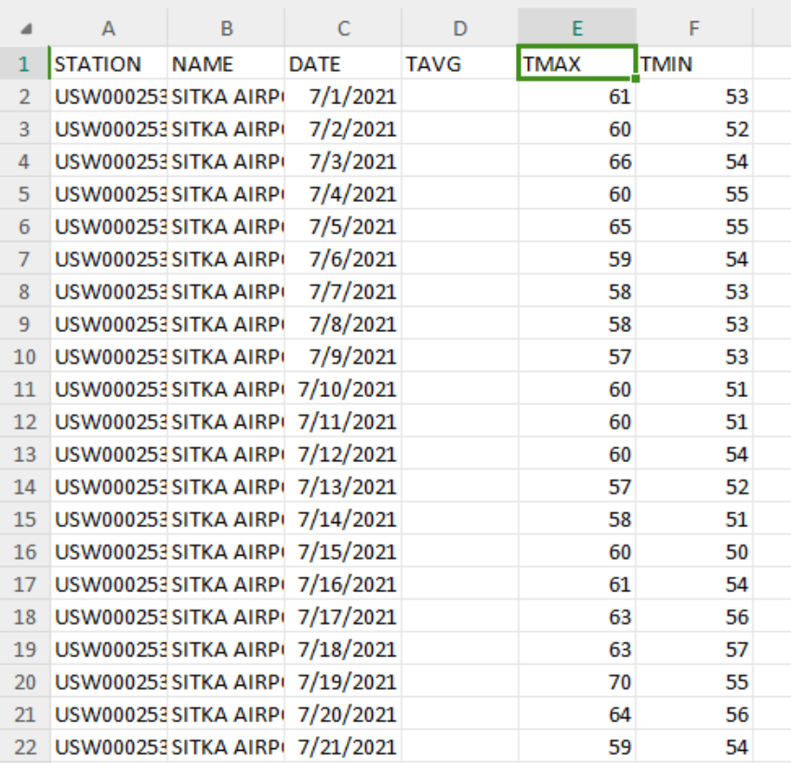
331 Printing the Headers and Their Positions, Extracting and Reading Data
In this phase of data exploration, we elucidate the method of printing CSV file headers alongside their respective positions within the dataset.
Leveraging Python's csv module, we instantiate a reader object and extract the header row, employing the enumerate() function to iterate over each header and its corresponding index.
This elucidates the structure of the dataset, facilitating informed data processing.
The subsequent analysis reveals that dates and high temperatures reside in columns 2 and 4, respectively.
Armed with this insight, we embark on the extraction of pertinent data, specifically high temperatures, iterating over each row and capturing the temperature values based on their index.
This meticulous approach lays the foundation for insightful data visualization and further analysis.

Slide 4
332 Plotting Data in a Temperature Chart, The datetime Module
To visually represent temperature data, we employ Matplotlib to craft an illustrative plot showcasing the daily highs.
After importing essential modules and initializing the data retrieval process, we delve into the heart of visualization, leveraging Matplotlib's capabilities.
By plotting the highs in red and specifying formatting particulars such as title, axis labels, and font sizes, we ensure clarity and aesthetic appeal in our output.
This line graph, depicted for July 2021 in Sitka, Alaska, serves as a succinct yet informative visual aid for comprehending temperature trends.
Additionally, by incorporating dates into our graph using the datetime module's strptime() method, we augment its utility, facilitating deeper temporal analysis.

Slide 5
334 Plotting Dates, Plotting a Longer Timeframe
In this computational endeavor, we elevate our plot's significance by incorporating dates onto the x-axis.
Through meticulous data extraction and manipulation, we construct datetime objects from the date information retrieved from the file.
These dates, alongside the corresponding high temperatures, enrich our visualization, offering a comprehensive portrayal of temperature trends.
Leveraging Matplotlib's capabilities, we present the data graphically, ensuring clarity and interpretability.
Notably, the call to `fig.autofmt_xdate()` optimizes label positioning, mitigating overlap.
By extending our analysis to encompass a full year of data, we deepen our understanding of Sitka's weather patterns, thereby fostering richer insights and informed decision-making.

Slide 6
336 Plotting a Second Data Series, Shading an Area in the Chart
In advancing our analysis, we enhance our graph's utility by integrating low temperatures alongside highs.
By extending our data extraction process to encompass low temperatures, we expand our dataset to include this critical aspect of weather dynamics.
Leveraging Matplotlib's capabilities, we overlay the high and low temperature series, meticulously distinguishing them through color coding.
We then augment our visualization by shading the area between the two datasets, providing immediate insight into temperature ranges.
Employing transparency control, we ensure the shading complements rather than overwhelms the plotted data.
Through these enhancements, our graph offers a comprehensive depiction of daily temperature variations, empowering deeper understanding and informed decision-making.

Slide 7
338 Error Checking
In our pursuit of versatile data analysis, we encounter challenges with data variability and integrity.
Weather stations may diverge in data collection methods or suffer occasional malfunctions, leading to incomplete datasets and potential program crashes.
To address this, we implement robust error-checking mechanisms.
By anticipating and handling exceptions during data extraction, we ensure program stability and reliability.
Utilizing Python's try-except-else construct, we fortify our code to gracefully manage missing data instances.
Additionally, we enhance program clarity by providing informative error messages and adjusting plot titles to accommodate diverse dataset sources.
Through meticulous error management, our analysis remains resilient, enabling accurate and insightful visualizations across disparate datasets.

Slide 8
341 Downloading Your Own Data
To download your own weather data from the NOAA Climate Data Online site:
1. Visit the site and select Daily Summaries.
2. Specify a date range and ZIP code.
3. View area details, then select a weather station.
4. Add selected station data to cart (free).
5. Choose Custom GHCN-Daily CSV format and confirm date range.
6. Select desired data types.
7. Review and submit the order with email. Receive confirmation and link for download. The downloaded data, structured similarly to the section's data, enables visualization with potentially different headers. Follow these steps for data acquisition and analysis.

Slide 9
342 TRY IT YOURSELF
In the provided exercises:
1. Visualize Sitka rainfall data from sitka_weather_2021_full.csv's PRCP column. Repeat for Death Valley for a contrast in rainfall.
2. Adjust y-axis scales on Sitka and Death Valley temperature graphs to compare temperature ranges accurately.
3. Obtain San Francisco temperature data for comparison with Sitka and Death Valley. Plot high-low temperature comparison.
4. Dynamically determine indexes for TMIN and TMAX columns using header row. Automatically generate graph titles from station names.
5. Explore additional visualizations for various weather aspects and locations of interest.

Slide 10
342 Mapping Global Datasets: GeoJSON Format, Downloading Earthquake Data, Examining GeoJSON Data
In this section, you'll download a dataset of recent global earthquakes in GeoJSON format, focusing on earthquake magnitudes and locations.
Using Python's json module, you'll convert the data to a more readable format.
The GeoJSON structure contains metadata detailing the file's generation and online source, along with earthquake-specific information stored in a list under "features".
Each earthquake is represented by a dictionary with properties like magnitude and location coordinates.
The "geometry" key holds the earthquake's spatial data.
Despite the nested structure, Python simplifies the data handling.
Conventions for longitude and latitude representation are noted, adhering to the GeoJSON format.
You'll parse this data to map earthquake occurrences using tools like Plotly's scatter_geo().

Slide 11
345 Making a List of All Earthquakes, Extracting Magnitudes
This section involves creating a list containing information on each earthquake.
Using Python's json module, earthquake data from the GeoJSON file is loaded and stored in a list.
By accessing the 'features' key, all earthquake dictionaries are extracted.
The code succinctly retrieves magnitudes for each earthquake by looping through the list of earthquake dictionaries and appending magnitudes to a separate list.
Printing the first 10 magnitudes confirms data extraction accuracy.
The next step involves extracting location data for mapping earthquake occurrences.
Despite the file's extensive content, concise code efficiently manages data extraction and manipulation.

Slide 12
346 Extracting Location Data, Building a World Map
To extract location data from earthquake records, access the 'geometry' dictionary where longitude and latitude are stored.
Iterate through earthquake dictionaries, retrieving magnitude, longitude, and latitude, appending them to respective lists.
Printing verifies correct data extraction.
For mapping earthquakes, Plotly Express is utilized.
With latitudes and longitudes lists, scatter_geo() overlays a scatterplot on a world map.
Importing plotly.express as px, scatter_geo() requires latitude and longitude lists as arguments.
The resulting map demonstrates global earthquake distribution.
This efficient process highlights the simplicity and power of Plotly Express, offering a clear visualization of earthquake activity with minimal code complexity.
Further adjustments can enhance map clarity and interpretability.

Slide 13
348 Representing Magnitudes, Customizing Marker Colors
To enhance earthquake maps, additional data like magnitudes can be represented.
Loading a file containing 30 days of earthquake activity, the size argument in px.scatter_geo() scales points based on magnitude.
The resulting map reveals tectonic plate boundaries more clearly.
Further customization involves using color to signify earthquake severity.
Utilizing Plotly's color scales, the color argument assigns colors based on magnitudes.
The color_continuous_scale argument specifies the color scale, while labels customize legend labeling.
Additionally, adjusting the base map projection for better visualization.
The resulting map displays earthquake magnitude through both color and size, offering improved insight into global seismic activity over 30 days.

Slide 14
350 Other Color Scales, Adding Hover Text
Plotly Express provides various color scales for data visualization.
Running `px.colors.named_colorscales()` reveals available options.
Experimenting with these scales can enhance visualizations, aiding in pattern recognition.
Adding hover text to earthquake maps offers informative details upon marker hover.
Extracting earthquake titles from the file, hover_name in px.scatter_geo() displays descriptions of each earthquake's location and magnitude.
This concise code yields a visually appealing and informative map of global seismic activity, demonstrating Plotly's customization capabilities for creating meaningful visualizations.

Slide 15
352 TRY IT YOURSELF
Refactoring the earthquake data extraction loop can be optimized by directly appending values from eq_dict to their respective lists, eliminating temporary variables and shortening the loop.
For automated titling, extract the dataset title from the metadata section of the GeoJSON file and assign it to the variable title.
Explore recent earthquake datasets from USGS for various time periods and magnitudes, creating visualizations of the latest seismic activity.
Utilize world_fires_1_day.csv to map global fire occurrences, incorporating data processing techniques and mapping skills demonstrated earlier.
NASA's Earth Observing System provides updated fire data for further analysis and visualization in various formats.

Slide 16
352 Summary
This chapter delved into real-world dataset manipulation, covering CSV and GeoJSON file processing.
With historical weather data, you explored Matplotlib, mastering datetime module usage and plotting multiple data series on one chart.
Utilizing Plotly, you visualized geographical data on world maps, learning map style customization.
Proficiency in CSV and JSON file handling enables analysis of diverse datasets, available in these formats online.
The upcoming chapter focuses on writing programs for automated data retrieval from online sources, followed by visualization creation.
These skills are valuable for both hobbyist programming and professional development, offering versatility and applicability across various domains.

