Slide 1
355 17 WORKING WITH APIS, USING AN API, Git and GitHub
In this discourse, we delve into crafting a self-contained script that constructs a visualization from dynamically fetched data.
Leveraging an Application Programming Interface (API), the script autonomously solicits specific insights from a website, utilizing this data to fashion an up-to-the-moment visualization.
APIs, integral to websites, facilitate interactions with programs via precise URLs, constituting API calls.
The requested data, often formatted in JSON or CSV, feeds into various applications, especially those interfacing with social media platforms.
Our narrative unfolds within the realm of GitHub, a collaborative platform for coding projects.
Employing GitHub's API, we extract details about Python projects, fashioning an interactive Plotly visualization.
GitHub, deriving its essence from Git, champions version control, safeguarding collaborative coding efforts, all encapsulated within repositories, each encompassing project essentials: code, collaborators, and issue tracking.
API call
The requested data will be returned in an easily processed format, such as JSON or CSV.
Most apps that use external data sources, such as apps that integrate with social media sites, rely on API calls.

Slide 2
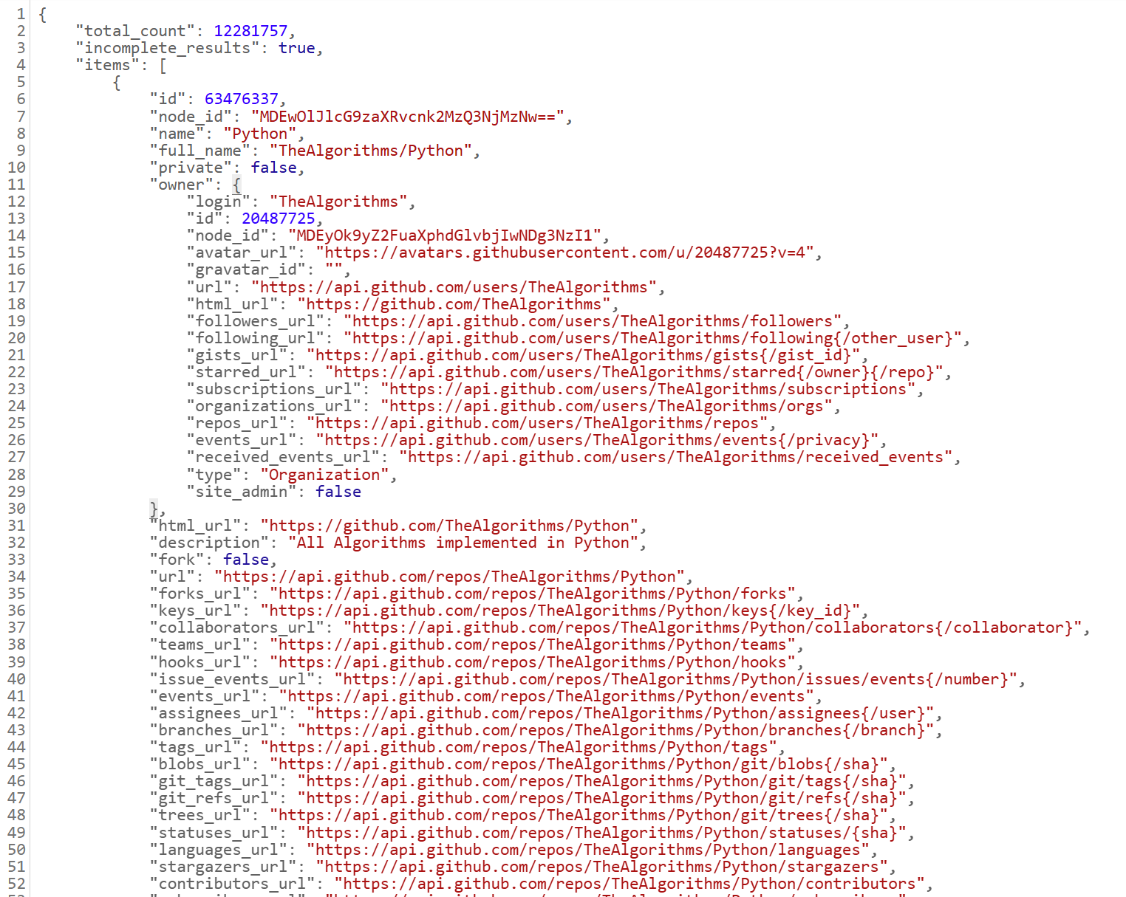
356 Git and GitHub, Requesting Data Using an API Call
GitHub, a hub for collaboration on coding projects, provides a rich dataset for analysis via its API.
We utilize this API to gather insights on Python projects, constructing interactive visualizations using Plotly.
Git, underlying GitHub, offers robust version control, tracking changes to project files and facilitating collaborative development.
Through Git, one can seamlessly manage project states, commit changes, and revert to previous iterations if needed.
GitHub repositories store project essentials like code, collaborators, and issues.
Using GitHub's API, we navigate its vast ecosystem, issuing queries to extract pertinent data.
These API calls return structured responses, enabling programmatic analysis and visualization of GitHub's wealth of information.
Github API
https://api.github.com/search/repositories?q=language:python+sort:stars

Slide 3
357 Installing Requests
The Requests package streamlines the process of fetching data from websites and analyzing the received responses in Python. To install Requests, pip is employed with the following command:
python -m pip install --user requests
For alternative command prompts like python3, the installation process remains analogous:
python3 -m pip install --user requests
Following installation, a program is constructed to execute an API call and handle the results automatically.
Initially, the requests module is imported, and the URL for the API call is defined, incorporating specific parameters such as the programming language (Python) and minimum star count (>10,000).
Headers are then specified to denote the API version and desired response format.
The call is initiated using `requests.get()` with the URL and headers provided, and the response object is captured.
By examining the status code attribute of the response, the success of the call is verified (a code of 200 indicates success).
The JSON response is then converted into a Python dictionary using the `json()` method for further processing.
Finally, the keys of the response dictionary are printed to analyze the obtained data, confirming the successful retrieval of information from the API.

Slide 4
358 Working with the Response Dictionary
Working with the Response Dictionary entails extracting and summarizing data retrieved from an API call.
Initially, we print the values associated with 'total_count' and 'incomplete_results', indicating the total number of Python repositories returned and whether the results are complete, respectively.
We then examine the 'items' key, containing a list of dictionaries representing individual repositories.
By printing the length of this list, we ascertain the number of repositories returned.
To delve deeper, we extract and analyze information from the first repository's dictionary, including the project's name, owner, stars, GitHub repository URL, creation and last update dates, and description.
This process illuminates insights into the most-starred Python project on GitHub, such as its owner, creation and update dates, and project description, aiding in comprehensive data exploration.

Slide 5
361 Summarizing the Top Repositories
In this Python script, we fetch data from an API call and process it to extract key information about multiple repositories.
The script uses a loop to iterate over each repository in the response and prints its name, owner, star count, GitHub URL, and description.
This process allows us to gather essential details about the repositories, such as "public-apis," "system-design-primer," and "PayloadsAllTheThings," which have varying star counts and purposes.
These details can help us identify interesting projects for further exploration.
The script's output includes a count of the total number of repositories and a message indicating that we're about to visualize the data, suggesting that this script is part of a larger data analysis or visualization project.

Slide 6
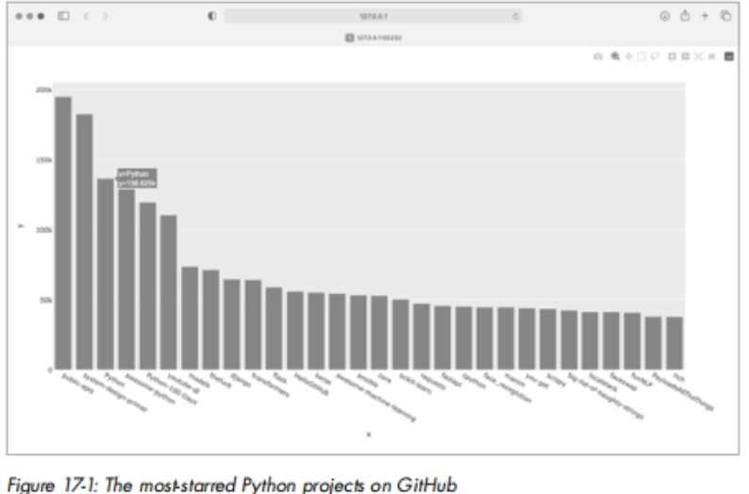
362 Monitoring API Limits, Visualizing Repositories Using Plotly
When working with APIs, understanding rate limits is crucial. APIs like GitHub's have limits on how many requests you can make in a given timeframe. By querying the rate limit endpoint (`https://api.github.com/rate_limit`), you can check your current usage status. The response includes details like the limit, remaining requests, and the time when your quota will reset. If you exceed the limit, the API will inform you, and you'll need to wait for the reset time.
For visualization, we can use Plotly to create interactive charts. In our example, we query GitHub for the most-starred Python projects and visualize their popularity. The bar chart displays the number of stars each project has, allowing users to click on a bar to visit the project's GitHub page. This approach helps visualize the relative popularity of Python projects on GitHub quickly and effectively.

Slide 7
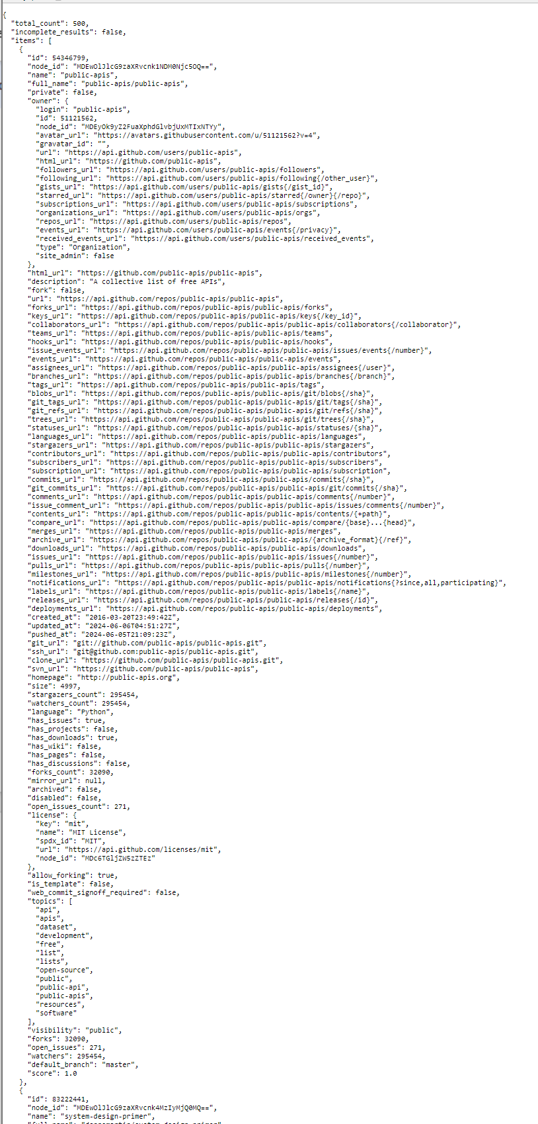
364 Styling the Chart, Adding Custom Tooltips
To style and customize Plotly charts, you can add a title and axis labels using `update_layout()` after creating the initial chart with `px.bar()`. For example, setting the title font size and axis title font sizes can improve readability.
Tooltips can provide additional information when hovering over chart elements. You can customize tooltips to show details like project descriptions and owners. To do this, extract the necessary data (e.g., owner, description) and format it into HTML for line breaks. Then, use the `hover_name` argument in `px.bar()` to display this custom tooltip text. This approach enhances the chart's interactivity and provides users with more detailed insights.
https://api.github.com/search/repositories?q=language:python+sort:stars+stars:%3E10000

Slide 8
366 Adding Clickable Links, Customizing Marker Colors
To add clickable links to a Plotly chart, use HTML to format the x-axis labels as active links. Extract the URLs from the data and create links with the anchor tag `<a href='URL'>link text</a>`. Update the x-values in `px.bar()` to use these links, enabling viewers to visit project pages on GitHub by clicking the project names on the chart. This enhances interactivity and user engagement.
Additionally, customize marker colors and opacity using `update_traces()` after creating the chart. Set the `marker_color` to a named CSS color (e.g., 'SteelBlue') and adjust `marker_opacity` to control transparency. These customizations improve the visual appeal and readability of the chart.

Slide 9
368 More About Plotly and the GitHub API
Plotly's documentation provides comprehensive guidance on using Plotly Express for various plots.
Start with "Plotly Express in Python" for an overview and detailed articles on specific chart types.
For advanced customization, "Styling Plotly Express Figures in Python" offers in-depth explanations.
To explore the GitHub API further, refer to GitHub's API documentation.
Learn how to access a wide range of GitHub data, including the Search section for details on searching repositories.
With a GitHub account, you can work with your own data and publicly available data from other repositories.
https://plotly.com/python/plotly-express
https://plotly.com/python/
styling-plotly-express.
https://docs.github.com/en/rest

Slide 10
368 The Hacker News API
The Hacker News API provides access to articles and comments on Hacker News without requiring registration.
By making API calls, you can retrieve data about top articles and their comments.
For example, querying `https://hacker-news.firebaseio.com/v0/item/31353677.json` returns information about the top article, including the author, score, and comments.
Using Python's `requests` library, you can fetch data from the API and format it for better readability.
By iterating through a list of article IDs and making API calls for each article, you can create a summary of the top articles on Hacker News, including their titles, discussion links, and comment counts.
Sorting this information allows you to identify the most popular and discussed articles.
news.ycombinator.com
https://hacker-news.firebaseio.com/v0/item/31353677.json
https://github.com/HackerNews/API

Slide 11
371 TRY IT YOURSELF
1. **Other Languages:** Modify `python_repos.py` to query and visualize the most popular projects in languages like JavaScript, Ruby, C, Java, Perl, Haskell, and Go. Adjust the API call to include the desired language parameter and update the visualization accordingly.
2. **Active Discussions:** Use data from `hn_submissions.py` to create a bar chart showing the most active discussions on Hacker News. Each bar's height should represent the number of comments, and the label should link to the discussion page. Handle KeyError exceptions for promotional posts.
3. **Testing `python_repos.py`:** Write `test_python_repos.py` using `pytest` to assert that the `status_code` is 200. Additionally, create assertions for the expected number of items returned and ensure the total number of repositories is greater than a specified amount.
4. **Further Exploration:** Explore the Plotly documentation and either the GitHub or Hacker News API documentation. Customize existing plots or create new visualizations using different data. For more API exploration, refer to the list of APIs in the GitHub repository at `https://github.com/public-apis`.

Slide 12
372 Summary
In this chapter, you learned to create self-contained programs that gather data using APIs and visualize it.
You explored the GitHub API for most-starred Python projects and briefly touched on the Hacker News API.
Using the Requests package, you automated API calls and processed their results.
You also customized Plotly charts.
In the next chapter, you'll use Django to build a web application as your final project.
This chapter's skills are foundational for interacting with APIs and data visualization, essential for various projects and applications.

