Slide 1
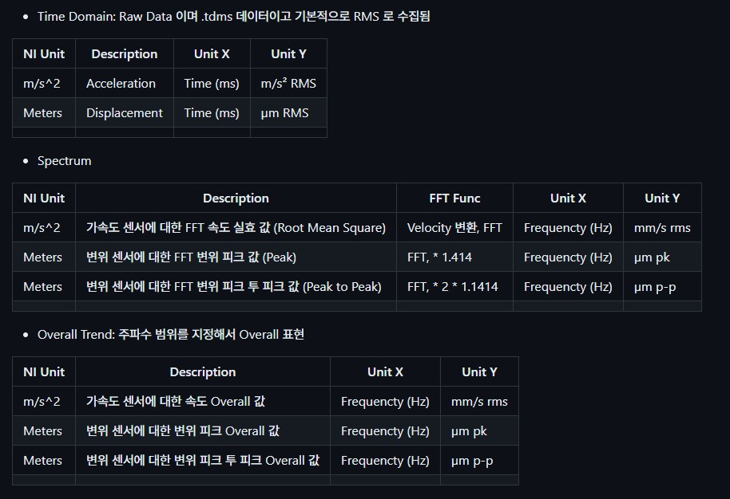

Slide 2

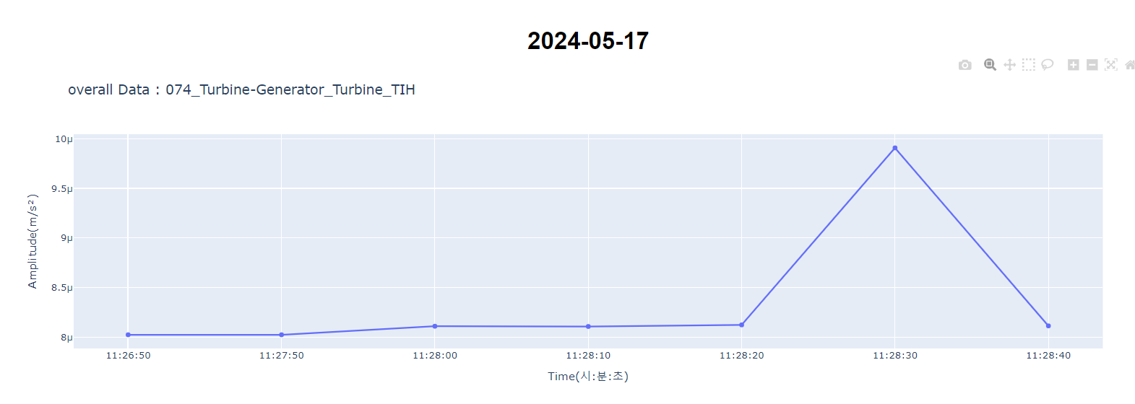
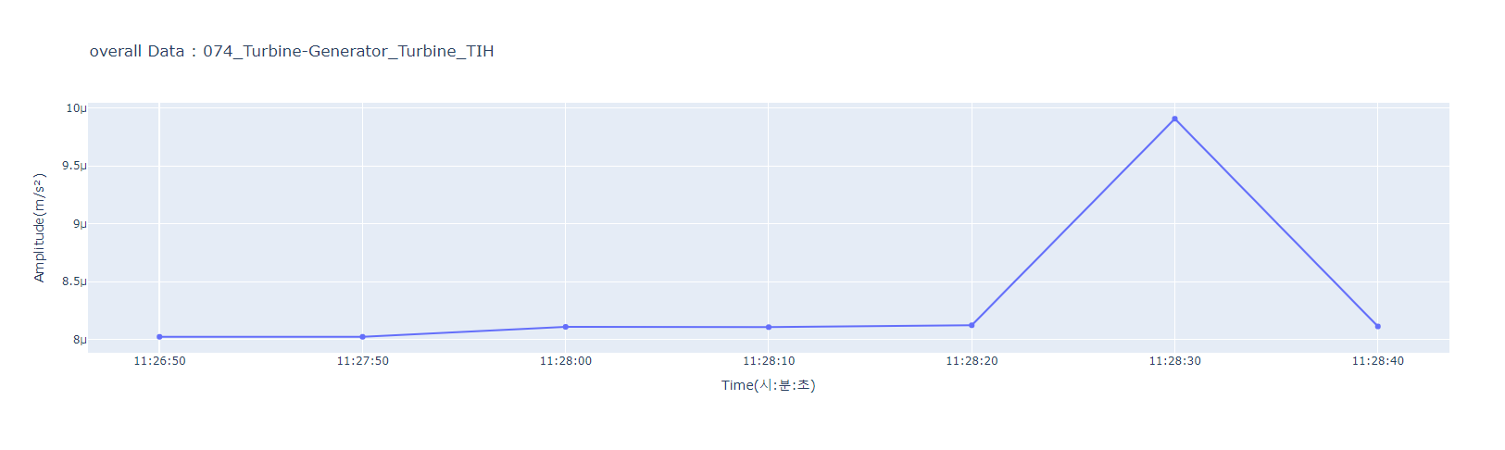
awesome-plot
Trend
Single
Dual
Multi
TDMS
overall
Time domain
Spectrum
2024-01-01
MOV
MIV
MIH
MOH

Slide 3

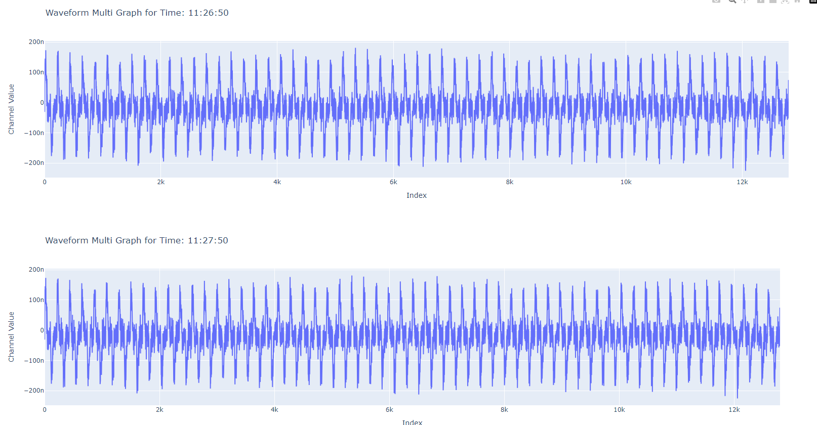

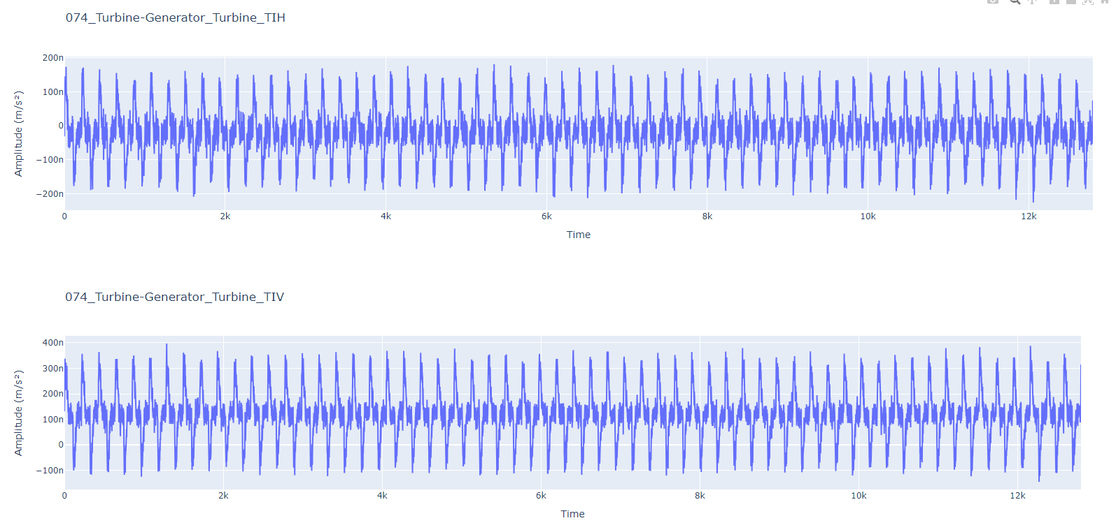
awesome-plot
Trend
Single
Dual
Multi
TDMS
overall
Time domain
Spectrum
2D
3D
2024-01-01
MOV
MOV
MIV
MIV
MIH
MIH
MOH
MOH
MIH
113050
113150
113250
MOV
113050
113150
113250

Slide 4
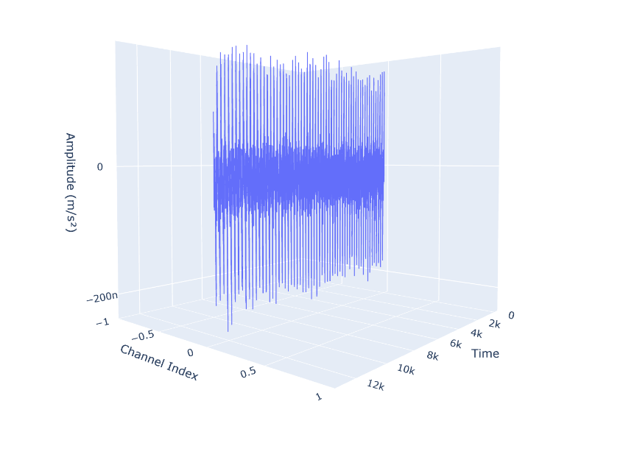
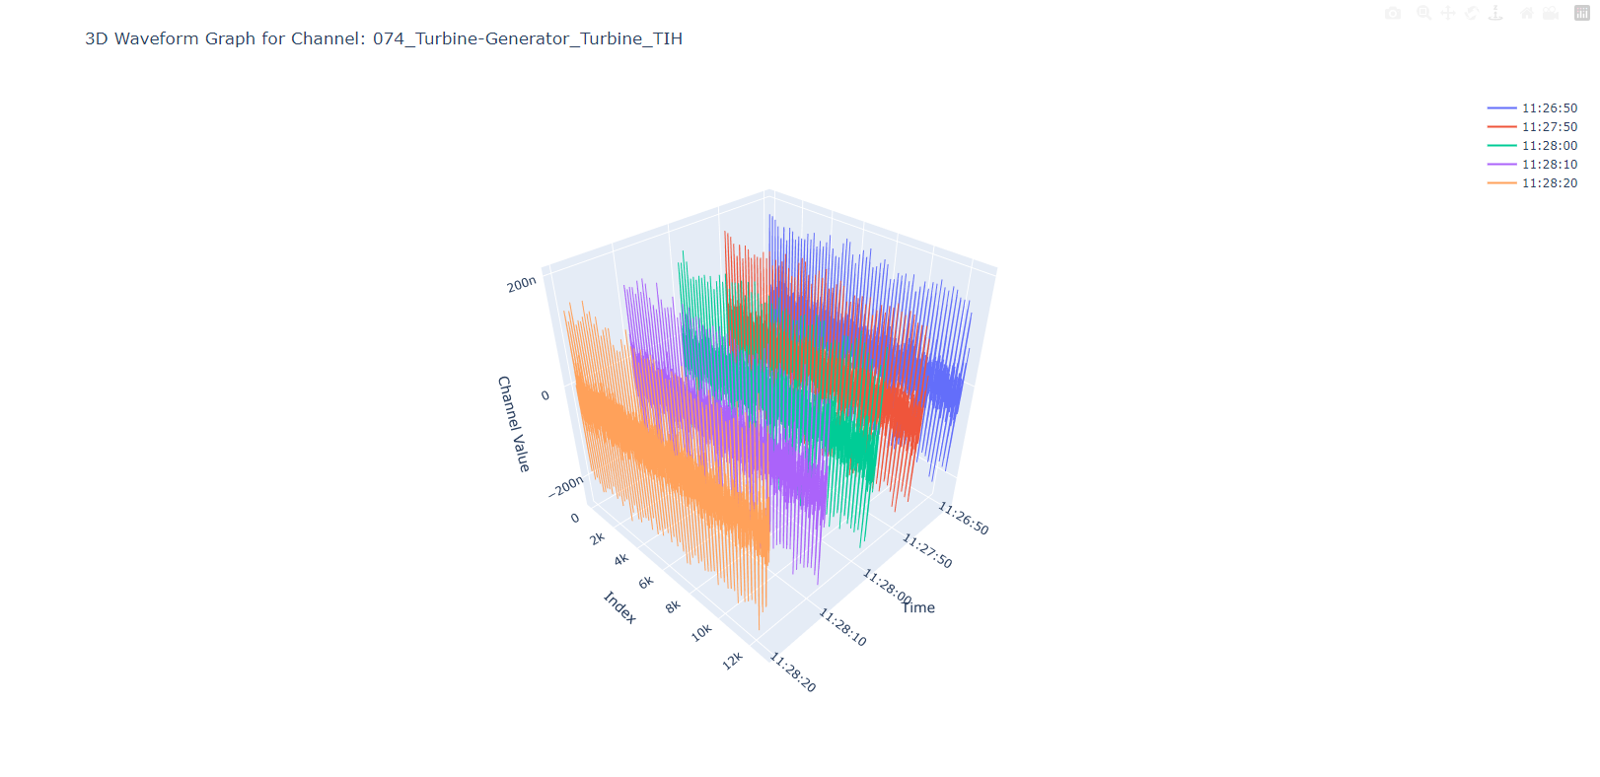
awesome-plot
Trend
Single
Dual
Multi
TDMS
overall
Time domain
Spectrum
2D
3D
2024-01-01
MOV
23-07-01
MIH
MIV
MIH
MOH
index
hhmmss
113050
113150
113250

Slide 5
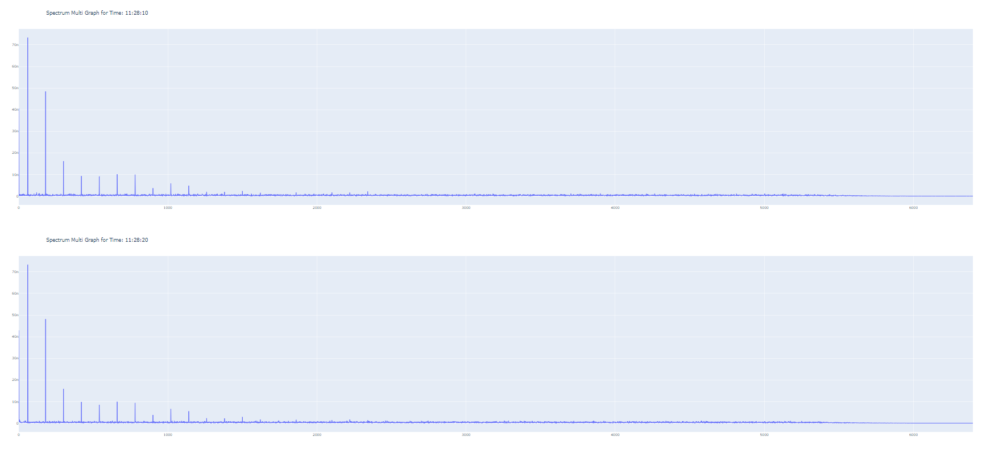
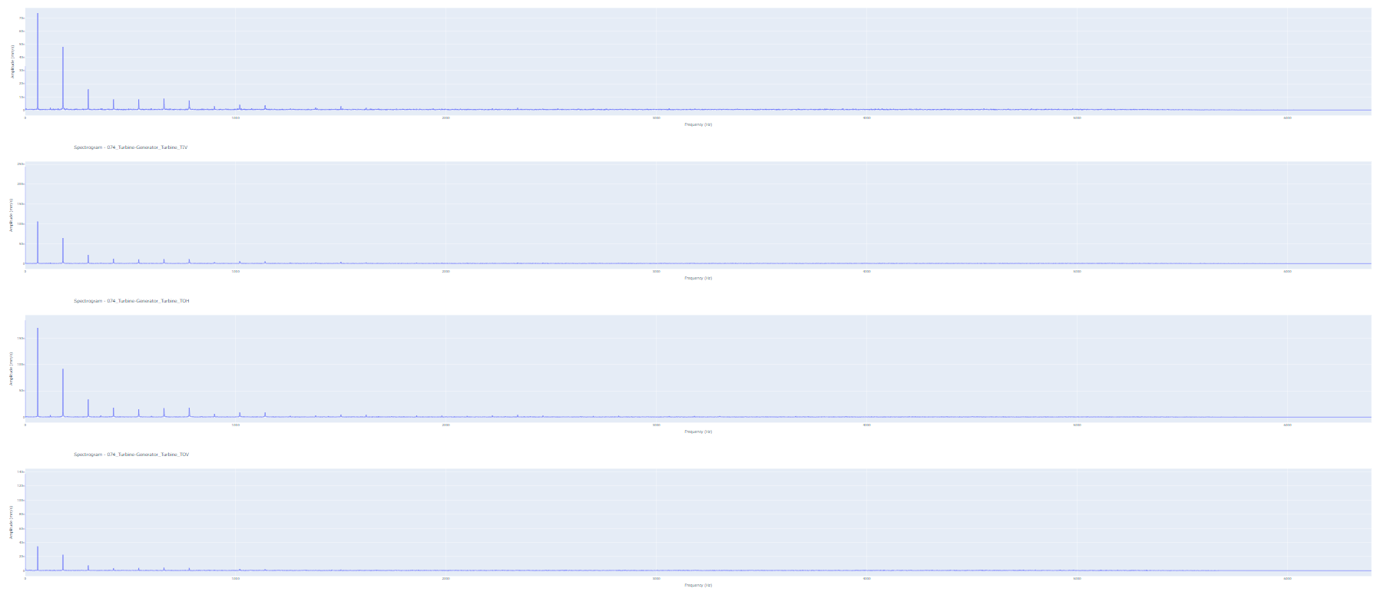
awesome-plot
Trend
Single
Dual
Multi
TDMS
overall
Time domain
Spectrum
2D
3D
2024-01-01
MOV
MIV
MOV
MIH
MOH
113050
113150
113050
113150
113250

Slide 6
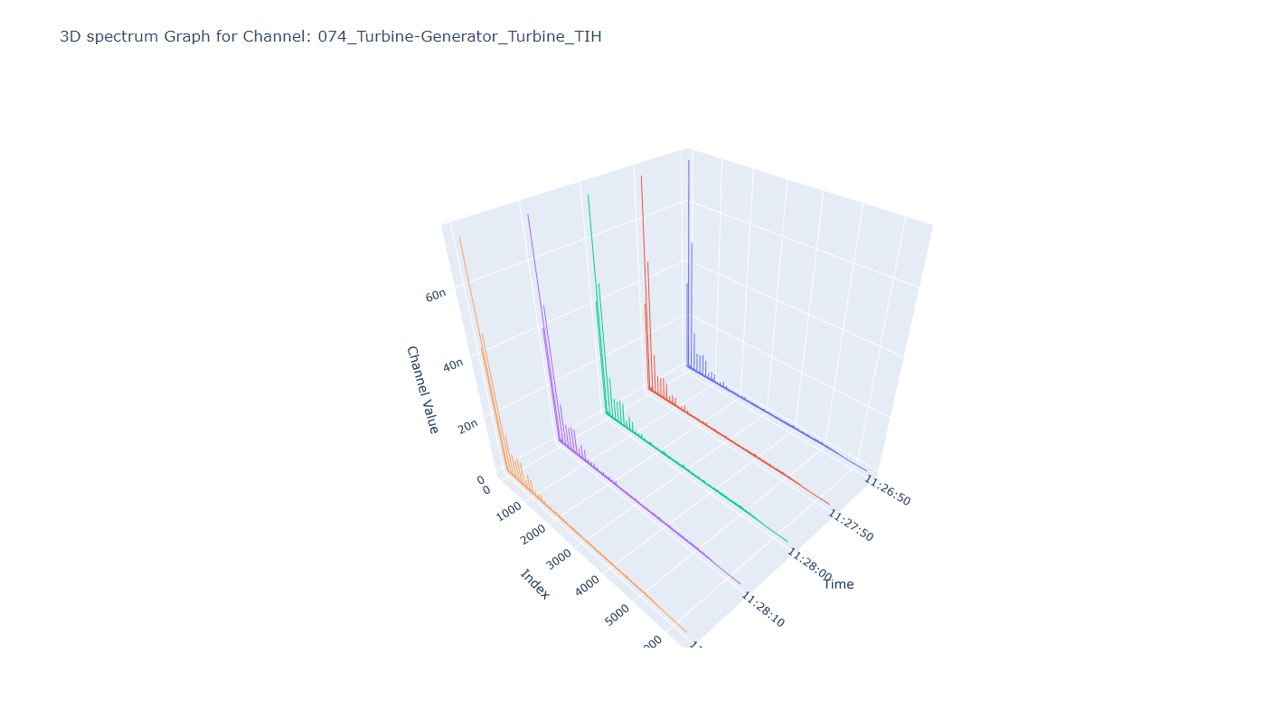
awesome-plot
Trend
Single
Dual
Multi
TDMS
overall
Time domain
Spectrum
2D
3D
2024-01-01
MOV
23-07-01
MIH
MIV
MIH
MOH
index
hhmmss
113050
113150
113250

Slide 7
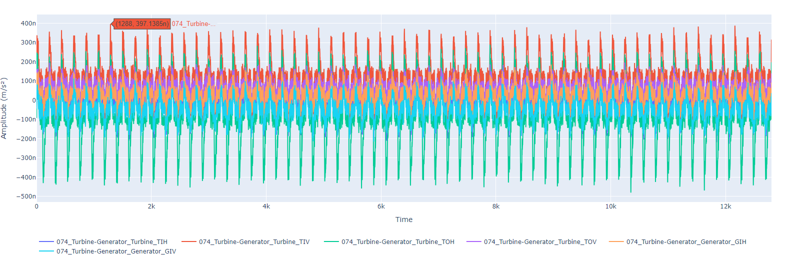
awesome-plot
Trend
Single
Dual
Multi
TDMS
Time domain
Spectrum
2024-01-01
113050.tdms
114050.tdms
113050.tdms
114050.tdms

Slide 8
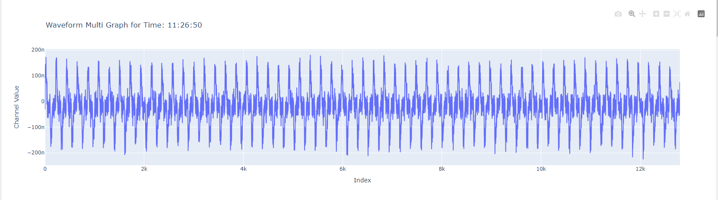
awesome-plot
Trend
Single
Dual
Multi
TDMS
Time domain
Spectrum
2024-01-01
Trend – time domain 2d에 날짜 선택기능만 추가된
MOV
MIV
MIH
MOH
113050.tdms
114050.tdms
113050.tdms
114050.tdms

Slide 9
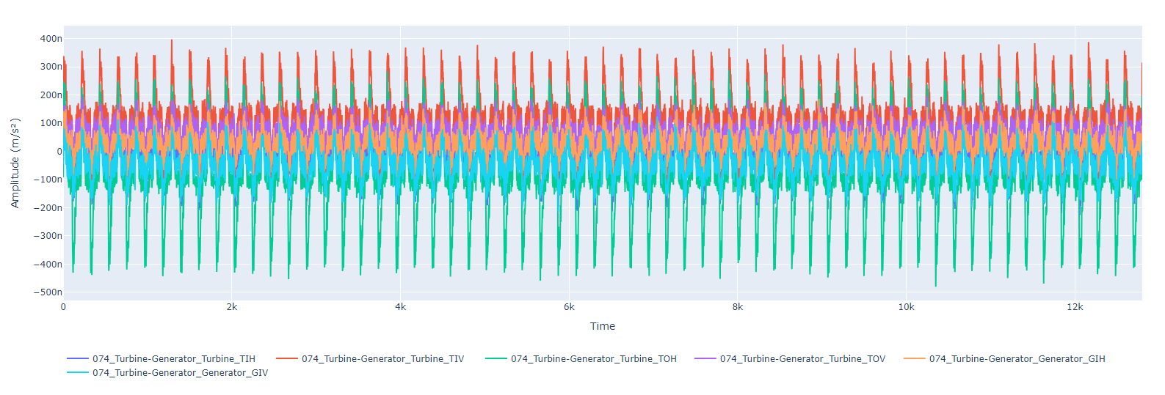
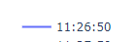
awesome-plot
Trend
Single
Dual
Multi
TDMS
Time domain
Spectrum
Trend – time domain 3d에 날짜 선택기능만 추가된
2024-01-01
MOV
MIV
MOH
MIH
MOH
113050.tdms
114050.tdms
113050.tdms
114050.tdms

Slide 10
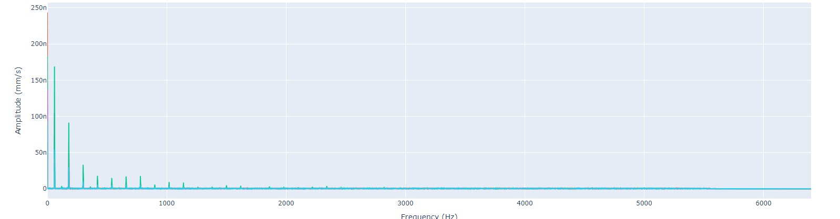
awesome-plot
Trend
Single
Dual
Multi
TDMS
Time domain
Spectrum
2024-01-01
113050.tdms
114050.tdms
113050.tdms
114050.tdms

Slide 11
awesome-plot
Trend
Single
Dual
Multi
TDMS
2024-01-01
113050.tdms
2024-01-01
113050.tdms
114050.tdms
113050.tdms
114050.tdms

Slide 12
awesome-plot
Trend
Single
Dual
Multi
TDMS
Time domain
Spectrum
2024-01-01
113050.tdms
114050.tdms
113050.tdms
114050.tdms

Slide 13
awesome-plot
Trend
Single
Dual
Multi
TDMS
Time domain
Spectrum
2024-01-01
113050.tdms
114050.tdms
113050.tdms
114050.tdms

Slide 14
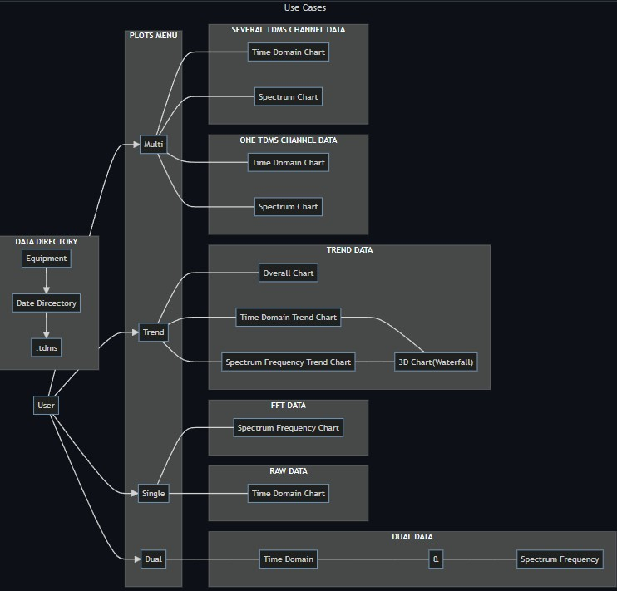


Slide 15

만들어야 하는 기능
Non – trend (1 tdms – N ch)
Trend (n tdms – 1 ch)
overall
Time domain – wave form
spectrum
3d
Multi 1
Time domain – wave form
spectrum
23-07-01
23-07-01
Time domain – wave form
spectrum
MIH
MIH
hhmmss
index
hhmmss
index
113150
113050
113150
113250
113050
113250
Multi 2
Time domain – wave form
spectrum
MIH
113050
MIH
113050
113150
113250
113150
MOV
113050
113150
113250

Slide 16
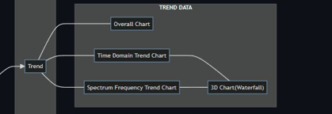
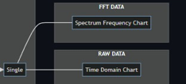
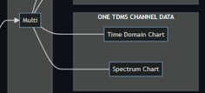
Multi – several tdms channel data
만들어야 하는 기능
Non – trend (1 tdms – N ch)
Trend (n tdms – 1 ch)
overall
Time domain – wave form
spectrum
3d
Multi 1
Time domain – wave form
spectrum
23-07-01
23-07-01
Time domain – wave form
spectrum
MIH
MIH
hhmmss
index
hhmmss
index
113150
113050
113150
113250
113050
113250
Multi 2
Time domain – wave form
spectrum
MIH
113050
MIH
113050
113150
113250
113150
MOV
113050
113150
113250

Slide 17
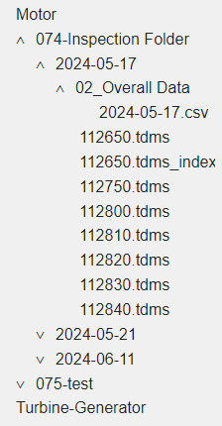
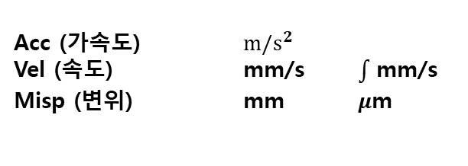
파일구조
센서단위
볼때
Acc (가속도) $m/s^{2}$
Vel (속도) mm/s mm/s
Misp (변위) mm $μ$m
Tdms 파일
Root Name | Title | Author | Date/Time | Groups | Description
112750 |  |  |  | 1
Group | Channels | Description
제목없음 | 6
제목없음
Channel | Datatype | Unit | Length | Minimum | Maximum | Description | NI_ChannelName | NI_UnitDescription | wf_increment | wf_samples | wf_start_offset | wf_start_time | Start Index
074_Turbine-Generator_Turbine_TIH | DT_FLOAT | Meters | 12800 |  |  |  | 074_Turbine-Generator_Turbine_TIH | Meters | 0.000078125 | 12800 | 0 | 2024-05-17 11:27:50.822 AM
074_Turbine-Generator_Turbine_TIV | DT_FLOAT | Meters | 12800 |  |  |  | 074_Turbine-Generator_Turbine_TIV | Meters | 0.000078125 | 12800 | 0 | 2024-05-17 11:27:50.822 AM
074_Turbine-Generator_Turbine_TOH | DT_FLOAT | Meters | 12800 |  |  |  | 074_Turbine-Generator_Turbine_TOH | Meters | 0.000078125 | 12800 | 0 | 2024-05-17 11:27:50.822 AM
074_Turbine-Generator_Turbine_TOV | DT_FLOAT | Meters | 12800 |  |  |  | 074_Turbine-Generator_Turbine_TOV | Meters | 0.000078125 | 12800 | 0 | 2024-05-17 11:27:50.822 AM
074_Turbine-Generator_Generator_GIH | DT_FLOAT | Meters | 12800 |  |  |  | 074_Turbine-Generator_Generator_GIH | Meters | 0.000078125 | 12800 | 0 | 2024-05-17 11:27:50.822 AM
074_Turbine-Generator_Generator_GIV | DT_FLOAT | Meters | 12800 |  |  |  | 074_Turbine-Generator_Generator_GIV | Meters | 0.000078125 | 12800 | 0 | 2024-05-17 11:27:50.822 AM

Slide 18
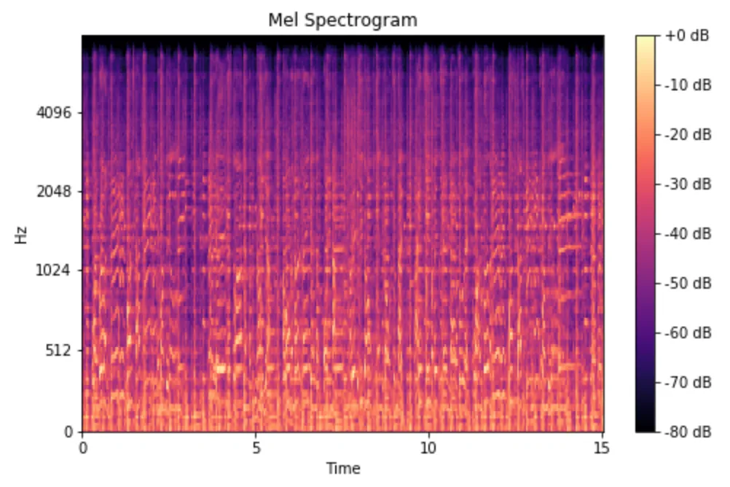
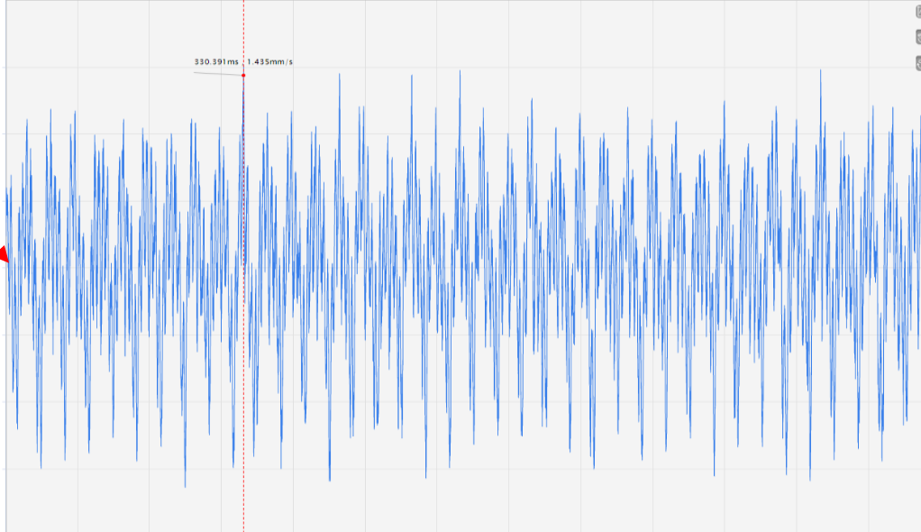
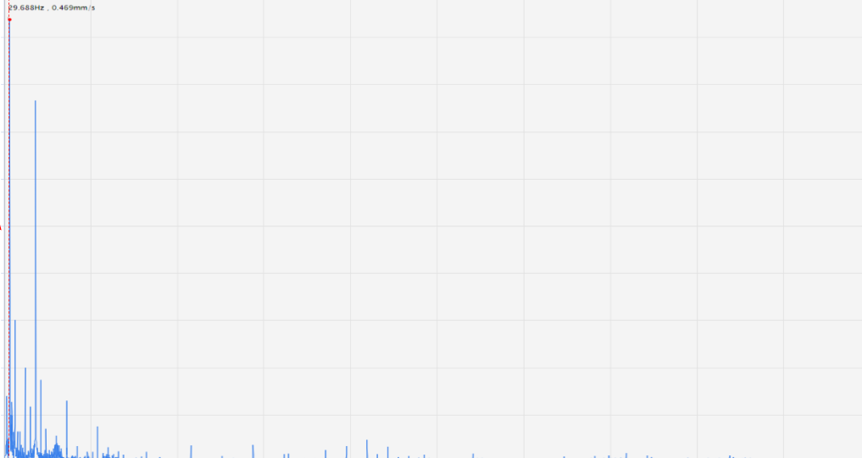

spectrogram
Time domain – wave form
적분
fft
mm/$s^{2}$
Amplitute
(진폭)
Time (1초/12800)
spectrum
제곱합 루트
lambda x : np.sum(x ** 2, axis=-1) ** 0.5
mm/s
Amplitute
(진폭)
Hz (0,6400)
overall
mm/s rms
inch/s rms

Slide 19
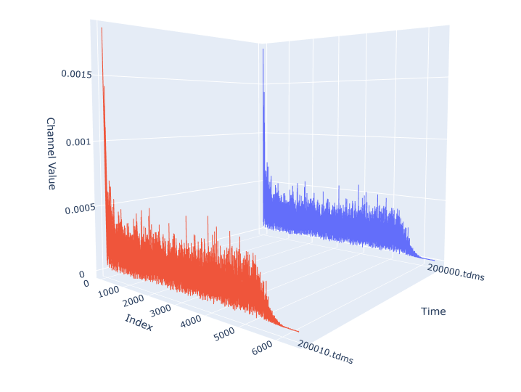
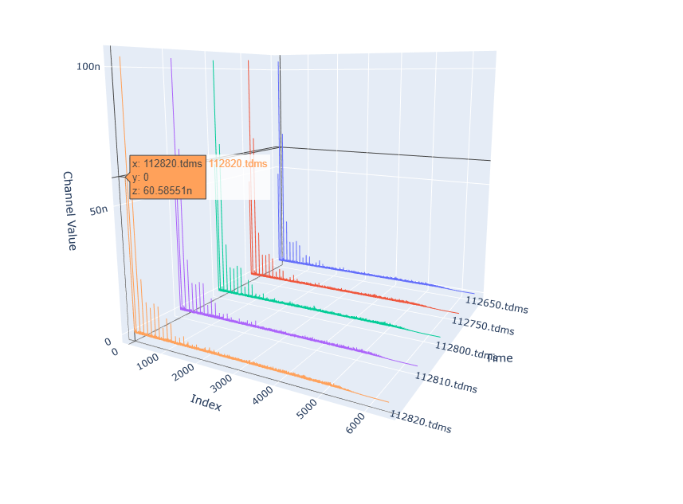
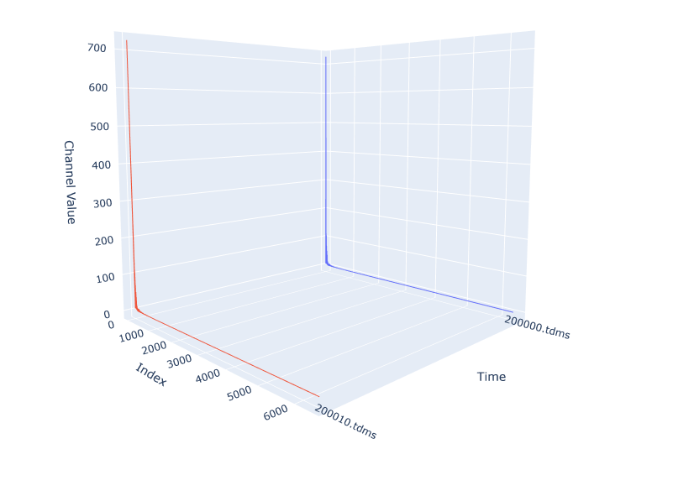
Meters 파일 fft후 1.414 곱한 그래프
m/s^2 파일 fft 그래프
m/s^2 파일
속도 변환 후 fft 그래프

Slide 20

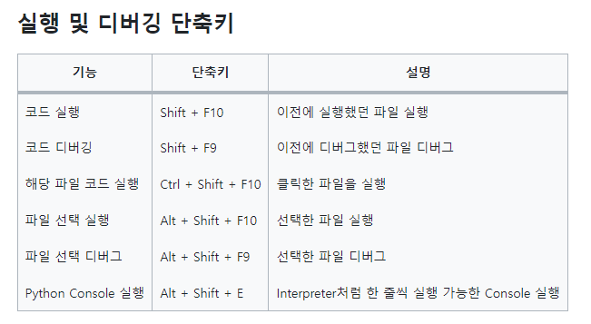
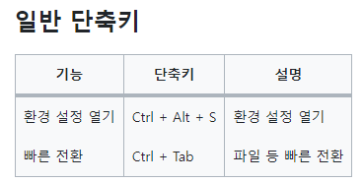
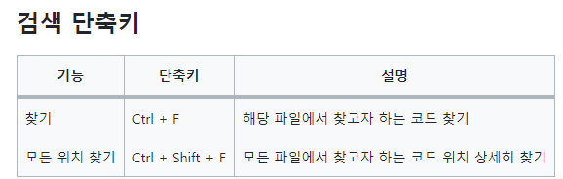

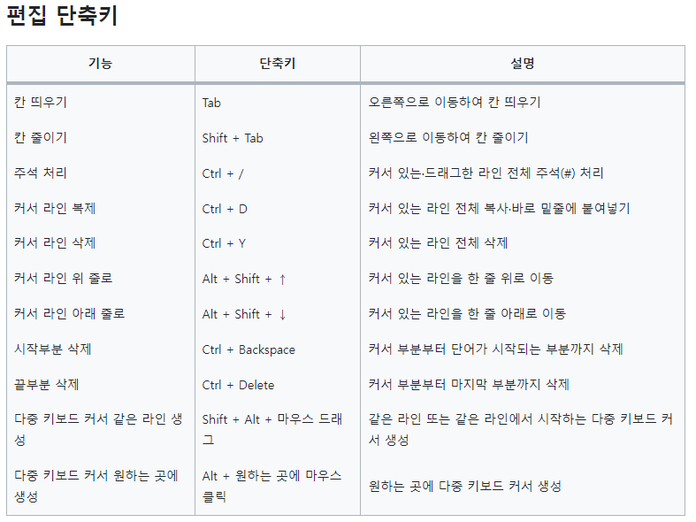
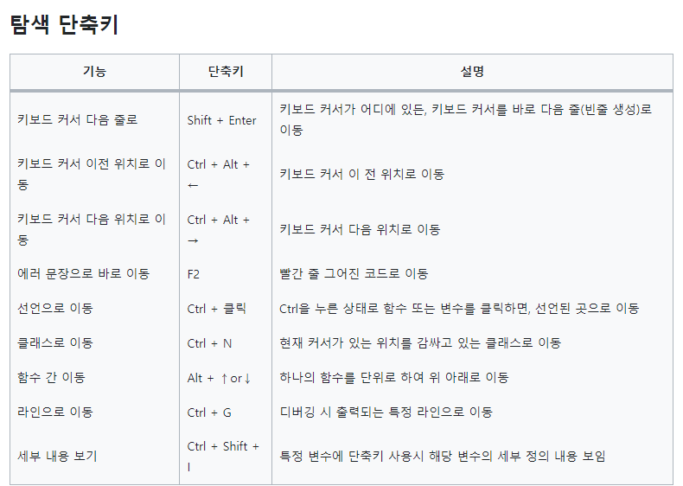
toggle 단축키
블록 펼치기
블록 접기
모두 펼치기
모두 접기
Ctrl + Num +
Ctrl + Num –
Ctrl + Shift + Num +
Ctrl + Shift + Num -

Slide 21
추가 기능
UI
Feature
레이아웃
단위

