Slide 1
Stack smash gcc
Mordechai Goodstein

Slide 2
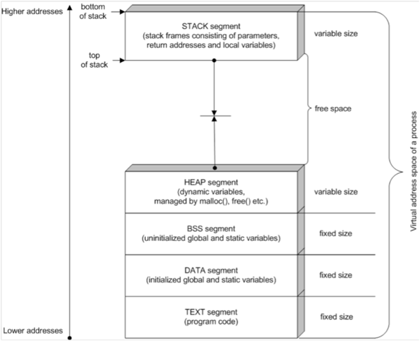
Segment layout

Slide 3
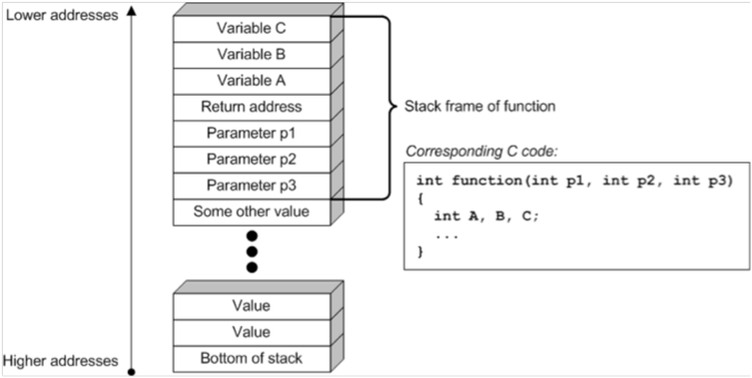
Stack layout

Slide 4
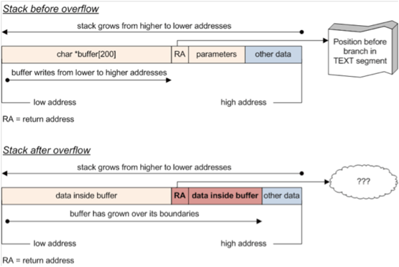
Buf in stack

Slide 5
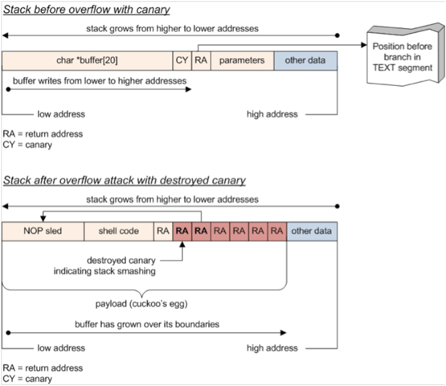
canarys

Slide 6
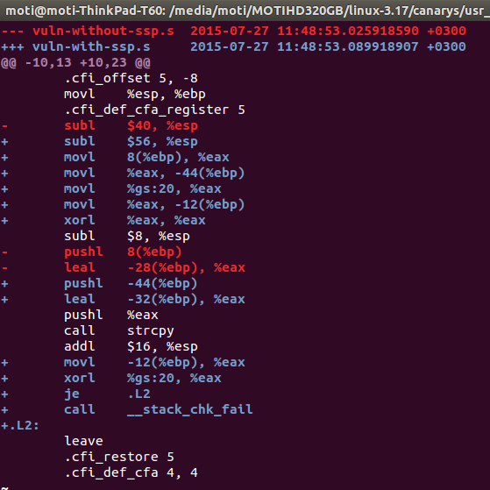
gcc diff

Slide 7
gcc stack-protector
-fstack-protector
Emit extra code to check for buffer overflows, such as stack smashing attacks. This is done by
adding a guard variable to functions with vulnerable objects. This includes functions that call
"alloca", and functions with buffers larger than 8 bytes. The guards are initialized when a
function is entered and then checked when the function exits. If a guard check fails, an error
message is printed and the program exits.
-fstack-protector-all
Like -fstack-protector except that all functions are protected.
-fstack-protector-strong
Like -fstack-protector but includes additional functions to be protected --- those that have local
array definitions, or have references to local frame addresses.
NOTE: In Ubuntu 14.10 and later versions, -fstack-protector-strong is enabled by default for C,
C++, ObjC, ObjC++, if none of -fno-stack-protector, -nostdlib, nor -ffreestanding are found.

Slide 8
How canarys are init?
static void __attribute__ ((constructor))
__guard_setup (void)
{
unsigned char *p;
int fd;
if (__stack_chk_guard != 0)
return;
#if defined (_WIN32) && !defined (__CYGWIN__)
HCRYPTPROV hprovider = 0;
if (CryptAcquireContext(&hprovider, NULL, NULL, PROV_RSA_FULL,
CRYPT_VERIFYCONTEXT | CRYPT_SILENT))
{
if (CryptGenRandom(hprovider, sizeof (__stack_chk_guard),
(BYTE *)&__stack_chk_guard) && __stack_chk_guard != 0)
{
CryptReleaseContext(hprovider, 0);
return;
}
CryptReleaseContext(hprovider, 0);
}
#else
fd = open ("/dev/urandom", O_RDONLY);
if (fd != -1)
{
ssize_t size = read (fd, &__stack_chk_guard,
sizeof (__stack_chk_guard));
close (fd);
if (size == sizeof(__stack_chk_guard) && __stack_chk_guard != 0)
return;
}
#endif
/* If a random generator can't be used, the protector switches the guard
to the "terminator canary". */
p = (unsigned char *) &__stack_chk_guard;
p[sizeof(__stack_chk_guard)-1] = 255;
p[sizeof(__stack_chk_guard)-2] = '\n';
p[0] = 0;
}

Slide 9
How programs get run I
the only system call that invokes a new program is execve()
main(int Argc ,char **Argv,char** envp)
struct linux_binprm
struct linux_binfmt
  names
binfmt_script.c
  recursion
binfmt_misc.c
  /proc/sys/fs/binfmt_misc

Slide 10
How programs get run II - ELF binaries
FORMAT
  PT_LOAD
  PT_INTERP
  PT_GNU_STACK
fs/binfmt_elf.c.
  flush_old_exec()
  setup_new_exec()
  setup_arg_pages(bprm,randomize_stack top(STACK_TOP),executable_stack);

Slide 11
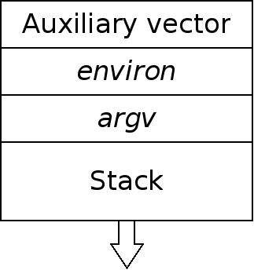
getauxval() and the auxiliary vector
LD_SHOW_AUXV=1 sleep 1
#include <sys/auxv.h>
  unsigned long int getauxval(unsigned long int type);
AT_PLATFORM
AT_RANDOM <==
AT_EXECFN
AT_ENTRY ???

Slide 12
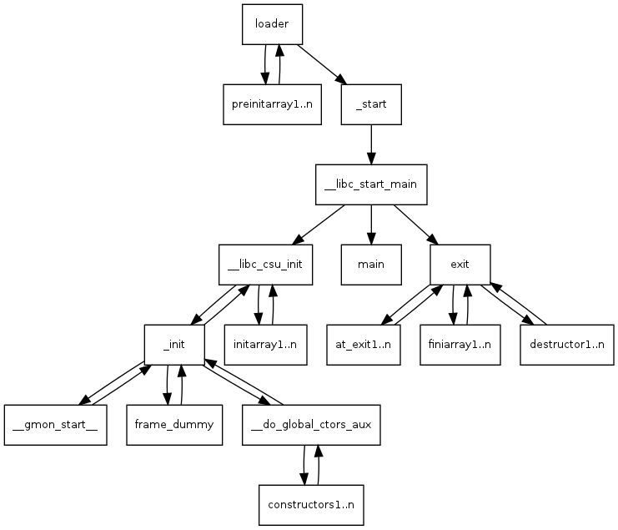
glibc

Slide 13
glibc
_dl_random : csu/dl-sysdef.c
_libc_start_main : csu/libc-start.c
we need to setup errno. */
__pthread_initialize_minimal ();
/* Set up the stack checker's canary. */
uintptr_t stack_chk_guard = _dl_setup_stack_chk_guard (_dl_random); //memcpy
# ifdef THREAD_SET_STACK_GUARD
THREAD_SET_STACK_GUARD (stack_chk_guard);
# else
__stack_chk_guard = stack_chk_guard;
# endif

Slide 14
KERNEL
task_struct stack_canary gs:014
New – do_fork → copy_process → dup_task → tsk->stack_canary = get_random_int();
Load - Syscall , switch_to
Syscall
  asm
  syscall_trace_enter
  Asm
  syscall_table

