Slide 1

NBA Player Performance vs Salary
Capstone Two Final Project
Godwin Omowele | July 2025

Slide 2
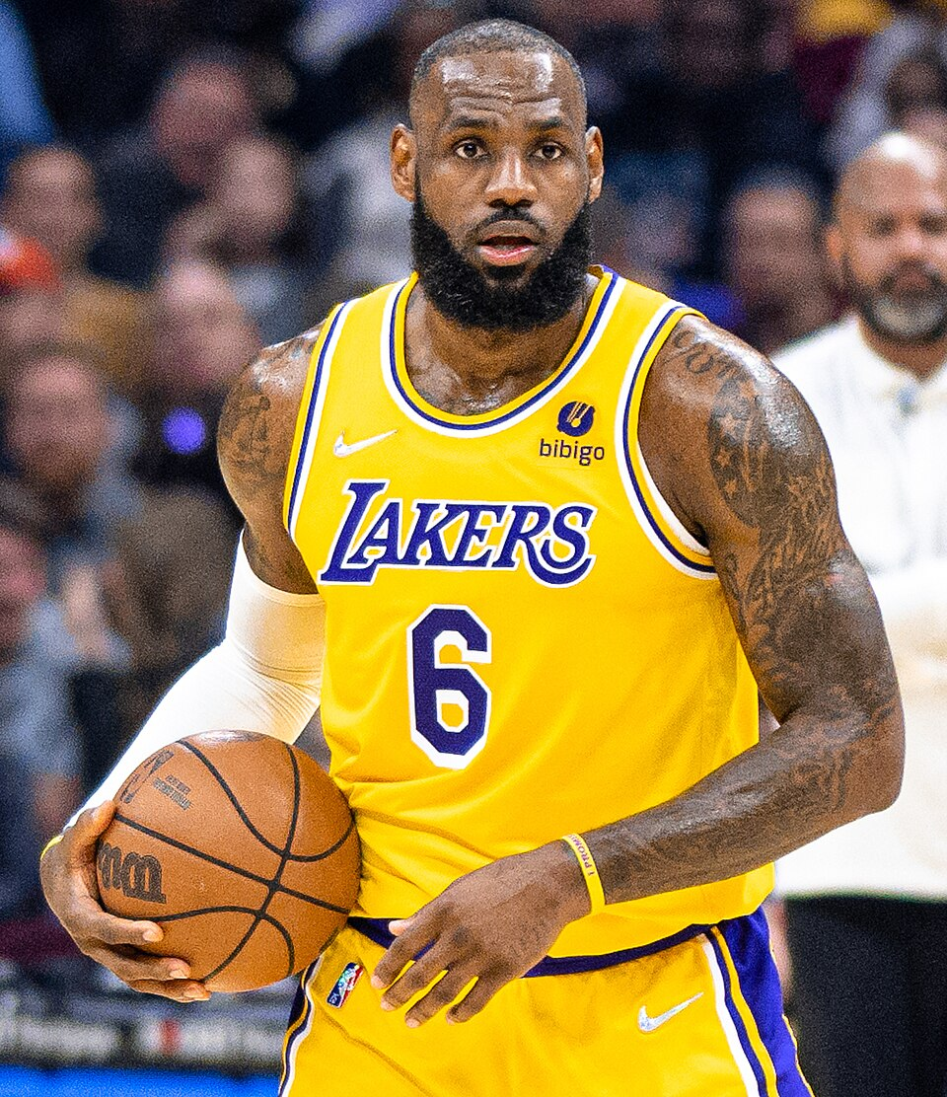
Problem Statement & Business Use Case
NBA teams spend hundreds of millions on player contracts
Goal: Analyze performance vs. salary to find under- and over-paid players
Use Case:
- Support contract negotiations
- Inform free-agent signings
- Optimize draft and salary cap strategy

Slide 3

Data Sources & Wrangling Steps
Data Sources:
- NBA player stats from Basketball Reference
- Salary data from HoopsHype & Spotrac
Wrangling:
- Merged datasets on Player
- Cleaned currency and formatted Salary
- Dropped unneeded rank/duplicate columns

Slide 4
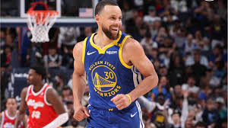
Exploratory Data Analysis Highlights
Key Visuals:
1. Salary Distribution: Most players $2M–$8M
2. PER vs Salary: Moderate positive correlation (r≈0.65)
3. Correlation Heatmap: BPM & Win Shares link to salary

Slide 5

Model Comparison (Test Set Metrics)
Linear Regression: RMSE=2.01e+16, MAE=3.99e+15, R²=-3.50e+18
Random Forest: RMSE=5.39e+06, MAE=3.15e+06, R²=0.748
XGBoost: RMSE=5.11e+06, MAE=3.01e+06, R²=0.774

Slide 6
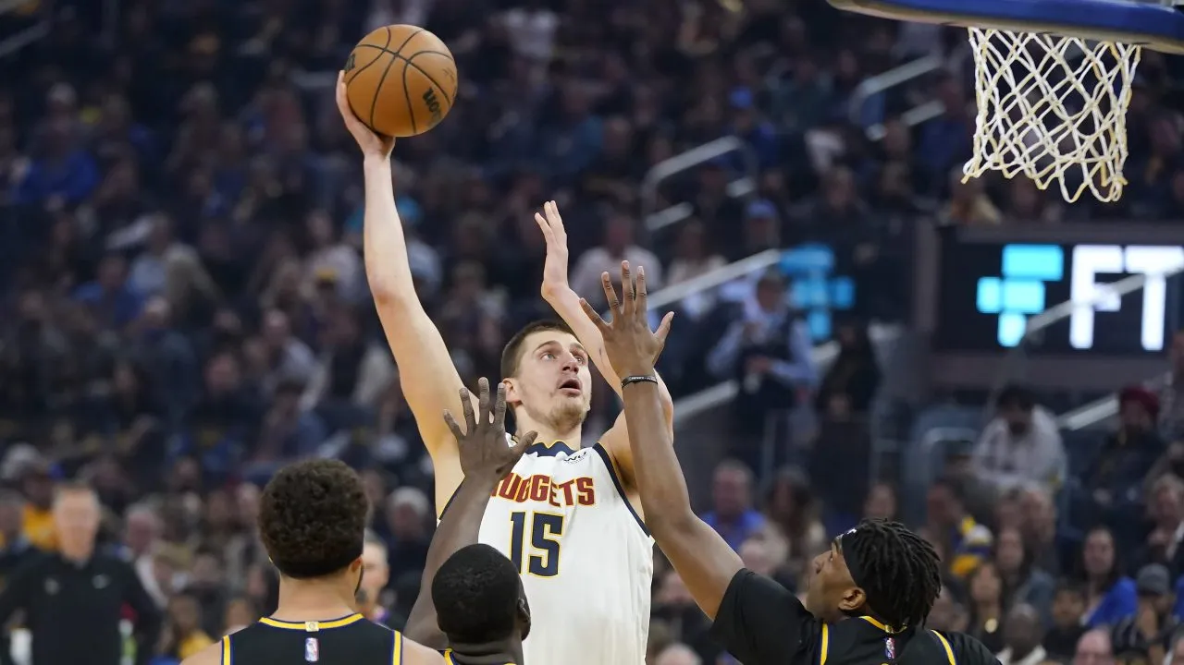
Final Model & Next Steps
Chosen Model: XGBoost (best RMSE & highest R²)
Recommendations:
- Identify top 10 under-paid players for contract leverage
- Extend analysis to multi-season trends
- Incorporate playoff performance and injury data

