Slide 1

Capstone Two Final Presentation
Godwin Omowele | July 2025
NBA Player Performance vs Salary

Slide 2
Problem & Use Case
Who Cares?
Data Sources
Wrangling Steps
EDA
Feature Eng.
Preprocessing
Modeling & Metrics
Assumptions & Limits
Conclusions & Next Steps
Q&A
Agenda

Slide 3

Problem & Use Case
Do NBA teams get value for player salaries?
Supports contract talks, free-agent signings, draft strategy.

Slide 4
Who Cares?
NBA GMs & Salary-cap managers
Player agents & athletes
Data-driven media & fans

Slide 5
Basketball-Reference: stats
HoopsHype & Spotrac: salaries
Data Sources

Slide 6
Merged on Player name
Cleaned currency, formatted Salary
Dropped duplicates/unneeded cols
Wrangling Steps

Slide 7
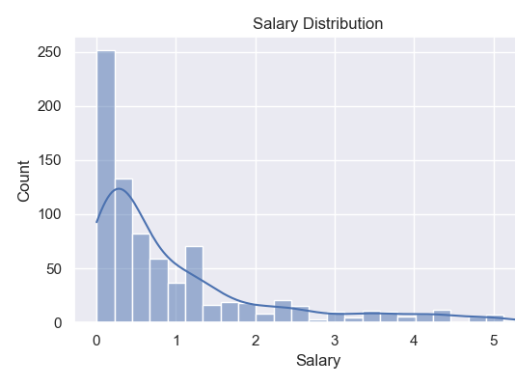
Salary Distribution

Slide 8
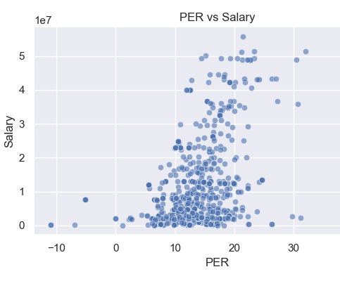
PER vs Salary Scatterplot

Slide 9
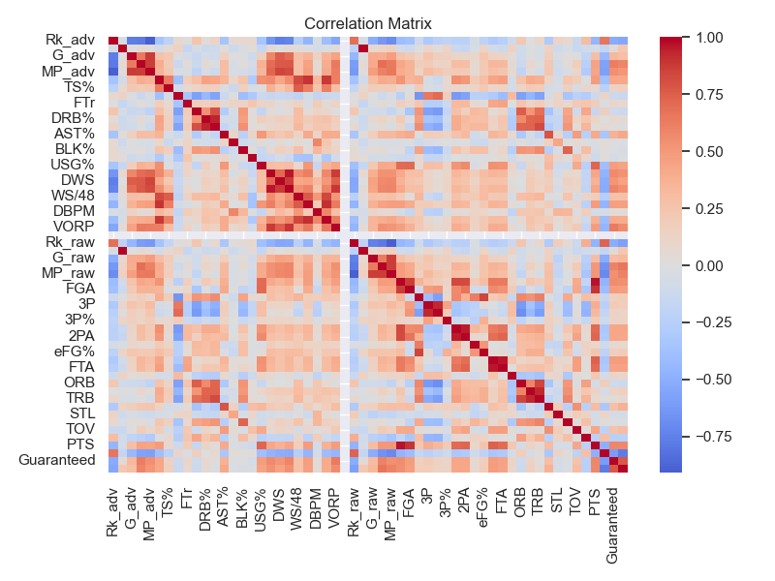
Correlation Heatmap

Slide 10
Created ‘Value per Dollar’ = key metrics ÷ salary
Ranked players by this value index
Feature Engineering

Slide 11
One-hot encode categoricals
Median-impute missings
StandardScale numerics
Train/test split: 75%/25%, random_state=42
Preprocessing Steps

Slide 12
Linear Regression: RMSE=2.01e+16, MAE=3.99e+15, R²=–3.50e+18
Random Forest: RMSE=5.39e+06, MAE=3.15e+06, R²=0.748
XGBoost: RMSE=5.11e+06, MAE=3.01e+06, R²=0.774
Modeling & Test Metrics

Slide 13
Single-season only
Excludes playoffs & injuries
Name merge may miss players
Future: multi-season & incentives
Assumptions & Limitations

Slide 14
Conclusions & Next Steps
Performance vs Salary corr R²≈0.77; $2–5M value gap
Identify top under-paid players
Extend to multi-season analysis
Include playoff & injury metrics

Slide 15

Questions & Feedback
Thank you! I welcome your questions and feedback.

