Slide 1
PROJECT STATUS REPORT
M.GOMATHI

Slide 2
PROJECT OVERVIEW
What is the project about?
1)Creating a dynamic web application
2)AAYL(Apply As You Learn) Project
Define the goal of this project
1)Dynamic Web Application for the vendors who host miscellaneous non-banking system for the clients.
Define the scope of this project
1)Can be used in all the miscellaneous non-banking vendors.

Slide 3
CURRENT STATUS
BACKEND
FRONTEND
INTEGRATION
What progress has been made since the previous milestone?
Which tasks have been completed?
1)Modelling and Designing of Project in UML
2)Creation of required tables in Derby Database
Is the project currently ahead of schedule, on track, or delayed?
The project is currently on track

Slide 4
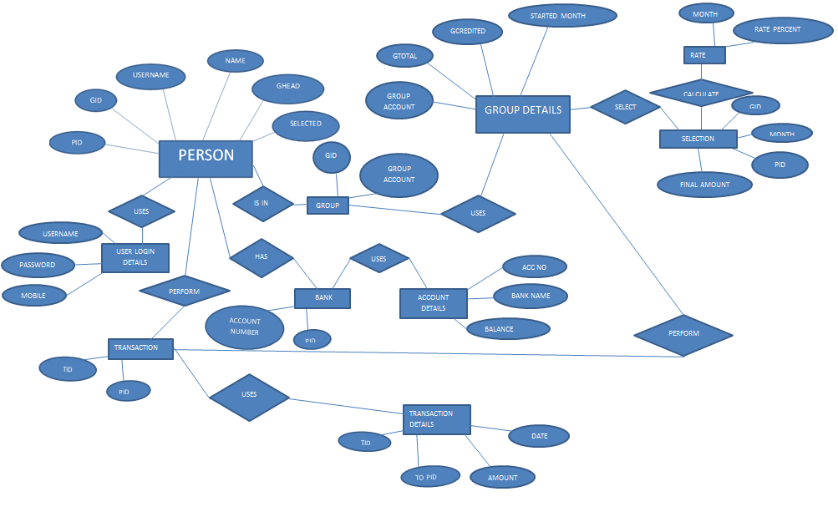
ER DIAGRAM

Slide 5
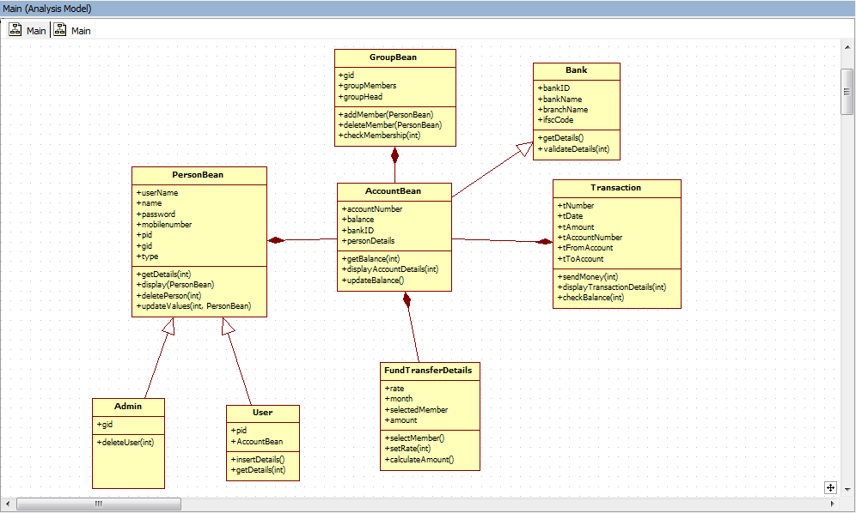
CLASS DIAGRAM

Slide 6
TECHNOLOGIES USED
FRONT END
BOOTSTRAP
BACK END
JAVA
HTML
CSS
JS
SQL
SERVLETS
DERBY DATABASE
ORACLE SERVER
ANGULAR JS

Slide 7
PLATFORM
NEXEN
FLEXIBLE CLIENT CENTRIC PLATFORM
DATA-DRIVEN INSIGHT
INTELLIGENT OPEN ARCHITECTURE
BUSINESS SOLUTIONS
GLOBAL INNOVATION CENTER
THE CLOUD
NEXEN – An open-source, cloud-based technology platform
NEXEN is designed to empower company clients to change the way they operate to be more flexible, efficient and fast.
Provides data-driven insights to empower clients to make evidence-based decisions faster.

Slide 8
Issues and Resolutions
Description of the issue
In modelling the project , like Where to start with ?
How was it resolved?
Using Class Diagram to get a complete picture of the project
Approaching the problem in a modular way.
What and how did it impact the project?
Time : Took about one to two weeks to model the project
Cost : No cost impact

Slide 9
Timeline
Modelling
30/01/2017
Class Diagram
ER Diagram
App
Database Integration
20/02/2017
SQL
JDBC
Java Source Code
09/02/2017
Bean
DAO
UI DESIGN
23/02/2017
HTML
CSS,BOOTSTRAP
SERVLETS
JS

Slide 10
LOOKING AHEAD
When is the next milestone?
To test the web application(Both Manual and Automatic testing-JUnit)
What are the expected deliverables?
A Web Application to ease the IT department
Known risks and issues
Security is the major issue

Slide 11
DEPENDENCIES AND RESOURCES
Project
Vendors
Manufacturing
Sales
Engineering
Remote Teams

Slide 12
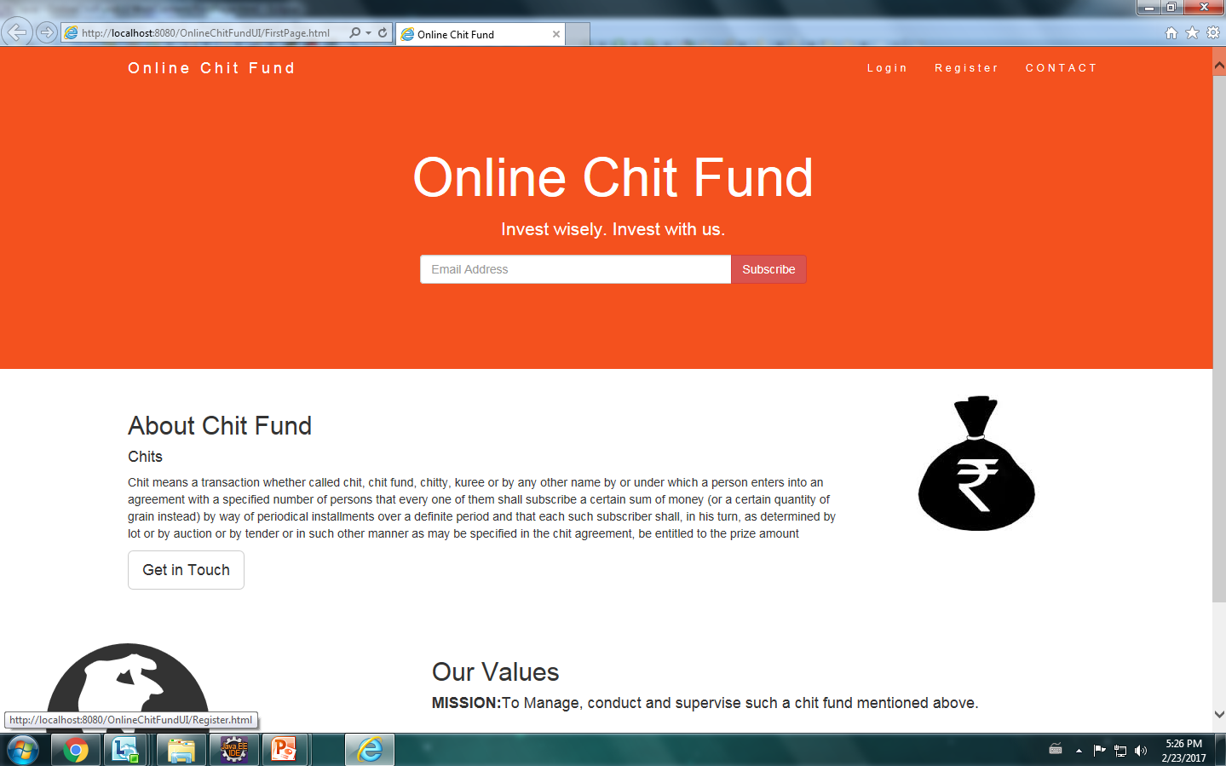
UI SAMPLE

Slide 13
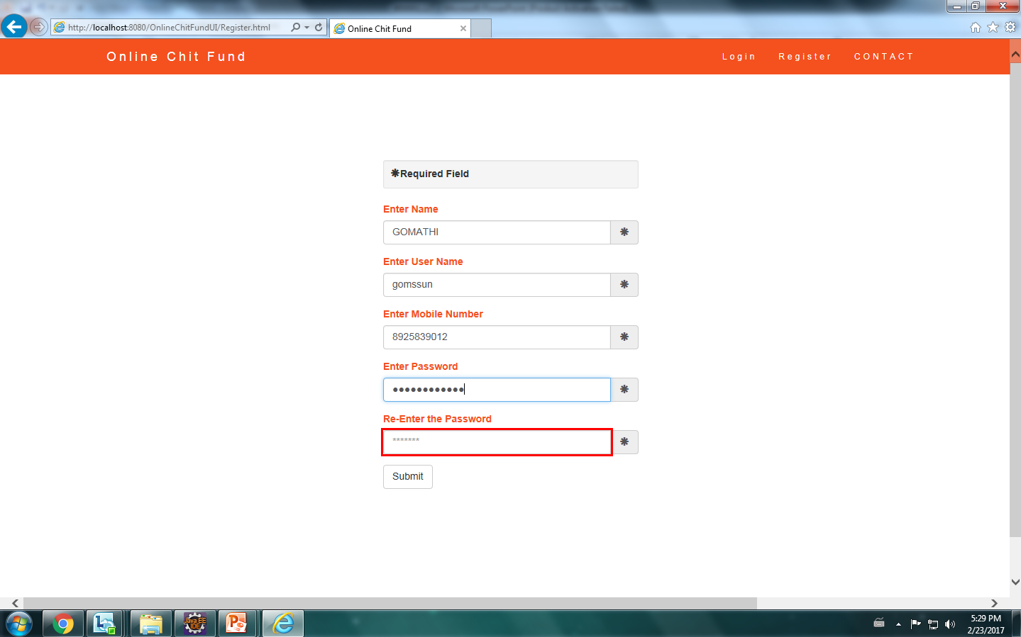
UI SAMPLE

Slide 14
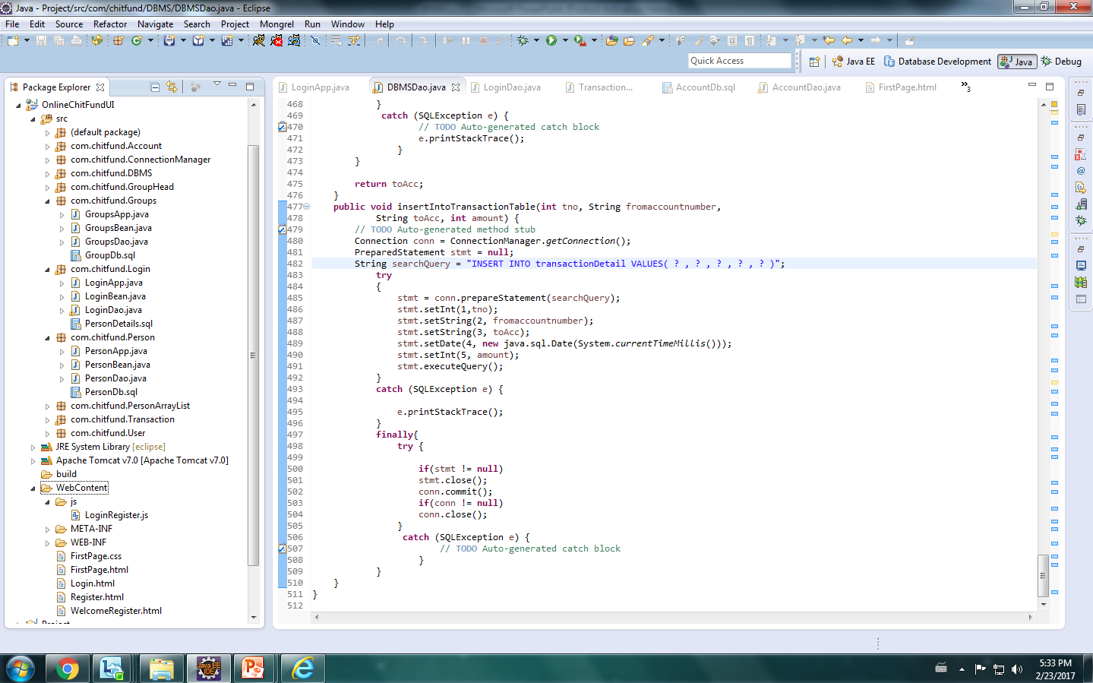
CODE SAMPLE

Slide 15
THANK YOU!

