Slide 1
Project Status Report (Internship- i|Nautix Company)
Presenter Name : Patel Vamshi Krishna
Presentation Date : 25/02/2017
Notes:
This template can be used as a starter file to give updates for project milestones.
Sections
Right-click on a slide to add sections. Sections can help to organize your slides or facilitate collaboration between multiple authors.
Notes
Use the Notes section for delivery notes or to provide additional details for the audience. View these notes in Presentation View during your presentation.
Keep in mind the font size (important for accessibility, visibility, videotaping, and online production)
Coordinated colors
Pay particular attention to the graphs, charts, and text boxes.
Consider that attendees will print in black and white or grayscale. Run a test print to make sure your colors work when printed in pure black and white and grayscale.
Graphics, tables, and graphs
Keep it simple: If possible, use consistent, non-distracting styles and colors.
Label all graphs and tables.

Slide 2
Project Overview
What is the project about?
1)Creating a dynamic web application
2)AAYL(Apply As You Learn) Project
Define the goal of this project
1)Web application for IT(Income Tax) Calculation for Customer who has account in various banks.
Define the scope of this project
1)Can be used in all the Nationalized banks
Notes:
What is the project about?
Define the goal of this project
Is it similar to projects in the past or is it a new effort?
Define the scope of this project
Is it an independent project or is it related to other projects?
* Note that this slide is not necessary for weekly status meetings

Slide 3
Current Status
What progress has been made since the previous milestone?
Which tasks have been completed?
1)Modelling and Designing of Project in UML
2)Creation of required tables in Derby Database
Is the project currently ahead of schedule, on track, or delayed?
The project is currently on track
Notes:
* If any of these issues caused a schedule delay or need to be discussed further, include details in next slide.

Slide 4
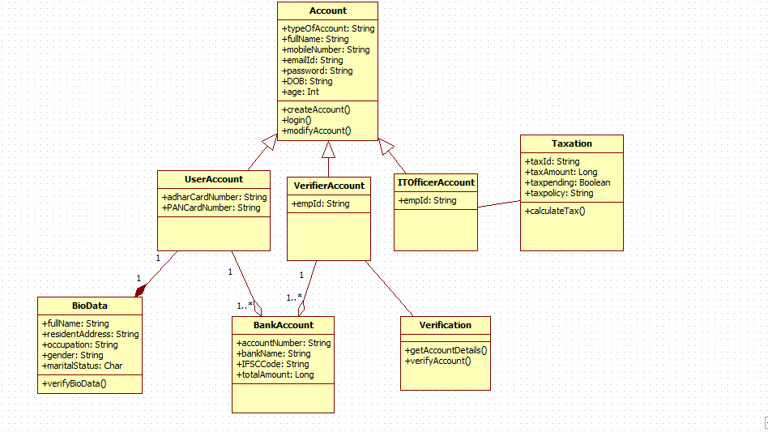

Slide 5
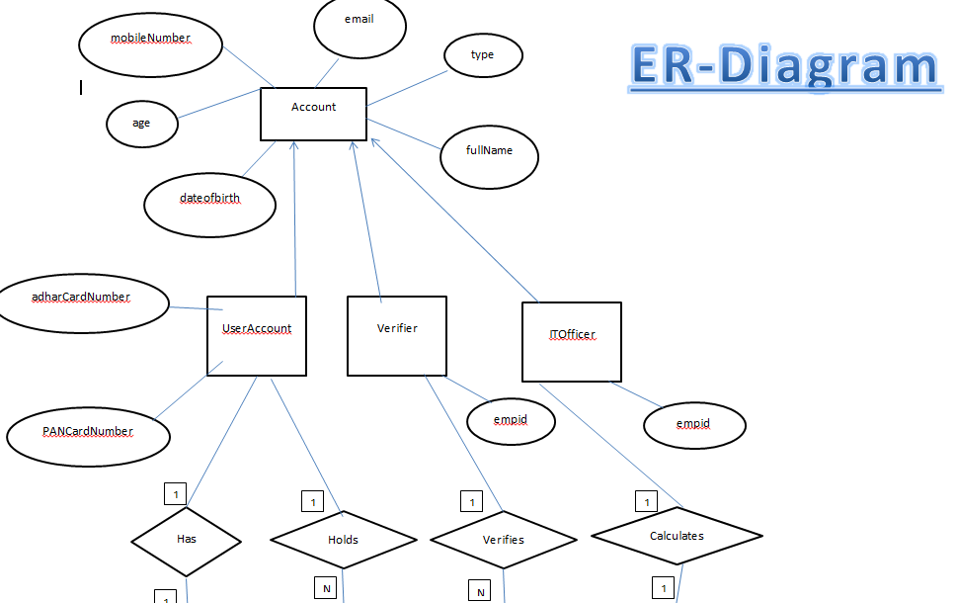

Slide 6
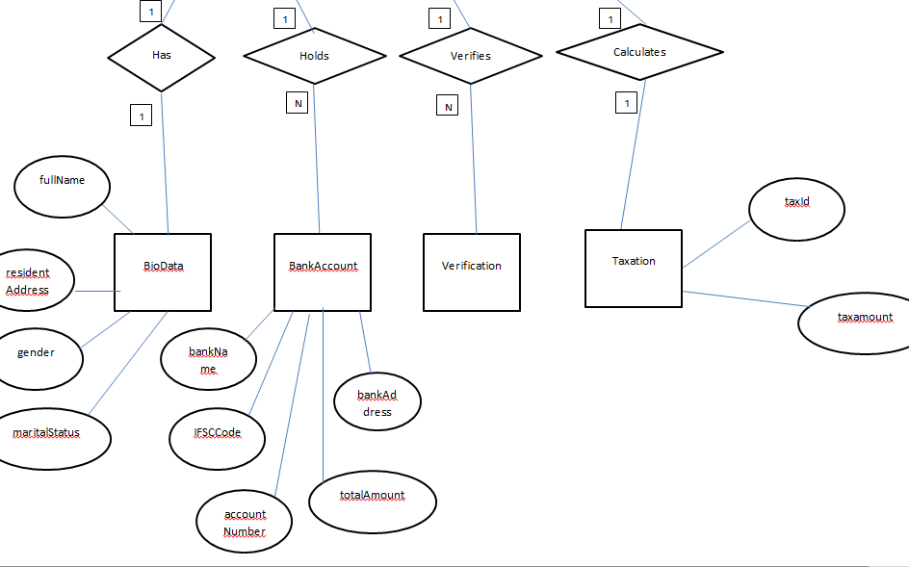

Slide 7
TECHNOLOGIES AND IDE USED
Unified Modelling Language
Java
SQL
Derby Database
HTML
CSS
JSP
SERVLETS
ECLIPSE
Star UML

Slide 8
PLATFORM TO BE WORKED ON “THE FUTURE”
NEXEN

Slide 9
What is NEXEN ?
“We are launching the biggest technological transformation in BNY Mellon’s history with NEXEN, our new open-source, cloud-based technology platform. NEXEN is designed to empower clients to change the way they operate to be more flexible, client-responsive, efficient and fast. Its cutting-edge capabilities will help clients at every stage of the investment lifecycle.”

Slide 10
Issues and Resolutions
Description of the issue
In modelling the project , like Where to start with ?
How was it resolved?
Used class diagram to get complete picture of the project
Divided the components into small parts and worked on that
What and how did it impact the project?
Time : Took about one to two weeks in modelling the project
Cost : No cost impact
Notes:
Duplicate this slide as necessary if there is more than one issue.
This and related slides can be moved to the appendix or hidden if necessary.

Slide 11
Timeline
Modelling
Creating Database
UI Design
31/01/2017
23/02/2017
Connecting UI and Database
07/03/2017
28/02/2017
Notes:
The following slides show several examples of timelines using SmartArt graphics.
Include a timeline for the project, clearly marking milestones, important dates, and highlight where the project is now.

Slide 12

Looking Ahead
When is the next milestone?
To test the application(Both Manual and Automatic testing)
What are the expected deliverables?
A Web Application to ease IT department
Known risks and issues
Security is the major issue

Slide 13
Sample UI…..Screenshot
Continued…………

Slide 14
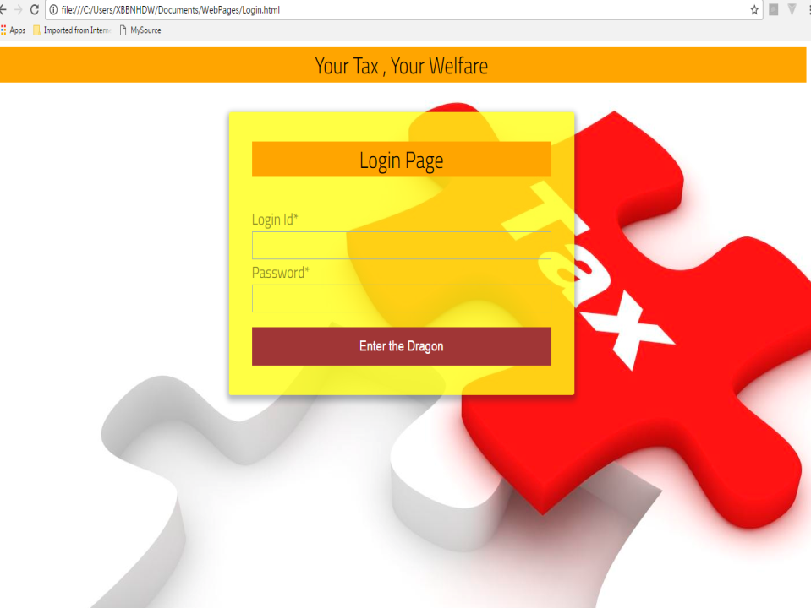

Slide 15
Database Code …Screenshot
Continued…………

Slide 16
