Slide 1
Second Hand Books Reservation
Company Name : iNautix Technologies
Presenter Name : A.K.Mohameed Musthafa

Slide 2
Project Goals
Objective:
To Develop a Web Application which enables students to buy/sell their old books to other students within the collage infrastructure.
BeNefits:
Time Saving , Reusability,
Cost-Effective.

Slide 3
Current Status:
What Progress has been made till now?
Class and E-R Modelling
Building Entities with functional components
Creating Web Pages
-for more info…
List location or contact for specification (or other related documents)

Slide 4
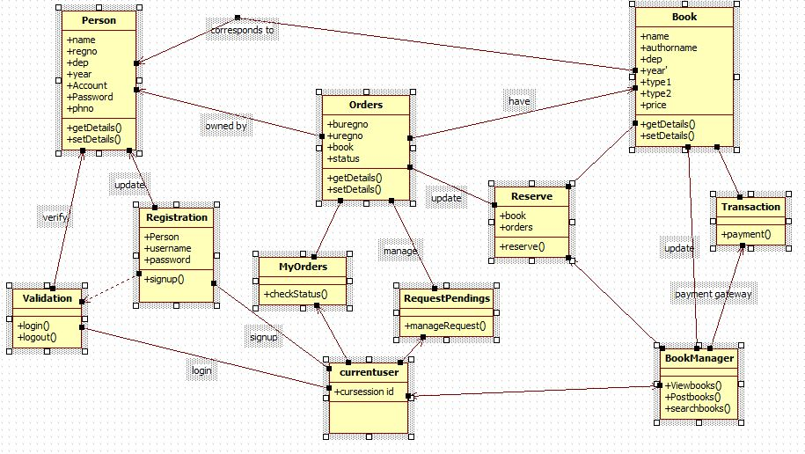
Class Diagram:

Slide 5
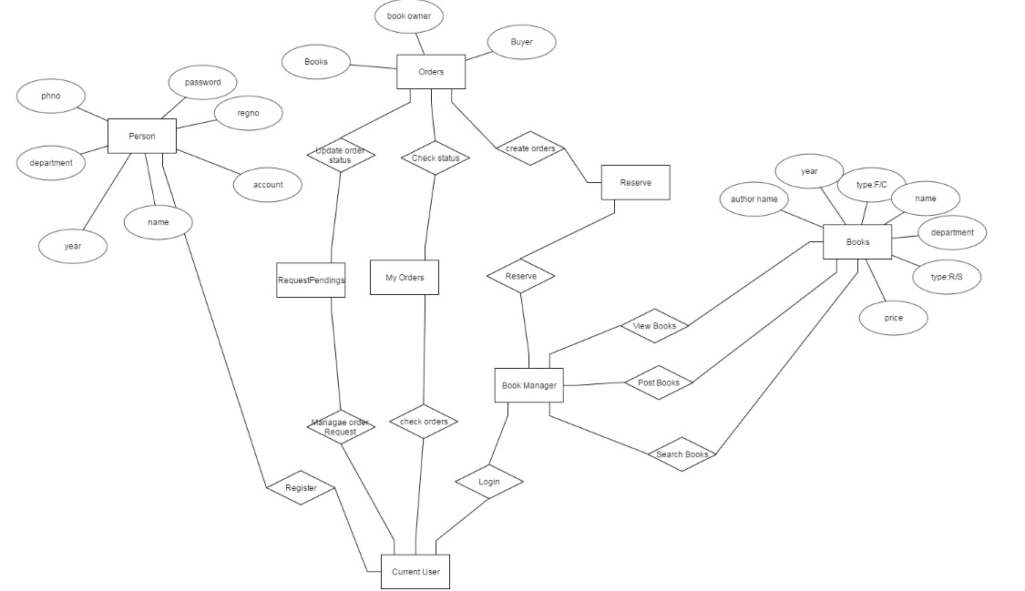
E-R DiaGRAM:

Slide 6
TECHNOLOGIES AND IDE USED
JAVA
SQL
HTML
CSS
ECLIPSE KEPLER 4.3v
starUML
DERBY DATABASE
JSP
APACHE TOMCAT SERVER 7.0v

Slide 7
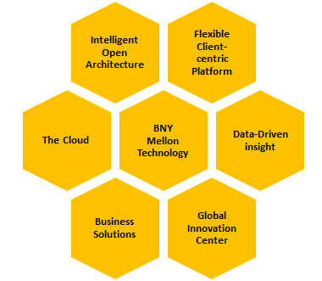

Next Gen Powerful Technology

Slide 8
Ecosystem(NEXEN)
New technology being used
Benefits : Increases speed and market innovation,provides a foundation for clients and flexible environment.
Open source, Cloud Environment
Standards being adopted
Benefits: “cutting-edge capabilities which help clients at every stage of the investment lifecycle.”
It has 100 applications running with 10-15k users per day and millions of transactions.

Slide 9
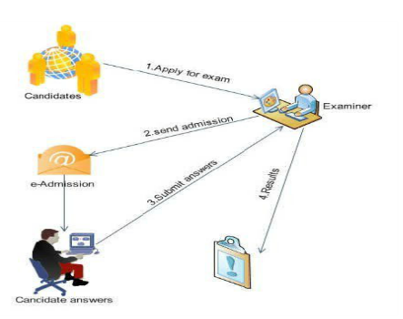
Procedures
Student:
Login ->Select Test by sending invitation to faculty -> Take Test -> View Results -> Provide Feedback on Exam
Faculty:
Login -> Accept Registration of candidates ->Creating Test ->Posting Questions
Admin : Backup of DB, Modifications to DB

Slide 10
Modelling
Creating Database
UI Design
31/01/2017
17/02/2017
Connecting UI and Database
07/03/2017
28/02/2017
Schedule

Slide 11
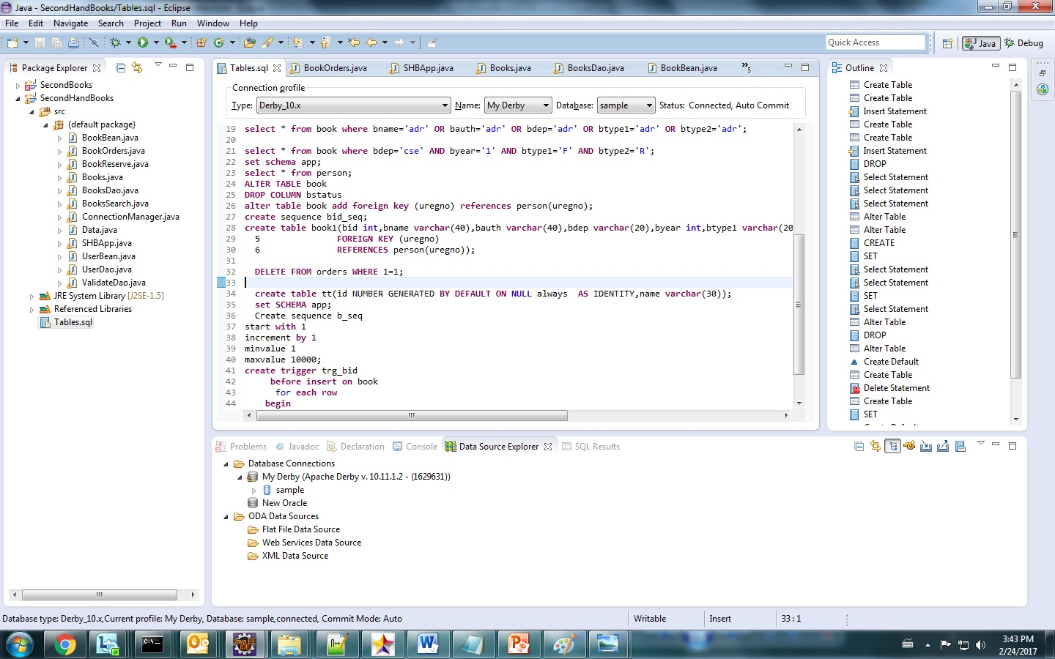

Slide 12
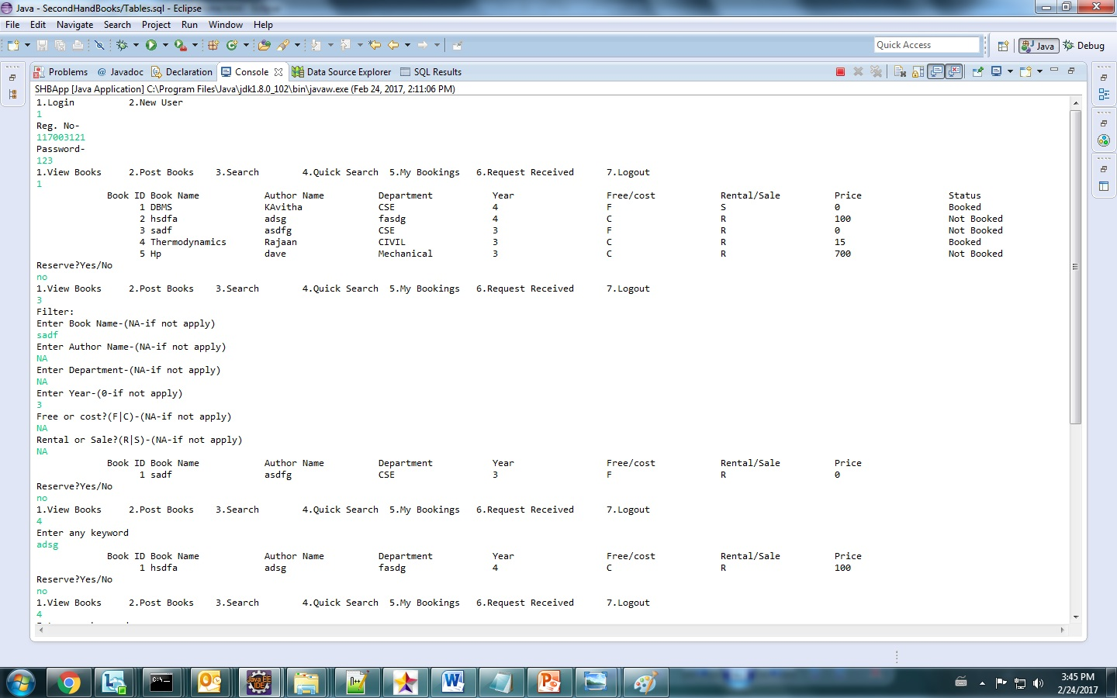

Slide 13
Schedule
-for more info…
List location or contact for detailed schedule (or other related documents)

Slide 14
Related Documents
Marketing plan
Location or contact name/phone
Budget
Location or contact name/phone
Post-mortem
Location or contact name/phone
Submit questions
Location or contact name/phone

