Slide 1
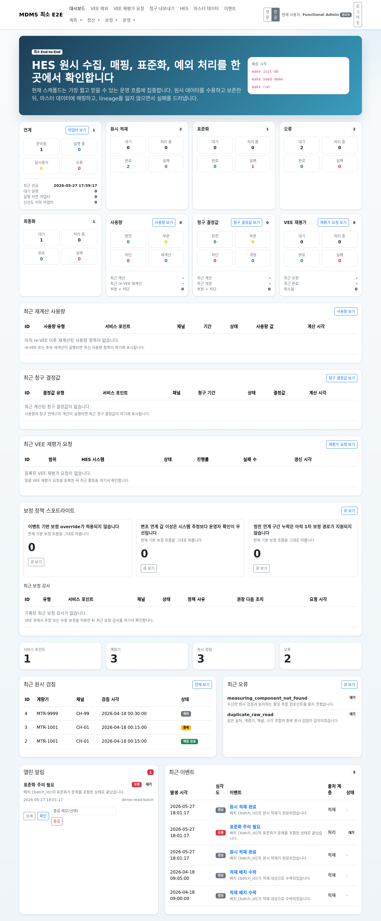
Slide 1. Title and scope
• title
- MDMS Preproduct Operator Manual
• subtitle
- bounded internal-use operating guide
• speaker focus
- what this system currently supports
- who should use admin versus operator
운영 시작 기준 화면

Slide 2
Slide 2. System at a glance
• PostgreSQL
• Flask web UI
• adapter queue commands
• HES, adapter, VEE, replay, export, and operational-event as the main operator
objects
시스템 전반 요약

Slide 3
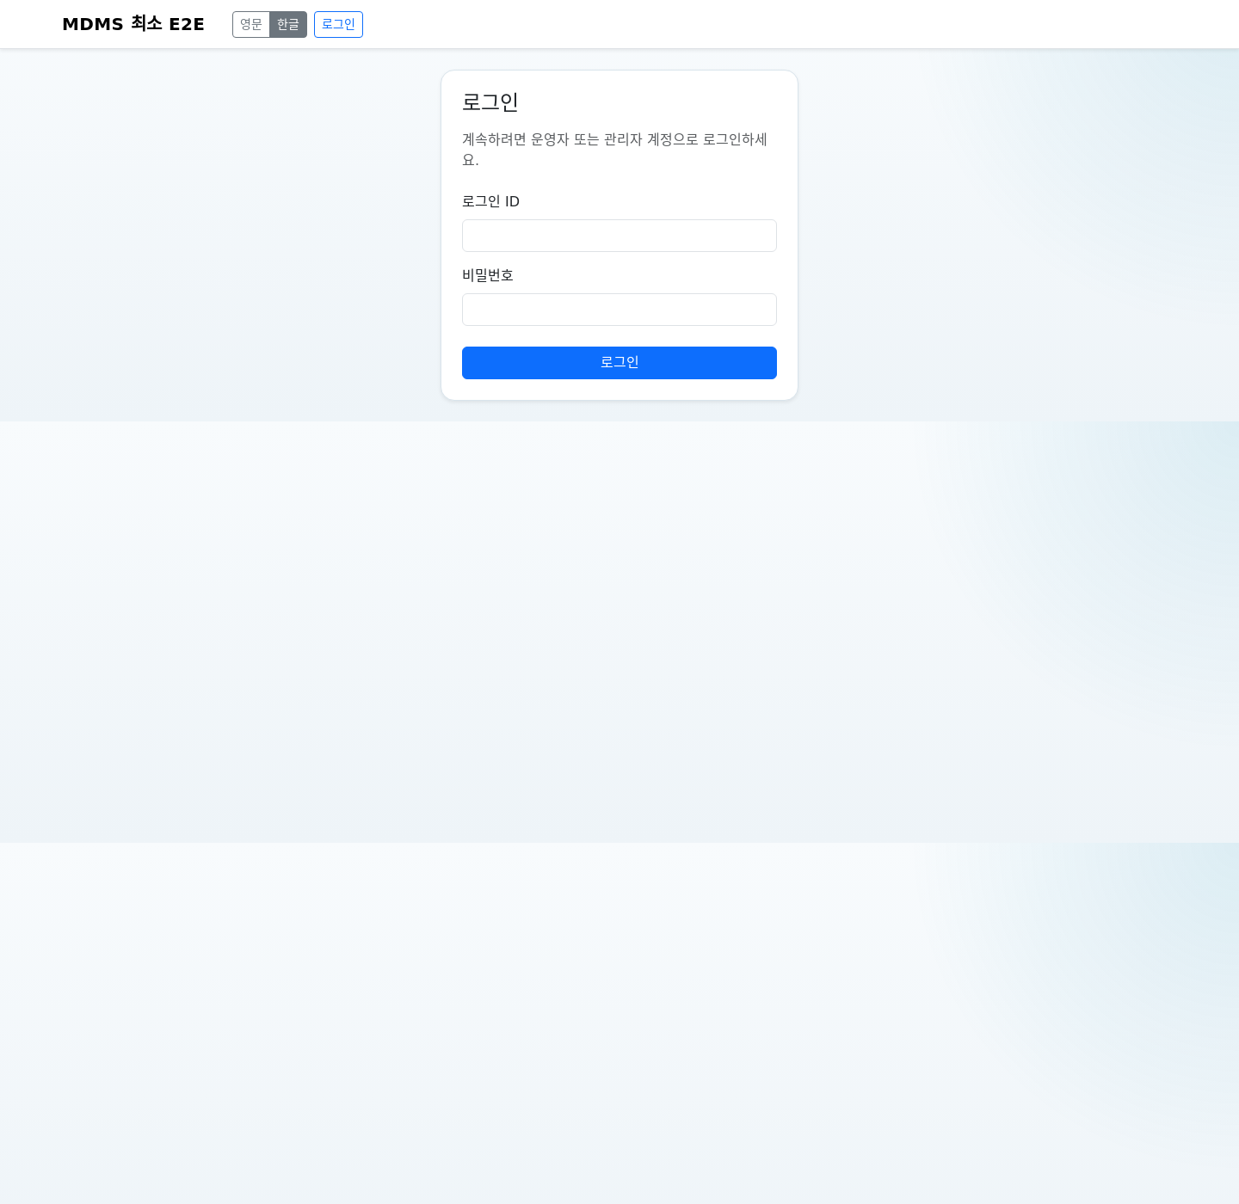
Slide 3. Startup procedure
• verify PostgreSQL
• activate environment
• first-time bootstrap commands only when needed
• start make run
• run adapter queue commands in separate shells when needed
• post-start checks
운영자 로그인 진입점

Slide 4
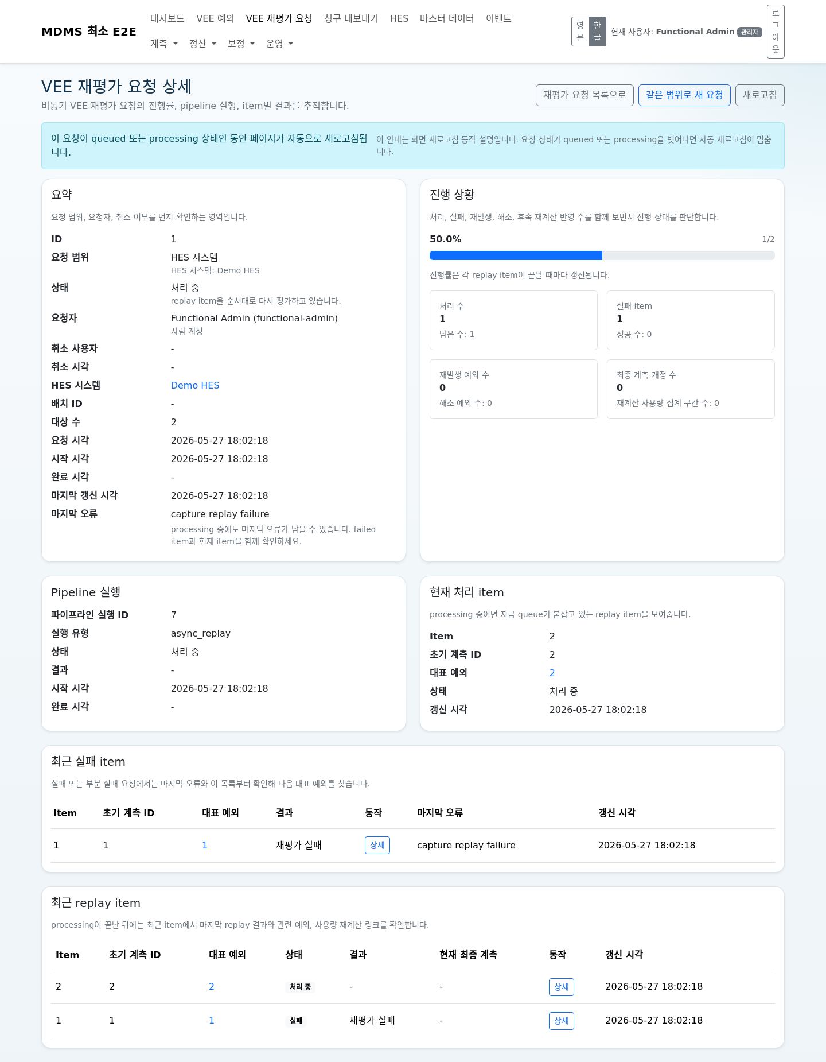
Slide 4. Shutdown procedure
• check in-flight replay, export, and adapter work
• stop worker shells first
• stop Flask
• stop PostgreSQL only when appropriate
• restart after abnormal stop
진행 중 요청 확인 예시

Slide 5
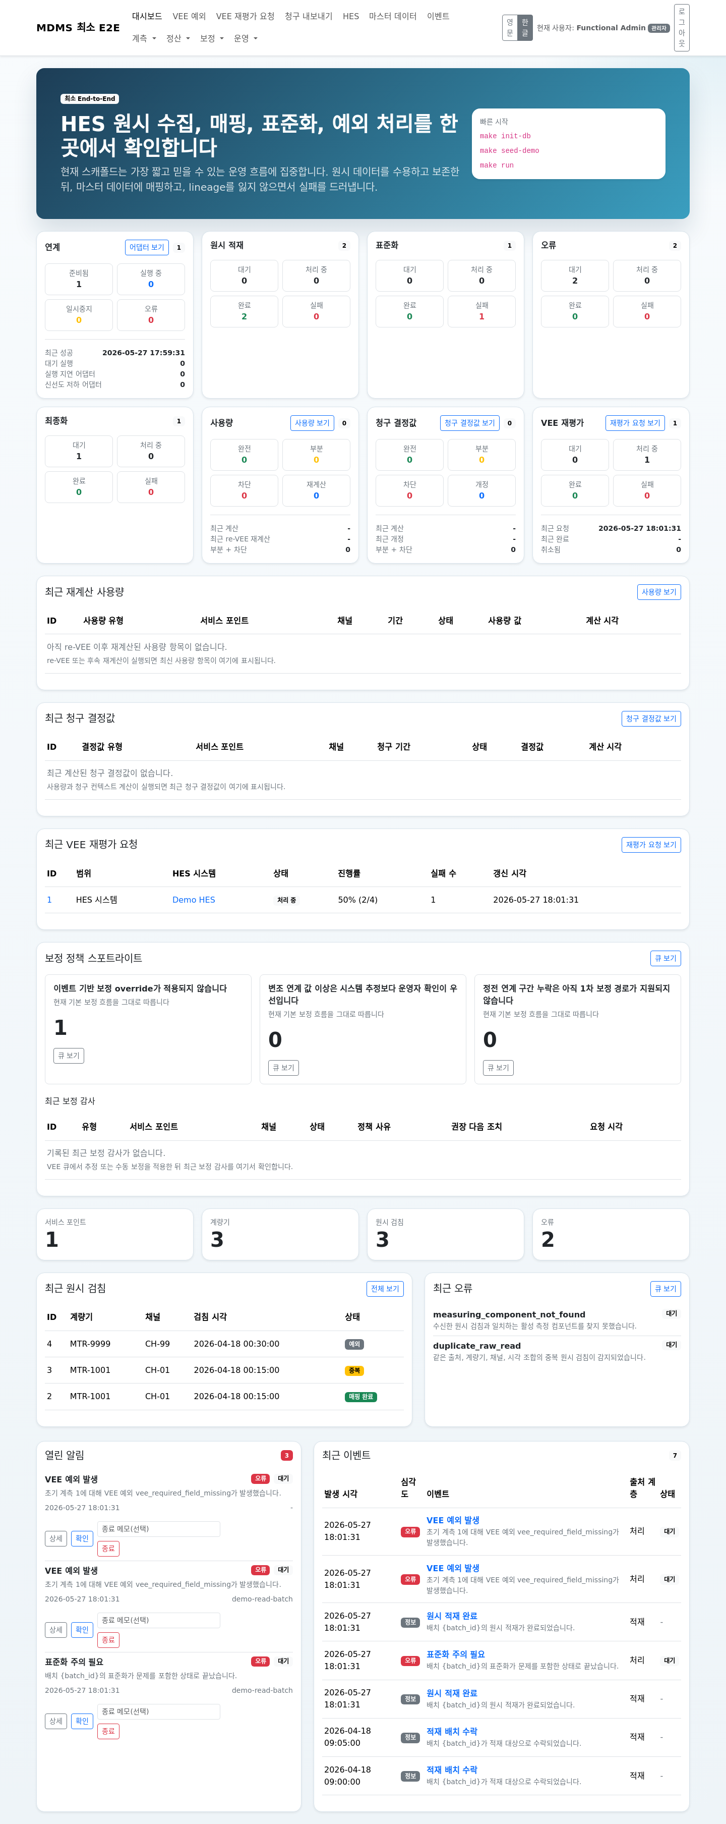
Slide 5. Daily opening checklist
• log in
• open dashboard
• review open alerts
• review recent operational events
• identify stale adapters, failed replay, failed export, or blocking VEE
우선 확인 대상이 있는 대시보드

Slide 6
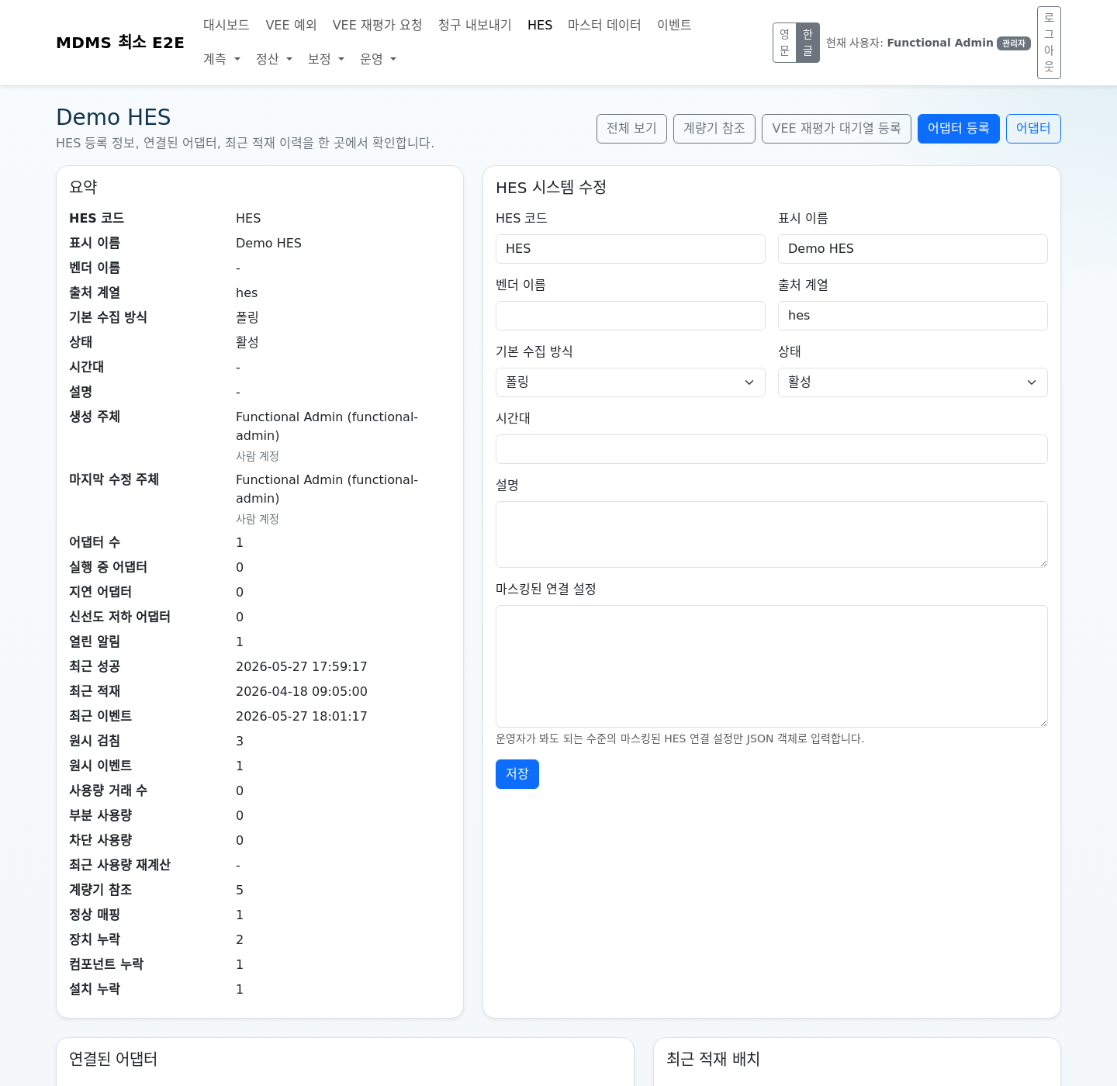
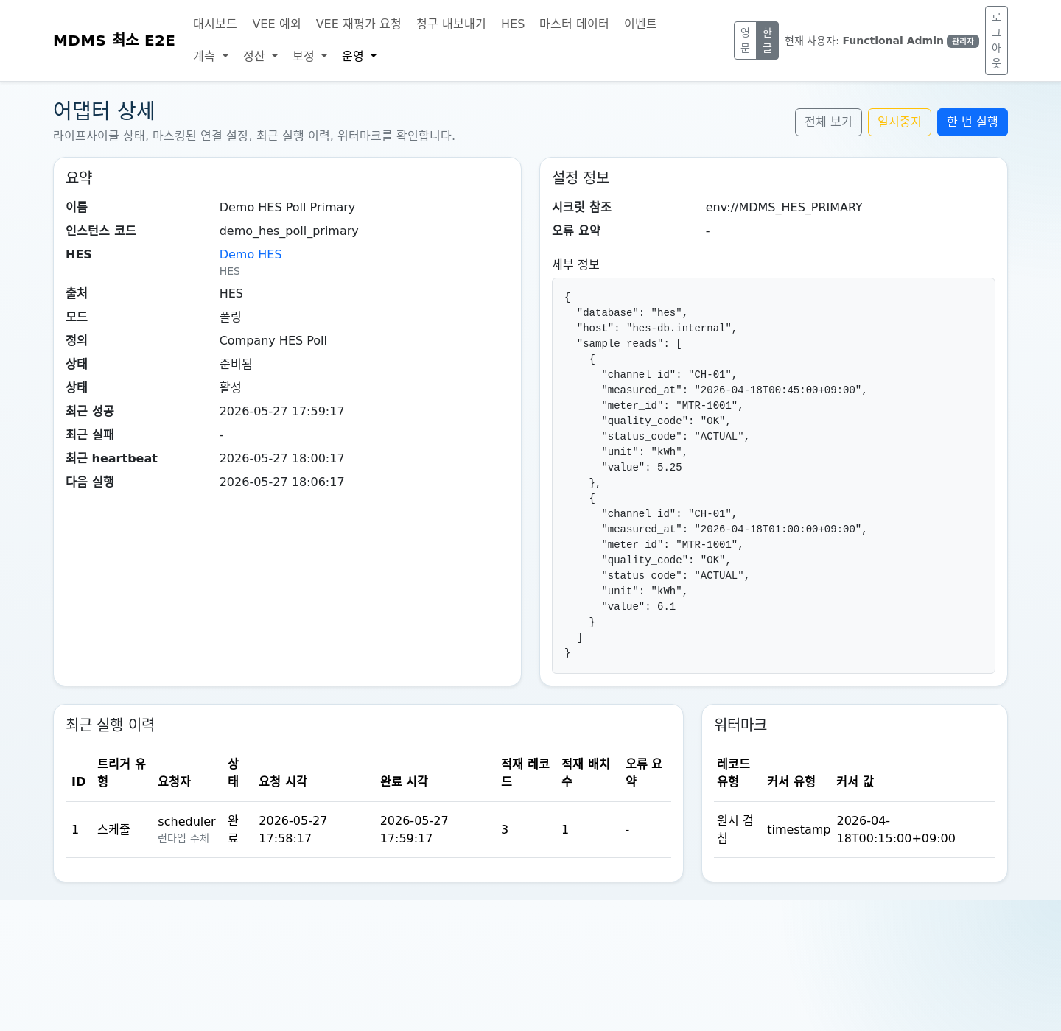
Slide 6. HES and adapter operations
• HES list and detail
• adapter list and detail
• Enable, Pause, Run Once
• runtime versus human actor interpretation
HES 상세
어댑터 상세

Slide 7
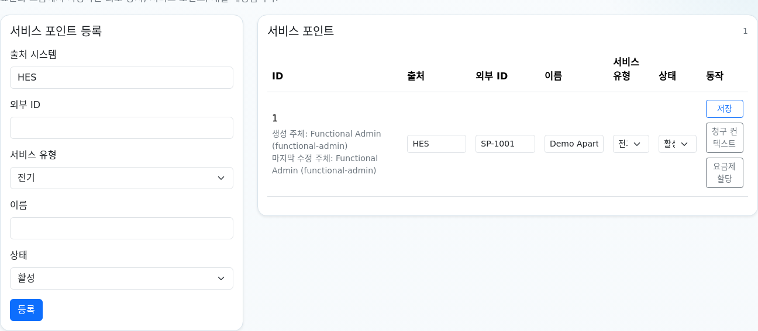
Slide 7. Master data minimum
• service point
• device
• measuring component
• installation history
• why mapping fails when these are missing
기본 마스터 데이터와 actor visibility

Slide 8
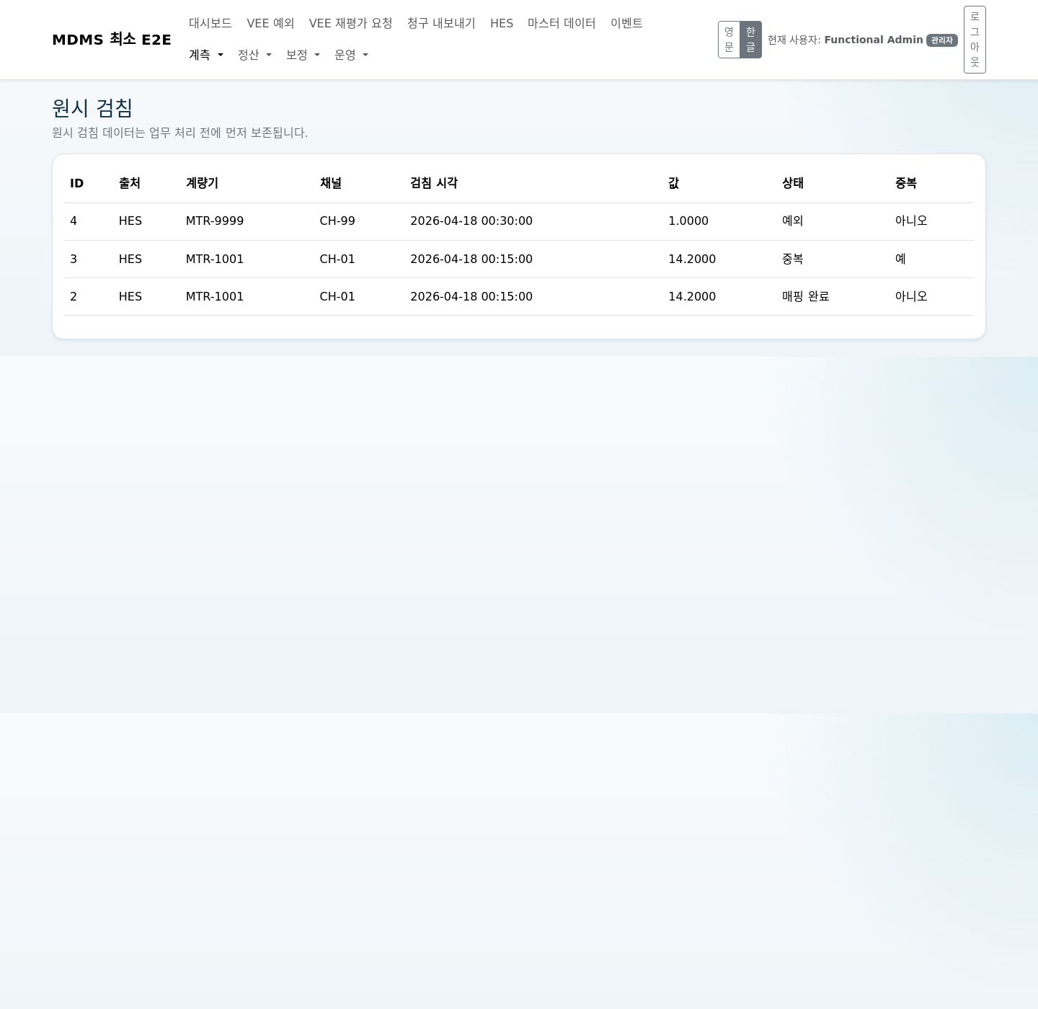
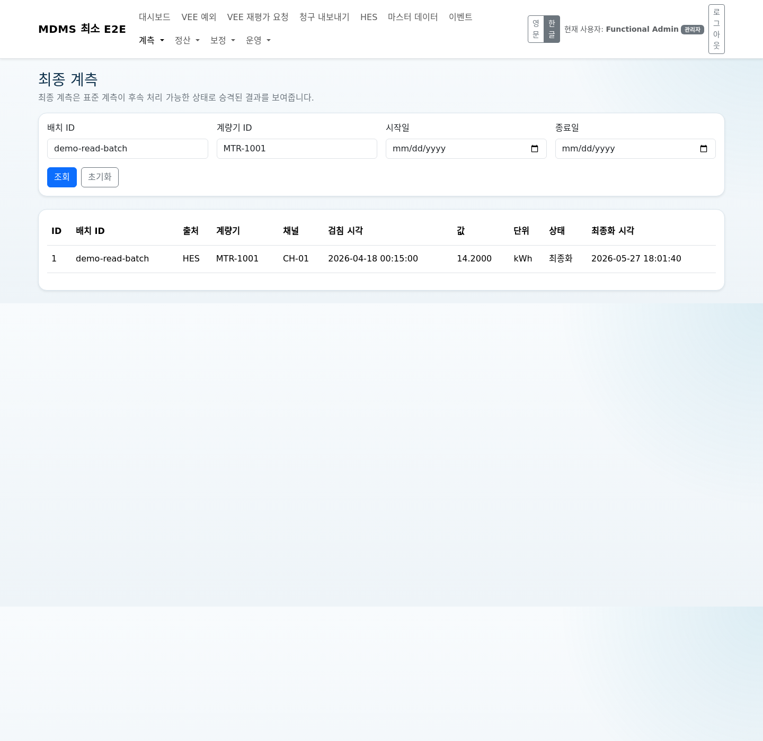
Slide 8. Raw, canonical, and final lineage
• review raw reads and raw events first
• confirm canonical progression
• confirm final authoritative state
• use lineage screens to trace one sample end to end
원시 검침 가시성
최종 계측 가시성

Slide 9
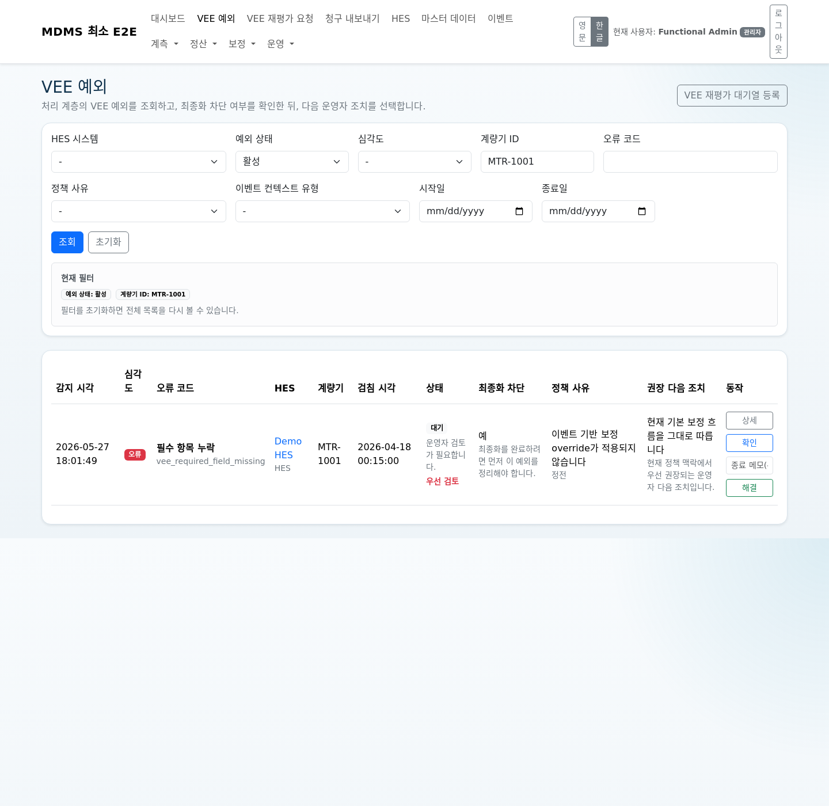
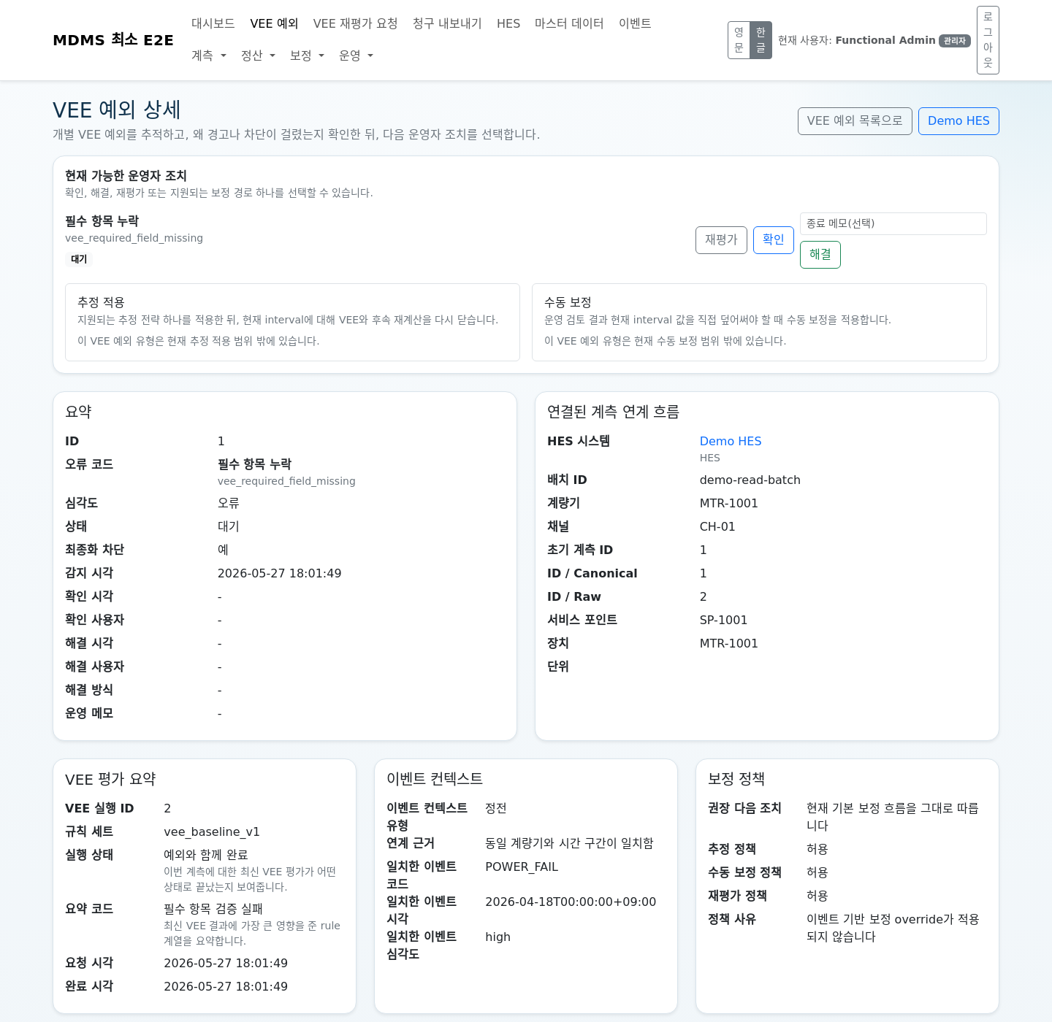
Slide 9. VEE exception triage
• start from the queue
• prioritize blocking items
• use detail view for blocked reason, event context, and next action
• understand re-evaluate versus correction
VEE 예외 큐
VEE 예외 상세

Slide 10
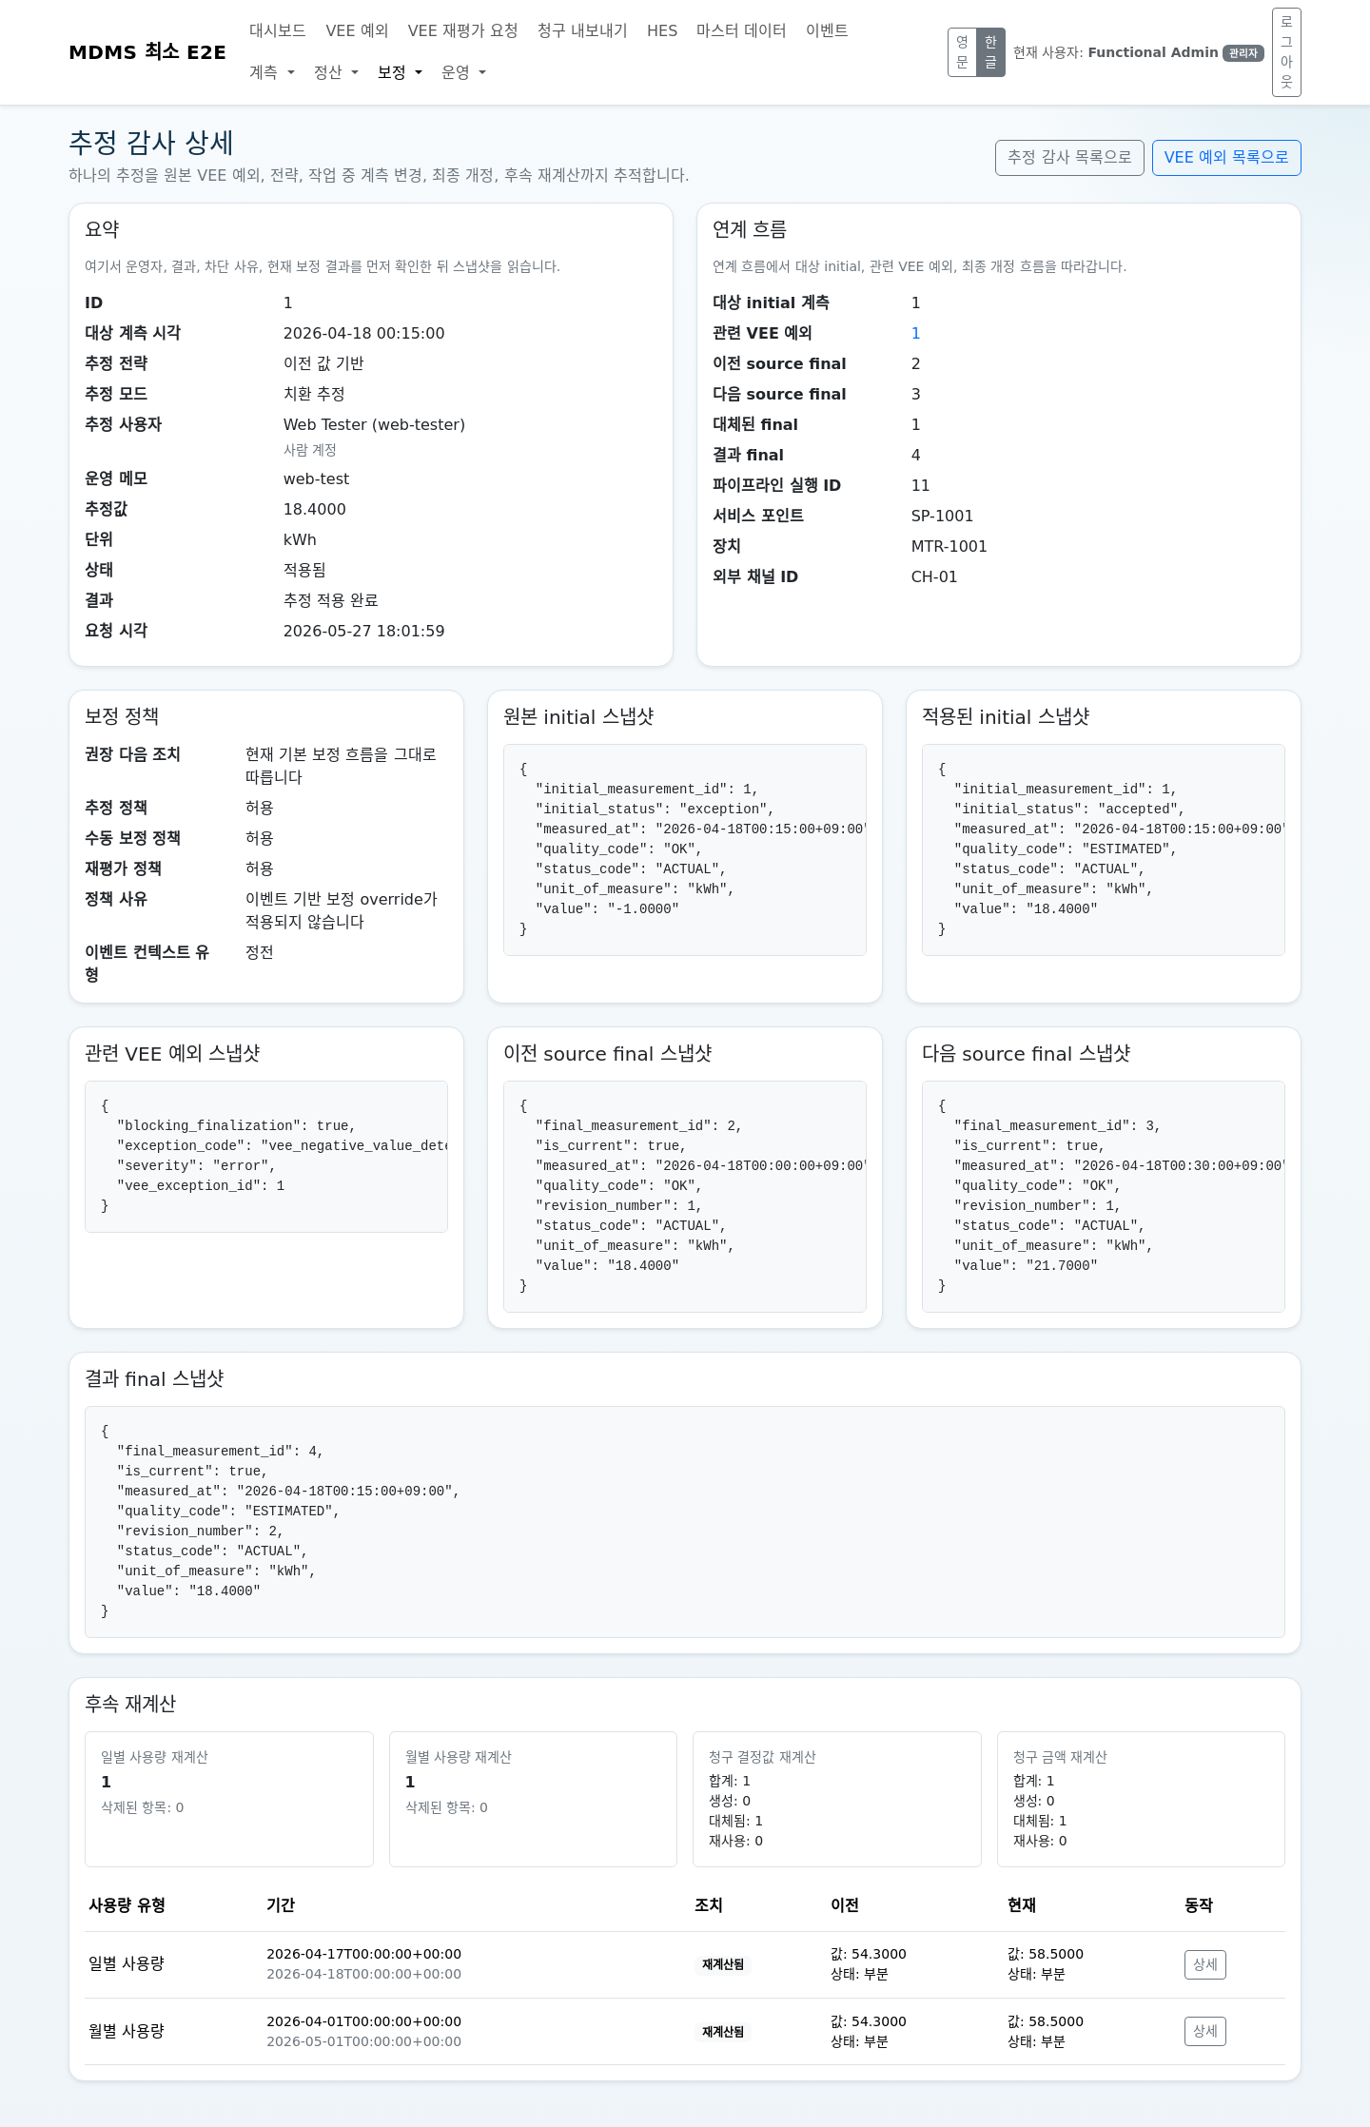
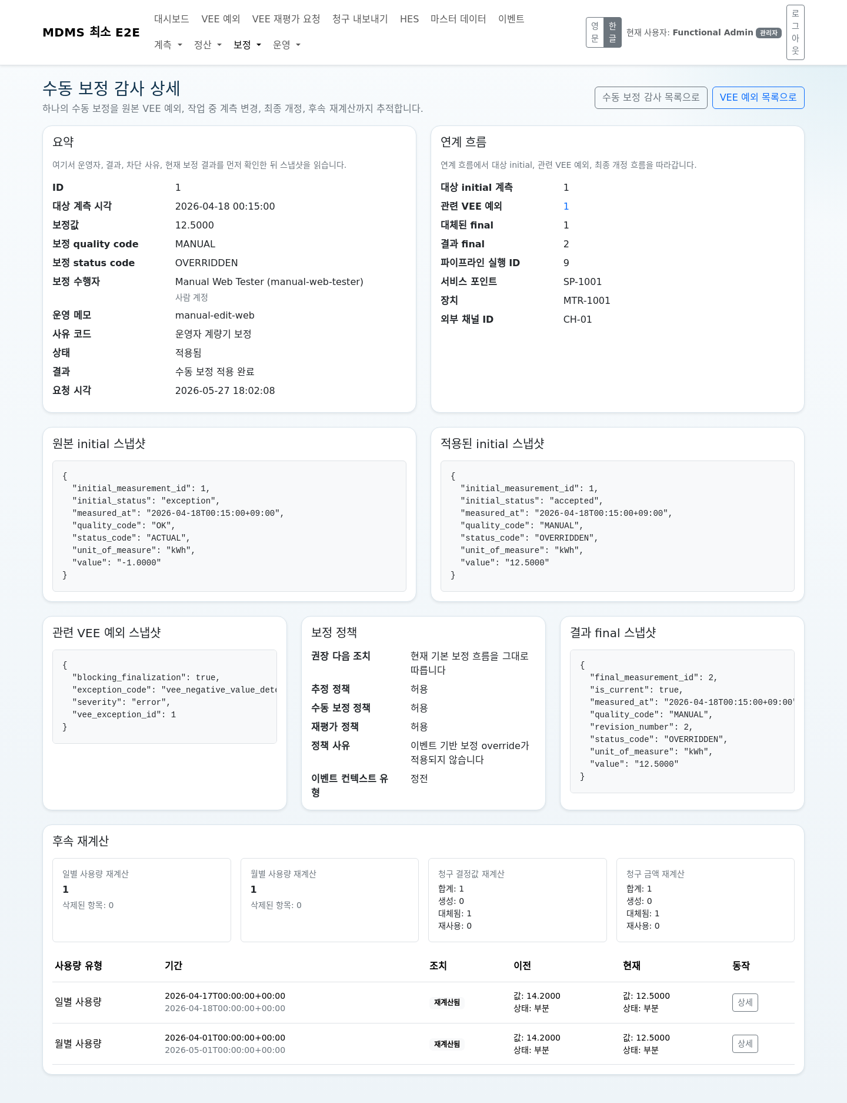
Slide 10. Estimation and manual edit
• when to use each correction path
• what to confirm after execution
• audit detail, actor lineage, memo, result code, and downstream impact
추정 감사 상세
수동 보정 감사 상세

Slide 11
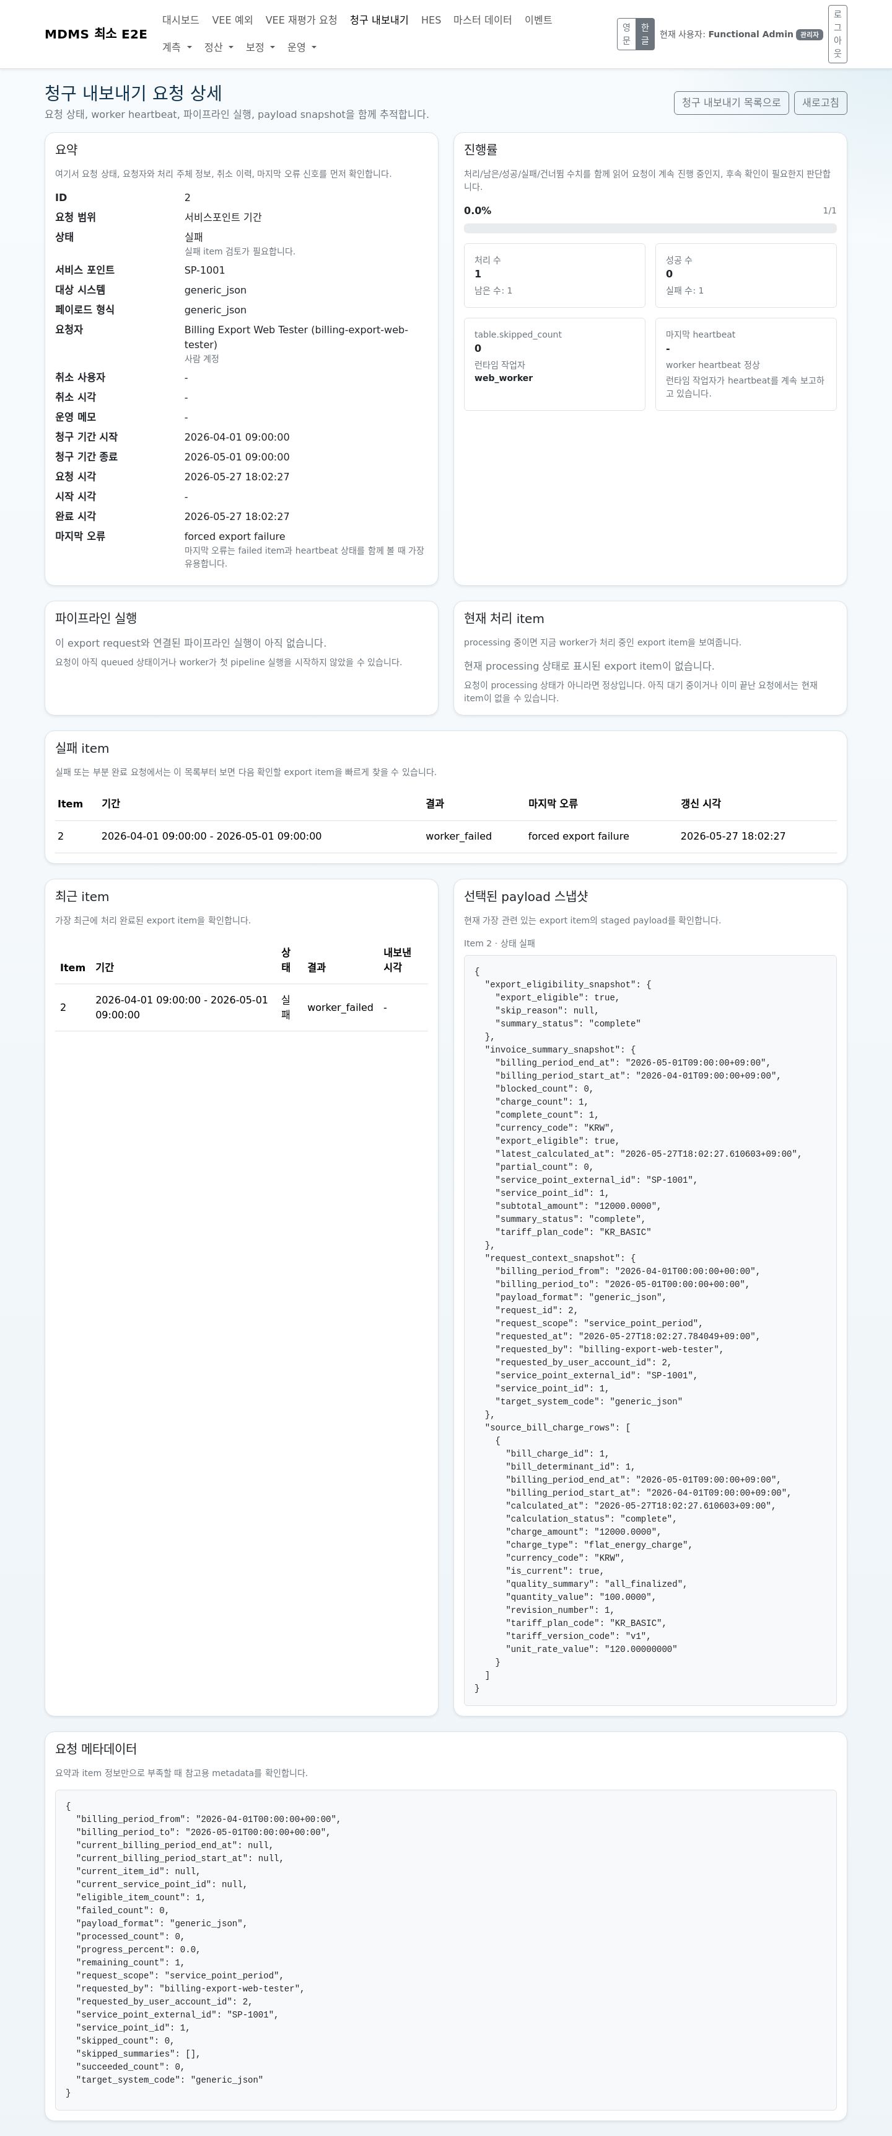
Slide 11. Replay and billing export
• replay request create, monitor, and cancel
• billing export create, inspect, rerun, recreate, or cancel
• processing state versus failed state versus quiet state
재평가 요청 상세
청구 내보내기 요청 상세

Slide 12
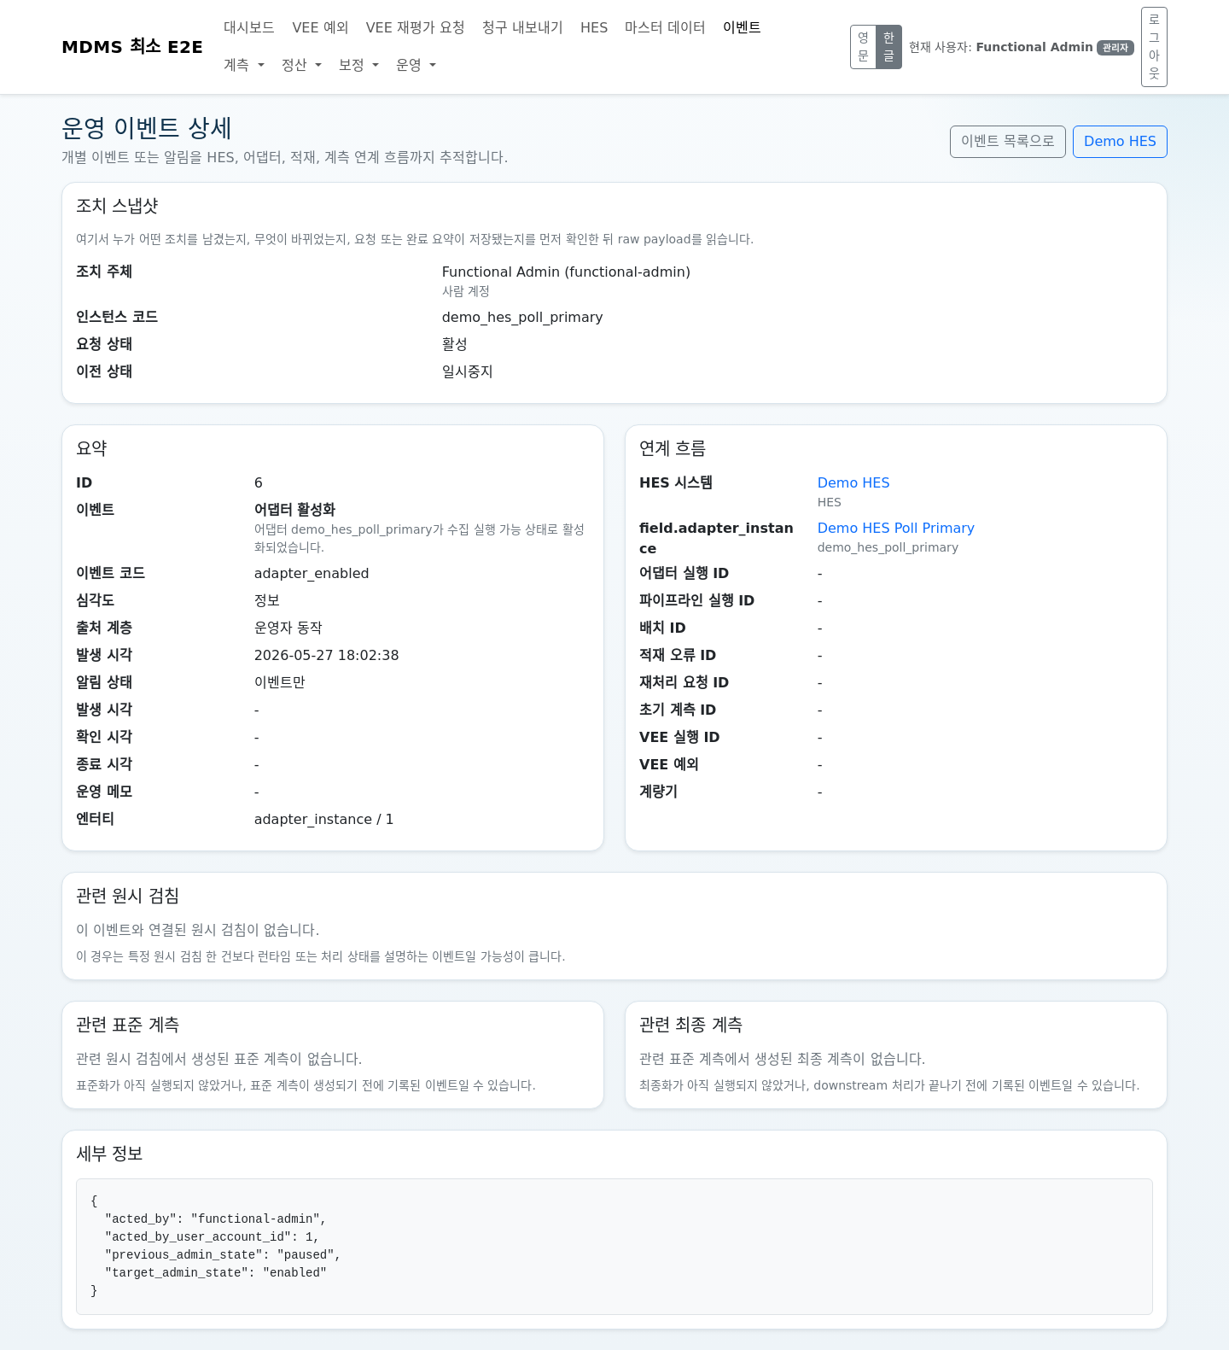
Slide 12. Operational events and accountability
• operational-event timeline
• action snapshot
• created actor and updated actor on admin-managed rows
• user action audit evidence meaning
운영 이벤트 조치 스냅샷
관리 row actor visibility

Slide 13
Slide 13. Incident quick guide
• stale adapter
• failed replay
• failed export
• blocking VEE
• missing master data
주의 필요 대시보드
런타임 점검 예시

Slide 14
Slide 14. Daily closing and limitations
• end-of-day checks
• whether to keep the local environment running
• current preproduct limitations
• escalation posture for repeated failures
## Packaging notes
For the first training deck:
• prefer Korean UI captures
• use the same account names consistently across screenshots
• mask secrets, credentials, and environment-specific identifiers
• keep one wide desktop viewport across the whole deck
• reserve space for captions that explain what the operator should look at first
일일 마감 기준 화면

