Slide 1
Software Testing Process, Design of Test cases and it`s importance
By : Anupam Baral

Slide 2
Software Testing
Software testing is an important process in the Software Development Lifecycle(SDLC). It involves verifying and validating that a Software Application is free of bugs, meets the technical requirements set by its Design and Development, and satisfies user requirements efficiently and effectively.
Software Testing is a process of verifying and validating whether the Software Product or Application is working as expected or not. The complete testing includes identifying errors and bugs that cause future problems for the performance of an application.
The main objective is to find defects or errors.
It checks whether the software meets user requirements.
Testing ensures quality, reliability, and performance of software.
It helps in delivering error-free software to the user.

Slide 3
OBJECTIVES OF SOFTWARE TESTING
The objective of software testing are :
To detect errors and defects before delivery.
To verify and validate software requirements.
To ensure software works as expected.
To improve customer satisfaction.
To reduce cost of future maintenance.

Slide 4
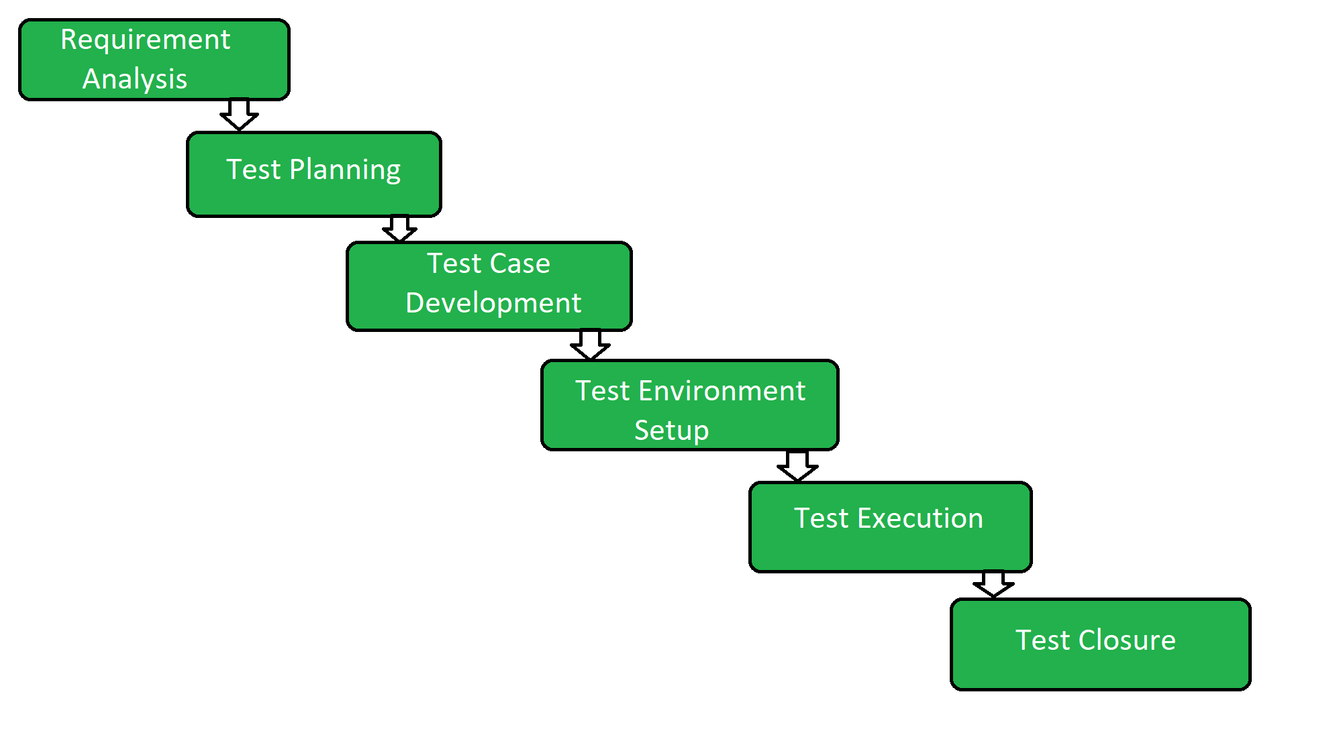
SOFTWARE TESTING PROCESS
The software testing process, often visualized as the Software Testing Life Cycle (STLC), is a systematic approach to ensuring software quality. The core phases involve analyzing requirements, planning, designing, setting up the environment, executing tests, tracking defects, and reporting .
The steps are :
Requirement Analysis
Test Planning
Test Case Design
Test Environment Setup
Test Execution
Defect Reporting
Test Closure
Fig : Software Testing Process Diagram (STLC Phases)

Slide 5
1. Requirement Analysis
Requirement Analysis is the first phase where the QA/testing team understands what needs to be tested.
The activities that take place during the Requirement Analysis stage include:
Reviewing the software requirements document (SRD) and other related documents
Interviewing stakeholders to gather additional information
Identifying any ambiguities or inconsistencies in the requirements
Identifying any missing or incomplete requirements
Identifying any potential risks or issues that may impact the testing process

Slide 6
2. Test Planning
Test Planning is the most crucial phase where the overall test strategy and plan are created.
The major activities carried out during the Test Planning phase include:
Identifying the testing objectives and scope
Developing a test strategy: selecting the testing methods and techniques that will be used
Identifying the testing environment and resources needed
Identifying the test cases that will be executed and the test data that will be used
Estimating the time and cost required for testing
Identifying the test deliverables and milestones
Assigning roles and responsibilities to the testing team
Reviewing and approving the test plan

Slide 7
3. Test Case Development
The Test Case Development phase testers design detailed test cases and prepare the necessary test data.
The main activities performed during the Test Case Development phase include:
Identifying the test cases that will be developed
Writing test cases that are clear, concise and easy to understand
Creating test data and test scenarios that will be used in the test cases
Identifying the expected results for each test case
Reviewing and validating the test cases
Updating the requirement traceability matrix (RTM) to map requirements to test cases

Slide 8
4. Test Environment Setup
Test Environment Setup defines the hardware, software and network conditions under which testing will be executed.
The activities involved in the Test Environment Setup phase include:
Install and configure required software, tools and databases.
Set up servers, browsers, operating systems and devices.
Prepare access credentials and permissions.
Validate the environment before test execution.

Slide 9
5. Test Execution
In Test Execution phase prepared test cases are executed in the defined environment. The activities performed during the Test Execution phase include:
Run manual or automated test cases.
Log defects with details like severity and priority.
Retest fixed defects (defect retesting).
Perform regression testing if required.
Collect and analyze test results.
Document and share test reports.

Slide 10
6. Test Closure
Test Closure is the final phase where testing activities are completed and documented. The final activities carried out during the Test Closure phase include:
Prepare a Test Summary Report (test cases executed, pass/fail count, defects found/resolved).
Ensure all defects are tracked and closed.
Clean up the test environment.
Archive test cases, data and reports.
Conduct a retrospective for lessons learned.
Share knowledge with stakeholders.

Slide 11
TEST CASE
A Test Case is a step-by-step guide used to check if a specific part of a software application works correctly as expected. It defines the actions to be taken, the required data, and the expected result to validate that a feature functions as per the requirements.
A test case is a set of conditions or steps.
It is used to verify a particular function of software.
Test cases are derived from requirements.
They help testers execute testing systematically.
Each test case has expected and actual results.

Slide 12
DESIGN OF TEST CASE
Designing test cases in software testing is a systematic process of defining the conditions and specific steps needed to verify that a software application functions correctly and meets its requirements. It involves understanding requirements, employing specific design techniques, and documenting the cases in a standardized format.
Test case design is the process of creating test cases.
It is done before test execution.
It is based on software requirements and specifications.
Both positive and negative scenarios are included.
Good test case design improves defect detection.

Slide 13
COMPONENTS OF A TEST CASE
Components:
Test Case ID: A unique name or number to identify the test case.
Title/Description: What the test case is meant to check.
Preconditions: What needs to be set up before running the test?
Test Steps: The actions to perform during the test.
Test Data: The specific information needed for the test.
Expected Result: What should happen if the software is working right?
Actual Result: What happens when the test is run.
Status: Whether the test passed or failed.
Postconditions: What should be true after the test.

Slide 14
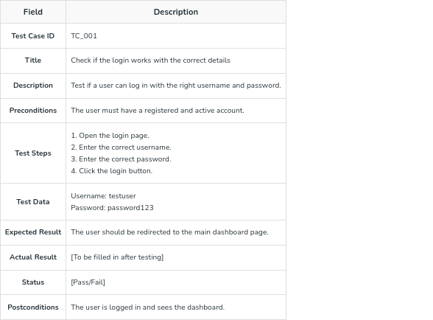
SAMPLE TEST CASE

Slide 15
IMPORTANCE OF TEST CASE DESIGN
Ensures maximum test coverage.
Helps in early detection of defects.
Improves software quality.
Saves testing time and cost.
Makes testing organized and repeatable.

Slide 16
ADVANTAGES OF SOFTWARE TESTING
Reduces software failure risk.
Improves system reliability.
Ensures customer satisfaction.
Increases confidence in software.
Supports smooth software deployment.

Slide 17
Thank You !
If any query , then ask on :
Www.noquestion.com | +9779800000000 | noquestion@gmail.com

