Slide 1
Skillup - A E-Learning platform
Department of Computer Application
Butwal Kalika Campus
Butwal-10,Rupandehi
Mid term presentation and defense
Students: Anupam Baral and Bibek Dangal
Coordinator: Aashish Neupane
Date : 2082/07/18

Slide 2
Outline
Introduction
Statement of Problem
Objectives
Literature review
Completed Task
Remaining Task
Related Projects
Your Contribution
Proposal Approach
Methodology
Expected Outcome
References
Annex

Slide 3
Introduction
E-Learning is education delivered via the Internet, networks, or standalone systems, using electronic media to facilitate skill and knowledge transfer.
It supports interaction between students and lecturers and distributes course materials online, leveraging technology for learning.
Rising demand for cost-effective education, government support for online learning, and widespread smartphone and Internet access fuel E-Learning growth
E-Learning is critical in the Information and Knowledge Age, enabling efficient acquisition, storage, and application of knowledge for organizational success.
E-Learning bridges learning and work by using the same tools and technologies, making it easier to incorporate education into professional environments.
SkillUp is an E-Learning platform offering flexible, device-based training in fields like Machine Learning and Programming, with real-time interaction for individual and group classes.

Slide 4
Statement of the Problem
Inefficient Assignment Submission: Students submit assignments via hard copies or personal emails, lacking a streamlined process.
Lack of Centralized Materials for Lecturers: New lecturers must independently source course materials, leading to inconsistency and inefficiency.
Mandatory Physical Presence: Students must attend classes in person .
Absence of Collaborative Platforms: Students lack effective platforms for sharing resources and engaging in monitored group discussions.

Slide 5
Objective(s)
The objective of this project is explained below:
Centralized Platform Development: Design and implement SkillUp, a web-based E-Learning platform to address limitations of traditional learning by providing a unified, interactive environment.
Resource Repository: Create a centralized repository for all course materials to ensure easy access for students and lecturers.
User-Friendly Interface: Design an intuitive and user-friendly interface to enhance the user experience for both students and lecturers.
Improved Communication: Enhance interaction and communication between students and lecturers through integrated tools.
Course Access and Management: Enable students to enroll in courses and access study materials, while allowing lecturers to create and manage courses efficiently.

Slide 6
Preliminary literature review
Enhanced Engagement and Usability E-Learning platforms like Moodle and iSpring create dynamic, accessible learning environments, with 78% of students reporting high usability, supporting SkillUp’s goal of a unified, user-friendly platform.
Centralized Resources and Cost-Effectiveness: These platforms provide centralized resource repositories, enabling cost-effective education delivery, aligning with SkillUp’s objective of seamless content access, though continuous updates are needed to stay technologically relevant.
Improved Interaction and Communication: Virtual platforms enhance teacher-student interaction, with 40.1% of students finding it easy to contact instructors and 42.3% rating virtual teaching positively, supporting SkillUp’s real-time discussion and feedback features.
Support for Digital Competency and Motivation: E-Learning fosters digital skills through blended learning and gamification, enhancing motivation and addressing practical disciplines, which SkillUp incorporates via its intuitive interface and interactive course creation.

Slide 7

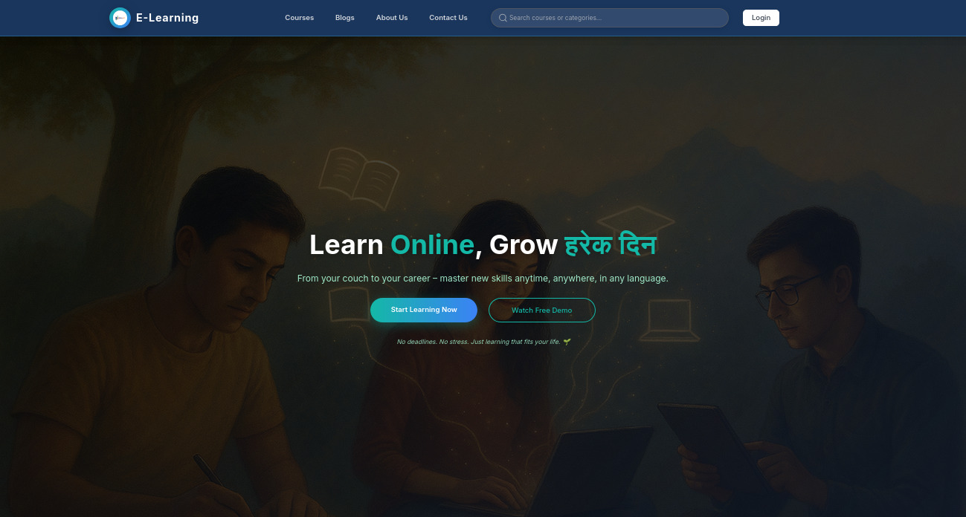
Landing Page of E-Learning Paltfrom

Slide 8
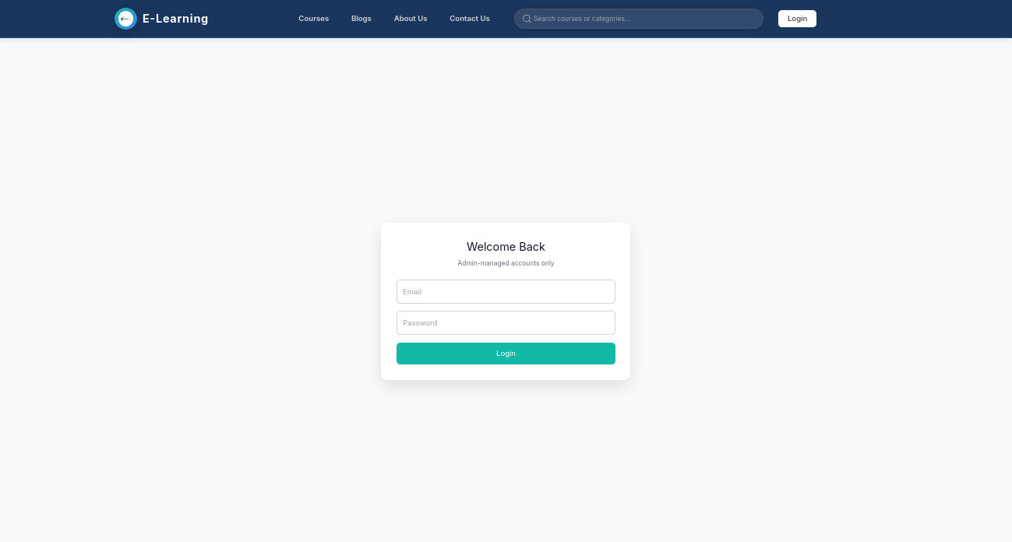
completed task - Login Page
Login page of E-Learning Platfrom

Slide 9
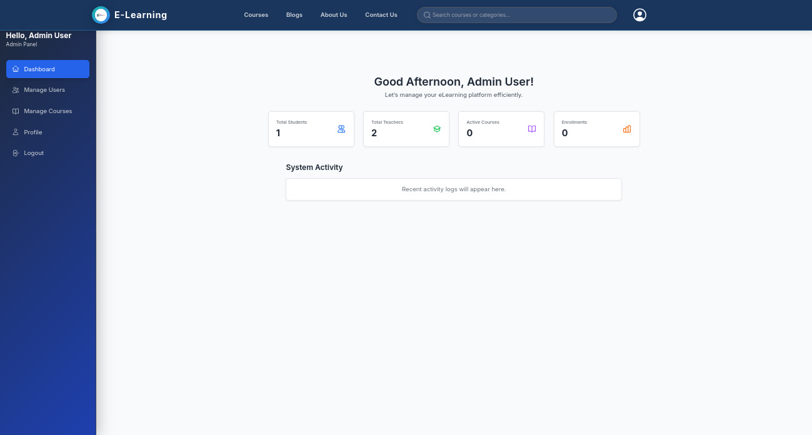
Admin Portal (Frontend and Backend)

Slide 10
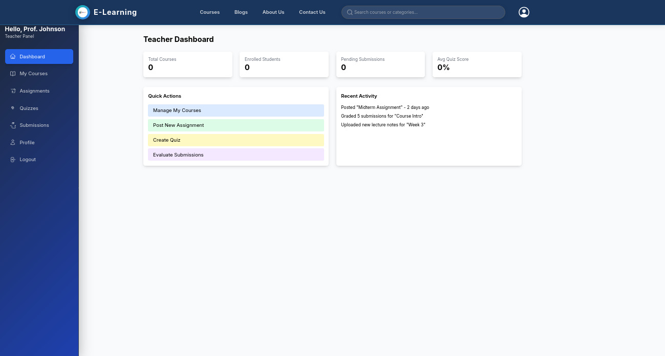
Teacher Portal (frontend)

Slide 11
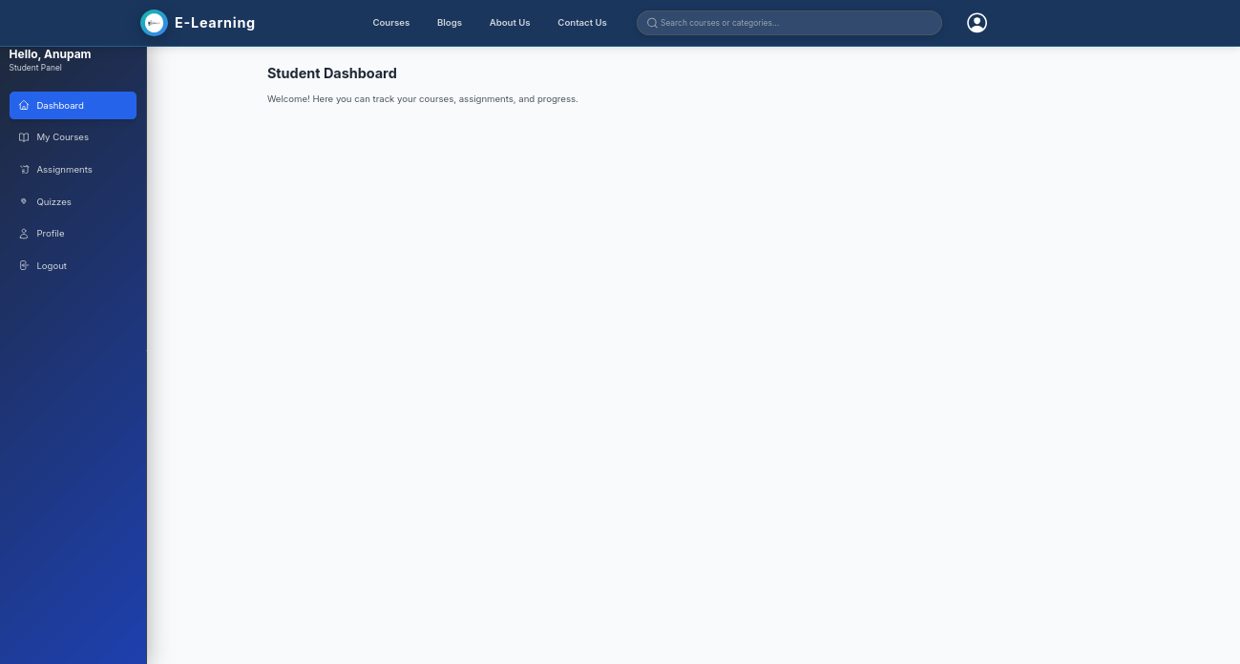
Student Portal (frontend)

Slide 12
Remaining task
Remaining Tasks
- Backend Design of Student and teacher
- Responsive Design of Website

Slide 13
Related Projects
The below are some related projects with my projects .
Moodle: An open-source learning management system offering course creation, resource sharing, and student-teacher interaction, widely used in educational institutions.
iSpring: A platform providing e-learning authoring tools and interactive courses, known for its user-friendly interface and integration with PowerPoint.
Canvas LMS: A cloud-based learning platform that supports online learning, assessments, and collaboration, adopted by many universities for its scalability.

Slide 14
Your Contribution
Localized Academic Focus: Unlike general platforms, SkillUp is designed specifically for Nepali academic institutions (e.g., TU campuses), integrating local curriculum like BCA courses with centralized repositories for region-specific resources, reducing dependency on global tools.
Centralized database for syllabus/resources.
Role-based access: Students submit online, lecturers manage easily.
Reduces physical dependencies; promotes anytime access.

Slide 15
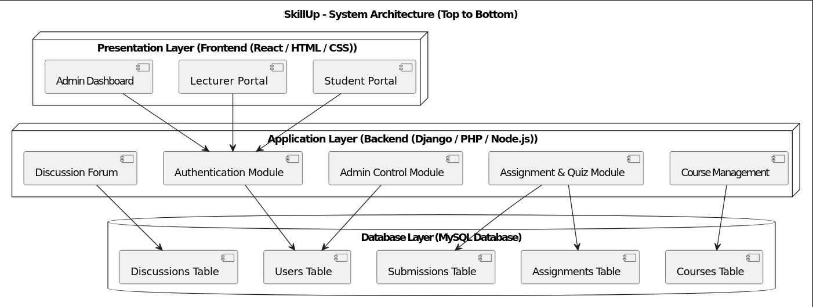
Proposed Approach
The System block diagram of this project is :

Slide 16
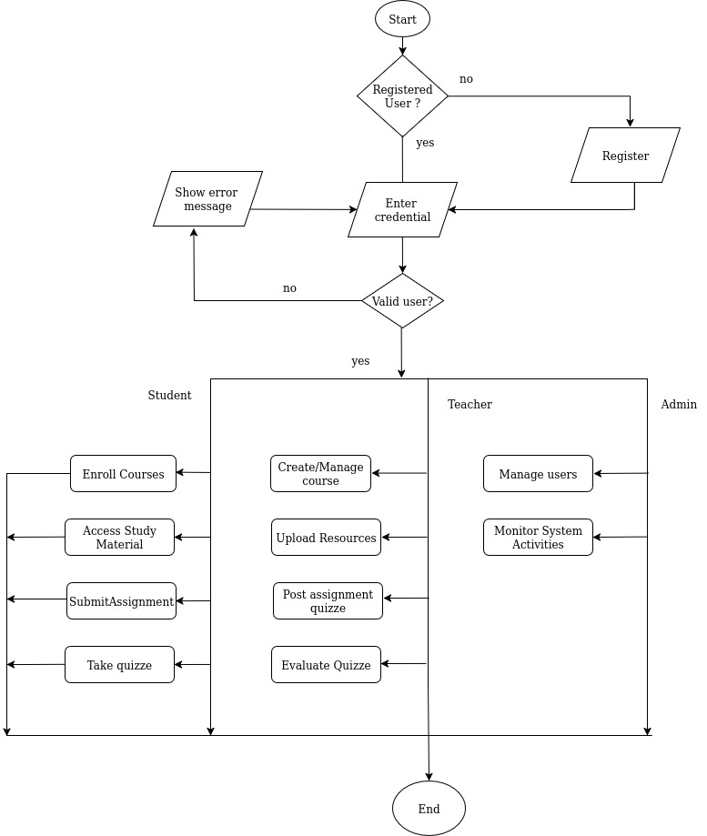
Proposed Approach
Describe your model, project with diagrams and all. You can use multiple slides under this topic.
This slide shows how users interact with SkillUp through a system flowchart.

Slide 17
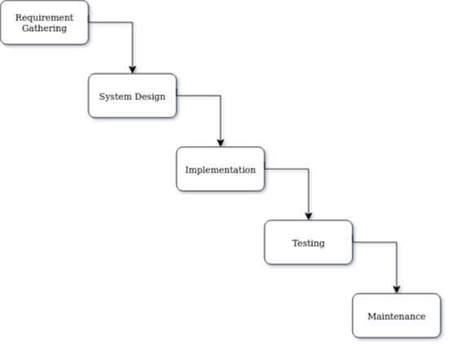
Methodology
We use the Waterfall Approach to develop SkillUp in a structured way.It follows sequential phases to ensure clear progress and quality.
Requirements and Planning : This phase of waterfall project management identifies what the project should do.
Design:The design phase solidifies and documents all your decisions.
Implementation:This phase executes your project plan and design to produce the desiredproduct.
Testing : The testing phase uses various quality metrics and customer satisfaction to measure the project’s success
Maintenance :It is also a phase to identify any errors you might have missed during the testing phase

Slide 18
Expected Outcome
SkillUp will bridge traditional and digital education, enhancing learning efficiency. Expected outcomes include:
Centralized Learning Resource:Unified storage for materials, assignments, and quizzes.
Improved Communication:Real-time interaction via forums and feedback.
Efficient Course Management:Easy course creation and student progress tracking.
Time and Cost Efficiency : Anytime, anywhere learning; reduced physical resource needs.
Enhanced Monitoring : Admin oversight of user activity and performance.

Slide 19
References
[1] A. Mayorga, K. Hernández, C. Aveiga, and S. Pacheco, "Construcción del conocimiento social mediante e-learning: límites y posibilidades en la enseñanza de Cultura Física," Podium: Revista de Ciencia y Tecnología en la Cultura Física, vol. 15, no. 1, pp. 99–110, 2020. [link]
[2]J. Morales, H. Sánchez, and M. Rico, "Aprendizaje divertido de programación con Gamificación," Revista Ibérica de Sistemas e Tecnologias de Informação, vol. 41, no. 3, pp. 17–33, 2021. [link]
[3] D. Pástor, G. Arcos, and A. Lagunes, "Desarrollo de capacidades de investigación para estudiantes universitarios mediante el uso de estrategias instruccionales en entornos virtuales de aprendizaje," Apertura, vol. 12, no. 1, pp. 6–21, 2020. [ Link]

Slide 20
Annex
Requirement and Feasibility Study: 5 days
System Design: 5 days
Database Design: 5 days
Frontend Development: 15 days
Backend Development: 10 days
Integration of Modules: 5 days
Testing & Debugging: 5 days
Documentation & Report Writing: 10 days
Final Submission & Presentation: 10 days

Slide 21
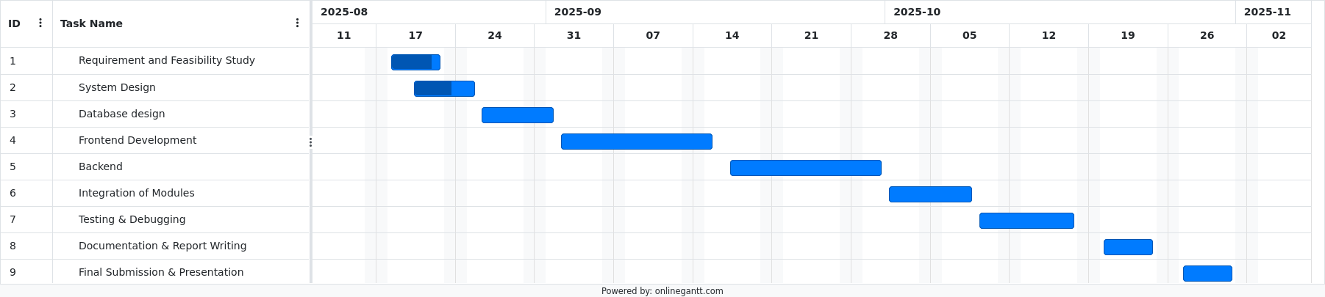
Annex

Slide 22
Queries/Comments/Feedback?
Thank YOU!!

