Slide 1


Introduction to Python
Saravanan Shanmugam

Slide 2
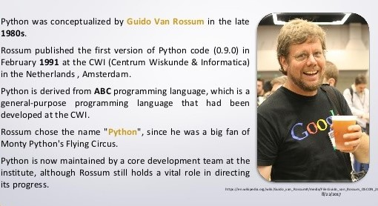
Python History
Notes:
Easy
When we say the word ‘easy’, we mean it in different contexts.
a. Easy to code
As we have seen in earlier lessons, Python is very easy to code. Compared to other popular languages like Java and C++, it is easier to code in Python. Anyone can learn python syntax in just a few hours. Though sure, mastering Python requires learning about all its advanced concepts and packages and modules. That takes time. Thus, it is programmer-friendly.
b. Easy to read
Being a high-level language, Python code is quite like English. Looking at it, you can tell what the code is supposed to do. Also, since it is dynamically-typed, it mandates indentation. This aids readability. Read: Applications of Python Programming Language
3. Expressive
First, let’s learn about expressiveness. Suppose we have two languages A and B, and all programs that can be made in A can be made in B using local transformations. However, there are some programs that can be made in B, but not in A, using local transformations. Then, B is said to be more expressive than A. Python provides us with a myriad of constructs that help us focus on the solution rather than on the syntax. This is one of the outstanding python features that tells you why you should learn Python.
4. Free and Open-Source
Firstly, Python is freely available. You can download it from the following link https://www.python.org/downloads/ For insight on how to download and install Python, refer to our tutorial on Python Installation. Secondly, it is open-source. This means that its source code is available to the public. You can download it, change it, use it, and distribute it. This is called FLOSS(Free/Libre and Open Source Software). As the Python community, we’re all headed toward one goal- an ever-bettering Python.
5. High- Level
As we discussed in point 2b, it is a high-level language. This means that as programmers, we don’t need to remember the system architecture. Nor do we need to manage the memory. This makes it more programmer-friendly and is 1 of the key python features.Any doubt yet in the features of Python. Please ask. Read: Pros and Cons of Python Programming Language
6. Portable
Let’s assume you’ve written a Python code for your Windows machine. Now, if you want to run it on a Mac, you don’t need to make changes to it for the same. In other words, you can take one code and run it on any machine, there is no need to write different code for different machines. This makes Python a portable language. However, you must avoid any system-dependent features in this case. Read: Career Opportunities in Python
7. Interpreted
If you’re any familiar with languages like C++ or Java, you must first compile it, and then run it. But in Python, there is no need to compile it. Internally, its source code is converted into an immediate form called bytecode. So, all you need to do is to run your Python code without worrying about linking to libraries, and a few other things. By interpreted, we mean the source code is executed line by line, and not all at once. Because of this, it is easier to debug your code. Also, interpreting makes it just slightly slower than Java, but that does not matter compared to the benefits it has to offer. Any doubt or query yet about the features of python programming language? If yes, Drop a comment and we will get back to you. Install Python on Windows
8. Object-Oriented
A programming language that can model the real world is said to be object-oriented. It focuses on objects, and combines data and functions. Contrarily, a procedure-oriented language revolves around functions, which are code that can be reused. Python supports both procedure-oriented and object-oriented programming which is one of the key python features. It also supports multiple inheritance, unlike Java. A class is a blueprint for such an object. It is an abstract data type, and holds no values. Read: Syntax in Python
9. Extensible
If needed, you can write some of your Python code in other languages like C++. This makes Python an extensible language, meaning that it can be extended to other languages. Let us look at some more Python features.
10. Embeddable
We just saw that we can put code in other languages in our Python source code. However, it is also possible to put our Python code in a source code in a different language like C++. This allows us to integrate scripting capabilities into our program of the other language. Read: Python tutorials for beginners
11. Large Standard Library
Python downloads with a large library that you can use so you don’t have to write your own code for every single thing. There are libraries for regular expressions, documentation-generation, unit-testing, web browsers, threading, databases, CGI, email, image manipulation, and a lot of other functionality.
12. GUI Programming
You can use Tk to create basic GUIs.
13. Dynamically Typed
Python is dynamically-typed. This means that the type for a value is decided at runtime, not in advance. This is why we don’t need to specify the type of data while declaring it. This is all about the features of python programming language tutorial. lets get to the conclusion. Read: Reasons why Learn Python
14. Features of Python: Conclusion
Now that you know what are the features of python, you know what makes it special. In this tutorial, we learned about various features of Python. We saw that it is interpreted, dynamically-typed, and object-oriented, among other python features. It is also portable, free, and easy. Now that’s some motivation to dive into the world of Python.

Slide 3
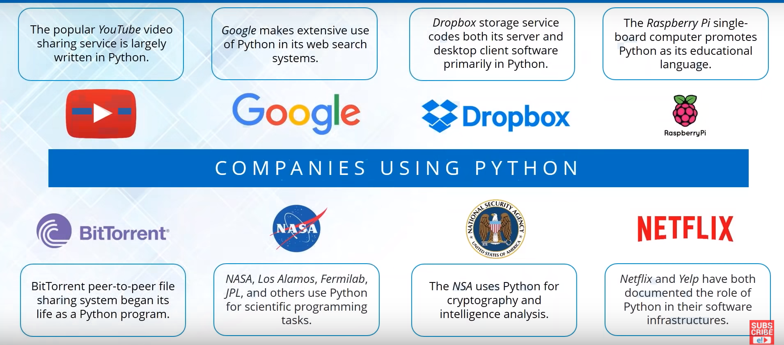
Companies using python
Notes:
Easy
When we say the word ‘easy’, we mean it in different contexts.
a. Easy to code
As we have seen in earlier lessons, Python is very easy to code. Compared to other popular languages like Java and C++, it is easier to code in Python. Anyone can learn python syntax in just a few hours. Though sure, mastering Python requires learning about all its advanced concepts and packages and modules. That takes time. Thus, it is programmer-friendly.
b. Easy to read
Being a high-level language, Python code is quite like English. Looking at it, you can tell what the code is supposed to do. Also, since it is dynamically-typed, it mandates indentation. This aids readability. Read: Applications of Python Programming Language
3. Expressive
First, let’s learn about expressiveness. Suppose we have two languages A and B, and all programs that can be made in A can be made in B using local transformations. However, there are some programs that can be made in B, but not in A, using local transformations. Then, B is said to be more expressive than A. Python provides us with a myriad of constructs that help us focus on the solution rather than on the syntax. This is one of the outstanding python features that tells you why you should learn Python.
4. Free and Open-Source
Firstly, Python is freely available. You can download it from the following link https://www.python.org/downloads/ For insight on how to download and install Python, refer to our tutorial on Python Installation. Secondly, it is open-source. This means that its source code is available to the public. You can download it, change it, use it, and distribute it. This is called FLOSS(Free/Libre and Open Source Software). As the Python community, we’re all headed toward one goal- an ever-bettering Python.
5. High- Level
As we discussed in point 2b, it is a high-level language. This means that as programmers, we don’t need to remember the system architecture. Nor do we need to manage the memory. This makes it more programmer-friendly and is 1 of the key python features.Any doubt yet in the features of Python. Please ask. Read: Pros and Cons of Python Programming Language
6. Portable
Let’s assume you’ve written a Python code for your Windows machine. Now, if you want to run it on a Mac, you don’t need to make changes to it for the same. In other words, you can take one code and run it on any machine, there is no need to write different code for different machines. This makes Python a portable language. However, you must avoid any system-dependent features in this case. Read: Career Opportunities in Python
7. Interpreted
If you’re any familiar with languages like C++ or Java, you must first compile it, and then run it. But in Python, there is no need to compile it. Internally, its source code is converted into an immediate form called bytecode. So, all you need to do is to run your Python code without worrying about linking to libraries, and a few other things. By interpreted, we mean the source code is executed line by line, and not all at once. Because of this, it is easier to debug your code. Also, interpreting makes it just slightly slower than Java, but that does not matter compared to the benefits it has to offer. Any doubt or query yet about the features of python programming language? If yes, Drop a comment and we will get back to you. Install Python on Windows
8. Object-Oriented
A programming language that can model the real world is said to be object-oriented. It focuses on objects, and combines data and functions. Contrarily, a procedure-oriented language revolves around functions, which are code that can be reused. Python supports both procedure-oriented and object-oriented programming which is one of the key python features. It also supports multiple inheritance, unlike Java. A class is a blueprint for such an object. It is an abstract data type, and holds no values. Read: Syntax in Python
9. Extensible
If needed, you can write some of your Python code in other languages like C++. This makes Python an extensible language, meaning that it can be extended to other languages. Let us look at some more Python features.
10. Embeddable
We just saw that we can put code in other languages in our Python source code. However, it is also possible to put our Python code in a source code in a different language like C++. This allows us to integrate scripting capabilities into our program of the other language. Read: Python tutorials for beginners
11. Large Standard Library
Python downloads with a large library that you can use so you don’t have to write your own code for every single thing. There are libraries for regular expressions, documentation-generation, unit-testing, web browsers, threading, databases, CGI, email, image manipulation, and a lot of other functionality.
12. GUI Programming
You can use Tk to create basic GUIs.
13. Dynamically Typed
Python is dynamically-typed. This means that the type for a value is decided at runtime, not in advance. This is why we don’t need to specify the type of data while declaring it. This is all about the features of python programming language tutorial. lets get to the conclusion. Read: Reasons why Learn Python
14. Features of Python: Conclusion
Now that you know what are the features of python, you know what makes it special. In this tutorial, we learned about various features of Python. We saw that it is interpreted, dynamically-typed, and object-oriented, among other python features. It is also portable, free, and easy. Now that’s some motivation to dive into the world of Python.

Slide 4
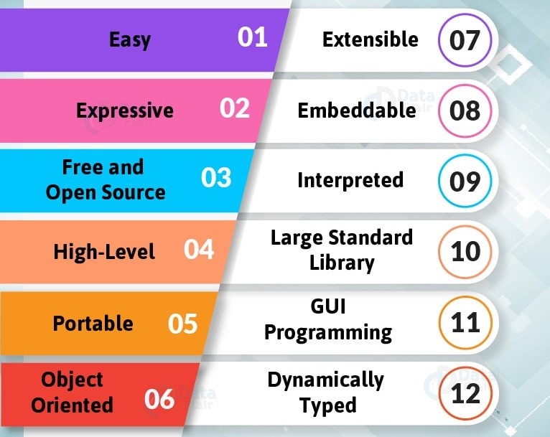
Python Features
Notes:
Easy
When we say the word ‘easy’, we mean it in different contexts.
a. Easy to code
As we have seen in earlier lessons, Python is very easy to code. Compared to other popular languages like Java and C++, it is easier to code in Python. Anyone can learn python syntax in just a few hours. Though sure, mastering Python requires learning about all its advanced concepts and packages and modules. That takes time. Thus, it is programmer-friendly.
b. Easy to read
Being a high-level language, Python code is quite like English. Looking at it, you can tell what the code is supposed to do. Also, since it is dynamically-typed, it mandates indentation. This aids readability. Read: Applications of Python Programming Language
3. Expressive
First, let’s learn about expressiveness. Suppose we have two languages A and B, and all programs that can be made in A can be made in B using local transformations. However, there are some programs that can be made in B, but not in A, using local transformations. Then, B is said to be more expressive than A. Python provides us with a myriad of constructs that help us focus on the solution rather than on the syntax. This is one of the outstanding python features that tells you why you should learn Python.
4. Free and Open-Source
Firstly, Python is freely available. You can download it from the following link https://www.python.org/downloads/ For insight on how to download and install Python, refer to our tutorial on Python Installation. Secondly, it is open-source. This means that its source code is available to the public. You can download it, change it, use it, and distribute it. This is called FLOSS(Free/Libre and Open Source Software). As the Python community, we’re all headed toward one goal- an ever-bettering Python.
5. High- Level
As we discussed in point 2b, it is a high-level language. This means that as programmers, we don’t need to remember the system architecture. Nor do we need to manage the memory. This makes it more programmer-friendly and is 1 of the key python features.Any doubt yet in the features of Python. Please ask. Read: Pros and Cons of Python Programming Language
6. Portable
Let’s assume you’ve written a Python code for your Windows machine. Now, if you want to run it on a Mac, you don’t need to make changes to it for the same. In other words, you can take one code and run it on any machine, there is no need to write different code for different machines. This makes Python a portable language. However, you must avoid any system-dependent features in this case. Read: Career Opportunities in Python
7. Interpreted
If you’re any familiar with languages like C++ or Java, you must first compile it, and then run it. But in Python, there is no need to compile it. Internally, its source code is converted into an immediate form called bytecode. So, all you need to do is to run your Python code without worrying about linking to libraries, and a few other things. By interpreted, we mean the source code is executed line by line, and not all at once. Because of this, it is easier to debug your code. Also, interpreting makes it just slightly slower than Java, but that does not matter compared to the benefits it has to offer. Any doubt or query yet about the features of python programming language? If yes, Drop a comment and we will get back to you. Install Python on Windows
8. Object-Oriented
A programming language that can model the real world is said to be object-oriented. It focuses on objects, and combines data and functions. Contrarily, a procedure-oriented language revolves around functions, which are code that can be reused. Python supports both procedure-oriented and object-oriented programming which is one of the key python features. It also supports multiple inheritance, unlike Java. A class is a blueprint for such an object. It is an abstract data type, and holds no values. Read: Syntax in Python
9. Extensible
If needed, you can write some of your Python code in other languages like C++. This makes Python an extensible language, meaning that it can be extended to other languages. Let us look at some more Python features.
10. Embeddable
We just saw that we can put code in other languages in our Python source code. However, it is also possible to put our Python code in a source code in a different language like C++. This allows us to integrate scripting capabilities into our program of the other language. Read: Python tutorials for beginners
11. Large Standard Library
Python downloads with a large library that you can use so you don’t have to write your own code for every single thing. There are libraries for regular expressions, documentation-generation, unit-testing, web browsers, threading, databases, CGI, email, image manipulation, and a lot of other functionality.
12. GUI Programming
You can use Tk to create basic GUIs.
13. Dynamically Typed
Python is dynamically-typed. This means that the type for a value is decided at runtime, not in advance. This is why we don’t need to specify the type of data while declaring it. This is all about the features of python programming language tutorial. lets get to the conclusion. Read: Reasons why Learn Python
14. Features of Python: Conclusion
Now that you know what are the features of python, you know what makes it special. In this tutorial, we learned about various features of Python. We saw that it is interpreted, dynamically-typed, and object-oriented, among other python features. It is also portable, free, and easy. Now that’s some motivation to dive into the world of Python.

Slide 5
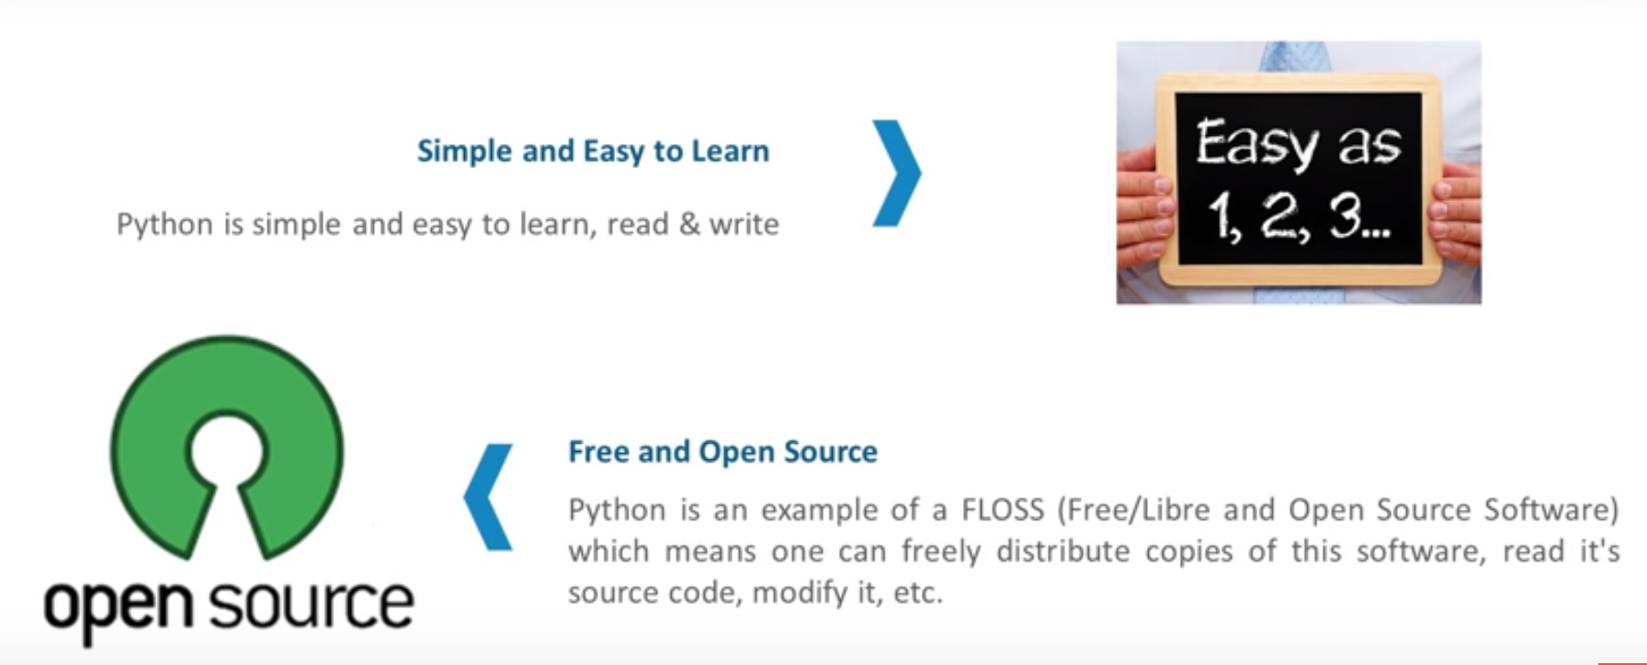
Why Python ?
Notes:
Easy
When we say the word ‘easy’, we mean it in different contexts.
a. Easy to code
As we have seen in earlier lessons, Python is very easy to code. Compared to other popular languages like Java and C++, it is easier to code in Python. Anyone can learn python syntax in just a few hours. Though sure, mastering Python requires learning about all its advanced concepts and packages and modules. That takes time. Thus, it is programmer-friendly.
b. Easy to read
Being a high-level language, Python code is quite like English. Looking at it, you can tell what the code is supposed to do. Also, since it is dynamically-typed, it mandates indentation. This aids readability. Read: Applications of Python Programming Language
3. Expressive
First, let’s learn about expressiveness. Suppose we have two languages A and B, and all programs that can be made in A can be made in B using local transformations. However, there are some programs that can be made in B, but not in A, using local transformations. Then, B is said to be more expressive than A. Python provides us with a myriad of constructs that help us focus on the solution rather than on the syntax. This is one of the outstanding python features that tells you why you should learn Python.
4. Free and Open-Source
Firstly, Python is freely available. You can download it from the following link https://www.python.org/downloads/ For insight on how to download and install Python, refer to our tutorial on Python Installation. Secondly, it is open-source. This means that its source code is available to the public. You can download it, change it, use it, and distribute it. This is called FLOSS(Free/Libre and Open Source Software). As the Python community, we’re all headed toward one goal- an ever-bettering Python.
5. High- Level
As we discussed in point 2b, it is a high-level language. This means that as programmers, we don’t need to remember the system architecture. Nor do we need to manage the memory. This makes it more programmer-friendly and is 1 of the key python features.Any doubt yet in the features of Python. Please ask. Read: Pros and Cons of Python Programming Language
6. Portable
Let’s assume you’ve written a Python code for your Windows machine. Now, if you want to run it on a Mac, you don’t need to make changes to it for the same. In other words, you can take one code and run it on any machine, there is no need to write different code for different machines. This makes Python a portable language. However, you must avoid any system-dependent features in this case. Read: Career Opportunities in Python
7. Interpreted
If you’re any familiar with languages like C++ or Java, you must first compile it, and then run it. But in Python, there is no need to compile it. Internally, its source code is converted into an immediate form called bytecode. So, all you need to do is to run your Python code without worrying about linking to libraries, and a few other things. By interpreted, we mean the source code is executed line by line, and not all at once. Because of this, it is easier to debug your code. Also, interpreting makes it just slightly slower than Java, but that does not matter compared to the benefits it has to offer. Any doubt or query yet about the features of python programming language? If yes, Drop a comment and we will get back to you. Install Python on Windows
8. Object-Oriented
A programming language that can model the real world is said to be object-oriented. It focuses on objects, and combines data and functions. Contrarily, a procedure-oriented language revolves around functions, which are code that can be reused. Python supports both procedure-oriented and object-oriented programming which is one of the key python features. It also supports multiple inheritance, unlike Java. A class is a blueprint for such an object. It is an abstract data type, and holds no values. Read: Syntax in Python
9. Extensible
If needed, you can write some of your Python code in other languages like C++. This makes Python an extensible language, meaning that it can be extended to other languages. Let us look at some more Python features.
10. Embeddable
We just saw that we can put code in other languages in our Python source code. However, it is also possible to put our Python code in a source code in a different language like C++. This allows us to integrate scripting capabilities into our program of the other language. Read: Python tutorials for beginners
11. Large Standard Library
Python downloads with a large library that you can use so you don’t have to write your own code for every single thing. There are libraries for regular expressions, documentation-generation, unit-testing, web browsers, threading, databases, CGI, email, image manipulation, and a lot of other functionality.
12. GUI Programming
You can use Tk to create basic GUIs.
13. Dynamically Typed
Python is dynamically-typed. This means that the type for a value is decided at runtime, not in advance. This is why we don’t need to specify the type of data while declaring it. This is all about the features of python programming language tutorial. lets get to the conclusion. Read: Reasons why Learn Python
14. Features of Python: Conclusion
Now that you know what are the features of python, you know what makes it special. In this tutorial, we learned about various features of Python. We saw that it is interpreted, dynamically-typed, and object-oriented, among other python features. It is also portable, free, and easy. Now that’s some motivation to dive into the world of Python.

Slide 6
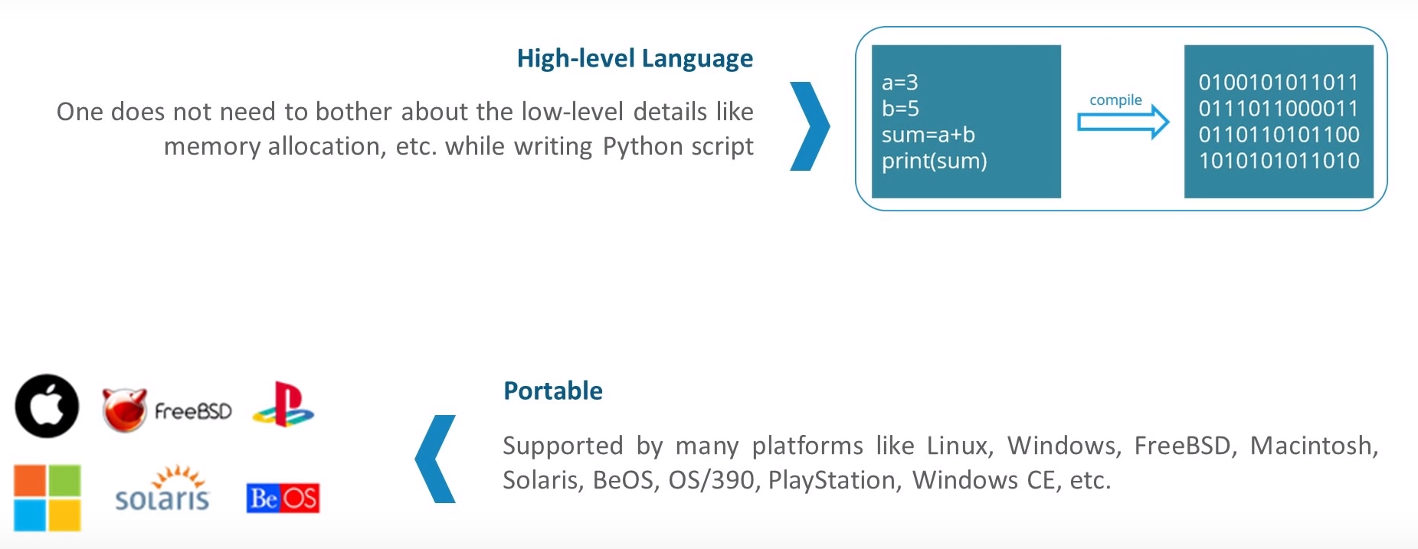
Why Python ?
Notes:
Easy
When we say the word ‘easy’, we mean it in different contexts.
a. Easy to code
As we have seen in earlier lessons, Python is very easy to code. Compared to other popular languages like Java and C++, it is easier to code in Python. Anyone can learn python syntax in just a few hours. Though sure, mastering Python requires learning about all its advanced concepts and packages and modules. That takes time. Thus, it is programmer-friendly.
b. Easy to read
Being a high-level language, Python code is quite like English. Looking at it, you can tell what the code is supposed to do. Also, since it is dynamically-typed, it mandates indentation. This aids readability. Read: Applications of Python Programming Language
3. Expressive
First, let’s learn about expressiveness. Suppose we have two languages A and B, and all programs that can be made in A can be made in B using local transformations. However, there are some programs that can be made in B, but not in A, using local transformations. Then, B is said to be more expressive than A. Python provides us with a myriad of constructs that help us focus on the solution rather than on the syntax. This is one of the outstanding python features that tells you why you should learn Python.
4. Free and Open-Source
Firstly, Python is freely available. You can download it from the following link https://www.python.org/downloads/ For insight on how to download and install Python, refer to our tutorial on Python Installation. Secondly, it is open-source. This means that its source code is available to the public. You can download it, change it, use it, and distribute it. This is called FLOSS(Free/Libre and Open Source Software). As the Python community, we’re all headed toward one goal- an ever-bettering Python.
5. High- Level
As we discussed in point 2b, it is a high-level language. This means that as programmers, we don’t need to remember the system architecture. Nor do we need to manage the memory. This makes it more programmer-friendly and is 1 of the key python features.Any doubt yet in the features of Python. Please ask. Read: Pros and Cons of Python Programming Language
6. Portable
Let’s assume you’ve written a Python code for your Windows machine. Now, if you want to run it on a Mac, you don’t need to make changes to it for the same. In other words, you can take one code and run it on any machine, there is no need to write different code for different machines. This makes Python a portable language. However, you must avoid any system-dependent features in this case. Read: Career Opportunities in Python
7. Interpreted
If you’re any familiar with languages like C++ or Java, you must first compile it, and then run it. But in Python, there is no need to compile it. Internally, its source code is converted into an immediate form called bytecode. So, all you need to do is to run your Python code without worrying about linking to libraries, and a few other things. By interpreted, we mean the source code is executed line by line, and not all at once. Because of this, it is easier to debug your code. Also, interpreting makes it just slightly slower than Java, but that does not matter compared to the benefits it has to offer. Any doubt or query yet about the features of python programming language? If yes, Drop a comment and we will get back to you. Install Python on Windows
8. Object-Oriented
A programming language that can model the real world is said to be object-oriented. It focuses on objects, and combines data and functions. Contrarily, a procedure-oriented language revolves around functions, which are code that can be reused. Python supports both procedure-oriented and object-oriented programming which is one of the key python features. It also supports multiple inheritance, unlike Java. A class is a blueprint for such an object. It is an abstract data type, and holds no values. Read: Syntax in Python
9. Extensible
If needed, you can write some of your Python code in other languages like C++. This makes Python an extensible language, meaning that it can be extended to other languages. Let us look at some more Python features.
10. Embeddable
We just saw that we can put code in other languages in our Python source code. However, it is also possible to put our Python code in a source code in a different language like C++. This allows us to integrate scripting capabilities into our program of the other language. Read: Python tutorials for beginners
11. Large Standard Library
Python downloads with a large library that you can use so you don’t have to write your own code for every single thing. There are libraries for regular expressions, documentation-generation, unit-testing, web browsers, threading, databases, CGI, email, image manipulation, and a lot of other functionality.
12. GUI Programming
You can use Tk to create basic GUIs.
13. Dynamically Typed
Python is dynamically-typed. This means that the type for a value is decided at runtime, not in advance. This is why we don’t need to specify the type of data while declaring it. This is all about the features of python programming language tutorial. lets get to the conclusion. Read: Reasons why Learn Python
14. Features of Python: Conclusion
Now that you know what are the features of python, you know what makes it special. In this tutorial, we learned about various features of Python. We saw that it is interpreted, dynamically-typed, and object-oriented, among other python features. It is also portable, free, and easy. Now that’s some motivation to dive into the world of Python.

Slide 7
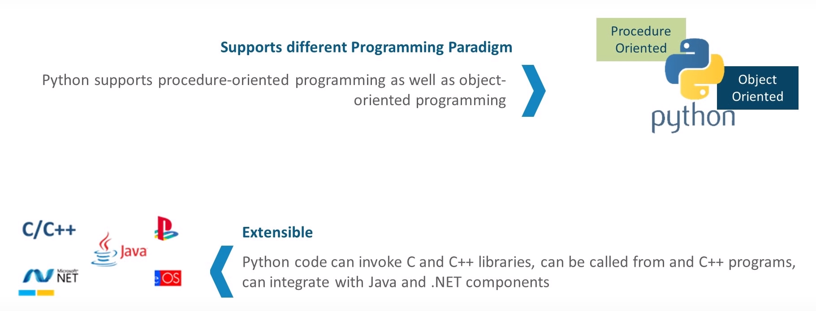
Why Python ?
Notes:
Easy
When we say the word ‘easy’, we mean it in different contexts.
a. Easy to code
As we have seen in earlier lessons, Python is very easy to code. Compared to other popular languages like Java and C++, it is easier to code in Python. Anyone can learn python syntax in just a few hours. Though sure, mastering Python requires learning about all its advanced concepts and packages and modules. That takes time. Thus, it is programmer-friendly.
b. Easy to read
Being a high-level language, Python code is quite like English. Looking at it, you can tell what the code is supposed to do. Also, since it is dynamically-typed, it mandates indentation. This aids readability. Read: Applications of Python Programming Language
3. Expressive
First, let’s learn about expressiveness. Suppose we have two languages A and B, and all programs that can be made in A can be made in B using local transformations. However, there are some programs that can be made in B, but not in A, using local transformations. Then, B is said to be more expressive than A. Python provides us with a myriad of constructs that help us focus on the solution rather than on the syntax. This is one of the outstanding python features that tells you why you should learn Python.
4. Free and Open-Source
Firstly, Python is freely available. You can download it from the following link https://www.python.org/downloads/ For insight on how to download and install Python, refer to our tutorial on Python Installation. Secondly, it is open-source. This means that its source code is available to the public. You can download it, change it, use it, and distribute it. This is called FLOSS(Free/Libre and Open Source Software). As the Python community, we’re all headed toward one goal- an ever-bettering Python.
5. High- Level
As we discussed in point 2b, it is a high-level language. This means that as programmers, we don’t need to remember the system architecture. Nor do we need to manage the memory. This makes it more programmer-friendly and is 1 of the key python features.Any doubt yet in the features of Python. Please ask. Read: Pros and Cons of Python Programming Language
6. Portable
Let’s assume you’ve written a Python code for your Windows machine. Now, if you want to run it on a Mac, you don’t need to make changes to it for the same. In other words, you can take one code and run it on any machine, there is no need to write different code for different machines. This makes Python a portable language. However, you must avoid any system-dependent features in this case. Read: Career Opportunities in Python
7. Interpreted
If you’re any familiar with languages like C++ or Java, you must first compile it, and then run it. But in Python, there is no need to compile it. Internally, its source code is converted into an immediate form called bytecode. So, all you need to do is to run your Python code without worrying about linking to libraries, and a few other things. By interpreted, we mean the source code is executed line by line, and not all at once. Because of this, it is easier to debug your code. Also, interpreting makes it just slightly slower than Java, but that does not matter compared to the benefits it has to offer. Any doubt or query yet about the features of python programming language? If yes, Drop a comment and we will get back to you. Install Python on Windows
8. Object-Oriented
A programming language that can model the real world is said to be object-oriented. It focuses on objects, and combines data and functions. Contrarily, a procedure-oriented language revolves around functions, which are code that can be reused. Python supports both procedure-oriented and object-oriented programming which is one of the key python features. It also supports multiple inheritance, unlike Java. A class is a blueprint for such an object. It is an abstract data type, and holds no values. Read: Syntax in Python
9. Extensible
If needed, you can write some of your Python code in other languages like C++. This makes Python an extensible language, meaning that it can be extended to other languages. Let us look at some more Python features.
10. Embeddable
We just saw that we can put code in other languages in our Python source code. However, it is also possible to put our Python code in a source code in a different language like C++. This allows us to integrate scripting capabilities into our program of the other language. Read: Python tutorials for beginners
11. Large Standard Library
Python downloads with a large library that you can use so you don’t have to write your own code for every single thing. There are libraries for regular expressions, documentation-generation, unit-testing, web browsers, threading, databases, CGI, email, image manipulation, and a lot of other functionality.
12. GUI Programming
You can use Tk to create basic GUIs.
13. Dynamically Typed
Python is dynamically-typed. This means that the type for a value is decided at runtime, not in advance. This is why we don’t need to specify the type of data while declaring it. This is all about the features of python programming language tutorial. lets get to the conclusion. Read: Reasons why Learn Python
14. Features of Python: Conclusion
Now that you know what are the features of python, you know what makes it special. In this tutorial, we learned about various features of Python. We saw that it is interpreted, dynamically-typed, and object-oriented, among other python features. It is also portable, free, and easy. Now that’s some motivation to dive into the world of Python.

Slide 8
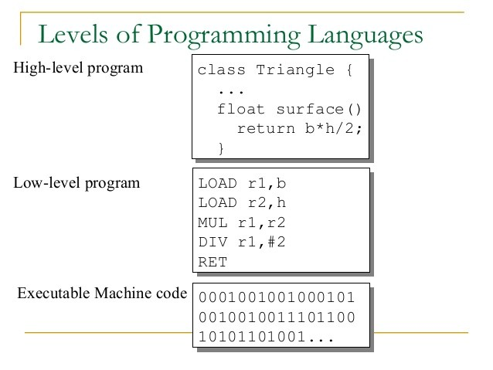
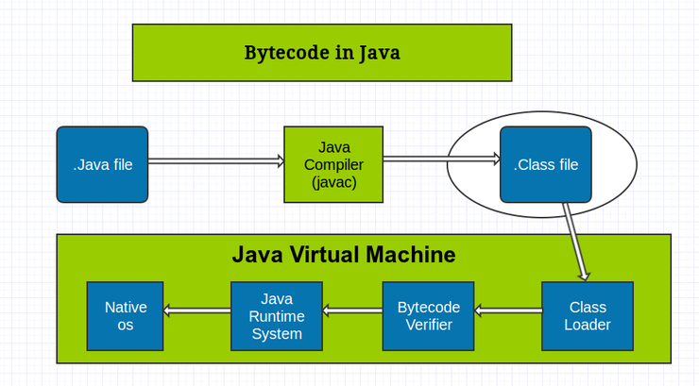
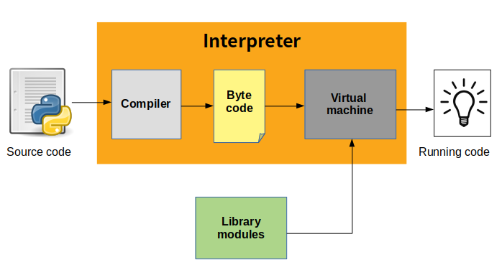
Python Interpreter
Notes:
Easy
When we say the word ‘easy’, we mean it in different contexts.
a. Easy to code
As we have seen in earlier lessons, Python is very easy to code. Compared to other popular languages like Java and C++, it is easier to code in Python. Anyone can learn python syntax in just a few hours. Though sure, mastering Python requires learning about all its advanced concepts and packages and modules. That takes time. Thus, it is programmer-friendly.
b. Easy to read
Being a high-level language, Python code is quite like English. Looking at it, you can tell what the code is supposed to do. Also, since it is dynamically-typed, it mandates indentation. This aids readability. Read: Applications of Python Programming Language
3. Expressive
First, let’s learn about expressiveness. Suppose we have two languages A and B, and all programs that can be made in A can be made in B using local transformations. However, there are some programs that can be made in B, but not in A, using local transformations. Then, B is said to be more expressive than A. Python provides us with a myriad of constructs that help us focus on the solution rather than on the syntax. This is one of the outstanding python features that tells you why you should learn Python.
4. Free and Open-Source
Firstly, Python is freely available. You can download it from the following link https://www.python.org/downloads/ For insight on how to download and install Python, refer to our tutorial on Python Installation. Secondly, it is open-source. This means that its source code is available to the public. You can download it, change it, use it, and distribute it. This is called FLOSS(Free/Libre and Open Source Software). As the Python community, we’re all headed toward one goal- an ever-bettering Python.
5. High- Level
As we discussed in point 2b, it is a high-level language. This means that as programmers, we don’t need to remember the system architecture. Nor do we need to manage the memory. This makes it more programmer-friendly and is 1 of the key python features.Any doubt yet in the features of Python. Please ask. Read: Pros and Cons of Python Programming Language
6. Portable
Let’s assume you’ve written a Python code for your Windows machine. Now, if you want to run it on a Mac, you don’t need to make changes to it for the same. In other words, you can take one code and run it on any machine, there is no need to write different code for different machines. This makes Python a portable language. However, you must avoid any system-dependent features in this case. Read: Career Opportunities in Python
7. Interpreted
If you’re any familiar with languages like C++ or Java, you must first compile it, and then run it. But in Python, there is no need to compile it. Internally, its source code is converted into an immediate form called bytecode. So, all you need to do is to run your Python code without worrying about linking to libraries, and a few other things. By interpreted, we mean the source code is executed line by line, and not all at once. Because of this, it is easier to debug your code. Also, interpreting makes it just slightly slower than Java, but that does not matter compared to the benefits it has to offer. Any doubt or query yet about the features of python programming language? If yes, Drop a comment and we will get back to you. Install Python on Windows
8. Object-Oriented
A programming language that can model the real world is said to be object-oriented. It focuses on objects, and combines data and functions. Contrarily, a procedure-oriented language revolves around functions, which are code that can be reused. Python supports both procedure-oriented and object-oriented programming which is one of the key python features. It also supports multiple inheritance, unlike Java. A class is a blueprint for such an object. It is an abstract data type, and holds no values. Read: Syntax in Python
9. Extensible
If needed, you can write some of your Python code in other languages like C++. This makes Python an extensible language, meaning that it can be extended to other languages. Let us look at some more Python features.
10. Embeddable
We just saw that we can put code in other languages in our Python source code. However, it is also possible to put our Python code in a source code in a different language like C++. This allows us to integrate scripting capabilities into our program of the other language. Read: Python tutorials for beginners
11. Large Standard Library
Python downloads with a large library that you can use so you don’t have to write your own code for every single thing. There are libraries for regular expressions, documentation-generation, unit-testing, web browsers, threading, databases, CGI, email, image manipulation, and a lot of other functionality.
12. GUI Programming
You can use Tk to create basic GUIs.
13. Dynamically Typed
Python is dynamically-typed. This means that the type for a value is decided at runtime, not in advance. This is why we don’t need to specify the type of data while declaring it. This is all about the features of python programming language tutorial. lets get to the conclusion. Read: Reasons why Learn Python
14. Features of Python: Conclusion
Now that you know what are the features of python, you know what makes it special. In this tutorial, we learned about various features of Python. We saw that it is interpreted, dynamically-typed, and object-oriented, among other python features. It is also portable, free, and easy. Now that’s some motivation to dive into the world of Python.

Slide 9
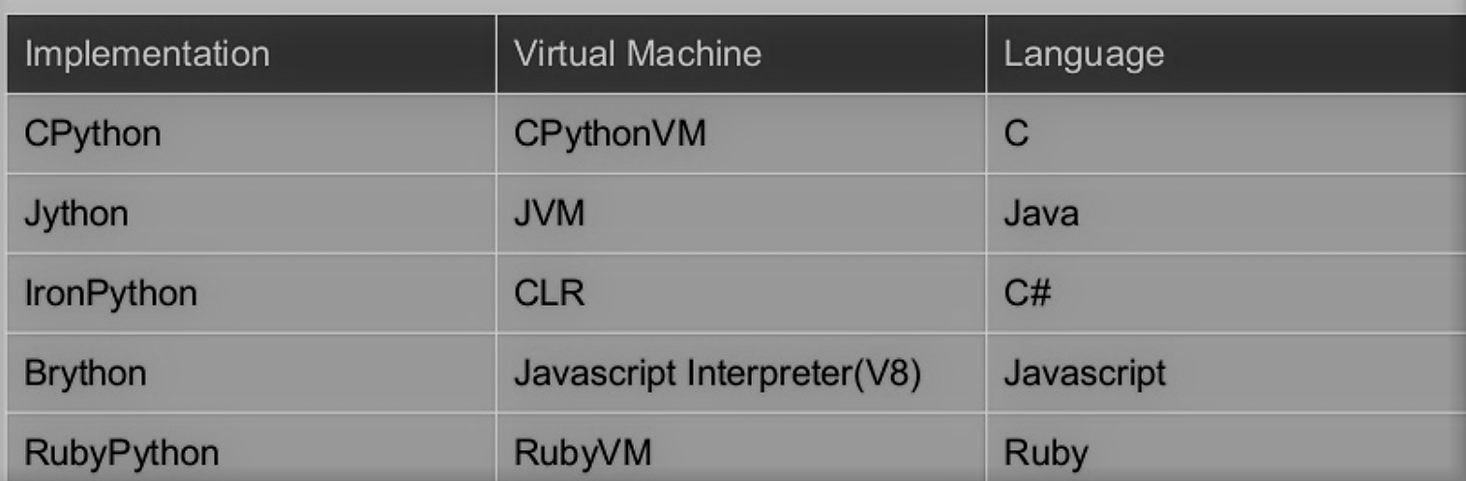
Flavors of Python
Notes:
Easy
When we say the word ‘easy’, we mean it in different contexts.
a. Easy to code
As we have seen in earlier lessons, Python is very easy to code. Compared to other popular languages like Java and C++, it is easier to code in Python. Anyone can learn python syntax in just a few hours. Though sure, mastering Python requires learning about all its advanced concepts and packages and modules. That takes time. Thus, it is programmer-friendly.
b. Easy to read
Being a high-level language, Python code is quite like English. Looking at it, you can tell what the code is supposed to do. Also, since it is dynamically-typed, it mandates indentation. This aids readability. Read: Applications of Python Programming Language
3. Expressive
First, let’s learn about expressiveness. Suppose we have two languages A and B, and all programs that can be made in A can be made in B using local transformations. However, there are some programs that can be made in B, but not in A, using local transformations. Then, B is said to be more expressive than A. Python provides us with a myriad of constructs that help us focus on the solution rather than on the syntax. This is one of the outstanding python features that tells you why you should learn Python.
4. Free and Open-Source
Firstly, Python is freely available. You can download it from the following link https://www.python.org/downloads/ For insight on how to download and install Python, refer to our tutorial on Python Installation. Secondly, it is open-source. This means that its source code is available to the public. You can download it, change it, use it, and distribute it. This is called FLOSS(Free/Libre and Open Source Software). As the Python community, we’re all headed toward one goal- an ever-bettering Python.
5. High- Level
As we discussed in point 2b, it is a high-level language. This means that as programmers, we don’t need to remember the system architecture. Nor do we need to manage the memory. This makes it more programmer-friendly and is 1 of the key python features.Any doubt yet in the features of Python. Please ask. Read: Pros and Cons of Python Programming Language
6. Portable
Let’s assume you’ve written a Python code for your Windows machine. Now, if you want to run it on a Mac, you don’t need to make changes to it for the same. In other words, you can take one code and run it on any machine, there is no need to write different code for different machines. This makes Python a portable language. However, you must avoid any system-dependent features in this case. Read: Career Opportunities in Python
7. Interpreted
If you’re any familiar with languages like C++ or Java, you must first compile it, and then run it. But in Python, there is no need to compile it. Internally, its source code is converted into an immediate form called bytecode. So, all you need to do is to run your Python code without worrying about linking to libraries, and a few other things. By interpreted, we mean the source code is executed line by line, and not all at once. Because of this, it is easier to debug your code. Also, interpreting makes it just slightly slower than Java, but that does not matter compared to the benefits it has to offer. Any doubt or query yet about the features of python programming language? If yes, Drop a comment and we will get back to you. Install Python on Windows
8. Object-Oriented
A programming language that can model the real world is said to be object-oriented. It focuses on objects, and combines data and functions. Contrarily, a procedure-oriented language revolves around functions, which are code that can be reused. Python supports both procedure-oriented and object-oriented programming which is one of the key python features. It also supports multiple inheritance, unlike Java. A class is a blueprint for such an object. It is an abstract data type, and holds no values. Read: Syntax in Python
9. Extensible
If needed, you can write some of your Python code in other languages like C++. This makes Python an extensible language, meaning that it can be extended to other languages. Let us look at some more Python features.
10. Embeddable
We just saw that we can put code in other languages in our Python source code. However, it is also possible to put our Python code in a source code in a different language like C++. This allows us to integrate scripting capabilities into our program of the other language. Read: Python tutorials for beginners
11. Large Standard Library
Python downloads with a large library that you can use so you don’t have to write your own code for every single thing. There are libraries for regular expressions, documentation-generation, unit-testing, web browsers, threading, databases, CGI, email, image manipulation, and a lot of other functionality.
12. GUI Programming
You can use Tk to create basic GUIs.
13. Dynamically Typed
Python is dynamically-typed. This means that the type for a value is decided at runtime, not in advance. This is why we don’t need to specify the type of data while declaring it. This is all about the features of python programming language tutorial. lets get to the conclusion. Read: Reasons why Learn Python
14. Features of Python: Conclusion
Now that you know what are the features of python, you know what makes it special. In this tutorial, we learned about various features of Python. We saw that it is interpreted, dynamically-typed, and object-oriented, among other python features. It is also portable, free, and easy. Now that’s some motivation to dive into the world of Python.

