Slide 1
JavaScript asynchronous programming. Callbacks, Promises and Observables.

Slide 2
Why we need these things? Why not loop?

Slide 3
How we can made the same task asynchronous?

Slide 4
How to have logic after this?

Slide 5
Why callback is bad?

Slide 6
Use of jQuery Deferred.

Slide 7
Use of native promise.

Slide 8
More promises examples.

Slide 9
Web worker way.

Slide 10
The good old XMLHttpRequest.

Slide 11
Reactive Libraries - RxJS and BaconJS

Slide 12
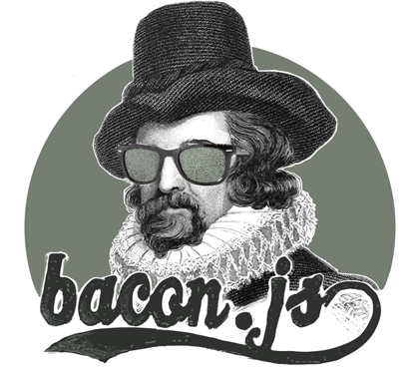
But why BaconJS and RxJS?

Slide 13
Q & A

