Slide 1
Data Analysis and Integration
Portugal's Economic and Human Development - A Century of Transformation
Project 26/27 – Group 20
Gonçalo Xavier (109560) & Rita Líbano Monteiro (110754)

Slide 2
Contents
1. Staging and Data Profiling
5. OLAP Cube and Saiku
2. Country-Code Reconciliation
6. MDX Queries
3. Data Warehouse Design
7. Analysis Questions
4. ETL Pipelines
8. Report and Data Quality

Slide 3
Task 1 – Staging and Data Profiling
Staging database, load pipeline, exploratory queries and data dictionaries

Slide 4
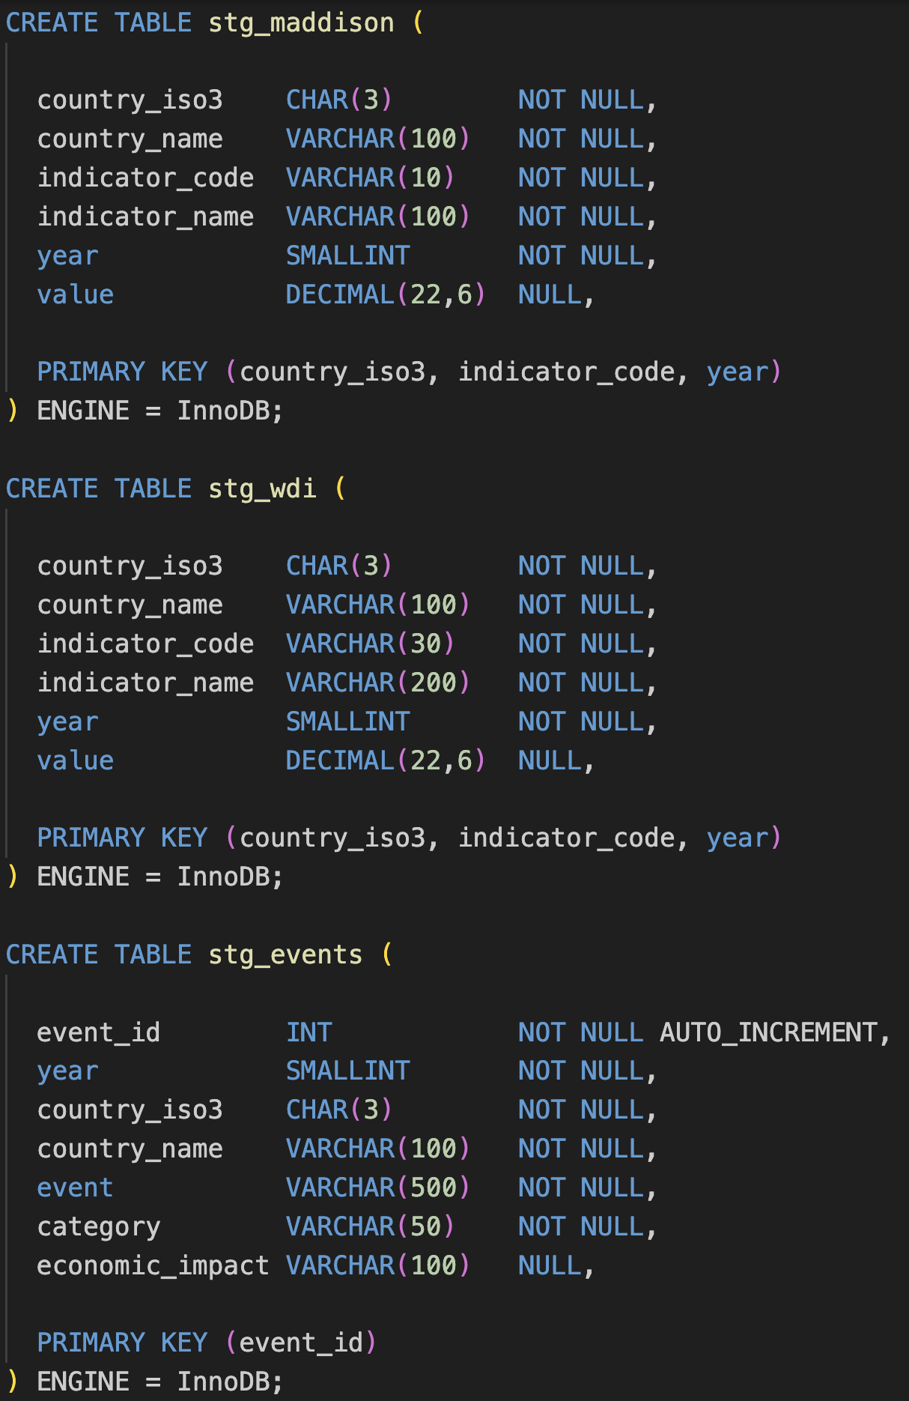
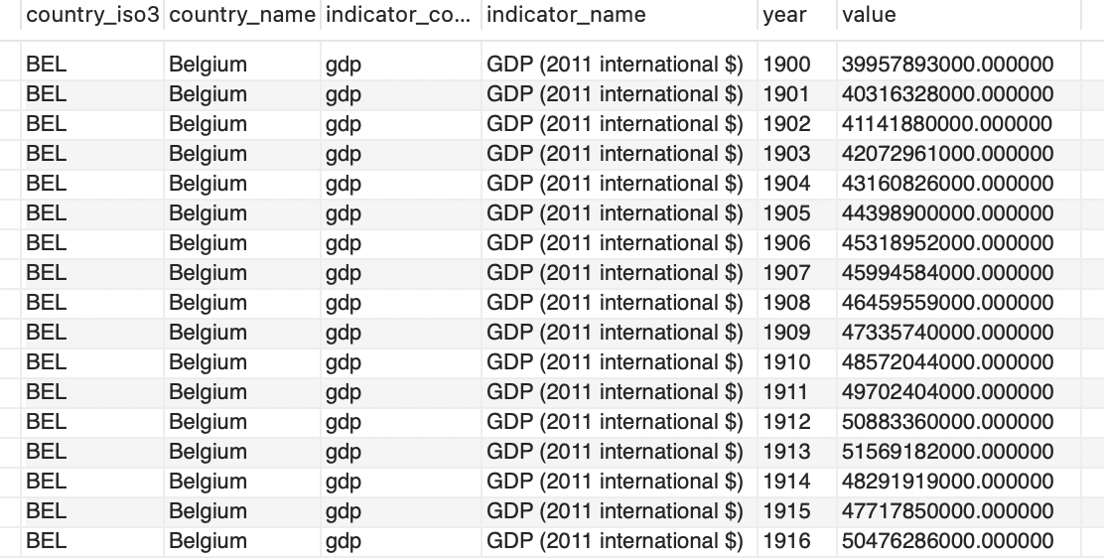
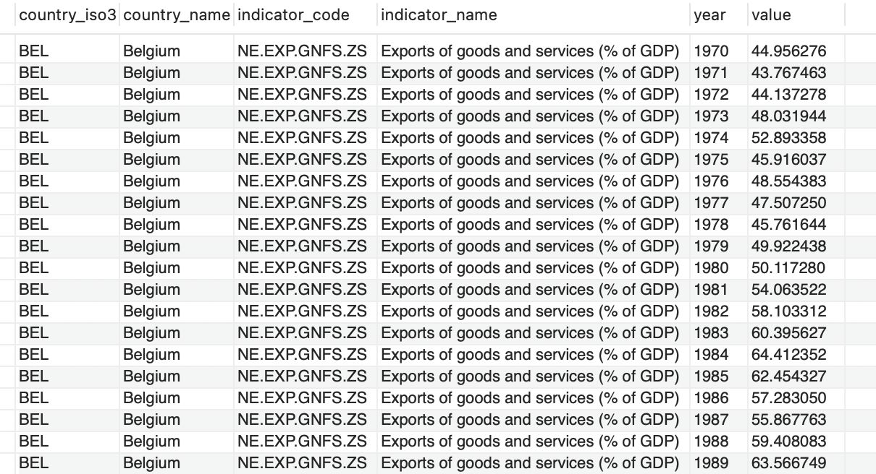
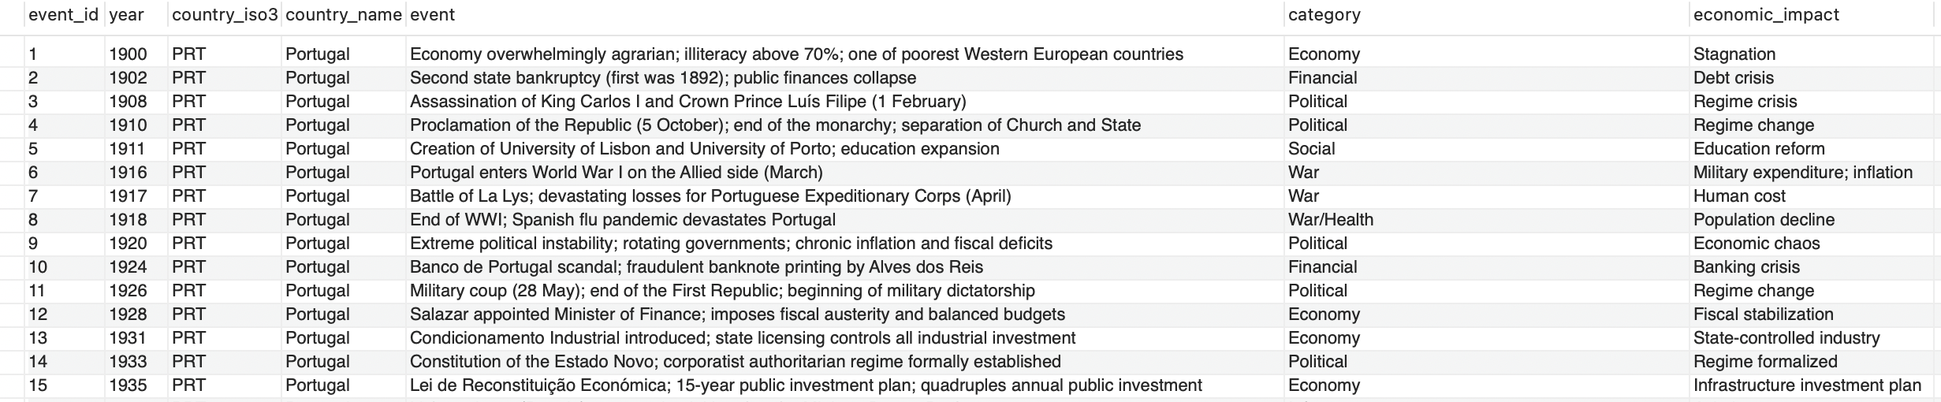
Staging schema with precise data types
Maddison and Wdi use the same composite primary key, each row is one value per country, indicator and year, so country and the indicator alone repeat every year
Events has no natural key so it was necessary to create a surrogate key

Slide 5
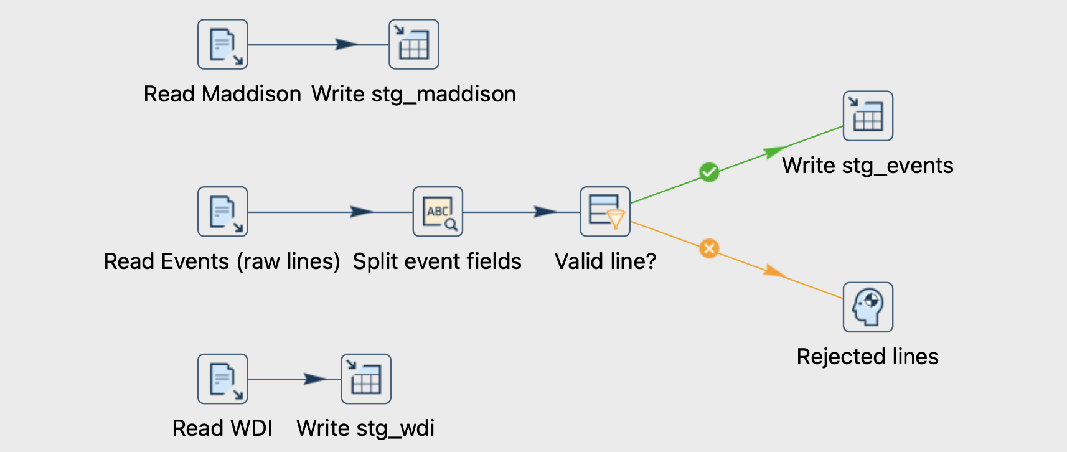
Load pipeline (one branch per source)
Maddison
CSV file input → Table output (stg_maddison)
Events
CSV file input → Regex evaluation → Filter rows → Table output
WDI
CSV file input → Table output (stg_wdi)

Slide 6
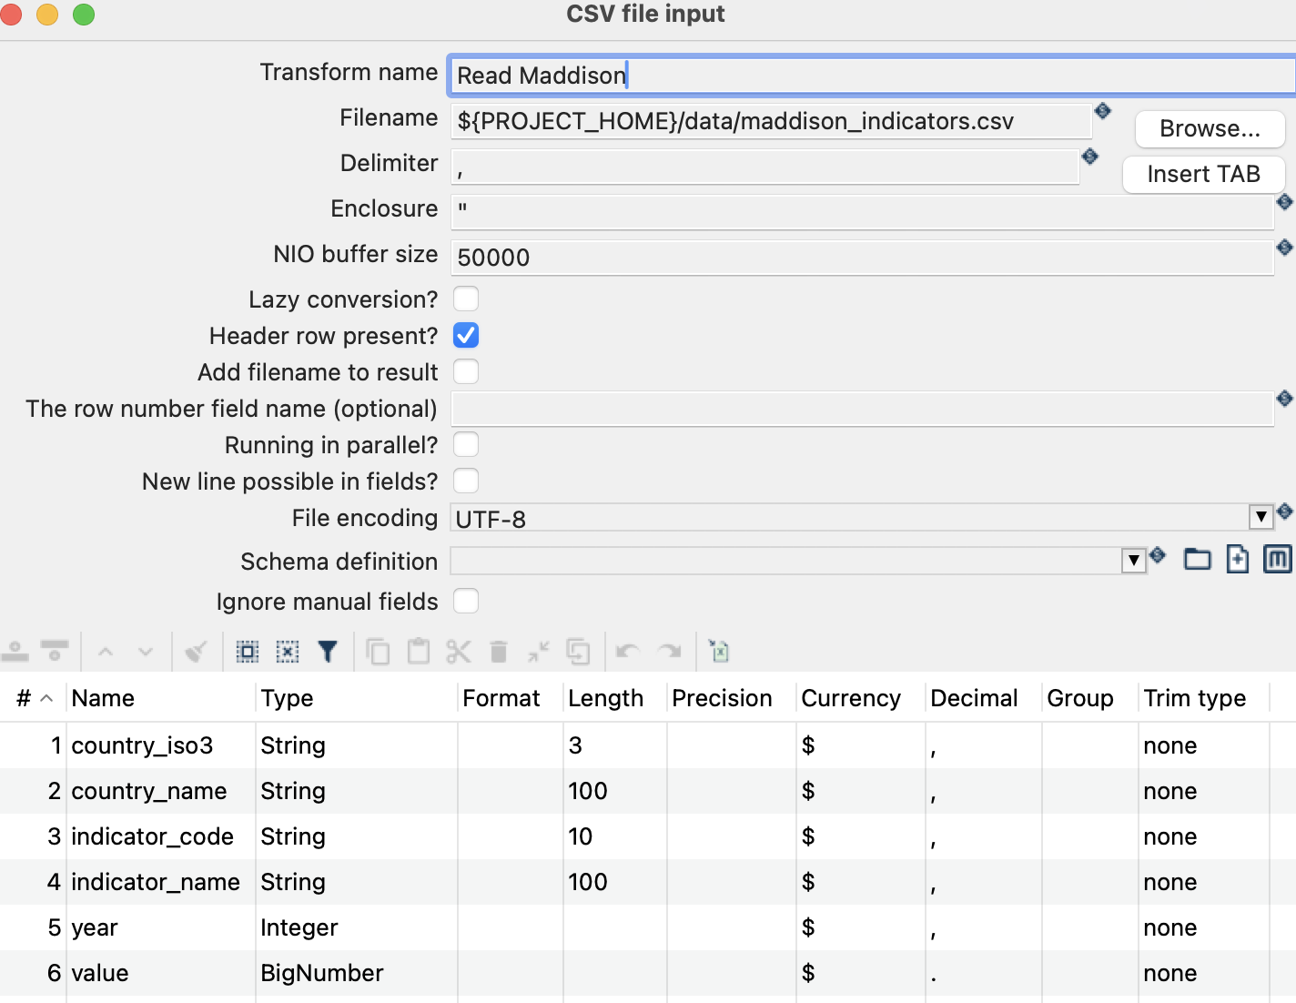
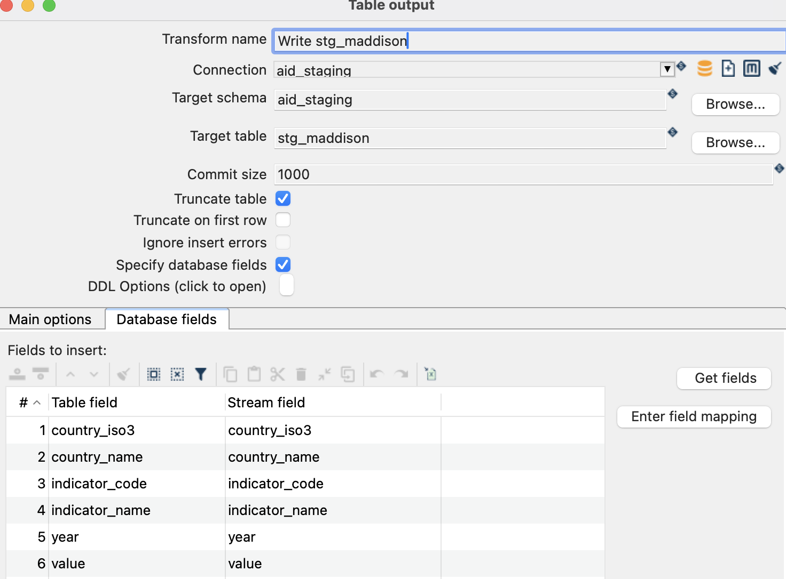
Key transform configurations
Path with ${PROJECT_HOME}, not an absolute path
year is Integer, value is BigNumber
Truncate table, the load can be re-run
Explicit mapping; event_id left to MySQL

Slide 7
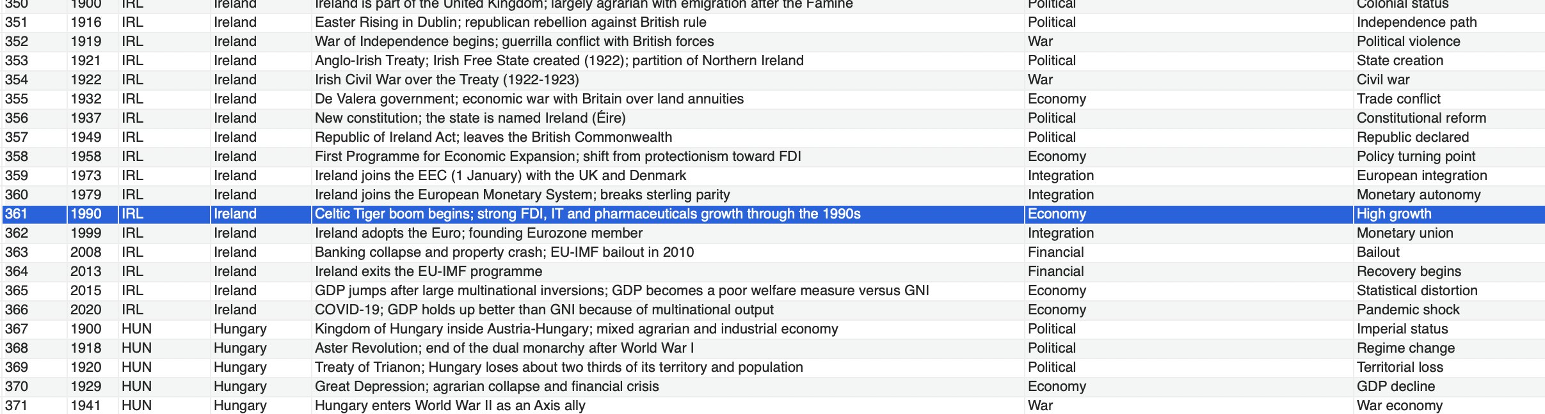
An unprotected comma
1990,IRL,Ireland,Celtic Tiger boom begins; strong FDI, IT and pharmaceuticals growth through the 1990s,Economy,High growth
We noted the presence of an unprotected comma in line 362 of the events csv file, which split that row into 7 fields instead of 6. Instead of editing the source file, the load pipeline reads each line and splits it with a regular expression that allows commas, only in the event field
Read the whole line (delimiter |)
Regex split into 6 fields
Filter is_valid = Y
Table output stg_events
^(\d{4}),([A-Z]{3}),([^,]*),(.*),([^,]*),([^,]*)$

Slide 8
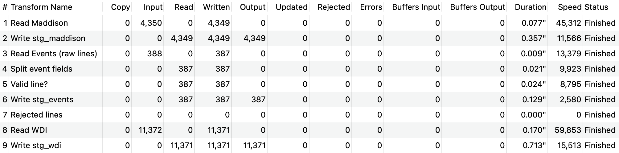
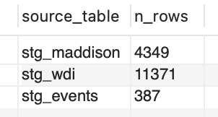
All rows loaded into staging
4,349
stg_maddison
4,350 lines incl. header
387
stg_events
388 lines incl. header
11,371
stg_wdi
11,372 lines incl. header

Slide 9
Profiling - six sections of queries (overview)
Section | Question | Key fact found
1. Row count per table | Which countries are in each source? | EU missing only in Maddison
2. Year ranges | Which years per source and country? | 1900–2025 overall but some gaps in the East
3. WDI coverage | Since when is each indicator available? | Sectors from 1995 and employment from 1991
4. Missing values | Where is data missing? | 0 NULLs missing data = absent rows
5. Data integrity | Are there duplicates? Consistent values? | 0 duplicates gdp = gdppc × pop × 1000
6. Historical events | How are events distributed? | Portugal 125 of 387

Slide 10
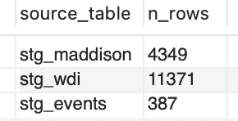
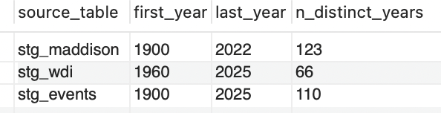
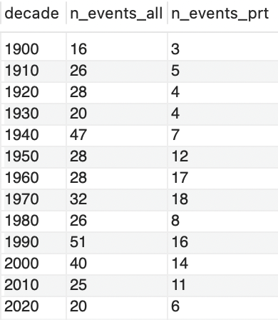
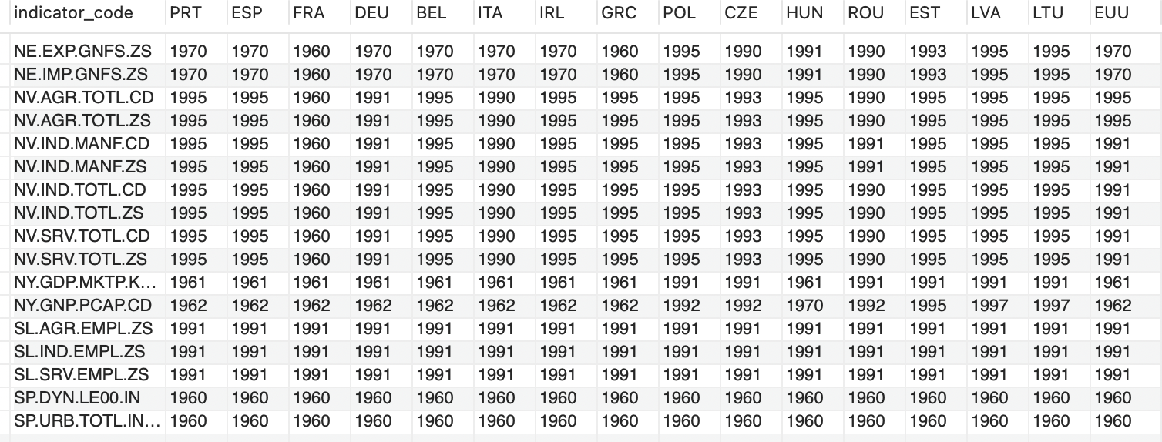
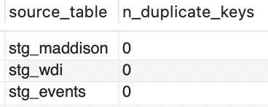

Profiling (query screenshots)

Slide 11
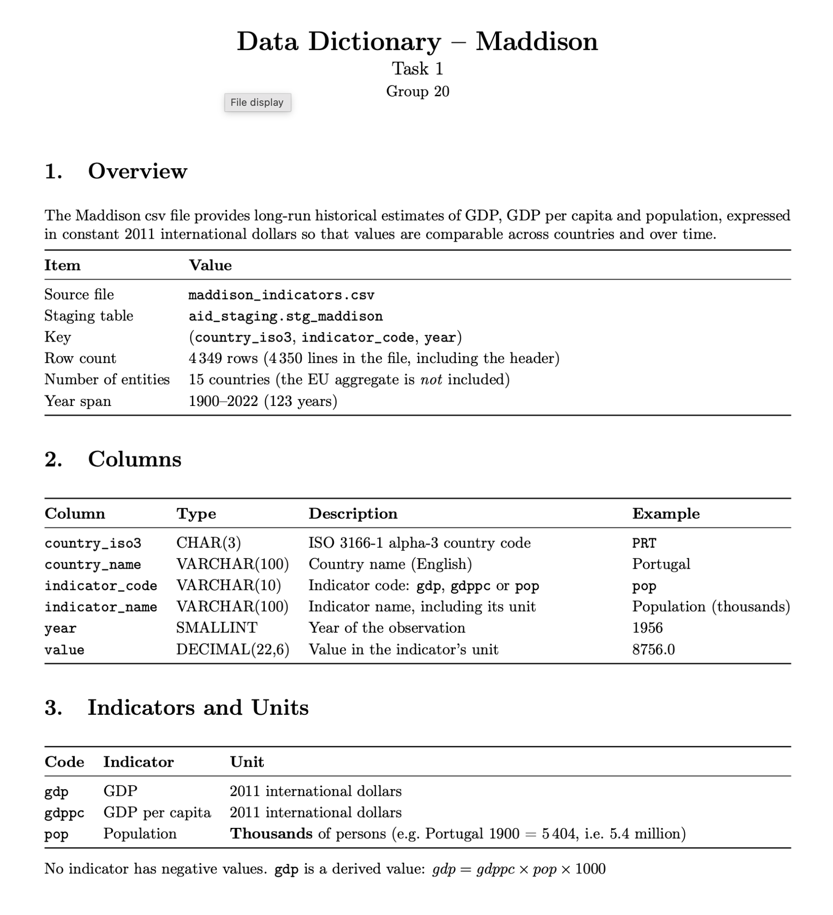
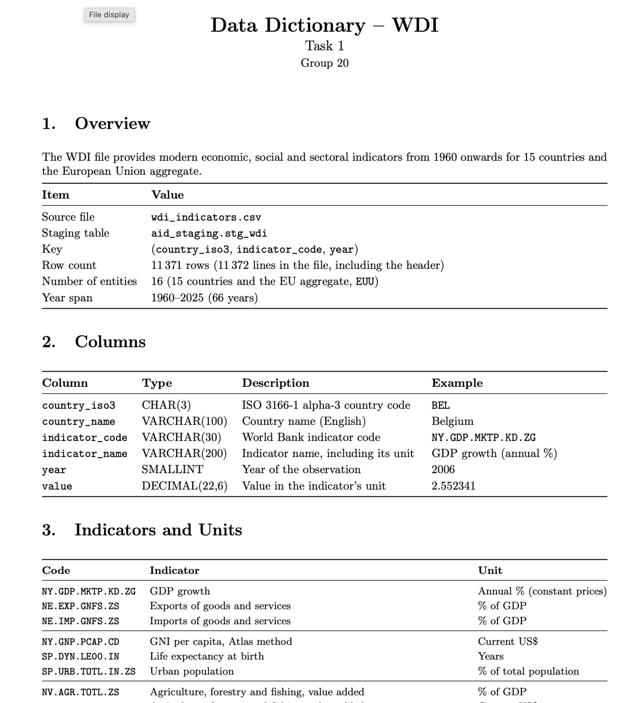
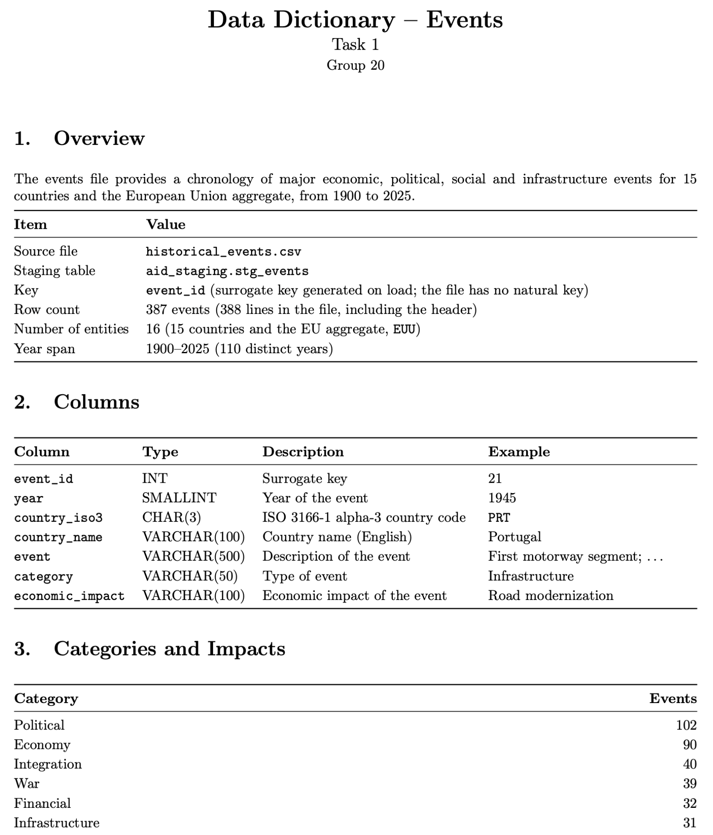
Data dictionaries
Maddison
WDI
Events
4,349 rows · 15 countries · 1900–2022
11,371 rows · 16 entities · 1960–2025
387 events · 16 entities · 1900–2025
Particularities and data quality:
EU missing
Missing data as absent rows
Romania – misalign indicators
Particularities and data quality:
Missing data as absent rows
EU included
Manufacturing is part of industry
No employment for manufacturing
Extreme GDP growth
Particularities and data quality:
Unprotected comma in one row
No natural key
Composite categories
No missing fields
Coverage beyond the indicators

Slide 12
Task 2 – Country-Code Reconciliation
Unified country mapping from the three sources, with country groups

Slide 13
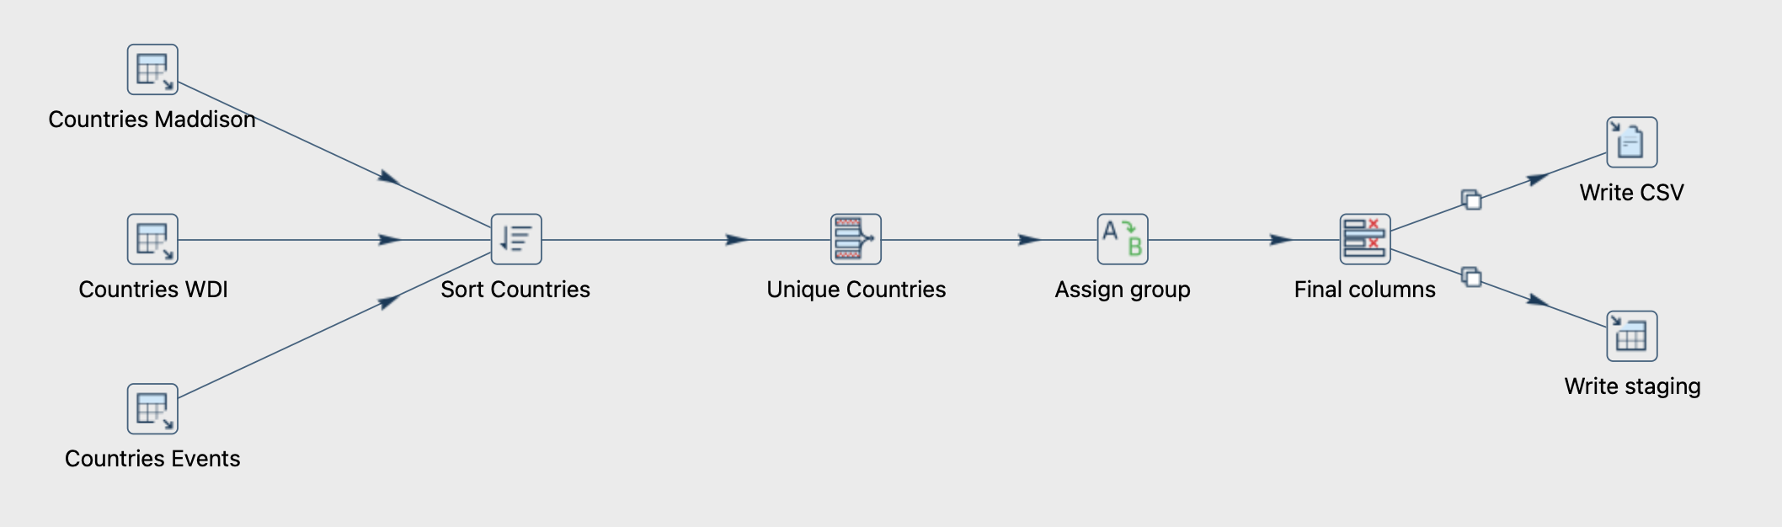
Reconciliation pipeline
Extract distinct countries
Sort and remove duplicates
Assign country group
Write CSV and staging
The pipeline extracts distinct countries from the three data sources and sorts them by code, and eliminates all duplicates, leaving 16 countries, and each one is assigned its country group with a value mapper. The resulting mapping is written both to a csv file and to the staging table

Slide 14
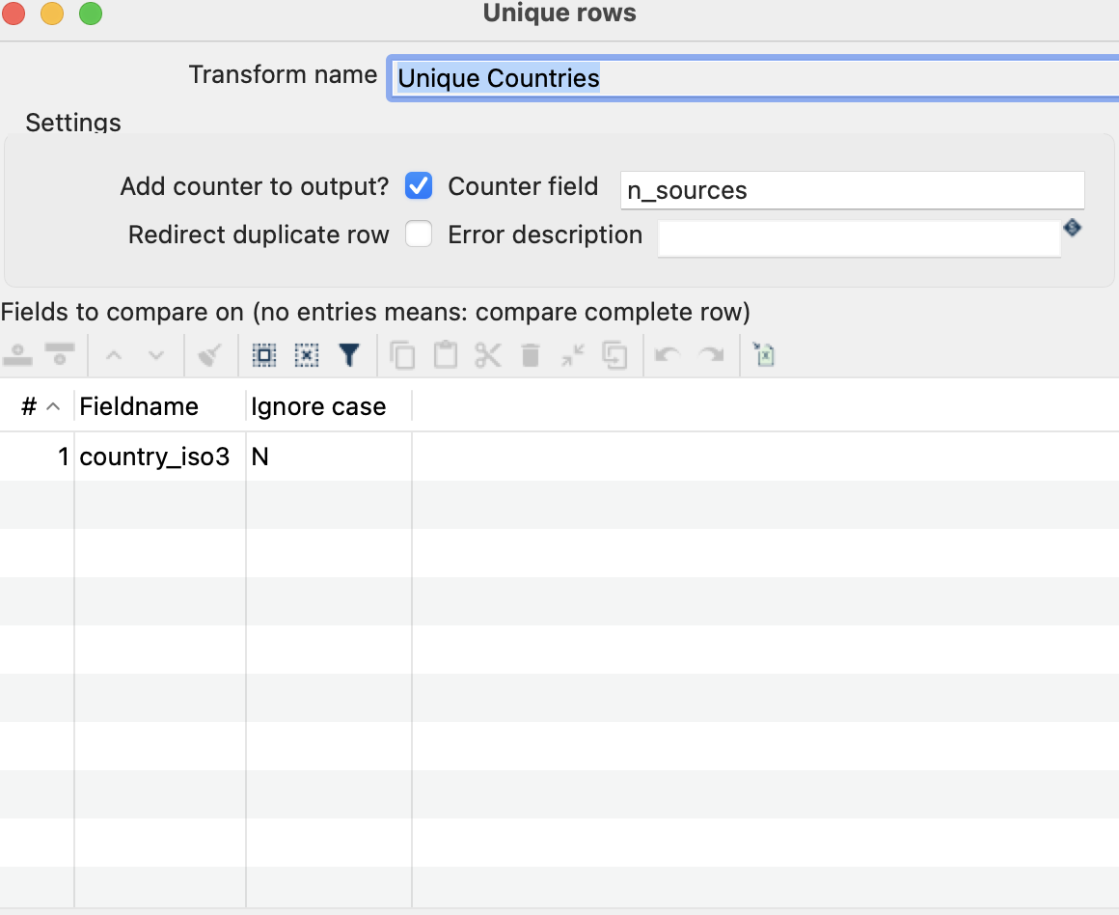
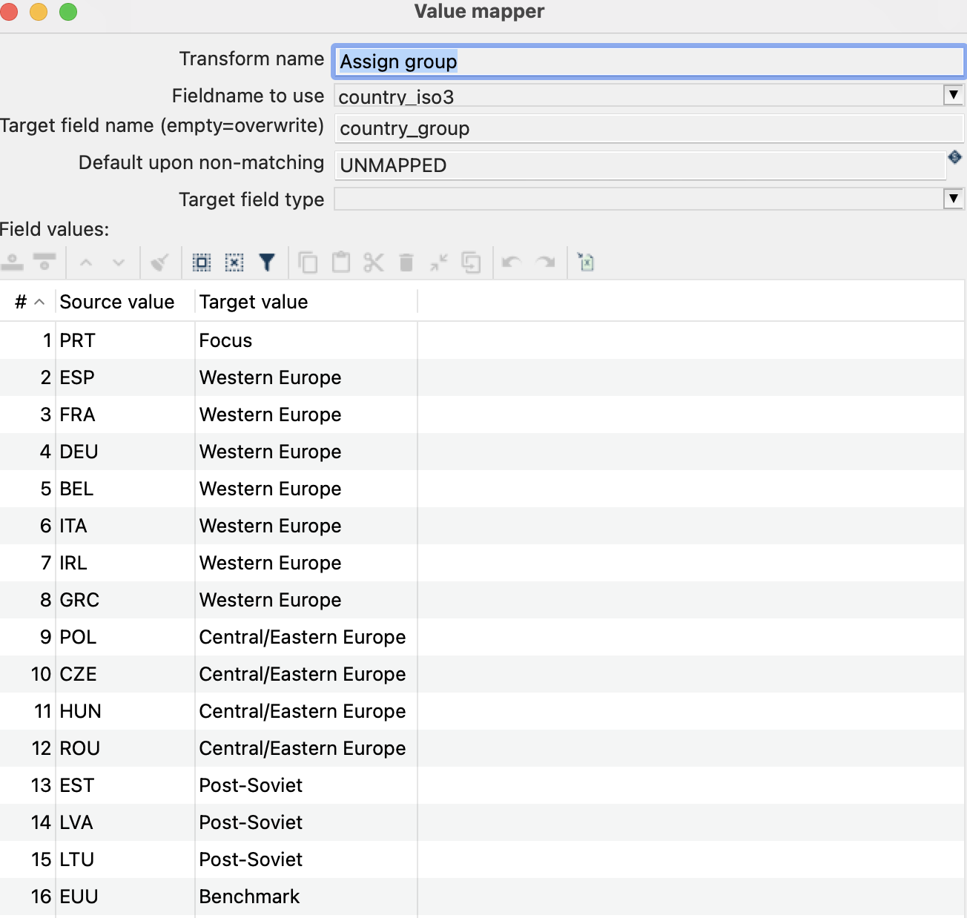
Key transform configurations
Unique rows only removes consecutive duplicates
n_sources counts in how many sources each country appears
16 mappings, default UNMAPPED makes any missing code visible

Slide 15
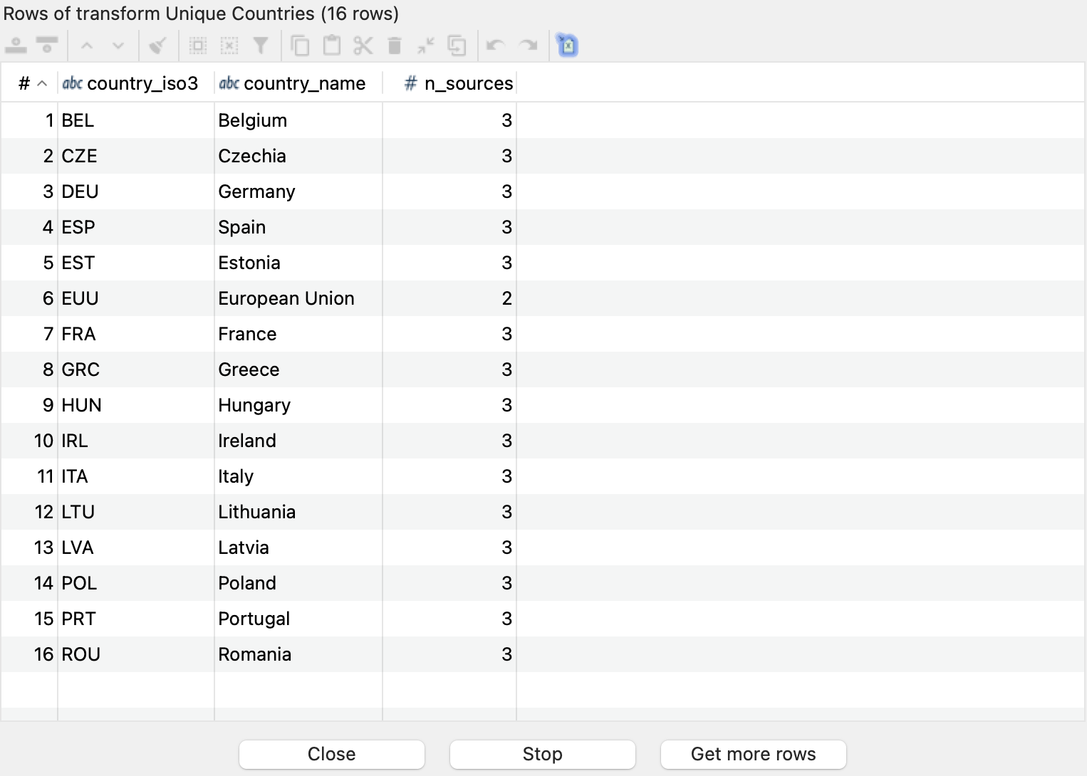
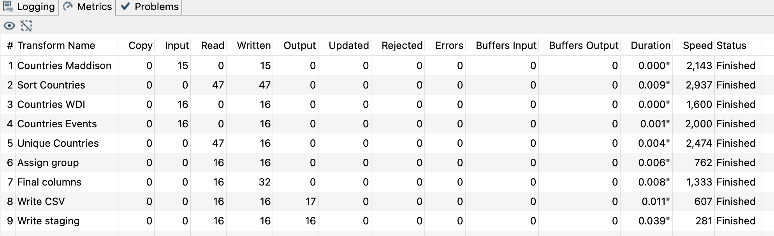
After running the pipeline
15
Maddison
EU aggregate missing
16
WDI
15 countries + EU
16
Events
15 countries + EU
Every country appears in all 3 sources (n_sources = 3), the EU aggregate appears in 2, as it is not in Maddison

Slide 16
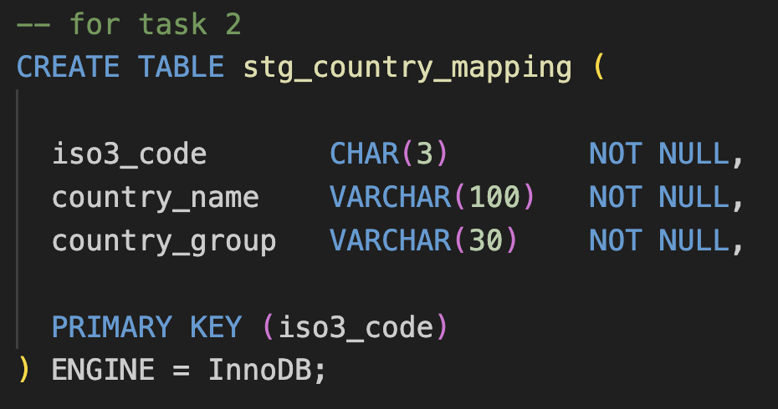
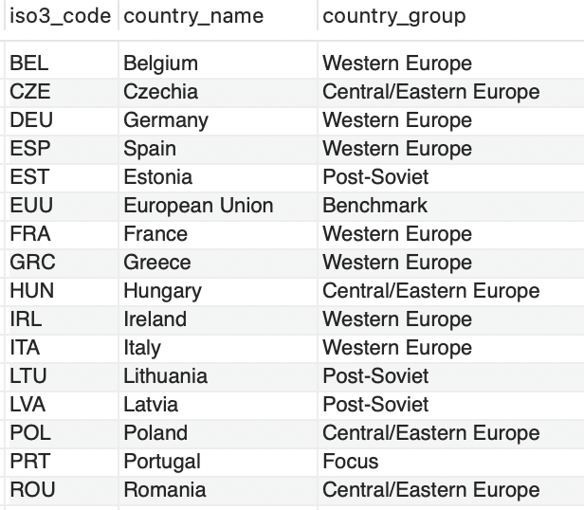
Unified country mapping
Country group | Countries | n
Focus | Portugal | 1
Western Europe | ESP, FRA, DEU, BEL, ITA, IRL, GRC | 7
Central / Eastern Europe | POL, CZE, HUN, ROU | 4
Post-Soviet | EST, LVA, LTU | 3
Benchmark | European Union | 1
The final mapping contains 16 rows, one per country, each with its code, name and one of the five country groups, it is stored both in the csv file and in the database table

Slide 17
Task 3 – Data Warehouse Design
Star schema with three fact tables, three dimensions and an events bridge

Slide 18
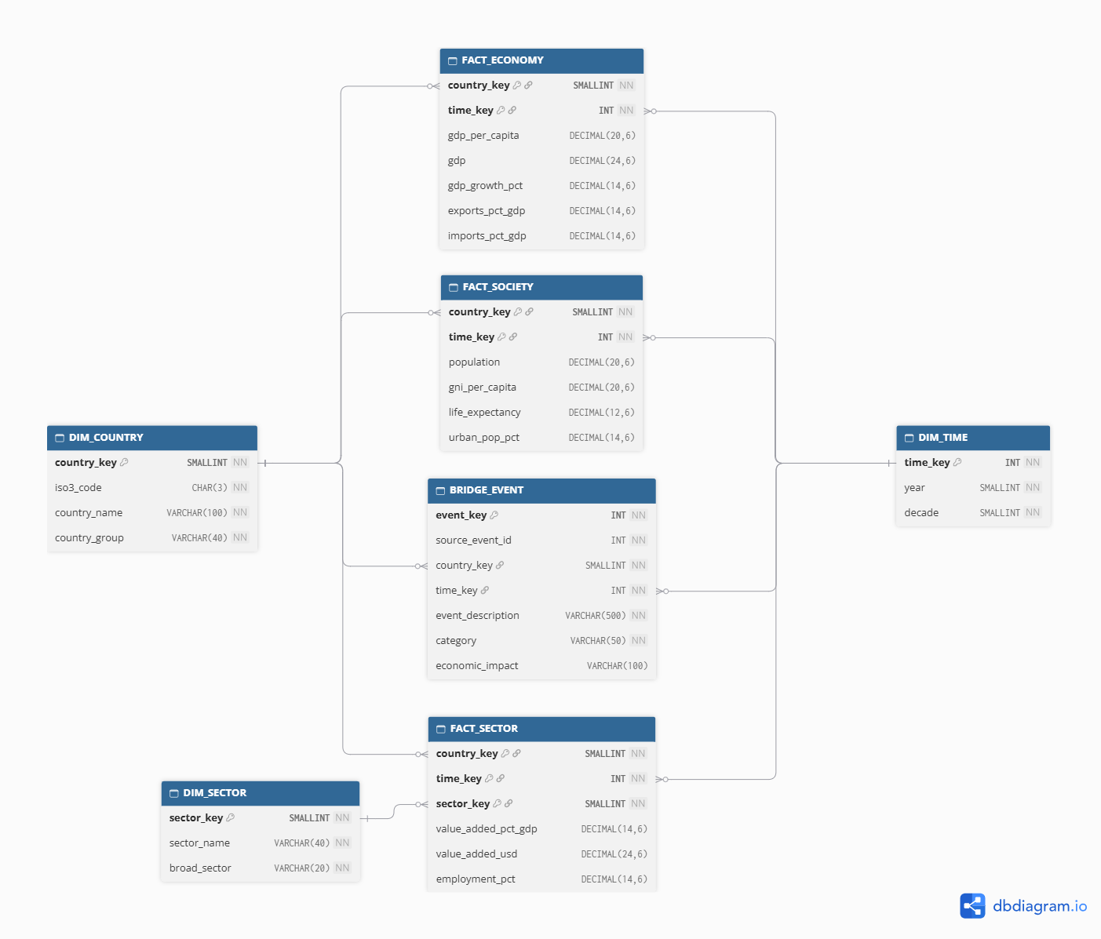
Star schema of the data warehouse
7 tables in a separate database (aid_dw), 3 facts, 3 dimensions with surrogate keys, and BRIDGE_EVENT
Notes:
Diagrama ER (task_03/schema_diagram.png), feito no dbdiagram.io.

Slide 19
Three fact tables, two grains
Fact table | Grain | Measures | Source
FACT_ECONOMY | Country × Year | gdp_per_capita, gdp, gdp_growth_pct, exports_pct_gdp, imports_pct_gdp | Maddison and WDI
FACT_SOCIETY | Country × Year | population, gni_per_capita, life_expectancy, urban_pop_pct | Maddison and WDI
FACT_SECTOR | Country × Year × Sector | value_added_pct_gdp, value_added_usd, employment_pct | WDI
Why three fact tables?
Economy and society are different subject areas, sector data has a finer grain. A single table would repeat country-level measures across sectors and aggregate them incorrectly
Why DIM_SECTOR only in FACT_SECTOR?
Only sector indicators are measured by sector. GDP, population or life expectancy do not belong to any sector
Notes:
Conteúdo retirado do design_justification.pdf.

Slide 20
Dimensions with surrogate keys
Dimension | Surrogate key | Natural key (unique) | Attributes | Hierarchy
DIM_COUNTRY | country_key | iso3_code | country_name, country_group | Country group → Country
DIM_TIME | time_key | year | decade | Decade → Year
DIM_SECTOR | sector_key | sector_name | broad_sector | Broad sector → Sector
Shared by all facts
DIM_COUNTRY and DIM_TIME are conformed, the three facts can be compared by country group, country, decade and year
Sector hierarchy
Primary → Agriculture, Secondary → Industry, Manufacturing, Tertiary → Services. Manufacturing is part of industry, never summed
Integrity rules
CHECK constraints on country_group, decade and broad_sector, unique natural keys, foreign keys from every fact

Slide 21
Events integrated as a bridge table
Option | Assessment | Choice
1. Standalone table joined by year | Simple, but loses the link to the country | –
2. Bridge to DIM_TIME and DIM_COUNTRY | Keeps country and year, allows several events per country-year | Chosen
3. New DIM_EVENT dimension | Does not fit the country-year grain | –
BRIDGE_EVENT - one row per event, with country_key, time_key, description, category and impact
source_event_id links each row to stg_events and prevents double loading
Events are queried separately from the measures, to avoid multiplying them
Notes:
O 24 vem da query 6.4 do profiling (task_01/exploratory_queries.sql).

