Slide 1
Information Visualization Visualization Sketch
G52-T
97036 – Martim Bravo
97090 - Gonçalo Adolfo
97402 - Francisco Delgado

Slide 2
Overview
01

Slide 3
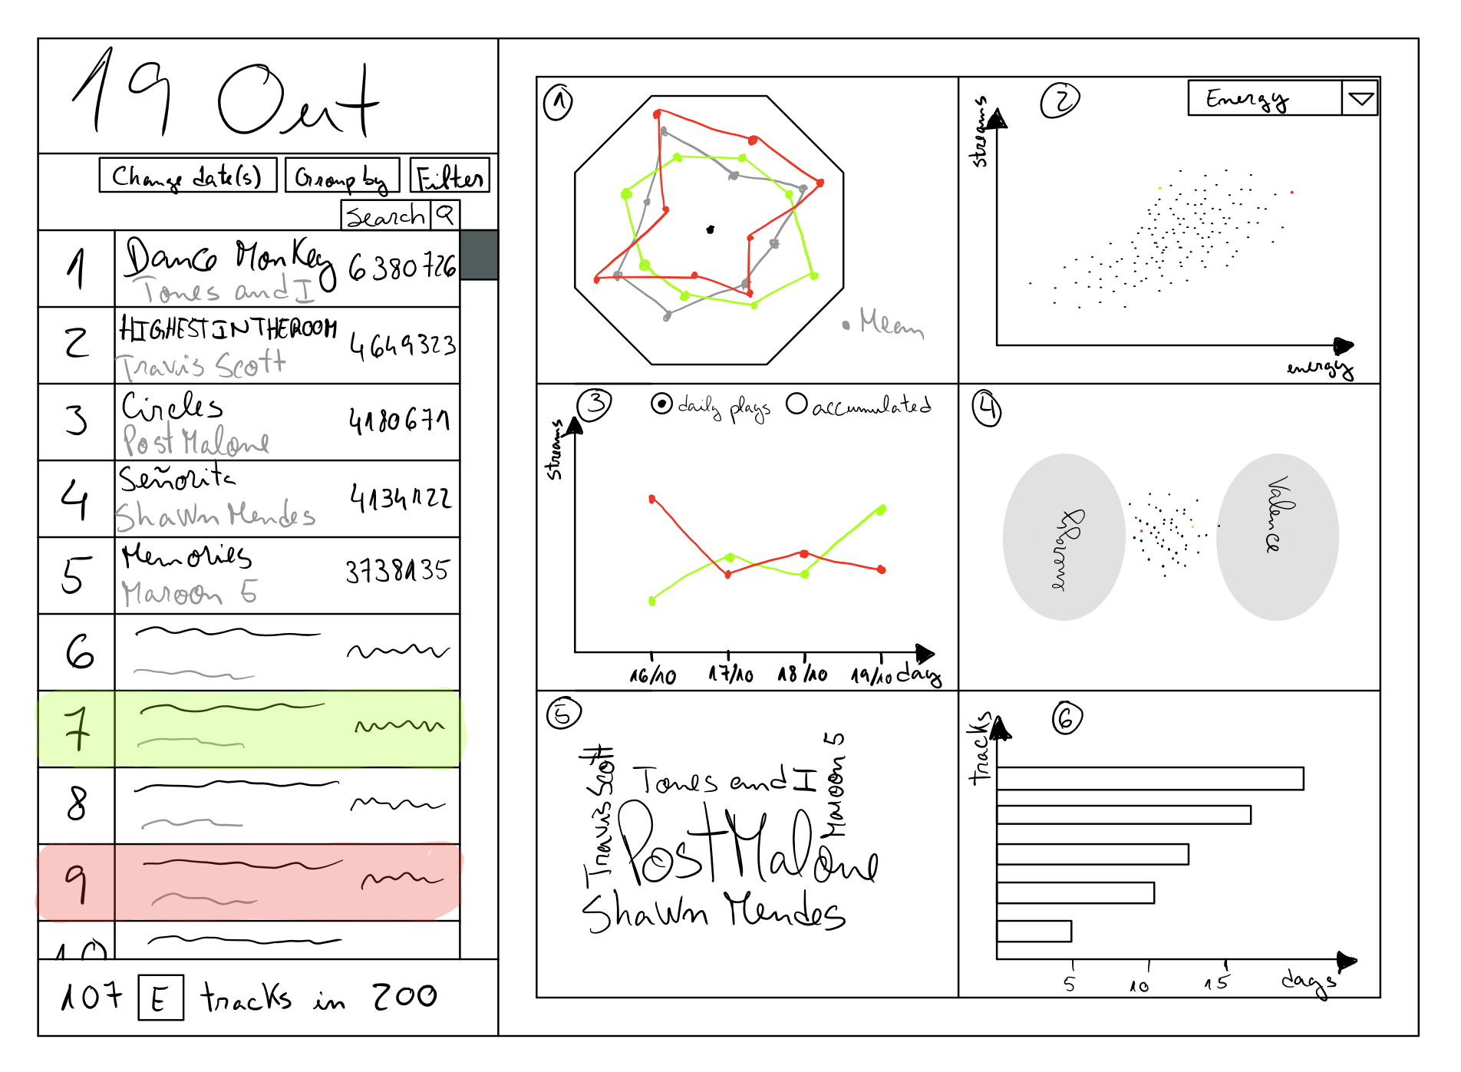
Overview

Slide 4
Overview (cont.)
The visualization has a list with the tracks for a given day (or interval between two dates) and all the idioms depend on the tracks that are being shown in the list
Spider chart: purpose to compare the features values between tracks (always shows mean values of the tracks in list)
Scatter plot: purpose to see if there is a correlation between a selected feature and the number of streams

Slide 5
Overview (cont.)
Line chart: shows the daily streams or the accumulated daily streams for the selected tracks
Multi-foci force layout: shows the distribution between multiple features
Word cloud: shows which artists have more streams for the day or time period selected
Bar chart: shows the tracks that spent more days consecutively for that time period

Slide 6
Visual encoding
02

Slide 7
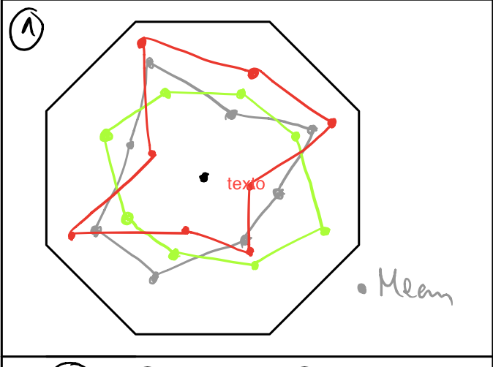
Visual Encoding
Idiom: Spider chart
Marks:
Point – A track feature
Channels:
Color – A selected track
Position (distance to the center) – Feature value

Slide 8
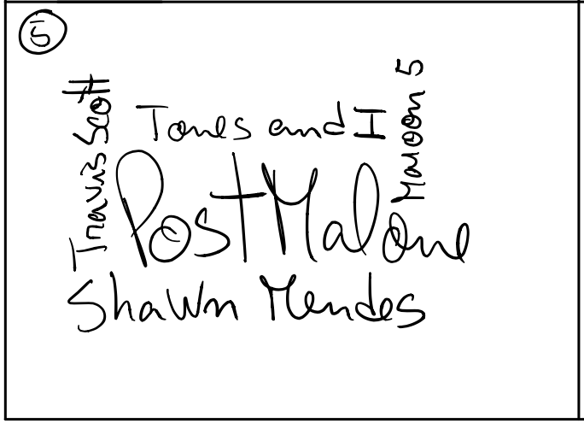
Visual Encoding
Idiom: Word Cloud
Marks:
Word – An artist
Channels:
Size – The artist’s accumulated streams

Slide 9
Answering the Questions
03

Slide 10
How does the features (energy, loudness, tempo, etc) of the track affect its popularity?
After selecting in the list on the left the desired tracks to analyze. They will appear on the Star Chart (Idiom 1) and be highlighted on the Scatter Plot (Idiom 2), that way we can analyze with the average of all the tracks in the desired period. And we can also analyze specific traits of the tracks on the scatter plot, which will appear what we select with the rest of the tracks

Slide 11
Which artists have had a good 2019? Which tracks were most played during a period?
To answer this question, we select in the list on the left, a range that spans all of 2019, and afterwards analyse the Word Cloud (Idiom 5) which will demonstrate with bigger letters the artists which were played the most. And also, by grouping the table on the left by artists we can analyse what were the streaming numbers for each artists track.

Slide 12
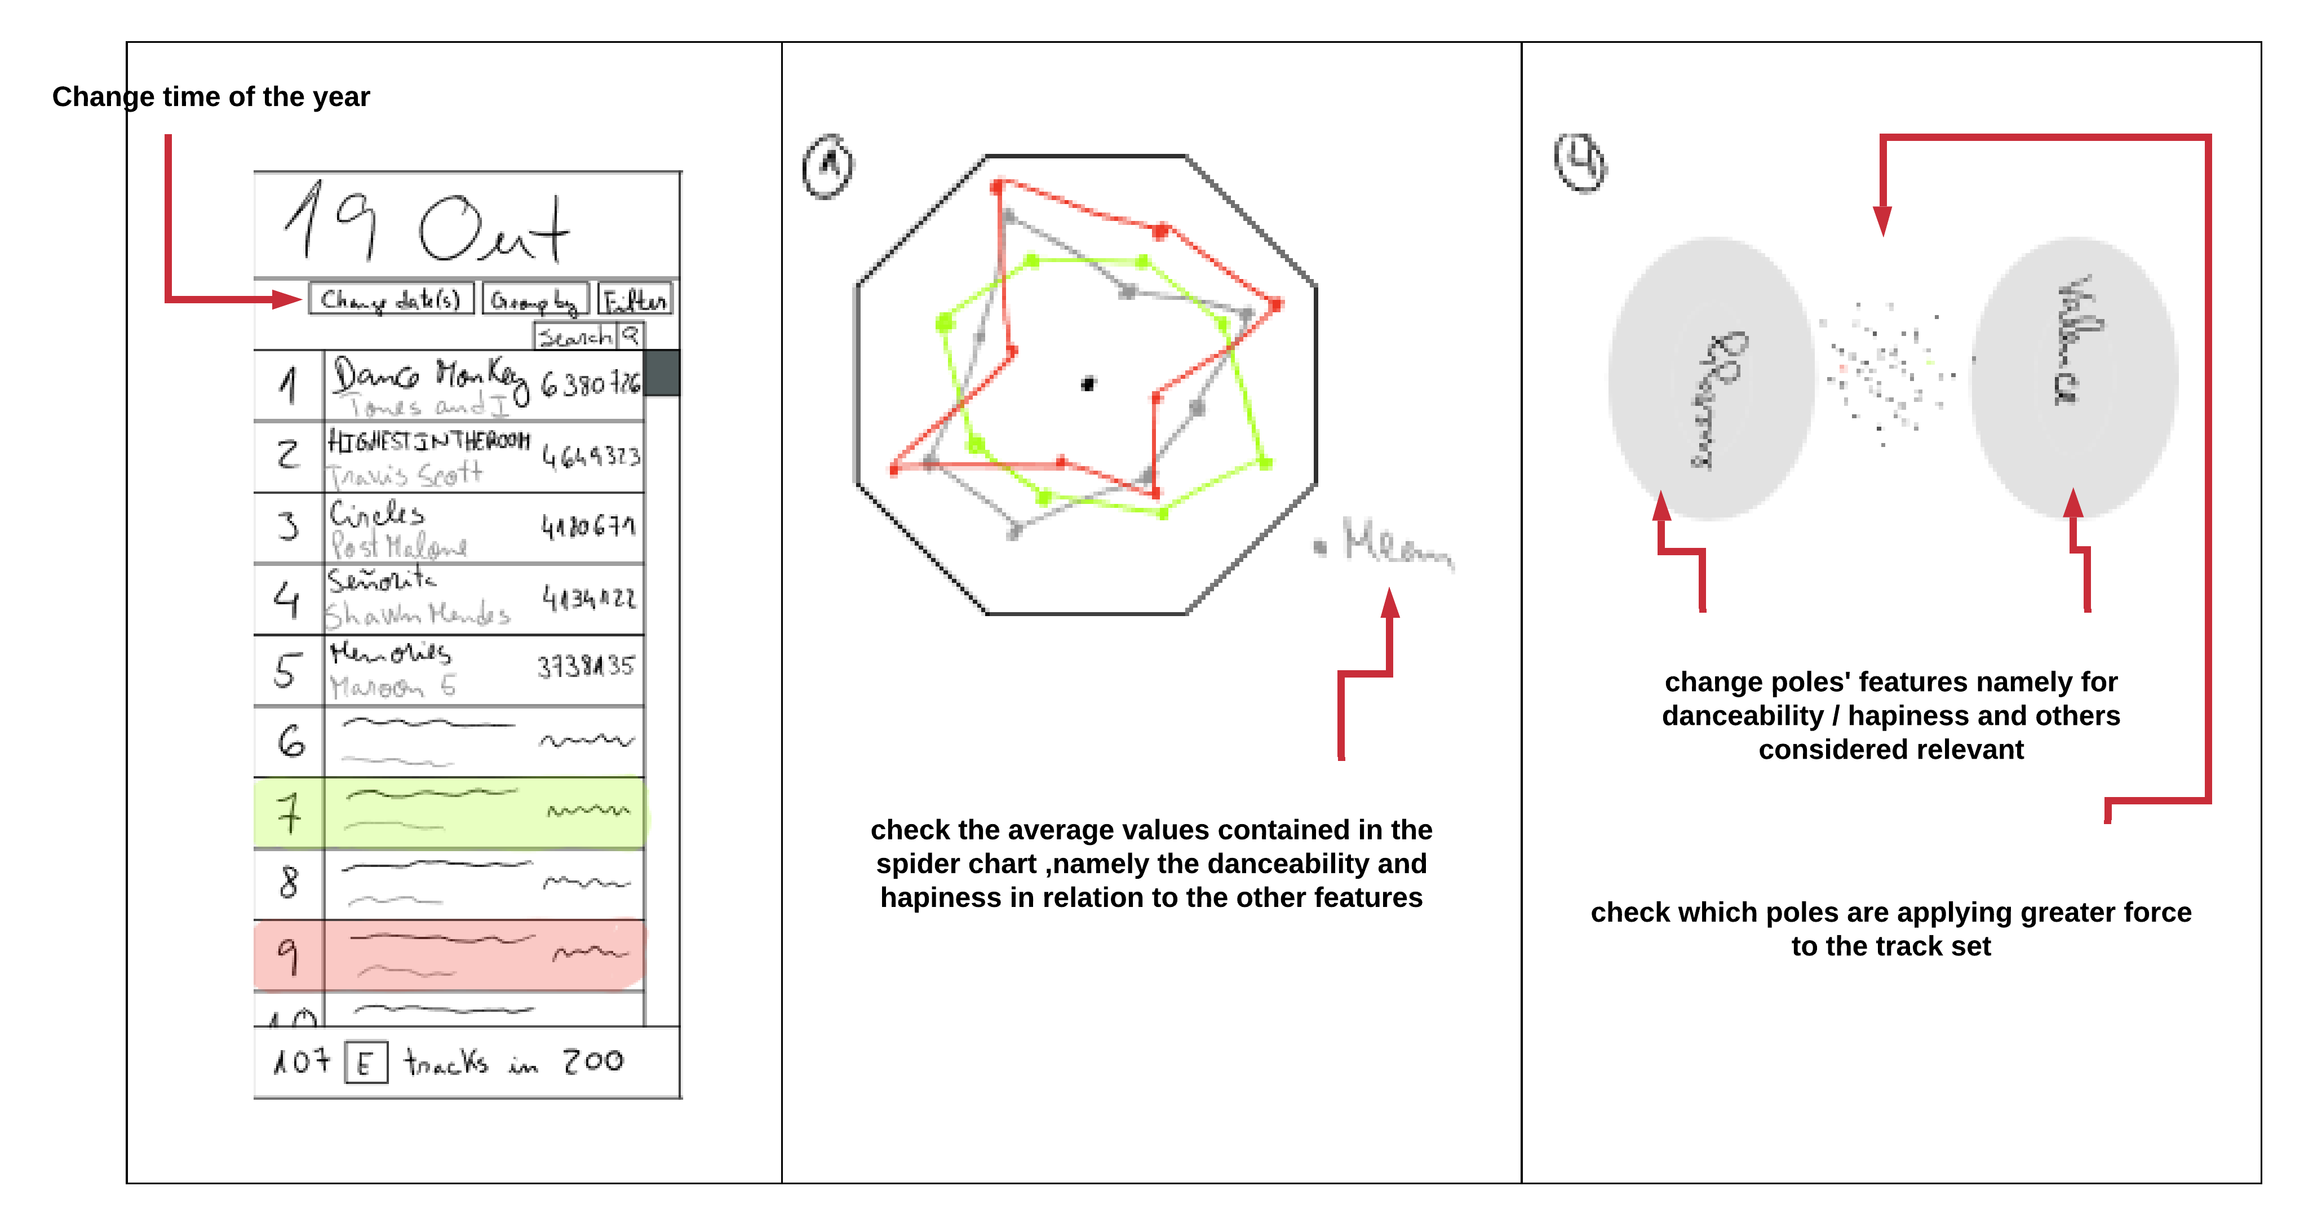
Is there any correlation between the happiness / danceability of the most listened tracks with the time of year?

