Slide 1

Camera User Tracking
Informatics Engineering and Multimedia
Final course project
Gonçalo Ferreira Eng. Pedro Mendes Jorge
Gonçalo Adolfo Eng. André Lourenço
Frederico Costa CardioID Tecnologies

Slide 2
Summary
Initial Analysis
Global architecture
Tracking algorithm architecture(1)
Tracking algorithm architecture(2)
Coral accelerator
Purposes
Schedule
Bibliography

Slide 3
Initial Analysis
Develop a system able to track users on entry/exit of public transportation
Use of surveillance cameras (RGB or RGB-D) in order to extract relevant information
Face/license plate/address number obfuscation for identity concealment due to the restictions made by GDPR (General Data Protection Regulation)
Raspberry pi integration
Usage of OpenCV library in Python

Slide 4
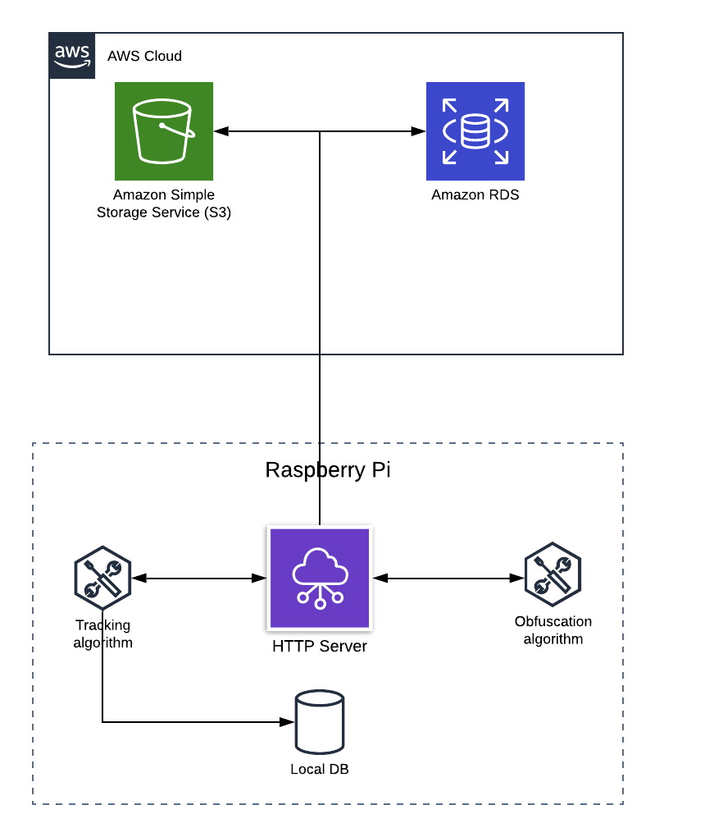
Global Architecture

Slide 5


Tracking algorithm architecture(1)
Motion pixel detection
Image processing
Features Extraction
Classification
Tracking algorithm
User identity correspondence
RGB/RGBD

Slide 6


Tracking algorithm architecture(2)
Deep learning
Feature extraction
Tracking algorithm
User identity correspondence
RGB/RGBD

Slide 7
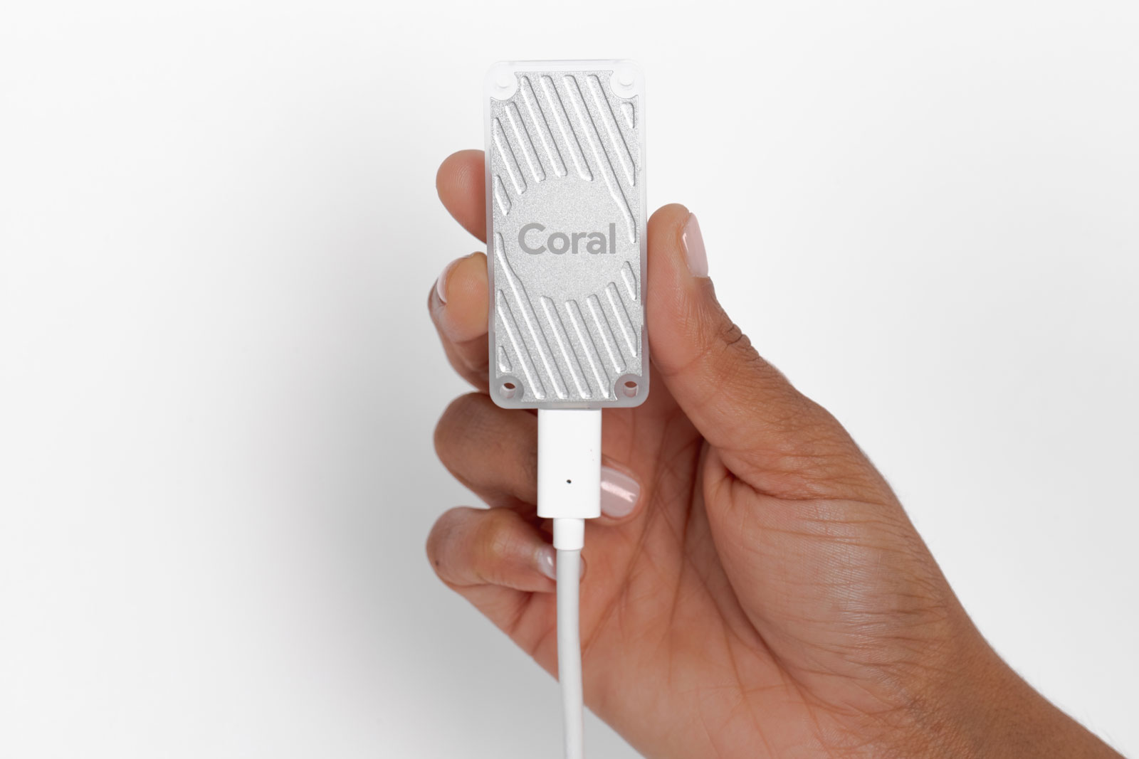
Coral accelerator
USB device that provides an Edge TPU as a coprocessor
Edge TPU enables the deployment of ML inference at the edge
Accelerates inferencing for machine learning models
Edge TPU: Chip for specific processing tasks in a precise domain as ML - Application Specific Integrated Circuits (ASICs)

Slide 8
Purposes
Store time instant on entry/exit
Predicting waiting times
Peak times
Daily flow
Trip time per person
Decision making through statistical studies

Slide 9
Schedule
MAR |  |  |  | APR |  |  |  | MAY |  |  |  | JUN
Tracking algorithm
Obfuscation algorithm
HTTP Server
Database development
Amazon configuration
Testing and results
Report
Presentation

Slide 10
Bibliography
“2018-19_LEIM_proposta_PRJ_07”, Paulo Trigo
Get started with the USB Accelerator - https://coral.withgoogle.com/tutorials/accelerator/

