Slide 1
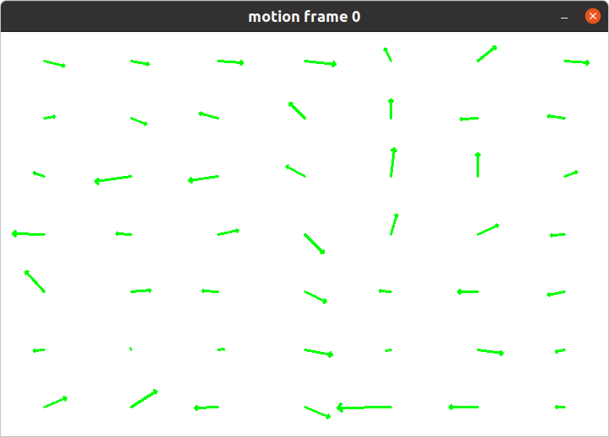
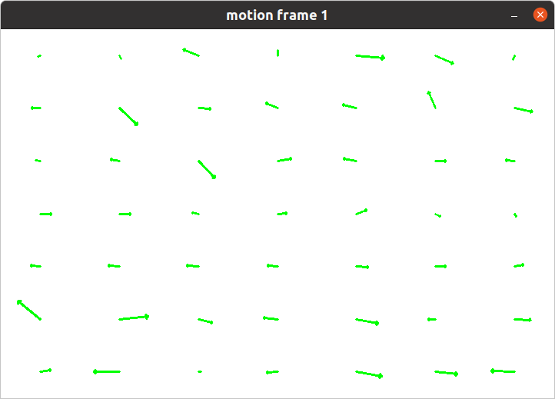
Switch Vector Fields

Slide 2
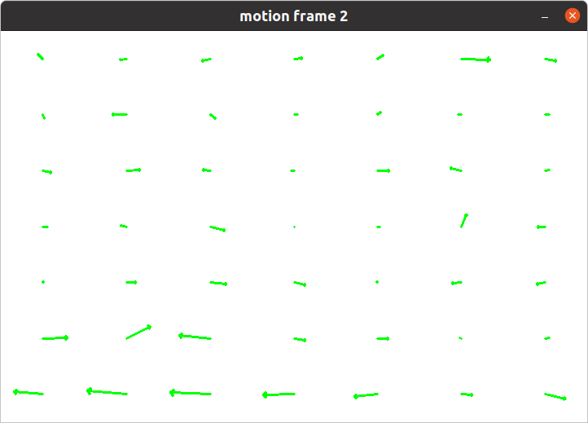
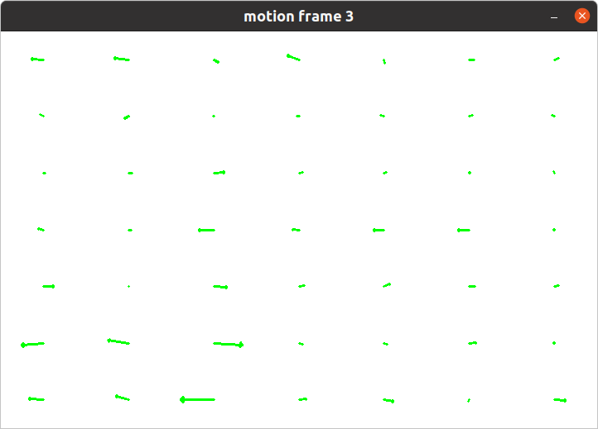
Switch Vector Fields

Slide 3
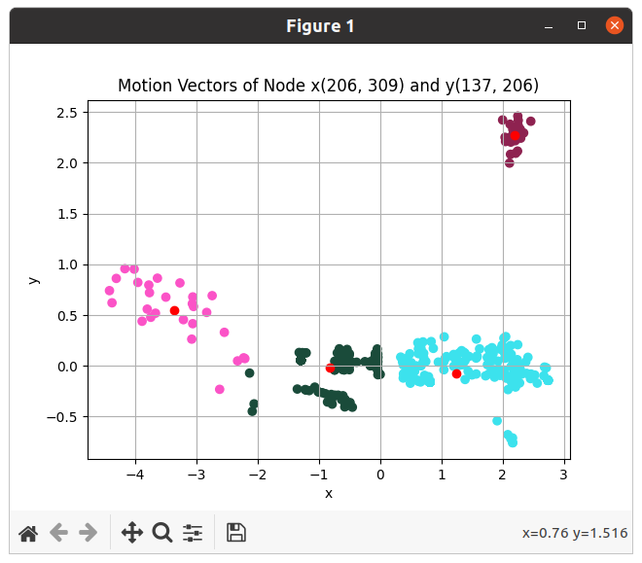
Switch Vector Fields

Slide 4
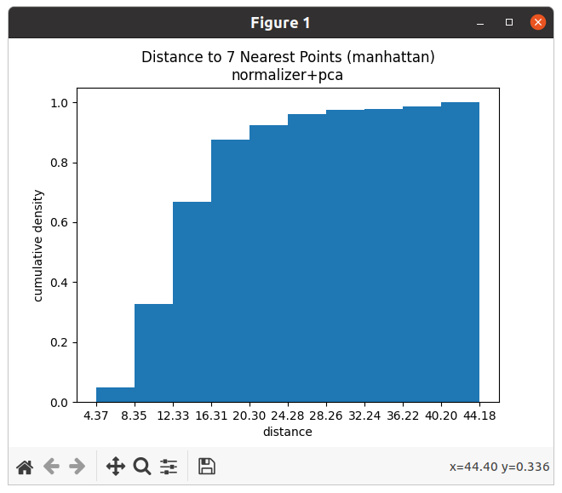

Anomaly Detection - DBSCAN

Slide 5
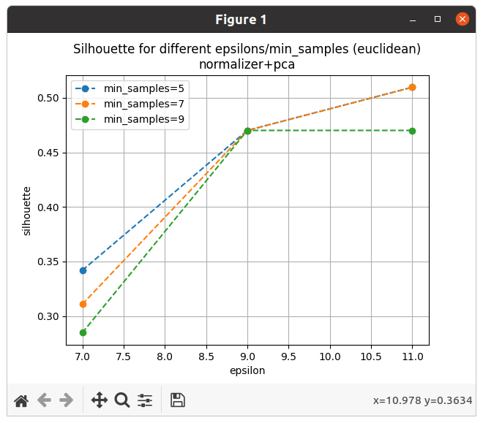
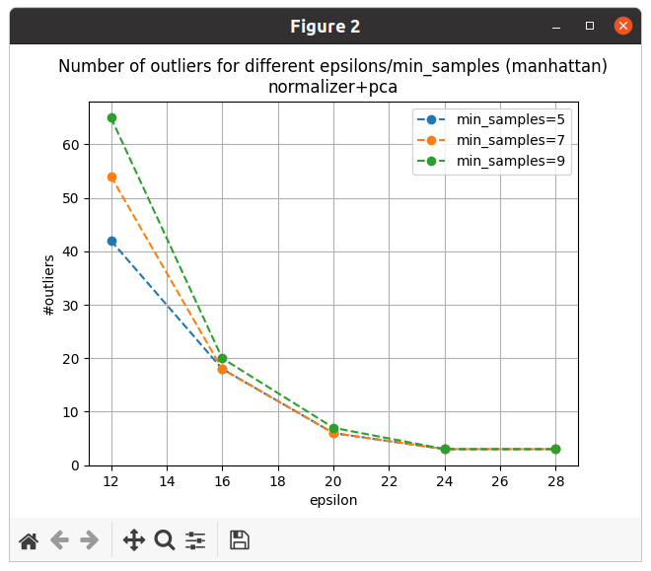
Anomaly Detection - DBSCAN

Slide 6
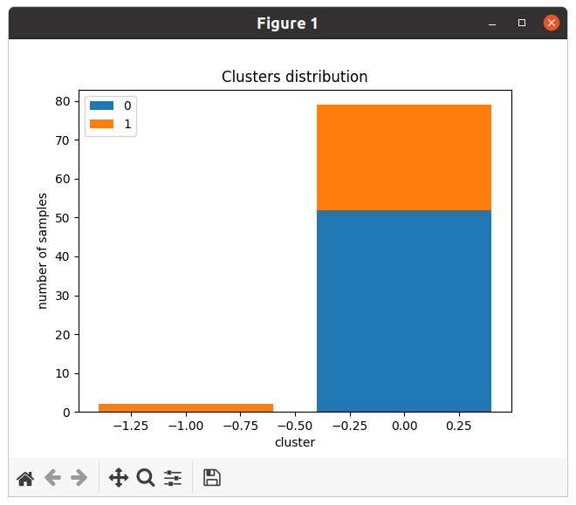
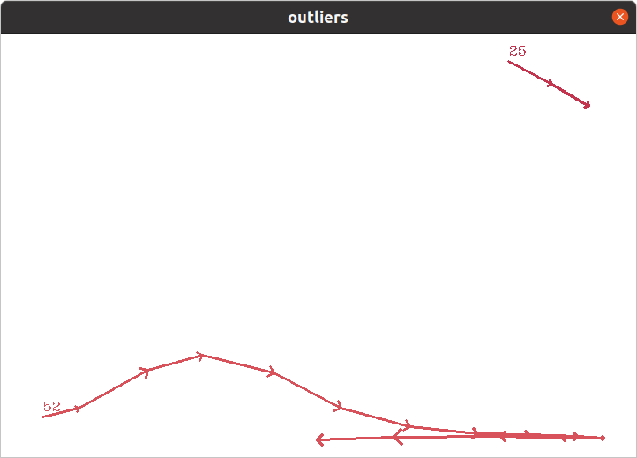
Anomaly Detection - DBSCAN
Mostrar trajetórias

Slide 7
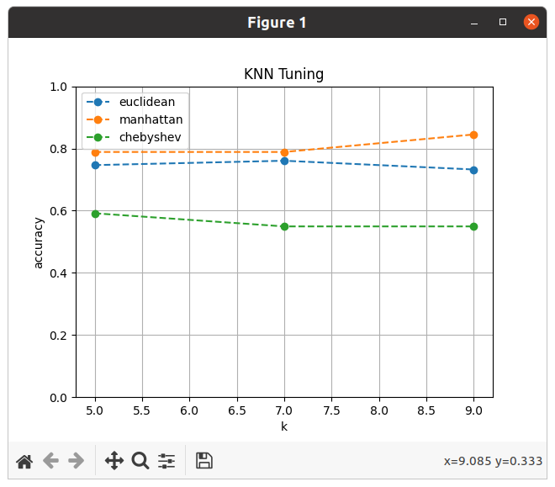
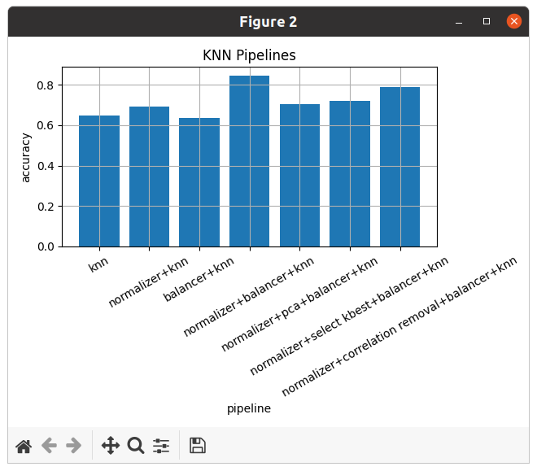
Interesting moments detection - KNN

Slide 8
Next steps
Switching vector fields training
Correction of some details based on previous feedbacks
Server implementation

