Slide 1


Fish Behavior Detection Different Approaches
Gonçalo Adolfo
Teachers Alexandre Bernardino and h.sofia pinto
Instituto superior Técnico, Universidade de Lisboa

Slide 2
Outline
Motivation
Example approaches
First idea
Conclusions

Slide 3
Motivation
Fish behavior
welfare
Abnormal detection
Feed monitoring

Slide 4
Motivation
Abnormal detection
Continuous visual inspection: tedious and time consuming
Footage of divers: invasive
Cameras installation: large amount of data
Feed monitoring
Optimize quantities and reduce costs
Fish keeper experience
Overfeeding/underfeeding Impact

Slide 5
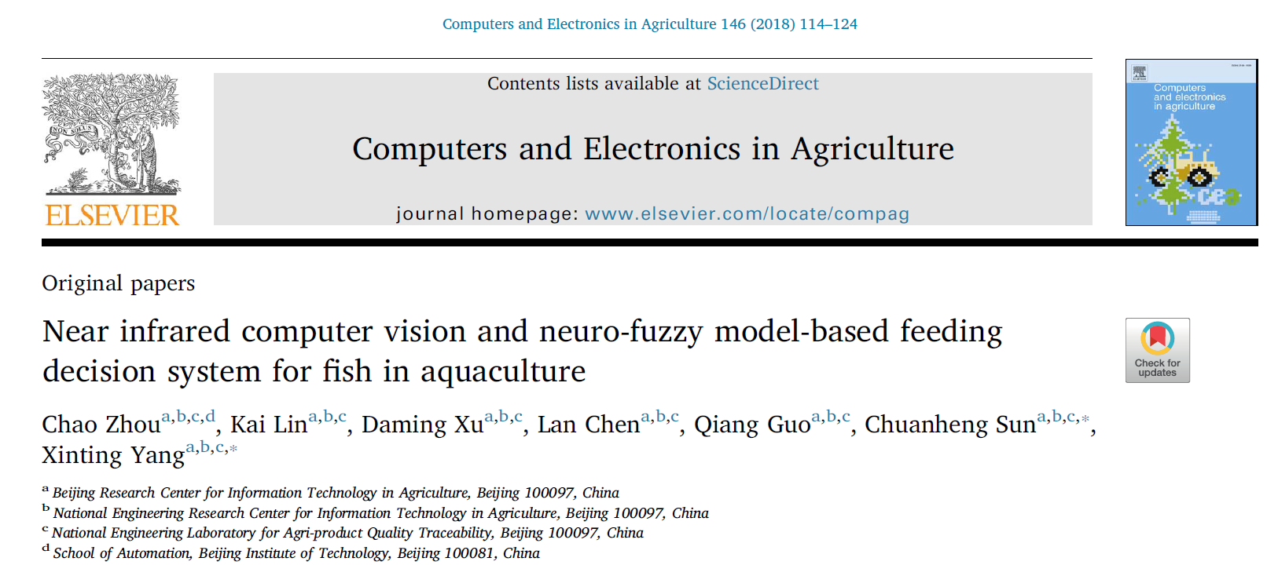
Example approach – feeding monitoring
Index that describes and quantifies the feeding behavior
Flocking index
Snatch intensity
Algorithm to decide if it is necessary to keep feeding during the feeding process

Slide 6
Approach comprehension
Does the flocking and snatching level describe the feeding behavior?
Is the stop mechanism useful?
Or helping to detect the feeding behavior is enough?

Slide 7
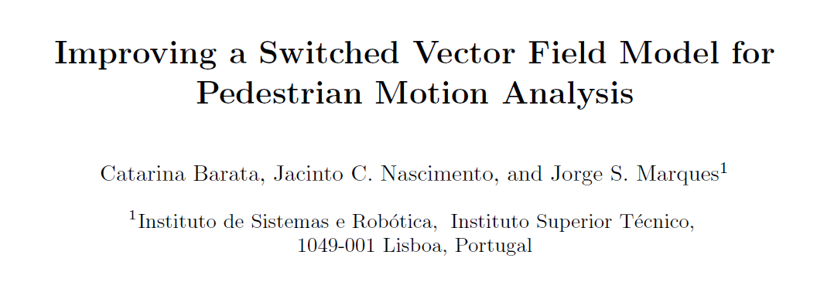
Example approach – abnormal behavior detection
Determines the set of velocity vectors for each part of the image space, and its odds
Given a new motion track, the model allows to calculate the likelihood

Slide 8
Approach comprehension
Can velocity transitions describe abnormal behaviors?
Does the spatial position influence the fish velocity?
Different species have different velocity patterns, right?

Slide 9
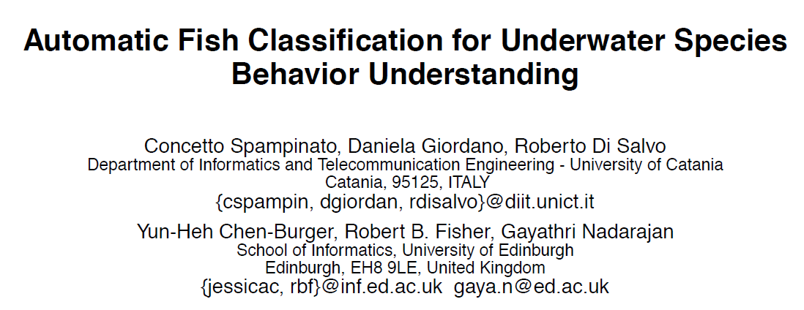
Example approach – abnormal behavior detection
Clustering of a set of motion tracks using spatial positions
Clusters with few motion tracks are considered events of interest

Slide 10
Approach comprehension
Can the spatial position be related to abnormal behaviors?
Should two motion tracks with inverse direction be considered similar?
What about other features? Such as shape?

Slide 11
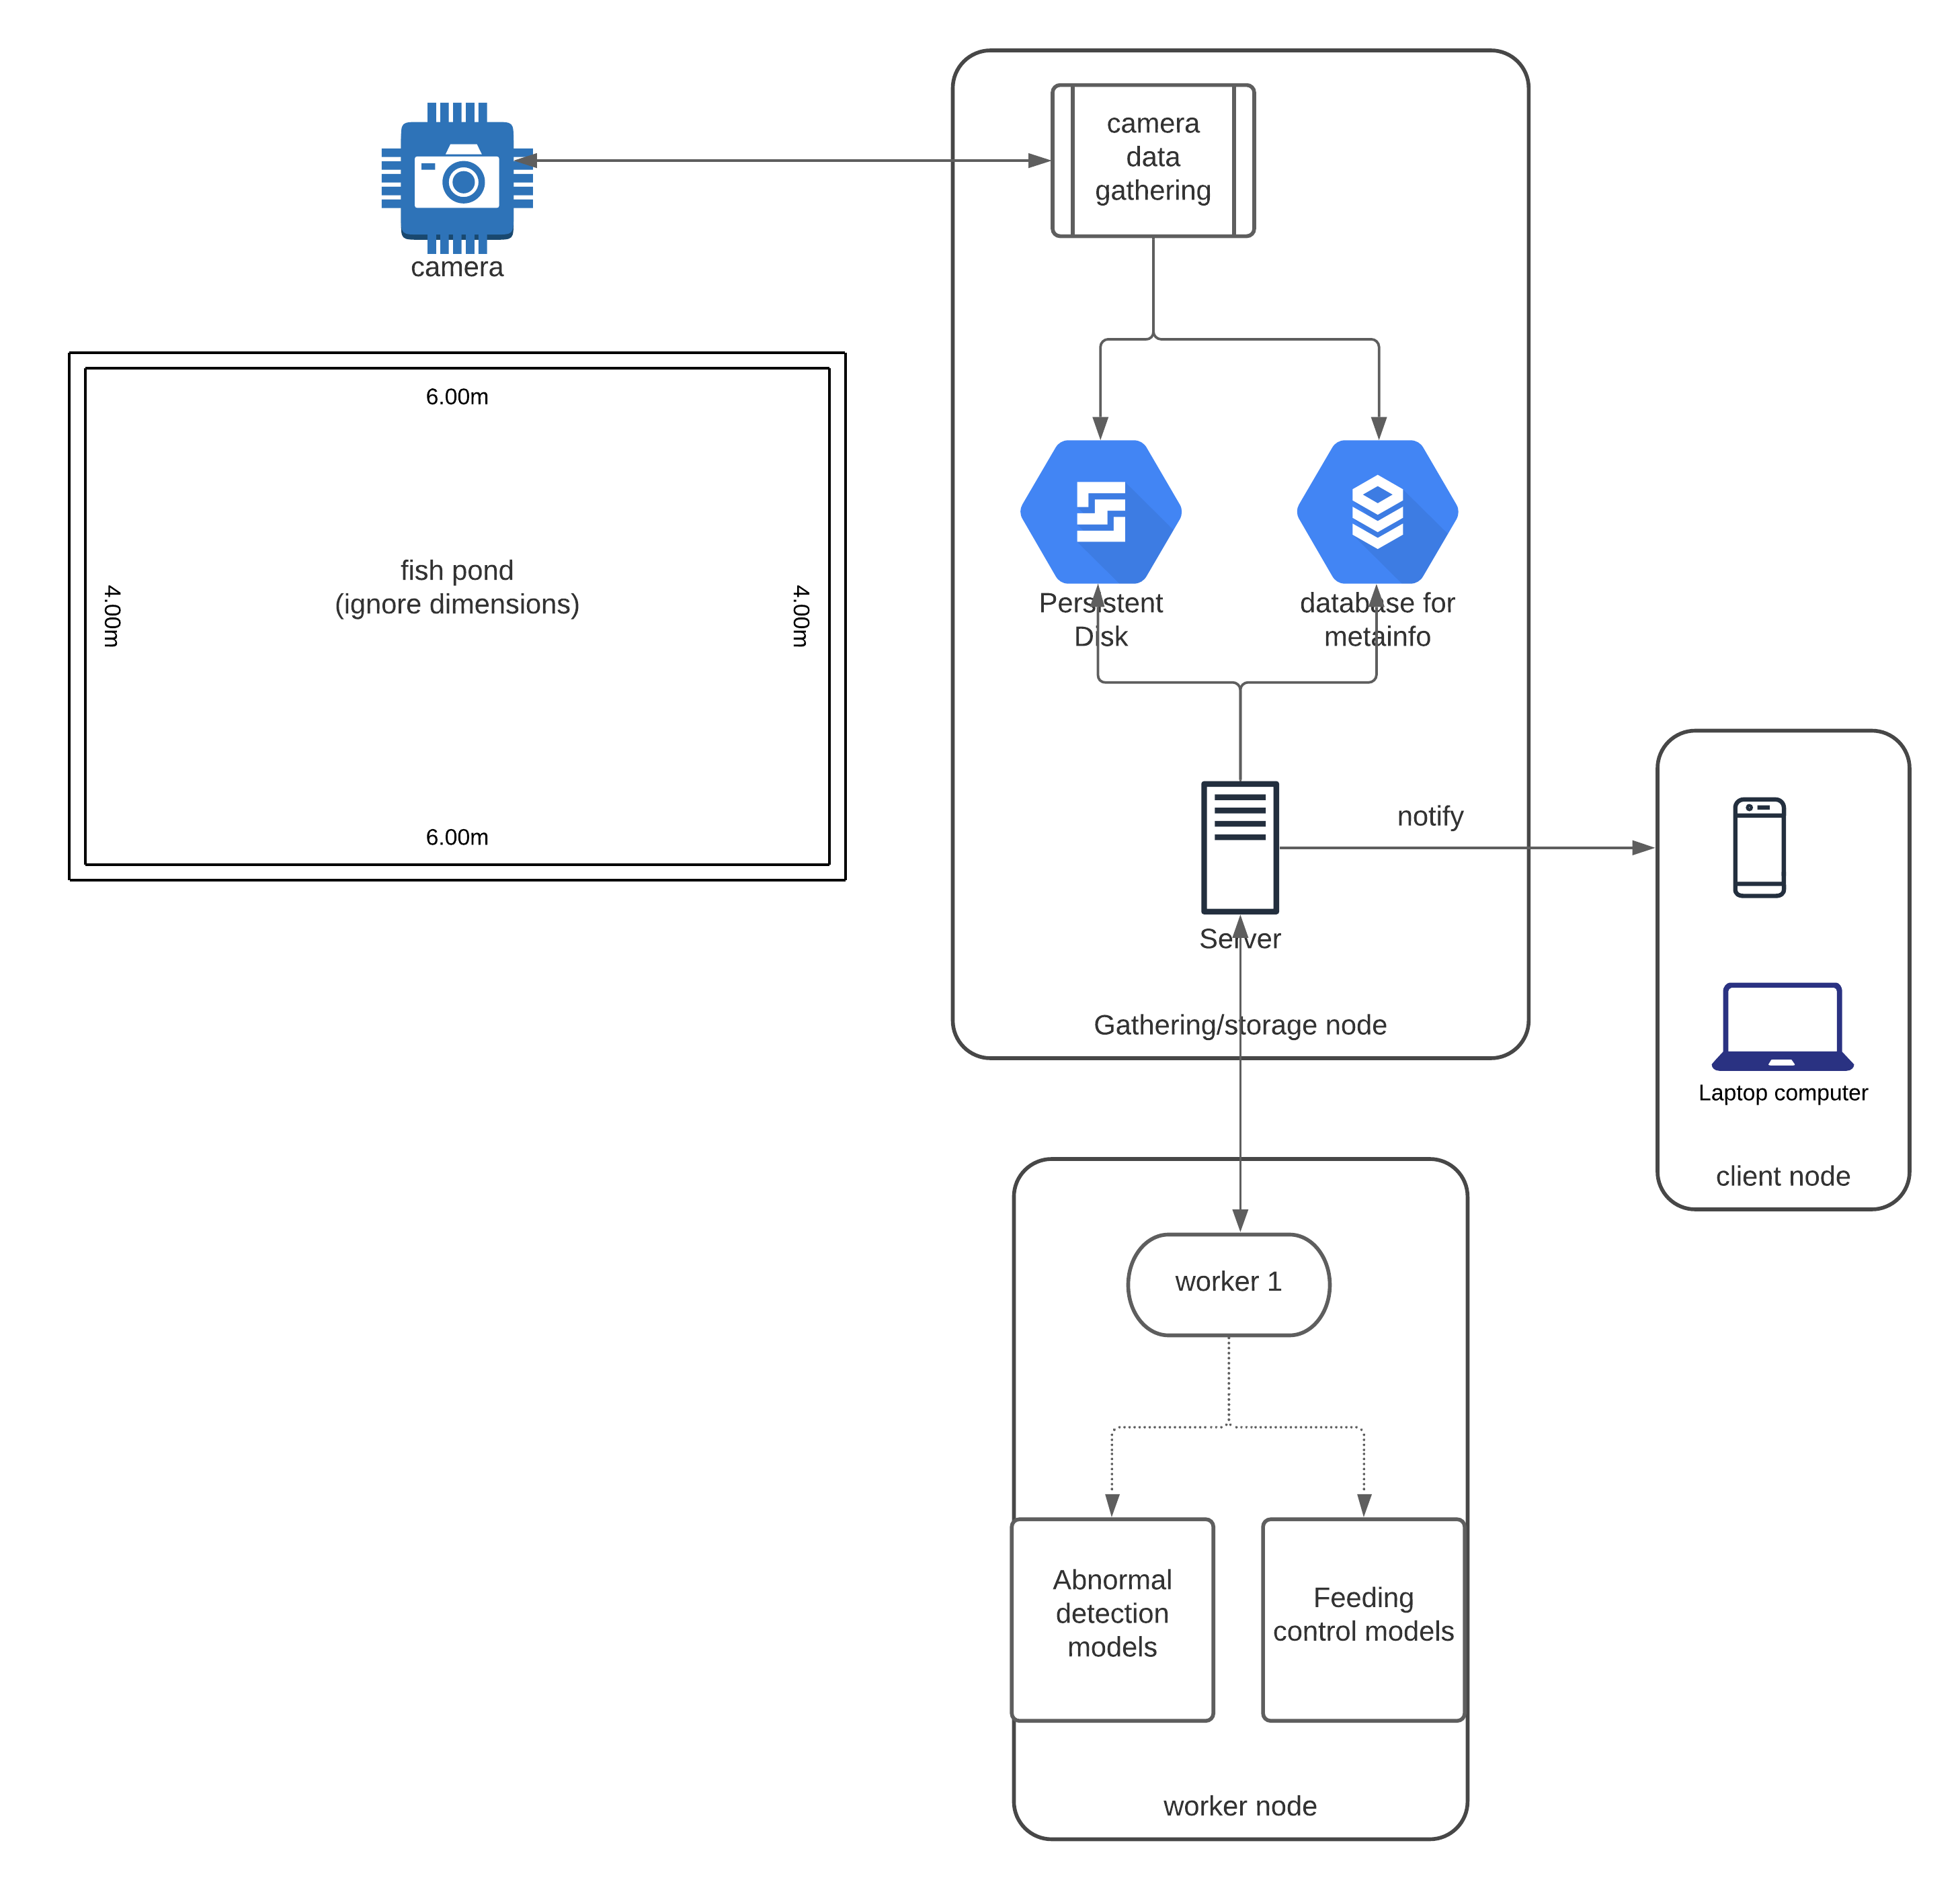

Slide 12
Conclusions
The main idea is to help biologists monitoring fish ponds
Detecting abnormal behaviors or monitoring feeding behavior
Different approaches take different features and algorithms into account
spatial position, motion track shape, velocities, dispersion
what makes sense in our context?
A first idea was presented that focus the notification of biologists through a mobile/web application
Is it useful? What features should it have?

