Slide 1


Fish Behavior Detection
Different Approaches
Gonçalo Adolfo
Teachers Alexandre Bernardino and h.sofia pinto
Instituto superior Técnico, Universidade de Lisboa

Slide 2
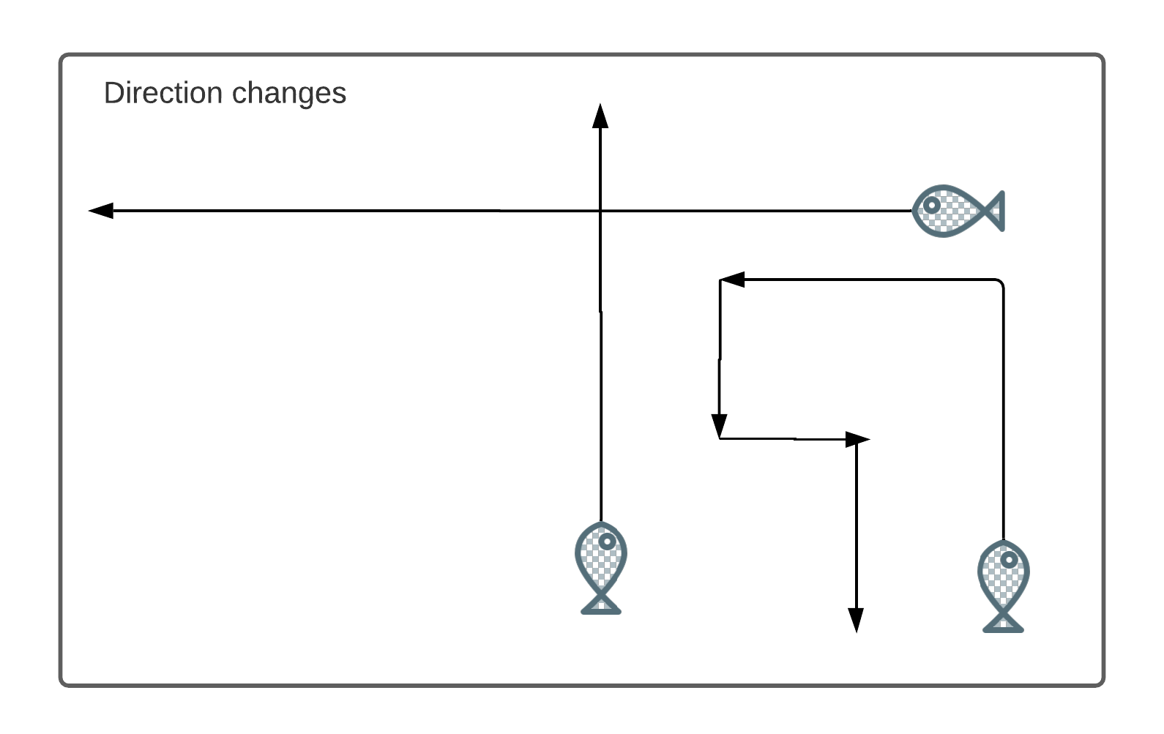

Slide 3
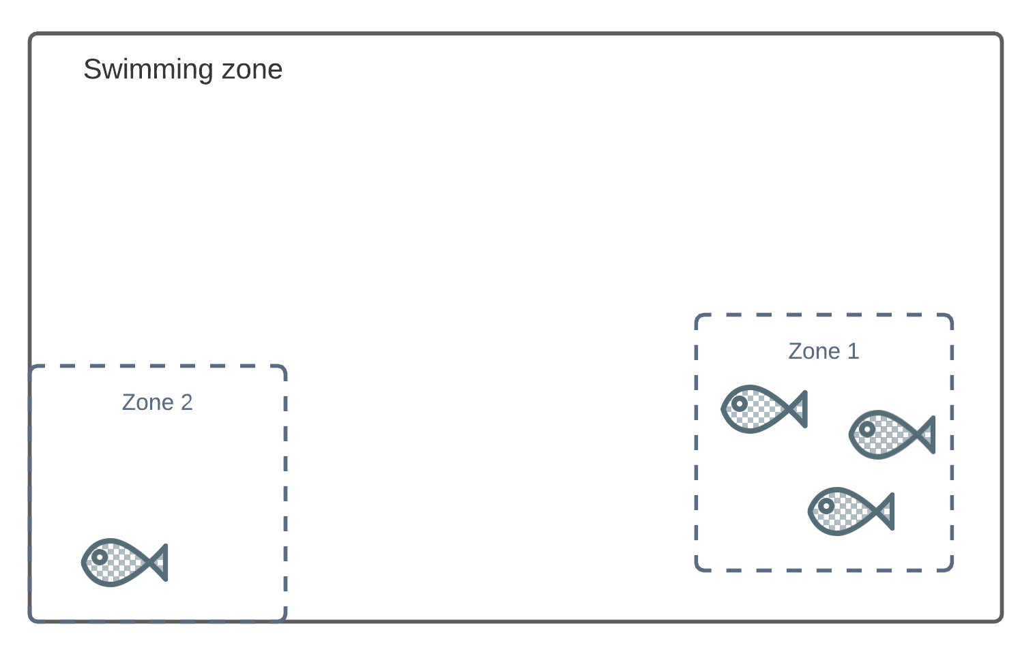

Slide 4
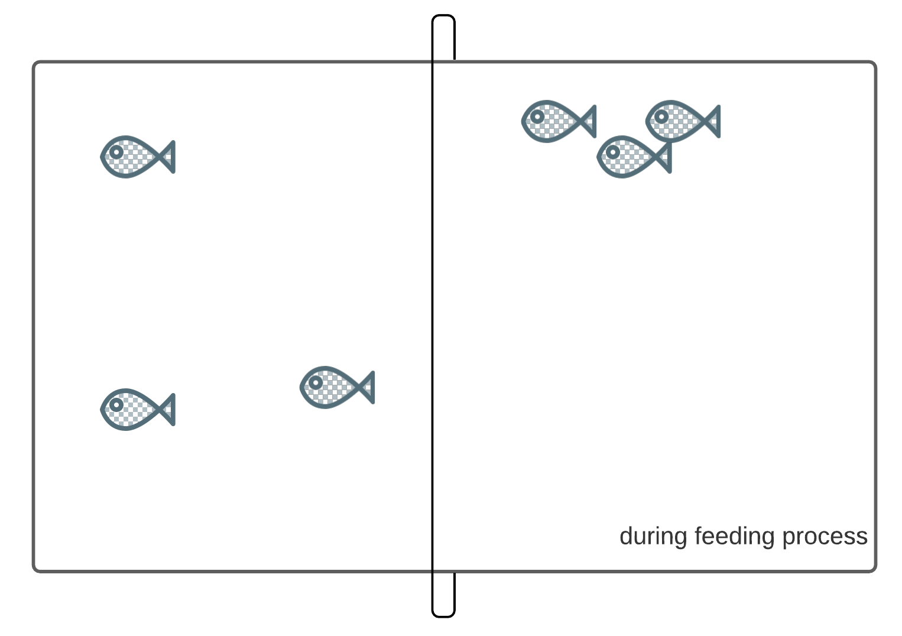

Slide 5
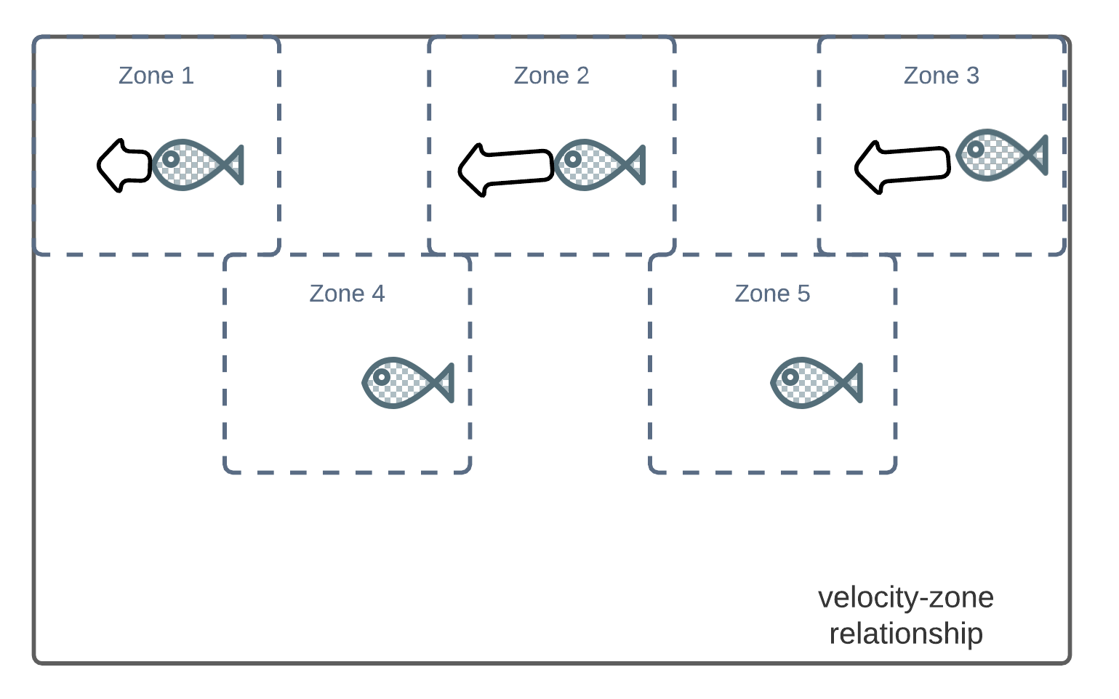

Slide 6
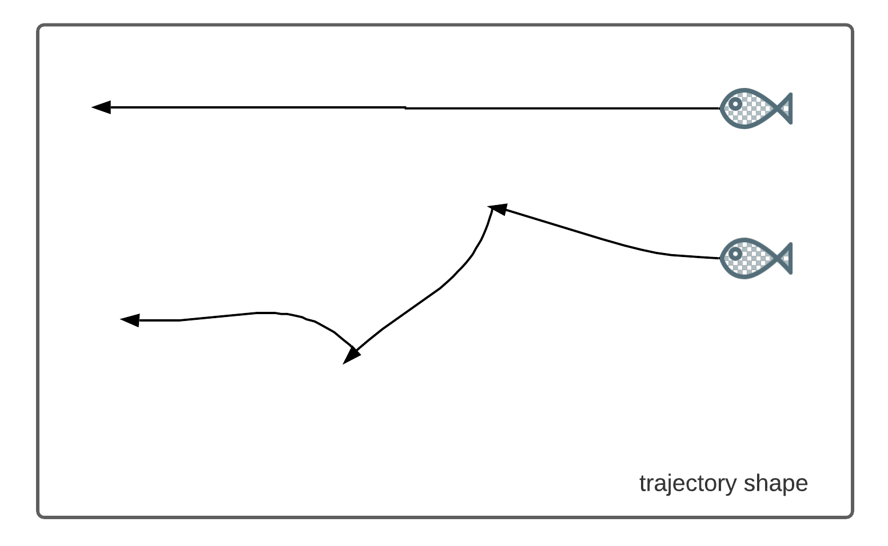

Slide 7
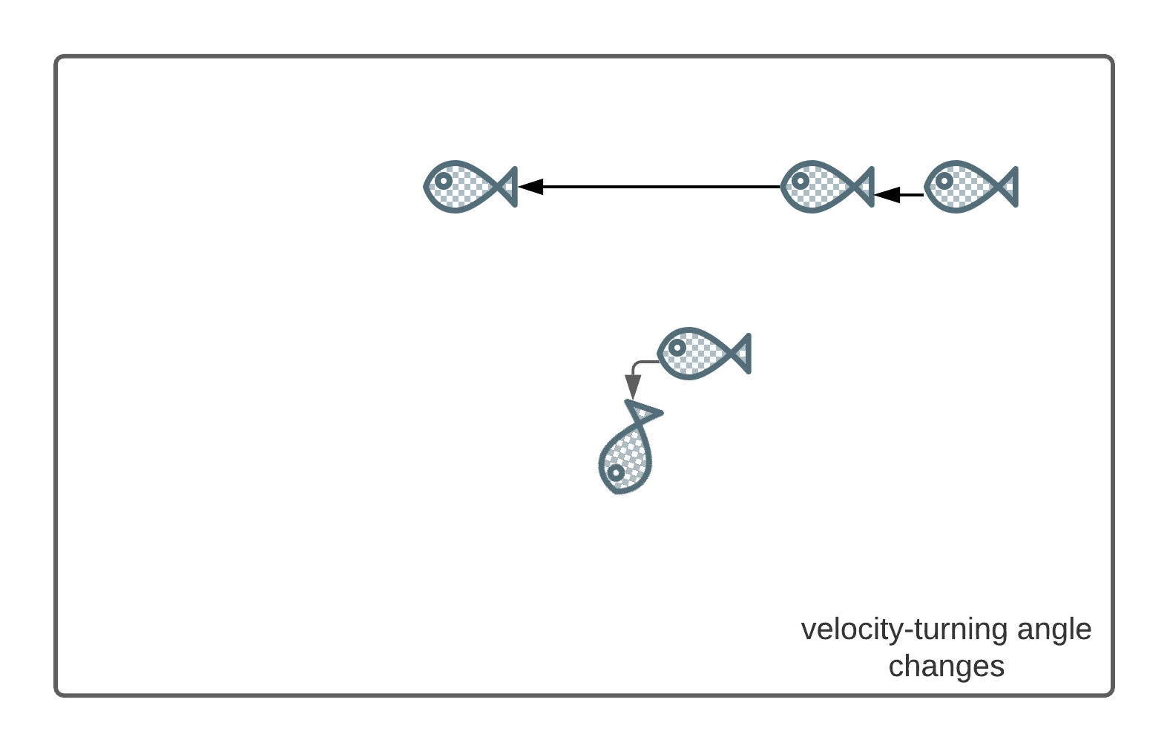

Slide 8
System Functionalities
Manually analyze certain periods of the day
Give alarms of abnormal behaviors
Control and manage activities: feeding, swimming, resting
Ability to receive feedback from users related to alarms quality

