Slide 1


Fish Behavior Detection
Gonçalo Adolfo
Teachers Alexandre Bernardino and H.Sofia Pinto
Instituto Superior Técnico, Universidade de Lisboa

Slide 2
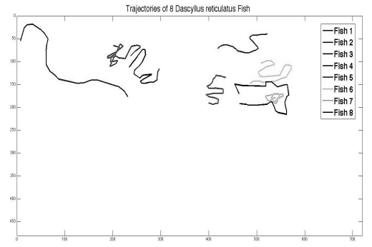
“Automatic Fish Classification for Underwater Species Behavior Understanding”
Author: Spampinato, Daniela et al
Year: 2010
Purpose: detect fishes in a given frame; follow them between consecutive frames; detect anomalous behaviors

Slide 3
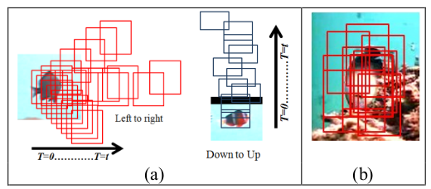
“A Filtering Mechanism for Normal Fish Trajectories”
Author: Beyan, Robert
Year: 2012
Purpose: Given a set of trajectories, be able to filter a set of normal trajectories

Slide 4
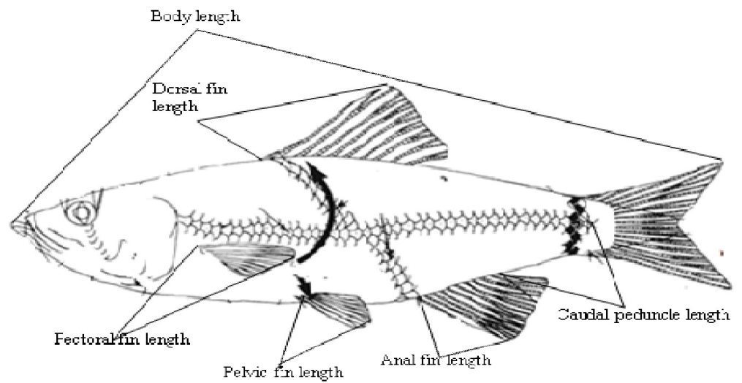
“Fish Classification Using Support Vector Machine”
Author: Ogunlana et al
Year: 2015
Purpose: given an image of a fish be able to classify it in the species to which it corresponds

Slide 5
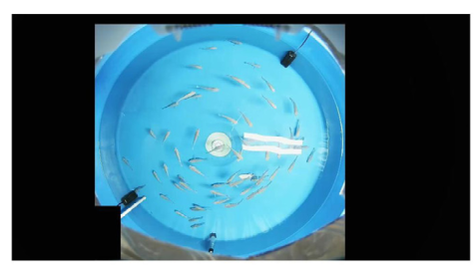
“Spatial behavioral characteristics and statistics-based kinetic energy modeling in special behaviors detection of a shoal of fish in a recirculating aquaculture system”
Author: Zhao, Jian et al
Year: 2016
Purpose: detect special behaviors (not of specific fish but of the school)

Slide 6
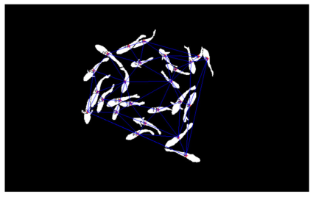
“Near-infrared imaging to quantify the feeding behavior of fish in aquaculture”
Author: Zhou, Chao et al
Year: 2017
Purpose: detect feeding behaviors

Slide 7
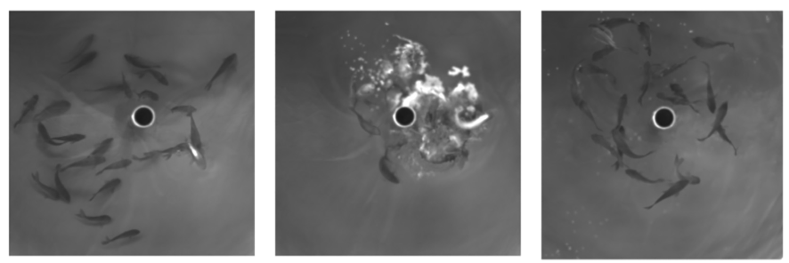
“Near infrared computer vision and neuro-fuzzy model-based feeding decision system for fish in aquaculture”
Author: Zhao, Chao et al
Year: 2017
Purpose: detect feeding behaviors and control when should feeding stop

Slide 8
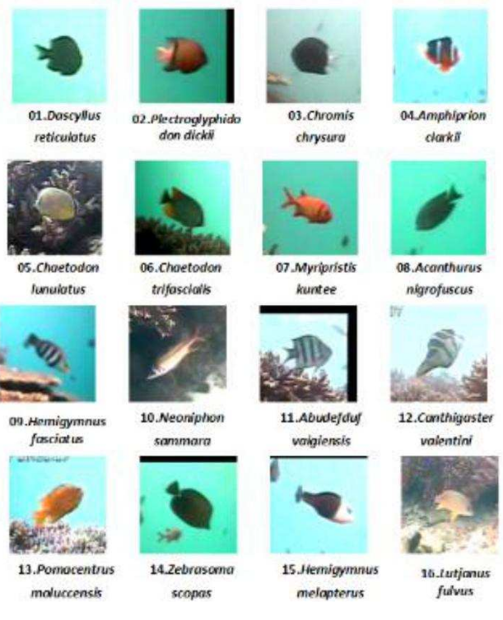
“Underwater Fish Species Classification using Convolutional Neural Network and Deep Learning”
Author: Rathi, Dhruv et al
Year: 2017
Purpose: given an image of a fish be able to classify it in the species to which it corresponds

Slide 9
“Evaluation of fish feeding intensity in aquaculture using a convolutional neural network and machine vision”
Author: Zhou, Chao et al
Year: 2019
Purpose: detect the level of hunger of the fishes present in an image
Base ideas:
  Several images are extracted for each level of hunger
  These images are used to train the algorithm, that will be able to associate image feature patterns to each level

Slide 10
“Detecting Abnormal Fish Behavior Using Motion Trajectories In Ubiquitous Environments”
Author: Anas, Youssef et al
Year: 2020
Purpose: detect fishes in a given frame; follow them between consecutive frames; detect abnormal behaviors
Base ideas:
  Estimate an image with the set of trajectories in a short period of time (10 seconds in this study)
  Train an algorithm to be able to classify each trajectories image, based on other examples

Slide 11
Summary - Functionalities
Produce alerts of abnormal/anomalous/special behaviors
Help to manage feeding
  Detect feeding behavior
  Detect level of hunger
Detect fishes/classify them according to specie

Slide 12
Other Useful Features
Be able to manually analyze vídeo of a period of time
  Number of detected fishes
  Detected species
  Areas of highest incidence
  Velocities/directions analyze
Specific behaviors:
  Manta ray moving near the bottom
  Shark in attack position
  Number of times the will shark go to the surface
  M.Hypostoma interaction during the day and if it replicates in the other days

Slide 13
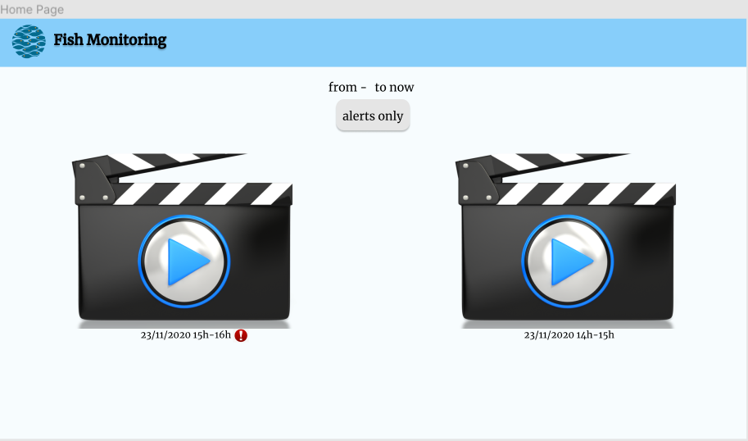

Slide 14
