Slide 1


Fish Behavior Detection
Gonçalo Adolfo
Teachers Alexandre Bernardino and H.Sofia Pinto
Instituto Superior Técnico, Universidade de Lisboa

Slide 2
Outline
Motivation
Related Work
Proposed Solution
System Evaluation
Planning

Slide 3






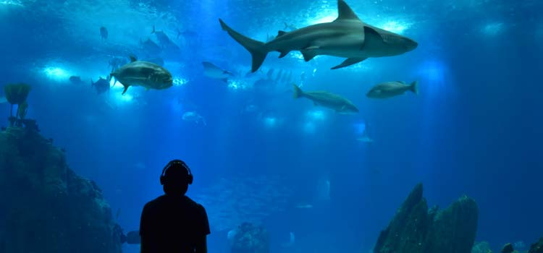
Motivation
Feeding
water quality, aggressive behaviors, lack of interest
Abnormalities
poor environmental integration, disease indicator
Other key activities
swallowing air
real time monitoring
footage analysis

Slide 4

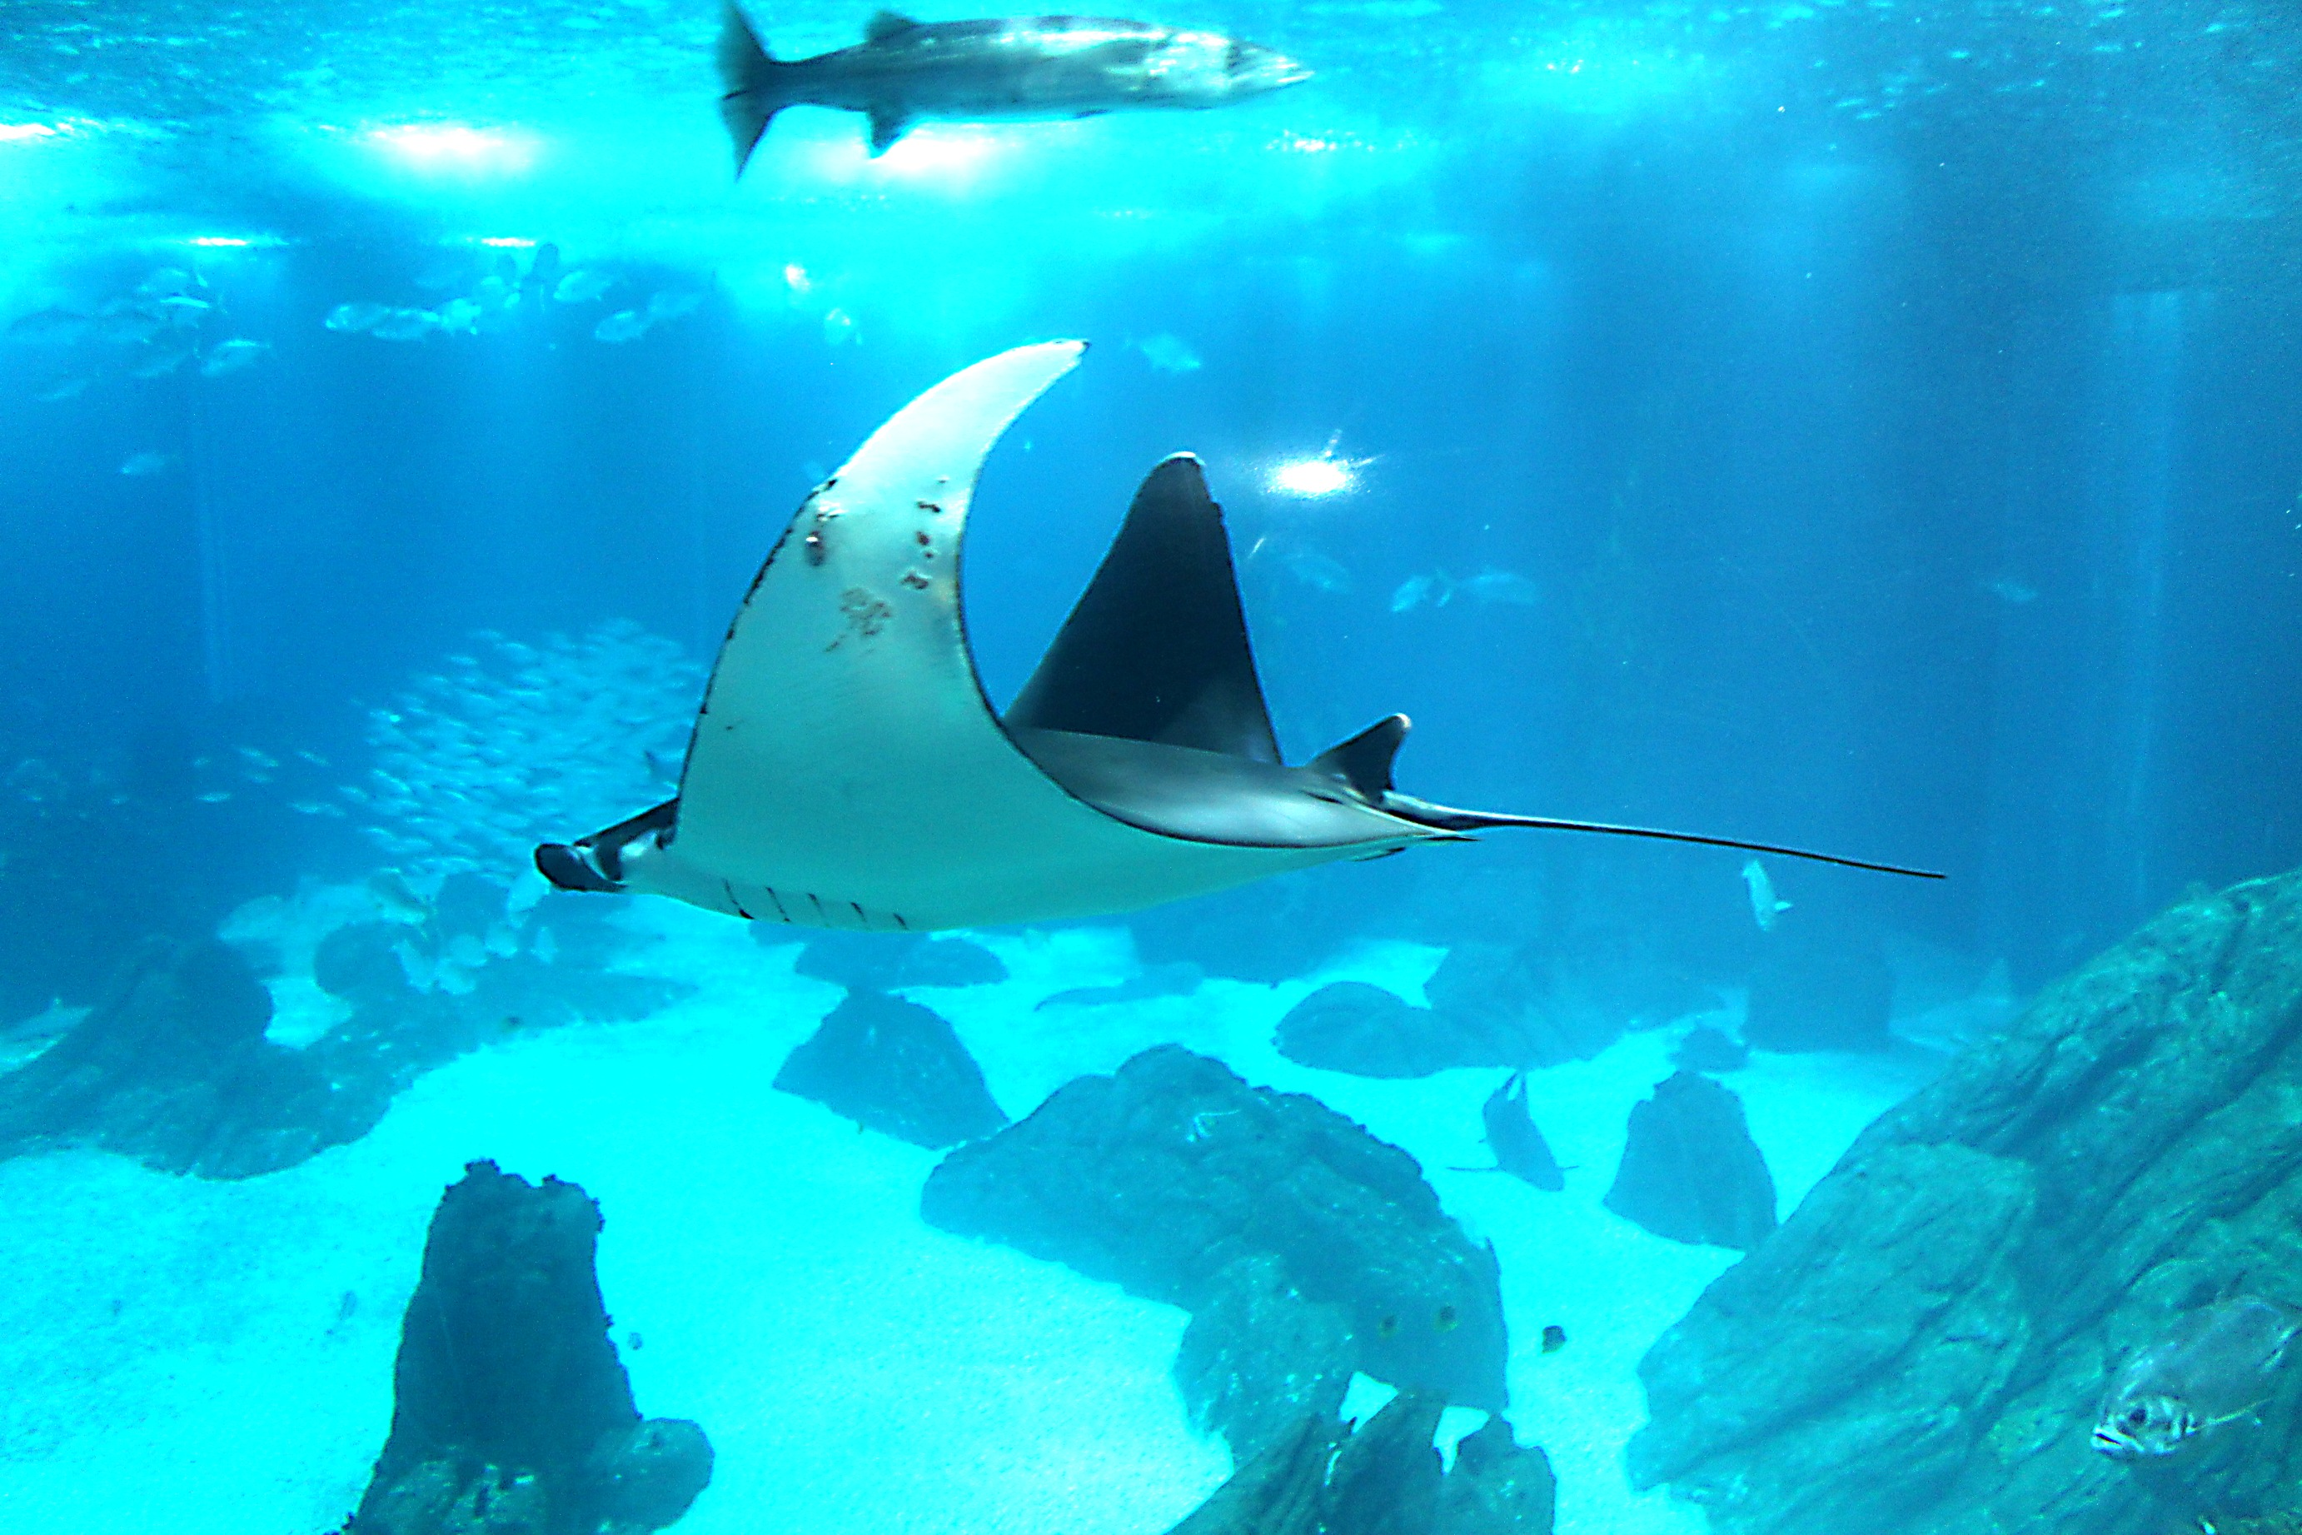
Project Goals
Purpose: help biologists monitoring fishes
Swallowing air
moves to the surface
-
Feeding
aggregation near the surface
Indian queue
Lack of interest
not interested in food during feeding period
not interested in food during feeding period
Abnormal
usually swim in pairs or trios; don’t swim near the bottom; velocity/direction sudden changes
velocity/direction sudden changes (e.g.: attacks)
sharks
manta ray

Slide 5
Project Context
“Video based live tracking of fishes in tanks”
José Castelo (2019/2020)
Detection: background subtraction
Tracking: position and color
Classification: color histogram or HOG
“Tracking animals in underwater videos”
João Santos (2020/2021)
Detection: comparison of several techniques
Tracking: color history, temporary track, motion prediction

Slide 6
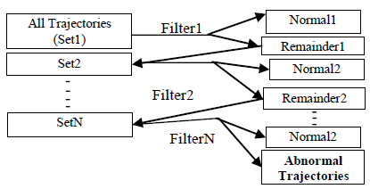
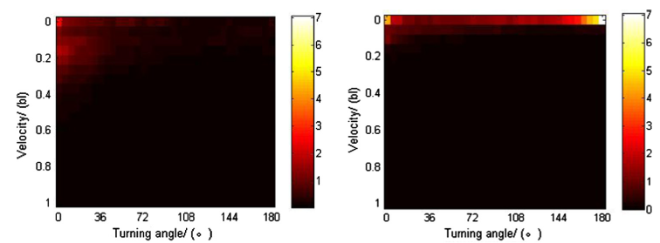
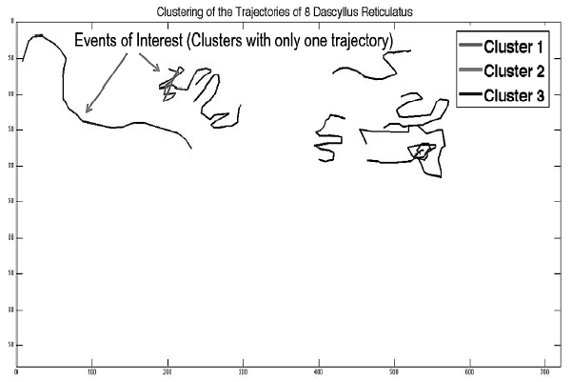
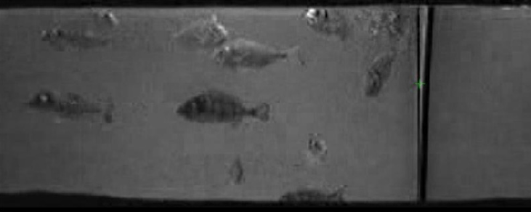
Abnormal Behavior Detection
Rule-based. From “A Filtering Mechanism for Normal Fish Trajectories” (2012)
Kinetic energy. From “Spatial behavioral characteristics and statistics-based kinetic energy modeling in special behaviors detection of a shoal of fish in a recirculating aquaculture system” (2016)
Clustering. From “Automatic Fish Classification for Underwater Species Behavior Understanding” (2010)
Position-based. From “computer-vision system and methodology for the analysis of fish behavior” (2011)

Slide 7
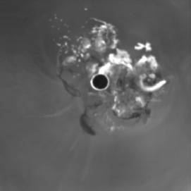
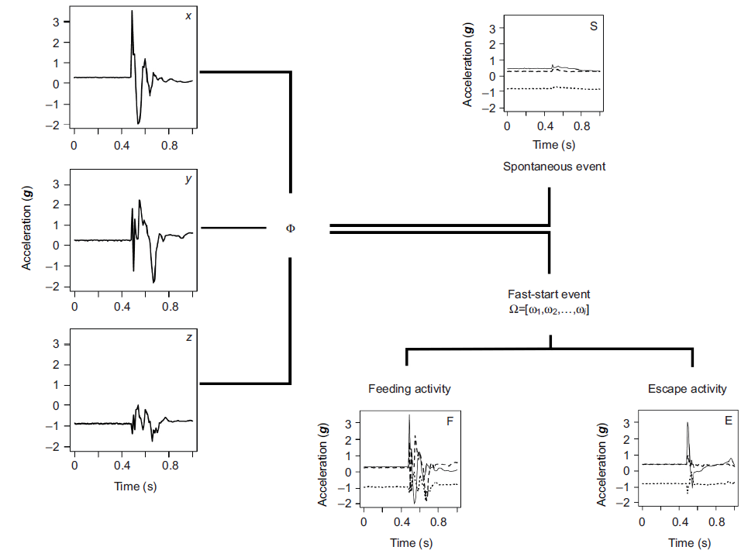
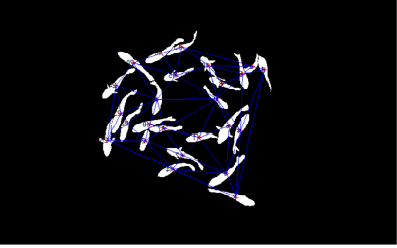
Activity Recognition
Feeding: snatching-based. From “Near infrared computer vision and neuro-fuzzy model-based feeding decision system for fish in aquaculture” (2018)
Feeding: aggregation-based. From “Near-infrared imaging to quantify the feeding behavior of fish in aquaculture” (2017)
Accelerometer approach. From “Accelerometer tags: detecting and identifying activities in fish and the effect of sampling frequency” (2013)

Slide 8
Main Limitations
Image plan
“Fast-start” behaviors
Costs, invasive (accelerometer)
Amount of data
Diversity of species

Slide 9
System Components
Goal: detect fish behaviors and give alerts to biologists
Behavior Detection Module
Detection
Tracking
Rule-Based
Machine Learning
Web Application

Slide 10
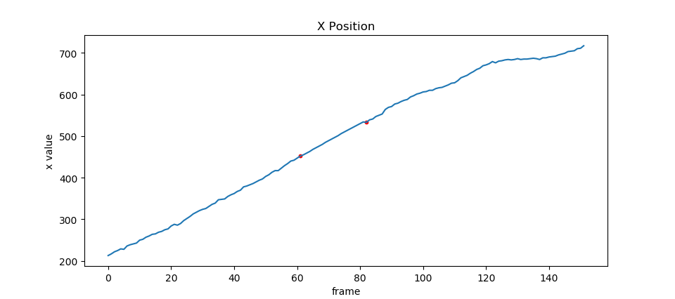
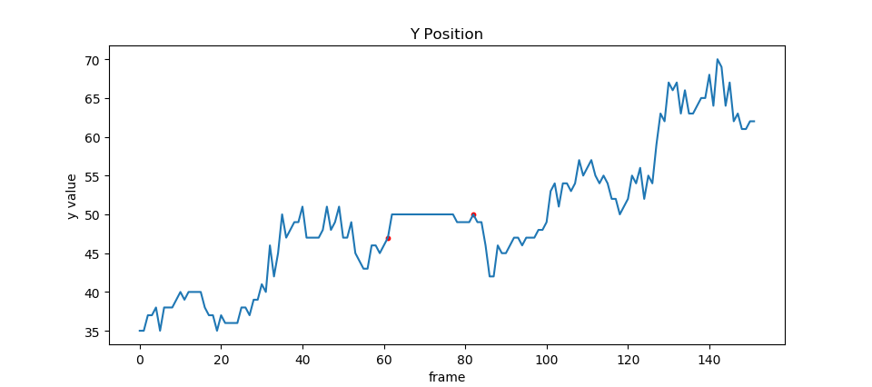


Trajectories Pre-Processing
Newton Interpolation

Slide 11
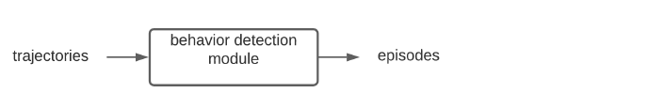
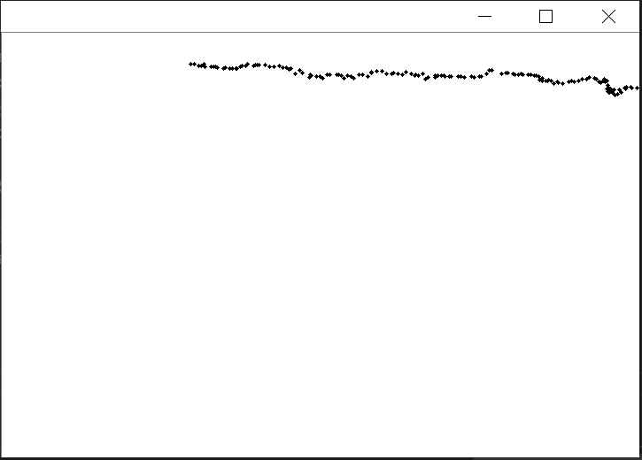
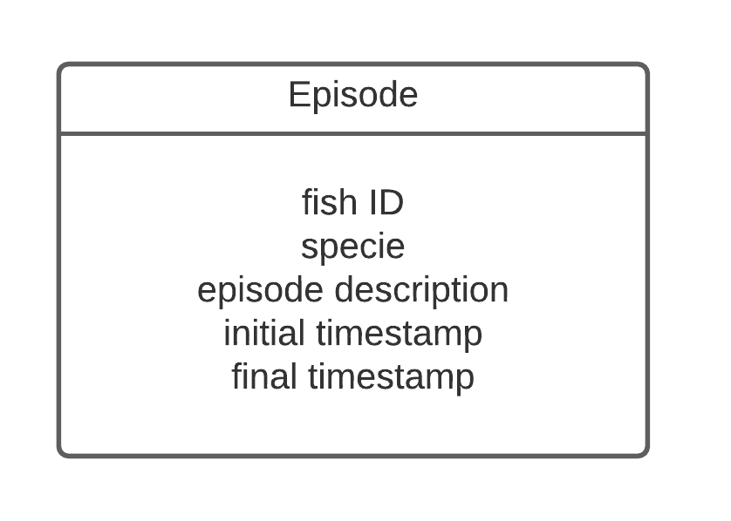

Behavior Detection Module Interface
Swallow air
Feeding
Lack of interest
Abnormal
$$T=[\left(t_{1},x_{1 },y_{1}\right), …,\left(t_{n},x_{n },y_{n}\right)]$$

Slide 12

Rule-based
Feeding
Lack of interest
Swallowing air
Abnormal
Delaunay Triangulation
Flocking Index
Outlier detection based on quartiles
Distance from reference zone (surface)
Dynamic threshold according to depth estimation
Feature(s) (velocity, turning angle) modeled as a 2D histogram, 2D Gaussian or other probability density function
Distance from Median Centroid (center of mass)
$$FIFFB=\frac{\sum_{i}^{n}{L1_{i}+L2_{i}+L3_{i}}}{n}$$

Slide 13
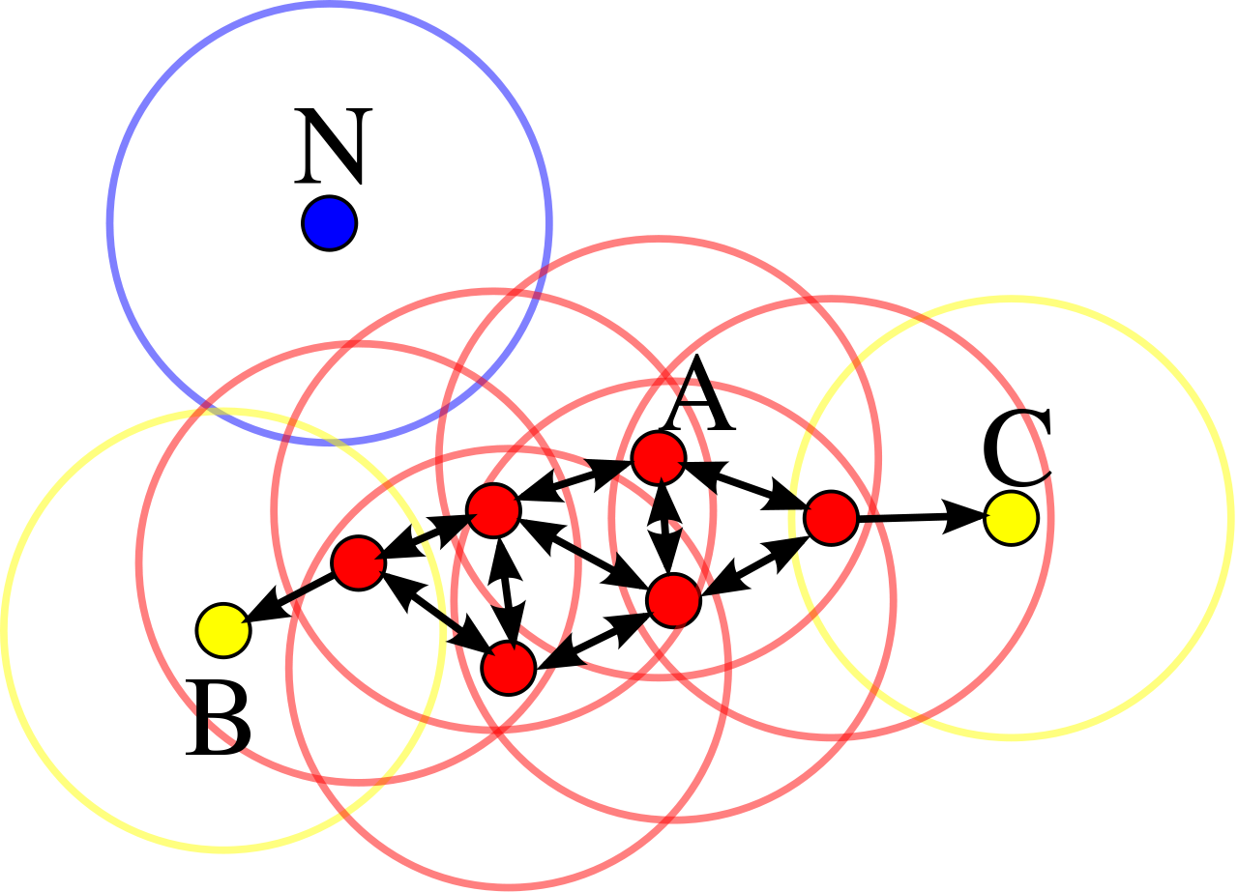
Improvements using ML – Feeding and Lack of Interest
Feeding behavior: aggregation
clustering density-based (example: DBScan)

Slide 14
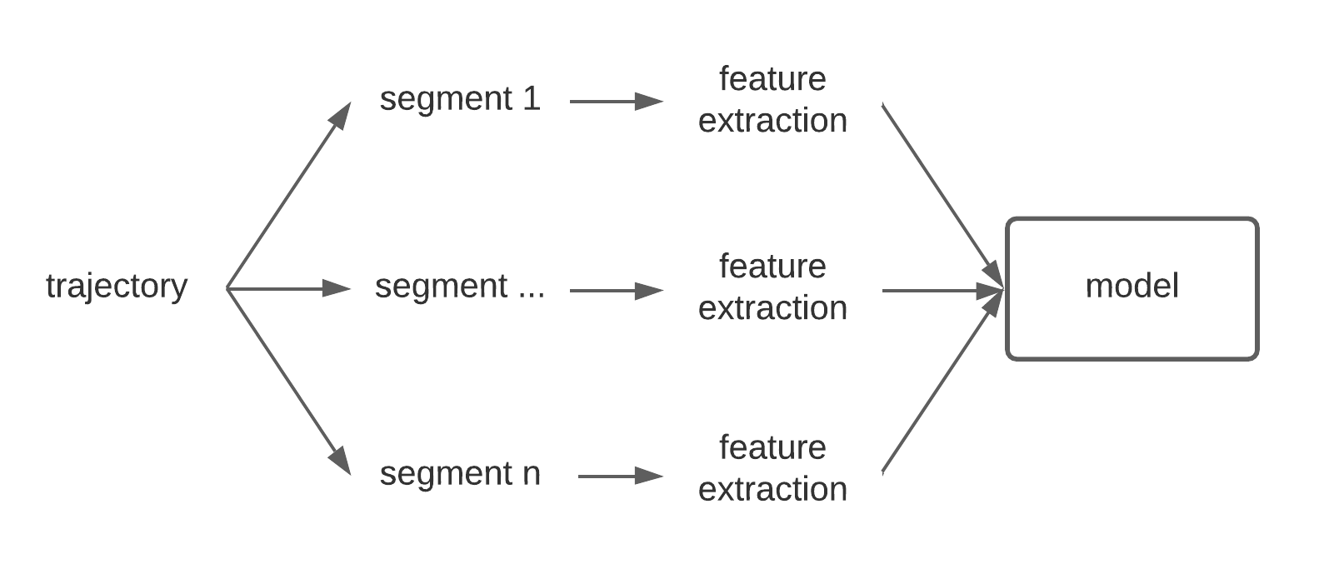
Improvements using ML – Behavior Classifier
Naïve Bayes
SVM
Random Forest
Deep Learning (?)
Input: trajectory and ground truth for each segment
Model Output: swallowing air, feeding, swimming, or abnormal label

Slide 15
Features
Velocity, Acceleration and Turning angle
Curvature Scale Space
Centred Distance Function
“Pass by” features
Normalized bounding box

Slide 16
Model Retraining
Model Drift Detection
Model Retraining
User feedback
Online techniques:
SVM: adjust the current weights only based on the new data
Random Forest: adding more decision trees to the ensemble according only to the new data

Slide 17
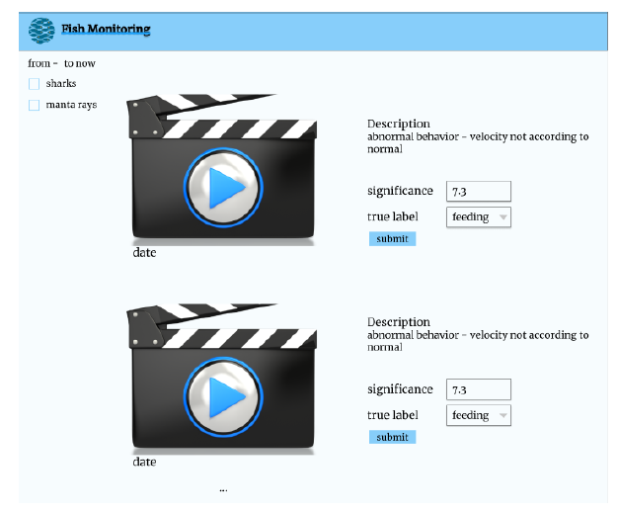
User Interface

Slide 18
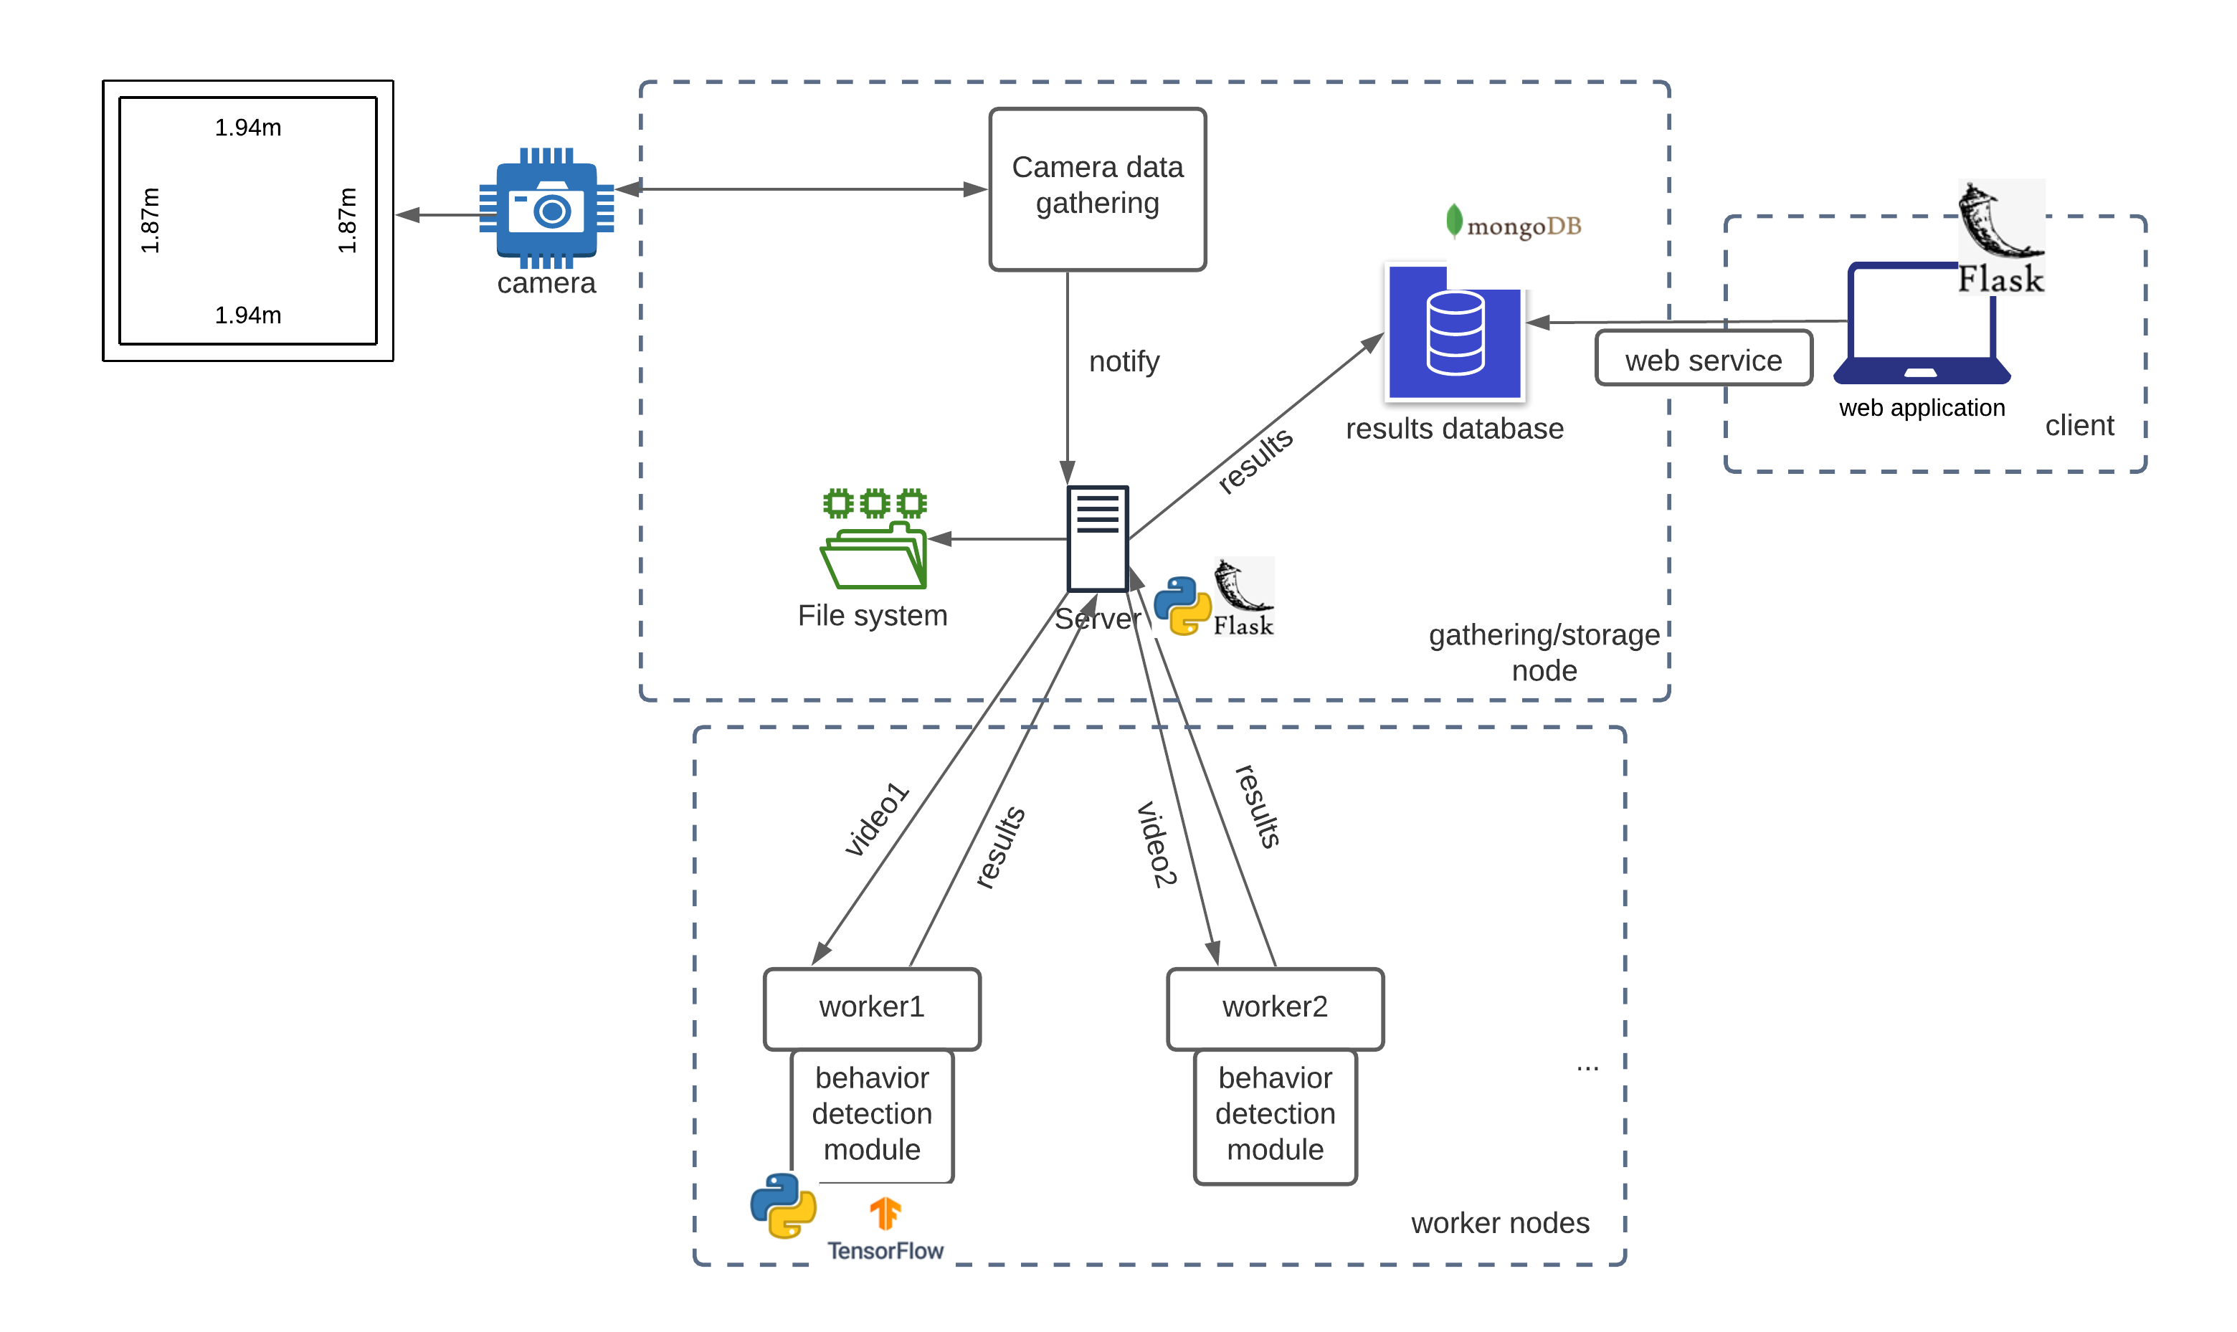
System Architecture

Slide 19
Evaluation
Data: new videos need to be recorded
Classifiers performance: precision, recall, f1-score, confusion matrix, roc curves
Episodes detection: same metrics
Alarms significance
Processing delay

Slide 20
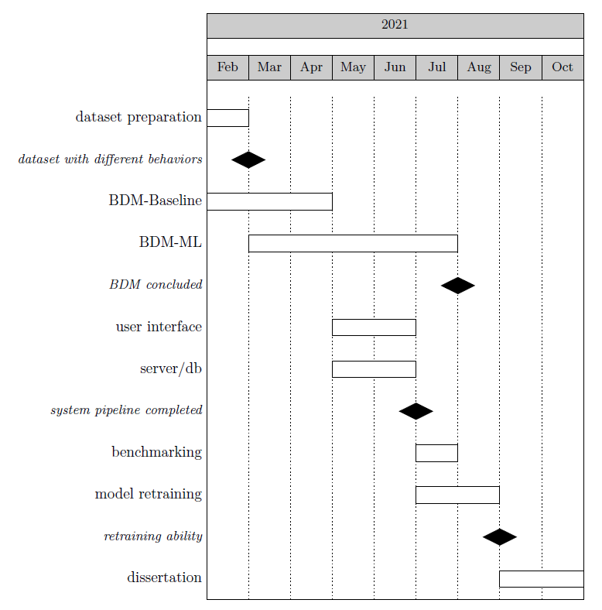
Planning

Slide 21
Conclusions
System capable of helping biologists monitoring fish behaviors
Sharks and manta rays
Feeding, Lack of Interest, Swallowing air and Abnormal behaviors
Rule-based and Machine Learning
Online training techniques
Web Application

