Slide 1


Fish Behavior Detection
Gonçalo Adolfo
Teachers Alexandre Bernardino and H.Sofia Pinto
Instituto Superior Técnico, Universidade de Lisboa

Slide 2
Outline
Motivation
Related Work
Proposed Solution
System Evaluation
Planning

Slide 3





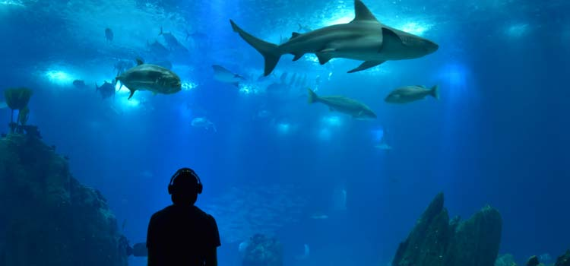
Motivation
Feeding
  water quality, aggressive behaviors, lack of interest
Abnormalities
  poor environmental integration, disease indicator
Other key activities
  swallowing air
real time monitoring
footage analysis

Slide 4
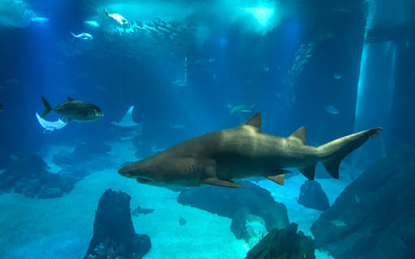
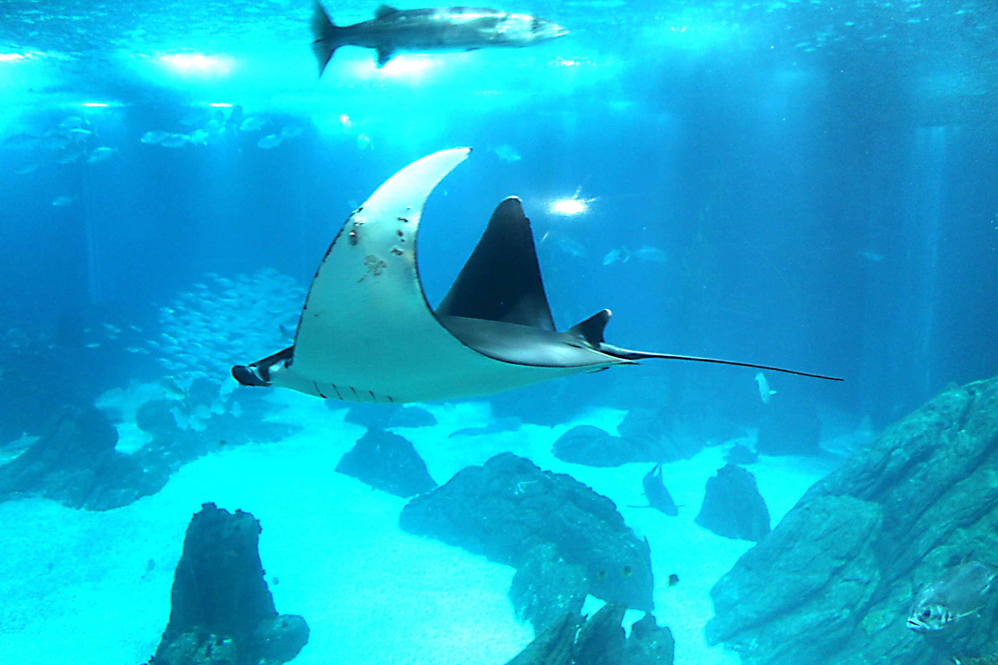
Project Goals
Purpose: help biologists monitoring fishes
Behavior detection
swallow air, feeding, lack of interest, abnormal
sharks
manta ray

Slide 5
Project Context
“Video based live tracking of fishes in tanks”, José Castelo (2019/2020)
Detection: background subtraction
Tracking: position and color
Classification: color histogram or HOG
“Tracking animals in underwater videos”, João Santos (2020/2021)
Detection: comparison of several techniques
Tracking: color history, temporary track, motion prediction

Slide 6
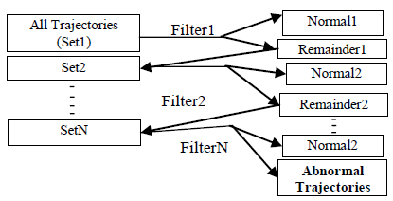
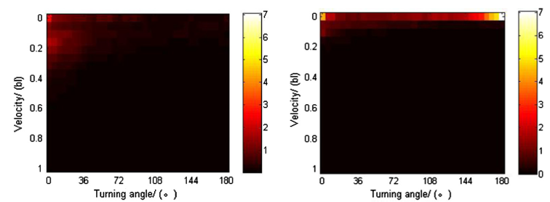
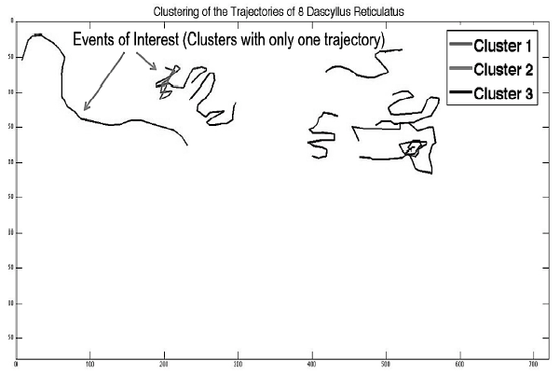
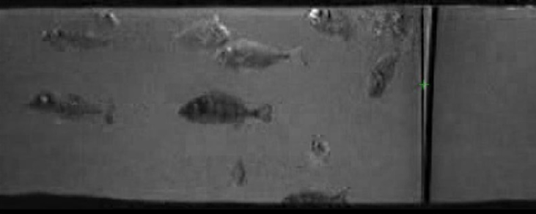
Abnormal Behavior Detection
Rule-based: position,
direction, motion prediction
Kinetic energy
Position-based
Clustering

Slide 7
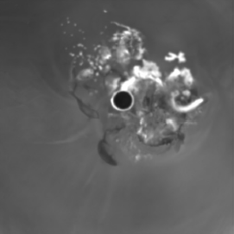
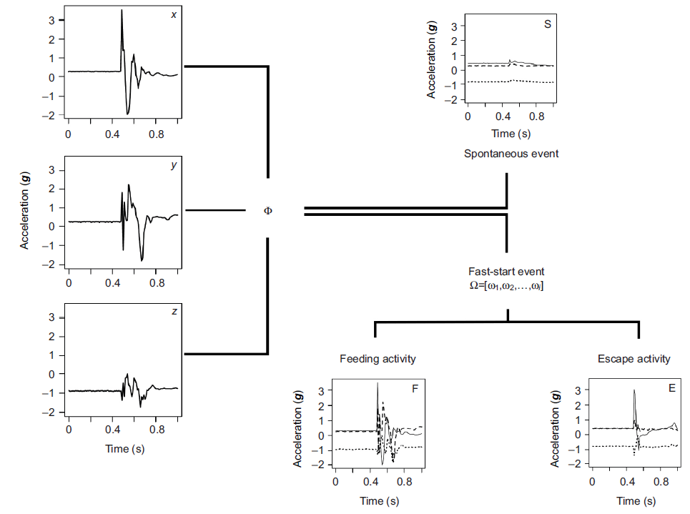
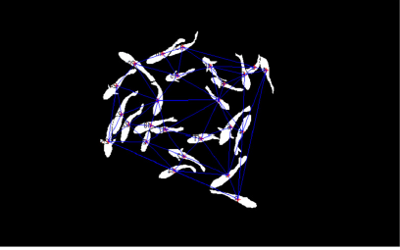
Activity Recognition
Feeding: snatching-based
Accelerometer approach
Feeding: aggregation-based

Slide 8
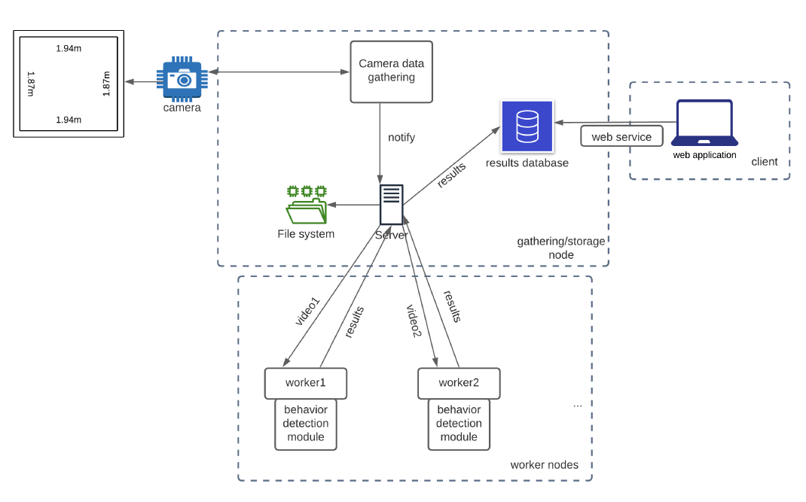
System Architecture

Slide 9
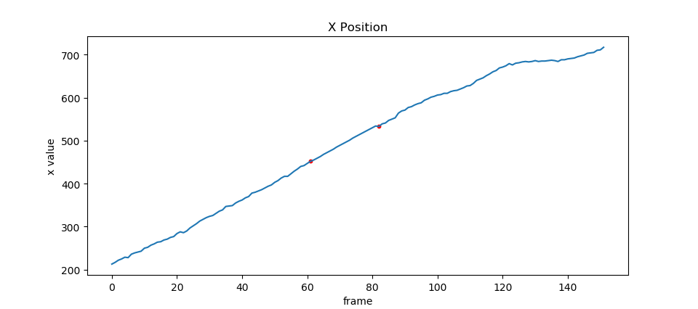
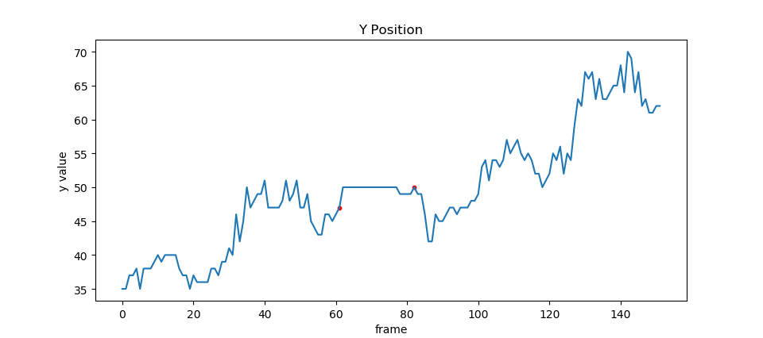


Trajectories Pre-Processing
Newton Interpolation

Slide 10
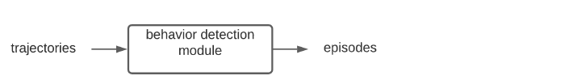
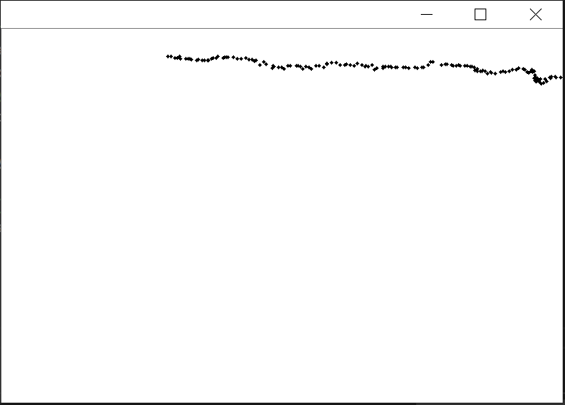
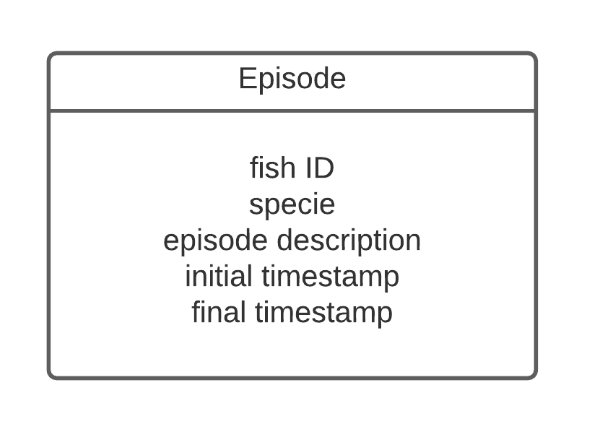

Behavior Detection Module Interface
Swallow air
Feeding
Lack of interest
Abnormal
$$T=[\left(t_{1},x_{1 },y_{1}\right), …,\left(t_{n},x_{n },y_{n}\right)]$$

Slide 11
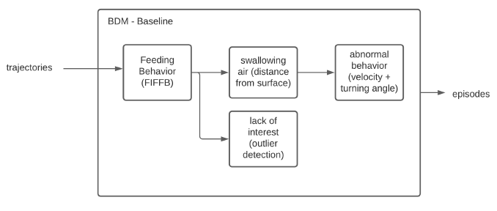
Baseline Approach

Slide 12
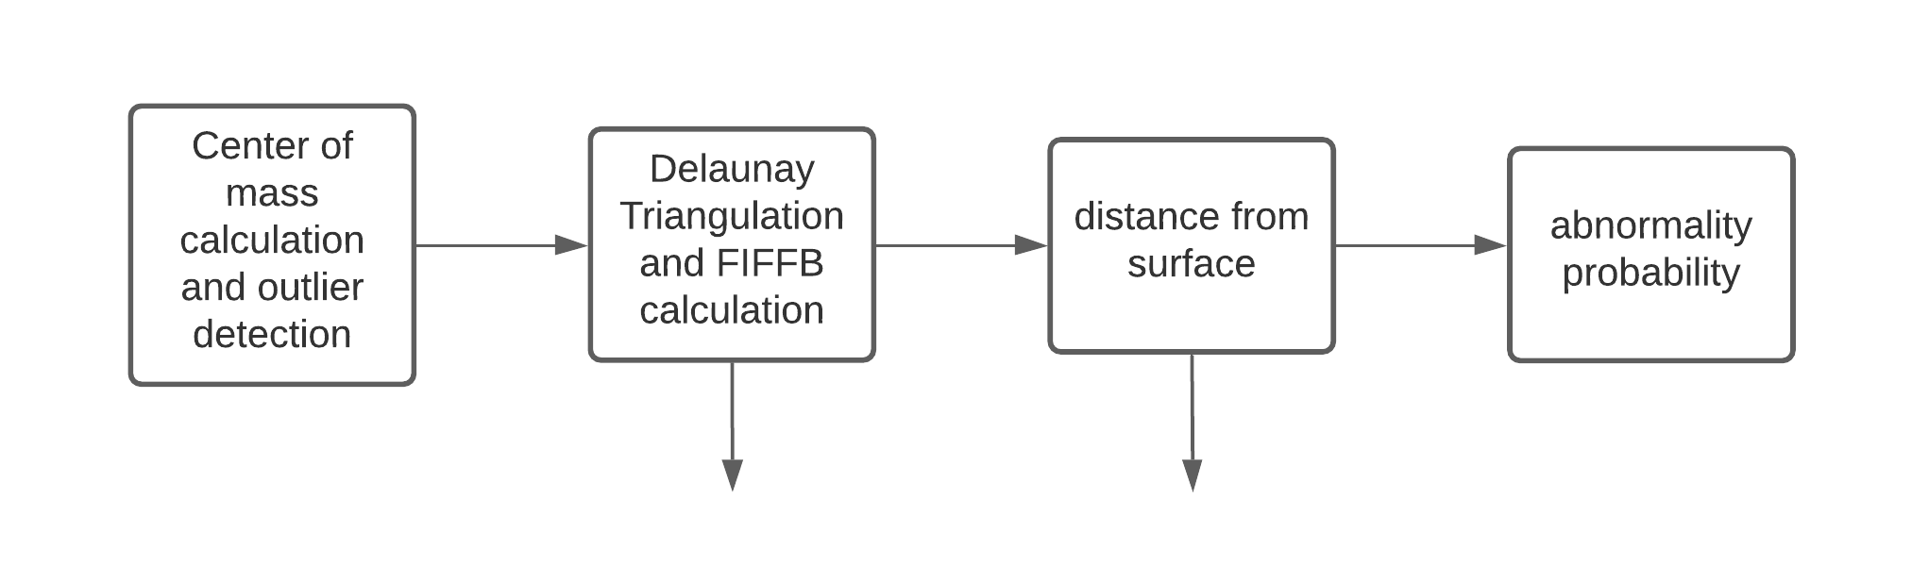
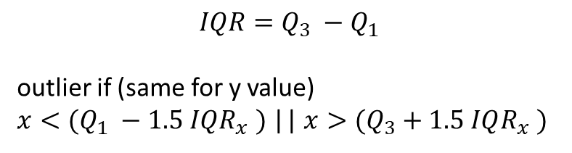




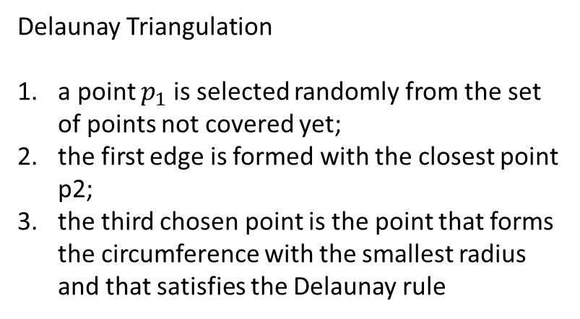
Baseline Approach
normality is modeled by a 2D histogram, a 2D gaussian or other probability density function
$$σ_{1}, σ_{2}$$
$$σ_{3}$$
$$σ_{4}$$
$$IQR=Q_{3} −Q_{1}$$
outlier if (same for y value)
$x<(Q_{1} −1.5 IQR_{x} )$|| $x>(Q_{3}+1.5 IQR_{x} )$
Delaunay Triangulation
a point $p_{1}$ is selected randomly from the set of points not covered yet;
the first edge is formed with the closest point p2;
the third chosen point is the point that forms the circumference with the smallest radius and that satisfies the Delaunay rule
$$FIFFB=\frac{\sum_{i}^{n}{L1_{i}+L2_{i}+L3_{i}}}{n}$$

Slide 13
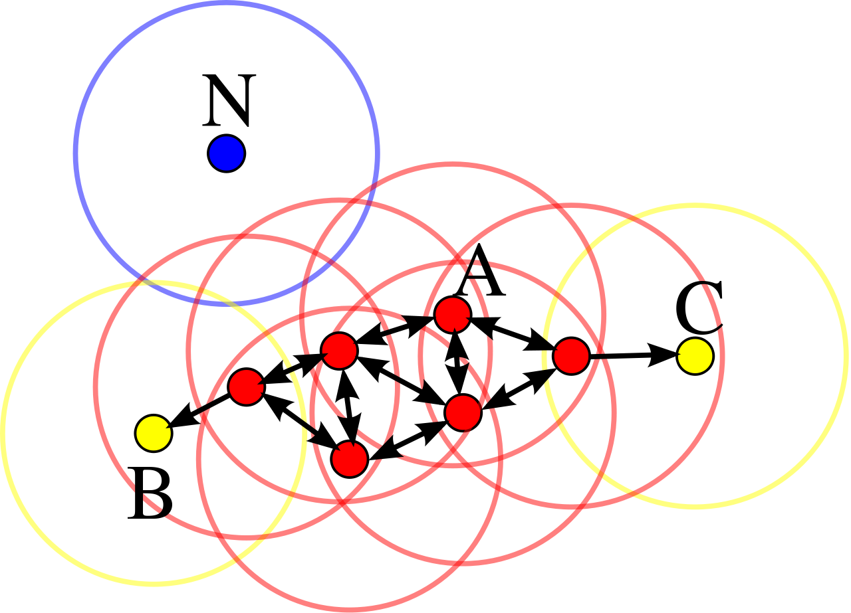
Improvements using ML – Feeding and Lack of Interest
Feeding behavior: aggregation
  clustering density-based (example: DBScan)

Slide 14
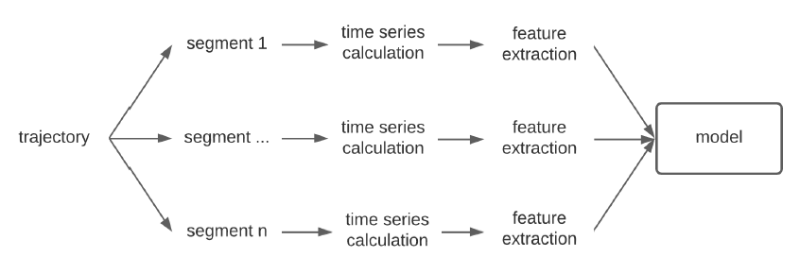
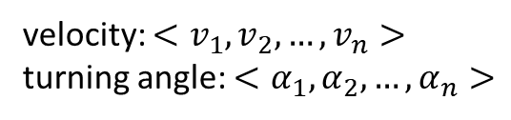
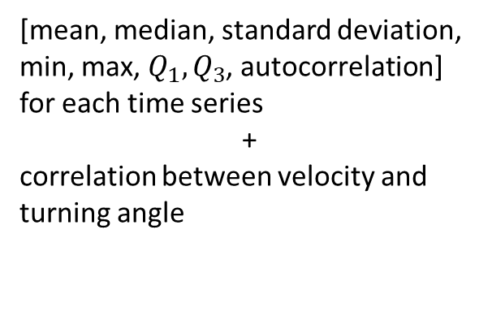
Improvements using ML – Behavior Classifier
Naïve Bayes
SVM
Random Forest
Deep Learning (?)
[mean, median, standard deviation, min, max, $Q_{1}, Q_{3}$, autocorrelation] for each time series
+
correlation between velocity and turning angle
velocity: $<v_{1},v_{2},…, v_{n}>$
turning angle: $<α_{1},α_{2},…, α_{n}>$

Slide 15
Other Features
Curvature Scale Space
Centred Distance Function
“Pass by” features
Normalized bounding box

Slide 16
Model Retraining
Model Drift Detection
Model Retraining
User feedback
Online techniques:
SVM: adjust the current weights only based on the new data
Random Forest: adding more decision trees to the ensemble according only to the new data

Slide 17
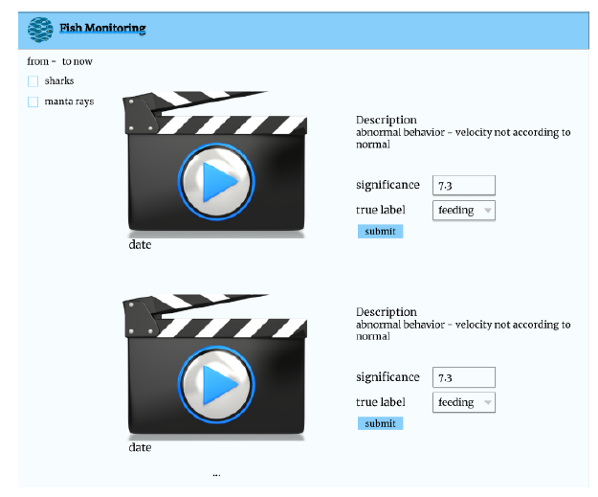
User Interface

Slide 18



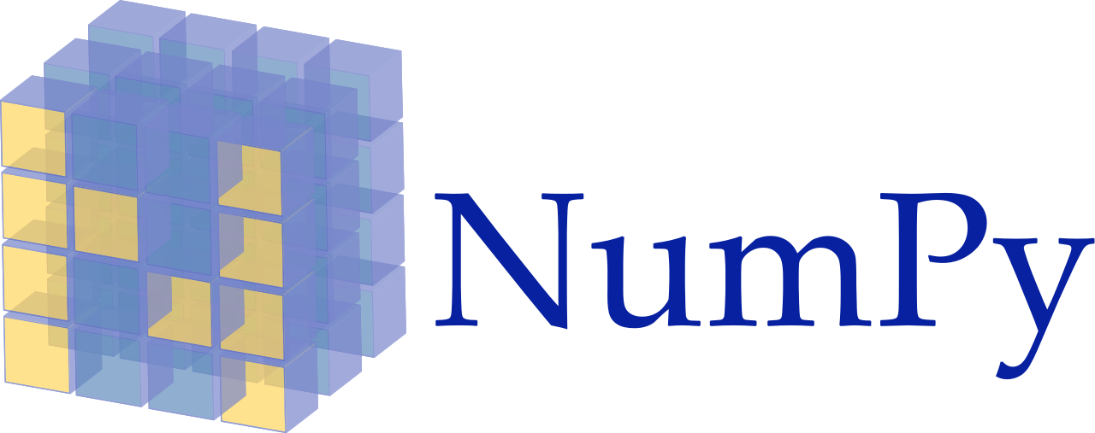





Technologies
Behavior Detection Module
Web Application/Web Services/Server-Worker node communication
Database

Slide 19
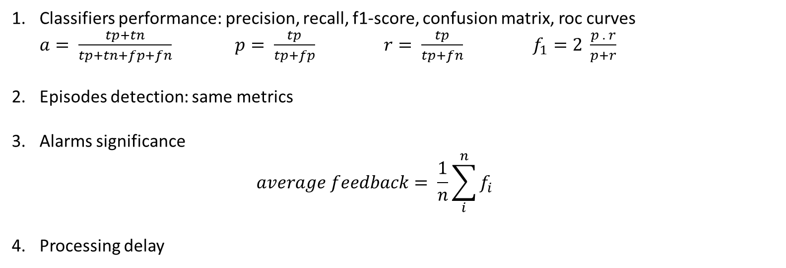
Evaluation
Classifiers performance: precision, recall, f1-score, confusion matrix, roc curves $a= \frac{tp+tn}{tp+tn+fp+fn}$ $p= \frac{tp}{tp+fp}$ $r= \frac{tp}{tp+fn}$ $f_{1}=2 \frac{p . r}{p+r}$
Episodes detection: same metrics
Alarms significance
  $$average feedback= \frac{1}{n}\sum_{i}^{n}{f_{i}}$$
Processing delay

Slide 20
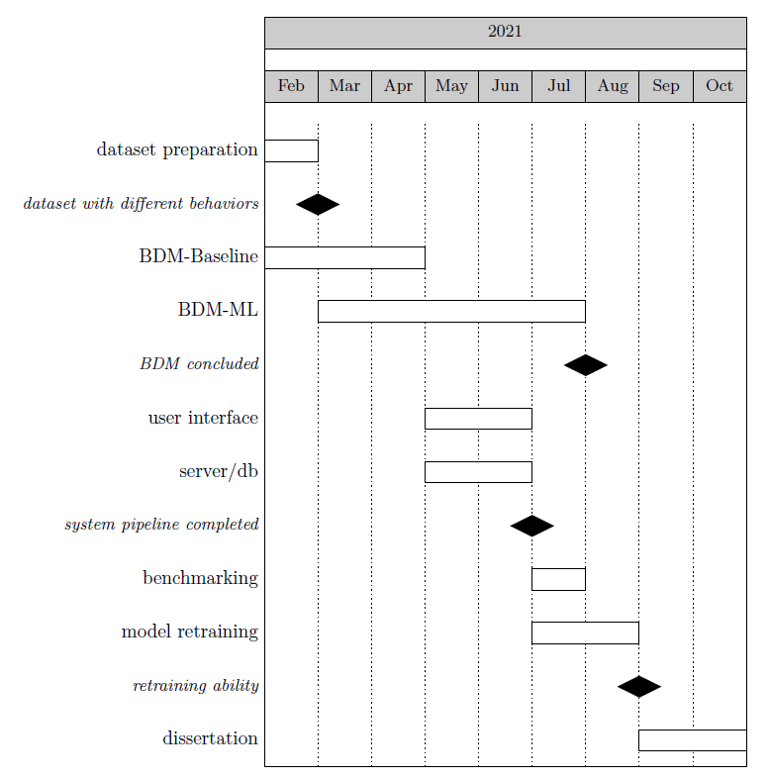
Planning

Slide 21
Conclusions
This project aims to develop a system capable of helping biologists monitoring fish behaviors
We focus on sharks and manta rays because of the results achieved on the underlying modules (detection and tracking)
Related works specially focus on feeding and abnormal behaviors
The system must be capable to detect Feeding, Lack of Interest, Swallowing air and Abnormal behaviors
It will be improved using Machine Learning methods
Online techniques will be used to retrain the deployed model
A user interface will be provided to be more user friendly to the final user (biologist)

